Slide 1
Data Storytelling: Kenya Poverty & Employment Trends
MEAL Context Analysis using World Bank Indicators

Slide 2
Why this data matters
Understanding poverty and employment trends is critical for effective MEAL planning.
These indicators explain why interventions are needed, who is most at risk, and how national conditions influence project outcomes.

Slide 3
Poverty Trend – What the data shows
• Poverty measures the % of people living below $3.00/day (2021 PPP)
• Early 1990s: ~32% below poverty line
• Peaked at 44.6% in 2005
• Declined to 37.7% by 2015

Slide 4
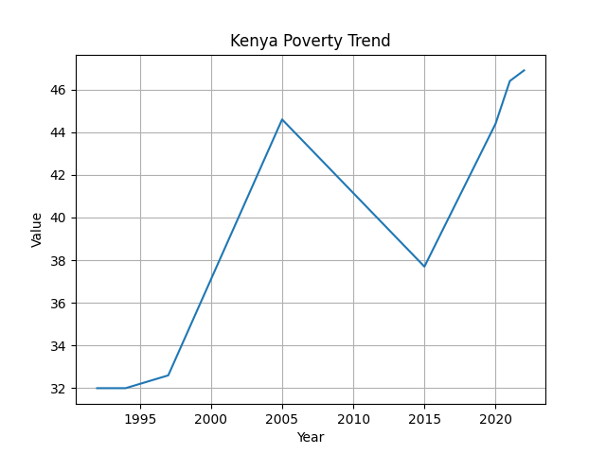
Kenya Poverty Trend

Slide 5
Employment Trend – What the data shows
• Unemployment ranges between 2.6% and 5.7%
• Spike during COVID-19 (2020–2022)
• Slight decline post-2022
Low unemployment does not equal economic security due to informal labor.

Slide 6
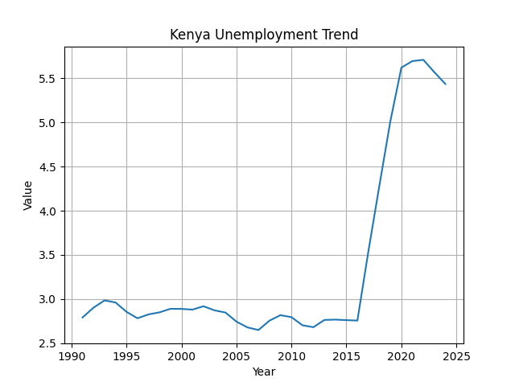
Kenya Unemployment Trend

Slide 7
Key Insight
Stable employment has not translated into proportional poverty reduction.
Jobs alone are not enough; income quality, productivity, and livelihood diversification matter.

Slide 8
MEAL Design Implications
• Focus on income growth, not job access alone
• Target vulnerable households, including the working poor
• Complement national data with household baseline/endline surveys

Slide 9
Conclusion
While Kenya has made progress in poverty reduction, vulnerability remains high.
Stable unemployment masks underemployment and low-income livelihoods.
Targeted livelihood and resilience interventions supported by strong MEAL systems are essential.

