Slide 1
Building a Leaderboard Web App
Michael Berrios – MB Kemoy Campbell – KC
08/20/2025

Slide 2
What is a Leaderboard?
List top players and their stats
Updates the stats
Reorganizes who is in first place to the last
Easy to keep track who the top players are among the millions for any game

Slide 3
Rock, Paper, Scissors
The game for this activity is Rock, Paper, Scissors
You will play against the computer
Your wins and losses will be displayed in the Leaderboard

Slide 4
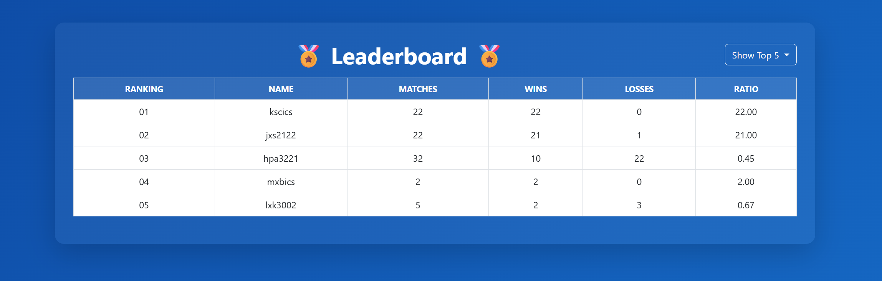
Update # of Tops
Players to Display
Player Names
Win Ratio
Player Position
Total Matches
Wins / Losses

Slide 5
Live Demo – Rock, Paper, Scissors
First, let’s demo a working version of the Leaderboard application
Observe the behaviors of the Leaderboard when the player Wins or Loses a match vs the Computer

Slide 6
DEMO TIME

Slide 7
Technologies to Develop the Web App
Before we dive into the technologies used to develop the web app, what is a web app?

Slide 8

What is a Web App?
Interactive Software accessed through a web browser
Chrome, Edge, Safari, etc.
Runs on a server but responds to user input
Can be accessed anywhere in the world when published, just like Youtube.com or Netflix.com

Slide 9
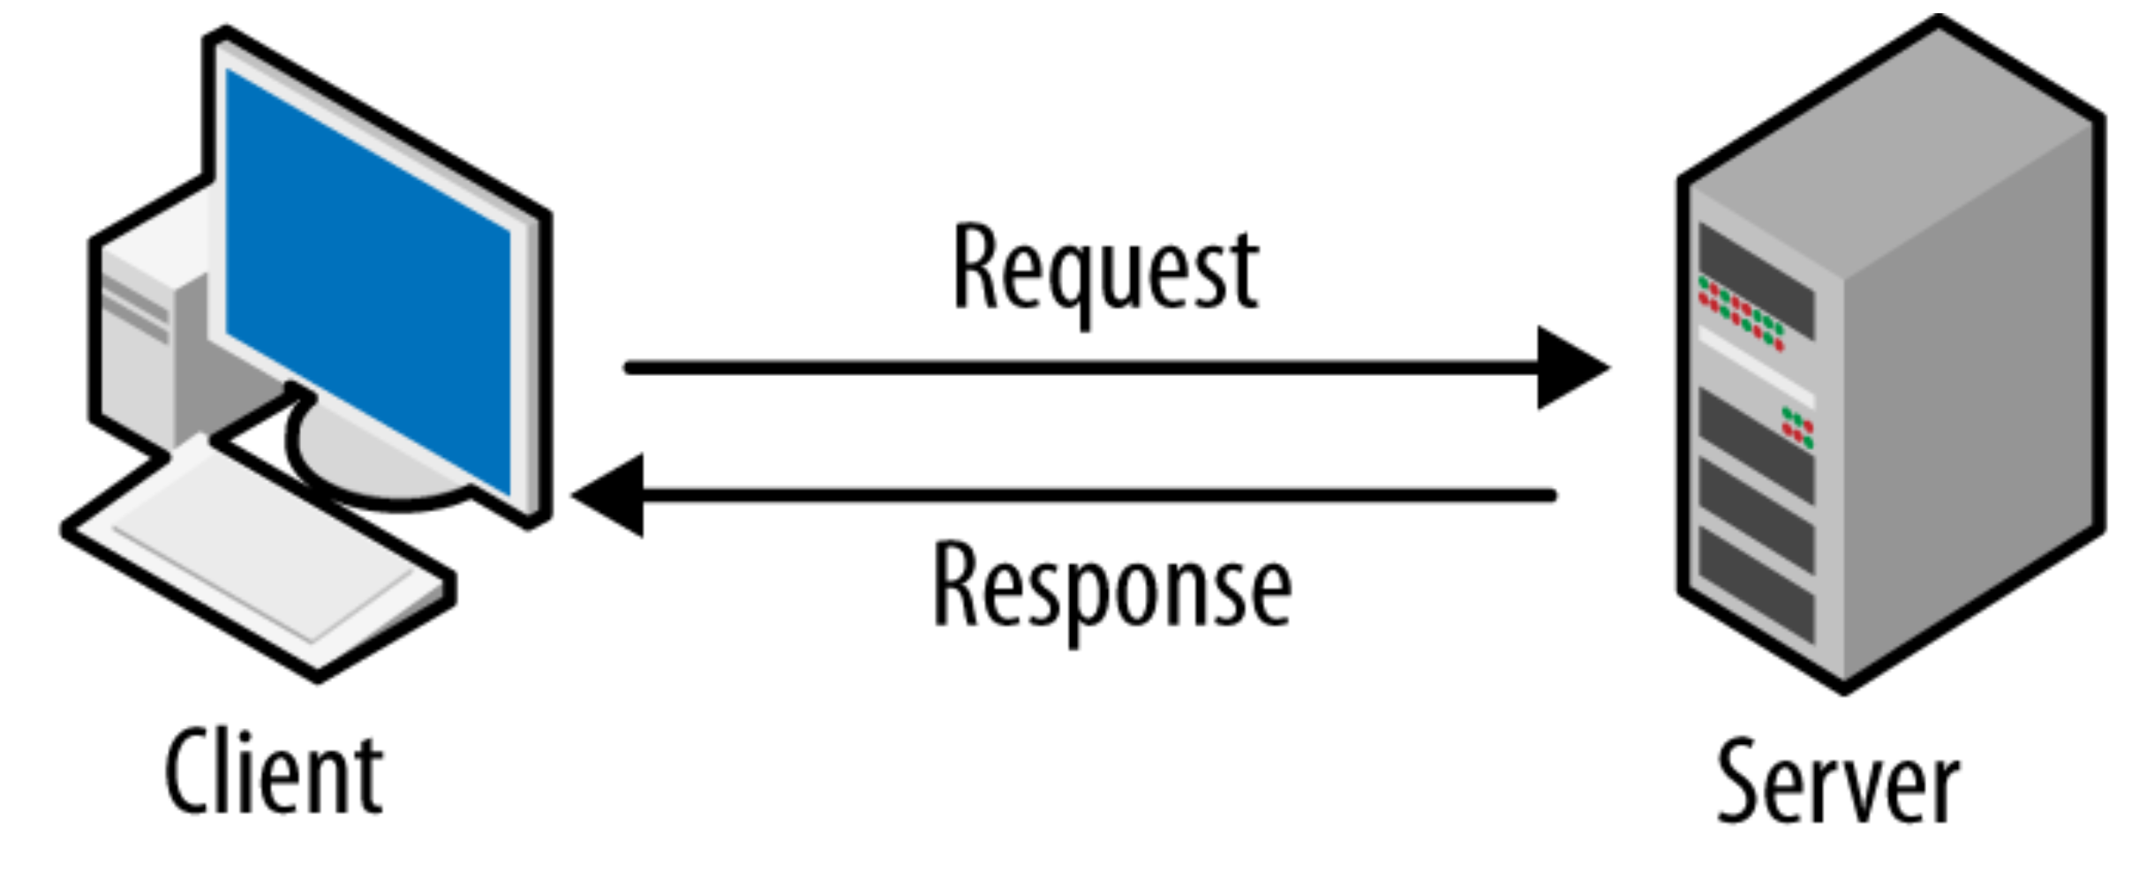
So,… How does a Web App work?
First let’s go over the basics
Client – The browser – is needed in order to access the web app and interact with the app
Server – The backend – takes care of handling requests/responses made by the client
Communication happens over HTTP (Hyper-Text Transfer Protocol)

Slide 10



Building the App
Front-End – What the user sees and can interact with
Design, Colors, Buttons and Functions
Technologies Needed –
HTML (Hyper-Text Markup Language – for layout)
CSS (Cascading Style Sheet – for styling and design)
JavaScript (Programming Language for web browsers)

Slide 11



Building the App Cont.
Back-End – Where user send requests
Server – Apache (Responsible for hosting and serving a web application over the internet)
PHP (Programming Language for the backend to handle requests)
MariaDB (Database to store application data)

Slide 12

Building the App Cont.
Code Editor
Before we can code, we need a code editor
Visual Studio Code to the Rescue!!! Free and Powerful

Slide 13
That is a lot for a Web App
Need a Server
Need to Code the Front-End and Back-End
Need a Database
Need Users (you ☺)

Slide 14
XAMPP to the RESCUE!
Installing all of that separately is too expensive and unneeded
Use a Development Environment like XAMPP – it’s Free!

Slide 15
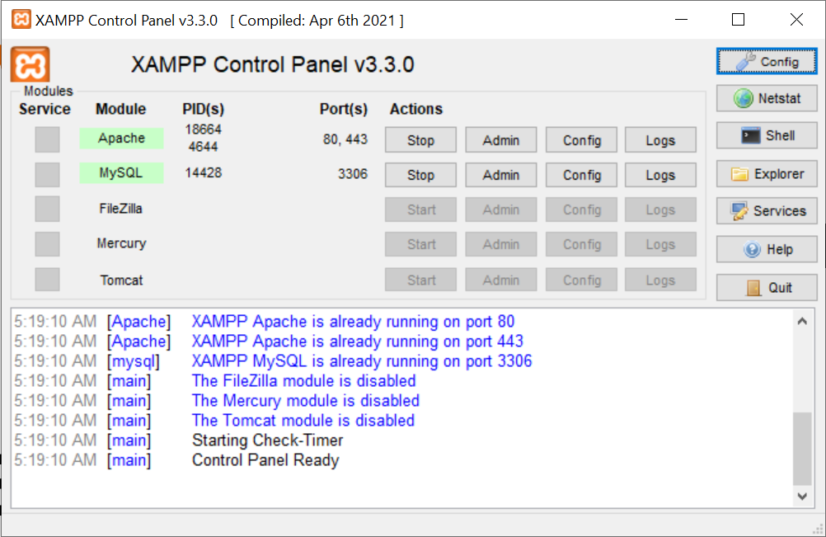
What is XAMPP?
X – Cross Platform (works in Windows, Linux, Mac)
A – Apache (web server)
M – MariaDB (database)
P – PHP (server programming language
P – Perl (scripting language)

Slide 16
So,.. Who’s ready to get started?
We will fix a broken Leaderboard app
You will code for:
fixing styling, and aesthetics of the app
fixing API calls (requests to the server)
We will fix a broken Rock, Paper, Scissors Python App
fixing API calls (requests to the server)
fixing missing/broken functions

Slide 17
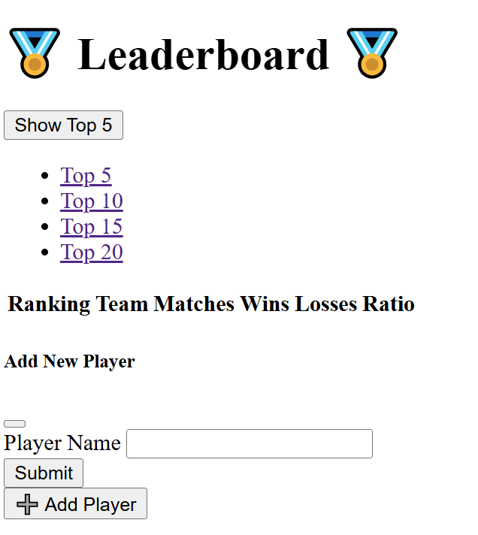
Let’s Fix the Styling!
Styling is Ewwww right now… it’s broken ☹

Slide 18
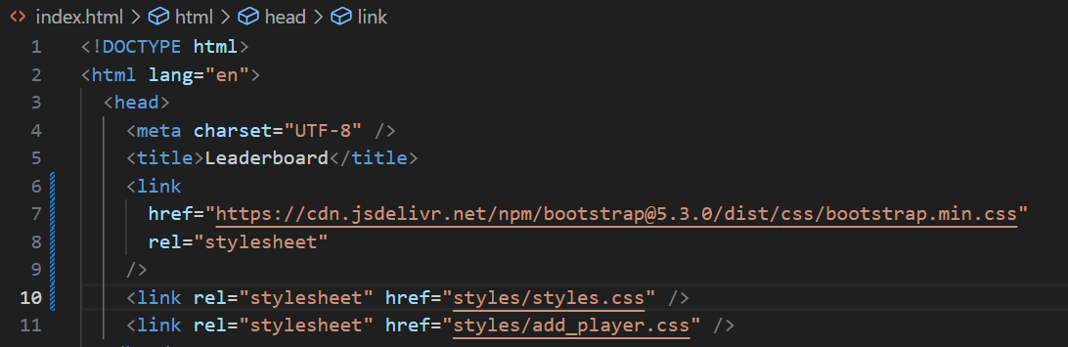
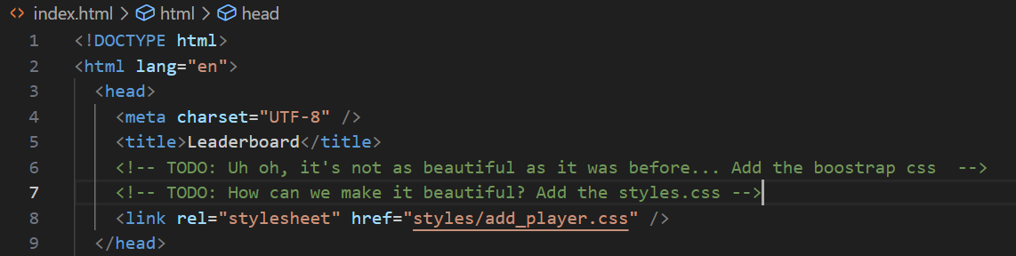
Let’s Fix the Styling in “index.html”
Import Boostrap CSS
Import Styles.css file

Slide 19
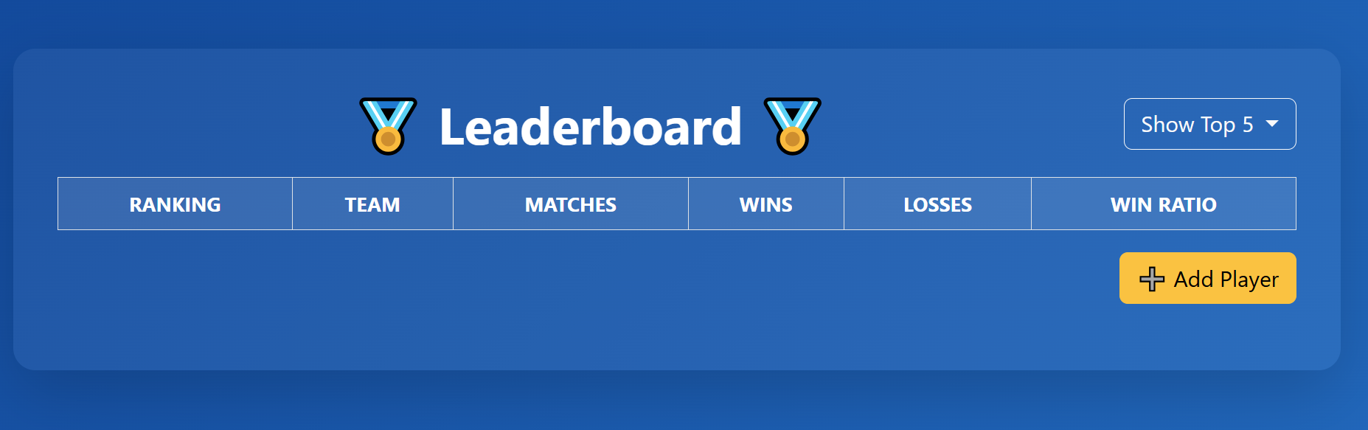

Much Better

Slide 20
Ufff… that was a lot of work
There you have it, a fully working Leaderboard Web App
Rock, Paper, Scissors
Congratulations!!!

Slide 21
What you Learned
Client / Server Interaction
Code - Front-End and Back-End
Database – Stores and Manipulate Data
Application Development / Software Engineering
Development Environment
Code Editor (Visual Studio Code)

Slide 22
FAQ – Ask Away!

Slide 23
Thank You!

