Slide 1
A 'Touch' of Website Development
Just the basics, please

Slide 2
Welcome!
Sit in your seats.
Start your computers.
In a short time you will get a feel for constructing a webpage.
Sort of – focused on editing some HTML, the language used to layout webpages.
Hopefully, it will be a magical experience!

Slide 3
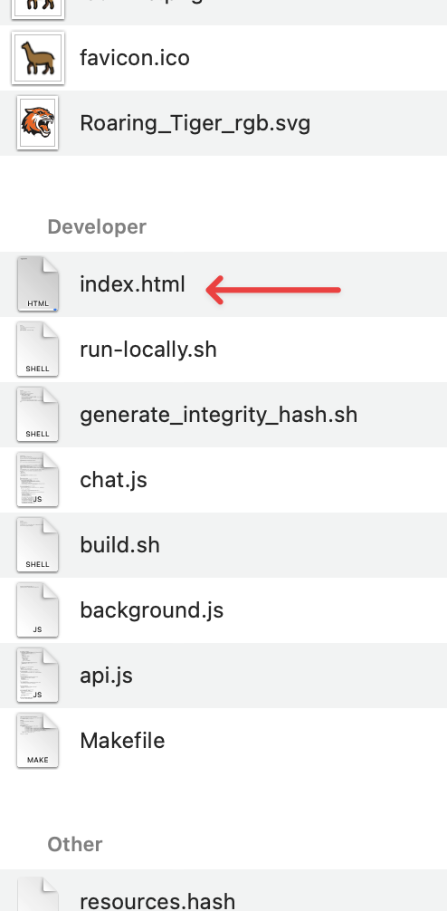
Here we go...
Launch Visual Studio Code (VSC). (It may already be open...)
Open a browser window (Edge is fine).
Open the folder " SVP-LLM-Web" on the desktop.
Drag the index.html file into the main VSC window.
Drag the same file from the SVP-LLM-Web folder into the browser window.
SVP-LLM-Web folder

Slide 4
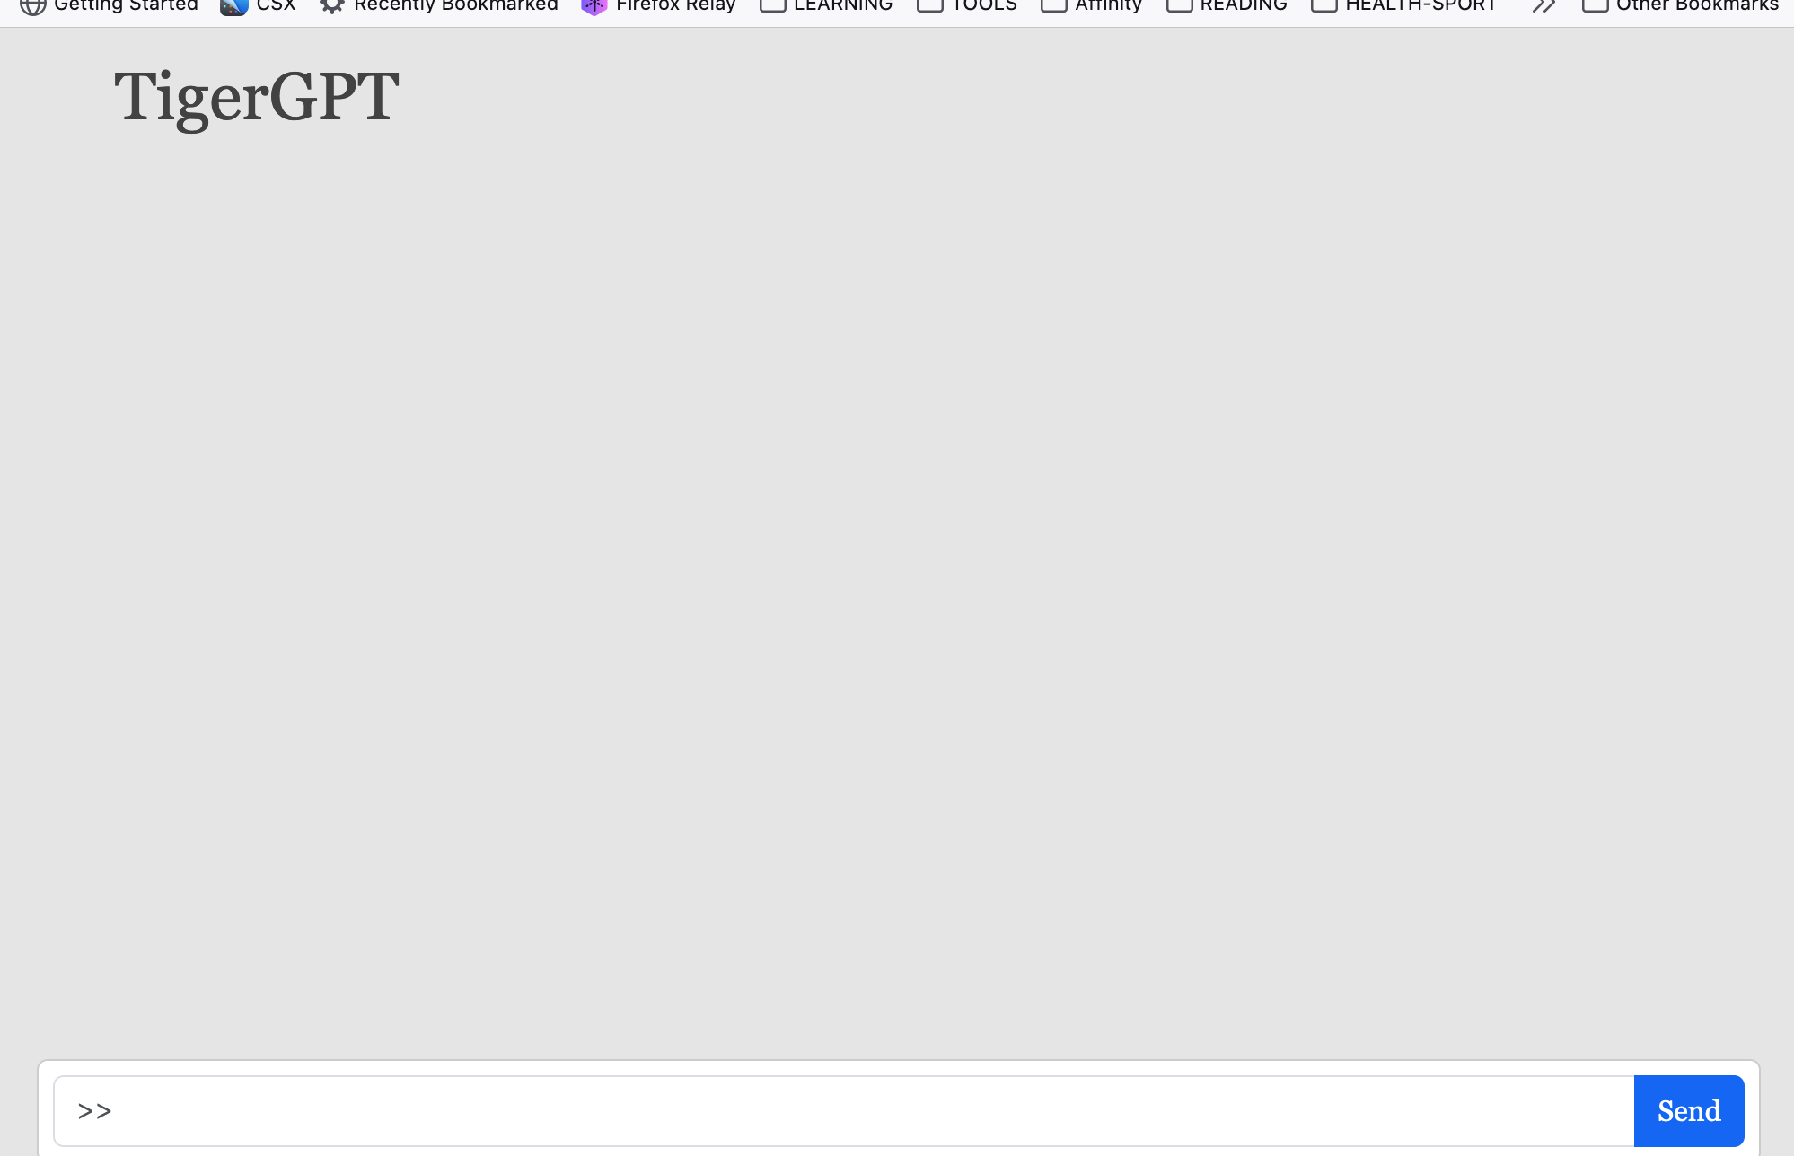
Keep going...
In the browser is a plain, boring, "AI chatbot". You can give it a question and the AI will give you an answer. Give that a try - later.
Let's first make this page more interesting!

Slide 5
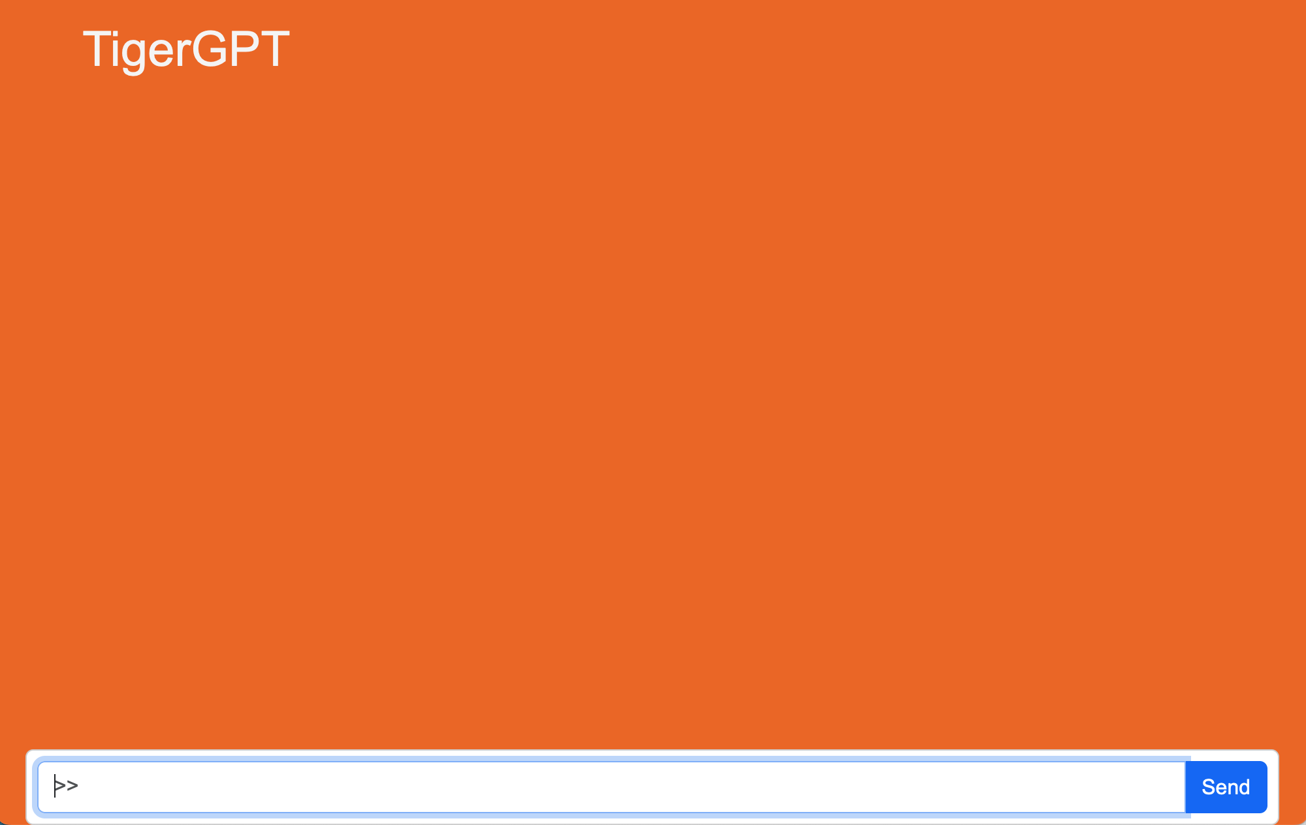
Step 1
Change the page background color to "RIT orange". Search for "Task 2..." and add the 'class=' part to the <body> element as shown:
Save and refresh the browser. Better than gray!
<body data-bs-theme="light" class="body-rit-orange">

Slide 6
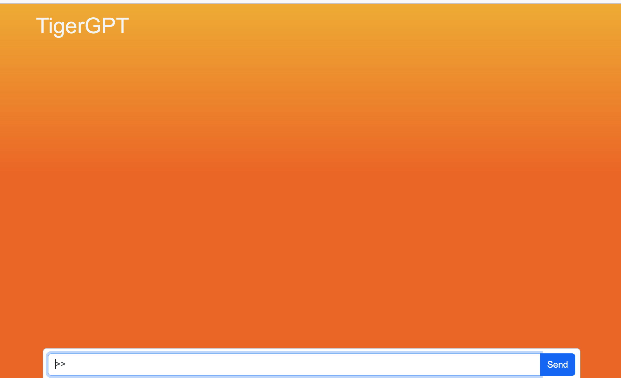
Step 2
Add a background color gradient, that starts at the top of the page.
Search for "Task 3..." and change the <div> element by adding 'bg-grad-yellow-trans' as shown:
Save and refresh the browser. Even better!
<div class="position-fixed w-100 fix-top bg-grad-yellow-trans">

Slide 7

Step 3
Make the logo to look more "futuristic" Search for "Task 5..." and modify the <h1> tag as shown below:
Save and refresh the browser. Magic!
<h1 class="orbitron-fancy">TigerGPT</h1>

Slide 8
The End
Time is up. Go ahead and type a question into the TigerChat prompt.
Example: Write an eight-line poem about the first year of college.
Did you get a good answer?
Thanks for participating. Join us on Wednesday for an extended web development experience.

