Slide 1
Experiencing Website Development
Just the basics, please

Slide 2
Goals for This activity
To “peek behind the curtain” of the languages used to create web pages.
To learn about two of the three core developer tools for webpage creation: HTML and CSS.
See if you feel a sense of "magic" in how a webpage design can be transformed with just a few markup changes.
Gain some exposure to the development tool Visual Studio Code to see how it can be useful while writing HTML mark-up. (Visual Studio Code is the #1 web development tool/editor in the world!)

Slide 3
How do web pages work?
Three primary parts:
HTML (Hypertext Markup Language)
CSS (Cascading Style Sheets)
JavaScript (Programming Language)
These three parts work together to define a web page and how it works
HTML
CSS
JavaScript

Slide 4
HTML – Hypertext Markup Language
Content & structure
HTML defines:
The content that is displayed on the page
The words
The images
The media
The structure for the page, e.g.,
Headings
Paragraphs
Sections ...
HTML does not control the appearance of the page.
One more thing, HTML is not really "code" -- it is mark up.
HTML
CSS
JavaScript

Slide 5
CSS – Cascading Style Sheets
CSS defines:
The appearance of the page, e.g.:
Colors
Positioning
Sizing
etc.
The design of the page for different platforms
Desktop
Tablet
Phone
HTML
CSS
JavaScript
Appearance & Design

Slide 6
Javascript
JavaScript defines:
The user control and feedback the user gets when interacting with a page:
Display changes
Basic form processing
Dynamic HTML changes
Dynamic CSS changes
Over time, quite a bit of interaction and animation is made possible in CSS updates, which simplifies development.
HTML
CSS
JavaScript
Interaction

Slide 7
frameworks
HTML
There are many frameworks for web development!
Bootstrap
React
Angular
ASP.NET
And many others
Frameworks work with all three parts of the page (HTML, CSS, JavaScript) to make development of sophisticated web pages easier.
Our activity file uses aspects of Bootstrap...
Frameworks
CSS
JavaScript

Slide 8
Activity Overview

Slide 9
Activity Overview
Today, you’ll continue to improve the web page you revised on Monday
We will supply you with a copy of Monday’s completed page
You’ll set up your environment to edit and view the page
You’ll add more content to enhance the page
Along the way, we’ll explain how your changes are examples of the HTML/CSS model

Slide 10
Activity Overview
Launch Visual Studio Code (VSC). Through that app, you will download the activity files.
Open the downloaded folder " SVP-LLM-Web". Open the Edge browser.
Drag the index2 file from the SVP-LLM-Web folder into the browser window.
In VSC, click the indexs.html file in the left column. This is the markup 'code' for the page you see in the browser window.
What you see in the browser is a plain, "AI collaborator". You can give it a question and the AI will display an answer. Give that a try.
You will begin with a simple page connected to an AI collaborator that prompts you to enter a query. That part works.
The web page is rather gray and boring. So, let's try to "enhance it" - with RIT colors!

Slide 11
Preparing your environment – I
This part may already be done for you. But just in case:
To open Visual Studio Code (VSC)
In the Windows search box in the task bar, enter “Visual Studio Code”
In the pop-up, click on “open” in the right-hand column
To open the Edge Browser:
Click on the Edge app icon in the taskbar
To position these two windows so you can work more efficiently:
Select the VSC window and press the “Windows” and left-arrow keys at the same time; the VSC window should move to the left side of your screen (you can release the keys)
Click on the Edge icon in the window that appears to the right; the browser should fill the right side of the screen

Slide 12
Preparing your environment – II
Locate and open the folder SVP-LLM-Web2
In that folder, locate the index file
Using the mouse, drag the index file to the VSC window
VSC should display the code of that file; (if a pop shows asking to Trust the file, click Open)
Using the mouse, drag the index file to the browser (Edge) window
The web page will display; (the browser interprets the code you see in VSC)
The page will have a yellow-to-orange background color transition and a title using the Orbitron font -- the state of the web page you created on Monday.
Your screen should now look like the image on the next page
Everything is in place! Let’s move on!!!

Slide 13
Preparing your environment – III
Your screen should now look like the image on the next page.
Let's do one more thing in VSC - to make you even more efficient!
Select from the File menu: Preferences
Beneath the title "Commonly Used", note the option: Files: Auto Save
Select from the drop-down menu "onWindowChange". If you recall that on Monday, you needed to remember to Save in VSC before switching to Edge and refreshing. This setting will automatically save your VSC changes when you select the Edge window and refresh the page.
Close the Settings tab (click the 'x')
Everything is in place! Let’s move on!!!

Slide 14
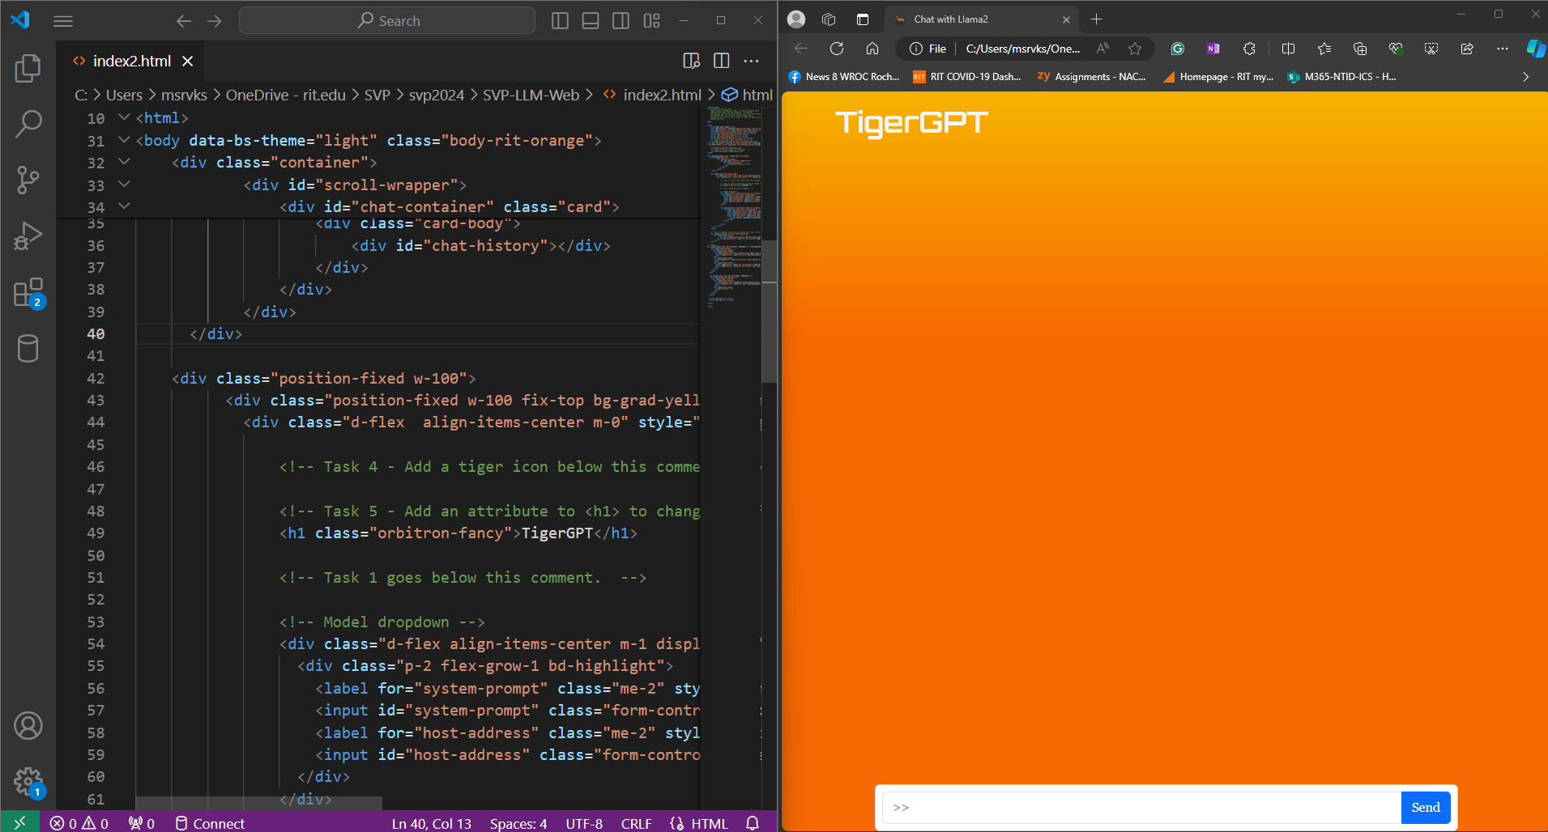

Slide 15
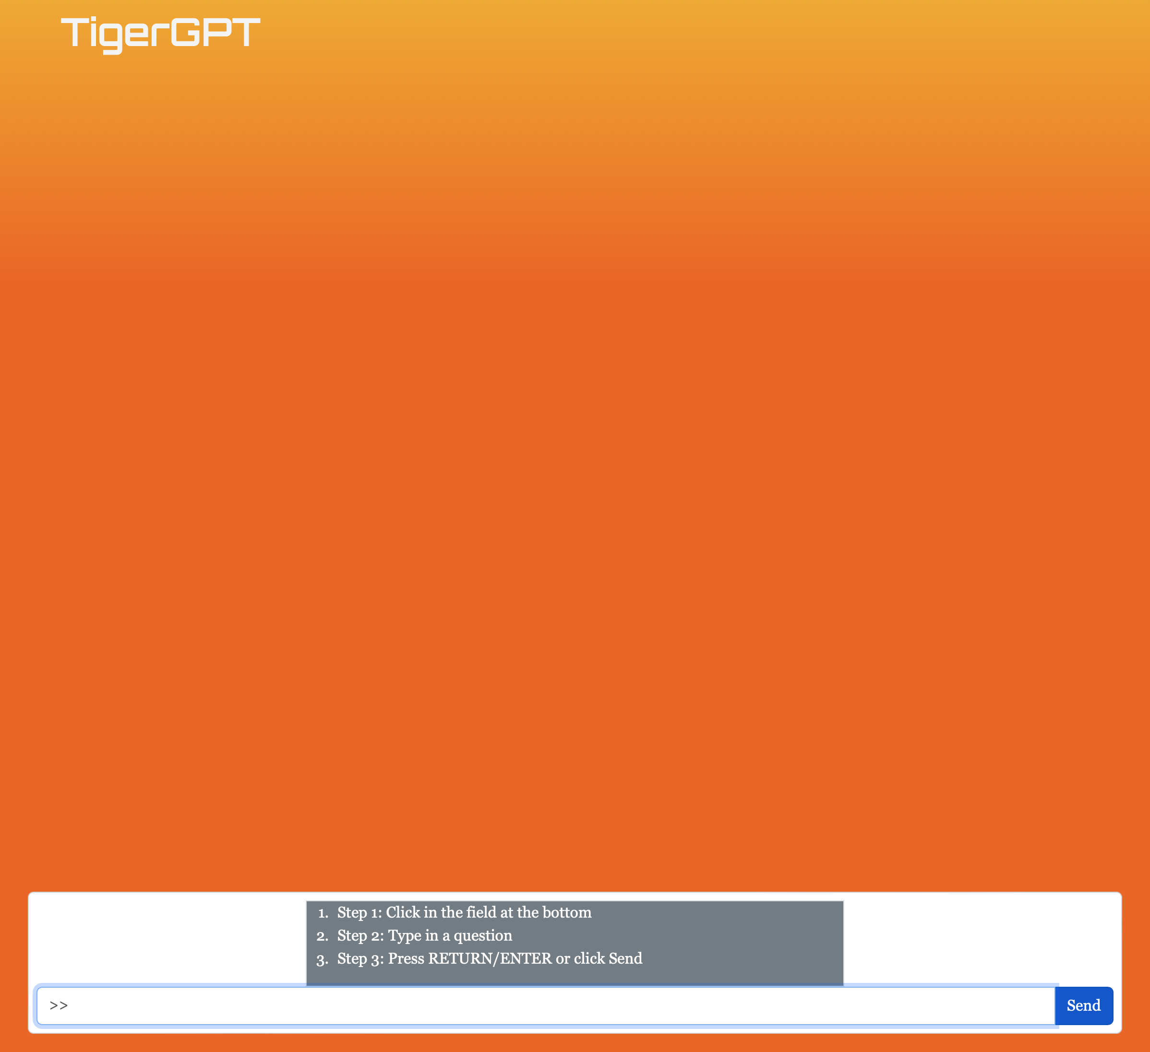
Task 1 in VSC
The basic web page needs some instructions. To add some instructions, search (Crtl+f) for the comment "Task 1...". Beneath the comment add these lines:
<div id="instruction" class="border">
<ol>
<li>Step 1:Click in the field at the bottom.</li>
<li>Step 2:Type in a question.</li>
<li>Step 3:Press RETURN/ENTER or click Send</li>
</ol>
</div>
Refresh the webpage in the browser. Do this after each time you make changes in VSC.
Your page should look like the one shown here:

Slide 16

Task 2
Add a tiger logo image in front of the title <h1>TigerGPT</h1>. Search for "Task 2..." and add this line:
<img src="Roaring_Tiger_rgb.svg" alt="rit tiger spirit mark" >
Save and refresh. Whoa!
Let's "tame" the huge tiger! Add the following: width="150" , to the end of the <img> element:
<img src= .... mark" width="150">
(Refresh the webpage in the browser)

Slide 17
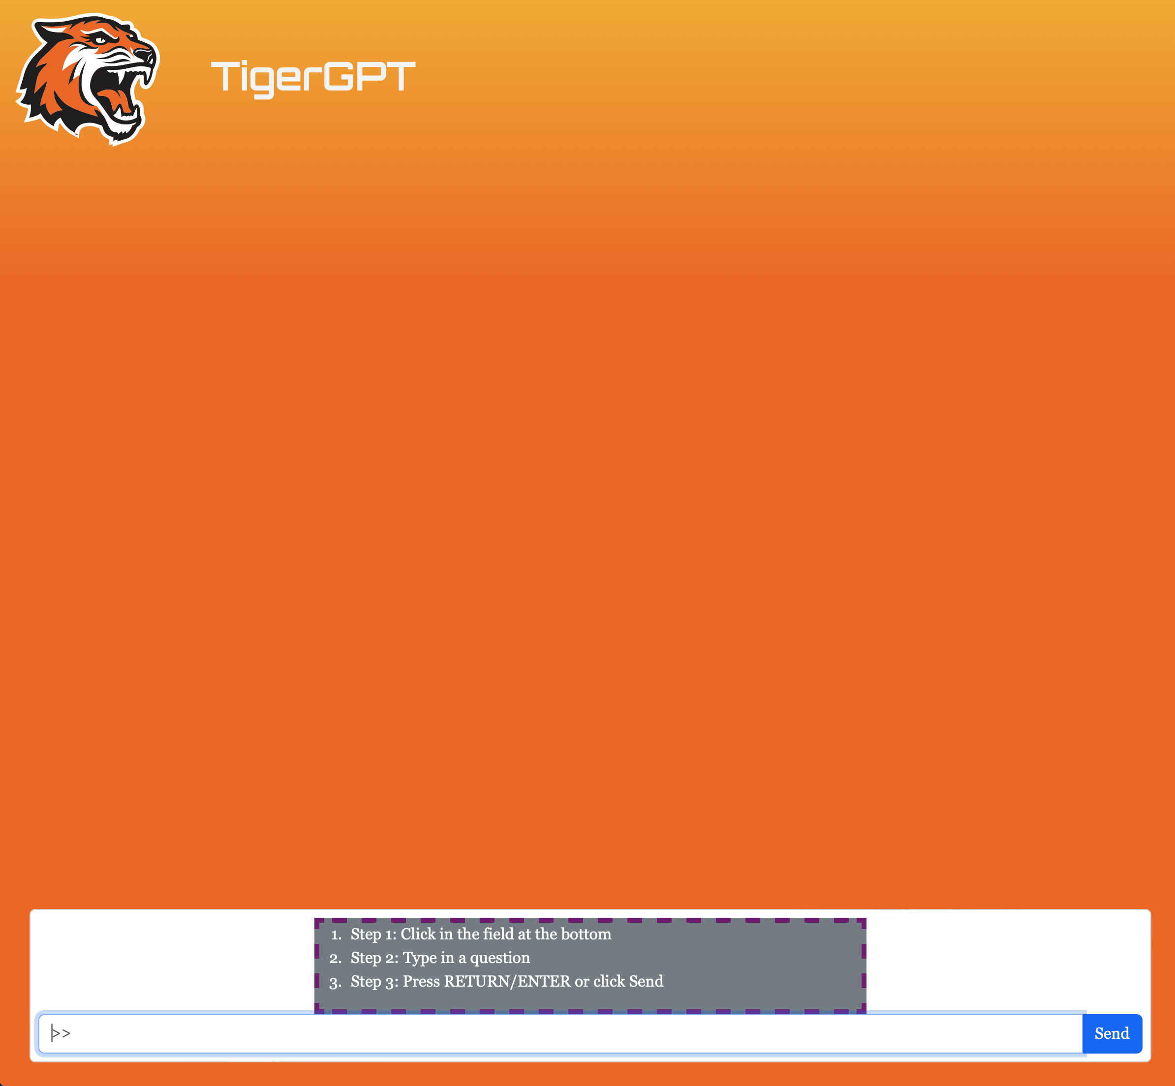
Task 3
Move the text field at the bottom, up from the screen's edge. Search for "Task 3..." and modify the line beneath the comment, adding: "mb-25" at the end of the class attribute:
<div class="container p-2 card mb-25" id="input-area">
– Refresh the webpage.
-----------
What do you think? Is the webpage somewhat more inviting?
Surely the instruction box could be improved...

Slide 18
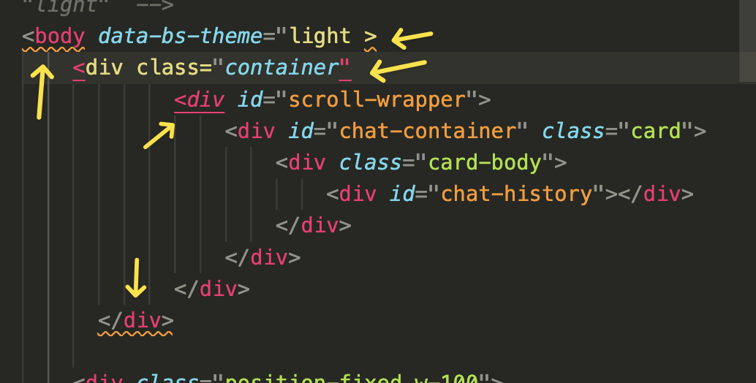

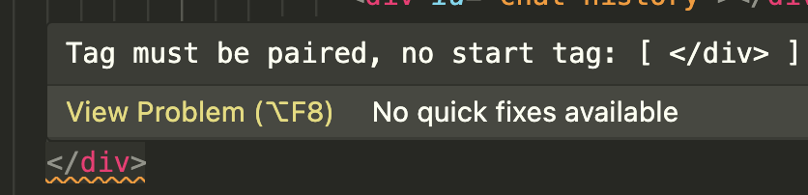
Why do we use VSC?
So far, we have been editing essentially plain text. That is all an HTML file is. Sure, there is a proliferation of "<" and ">" symbols, but a plain text editor could do the job.
VSC can tell you when you have errors in your mark up, and even provide hints to needed corrections.
Study the example on the right. Follow also a demonstration by the instructor...
The orange zig-zag underline indicates problems in that line or adjacent lines.
Hover the mouse cursor on the underline to read what the error might be.

Slide 19
Working In CSS
Let's make some changing in CSS, to experience its power.
In the SVP-LLM-Web folder, locate the svpcss.css file. Drag the file icon next to the tab with index.html, and release. You should be looking at CSS code...
We will next work on improving the instruction box in a variety of ways.

Slide 20
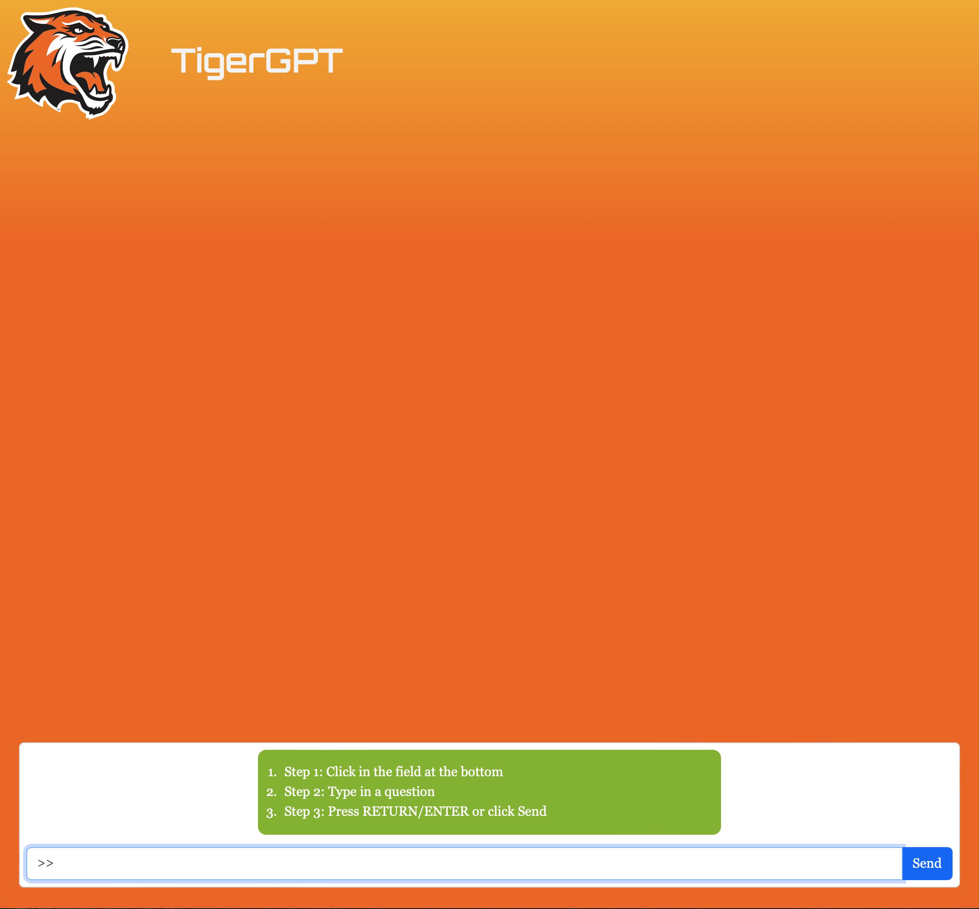
Task 4 - In CSS
Search for "Task 4". Below the comment is the ID instruction (block) rule. Change the lines of CSS between the { } brackets to what is shown below:
margin-inline: auto;
width: 50%;
background-color: var(--rit-accgreen);
color:white;
margin-bottom:15px;
padding-top:15px;
border-radius: 10px;
Save the CSS file and refresh Edge.
Better?
You get the idea -- the potential of customizing a web page. GREAT WORK!

