Slide 1
A 'Touch' of Website Development
Just the basics, please

Slide 2
Welcome!
Sit in your seats.
Start your computers.
In a short time you will get a feel for constructing a webpage.
You will be editing some HTML, the language used to layout webpages.
This will will be a magical experience!

Slide 3
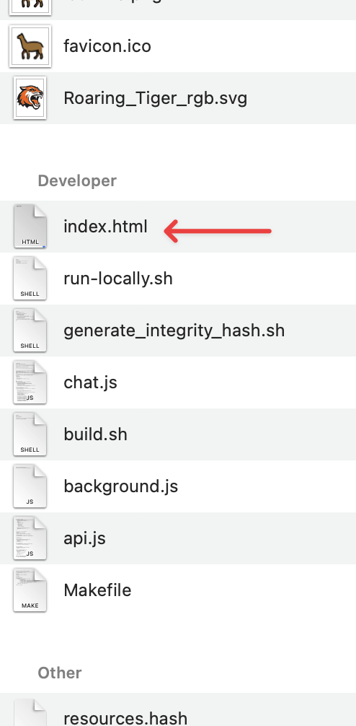
Here we go...
Launch Visual Studio Code (VSC).
(It may already be open...)
Open a browser window (Edge is fine).
Open the folder " SVP-LLM-Web" on the desktop.
Drag the index.html file into the main VSC window.
Drag the same file from the SVP-LLM-Web folder into the browser window.
SVP-LLM-Web folder

Slide 4
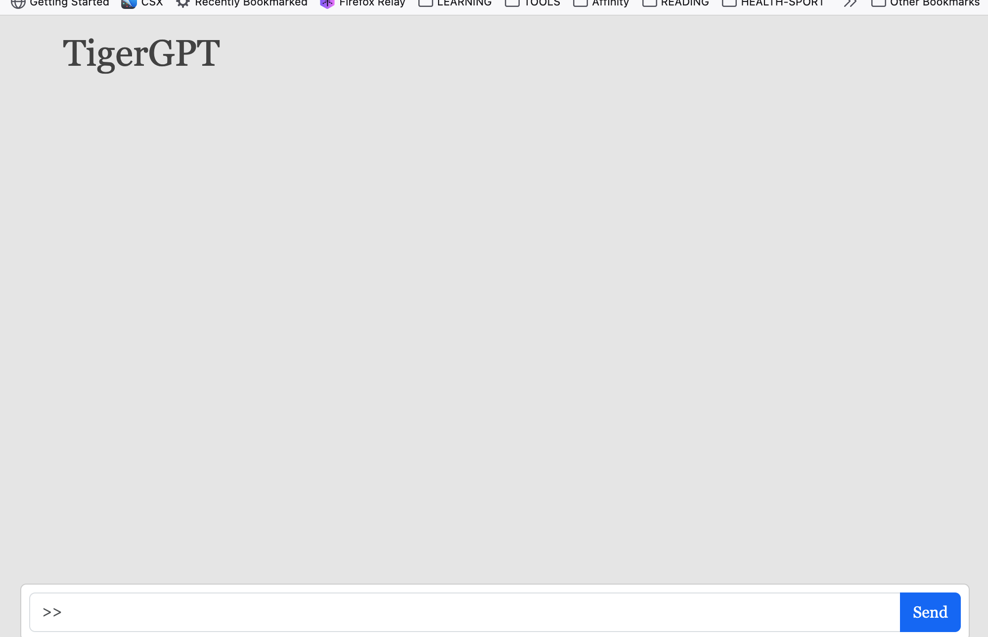
Keep going...
In the browser is a plain, boring,
"AI chatbot". You can give it a question and the AI will give you an answer. Give that a try - later.
Let's first make this page more interesting!

Slide 5
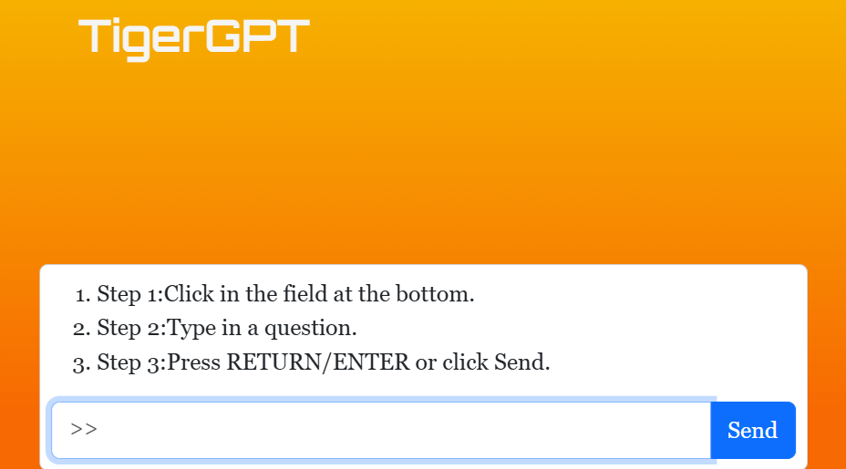
Step 1
Find Task 1 in your manual and in code.
Let’s add instructions for the user to follow. Currently it’s just a blank orange page.
<div>
<ol>
<li>Step 1: Click in the field at the bottom.</li>
<li>Step 2: Type in a question.</li>
<li>Step 3: Press RETURN/Enter…Send</li>
</ol>
</div>

Slide 6

Step 1
Change the page background color to "RIT orange". Search for "Task 2..." and add the 'class=' part to the <body> element as shown:
Save and refresh the browser.
Better than gray!
<body data-bs-theme="light" class="body-rit-orange">

Slide 7
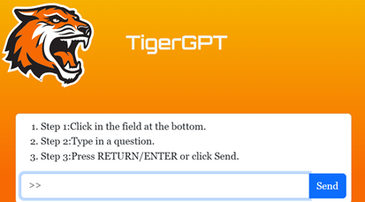
Step 2
Find Task 2 in your manual and in code.
Add the RIT Tiger Logo
<img src="Roaring_Tiger_rgb.svg" alt="RIT Tiger Spirit Mark" width="150">

Slide 8

Step 2
Add a background color gradient,
that starts at the top of the page.
Search for "Task 3..." and change the <div> element by adding 'bg-grad-yellow-trans' as shown:
Save and refresh the browser.
Even better!
<div class="position-fixed w-100
fix-top bg-grad-yellow-trans">

Slide 9
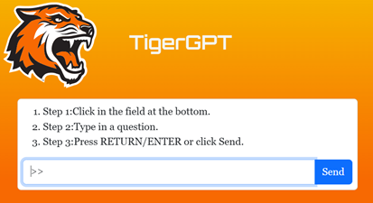
Step 3
Find Task 3 in the manual and in code.
Add some spacing after the prompt to make the page more professional
<div class="container p-2 card mb-25" id="input-area">

Slide 10

Step 3
Find Task 3 in the manual and in code.
Add some spacing after the prompt to make the page more professional
<h1 class="orbitron-fancy">TigerGPT</h1>

Slide 11
The End
Time is up. Go ahead and type a question into the TigerChat prompt.
Example: Write an eight-line poem about the first year of college.
Did you get a good answer?
Thanks for participating.
Join us on Wednesday for an extended web development experience.

