Slide 1
Mobile App Development (MAD)
(Elective)
Year 2 & 3 (2021), Semester 3 & 5
Teaching Team:
Mr Teo Wen Qiang, Wesley
Mr Low Kheng Hian, Ben

Slide 2
Objectives
Practical 1
Practical 2
Shared Preference
SQLite

Slide 3

Shared Preferences

Slide 4
Shared Preferences
Key-value store
Storing data persistently in app
Stored format: XML files
Saved as unencrypted format
Default and named preferences sets
Uses: Settings, Key/Value data
Simple API and easy to use

Slide 5
Shared Preferences
Main Activity
onStart()
onResume()
Settings XML
Input Action
Input Action
Input Action

Slide 6
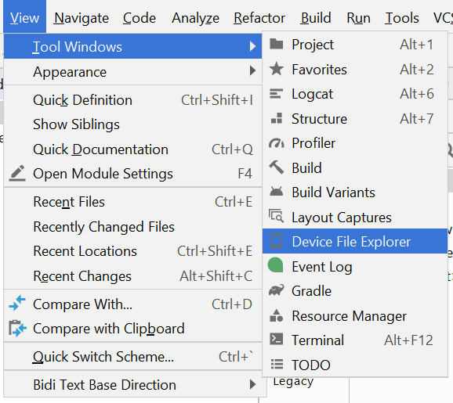
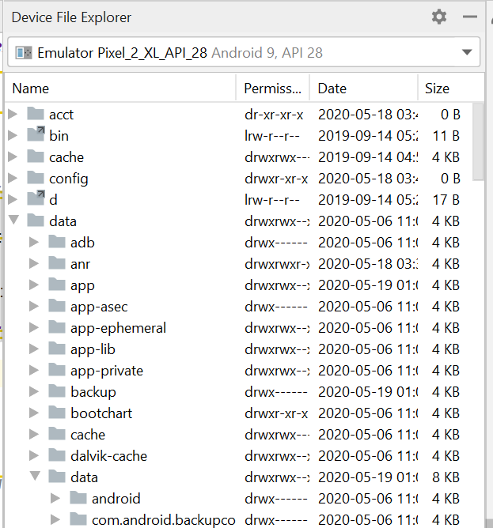
Shared Preferences
Emulator/ Device to be connected.
Access the Device File Explorer.
Shared preference xml file
Data> Data> App name> shared_prefs> file.xml

Slide 7
Shared Preferences
//save data of User Name
SharedPreferences.Editor editor = getSharedPreferences(PREF_NAME, MODE).edit();
editor.putstring(KEY, VALUE);
editor.apply();
//read data of User Name
SharedPreferences prefs = getSharedPreferences(PREFS_NAME, MODE);
String value = prefs.getString(KEY, “ “);

Slide 8
Shared Preferences
MODE
MODE_APPEND
MODE_ENABLE_WRITE_AHEAD_LOGGING
MODE_MULTI_PROCESS (Deprecated in API 23)
MODE_PRIVATE
Only accessible to calling application.
MODE_WORLD_READABLE (Deprecated in API 17)
Allow other application to read the preferences.
MODE_WORLD_WRITABLE (Deprecated in API 17)
Allow other application to write the preferences.
Notes:
https://developer.android.com/reference/android/content/Context#getSharedPreferences(java.lang.String,%20int)

Slide 9
Practical 1
Create a login page and a account registration page for a weather app.
The app should check and determines whether the user has a registered account and reacts accordingly. i.e. “Account Not Found” or “Account authenticated” etc.
It should allow the user to create as a new user asking for their username and password.
The created data shall be stored using shared preferences.
The user shall then be able to login to a simple weather page using the newly created account.

Slide 10
SQLite

Slide 11
SQLite Databases
Open source embedded database.
Built in to Android SDK, including classes and interfaces.
import android.database.sqlite.SQLiteDatabase;
import android.database.sqlite.SQLiteOpenHelper;
Internally linked to application’s ID.
Database deleted at the deletion of the application.

Slide 12
How it works?
Use of SQLiteOpenHelper, SQLiteDatabase
SQL Data
Source
SQLiteOpenHelper
SQLiteDatabase
UserData dbUserData = new UserData(); //New User Data Object
dbUserData.setMyUserName(dbUserName); // Set User Name
dbUserData.setMyPassword(dbPassword); // Set Password
dbHandler.addUser(dbUserData); // Add User Data Object to DB

Slide 13
Feature of SQLite
Application file format – Transactions guarantee ACID [Atomicity, Consistency , Isolation, Durability] even after system crashes and power failures.
Temporary data analysis – Command line client, import CSV files and use sql to analyze & generate reports.
Embedded devices – Applicable to small, reliable and portable like mobiles.
Portable - uses only ANSI-standard C and VFS, file format is cross platform (little vs. big endian, 32 vs. 64 bit)

Slide 14
Feature of SQLite
Reliable – has 100% test coverage, open source code and bug database, transactions are ACID even if power fails.
Small – 300 kb library, runs in 16kb stack and 100kb heap.
Single Database File – An SQLite database is a single ordinary disk file that can be located anywhere in the directory hierarchy.
Readable source code – The source code to SQLite is designed to be readable and accessible to the average programmer.

Slide 15
Disadvantages
High concurrency – reader/writer locks on the entire file.
Huge datasets – DB file can’t exceed file system limit or 2TB.
Access control – we don’t have any user interface to operate Sqlite database objects as in MYSQL / SQL Server /Oracle. All the objects are virtual. However there are few third party UI are available in the market.

Slide 16
An SQLite Example

Slide 17
SQLite Coding Example
Name of the table will be Product
Product
-productid : int -productname : String -productquantity : int
…
Primary Key / Auto Increment

Slide 18
Data Model
public class Product {
private int _id;
private String _productname;
private int _quantity;
public Product() { }
public Product(int id, String productname, int quantity) {
this._id = id;
this._productname = productname;
this._quantity = quantity;
}
public Product(String productname, int quantity) {
this._productname = productname;
this._quantity = quantity;
}
//continued on next page…

Slide 19
Data Model
public void setID(int id) {
this._id = id;
}
public int getID() {
return this._id;
}
public void setProductName(String productname) {
this._productname = productname;
}
public String getProductName() {
return this._productname;
}
public void setQuantity(int quantity) {
this._quantity = quantity;
}
public int getQuantity() {
return this._quantity;
}
} //Product

Slide 20
Implementing the Data Handler
import android.database.sqlite.SQLiteDatabase;
import android.database.sqlite.SQLiteOpenHelper;
public class MyDBHandler extends SQLiteOpenHelper {
@Override
public void onCreate(SQLiteDatabase db)
{
}
@Override
public void onUpgrade(SQLiteDatabase db, int oldVersion, int newVersion)
{
}
}
TEMPLATE

Slide 21
Implementing the Data Handler
public class MyDBHandler extends SQLiteOpenHelper {
private static final int DATABASE_VERSION = 1;
private static final String DATABASE_NAME = "productDB.db";
public static final String TABLE_PRODUCTS = "products";
public static final String COLUMN_ID = "_id";
public static final String COLUMN_PRODUCTNAME = "productname";
public static final String COLUMN_QUANTITY = "quantity";
public MyDBHandler(Context context, String name,
SQLiteDatabase.CursorFactory factory,
int version)
{
super(context, DATABASE_NAME, factory, DATABASE_VERSION);
}
…
}
MyDBHandler.java
Modify the code to declare constants for the database name, table name, table columns and database version and to add the constructor method

Slide 22
Implementing the Data Handler
@Override
public void onCreate(SQLiteDatabase db) {
String CREATE_PRODUCTS_TABLE = "CREATE TABLE " +
TABLE_PRODUCTS +
(" + COLUMN_ID + " INTEGER PRIMARY KEY AUTOINCREMENT,"
+ COLUMN_PRODUCTNAME
+ " TEXT," + COLUMN_QUANTITY + " INTEGER" + ")";
db.execSQL(CREATE_PRODUCTS_TABLE);
}
@Override
public void onUpgrade(SQLiteDatabase db, int oldVersion, int newVersion)
{
db.execSQL("DROP TABLE IF EXISTS " + TABLE_PRODUCTS);
onCreate(db);
}
This needs to be implemented so that the products table is created when the database is first initialized

Slide 23
The Add Handler Method
public void addProduct(Product product) {
ContentValues values = new ContentValues();
values.put(COLUMN_PRODUCTNAME, product.getProductName());
values.put(COLUMN_QUANTITY, product.getQuantity());
SQLiteDatabase db = this.getWritableDatabase();
db.insert(TABLE_PRODUCTS, null, values);
db.close();
}
A ContentValues object will be created in the body of the method and primed with key-value pairs for the data columns extracted from the Product object.

Slide 24
The Query Handler Method
public Product findProduct(String productname) {
String query = "SELECT * FROM " + TABLE_PRODUCTS + " WHERE "
+ COLUMN_PRODUCTNAME
+ " = \"" + productname + "\"";
SQLiteDatabase db = this.getWritableDatabase();
Cursor cursor = db.rawQuery(query, null);
Product product = new Product();
//continued on next page…
Using this string, a SQL SELECT statement will be constructed
to find all matching records in the table.
Notes:
https://developer.android.com/reference/android/database/sqlite/SQLiteOpenHelper.html#getReadableDatabase%28%29

Slide 25
The Query Handler Method
if (cursor.moveToFirst()) {
product.setID(Integer.parseInt(cursor.getString(0)));
product.setProductName(cursor.getString(1));
product.setQuantity(Integer.parseInt(cursor.getString(2)));
cursor.close();
} else {
product = null;
}
db.close();
return product;
} //findProduct

Slide 26
The Delete Handler Method
public boolean deleteProduct(String productname) {
boolean result = false;
String query = "SELECT * FROM " + TABLE_PRODUCTS + " WHERE "
+ COLUMN_PRODUCTNAME + " = \""
+ productname + "\"";
SQLiteDatabase db = this.getWritableDatabase();
Cursor cursor = db.rawQuery(query, null);
Product product = new Product();
//continued on next page…
The method will use a SQL SELECT statement to search for the entry based on the product name and, if located, delete it from the table.

Slide 27
The Delete Handler Method
if (cursor.moveToFirst()) {
product.setID(Integer.parseInt(cursor.getString(0)));
db.delete(TABLE_PRODUCTS, COLUMN_ID + " = ?",
new String[] { String.valueOf(product.getID()) });
cursor.close();
result = true;
}
db.close();
return result;
} //deleteProduct

Slide 28
Other features of Cursor class
boolean result = cursor.<method>
if(result)
{
//do something
}
cursor.moveToFirst()
Moves the cursor to the first row.
This method will return a false if the cursor is empty.
cursor.moveToLast()
Moves the cursor to the last row.
This method will return a false if the cursor is empty.
cursor.moveToNext()
Moves the cursor to the next row.
This method will return a false if the cursor is past the last entry in the result.
cursor.moveToPosition(int position)
Moves the cursor to an absolute position.
This method will return a true if the request destination was reachable, otherwise it will return a false.

Slide 29
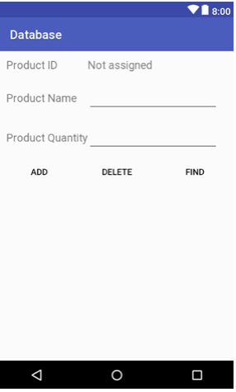
UI Layout and Implementation
//ADD
public void newProduct (View view) {
MyDBHandler dbHandler = new MyDBHandler(this, null, null, 1);
int quantity = Integer.parseInt(quantityBox.getText().toString());
Product product = new Product(productBox.getText().toString(),
quantity);
dbHandler.addProduct(product);
productBox.setText("");
quantityBox.setText("");
}

Slide 30
UI Layout and Implementation
//DELETE
public void removeProduct (View view) {
MyDBHandler dbHandler = new MyDBHandler(this, null, null, 1);
boolean result = dbHandler.deleteProduct(
productBox.getText().toString());
if (result)
{
idView.setText("Record Deleted");
productBox.setText("");
quantityBox.setText("");
}
else {
idView.setText("No Match Found");
}
}

Slide 31
UI Layout and Implementation
//FIND
public void lookupProduct (View view) {
MyDBHandler dbHandler = new MyDBHandler(this, null, null, 1);
Product product =
dbHandler.findProduct(productBox.getText().toString());
if (product != null) {
idView.setText(String.valueOf(product.getID()));
quantityBox.setText(String.valueOf(product.getQuantity()));
} else {
idView.setText("No Match Found");
}
}

Slide 32
Practical 2
Make use of practical 1 to expand the number of registered account to multiple accounts.
The created data shall be stored using SQLite.
Create a new page for managing the user accounts.
It should allow the administrator to list out information of existing users and delete unused accounts.

Slide 33
Summary
Shared Preferences
SQL Lite

Slide 34
Resources

Slide 35
Storing and accessing Shared Preferences
https://guides.codepath.com/android/Storing-and-Accessing-SharedPreferences
SQLite Differences
https://www.sqlite.org/different.html

