Slide 1
STUDENT DETAILS
NAME : MADDULA VIJAYA LAKSHMI
SKILLSBUILD EMAIL ID : vijayalakshmi.maddula2102@gmail.com
COLLEGE NAME : SRI VASAVI ENGINEERING COLLEGE
COLLEGE STATE : ANDHRA PRADESH
INTERNSHIP DOMAIN : DATA ANALYTICS
START DATE & END DATE : 05-06-2023 T0 23-07-2023

Slide 2
PROJECT TOPIC DOCTOR VISIT ANALYSIS USING PYTHON
Doctor visit analysis using Python involves the application of data manipulation, statistical techniques, and data visualization to gain insights from collected data related to patient visits to doctors or healthcare providers. The analysis aims to extract valuable information to improve healthcare services, identify patterns, and make data-driven decisions.
Analysing various factors like count of male and female visiting the hospital, no.of people having illnesses and many more.

Slide 3
AGENDA
The agenda for a doctor visit analysis project using Python typically involves various steps
Displaying first 15 rows with all the attributes
Count of people affected by illness
Plotting the income of the people
Count of individual male and female
Plotting various factors with different plotting techniques
Histogram
Boxplot
Pie chart

Slide 4
PROJECT OVERVIEW
The project mainly deals with analyzing of various factors like
Age, Gender, Income, Health factor, illness
Age helps to identify which age group people are mostly entering in to hospitals
Gender denotes no of males and females are attending
df["gender"].value_counts()
Illness indicates how many people are suffering from their illness it als helps to identify the count of diseases they are suffering.
df["illness"].value_counts()
Health Factor indicates the strength people are having.

Slide 5
WHO ARE THE END USERS
End users the one the people around us who are continuously suffering with illness and visiting doctors all the time to improve their situation.
This project indicates how many people are attending hospitals of different ages.
People always need to have a good care of their health in order to have a beautiful life.
Many diseases will be cured with the help of self care.
it is important for healthcare professionals to embrace data science and leverage its power to drive innovation and progress.

Slide 6
SOLUTION AND ITS VALUE PROPOSITION
The Project which contains the data set shows that many people are having more than one illness
This should be taken by every individual very seriously
By taking proper healthy diet
Exercise regularly
Drinking lot of water everyday based on their capacity
Having proper sleep
Decreasing the screen time

Slide 7
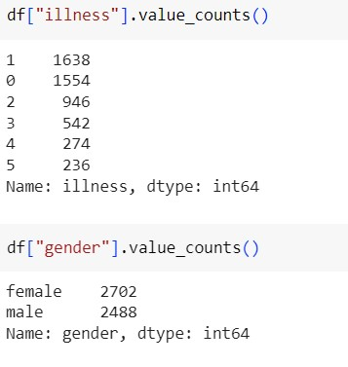
PROJECT VIEW
Importing all the required libraries
import matplotlib.pyplot as plt
import pandas as pd
import numpy as np
import seaborn as sns

Slide 8
CUSTOMISATION
I customize my project as one of the innovative creation which was done by me and it was helpful to others.
Normally we don’t found these type of data that is which was completely analyzed and identified the problems so based on these results the people’s mind set should change.
In this project I use some creative methods like representing the data in bar graphs, visualizing the data with histograms and scatterplots which are some new innovative creations and it may be unique.

Slide 9
MODELLING
In this project I have used different libraries like NumPy, pandas, matplotlib, seaborn
NUMPY: NumPy is a powerful Python library for numerical computing, providing efficient arrays and mathematical functions to work with large datasets and perform complex operations easily.
PANDAS: Pandas is a popular Python library used for data manipulation and analysis. It provides data structures like Data Frames and Series, along with a wide range of functions, making it convenient for working with structured data.
MATPLOTLIB: Matplotlib is a widely-used Python library for creating static, interactive, and publication-quality visualizations, offering a flexible and customizable interface for generating plots, charts, and graphs with ease.
SEABORN: Seaborn is a Python data visualization library built on top of Matplotlib, providing a high-level interface for creating attractive statistical graphics with minimal code, making it particularly useful for exploratory data analysis.

Slide 10
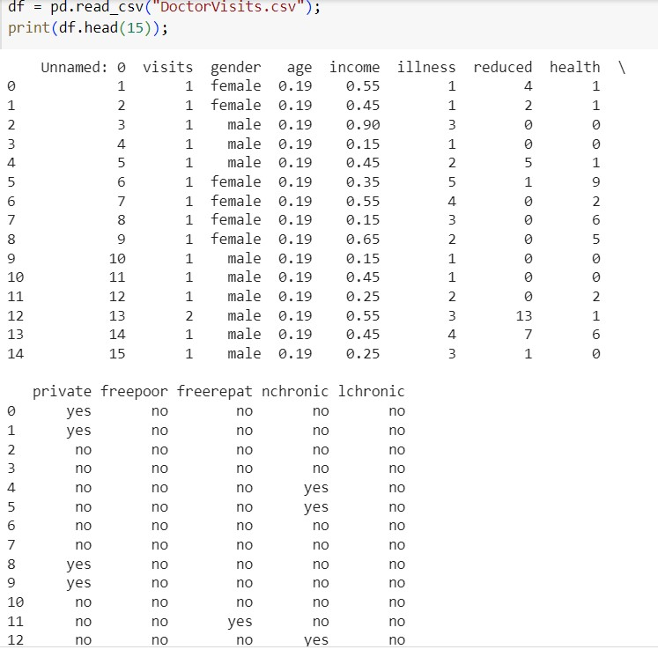
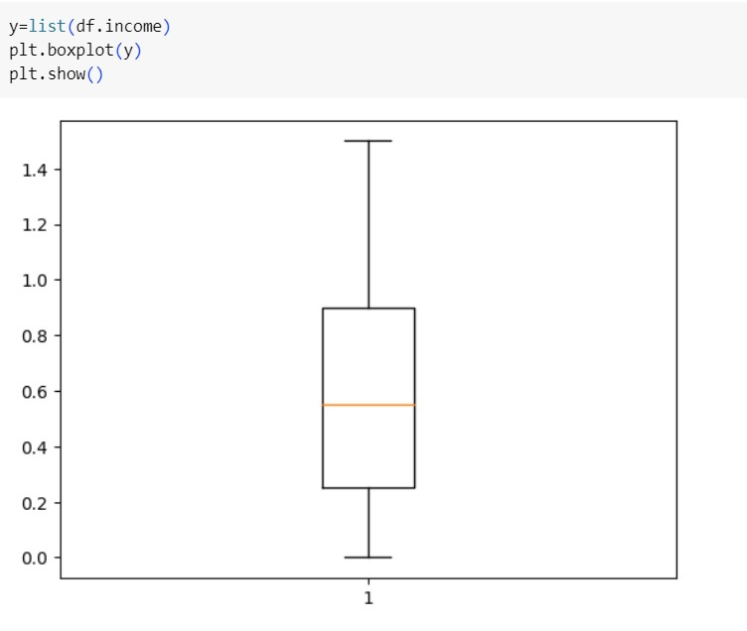
RESULTS

Slide 11
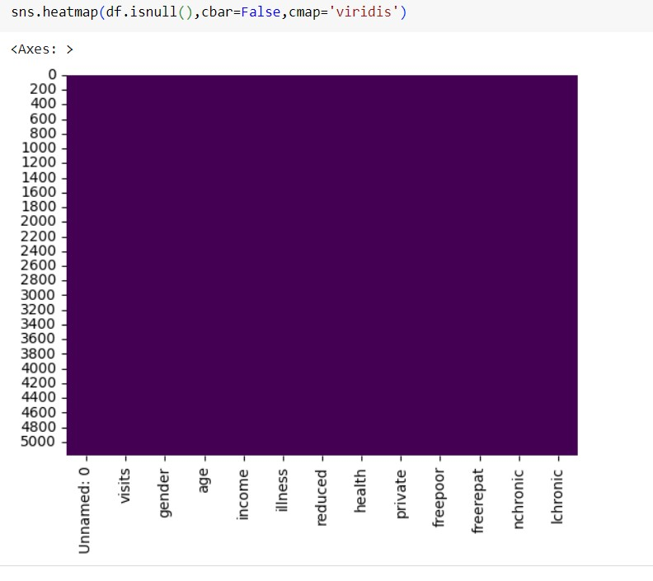
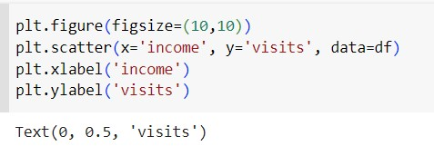
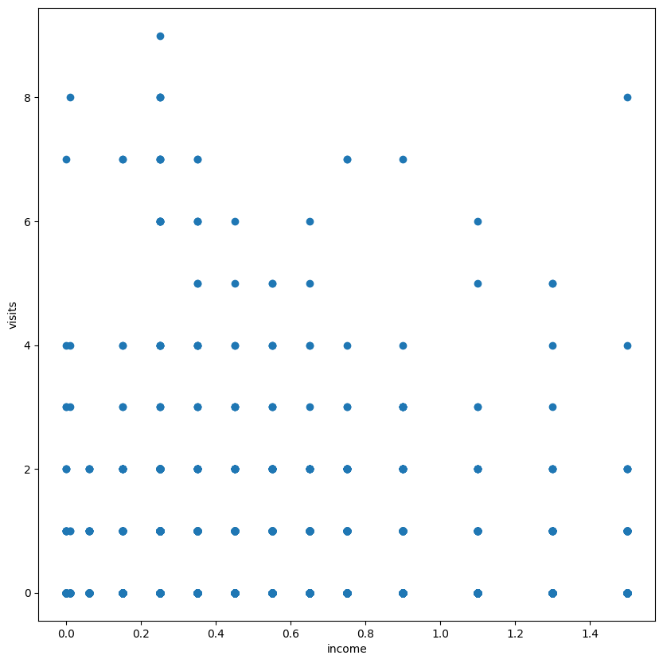

Slide 12
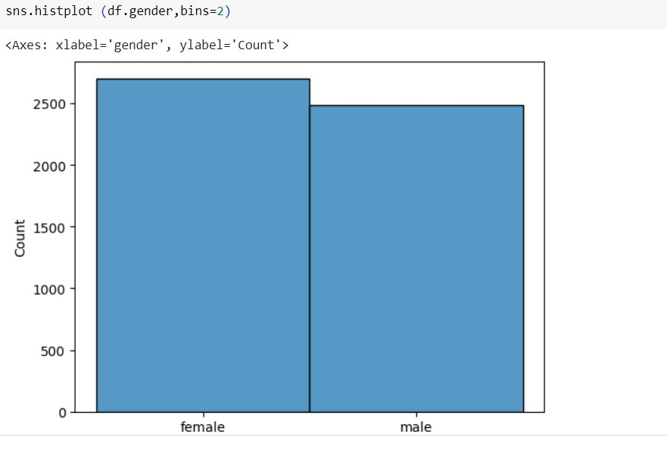
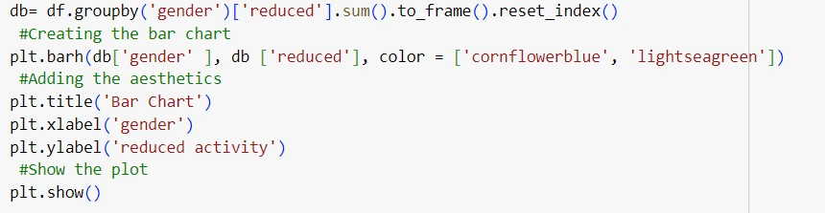
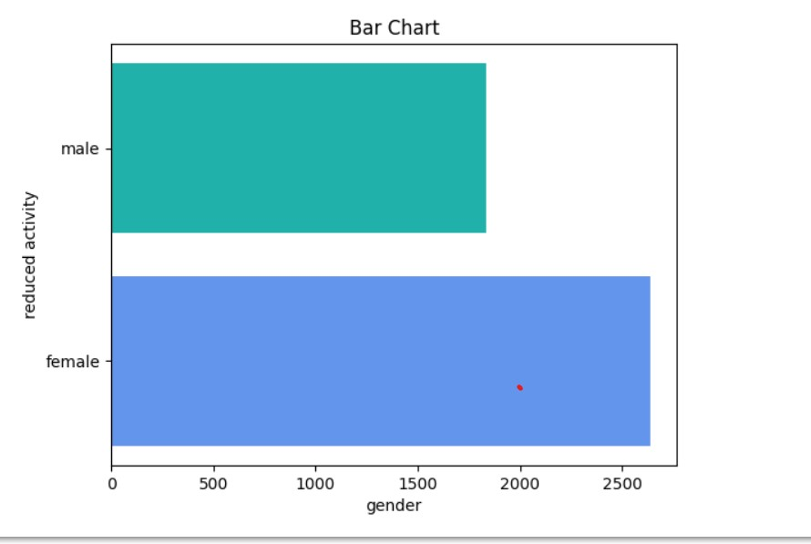

Slide 13
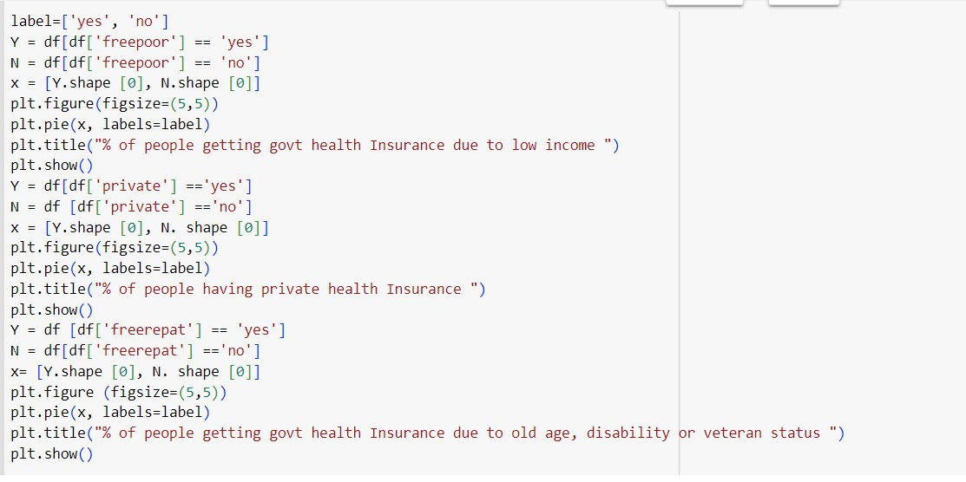
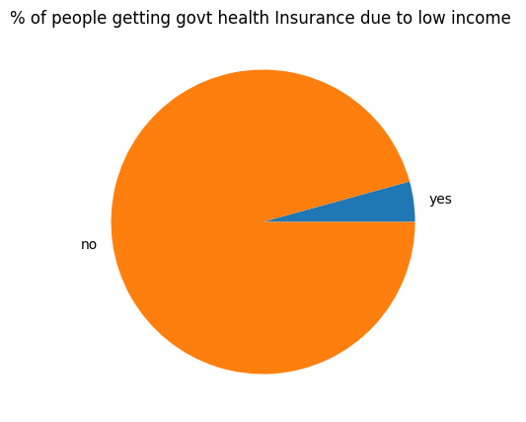

Slide 14
LINKS
Google colab link: https://colab.research.google.com/drive/17CriiWrDGFBfc0ju_hweMoR2Sx2rXiXw?usp=sharing

Slide 15


