Slide 1
AI-Powered PPT & DOC Generator for University Students

Slide 2
The Problem & Our Solution
**The Problem: Student Document Creation Bottleneck**
University students face immense pressure to produce high-quality documents (presentations, essays, reports) under tight deadlines. Time constraints, writer's block, and formatting complexities hinder productivity and impact academic performance. Students often struggle with structuring information effectively and adhering to specific formatting guidelines required by professors.
**Our Solution: AI-Powered Document Generation**
We offer an AI-driven platform that automatically generates PPT presentations and DOC documents based on user-provided information. Input a topic, keywords, and desired length, and the AI constructs a well-structured, formatted document. Focus on content, not on tedious formatting and design – and spend less time battling writer’s block.

Slide 3
Key Features & Benefits
Automated Content Generation: Our AI algorithms create structured PPT decks and DOC documents from simple text prompts, saving students valuable time.
Customizable Templates & Styles: Users can select from a variety of pre-designed templates and customize fonts, colors, and layouts to match their preferences.
Seamless Integration with Academic Resources: The generator integrates with research databases and citation tools for easy sourcing and accurate referencing.
Real-Time Collaboration: Multiple users can collaborate on the same document simultaneously, facilitating teamwork on group projects.
Plagiarism Detection: An integrated plagiarism checker ensures originality and academic integrity for all generated content.
Multi-Language Support: Generate documents in multiple languages to cater to international students and global research projects.

Slide 4
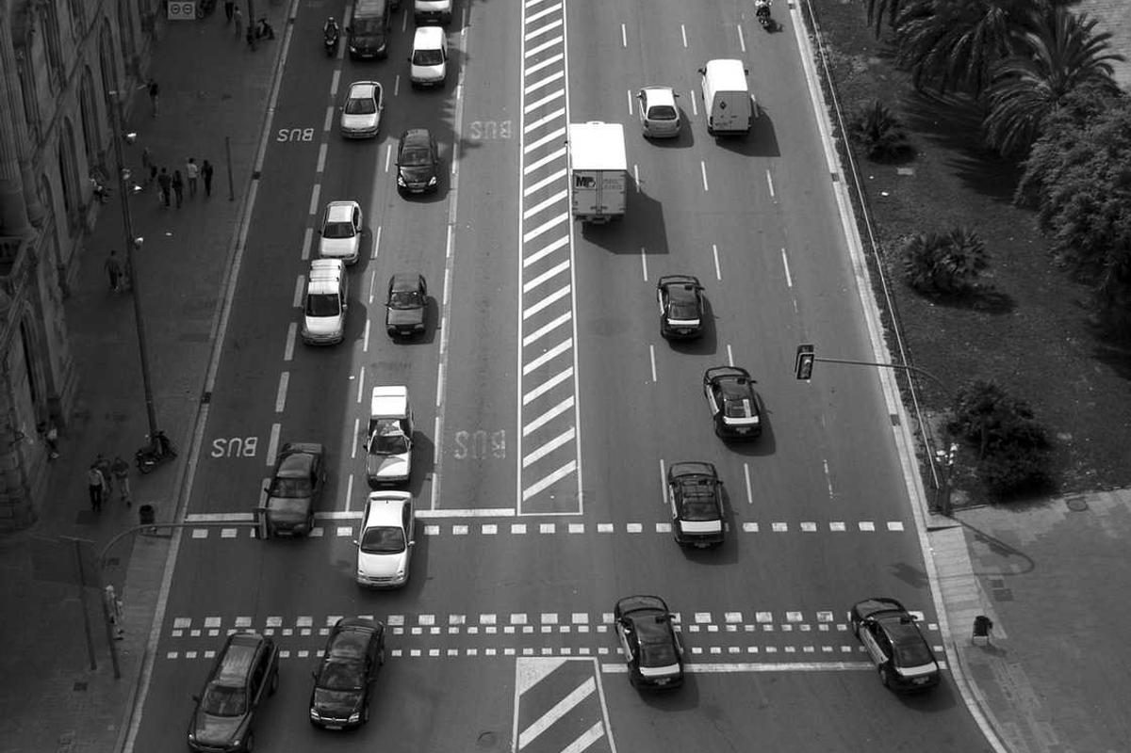
Demo Flow: From Input to Output
This flowchart illustrates the process: users input a topic, the AI generates content, users refine the content, and export the polished presentation or document.

Slide 5
Next Steps: Empowering Your Academic Success
Sign up for a free trial and experience the power of AI-driven document creation firsthand.
Explore our range of customizable templates and formatting options to find your perfect style.
Join our online community to share tips, collaborate with other users, and provide feedback.
Contact our support team with any questions or concerns you may have.
Unlock premium features like advanced plagiarism checking and multi-language support for enhanced performance.

