Slide 1
AI-Powered PPT & DOC Generator: Unleash Academic Productivity

Slide 2
The Problem & Our Solution
**The Challenge:** Students spend countless hours creating presentations and documents, diverting time from actual learning. Research, formatting, and design become major obstacles. Maintaining consistent branding and avoiding plagiarism adds to the complexity.
**The Solution: AI-Powered Generator:** Our tool streamlines content creation by automating research summarization, template design, and citation management. Students input their topic, and the AI generates a draft, saving time and improving quality, allowing for focused learning.

Slide 3
Key Features & Tech Stack
Automated Content Generation: Generates PPT and DOC drafts from a single topic input, providing a starting point for customization.
Smart Template Design: Applies visually appealing and academically appropriate templates automatically, ensuring a professional look.
AI-Powered Research Summarization: Extracts key information from research papers and websites, creating concise summaries for use in documents.
Automatic Citation Management: Integrates with citation styles (MLA, APA, Chicago) to ensure proper attribution and avoid plagiarism.
Our tech stack includes Python (for backend logic), React (for user interface), and OpenAI API (for content generation).
Built-in Plagiarism Checker: Compares the generated content with a vast database of academic and web resources.

Slide 4
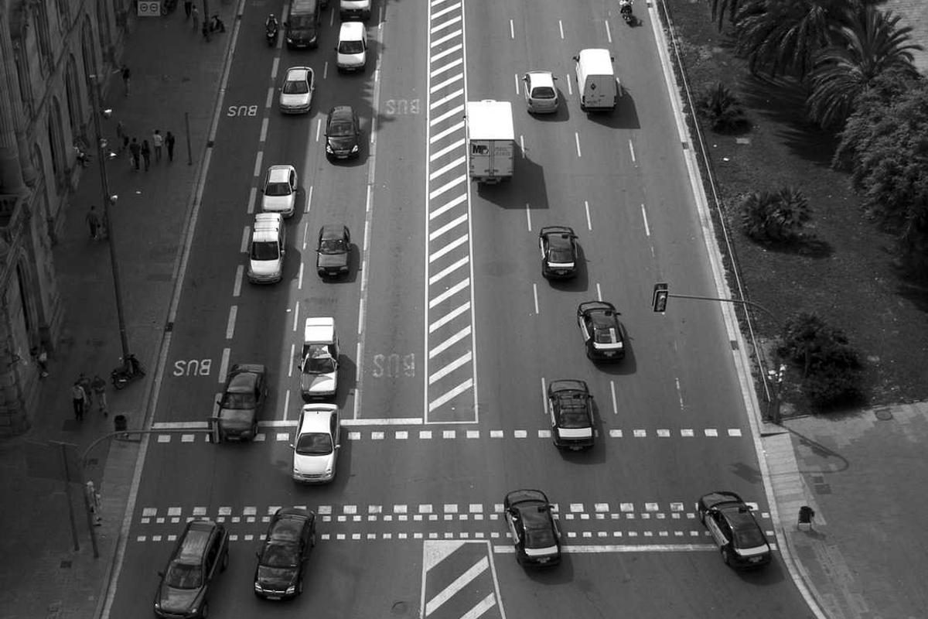
Demo Flow: From Idea to Presentation
This diagram illustrates the streamlined workflow: Input topic, AI generates draft, user customizes, then exports the final PPT or DOC.

Slide 5
Next Steps: Empower Your Academic Journey
Sign up for a free trial and experience the power of AI-driven content creation firsthand.
Explore our premium features for advanced customization and unlimited document generation.
Provide feedback to help us improve the tool and better meet your academic needs.
Join our online community to connect with other students and share best practices.
Check our website for upcoming workshops and tutorials on effective presentation design.
Contact us directly with questions or suggestions – we're here to support your success.

