Slide 1
MADESHWARAN M
Final Project
3/21/2024 Annual Review

Slide 2
PROJECT TITLE
Android app market and review analysis using deep learning

Slide 3
AGENDA
An introduction to sentiment analysis and its importance in understanding user opinions; followed by data collection and preprocessing methods, including text normalization and noise removal. Then, exploring sentiment analysis techniques such as lexicon-based and machine learning approaches, and their implementation in Android apps using relevant libraries. Evaluation and validation methods for assessing sentiment analysis performance, along with strategies for enhancements and optimization, are crucial. Additionally, considerations for user experience and visualization of sentiment analysis results, and showcasing case studies and best practices for successful implementations, are essential aspects to cover.

Slide 4

PROBLEM STATEMENT
Despite the abundance of feedback, deciphering sentiment manually is time-consuming and prone to errors. This necessitates the development of efficient sentiment analysis techniques tailored for the Android platform to automate the process. The challenge lies in implementing robust sentiment analysis algorithms that can handle diverse linguistic expressions and nuances, ensuring reliable insights. Consequently, the goal is to create a seamless and informative user experience by integrating sophisticated sentiment analysis functionalities into Android apps, ultimately aiding developers in making data-driven decisions for app improvement and user satisfaction.

Slide 5

PROJECT OVERVIEW
The project aims to develop a sentiment analysis system for Android app market reviews to enhance user experience and aid developers in understanding user feedback. Leveraging natural language processing techniques, the system will automate the analysis of user sentiments expressed in app reviews. Key objectives include collecting and preprocessing data, implementing sentiment analysis algorithms tailored for the Android platform, and integrating the system into Android apps. The project seeks to provide actionable insights to developers, facilitating informed decision-making for app improvement and user satisfaction.

Slide 6
OBJECTIVE:
Develop a sentiment analysis system specifically designed for analyzing user feedback in the Android app market.
Collect a comprehensive dataset of app reviews from the Android platform for training and evaluation purposes.
Preprocess the collected data to clean and standardize text inputs, including tasks such as tokenization, stopword removal, and text normalization.
Implement and experiment with various sentiment analysis techniques, including lexicon-based, machine learning, and deep learning approaches, to determine the most effective method for Android app reviews.
Integrate the sentiment analysis system into Android applications, enabling developers to obtain real-time insights into user sentiments and feedback.
Provide actionable insights and visualizations derived from sentiment analysis results to aid developers in making data-driven decisions for app improvement and enhancing user satisfaction.

Slide 7
YOUR SOLUTION AND ITS VALUE PROPOSITION
User Experience Improvement:
Insightful Feedback: Provide developers with valuable insights into user sentiments, allowing them to address issues and enhance features based on user feedback.
Enhanced App Quality: Enable developers to identify areas of improvement within their apps, leading to the development of higher-quality and more user-centric applications.
Developer Efficiency:
Automated Analysis: Automate the process of analyzing user reviews, saving developers time and resources typically spent manually parsing through feedback.
Competitive Advantage:
Data-Driven Decisions: Equip developers with data-driven insights derived from sentiment analysis, enabling them to make informed decisions regarding app updates, feature enhancements, and marketing strategies.

Slide 8
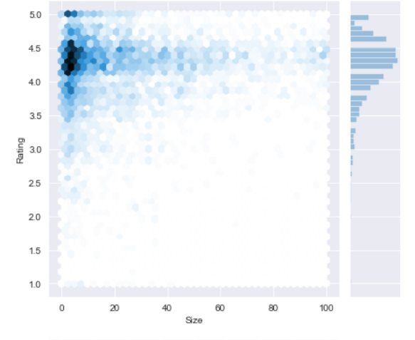
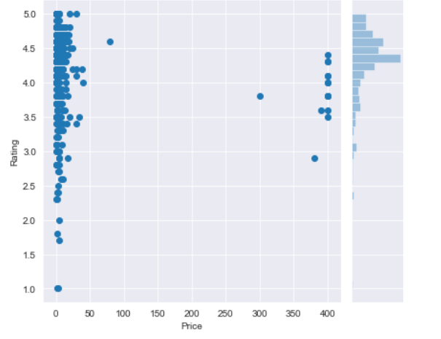
RESULTS

Slide 9
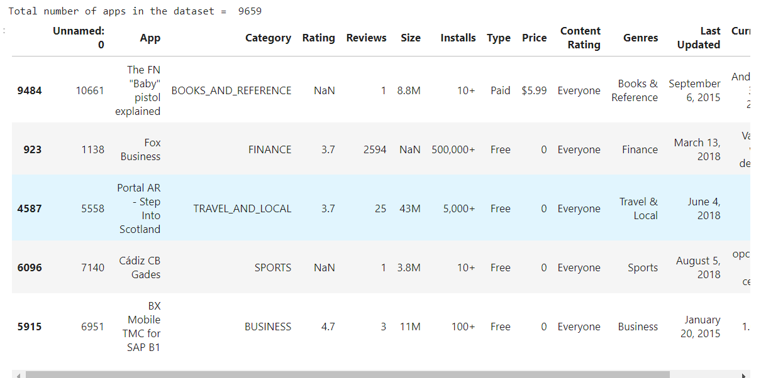
RESULTS

Slide 10
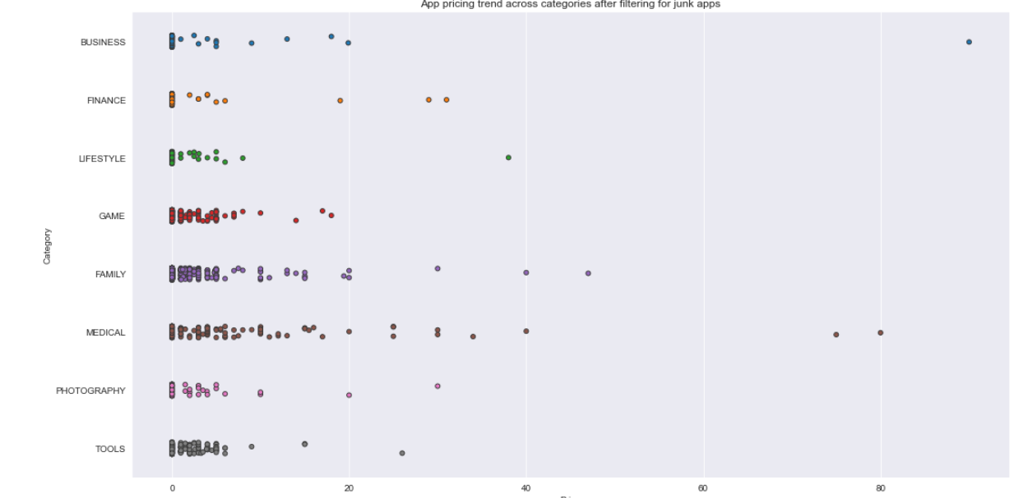
Results
DRIVE LINK
https://drive.google.com/file/d/13zqxFj3Z9uw2PikgnZyK1JebaFz3Blwp/view?usp=sharing

