Slide 1



Hostel Management System – WebApp
BY:
MADHANKUMAR C 23CDR082
KARTHIKRAJA S 23CDR069
POORNACHANDRAN NC 23CDR120
Review 2 – 15/3/25

Slide 2
Project Recap
This project aims to transform hostel management into a digital process.
It provides tailored dashboards for students and administrators, making hostel operations more efficient and transparent.
2

Slide 3
Database Design
Students: name, reg. no., room, department
Rooms: room no., capacity, availability
Attendance: student ID, date, status
Payments: student ID, amount, date
Maintenance: request details from students

Slide 4
Features Implemented So Far
Secure login system for students and admins
Admin can add/view/delete student details
Room allocation handled dynamically
Student views attendance and payment status
Maintenance requests can be raised by students

Slide 5
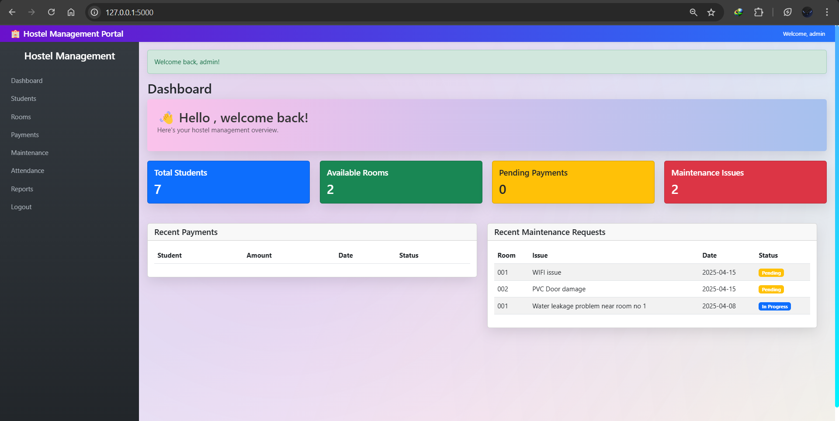
Admin panel

Slide 6
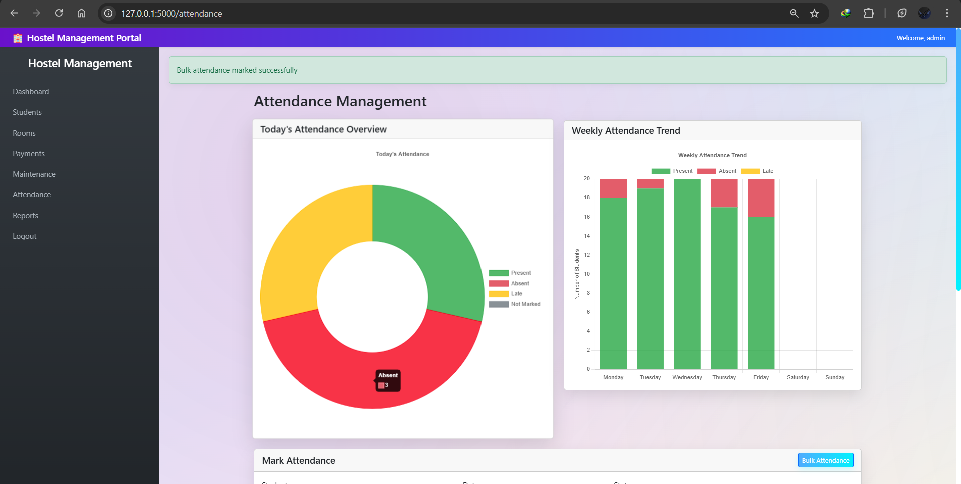
Attendance panel

Slide 7
Thank you!

