Slide 1

DUSHYATH RAO
SACHIDNANDA NAYAK
MADHAN RAJ
AKASHA
ANTHONY KEVIN
23BTCE118
23BTCE160
23BTCE134
23BTCE105
23BTCE107

Slide 2
A Responsive Restaurant Website Design

Slide 3
Introduction
The project is a responsive website for "Fx Restaurant" designed to enhance the online dining experience by showcasing the restaurant's special dishes, menu, and customer reviews, and providing an easy ordering system.
Importance of Responsive Design: Ensures the website is accessible and visually appealing on all devices, improving user experience and engagement.
Objectives: Present the restaurant's offerings attractively. Provide a seamless and user-friendly navigation experience. Enable customers to easily place orders online.

Slide 4
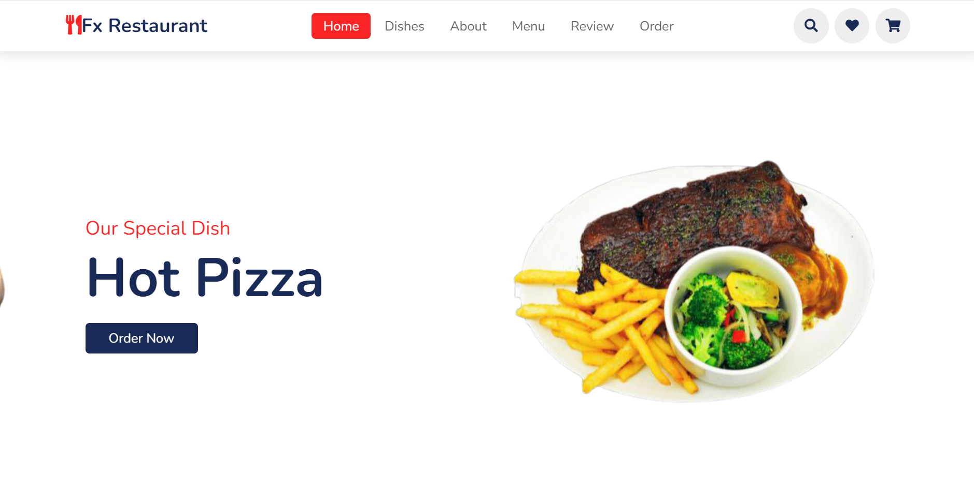
Home page
Description: The home page features the restaurant's logo, navigation menu, special dish highlights with attractive images, and call-to-action buttons like "Order Now."

Slide 5
Dishes Section
Overview: The popular dishes section showcases various dishes with images, ratings, prices, and an "Add to Cart" button.

Slide 6
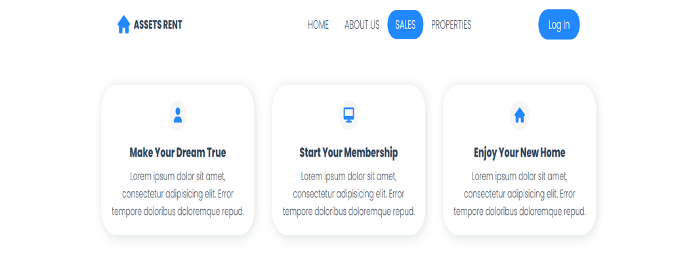
Sales pag

Slide 7
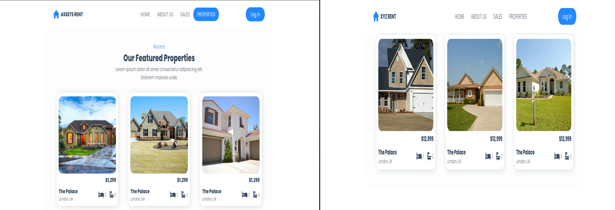
Properties Page

Slide 8
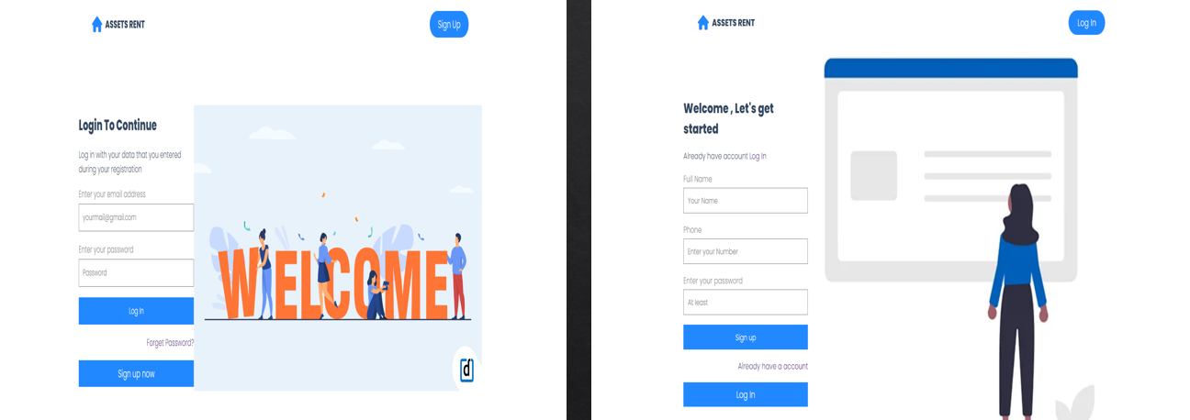
Login and Sign Up Page

Slide 9
Conclusion
Finding Rental Properties:
Browse through rental listings.
Use advanced filters to find properties that match your criteria.
Detailed
Access high-quality photos and comprehensive descriptions.
Scheduling
Easily schedule property viewings.
Coordinate appointments directly through the platform.

Slide 10
Thank You

