Slide 1
Employee Data Analysis using Excel
STUDENT NAME:Madhan V
REGISTER NO:3112200229
DEPARTMENT:B.com Accounting and Finance
COLLEGE S.I.V.E.T college

Slide 2
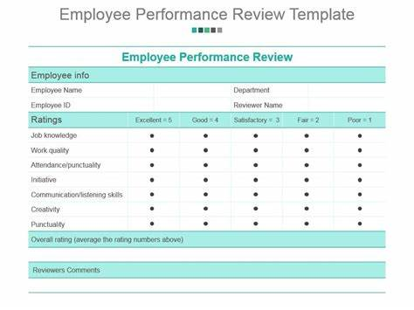
PROJECT TITLE
Employee Performance Analysis using Excel

Slide 3


AGENDA
Problem Statement
Project Overview
End Users
Our Solution and Proposition
Dataset Description
Modelling Approach
Results and Discussion
Conclusion
3/21/2024 Annual Review

Slide 4

PROBLEM STATEMENT
Difficulty evaluating performance: This can lead to a high turnover, more turnover, more errors, and a reduced ability to manage improvement. Skills gaps: Organizations may not be aware of skills gaps in their employees , position of groups. Irregular performance activities: There may be lack ok regular performance reviews and management activities

Slide 5

PROJECT OVERVIEW
.
A perform review, also known as employee evaluation of performance appraisal, is a formal assessment that helps identity an employee's strength and weakness, and set goals for there feature

Slide 6


WHO ARE THE END USERS?

Slide 7

OUR SOLUTION AND ITS VALUE PROPOSITION
Conditional formatting in Excel lets you highlight into or make data stand out by applying custom rules to cells The formula is often = FILTER ( array , filter criteria, optional value) Pivot table in Excel is a feature that help you organize and summarize data in a spread sheet

Slide 8
Dataset Description
Employee - kaggle Features - 26 Employee id - number Name - Text Employee type Performance level Gender - male and female Employee rating - number

Slide 9

THE "WOW" IN OUR SOLUTION
Performance level=IFS (Z8>5, "VERY HIGH", Z8>=4, "HIGH", Z8=3,"MED", TRUE, "LOW"
3/21/2024 Annual Review
9

Slide 10
MODELLING
1. Data collection (1) columns (2) name (3) role 2. Feature collection (1) sort (2) pivot tables (3) Format 3. Data cleaning (1) remove extra spaces (2) fill missing values
10

Slide 11
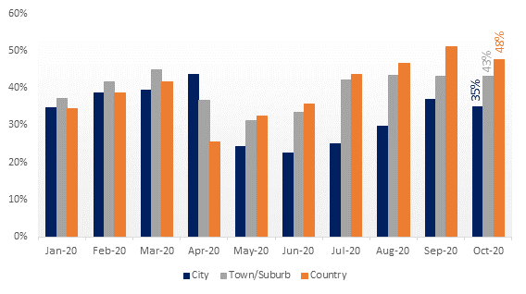
RESULTS
11

Slide 12
conclusion
A conclusion of an employee performance analysis can include an summary of the employee's performance, their strengths, and areas for improvement

