Slide 1


Slide 2
ANAESTHESIA – is the reversible loss of response to noxious stimuli.
GENERAL ANAESTHESIA – when anaesthesia is associated with loss of conciousness.
LOCAL ANAESTHESIA – when conciousness is maintained during anaesthesia.
Notes:
KWI- essence.

Slide 3
BALANCED ANAESTHESIA
Unconciousness
Analgesia
Muscle relaxation
Abolition of compensatory reflex response
General anesthetics have therapeutic indices of about 2 - 4.

Slide 4
PREANAESTHETIC MEDICATION
It is the use of drugs prior to anesthesia to make it more safe and pleasant.
To relieve anxiety – benzodiazepines.
To prevent allergic reactions – antihistaminics.
To prevent nausea and vomiting – antiemetics.
To provide analgesia – opioids.
To prevent acidity – proton pump inhibitor
To prevent bradycardia and secretion – atropine.

Slide 5
STAGES OF ANESTHESIA
Stage I : Analgesia
Stage II : Excitement, combative
behavior – dangerous state
Stage III : Surgical anesthesia
        -Plane 1- roving movements of eyeballs
        -Plane 2- prog. loss of corneal reflex (surgery)
        -Plane 3- pupils start dilating, muscle relaxation
        -Plane4- only abdo respi, fully dilated pupils
Stage IV : Medullary paralysis –
respiratory and vasomotor
control ceases.

Slide 6
MOLECULAR MECHANISM OF THE GA
GABA –A : Potentiation by Halothane,
Propofol, Etomidate
NMDA receptors : inhibited by Ketamine &
N2O

Slide 7
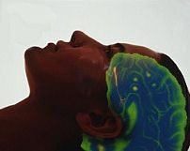
The main target of anaesthetics is the brain

Slide 8
CLASSIFICATION
There are two types of anaesthetics :
Inhalational --- for maintenance
Intravenous --- for induction and short procedures
Inhalation anaesthetics:
Advantage of controlling the depth of anesthesia.
Metabolism is very minimal.
Excreted by exhalation.

Slide 9
INHALATIONAL ANAESTHETICS
Non-halogenated gas
Nitrous oxide
Halogenated hydrocarbons
Halothane
Enflurane
Isoflurane
Desflurane
Sevoflurane
Methoxyflurane – nephrotoxicity.

Slide 10
The important characteristics of Inhalational anaesthetics which govern the anaesthesia are
Partial pressure of anaesthetic in inspired gas
Pulmonary ventilation
Alveolar exchange
Solubility in the blood
(blood : gas partition co-efficient)
Solubility in the fat
(oil : gas partition co-efficient)

Slide 11
BLOOD : GAS PARTITION CO-EFFICIENT
It is a measure of solubility in the blood.
It determines the rate of induction and recovery of Inhalational anesthetics.
Lower the blood : gas co-efficient – faster the induction and recovery – Nitrous oxide.
Higher the blood : gas co-efficient – slower induction and recovery – Halothane.

Slide 12
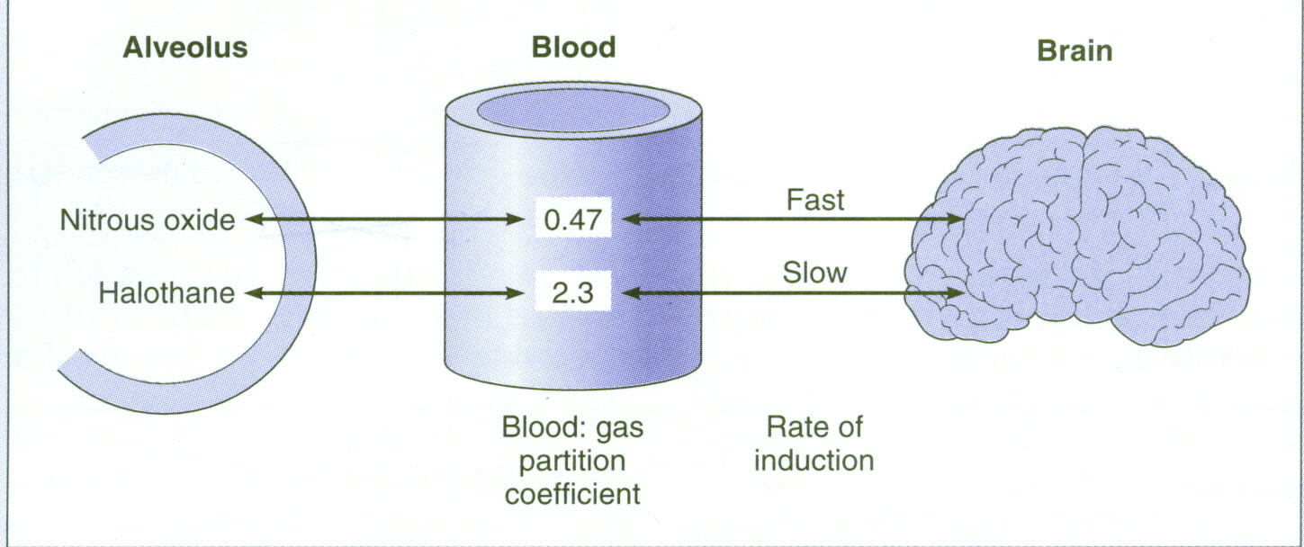
BLOOD GAS PARTITION CO-EFFICIENT

Slide 13
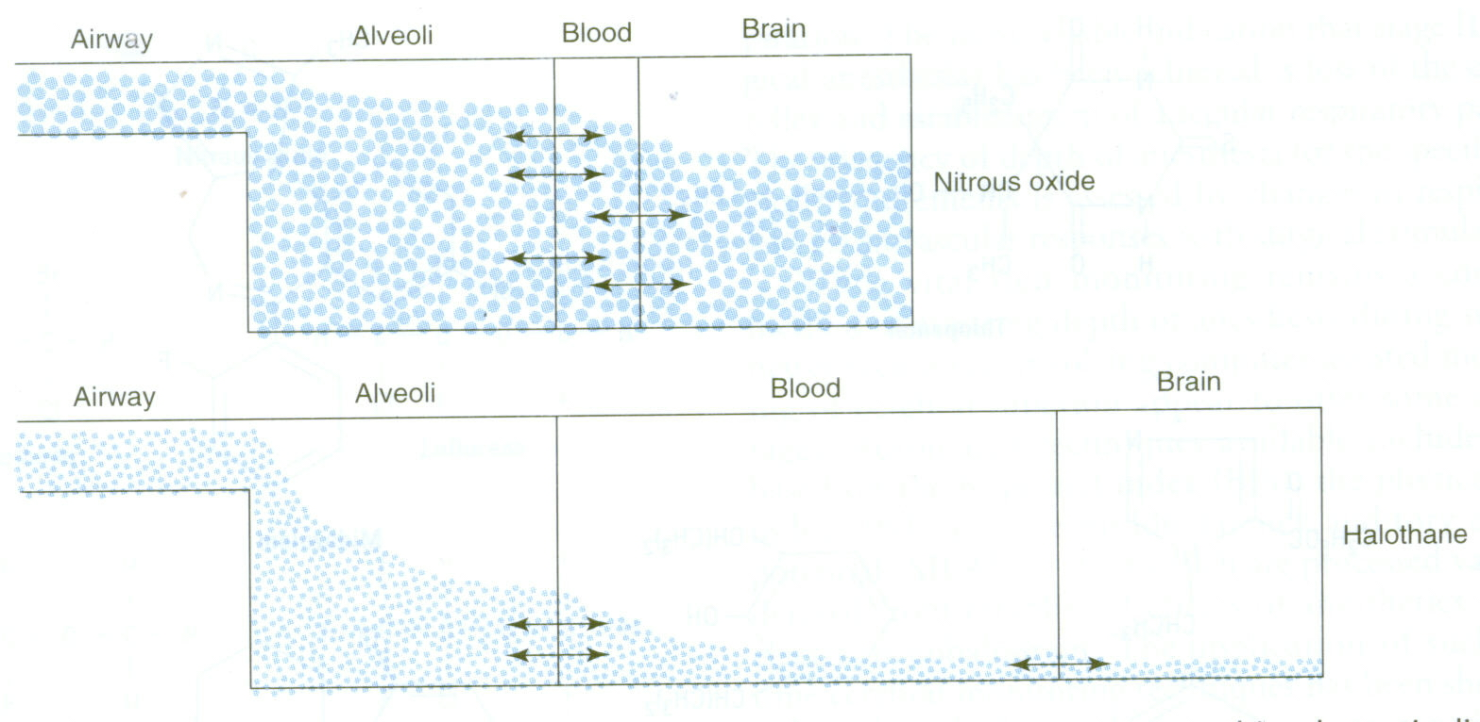
Agents with low solubility in blood quickly saturate the blood. The additional anesthetic molecules are then readily transferred to the brain.
BLOOD GAS PARTITION COEFFICIENT
Notes:
Imagine two cups of warm water: into one you put a spoon of sugar and into the other a spoon of sand. Which will be in higher concentration in the bottom of the cup? The sand is insoluble, the sugar dissolves, so very little reaches the bottom. For bottom of cup read brain.
The blood:gas partition coefficient is the ratio of the concentrations of anesthetic gas in the blood and gas phases at equilibrium. In general, the blood:gas partition coefficient represents the capacity of the blood or a specific tissue to absorb the anesthetic. A higher blood:gas partition coefficient (e.g., 2.0 equals a 2% blood concentration and a 1% lung concentration at equilibrium) shows greater affinity for the blood. An anesthetic that has a blood concentration of 3% and a lung concentration of 6% at equilibrium would have a partition coefficient of 0.5, showing a greater affinity for the gas phase.
The blood/gas partition coefficient describes how the gas will partition itself between the two phases after equilibrium has been reached. Isoflurane for example has a blood/gas partition coefficient of 1.4. This means that if the gas is in equilibrium the concentration in blood will be 1.4 times higher than the concentration in the alveoli. A higher blood gas partition coefficient means a higher uptake of the gas into the blood and therefore a slower induction time. It takes longer until the equilibrium with the brain partial pressure of the gas is reached
Agents with low blood solubility require few molecules to dissolve into the blood to raise the partial pressure to equilibrium.

Slide 14
OIL: GAS PARTITION CO-EFFICIENT
It is a measure of lipid solubility.
Lipid solubility - correlates strongly with the potency of the anesthetic.
Higher the lipid solubility – potent anesthetic e.g., halothane

Slide 15
MAC value is a measure of inhalational anesthetic potency.
It is defined as the minimum alveolar anesthetic concentration ( % of the inspired air) at which 50% of patients do not respond to a surgical stimulus.
MAC values are additive and lower in the presence of opioids.
MAC values 1.1 to 1.2 used during surgery.

Slide 16
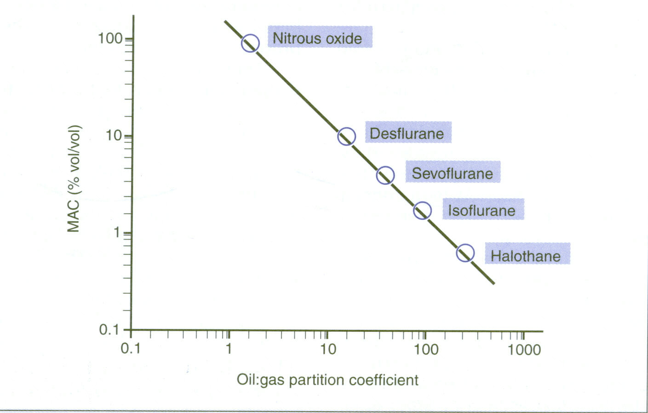
OIL GAS PARTITION CO-EFFICIENT
Higher the Oil: Gas Partition Co-efficient lower the MAC . E.g., Halothane
0.8
1.4
220

Slide 17
Inhalation Anesthetic | MAC value % | Oil: Gas partition
Nitrous oxide | >100 | 1.4
Desflurane | 7.2 | 23
Sevoflurane | 2.5 | 53
Isoflurane | 1.3 | 91
Halothane | 0.8 | 220

Slide 18
Second gas effect
Nitrous oxide is very insoluble in blood and other tissues.
This results in rapid equilibration.
The rapid uptake of N₂O from alveolar gas serves to concentrate coadministered halogenated anesthetics.
This effect (the "second gas effect") speeds induction of anesthesia.

Slide 19
Diffusional hypoxia
On discontinuation of N₂O administration, nitrous oxide gas can diffuse from blood to the alveoli, diluting O₂ in the lung.
This can produce an effect called diffusional hypoxia.
To avoid hypoxia, 100% O₂ should be administered when N₂O is discontinued.

Slide 20
INHALATIONAL ANESTHETICS
Nitrous oxide:
Safest inhalational anaesthetic.
Noninflammable, nonirritating
Low potency anaesthetic, poor muscle relaxant but a good analgesic.
No toxic effect on the heart, liver and kidney.
A/E- diffusional hypoxia, megaloblastic anemia.

Slide 21
INHALATIONAL ANESTHETICS
Ether
Potent anaesthetic, good analgesic, good muscle relaxants.
Irritant, inflammable, explosive
Induction is very slow and unpleasant (highly soluble in blood)
Recovery is slow

Slide 22
INHALATIONAL ANESTHETICS
Halothane:
It is a potent anesthetic.
Poor analgesic, poor muscle relaxant.
Induction is pleasant.
It sensitizes the heart to catecholamines.
It dilates bronchus – preferred in asthmatics.
It inhibits uterine contractions.
Halothane hepatitis and malignant hyperthermia can occur.

Slide 23
INHALATIONAL ANESTHETICS
Enflurane:
Sweet and ethereal odor.
Generally do not sensitizes the heart to catecholamines.
Seizures occurs at deeper levels –contraindicated in epileptics.
Caution in renal failure due to fluoride.

Slide 24
INHALATIONAL ANESTHETICS
Isoflurane:
It is commonly used with oxygen or nitrous oxide.
It do not sensitize the heart to catecholamines.
Its pungency can irritate the respiratory system.

Slide 25
INHALATIONAL ANESTHETICS
Desflurane:
It is delivered through special vaporizer.
It is a popular anesthetic for day care surgery.
Induction and recovery is fast, cognitive and motor impairment are short lived
It irritates the air passages producing cough and laryngospasm.

Slide 26
INHALATIONAL ANESTHETICS
Sevoflurane:
Induction and recovery is fast.
It is pleasant and acceptable due to lack of pungency.
It does not cause air way irritancy.
Concerns about nephrotoxicity.

Slide 27
Anesthetic | B:G PC | O:G PC | Features | Notes
Halothane | 2.3 | 220 | PLEASANT | Arrhythmia Hepatitis Hyperthermia
Enflurane | 1.9 | 98 | PUNGENT | Seizures Hyperthermia
Isoflurane | 1.4 | 91 | PUNGENT | Widely used
Sevoflurane | 0.62 | 53 | PLEASANT | Nephrotoxicity
Desflurane | 0.42 | 23 | IRRITANT | Cough
Nitrous | 0.47 | 1.4 | PLEASANT | Anemia

Slide 28
PARENTERAL ANAESTHETICS (IV)
These are used for induction of anesthesia.
Rapid onset of action.
Recovery is mainly by redistribution.
Also reduce the amount of inhalation anesthetic for maintenance.
E.g., thiopental, midazolam propofol, etomidate, ketamine.

Slide 29
PARENTERAL ANAESTHETICS
Thiopental (Pentothal):
It is an ultra short acting barbiturates.
Consciousness regained within 10-20 mins by redistribution to skeletal muscle.
It do not increase ICT.
It is eliminated slowly from the body by metabolism and produce hang over.
It can be used for rapid control of seizures.
A/E – Laryngospasm, acute intermittent porphyria
    -- pain, necrosis, gangrene on extravasation &
    inadvertant arterial injection

Slide 30
PARENTERAL ANAESTHETICS
Propofol :
Most commonly used IV anesthetic.
Unconsciousness in ~ 45 seconds and lasts ~15 minutes.
Anti-emetic in action.
Non-irritant to airways.
Suited for day care surgery - residual impairment is less marked.
A/E- pain during injection, fall in BP

Slide 31
PARENTERAL ANAESTHETICS
Ketamine : Dissociative anesthesia
Produce - profound analgesia, immobility, amnesia with light sleep.
Acts by blocking NMDA receptors
Heart rate and BP are elevated due to sympathetic stimulation.
Respiration is not depressed and reflexes are not abolished.

Slide 32
PARENTERAL ANAESTHETICS
Ketamine
Emergence delirium, hallucinations and involuntary movements occurs during recovery (can be minimized by diazepam or midazolam).
It is useful for burn dressing and trauma surgery.
Dangerous for hypertensive and IHD.

Slide 33
PARENTERAL ANAESTHETICS
Neuroleptanalgesia
It is characterized by calmness, psychic indifference and intense analgesia without total loss of consciousness.
Combination of Fentanyl and Droperidol.
A/E- chest wall rigidity
Notes:
Neurolept analgesia/anesthesia may be especially useful in the elderly, debililitated or seriously ill patient.

Slide 34
PARENTERAL ANAESTHETICS
Neuroleptanalgesia
It is associated with decreased motor functions, suppressed autonomic reflexes, cardiovascular stability with mild amnesia.
It causes drowsiness but respond to commands.
Used for endoscopies, angiography and minor operations.

Slide 35
Anesthetic I.V | Duration mins | Analgesia | Muscle relaxation | Others
Thiopental | 5 - 10 | --- | --- | Respiratory depression
Propofol | 5-10 | --- | --- | Respiratory depression
Ketamine | 5-10 | +++ | --- | Hallucinations
Midazolam | 5-20 | --- | +++ | Amnesia
Fentanyl | 5-10 | +++ | --- | Respiratory depression

Slide 36
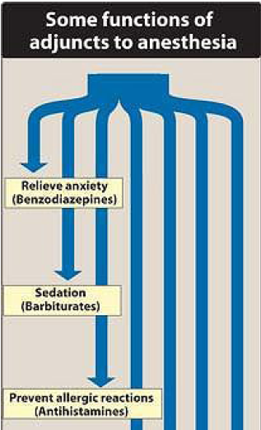
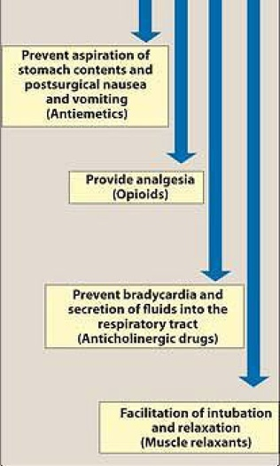

Slide 37
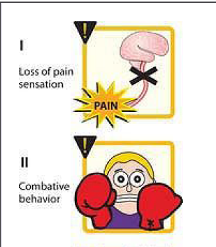
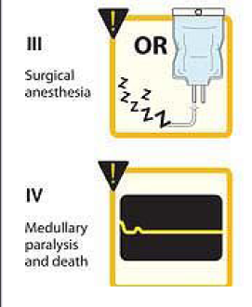
STAGES OF ANESTHESIA

Slide 38

Alcohol

Slide 39
Effects of alcohol
CNS
Depressant
excitation and euphoria are experienced at lower plasma concentrations
promotes GABAA receptor
inhibits NMDA receptors
Turnover of NA in brain is enhanced.

Slide 40
CVS
Moderate doses
-tachycardia
-mild rise in BP
Large doses
-direct myocardial & vasomotor centre depression
-fall in BP
chronic alcoholism
-hypertension
-cardiomyopathy
-cardiac arrhythmias

Slide 41
GIT
dilute alcohol (10%)
-↑gastric secretion
Higher concentrations(20%)
-↓ gastric secretion
- vomiting
- gastritis
heavy drinking
-Acute pancreatitis

Slide 42
Acute alcoholic toxicity
Signs & Symptoms
Treatment
Hypotension
Gastritis
respiratory
Depression
coma and death.
Gastric lavage
Fluid
glucose
PPR

Slide 43
Withdrawl syndrome
Anxiety
sweating
Tremor
Confusion
Hallucinations
delirium tremens
convulsions
Collapse
Treatment
benzodiazepines
Chordiazepoxide or
diazepam

Slide 44
Disulfiram- Aldehyde dehydrogenase inhibitor
Aldehyde syndrome
flushing
burning sensation
headache
Perspiration
tightness in chest
Dizziness
vomiting, visual disturbances
Mental confusion
Collapse

Slide 45
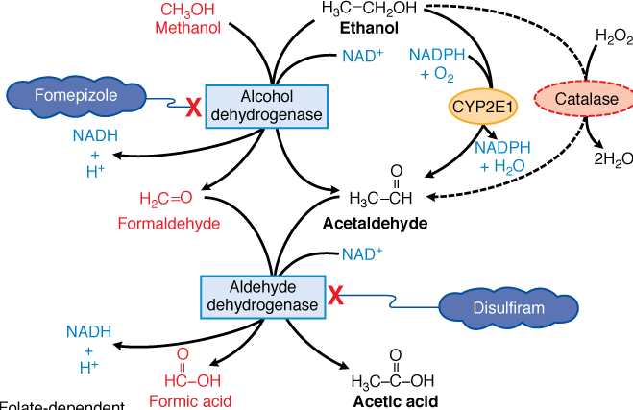

Slide 46
Methanol poisoning
Toxic effects are due to formic acid
vomiting, headache, epigastric pain, uneasiness,
dyspnoea, bradycardia and hypotension, delirium
blindness
death due to respiratory failure
Treatment
Symptomatic
Ethanol
Haemodialysis
Fomepizole (4-methylpyrazole)
Folate therapy (Calcium leucovorin)

Slide 47
MCQs
Q1. Preanaesthetic medication is given:
to decrease the duration of surgery
to make the anaesthetic procedure pleasant and safe
to control patients comorbidity
to maintain blood pressure
Ans. B

Slide 48
Q2. Which of the following is NOT used as preanaesthetic medication:
Glycopyrrolate
Pethidine
Pantoprazole
Adrenaline
Ans. D

Slide 49
Q3. Dissociative anaesthesia' is induced by:
Thiopentone
Midazolam
Ketamine
Nitrous oxide
Ans. C

Slide 50
Q4. Malignant hyperthermia may be a complication of use of the following anaesthetic:
A. Ether
B. Halothane
C. Nitrous oxide
D. Propofol
Ans. B

Slide 51
Q5. The following general anaesthetic has good analgesic but poor muscle relaxant action:
Halothane
Nitrous oxide
Ether
Isoflurane
Ans. B

Slide 52
Q6. 'Second gas effect' is exerted by the following gas when coadministered with halothane:
A. Nitrogen
B. Nitrous oxide
C. Nitric oxide
D. CO2
Ans. B

Slide 53
Q7. Which general anaesthetic selectively inhibits excitatory NMDA receptors:
Propofol
Halothane
Desflurane
Ketamine
Ans. D

Slide 54
Q8. Which of the following is NOT a component of anaesthetic state?
Amnesia
Analgesia
Hyperthermia
Unconsciousness
Ans. C

Slide 55
Q9. The minimal alveolar concentration of an inhalational anaesthetic is a measure of
Therapeutic index
Potency
Efficacy
Diffusibuity
Ans. B

Slide 56
        Thank you

Slide 57
Bibliography
Essentials of Medical Pharmacology -7th edition by KD Tripathi
Goodman & Gilman's the Pharmacological Basis of Therapeutics 12th edition by Laurence Brunton (Editor)
Lippincott's Illustrated Reviews: Pharmacology - 6th edition by Richard A. Harvey
Basic and Clinical pharmacology 11th edition by Bertram G Katzung
Rang & Dale's Pharmacology -7th edition
by Humphrey P. Rang
Clinical Pharmacology 11th edition By Bennett and Brown, Churchill Livingstone
Principles of Pharmacology 2nd edition by HL Sharma and KK Sharma
Review of Pharmacology by Gobind Sparsh

