Slide 1
Cyclist bike-share analysis
Data analysis and Data visualisation

Slide 2
TASK
To visualize the usage of cyclistic bikes amoung casual riders and membership riders.
Design a new marketing strategy to convert casual riders into annual members.

Slide 3
SUPPORTING VISUALS

Slide 4
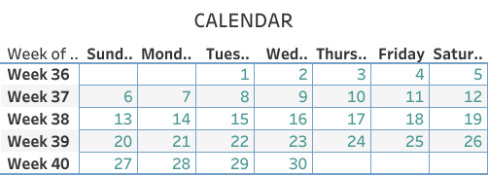
RIDING CALENDAR

Slide 5
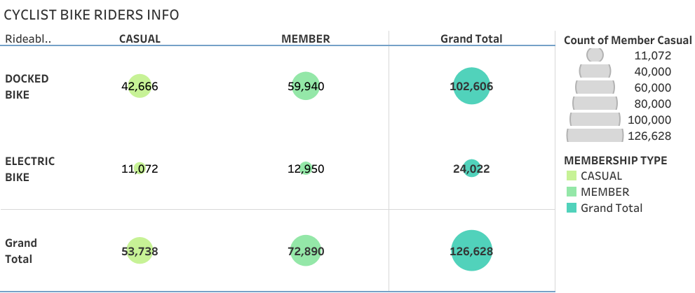

Slide 6
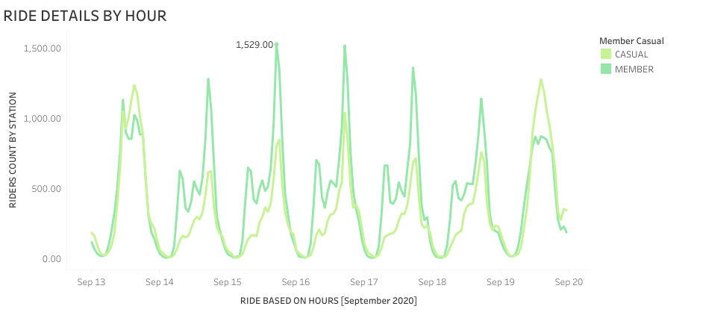

Slide 7
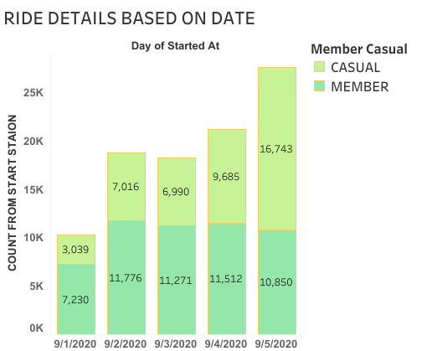

Slide 8
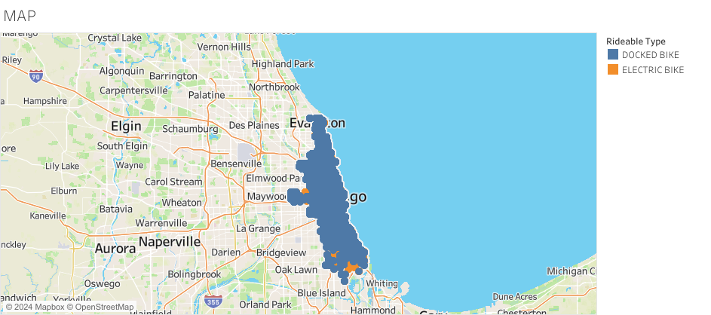

Slide 9
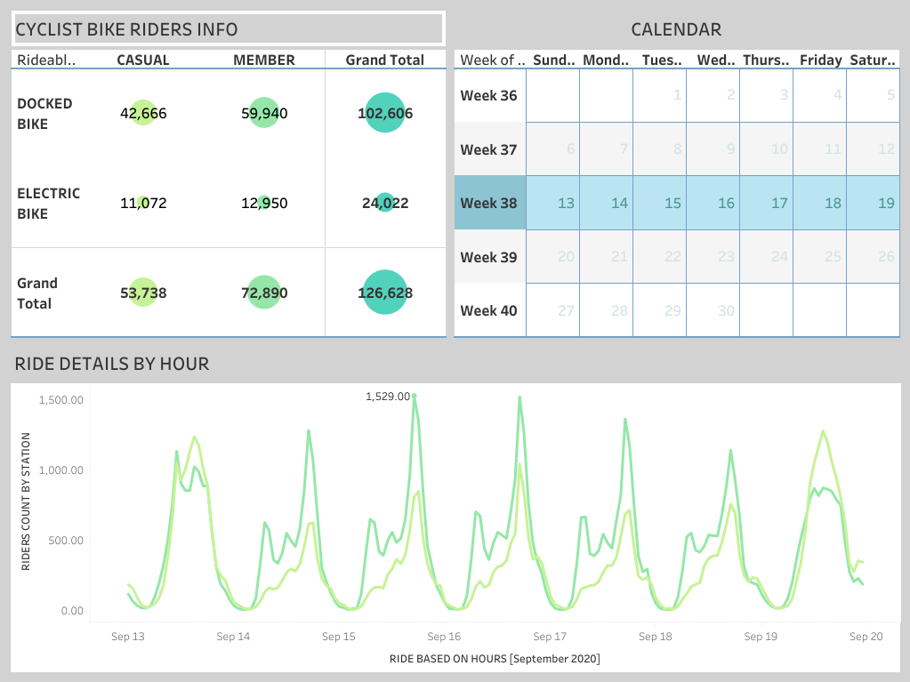

Slide 10
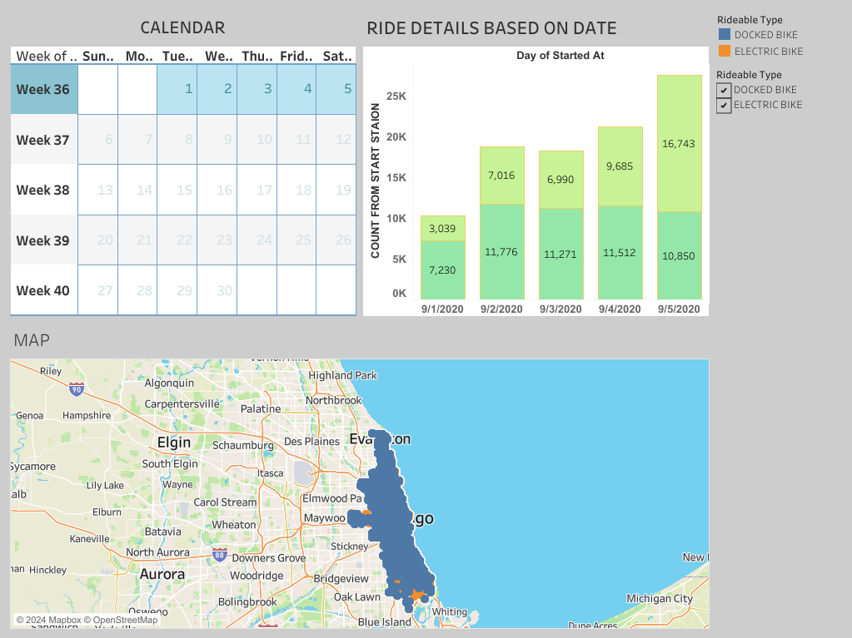

Slide 11
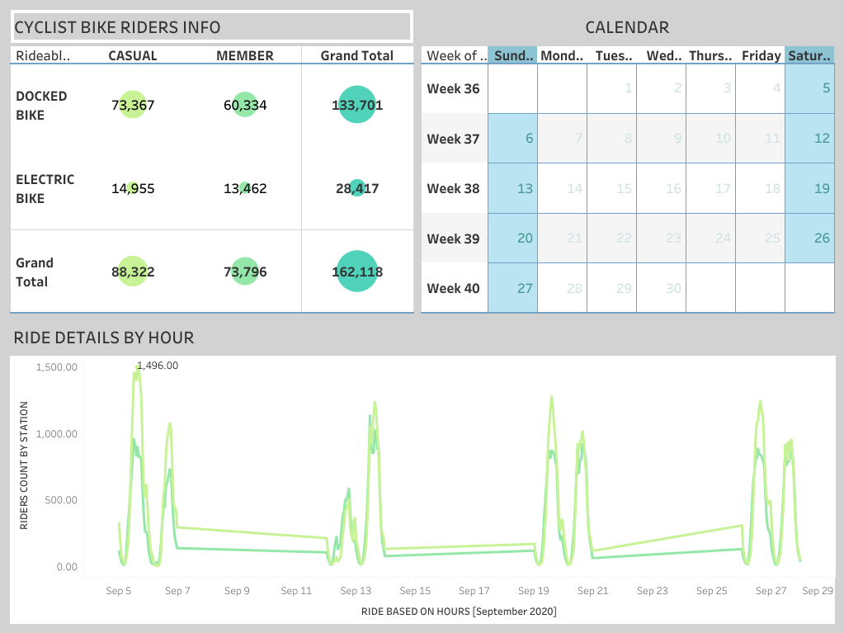
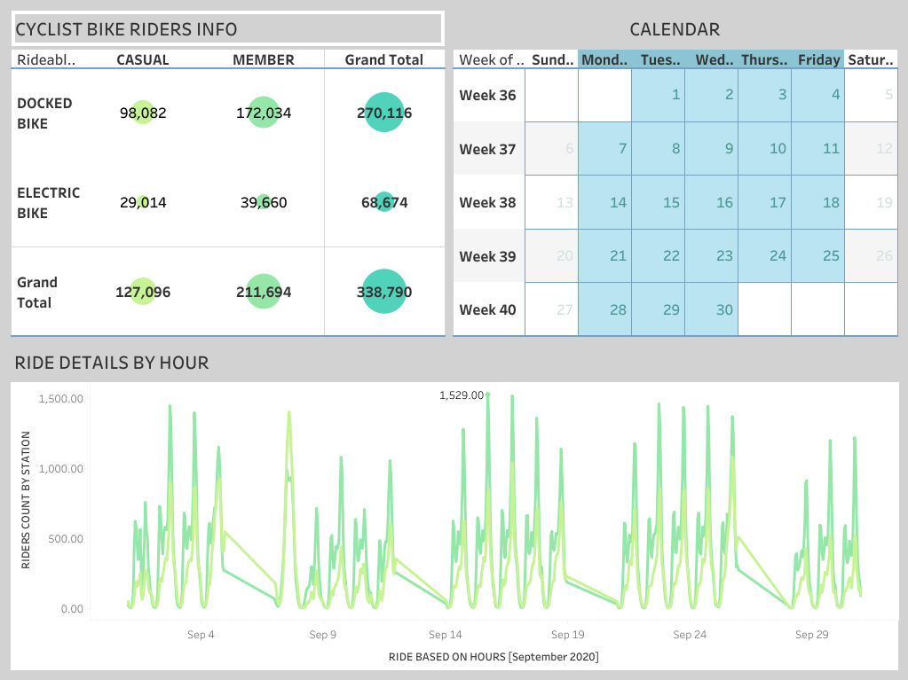
FINDINGS – Casual members are riding more in the weekends than weekdays.

Slide 12
RECOMMENDATIONS
Since no sufficient information regarding casual riders riding purpose on weekends,
Suggesting that organising weekend rally through the company to attract the riders.
Launch advertising campaign through social media and influencers.

