Slide 1
Secure data hiding in image using steganography
CAPSTONE PROJECT
Presented By:
Student Name : Jangampalli Madhusudhan
College Name & Department : Srinivasa Ramanujan institute of technology , Department of Electronics and Communication

Slide 2
OUTLINE
Problem Statement
Technology used
Wow factor
End users
Result
Conclusion
Git-hub Link
Future scope

Slide 3
Problem Statement
This project aims to create a secure method for hiding and retrieving messages in images, using steganography techniques. The problem being solved is ensuring that sensitive information can be shared securely without being detected by unauthorized parties. By embedding data in an image file, the project ensures that the presence of the data is hidden in plain sight, offering a simple yet effective method of data protection.

Slide 4
Technology used
OpenCV (cv2): OpenCV is used to load and modify images, allowing pixel values to be manipulated for embedding the hidden message. It provides the tools to interact with the image data at a granular level, enabling the stealthy embedding of information within the image without affecting its visual quality.
Steganography: Steganography is the process of hiding data within an image file in a way that doesn’t alter its visible appearance significantly. This technique ensures that the message remains undetectable, even if the image is shared or transferred, allowing secure communication in plain sight.
Password Encryption: A password-based encryption system adds an additional layer of security. Only users who input the correct passcode can decrypt and reveal the hidden message. This ensures that even if the image is intercepted, the data remains secure and accessible only to authorized individuals.

Slide 5
Wow factors
The most exciting feature of this project is its seamless integration of steganography with a user-friendly interface. This allows individuals to easily hide messages within images, making it accessible to anyone, regardless of technical expertise.
It demonstrates the creative application of cryptographic principles, showcasing how secure data transfer can be achieved in the digital world. The visual concealment of messages within everyday media like images is not only innovative but practical for real-world use.
Additionally, the password encryption feature adds an extra layer of security, ensuring that the hidden message is protected from unauthorized access. This combination of simplicity and security makes the system both effective and powerful for safe digital communication.

Slide 6
End users
Privacy-Conscious Individuals: This system is perfect for individuals who want to secure personal messages from unauthorized access. It provides a discreet way to communicate sensitive information without the risk of interception, ensuring personal privacy in digital exchanges.
Organizations: Companies and organizations can use this technology to securely transfer sensitive information without raising suspicion. It's particularly useful for protecting confidential business data, internal communications, and intellectual property, ensuring that valuable information remains hidden from unauthorized parties.
Digital Media Professionals: For professionals in media, this tool allows them to embed data within images or videos without revealing it to the audience. This is ideal for applications such as watermarking, copyright protection, or embedding metadata, ensuring that the data is secure and undetectable by viewers.

Slide 7
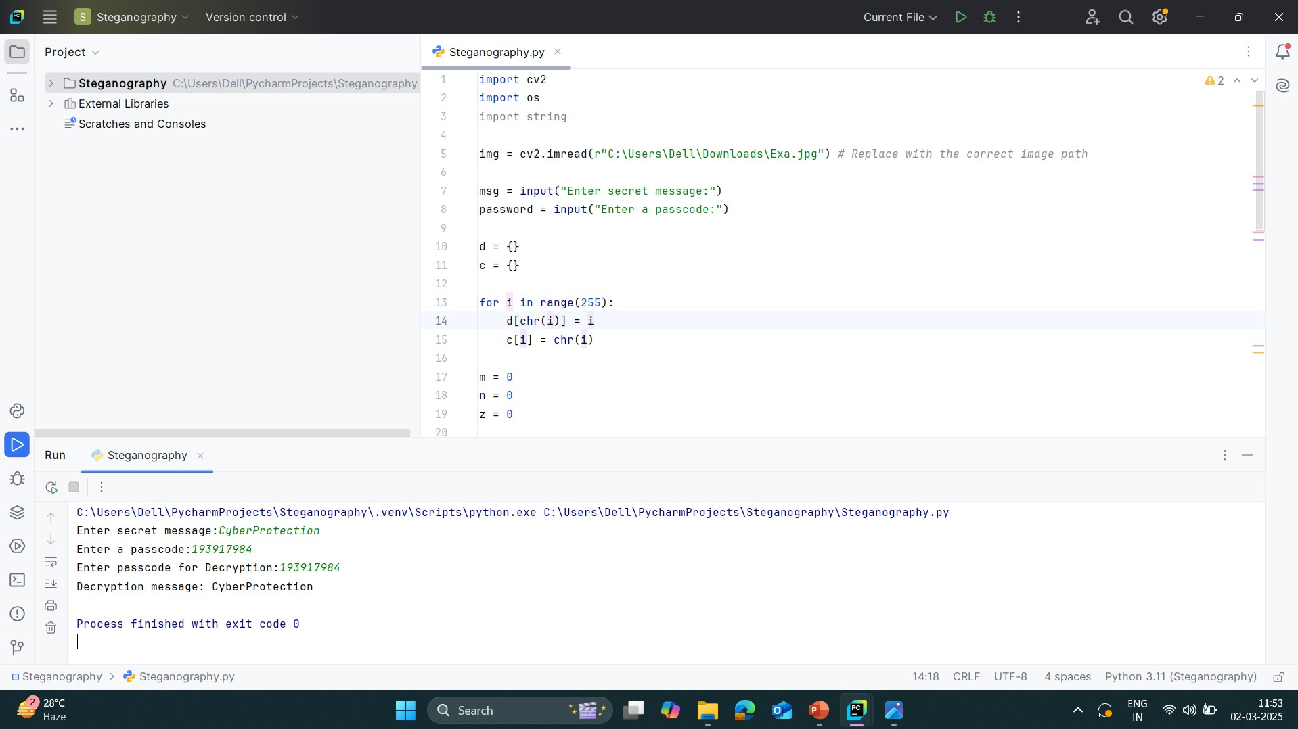

Results

Slide 8

Results

Slide 9

Results

Slide 10
Conclusion
This project provides a secure and efficient method for hiding and retrieving messages within images using steganography. By embedding sensitive information in image files, it ensures that data remains concealed from unauthorized parties while allowing intended recipients to retrieve it securely. This approach offers a discreet and effective solution for data protection, making it suitable for secure communication. Future improvements could focus on enhancing the robustness of the technique against detection and improving the efficiency of data extraction.

Slide 11
GitHub Link
https://github.com/MADHUSUDHANJANGAMPALLI/steganography

Slide 12
Future scope
Cross-Platform Compatibility: Expanding the project to work across multiple operating systems, including mobile devices and cloud-based platforms.
Higher Data Capacity Storage: Improving embedding techniques to allow larger amounts of data to be stored within images without compromising security.
Blockchain Integration: Utilizing blockchain technology for verification and tracking of hidden messages to enhance transparency and security.
Steganography in Video and Audio: Extending the concept to video and audio files to create a more versatile secure communication system.
Resilience Against Attacks: Strengthening the algorithm against steganalysis attacks and ensuring robustness against various image modifications like resizing and filtering.

Slide 13
THANK YOU

