Slide 1
Numerical Optimization using the Levenberg-Marquardt Algorithm
Leif Zinn-Bjorkman
EES-16
LA-UR-11-12010

Slide 2
The Basic Least-Squares Problem

Slide 3
Optimization Algorithms
Advantages: F(x) will decrease after every iteration.
-Decreases cost most quickly for a given change in parameter values.
Disadvantages: Algorithm tends to zigzag along the bottom of long narrow canyons. Approaches the best fit very slowly.
Gradient descent = Steepest descent = First-order gradient-based method
Source: Wikipedia

Slide 4
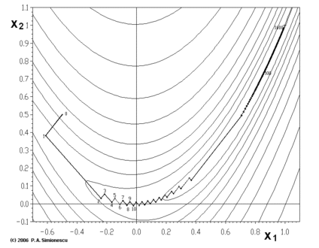

Slide 5
Optimization Algorithms
Advantages: Decreases cost most efficiently for a change in its behavior.
-Converges quickly in canyons
Disadvantages: Prone to parameter evaporation (parameters returned by the algorithm are far from reasonable values).
-Algorithm converges slowly or not at all if initial guess is far from minimum or matrix is ill-conditioned.
(JTJ) applied to approximate second-order Hessian matrix.
Gauss-Newton = Second-order curvature-based method
Source: Wikipedia

Slide 6
The Levenberg-Marquardt Algorithm
LM algorithm combines the advantages of gradient-descent and Gauss-Newton methods.
-LM steps are linear combination of Gradient-descent and Gauss-Newton steps based on adaptive rules
Gradient-descent dominated steps until the canyon is reached, followed by Gauss-Newton dominated steps.

Slide 7
The Levenberg-Marquardt Algorithm
J = jacobian matrix of derivatives of the residuals with respect to the parameters λ = damping parameter (adaptive balance between the 2 steps)
r = residual vector

Slide 8
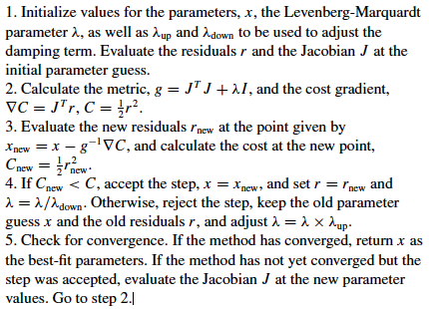
Description (pseudocode) of the LM algorithm – from Transtrum, Machta, Sethna, 2011

Slide 9
LevMar Convergence Criteria as implemented in MADS
Algorithm stops when:
Objective function value is below a cutoff value (if specified) OR
J^{T}r is small (max element <= eps) OR
Relative change in p is small (<= eps²||p||) OR
Almost singular solution OR
Model predictions are within a certain range of the true minimizer (if provided) OR
Algorithm returns invalid (NaN or inf) values OR
Maximum number of iterations is reached.

Slide 10
Choosing the Damping Parameter (λ)
Choice of λ is very important for success rate and efficiency of the LM algorithm.
Increasing λ decreases step size, and vice versa. So if a step is unacceptable, λ should be increased until a smaller, acceptable step is found. If a step is accepted, we want to increase step size by decreasing λ, in order to proceed more quickly in the correct descent direction, speeding up convergence rate.
Source: Transtrum PhD dissertation, 2011

Slide 11
Schemes for Updating λ
Direct method – increase λ by a fixed factor for uphill steps, decrease λ by the same fixed factor for downhill steps.
Direct method/Delayed gratification – increase λ by a small fixed factor for uphill steps, decrease λ by a larger fixed factor for downhill steps.
Indirect method – choose an initial step size Δ, then find a λ such that
Source: Transtrum dissertation, Transtrum, Machta, Sethna, 2011

Slide 12
Motivation for Delayed Gratification Method
Direct method with equal up and down adjustments tends to move downhill too quickly, greatly reducing steps that will be allowed at successive iterations, which slows convergence rate (although it appears to have no effect on success rate).
By using delayed gratification, we choose the smallest λ that does not produce an uphill step, which slows initial downhill progression but speeds up convergence rate near the solution.
Source: Transtrum, Machta, Sethna, 2011

Slide 13
Test Function | Method | Success Rate | Av. Jacobian Evals.
Rosenbrock | Direct | 0.987 | 17.9
 | Delayed Gratification | 0.965 | 13.4
 | Indirect | 0.946 | 32.6
Powell’s Quadratic | Direct | 0.783 | 11.8
 | Delayed Gratification | 0.812 | 10.9
 | Indirect | 0.643 | 62.1
Exponential Data Fitting I | Direct | 0.017 | 61.7
 | Delayed Gratification | 0.161 | 38.5
 | Indirect | 0.054 | 42.3
Exponential Data Fitting II | Direct | 0.009 | 138
 | Delayed Gratification | 0.008 | 73.2
 | Indirect | 0.013 | 167

Slide 14
The Rosenbrock Function
A controls the narrowness of the canyon
Ideal for testing optimization algorithms because of the difficulty of convergence. Finding the valley that contains the global minimum (1, 1) is trivial, but moving along the valley to the minimum is very difficult.
No local minima, though higher dimensional forms contain several at unknown locations, making it difficult to test them for success rate.

Slide 15
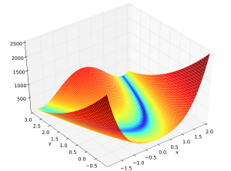

Slide 16
Performance of the LM Algorithm on the Rosenbrock Function
Dimension | Success Rate | Av. Jacobian Evals.
2 | 0.965 | 13.4
3 | 0.993 | 29.3
4 | 0.764 | 43.6
5 | 0.826 | 19.6
6 | 0.825 | 23.7
7 | 0.871 | 24.5
8 | 0.845 | 22.6
9 | 0.844 | 24.3
10 | 0.862 | 28.1

Slide 17
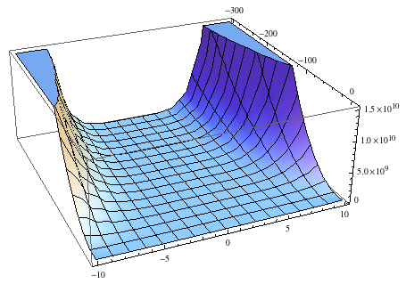

Slide 18


Geodesic Acceleration
Suggested by Transtrum, Machta, Sethna (2011) as a further improvement to the LM algorithm.
Second order correction to step – proposed step represents a truncated Taylor series:
In order to accept a step with acceleration added, need where α is of order 1.

Slide 19
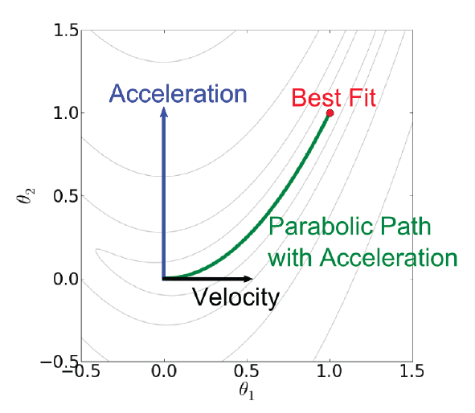
Source: Transtrum PhD dissertation

Slide 20
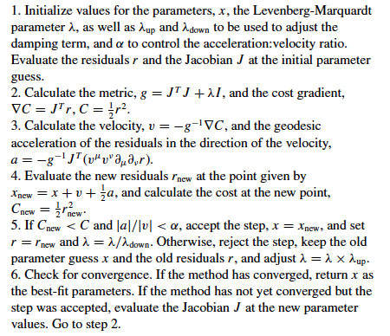
Description (pseudocode) of the LM algorithm with acceleration – from Transtrum, Machta, Sethna, 2011

Slide 21

Computation of Geodesic Acceleration
Analytic version – directional second derivative of the residuals in the direction of the velocity.
Finite difference estimation – two additional
function evals:

Slide 22
Modified Rosenbrock Function
Used to demonstrate effectiveness of adding acceleration to algorithm.
Residuals given by:
A and n control narrowness of the canyon – as A and n increase, canyon narrows. Global minimum at (0,0).

Slide 23
Modified Rosenbrock Tests
Tested function with 4 different “complexities”:
1. A = 10, n = 2
2. A = 100, n = 3
3. A = 1000, n = 4
4. A = 1000, n = 5
Initial Guess: (1,1) Convergence criteria: OF < 1e-12
Comparison between non-acceleration and acceleration versions of algorithm (both with delayed gratification technique for updating λ).

Slide 24
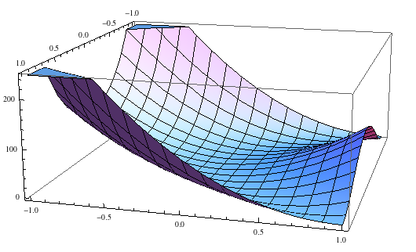

Slide 25
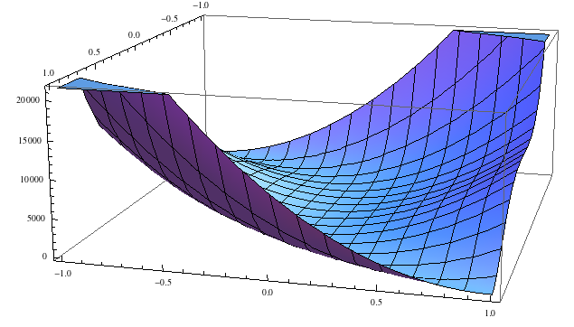

Slide 26
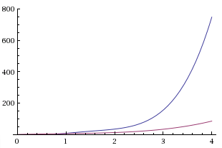
Original LM vs LM w/ accel for Modified Rosenbrock
Blue - original
Pink - LM w/ acceleration
Complexity

Slide 27

Test functions

Slide 28
Function | Success Rate (Original Version) | Success Rate (Accel Version) | Average Jac. Evals. (Original Version) | Average Jac. Evals (Accel Version)
2-D Tripod | 0.0 | 0.488 | 1535 | 11.0
2-D Clerc’s F1 | 0.896 | 0.909 | 506 | 4.7
Beale | 0.518 | 0.514 | 19.4 | 12.0
De Jong | 1.0 | 1.0 | 9.7 | 6.9
Powell’s Quadratic | 0.792 | 0.810 | 10.9 | 8.4
Parsopoulos | 1.0 | 0.994 | 3.6 | 4.0
Exponential Data Fitting I | 0.154 | 0.068 | 37.4 | 17.6
Exponential Data Fitting II | 0.006 | 0.009 | 74.4 | 87.5
2-D Rosenbrock | 0.965 | 0.936 | 13.3 | 29.8

Slide 29
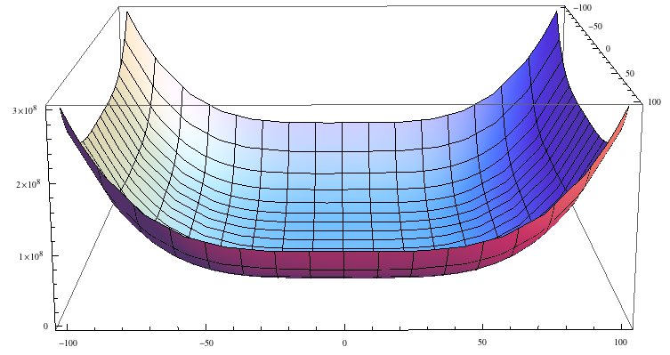

Slide 30
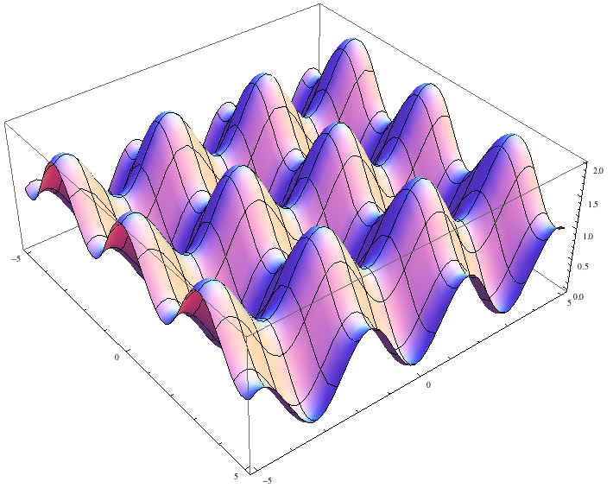

Slide 31
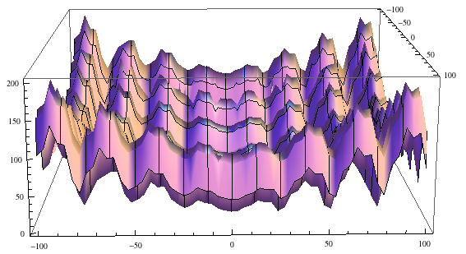

Slide 32
Conclusions
Levenberg-Marquardt algorithm is a very efficient technique for finding minima, and performs well on most test functions.
The algorithm includes many different variables that determine its efficiency and success rate. The ideal values of these variables are very dependent on the test function.
Implementing delayed gratification into the algorithm leads to higher success rate and fewer jacobian evaluations.
Acceleration is an effective addition, but only in controlled situations – performance depends greatly on initial guess. Often, delayed gratification alone is enough to ensure an efficient and reliable fit, but for certain problems, acceleration can help a great deal.
Proposed LM improvements and applied test functions are implemented in MADS (http://mads.lanl.gov)

