Slide 1
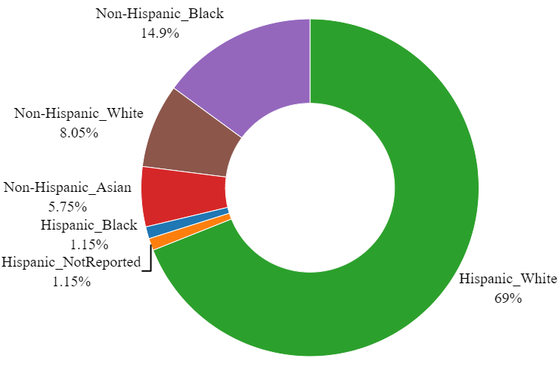
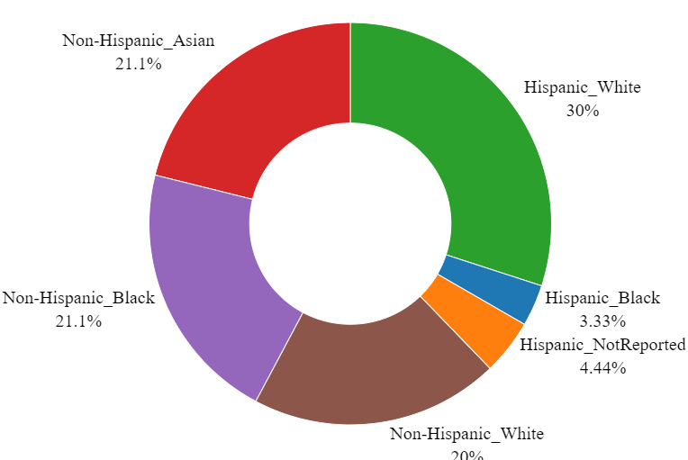
MNP Dataset
N = 177
Preterm
N = 87
Term
N = 90

