Slide 1
Obesity model
Notes:
Ok I built a logistic regression model that used the training participant data in parallel slopes to predict BMI levels and subsequently Obesity

Slide 2
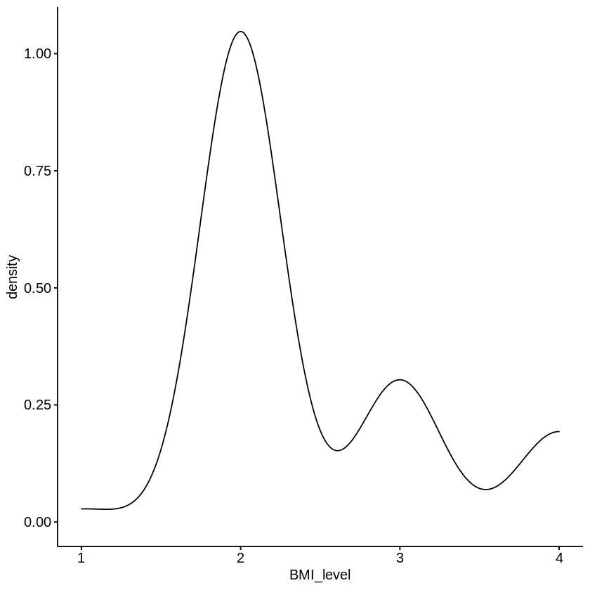
Data wrangling
import the training and testing datasets
Convert the date columns from character to date time format
Plot the data to get a general idea of the distribution

Slide 3
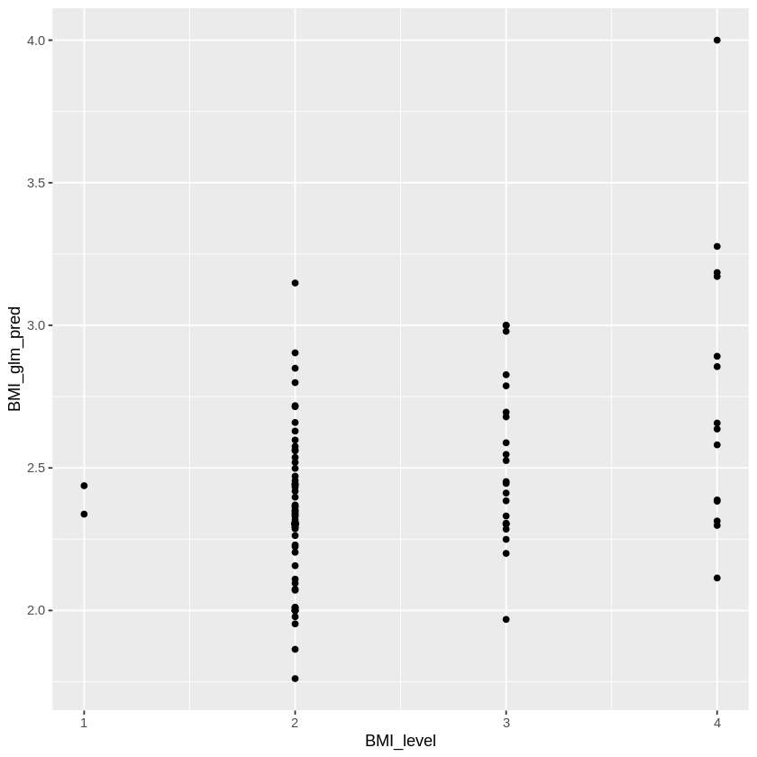
logistic regression model
Obesity model based on BMI score because it has higher resolution than 1 or 0 for obese
Downstream conversion of BMI_Score to Obesity

Slide 4
results
Obesity model based on BMI score because it has higher resolution than 1 or 0 for obese
Downstream conversion of BMI_Score to Obesity

