Slide 1



Multi-omics study of host-microbiota interactions to reveal and verify various microbiome aspects in pregnant women with type 1 diabetes (T1D) and their newborns
Marzena Gajecka, Michael Jochum
Prof. Aagaard Lab Meeting, August the 18th, 2020

Slide 2
Project questions
Characteristics of vaginal microbiota in T1D pregnant women vs unaffected pregnant women.
Characteristics of microbiota in samples derived from newborn babes (stool samples/ear swabs), taking into consideration differences between the mother’ phenotype (T1D vs unaffected mothers).
Aspects of microbiota transfer, based on microbiota found in mothers in the 3 various vaginal regions and anus, incl. mother’ phenotype differences.
Consequences of the c-section, and antibiotic prophylaxis in mothers for newborn babes: mother-newborn baby microbiota transfer.
Clinical correlations – various clinical findings vs. specific microbiota, over- and underrepresented.

Slide 3
Study design_T1D pregnant women, Controls, and materials in the Microbiome study
Ascertainement, clinical information obtained:
T1D Controls ∑
Pregnant women 50 42 92
Newborns 48 42 90
Sequencing method and analyzes:
16S rRNA, Illumina, Primers 515F–806R
530 samples sequenced
Seq data of 527 samples analyzed

Slide 4
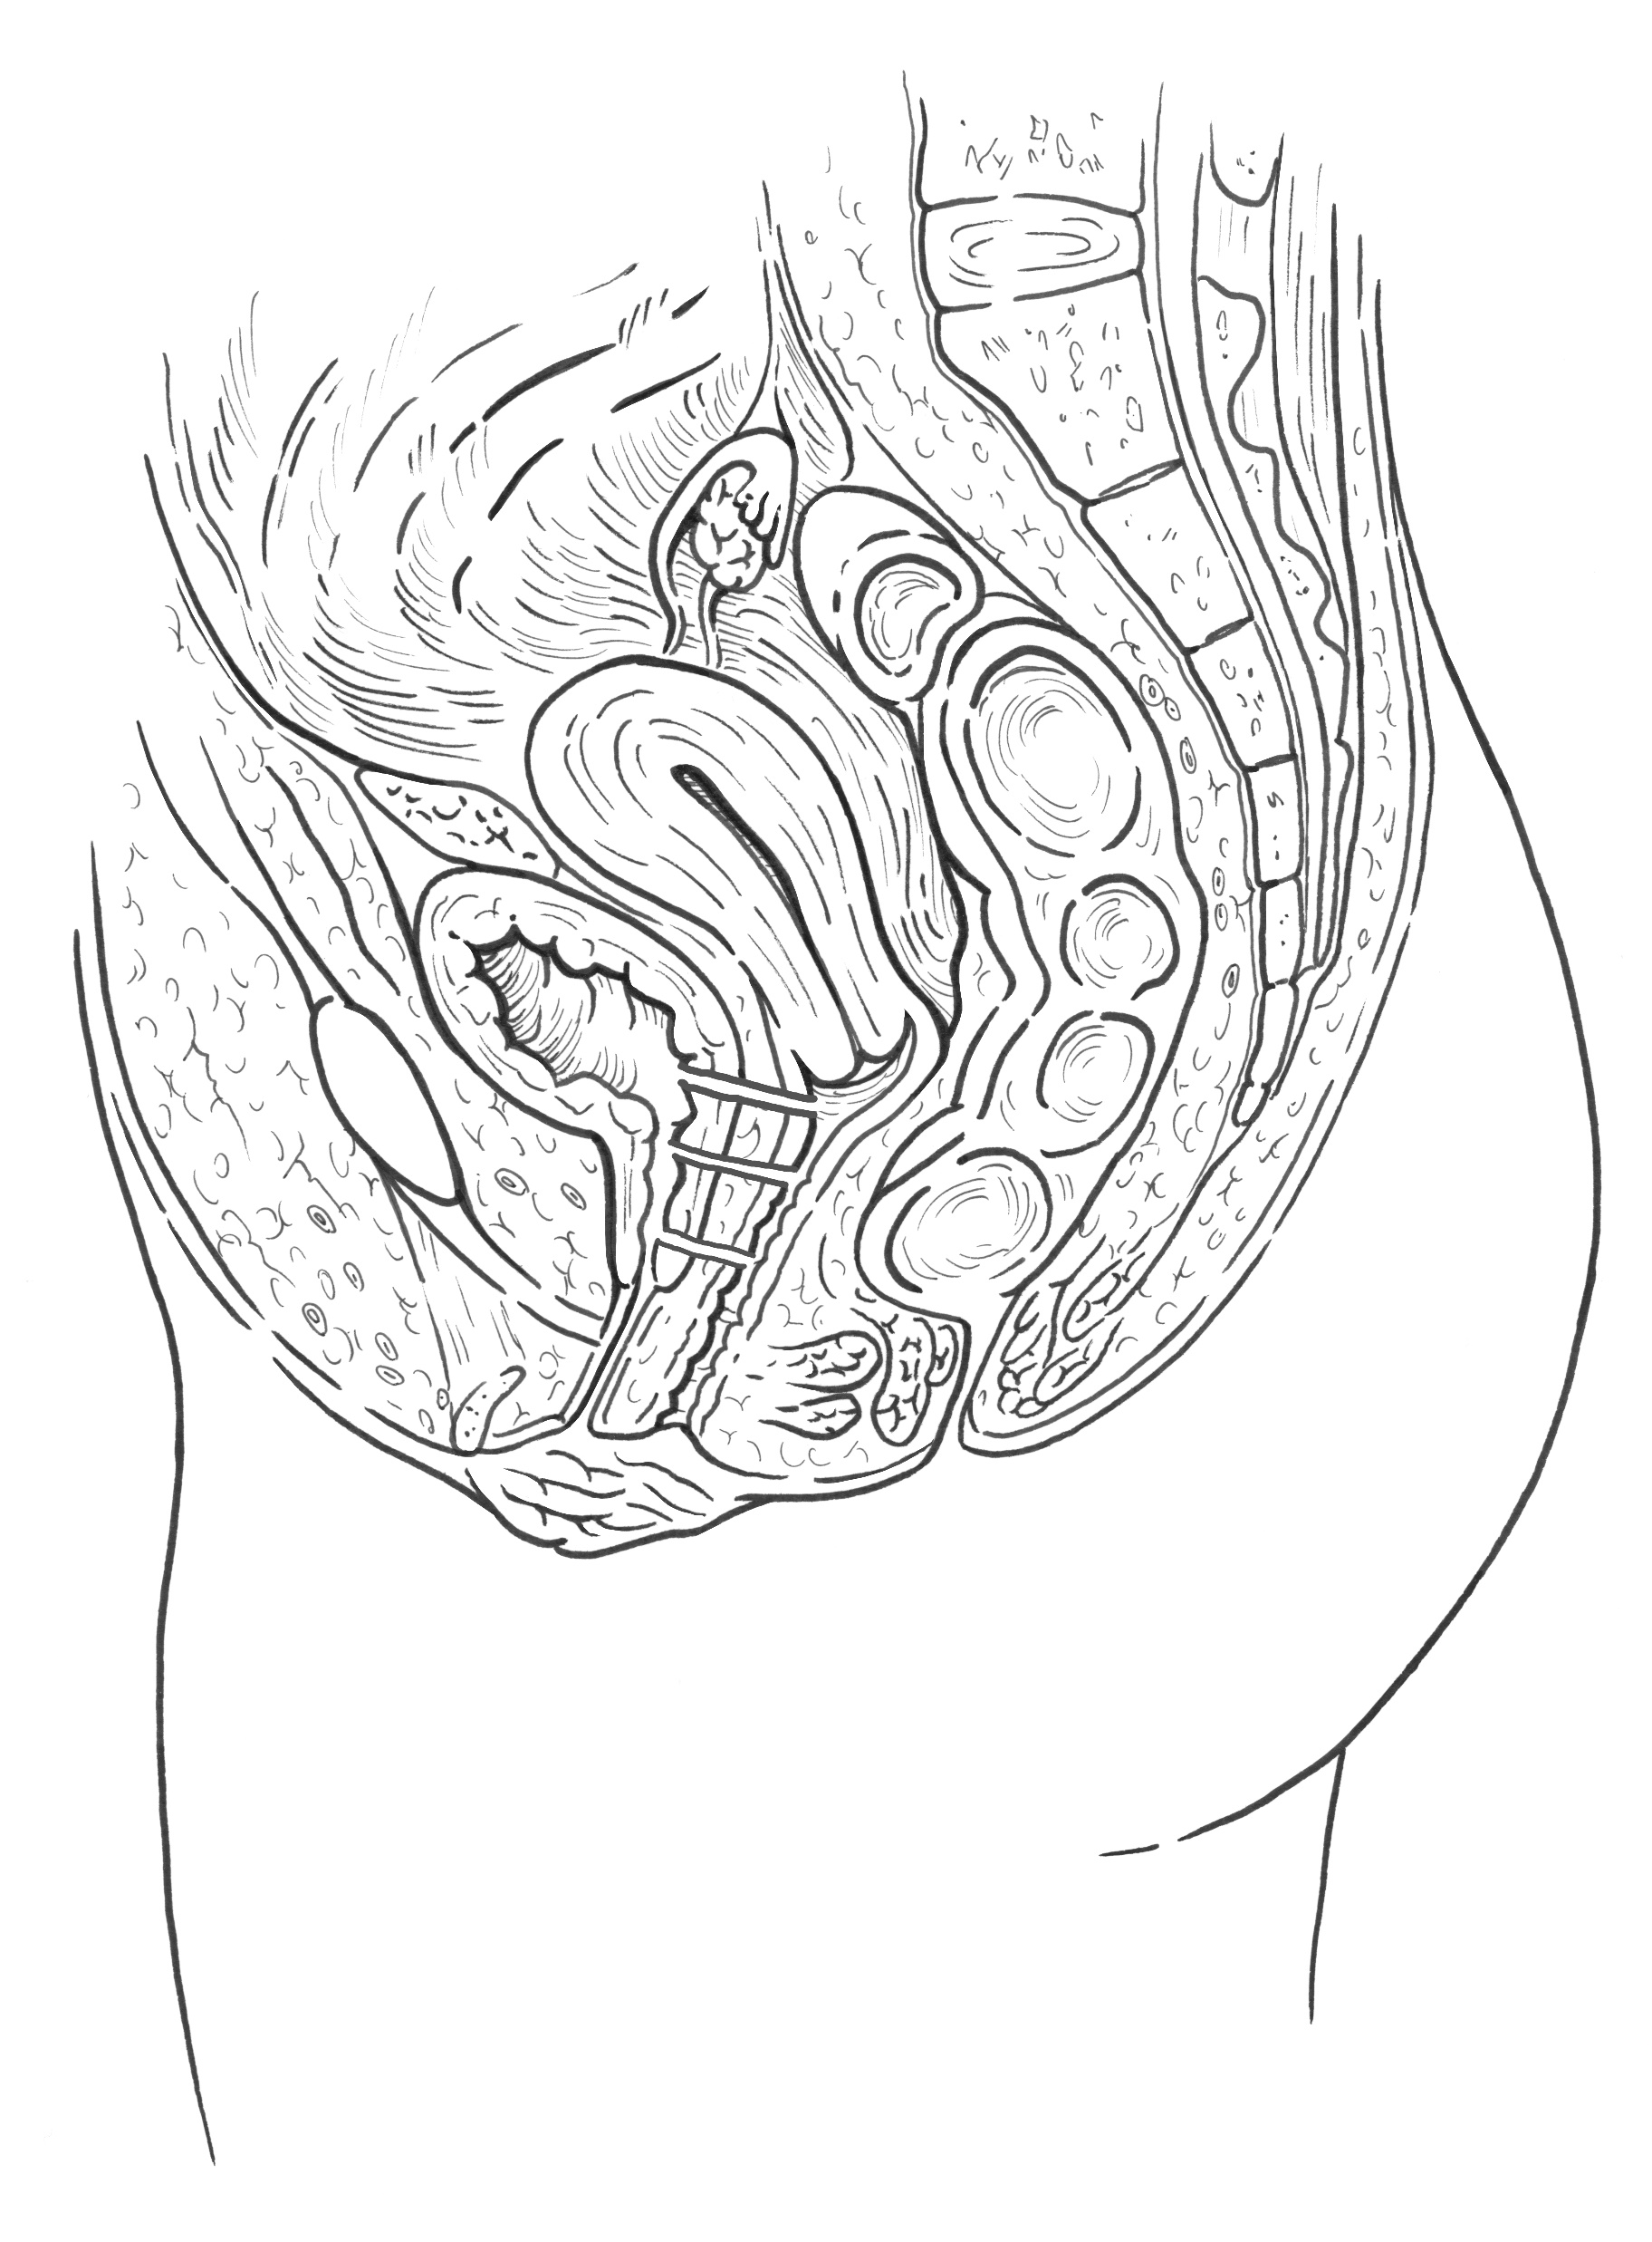
Study design_T1D pregnant women, Controls, and materials in the Microbiome study
Sample sets of 6 materials:
Pregnant woman - 4 swabs:
vaginal introitus (A)
vagina (B) (vaginal canal, in the middle)
cervix (C)
Anus (D)
Newborn:
stool sample (no meconium samples, later feces) and
ear swab [collected 24-72 h after birth]
C
B
A
D

Slide 5
Mother's Clinical Characteristics
 | T1D group (n=50) | Control group (n=42) | P value
Age, mean ± SD | 29,7 ± 4,3 | 32,4 ± 4,0
Ethnicity - Caucasian | 50 (100%) | 42 (100%)
Geographical location - Poland | 50 (100%) | 42 (100%)
Delivery mode |  |  | 0.1969
Caesarian | 33 (66%) | 20 (47.5%)
Vaginal | 12 (24%) | 17 (40.5%)
Vacuum-assisted vaginal delivery | 5 (10%) | 5 (12%)
Preterm(<37 weeks)
Yes | 0 (0%) | 0 (0%)
No | 50 (100%)* | 42 (100%)
Gestation (weeks), mean ± SD | 38,1 ± 0,7 | 39,2 ± 1,0 | <0.0001 ***
Parity
Primiparity | 28 (56%) | 14 (33.5%)
Multiparity | 20 (40%) | 27 (64.5%)
NA | 2 (4%) | 1 (2%)
Miscarriages
yes | 7 (14%) | 8 (19%)
no | 41 (82%) | 33 (79%)
NA | 2 (4%) | 1 (2%)
Clinical Information Table in accordance with Stewart et al. 2018
*one newborn wk 36+6
Notes:
No preterm babies involved

Slide 6
Mother's Clinical Characteristics | T1D group (n=50) | Control group (n=42)
Maternal diabetes
T1D | 50 (100%) | 0 (0%)
T2D | 0 (0%) | 0 (0%)
Gestational | 0 (0%) | 0 (0%)
None | 0 (0%) | 42 (100%)
Age at T1D diagnosis, mean ± SD | 17,91 ± 8,21 | NA
Duration of T1D (years), mean ± SD | 12,56 ± 7,02 | NA
Diabetes medication (insulin therapy)
Yes | 49 (98%) | 0 (0%)
No | 0 (0%) | 42 (100%)
NA | 1 (2%) | 0 (0%)
Time of insulin therapy (years), mean ± SD | 12,52 ± 17,09 | NA
Age at the beginning of insulin therapy (years), mean ± SD | 17,97 ± 8,30 | NA
Classification of pregestational diabetes (modified P. White classification)****
Class A | 0 (0%) | NA
Class B | 18 (36%) | NA
Class C | 15 (30%) | NA
Class D | 11 (22%) | NA
Class R | 5 (10%) | NA
Class F | 0 (0%) | NA
Class RF | 1 (2%) | NA
Class H | 0 (0%) | NA
Class T | 0 (0%) | NA
**** according to Wender-Ożegowska E, Bomba-Opoń D, et al. Standards of Polish Society of Gynecologists and Obstetricians in management of women with diabetes. Ginekol Pol. 2018;89(6):341-350. doi: 10.5603/GP.a2018.0059.
Notes:
No preterm babies involved

Slide 7
Mother's Clinical Characteristics
 | T1D group (n=50) | Control group (n=42)
Retinopathy
yes | 10 (20%) | 0 (0%)
no | 38 (76%) | 42 (100%)
NA | 2 (4%) | 0 (0%)
Hypothyroidism
yes | 23 (46%) | 10 (23.5%)
no | 27 (54%) | 31 (74%)
NA | 2 (4%) | 1 (2.5%)
Notes:
No preterm babies involved

Slide 8
Mother's Clinical Characteristics
 | T1D group (n=50) | Control group (n=42)
Probiotic before pregnancy (including synbiotics)
Yes | 12 (24%) | 15 (35.5%)
No | 28 (56%) | 15 (35.5%)
NA | 10 (20%) | 12 (29%)
Probiotic during pregnancy (including synbiotics)
yes | 5 (10%) | 29 (69%)
no | 35 (70%) | 1 (2%)
NA | 10 (20%) | 12 (29%)
Probiotic products before pregnancy
yes | 38 (76%) | 27 (64%)
no | 2 (4%) | 3 (7%)
NA | 10 (20%) | 12 (29%)
Probiotic products during pregnancy
yes | 38 (76%) | 30 (71%)
no | 2 (4%) | 0 (0%)
NA | 10 (20%) | 12 (29%)
Supplements inluding XXXX genera
were taken by T1D and conrol pregnant women,
information concerning the intake, the qualitative data will be available form the diatary assessment
Notes:
No preterm babies involved

Slide 9
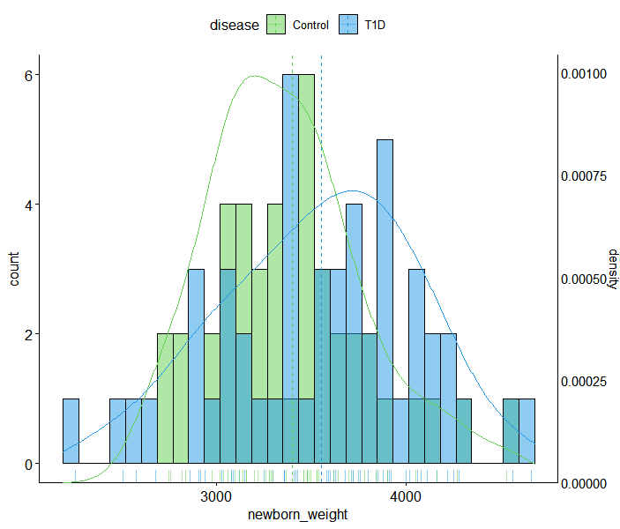
Newborn weight Distribution
Neonate's Clinical Characteristics
 | T1D group (n=48) | Control group (n=42) | P value
Sex
Male | 26 (54%) | 24 (57%)
female | 22 (46%) | 18 (43%)
Birth weight
SGA | 4 (8%) | 0 (0%)
AGA | 31 (65%) | 39 (93%)
LGA | 13 (27%) | 3 (7%)
Birth weight (kg), mean ± SD | 3402.595 ± 522,59 | 3405,45 ± 395,51 | 0.1263518

Slide 10
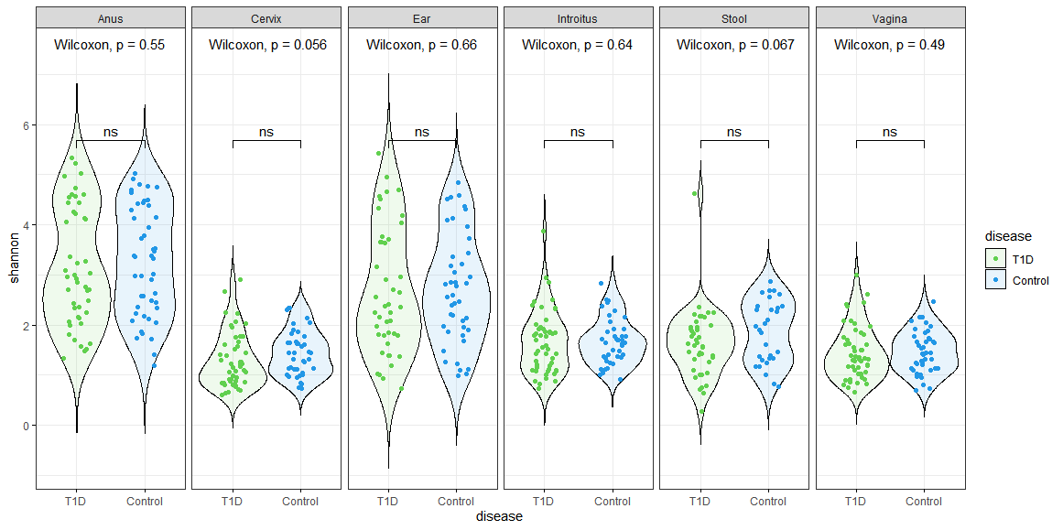
Alpha diversity estimates (Shannon)
library(microbiome)
library(ggpubr)
sam<-data.frame(sample_data(ASV_physeq_core))
alpha<-alpha(x = ASV_physeq_core,index = "shannon")
sam$shannon<-alpha$diversity_shannon
ggviolin(sam, x = "disease", y = "shannon", fill = "disease",
palette =c("#61D04F","#2297E6"),theme_bw()+
add = "boxplot", add.params = list(fill = "white"))+
stat_compare_means(comparisons = my_comparisons, label = "p.signif")+ # Add significance levels
stat_compare_means(label.y = 10) +facet_grid(facets = ~SampleType) # Add global the p-value

Slide 11
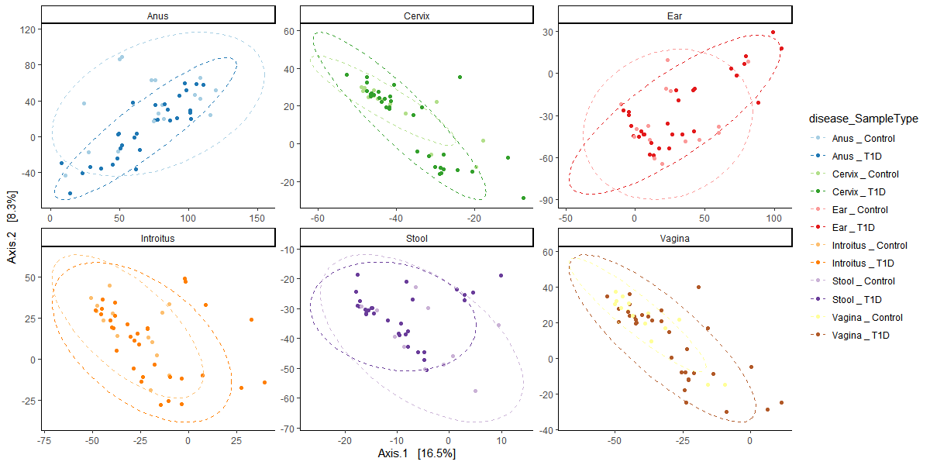
Beta Diversity PCoA plots comparing the T1D and control samples
across all microbiome sample types
Notes:
How different is the microbial composition in one material compared to another?

Slide 12
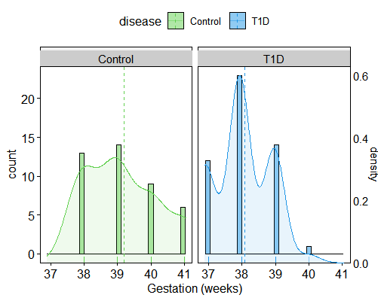
Continuous Variables_Delivery week (37-41, no preterm babies)
Mother's Clinical Characteristics
 | T1D group (n=50) | Control group (n=42)
Gestation (weeks), mean ± SD | 38,1 ± 0,7 | 39,2 ± 1,0
p <0.0001 ***
Weeks of Gestation Distribution

Slide 13
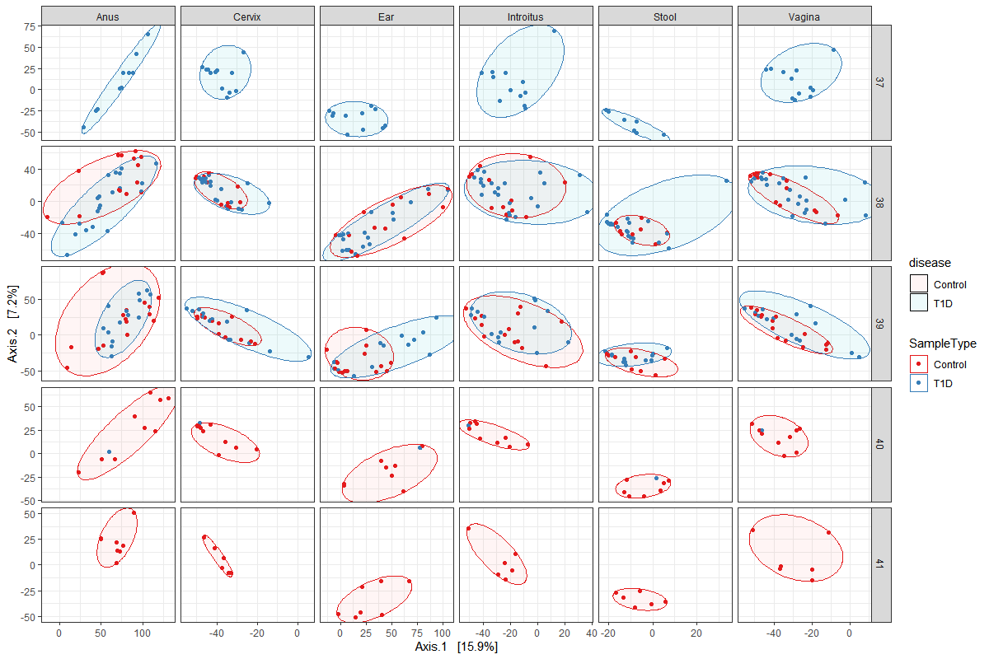
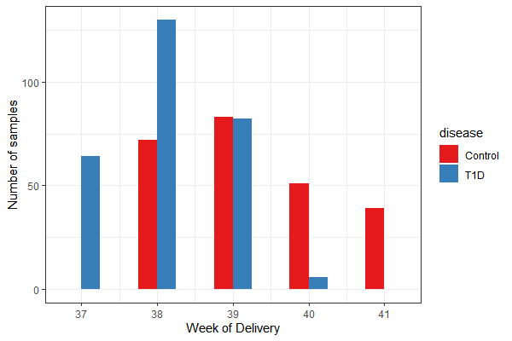
Delivery week (37-41, no preterm babies) and Beta diversity (adonis permanova)
Table X. Beta Diversity Bray Curtis adonis permanova of VST transformed counts versus week of delivery stratified by sample type.
 | Df | SumsOfSqs | MeanSqs | F.Model | R2 | Pr(>F)
disease | 1 | 23963 | 23963 | 1.9261 | 0.00377 | 0.0001 | ***
week of delivery | 1 | 18700 | 18700 | 1.5031 | 0.00294 | 0.0024 | **
disease:week of delivery | 1 | 18144 | 18144 | 1.4584 | 0.00285 | 0.002 | **
Residuals | 506 | 6295123 | 12441 |  | 0.99043
Total | 509 | 6355930 |  |  | 1
---
Signif. codes: 0 ‘***’ 0.001 ‘**’ 0.01 ‘*’ 0.05 ‘.’ 0.1 ‘ ’ 1
Notes:
Dr. Aagaard: The week of delivery stands in part because of such a strong inverse….no Type I DM goes past 39 weeks.

Slide 14
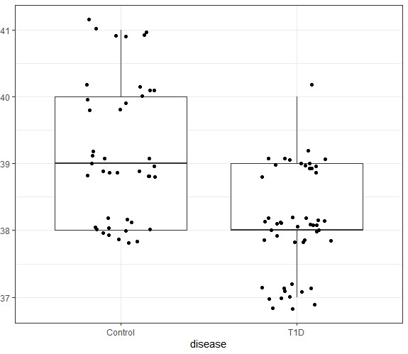
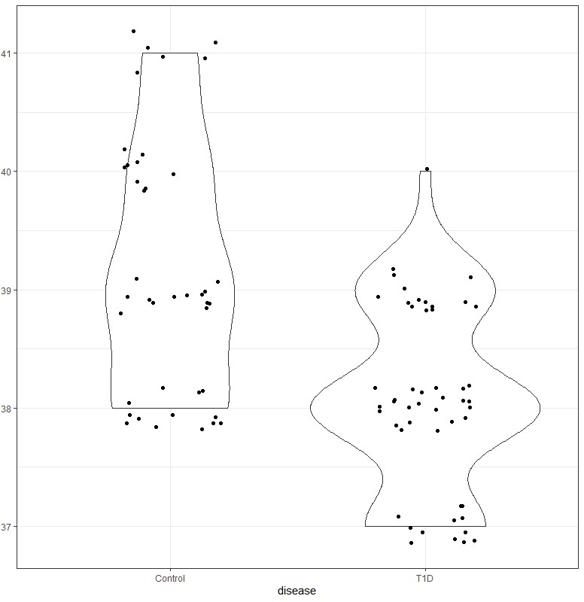
Continuous Variables_disease state and week of delivery
DELIVERY WEEK
DELIVERY WEEK
Figure X. Violin plot comparison between disease state and week of delivery [p < 0.0001]

Slide 15
Continuous Variables_selected dietery aspects and BMI
Mother's Clinical Characteristics
 | T1D group (n=50) | Control group (n=42) | P value
Pre-pregnancy BMI, mean ± SD | 23,19 ± 2,95 | 22,46 ± 2,56 | 0.2535
Pre-pregnancy BMI
Underweight | 1 (2%) | 1 (2%)
Normal | 35 (70%) | 33 (79%)
Overweight | 13 (26%) | 7 (17%)
Obese | 1 (2%) | 0 (0%)
NA | 0 (0%) | 1 (2%)
Before-birth BMI, mean ± SD | 28,12 ± 3,75 | 27,46 ± 2,97
Weight gain (kg), mean ± SD | 13,61 ± 5,34 | 14,00 ± 3,79
Weight gain
Non-excess | 32 (64%) | 26 (62%)
Excess | 18 (38%) | 15 (36%)
NA | 0 (0%) | 1 (2%)
Energy from fat [%]**, mean ± SD | 30,80 ± 5,09 | 27,79± 4,83
Energy derived from carbohydrates [%]**, mean ± SD | 50,85 ± 5,33 | 55,47 ± 5,30
Energy derived from total protein [%]**, mean ± SD | 18,35 ± 3,01 | 16,74 ± 1,59
**counting based on 24-hours dietetic recall for 7-days received from 33 T1D patients and 14 controls

Slide 16
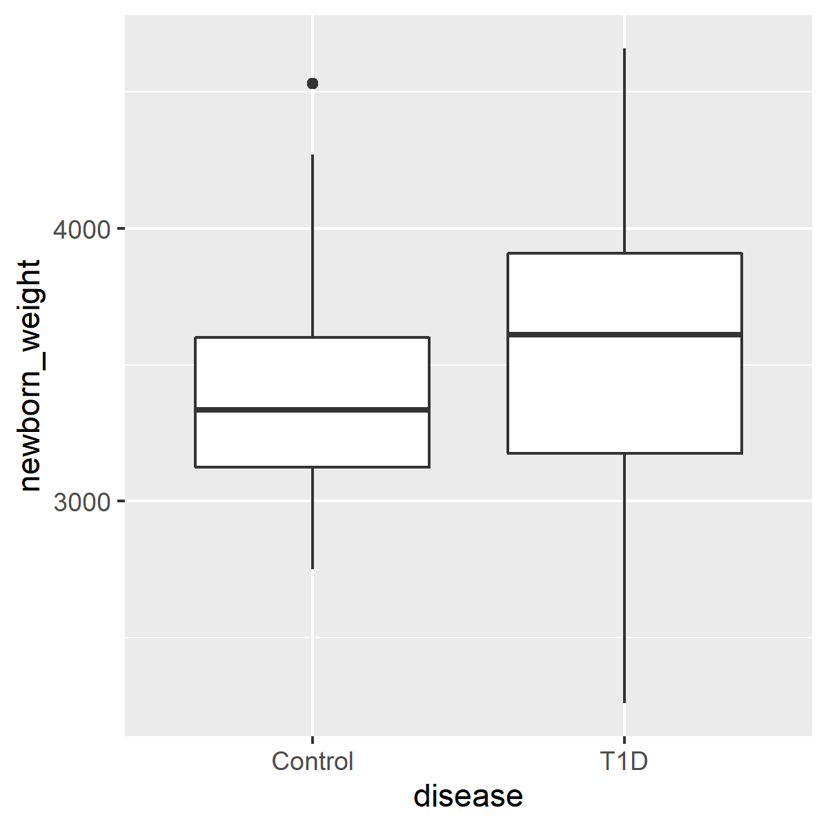
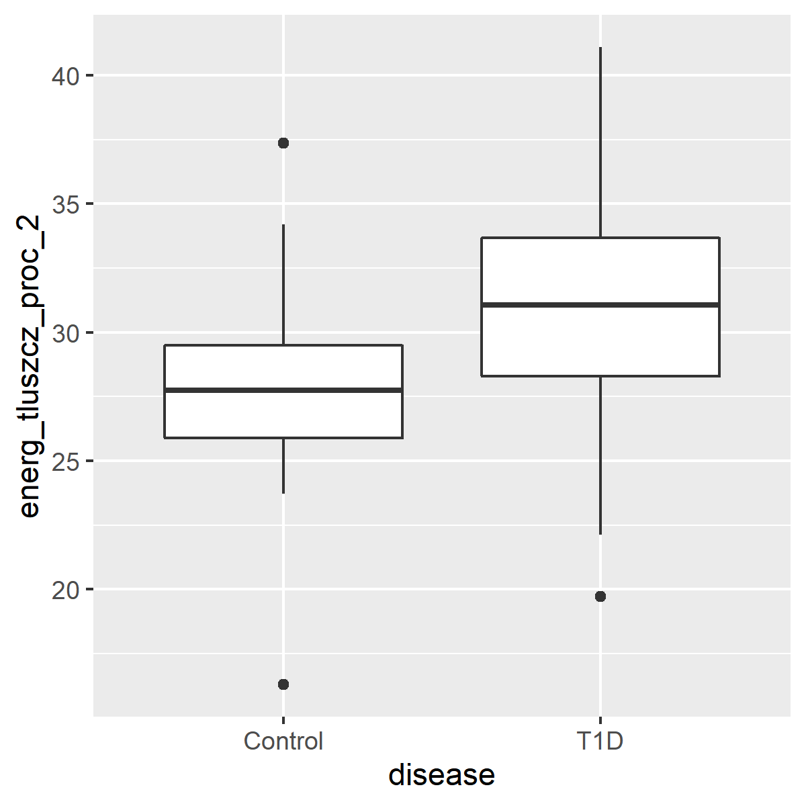
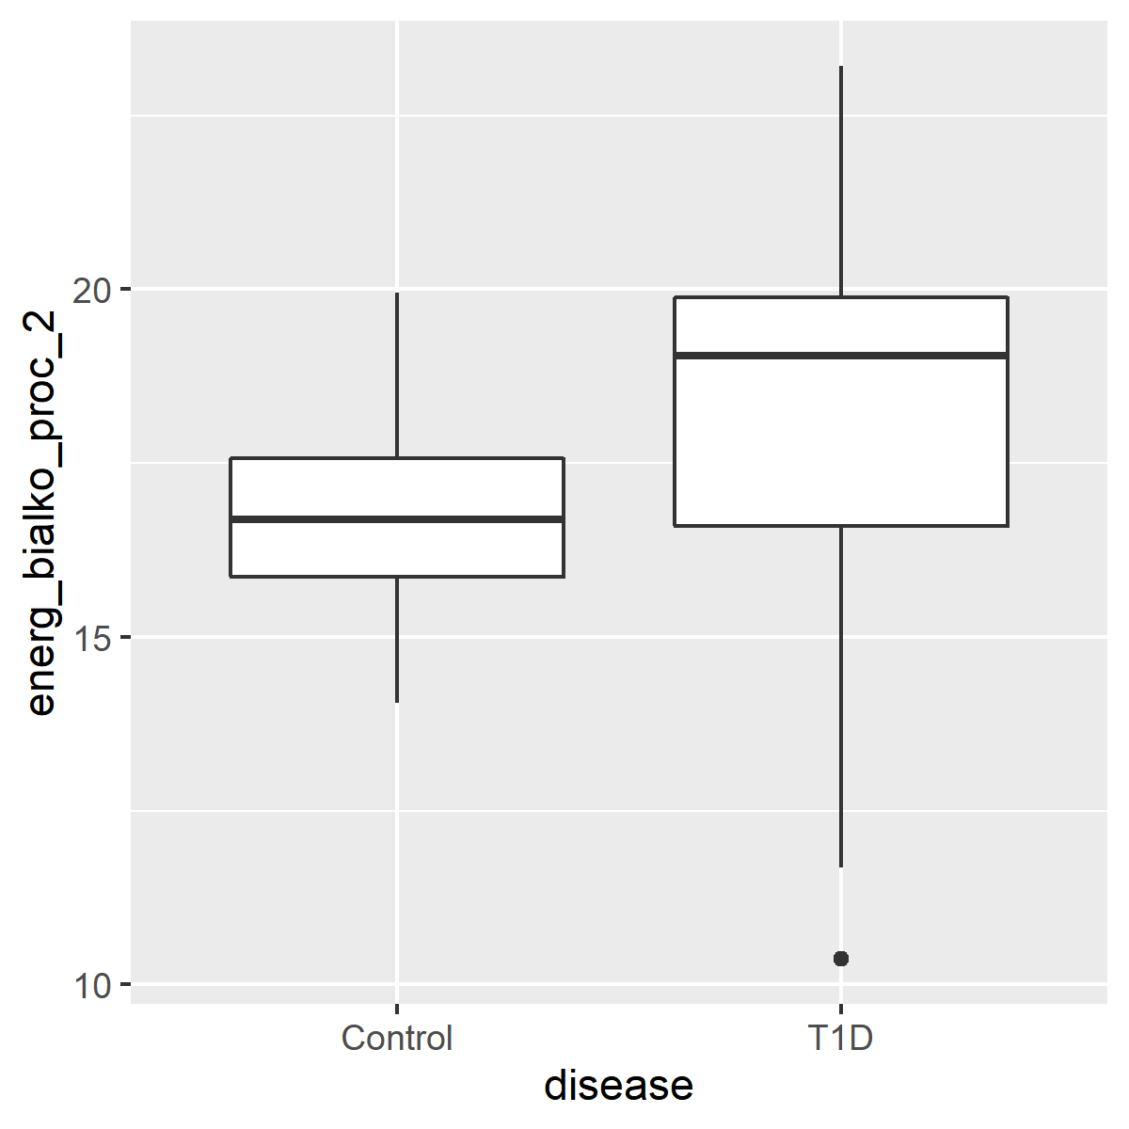
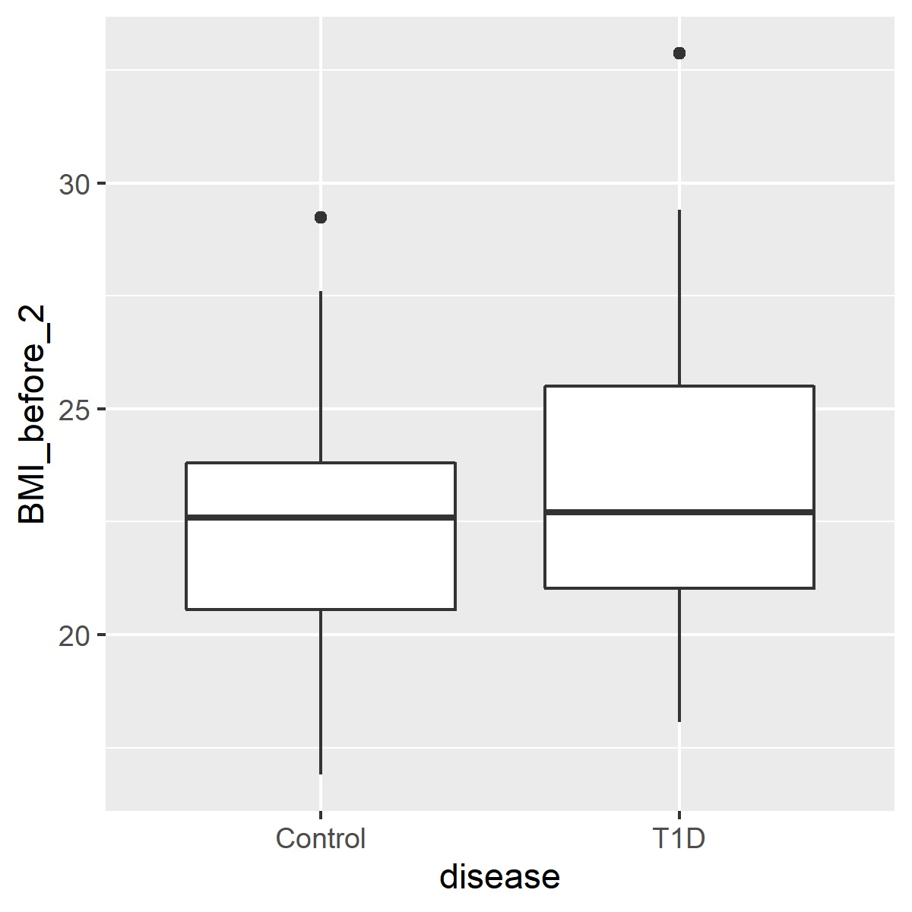
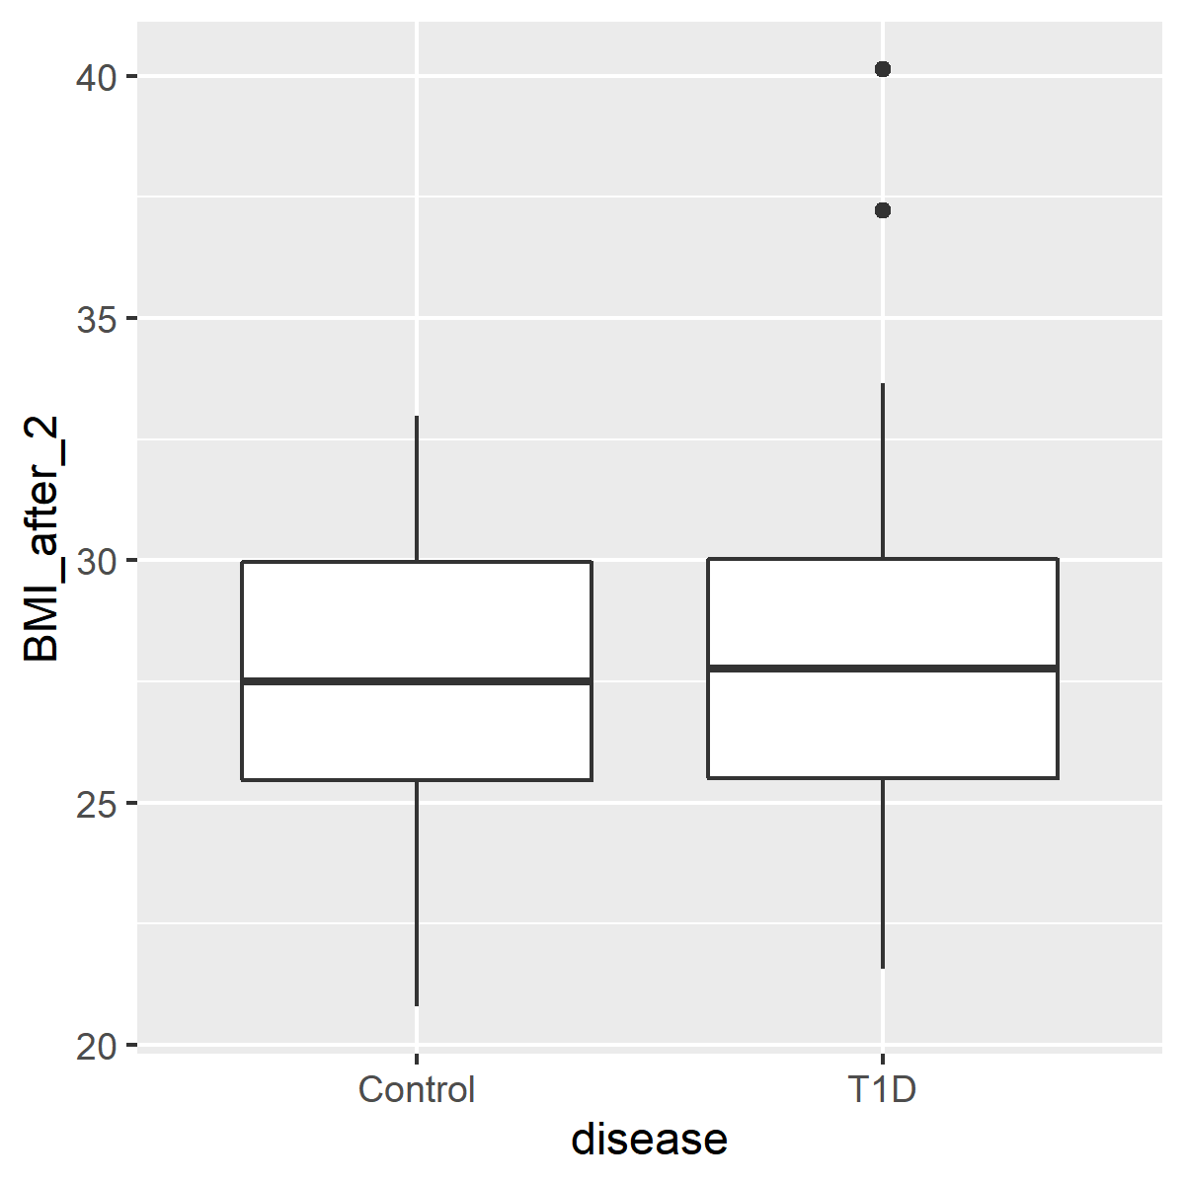
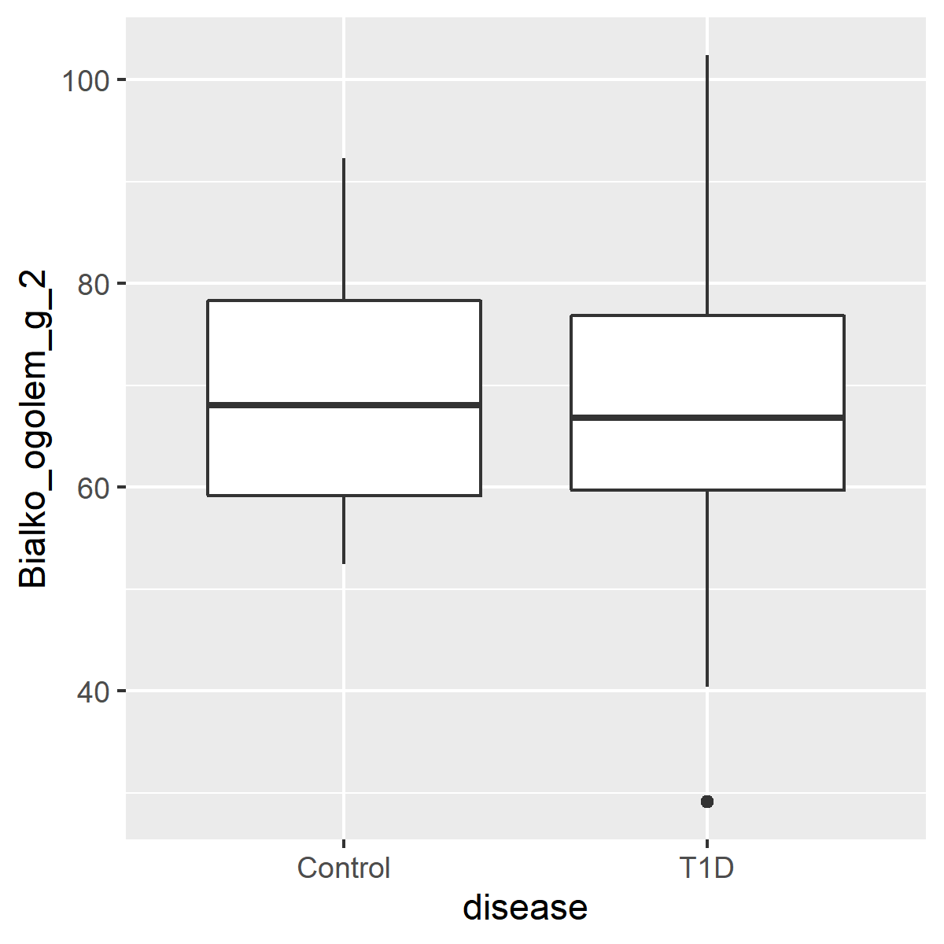
Continuous Variables
NEWBORN_WEIGHT ENERGY DERIVED FROM FAT [%] ENERGY DERIVED FROM PROTEIN [%]
BMI_BEFORE pregnancy BMI_AFTER (just before delivery) PROTEIN INTAKE_total protein [g]
Figure X. Box and whisker plot comparisons of continuous variable and disease.
Box enclosure and whiskers represent the 25th and 75th percentiles, respectively. Median is denoted by the horizontal line, and outliers are portrayed as points outside the box.
Notes:
I will add p values to the particular comparisons

Slide 17
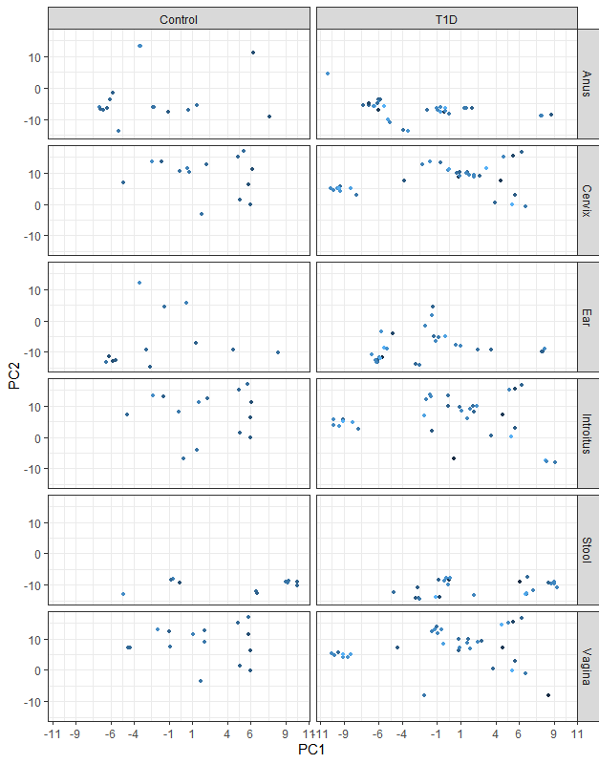
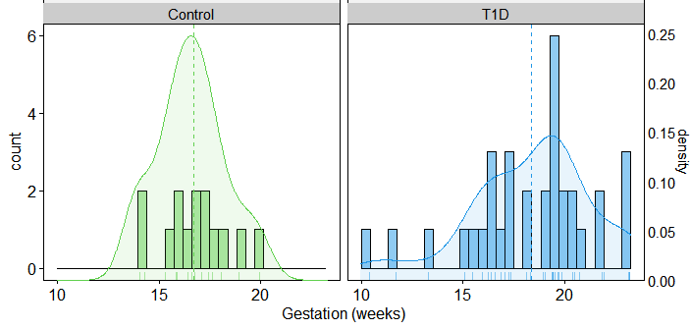
Beta Diversity Bray Curtis adonis permanova
% energy from protein
Table X. Beta Diversity Bray Curtis adonis permanova of VST transformed counts versus percent energy derived from protein stratified by sample type
sam$energ_bialko_proc_2<-as.numeric(sam$energ_bialko_proc_2)
sample_data(ASV_physeq_core)<-sample_data(sam)
a<-subset_samples(ASV_physeq_core, energ_bialko_proc_2!="NA")
plot_landscape(method = "t-SNE",
distance = "bray",
transformation = "compositional",
col = "energ_bialko_proc_2",
x = a,shading = F)+
facet_grid(facets = meta(a)$SampleType~meta(a)$disease)+theme_bw()
 | Df | SumsOfSqs | MeanSqs | F.Model | R2 | Pr(>F)
disease | 1 | 23207 | 23207 | 1.9412 | 0.00728 | 0.0001 | ***
energ_bialko_proc_2 | 1 | 16539 | 16539 | 1.3835 | 0.00519 | 0.002 | **
disease:energ_bialko_proc_2 | 1 | 17810 | 17810 | 1.4898 | 0.00558 | 0.0027 | **
Residuals | 262 | 3132107 | 11955 |  | 0.98196
Total | 265 | 3189663 |  |  | 1
Signif. codes: 0 ‘***’ 0.001 ‘**’ 0.01 ‘*’ 0.05 ‘.’ 0.1 ‘ ’ 1

Slide 18
Delivery mode and Antibiotic prophylaxis
Mother's Clinical Characteristics
 | T1D group (n=50) | Control group (n=42) | P value
Antibiotics prophylaxis |  |  | 0.05781
Yes | 34 (68%) | 20 (47.5%)
no | 16 (32%) | 22 (52.5%)
Cause of antibiotics prophylaxis***** |  |  | 0.06743 (chisq)
C-section | 28 (80%) | 12 (54%)
Streptococcus agalactiae | 5 (14%) | 5 (23%)
Chorioamnionitis | 0 (0%) | 0 (0%)
Maternal bacterial endocarditis | 0 (0%) | 0 (0%)
Premature rupture of membranes | 2 (6%) | 5 (23%)
Used Antibiotic******
cefuroxime | 18 (51,5%) | 7 (30,5%)
ampicillin | 6 (17%) | 4 (17%)
cefazolin | 11 (31,5%) | 10 (43,5%)
clindamycin | 0 (0%) | 1 (4,5%)
cefalexin | 0 (0%) | 1 (4,5%)
*****in one T1D patient and two controls there were more than one cause of using the antibiotics profilaxy
******in one T1D patient and three controls more than one antibiotic was administrated
Notes:
DZ: Tutaj abundance pomiędzy dwoma pierwszymi
PROM profilaktyka ( rozpoczęta 6h po pęknięciu błon płodowych
Chorioamnionitis (intra-amniotic infection (IAI)_
No preterm, dobrze kontrolowana cukrzyca

Slide 19
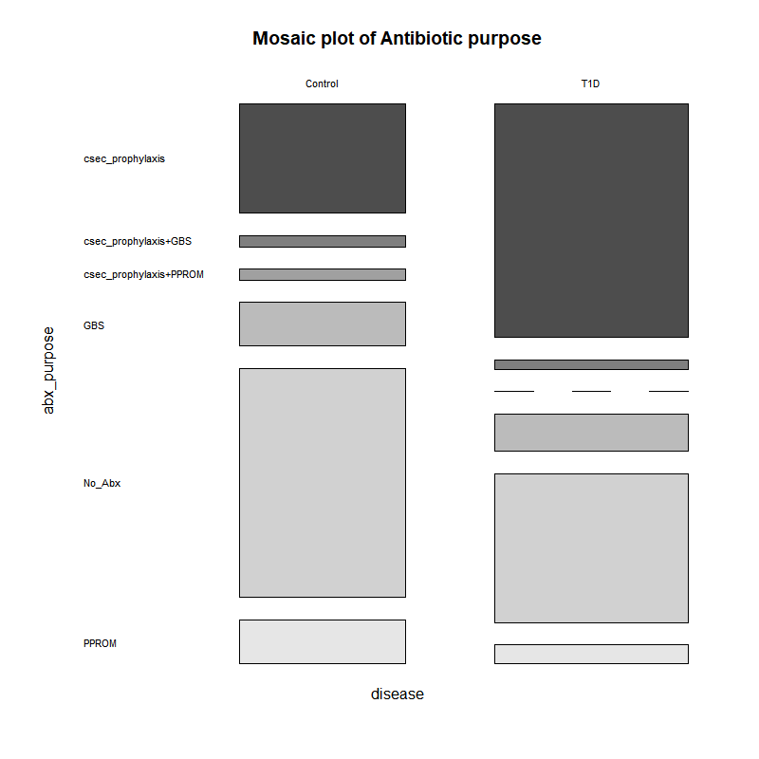

Slide 20
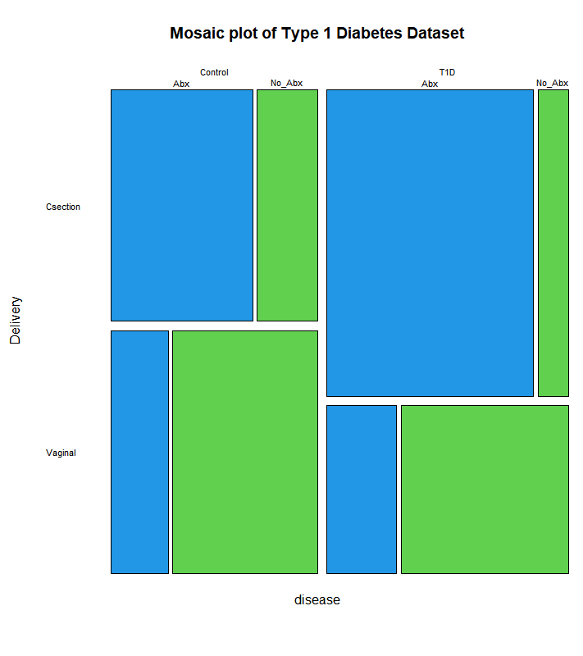
Beta Diversity Bray Curtis adonis permanova
C-section vs Vaginal
Table X. Beta Diversity Bray Curtis adonis permanova of VST transformed counts versus Delivery stratified by sample type
 | Df | SumsOfSqs | MeanSqs | F.Model | R2 | Pr(>F)
disease | 1 | 17149 | 17149 | 1.4868 | 0.00968 | 0.0248 | *
Delivery | 1 | 23172 | 23172 | 2.009 | 0.01309 | 0.0008 | ***
disease:Delivery | 1 | 11811 | 11811 | 1.024 | 0.00667 | 0.2259
Residuals | 149 | 1718543 | 11534 |  | 0.97056
Total | 152 | 1770674 |  |  | 1
---
Signif. codes: 0 ‘***’ 0.001 ‘**’ 0.01 ‘*’ 0.05 ‘.’ 0.1 ‘ ’ 1
Antibiotics
Table X. Beta Diversity Bray Curtis adonis permanova of VST transformed counts versus Antibiotics stratified by sample type
 | Df | SumsOfSqs | MeanSqs | F.Model | R2 | Pr(>F)
disease | 1 | 23963 | 23963 | 1.926 | 0.00377 | 0.0003 | ***
Antibiotics_2 | 1 | 19261 | 19261 | 1.5482 | 0.00303 | 0.0013 | **
disease:Antibiotics_2 | 1 | 17335 | 17335 | 1.3933 | 0.00273 | 0.0064 | **
Residuals | 506 | 6295371 | 12441 |  | 0.99047
Total | 509 | 6355930 |  |  | 1
---
Signif. codes: 0 ‘***’ 0.001 ‘**’ 0.01 ‘*’ 0.05 ‘.’ 0.1 ‘ ’ 1
Notes:
Dr Aagaard: So significance is lost on disease by delivery, but retained on disease by antibiotics. The week of delivery stands in part because of such a strong inverse….no Type I DM goes past 39 weeks (August 13, 2020)
Michael: Removal of the "SampleType" column in the adonis because we are stratifying against it (August 13, 2020)

Slide 21
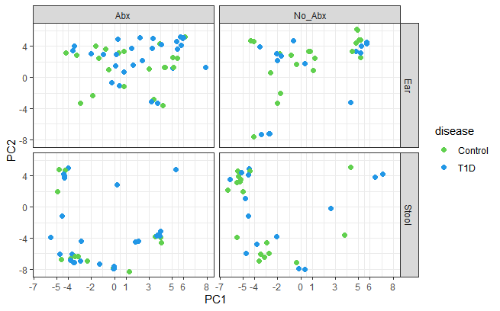
Beta Diversity Bray Curtis adonis permanova
Antibiotics
Table X. Beta Diversity Bray Curtis adonis permanova of VST transformed counts versus Antibiotics stratified by sample type
 | Df | SumsOfSqs | MeanSqs | F.Model | R2 | Pr(>F)
disease | 1 | 23963 | 23963 | 1.926 | 0.00377 | 0.0003 | ***
Antibiotics_2 | 1 | 19261 | 19261 | 1.5482 | 0.00303 | 0.0013 | **
disease:Antibiotics_2 | 1 | 17335 | 17335 | 1.3933 | 0.00273 | 0.0064 | **
Residuals | 506 | 6295371 | 12441 |  | 0.99047
Total | 509 | 6355930 |  |  | 1
---
Signif. codes: 0 ‘***’ 0.001 ‘**’ 0.01 ‘*’ 0.05 ‘.’ 0.1 ‘ ’ 1
Notes:
Dr Aagaard: So significance is lost on disease by delivery, but retained on disease by antibiotics. The week of delivery stands in part because of such a strong inverse….no Type I DM goes past 39 weeks (August 13, 2020)
Michael: Removal of the "SampleType" column in the adonis because we are stratifying against it (August 13, 2020)

Slide 22
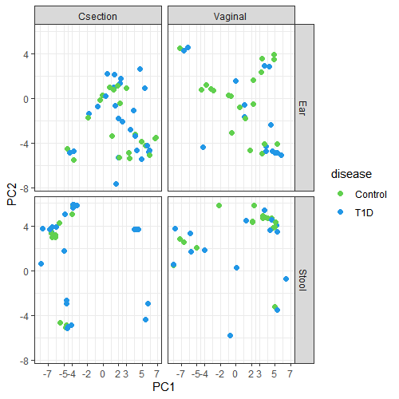
Beta Diversity Bray Curtis adonis permanova
C-section vs Vaginal
Table X. Beta Diversity Bray Curtis adonis permanova of VST transformed counts versus Delivery stratified by sample type
 | Df | SumsOfSqs | MeanSqs | F.Model | R2 | Pr(>F)
disease | 1 | 17149 | 17149 | 1.4868 | 0.00968 | 0.0248 | *
Delivery | 1 | 23172 | 23172 | 2.009 | 0.01309 | 0.0008 | ***
disease:Delivery | 1 | 11811 | 11811 | 1.024 | 0.00667 | 0.2259
Residuals | 149 | 1718543 | 11534 |  | 0.97056
Total | 152 | 1770674 |  |  | 1
---
Signif. codes: 0 ‘***’ 0.001 ‘**’ 0.01 ‘*’ 0.05 ‘.’ 0.1 ‘ ’ 1
Notes:
Dr Aagaard: So significance is lost on disease by delivery, but retained on disease by antibiotics. The week of delivery stands in part because of such a strong inverse….no Type I DM goes past 39 weeks (August 13, 2020)
Michael: Removal of the "SampleType" column in the adonis because we are stratifying against it (August 13, 2020)

Slide 23
Differentially Expressed Taxa associated with Type 1 Diabetes

Slide 24
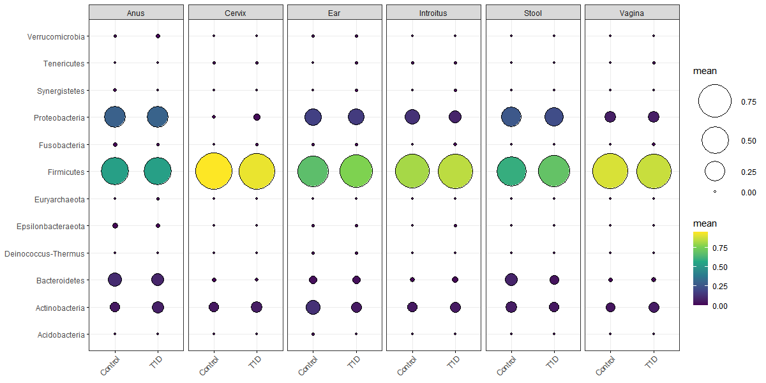
Microbiota relative abundance, Newborns and Mothers, separately
Mean relative abundance
Notes:
Just to remind

Slide 25
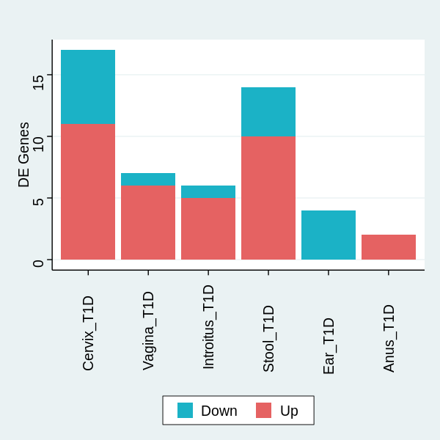
Table X. Log 2-fold change and p value of differentially expressed genera associated with Type 1 Diabetes
Vagina |  |  |  |  |  |  |  | Infant Stool
Genus | baseMean | log2FoldChange | lfcSE | stat | pvalue | padj |  | Genus | baseMean | log2FoldChange | lfcSE | stat | pvalue | padj
Sneathia | 0.91355325 | 49.75205694 | 3.13553 | 15.86719 | 1.07E-56 | 2.44E-54 |  | Fusicatenibacter | 4.220115 | 26.4382456 | 1.231132084 | 21.47474 | 2.68E-102 | 3.03E-100
Intestinibacter | 2.25394947 | 14.81940553 | 1.300908 | 11.39159 | 4.61E-30 | 5.25E-28 |  | Fusobacterium | 8.180648 | 20.08683224 | 1.35277147 | 14.84865 | 7.10E-50 | 4.01E-48
Atopobium | 96.63138911 | 6.817629914 | 1.005162 | 6.782617 | 1.18E-11 | 8.97E-10 |  | Megasphaera | 3.663976 | 15.61100439 | 1.620942737 | 9.630818 | 5.93E-22 | 2.23E-20
Megasphaera | 3.663975758 | 7.795750046 | 1.382241 | 5.639935 | 1.70E-08 | 9.70E-07 |  | Anaeroglobus | 2.730555 | 19.46259187 | 2.232914701 | 8.716227 | 2.88E-18 | 8.13E-17
Streptococcus | 1247.347326 | -3.575171258 | 0.710685 | -5.0306 | 4.89E-07 | 2.23E-05 |  | Pseudomonas | 5.238713 | 7.50531745 | 0.927683487 | 8.090386 | 5.95E-16 | 1.34E-14
Gemella | 7.791854732 | 7.025311314 | 1.569641 | 4.475743 | 7.61E-06 | 0.000289 |  | Collinsella | 5.822142 | -8.766264106 | 1.128939518 | -7.76504 | 8.16E-15 | 1.54E-13
Prevotella_6 | 30.81174732 | 3.78113307 | 0.950575 | 3.977733 | 6.96E-05 | 0.002266 |  | Romboutsia | 2.192765 | 6.40497023 | 1.202747682 | 5.325282 | 1.01E-07 | 1.63E-06
Introitus |  |  |  |  |  |  |  | Peptoniphilus | 132.7484 | 3.420168182 | 0.746132643 | 4.583861 | 4.56E-06 | 6.45E-05
Genus | baseMean | log2FoldChange | lfcSE | stat | pvalue | padj |  | Terrisporobacter | 2.507783 | -7.662802823 | 1.690229063 | -4.53359 | 5.80E-06 | 7.28E-05
Gemella | 7.791854732 | 21.37686055 | 1.594903 | 13.40323 | 5.79E-41 | 1.32E-38 |  | Sutterella | 3.176991 | -5.191498608 | 1.197334093 | -4.33588 | 1.45E-05 | 0.00016405
Citrobacter | 13.1186876 | 15.31044525 | 1.496272 | 10.2324 | 1.42E-24 | 1.62E-22 |  | Dialister | 33.95076 | 3.498783559 | 0.957451276 | 3.654268 | 0.000258 | 0.002649509
Terrisporobacter | 2.507782593 | 14.70171656 | 1.528636 | 9.617539 | 6.74E-22 | 5.12E-20 |  | Bacteroides | 325.9302 | -3.032249963 | 0.875592579 | -3.46308 | 0.000534 | 0.005028719
Enhydrobacter | 2.725316164 | -5.10656261 | 0.868546 | -5.87944 | 4.12E-09 | 2.35E-07 |  | Actinomyces | 7.449215 | 2.884909904 | 0.849028514 | 3.397895 | 0.000679 | 0.005902636
Klebsiella | 110.8625127 | 7.790694435 | 1.360577 | 5.726023 | 1.03E-08 | 4.69E-07 |  | Lachnoclostridium | 1.616491 | 3.844592112 | 1.188055273 | 3.236038 | 0.001212 | 0.009782669
Staphylococcus | 11942.16678 | 2.430468841 | 0.578343 | 4.202468 | 2.64E-05 | 0.001003 |  | Infant Ear
Cervix |  |  |  |  |  |  |  | Genus | baseMean | log2FoldChange | lfcSE | stat | pvalue | padj
Genus | baseMean | log2FoldChange | lfcSE | stat | pvalue | padj |  | Rothia | 104.7048 | -7.754220456 | 0.944265916 | -8.2119 | 2.18E-16 | 4.96E-14
Enhydrobacter | 2.725316164 | 18.47318766 | 0.920473 | 20.06924 | 1.37E-89 | 2.03E-87 |  | Micrococcus | 34.24541 | -3.706357826 | 0.738726707 | -5.01722 | 5.24E-07 | 5.98E-05
Parabacteroides | 10.16690706 | 16.90968828 | 0.981441 | 17.22944 | 1.60E-66 | 1.18E-64 |  | Escherichia/Shigella | 9056.504 | -3.049190658 | 0.743220907 | -4.10267 | 4.08E-05 | 0.003103903
Collinsella | 5.822141559 | -15.18735083 | 1.050767 | -14.4536 | 2.38E-47 | 1.17E-45 |  | Kocuria | 7.549618 | -3.286509007 | 0.821777475 | -3.99927 | 6.35E-05 | 0.003621694
Intestinibacter | 2.25394947 | 17.91541358 | 1.314871 | 13.62523 | 2.84E-42 | 1.05E-40
Sneathia | 0.91355325 | 42.94575628 | 3.185337 | 13.48233 | 1.99E-41 | 5.88E-40
Fusicatenibacter | 4.220114744 | 14.23939158 | 1.11886 | 12.7267 | 4.20E-37 | 1.04E-35
Terrisporobacter | 2.507782593 | 14.19701848 | 1.528636 | 9.287377 | 1.58E-20 | 3.34E-19
Bacteroides | 325.9301607 | 6.338634935 | 0.836282 | 7.579545 | 3.47E-14 | 6.42E-13
Jonquetella | 1.868206931 | 15.34681861 | 2.035424 | 7.539862 | 4.70E-14 | 7.74E-13
Atopobium | 96.63138911 | 6.622227482 | 1.020744 | 6.487647 | 8.72E-11 | 1.29E-09
Bifidobacterium | 521.8067153 | -5.863567853 | 0.969993 | -6.04496 | 1.49E-09 | 2.01E-08
Anaerococcus | 218.5977436 | -3.201892621 | 0.630139 | -5.08125 | 3.75E-07 | 4.62E-06
Gemella | 7.791854732 | 7.914833526 | 1.58885 | 4.981487 | 6.31E-07 | 7.18E-06
Enterococcus | 11413.42655 | -2.766598003 | 0.685799 | -4.03412 | 5.48E-05 | 0.000579
Escherichia/Shigella | 9056.503563 | 2.792875562 | 0.73106 | 3.82031 | 0.000133 | 0.001315
Staphylococcus | 11942.16678 | -2.088343619 | 0.580015 | -3.6005 | 0.000318 | 0.002938
Fusobacterium | 8.180647569 | -3.9099907 | 1.201969 | -3.25299 | 0.001142 | 0.009942
Anus
Genus | baseMean | log2FoldChange | lfcSE | stat | pvalue | padj
Staphylococcus | 11942.16678 | 3.133243112 | 0.56915 | 5.505127 | 3.69E-08 | 8.41E-06
Sneathia | 0.91355325 | 13.85718931 | 3.134176 | 4.421318 | 9.81E-06 | 0.001118
Notes:
Separate analysis by sample type

Slide 26
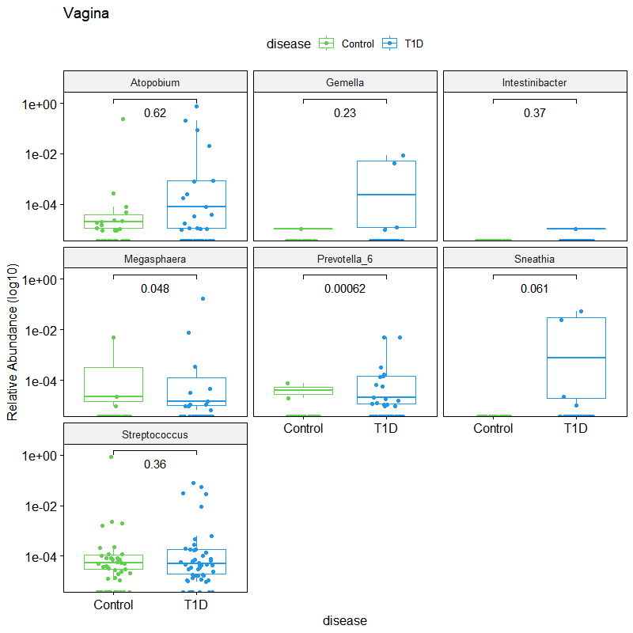
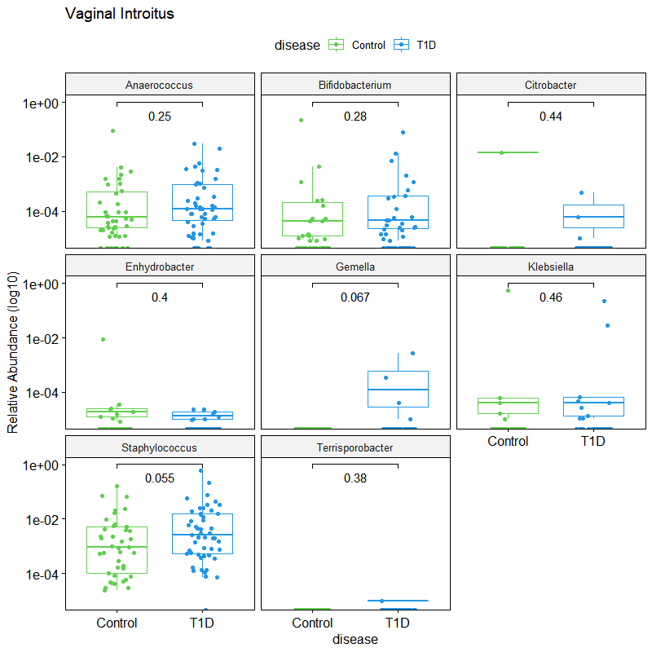
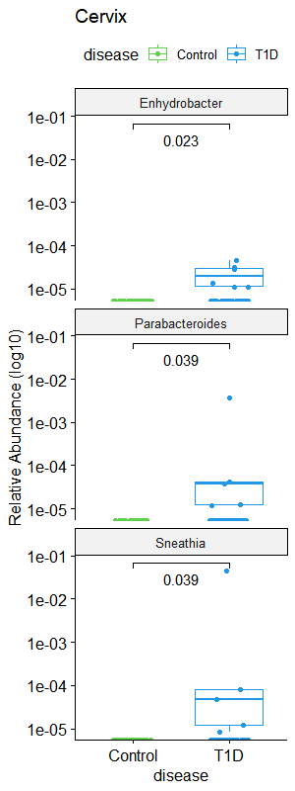
A) Mid-vaginal canal
B) Vaginal Introitus
C) Cervix
Figure X. Wilcox test comparisons of differentially expressed genera associated with Type 1 Diabetes in the A) Vaginal canal, B) Vaginal Introitus, C) Cervix, and D) Anus samples

Slide 27
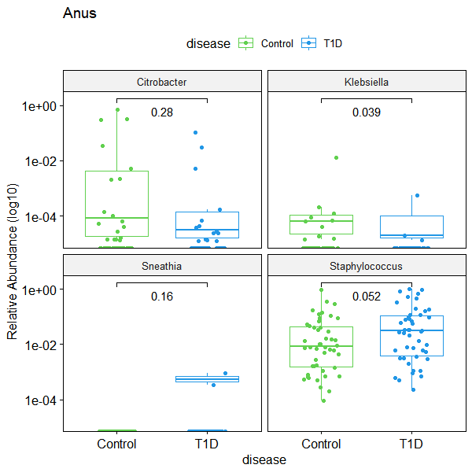
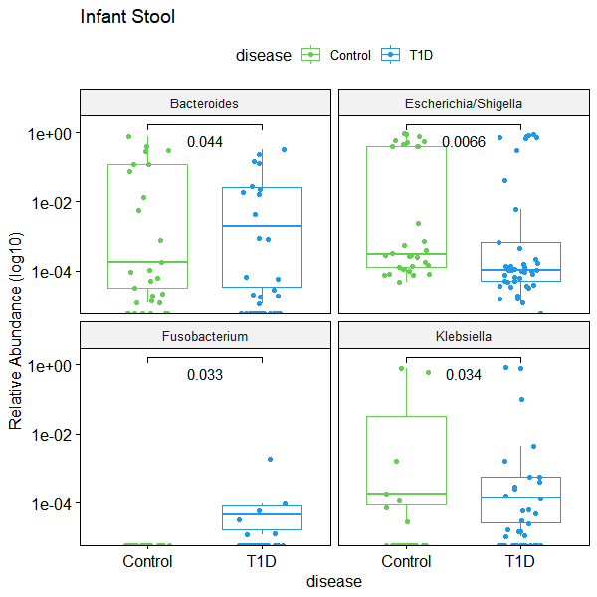
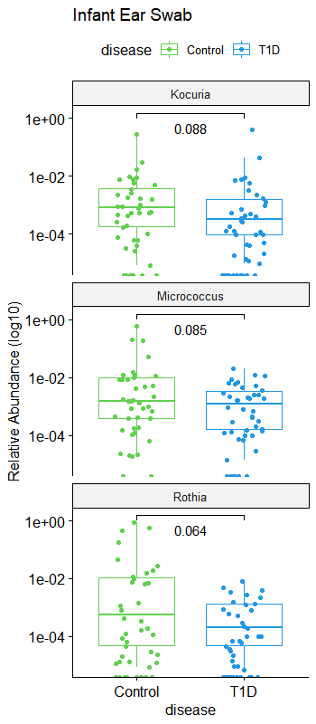
D) Anus
E) Infant Stool
F) Infant Ear swab
Figure X. Wilcox test comparisons of differentially expressed genera associated with Type 1 Diabetes in the
D) Anus, E) Infant stool, and F) infant ear microbiomes.

Slide 28
Influence of GLYCEAMIC CONTROL in the first, second and third (before delivery) pregnancy trimesters in T1D mothers
on HYPOGLYCEMIA in their newborns
In accordance to the recommendations of the Polish Diabetes Association, one of the criteria for good diabetes control during pregnancy is a glycated hemoglobin level ≤ 6.1% (43 mmol/mol);
2-5 blood glucose level [mg/dl] measurements over time, in newborns of T1D mothers only

Slide 29
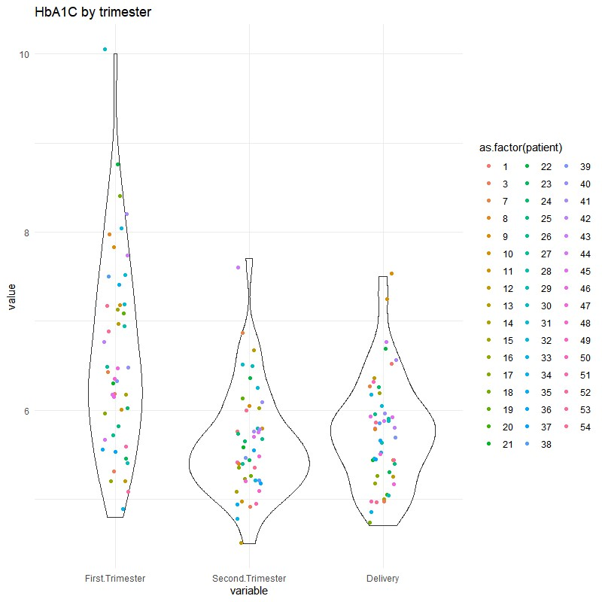
GLYCAEMIC CONTROL
during first, second and third (before delivery) pregnancy trimesters in T1D mothers
Here, differences between first and second trimesters, and first and third trimesters were statistically significant;
Glycaemic control was satisfactory in second and third trimesters
Tukey multiple comparisons of means [95% family-wise confidence level]
Variable diff lwr upr p adj
Second.Trimester-First.Trimester -0.9936170 -1.3829062 -0.6043278 0.0000000
Delivery-First.Trimester -0.8586383 -1.2420437 -0.4752329 0.0000013
Delivery-Second.Trimester 0.1349787 -0.2484267 0.5183841 0.6826300
Notes:
August 14th – HbA1c modified figure (without duplicates) + STAT_MJ (August14)

Slide 30
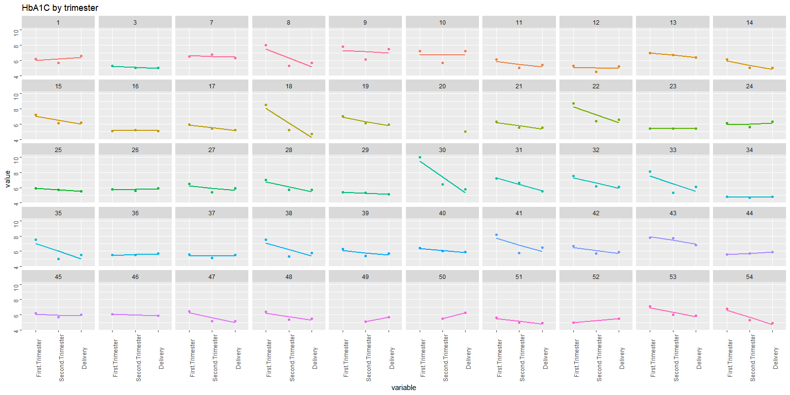
GLYCAEMIC control
during first, second and third (before delivery) pregnancy trimesters in T1D mothers

Slide 31
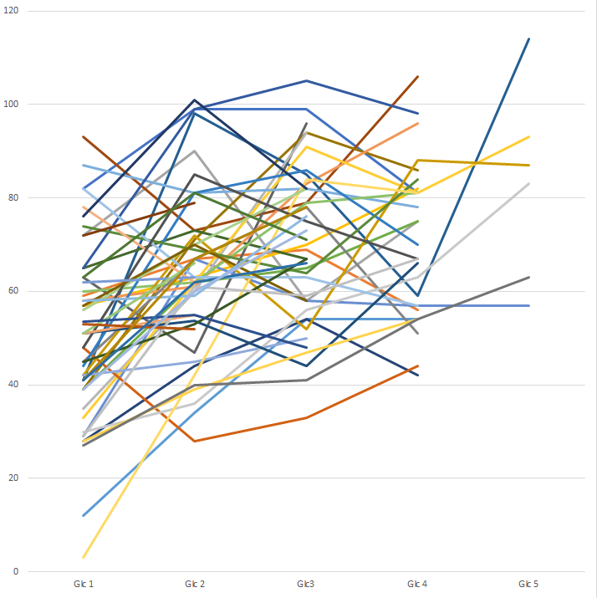
HYPOGLYCEMIA in newborns of T1D mothers_Glucose timepoints analysis
2-5 blood glucose level [mg/dl] measurements over time,
in newborns of T1D mothers only
blood glucose level [mg/dl]

Slide 32
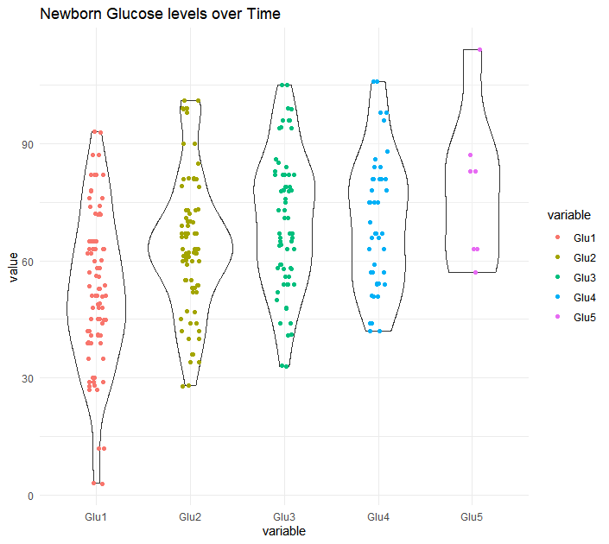
HYPOGLYCEMIA in newborns of T1D mothers_Glucose timepoints analysis
Notes:
30 July 2020

Slide 33
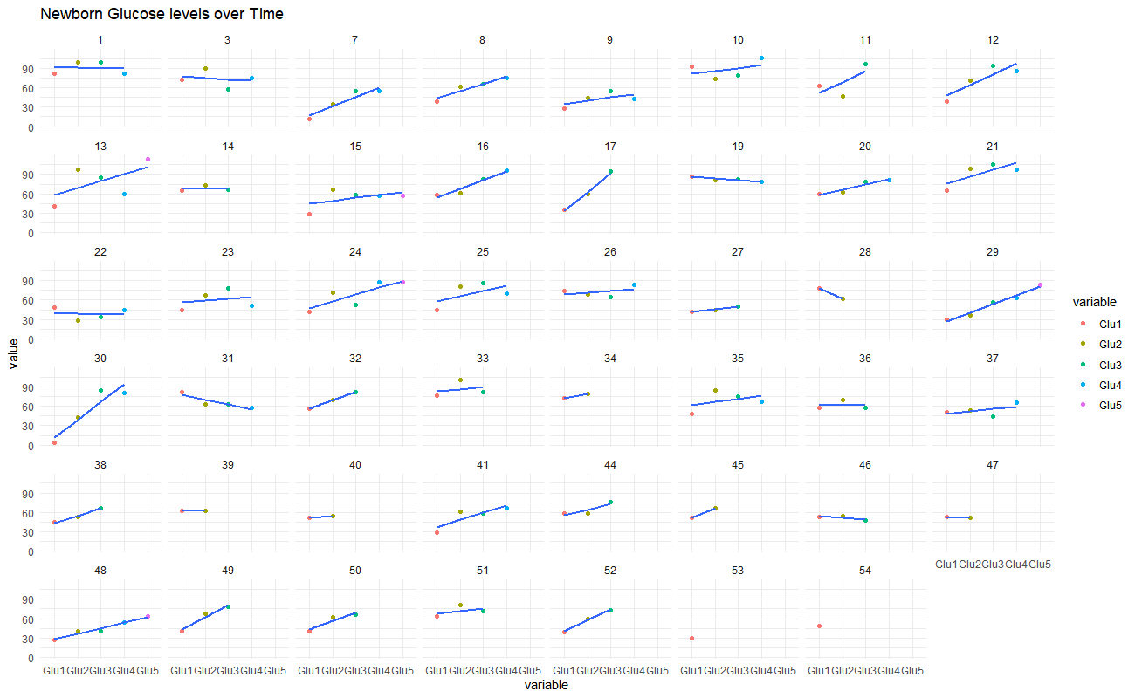
HYPOGLYCEMIA in newborns of T1D mothers_Glucose timepoints analysis
Notes:
30 July 2020

Slide 34
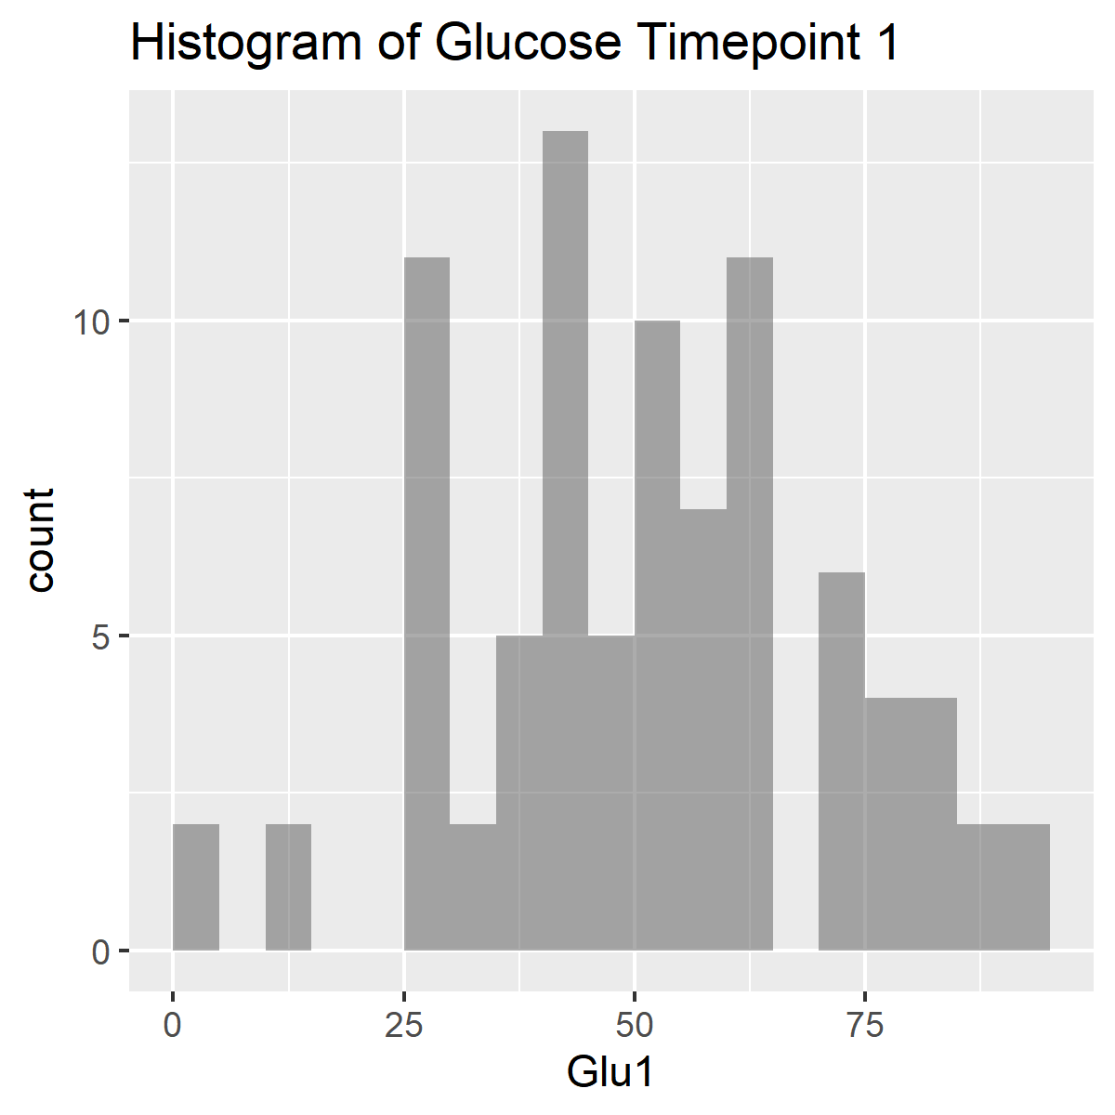
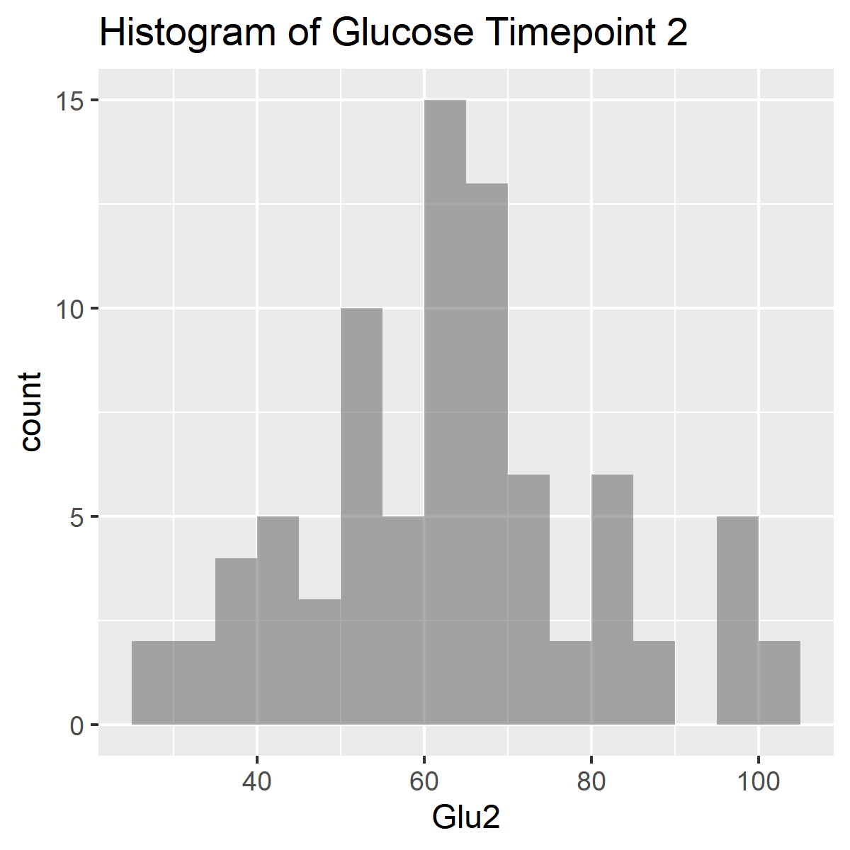
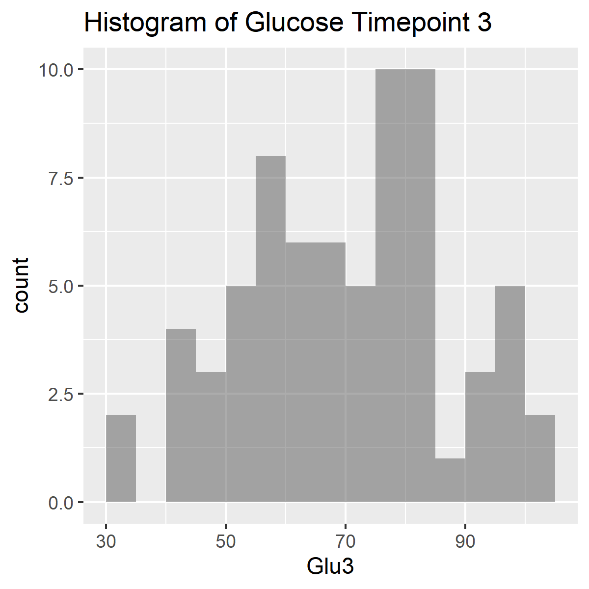
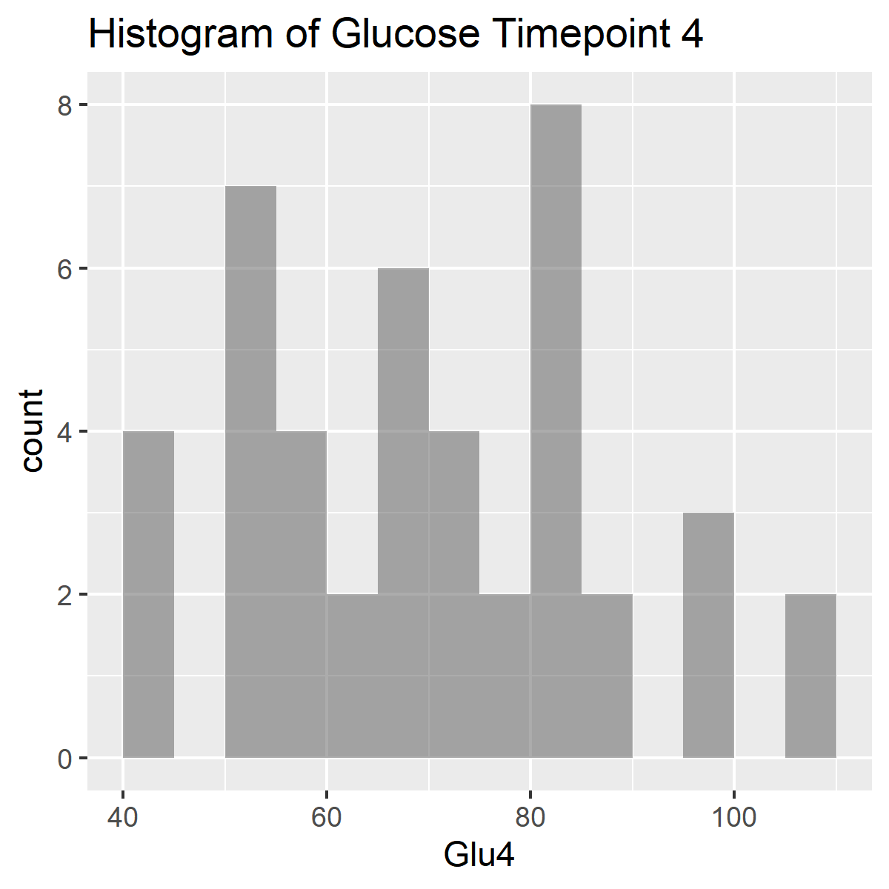
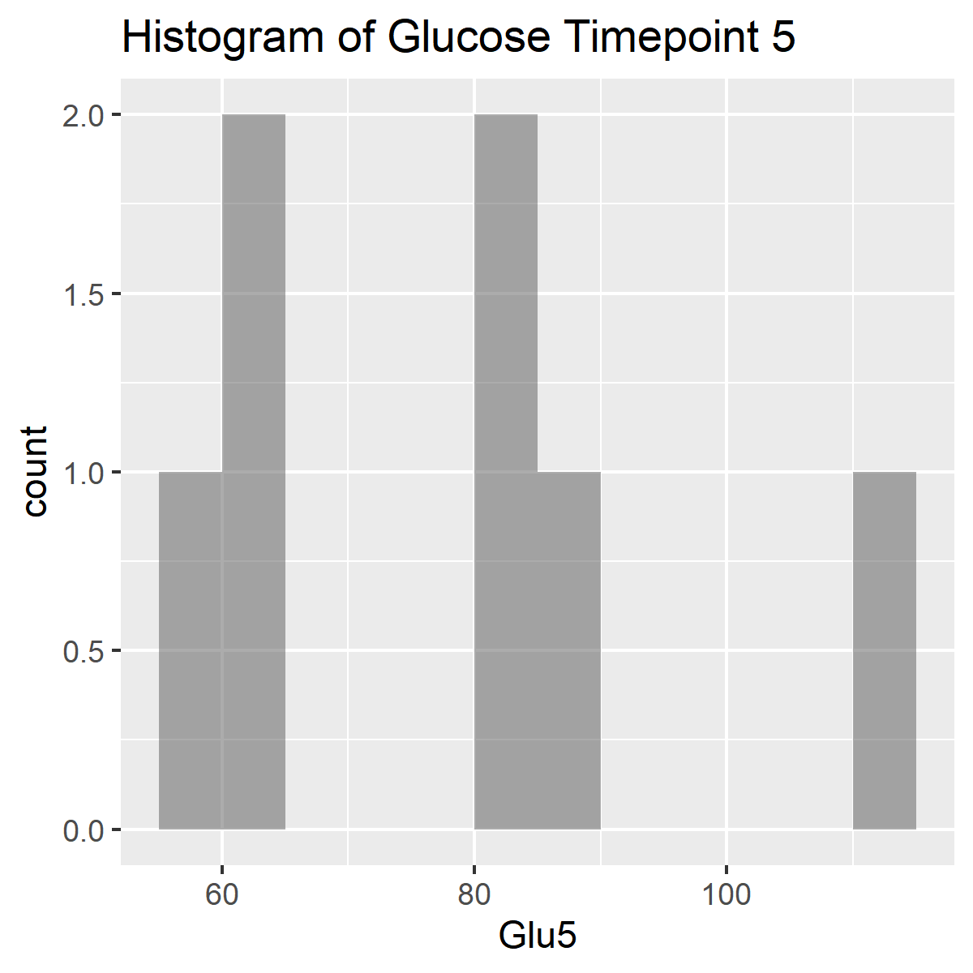
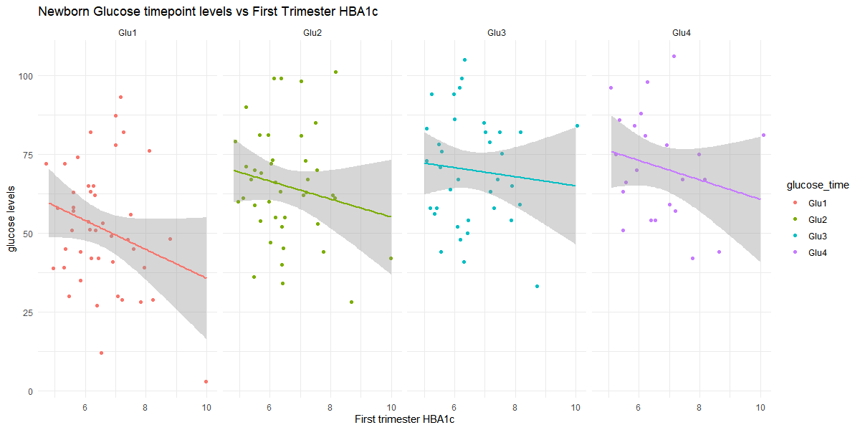
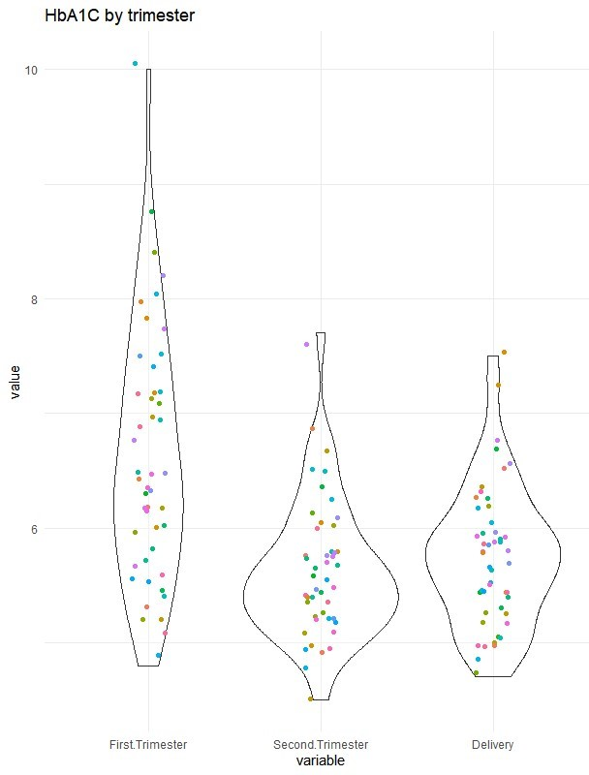
Influence of GLYCEAMIC CONTROL in the 1st pregnancy trimester in T1D mothers
on HYPOGLYCEMIA in their newborns
Notes:
30 July 2020; August 14th – HbA1c modified figure (without duplicates) + STAT_MJ

Slide 35
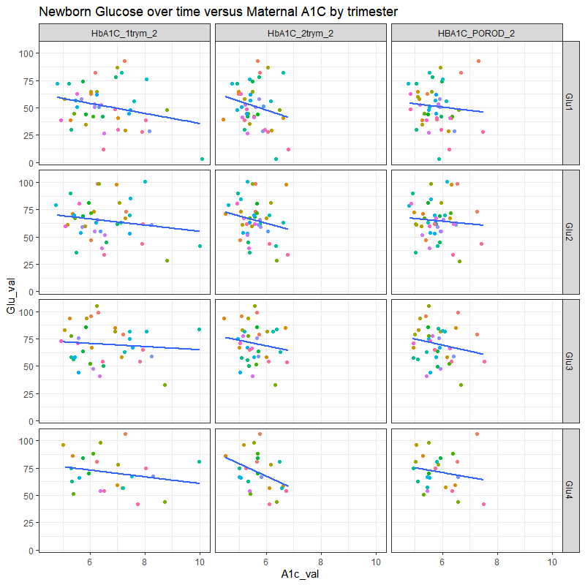

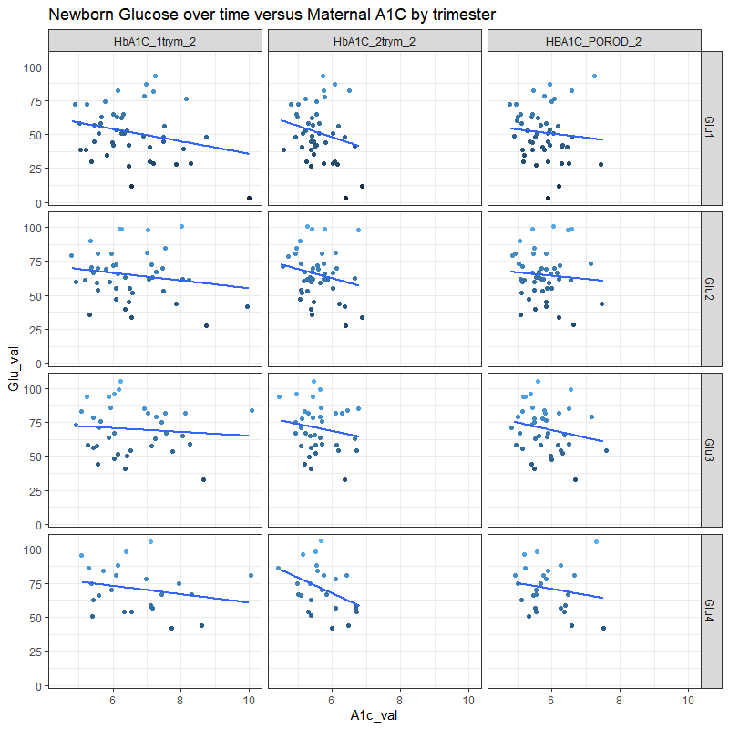
Influence of GLYCEAMIC CONTROL by trimester in T1D mothers on HYPOGLYCEMIA in their newborns
Pearson's product-moment correlation between Delivery HBA1c and glucose timepoint 1
data: Delivery HBA1c and glu1
t = -0.62595, df = 45, p-value = 0.5345
alternative hypothesis: true correlation is not equal to 0
95 percent confidence interval:
-0.3701970 0.1995847
sample estimates:
cor -0.09290696
Linear regression model for 1st trimester HBA1c and the interaction effects of glucose timepoints 1-4.
Coefficients:
Estimate Std. Error t value Pr(>|t|)
(Intercept) 3.883e+00 3.888e+00 0.999 0.326
Glu1 5.544e-02 7.791e-02 0.712 0.482
Glu2 8.776e-02 7.135e-02 1.230 0.228
Glu3 2.546e-02 5.433e-02 0.469 0.643
Glu1:Glu2 -1.793e-03 1.271e-03 -1.411 0.168
Glu1:Glu3 -7.781e-04 1.037e-03 -0.751 0.459
Glu2:Glu3 -1.179e-03 9.474e-04 -1.245 0.223
Glu1:Glu2:Glu3 2.422e-05 1.622e-05 1.493 0.146
(Dispersion parameter for gaussian family taken to be 0.3251273)
Null deviance: 13.530 on 38 degrees of freedom
Residual deviance: 10.079 on 31 degrees of freedom
(100 observations deleted due to missingness)
AIC: 75.906
Number of Fisher Scoring iterations: 2
Notes:
30 July 2020; August 14th – modified figure (without duplicates) + STAT_MJ
Why the STAT data is the same for the 1st and 3rd trimesters?

Slide 36
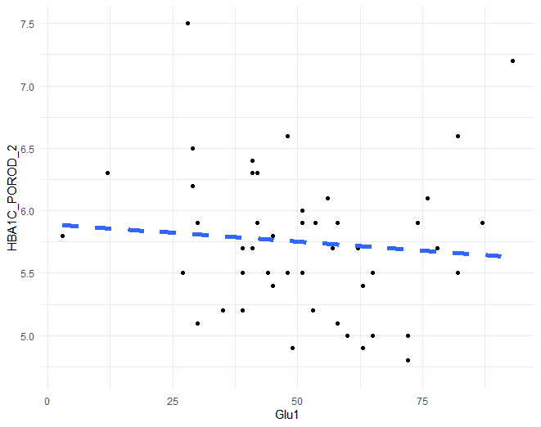
Pearson's product-moment correlation between Delivery HBA1c and glucose timepoint 1
data: Delivery HBA1c and glu1
t = -0.62595, df = 45, p-value = 0.5345
alternative hypothesis: true correlation is not equal to 0
95 percent confidence interval:
-0.3701970 0.1995847
sample estimates:
cor -0.09290696
Influence of GLYCEAMIC CONTROL at Delivery in T1D mothers on HYPOGLYCEMIA in their newborns
Linear regression model for 1st trimester HBA1c and the interaction effects of glucose timepoints 1-4.
Coefficients:
Estimate Std. Error t value Pr(>|t|)
(Intercept) 3.883e+00 3.888e+00 0.999 0.326
Glu1 5.544e-02 7.791e-02 0.712 0.482
Glu2 8.776e-02 7.135e-02 1.230 0.228
Glu3 2.546e-02 5.433e-02 0.469 0.643
Glu1:Glu2 -1.793e-03 1.271e-03 -1.411 0.168
Glu1:Glu3 -7.781e-04 1.037e-03 -0.751 0.459
Glu2:Glu3 -1.179e-03 9.474e-04 -1.245 0.223
Glu1:Glu2:Glu3 2.422e-05 1.622e-05 1.493 0.146
(Dispersion parameter for gaussian family taken to be 0.3251273)
Null deviance: 13.530 on 38 degrees of freedom
Residual deviance: 10.079 on 31 degrees of freedom
(100 observations deleted due to missingness)
AIC: 75.906
Number of Fisher Scoring iterations: 2
Notes:
30 July 2020; August 14th – modified figure (without duplicates) + STAT_MJ

Slide 37
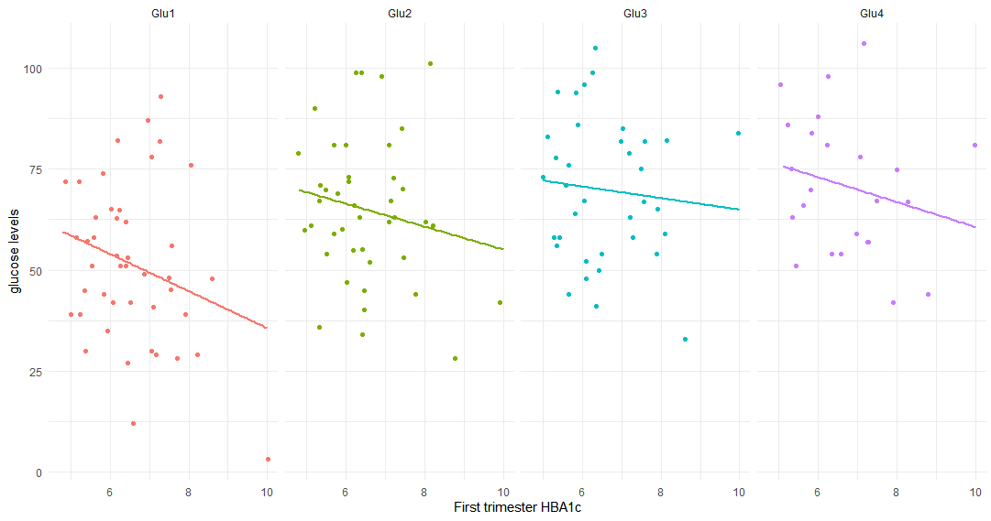
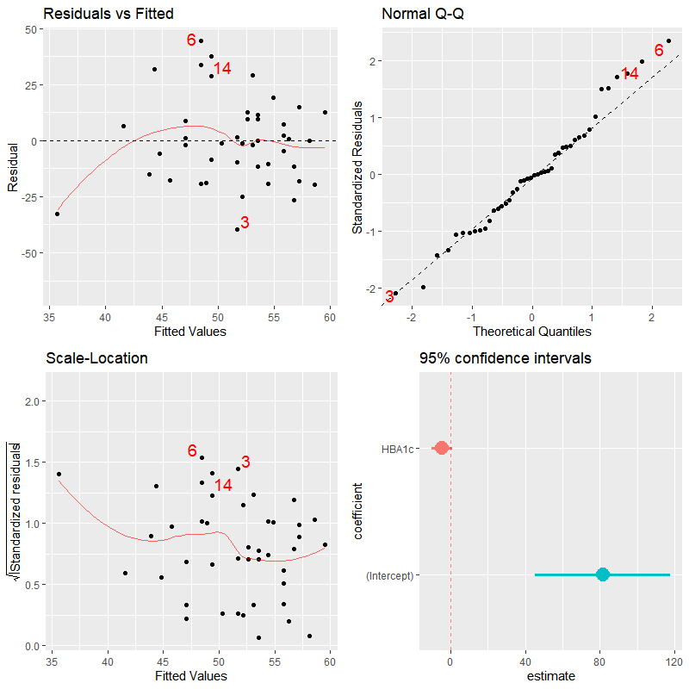
Pearson's product-moment correlation between 1st trimester HBA1c and glucose timepoint 1
data: HBA1c and glu1
t = -1.6874, df = 42, p-value = 0.09894
alternative hypothesis:
true correlation is not equal to 0
95 percent confidence interval:
-0.51065126 0.04854136
sample estimates:
Correlation : -0.2519701
Linear regression model for 1st trimester HBA1c and the interaction effects of glucose timepoints 1-4.
Coefficients:
Estimate Std. Error t value Pr(>|t|)
(Intercept) -2.990e+00 7.710e+00 -0.388 0.7011
glu1 2.345e-01 1.541e-01 1.521 0.1394
glu2 1.431e-01 1.419e-01 1.009 0.3218
glu3 1.771e-01 1.076e-01 1.646 0.1109
glu1:glu2 -3.305e-03 2.521e-03 -1.311 0.2005
glu1:glu3 -4.041e-03 2.049e-03 -1.972 0.0586 .
glu2:glu3 -2.551e-03 1.880e-03 -1.357 0.1856
glu1:glu2:glu3 5.500e-05 3.213e-05 1.712 0.0980 .
Dispersion parameter for gaussian family taken to be
1.263929)
Null deviance: 46.192 on 35 degrees of freedom
Residual deviance: 35.390 on 28 degrees of freedom
(8 observations deleted due to missingness)
AIC: 119.55
Number of Fisher Scoring iterations: 2
Notes:
30 July 2020_ to be modyfied August 15_MJ

Slide 38
Notes:
30 July 2020; to be modyfied August 15_MJ

Slide 39
In TOTAL 17 duplicated samples
In newborn T1D group we have duplicated samples:
11c.u.S20 Ear T1D_Ear T1D_Infant_Ear
11c.u.S70 Ear T1D_Ear T1D_Infant_Ear
23c.u.S101 Ear T1D_Ear T1D_Infant_Ear
23c.u.S64 Ear T1D_Ear T1D_Infant_Ear
In newborn control group
33k.u.S81 Ear Control_Ear Control_Infant_Ear
33k.u.S95 Ear Control_Ear Control_Infant_Ear
26k.u.S21 Ear Control_Ear Control_Infant_Ear
26k.u.S59 Ear Control_Ear Control_Infant_Ear
36k.u.S10 Ear Control_Ear Control_Infant_Ear
36k.u.S24 Ear Control_Ear Control_Infant_Ear
41k.u.S23 Ear Control_Ear Control_Infant_Ear
41k.u.S58 Ear Control_Ear Control_Infant_Ear
In mothers T1D group
12c.o.S74 Anus T1D_Anus T1D_Mother_Anus
12c.o.S82 Anus T1D_Anus T1D_Mother_Anus
17c.o.S15 Anus T1D_Anus T1D_Mother_Anus
17c.o.S94 Anus T1D_Anus T1D_Mother_Anus
In mother control group
2k.o.S61 Anus Control_Anus Control_Mother_Anus
2k.o.S73 Anus Control_Anus Control_Mother_Anus
21k.o.S35 Anus Control_Anus Control_Mother_Anus
21k.o.S4 Anus Control_Anus Control_Mother_Anus
22k.o.S11 Anus Control_Anus Control_Mother_Anus
22k.o.S16 Anus Control_Anus Control_Mother_Anus
23k.m2.S15 Vagina Control_Vagina Control_Mother_Vagina
23k.m2.S71 Vagina Control_Vagina Control_Mother_Vagina
24k.o.S47 Anus Control_Anus Control_Mother_Anus
24k.o.S471 Anus Control_Anus Control_Mother_Anus
26k.o.S40 Anus Control_Anus Control_Mother_Anus
26k.o.S71 Anus Control_Anus Control_Mother_Anus
33k.o.S12 Anus Control_Anus Control_Mother_Anus
33k.o.S65 Anus Control_Anus Control_Mother_Anus
39k.o.S36 Anus Control_Anus Control_Mother_Anus
39k.o.S42 Anus Control_Anus Control_Mother_Anus
5k.m2.S32 Vagina Control_Vagina Control_Mother_Vagina
5k.m2.S82 Vagina Control_Vagina Control_Mother_Vagina

Slide 40
Clinicians involved:
Prof. Ewa Wender-Ozegowska, MD, PhD, and Dr. Pawel Gutaj, MD, PhD, gynaecologists
Prof. Tomasz Szczapa, MD, PhD, neonatologist
Poznan University of Medical Sciences, Poznan, Poland
Researchers (Microbiome study only):
Kasia Jaskiewicz, MSc, PhD Student
Institute of Human Genetics, PAS, Poznan, Poland
Dorota Kaminska, PhD
Poznan University of Medical Sciences, Poznan, Poland
Małgorzata Rydzanicz, PhD
Medical University of Warsaw, Warsaw, Poland

Slide 41
Thank you

Slide 42
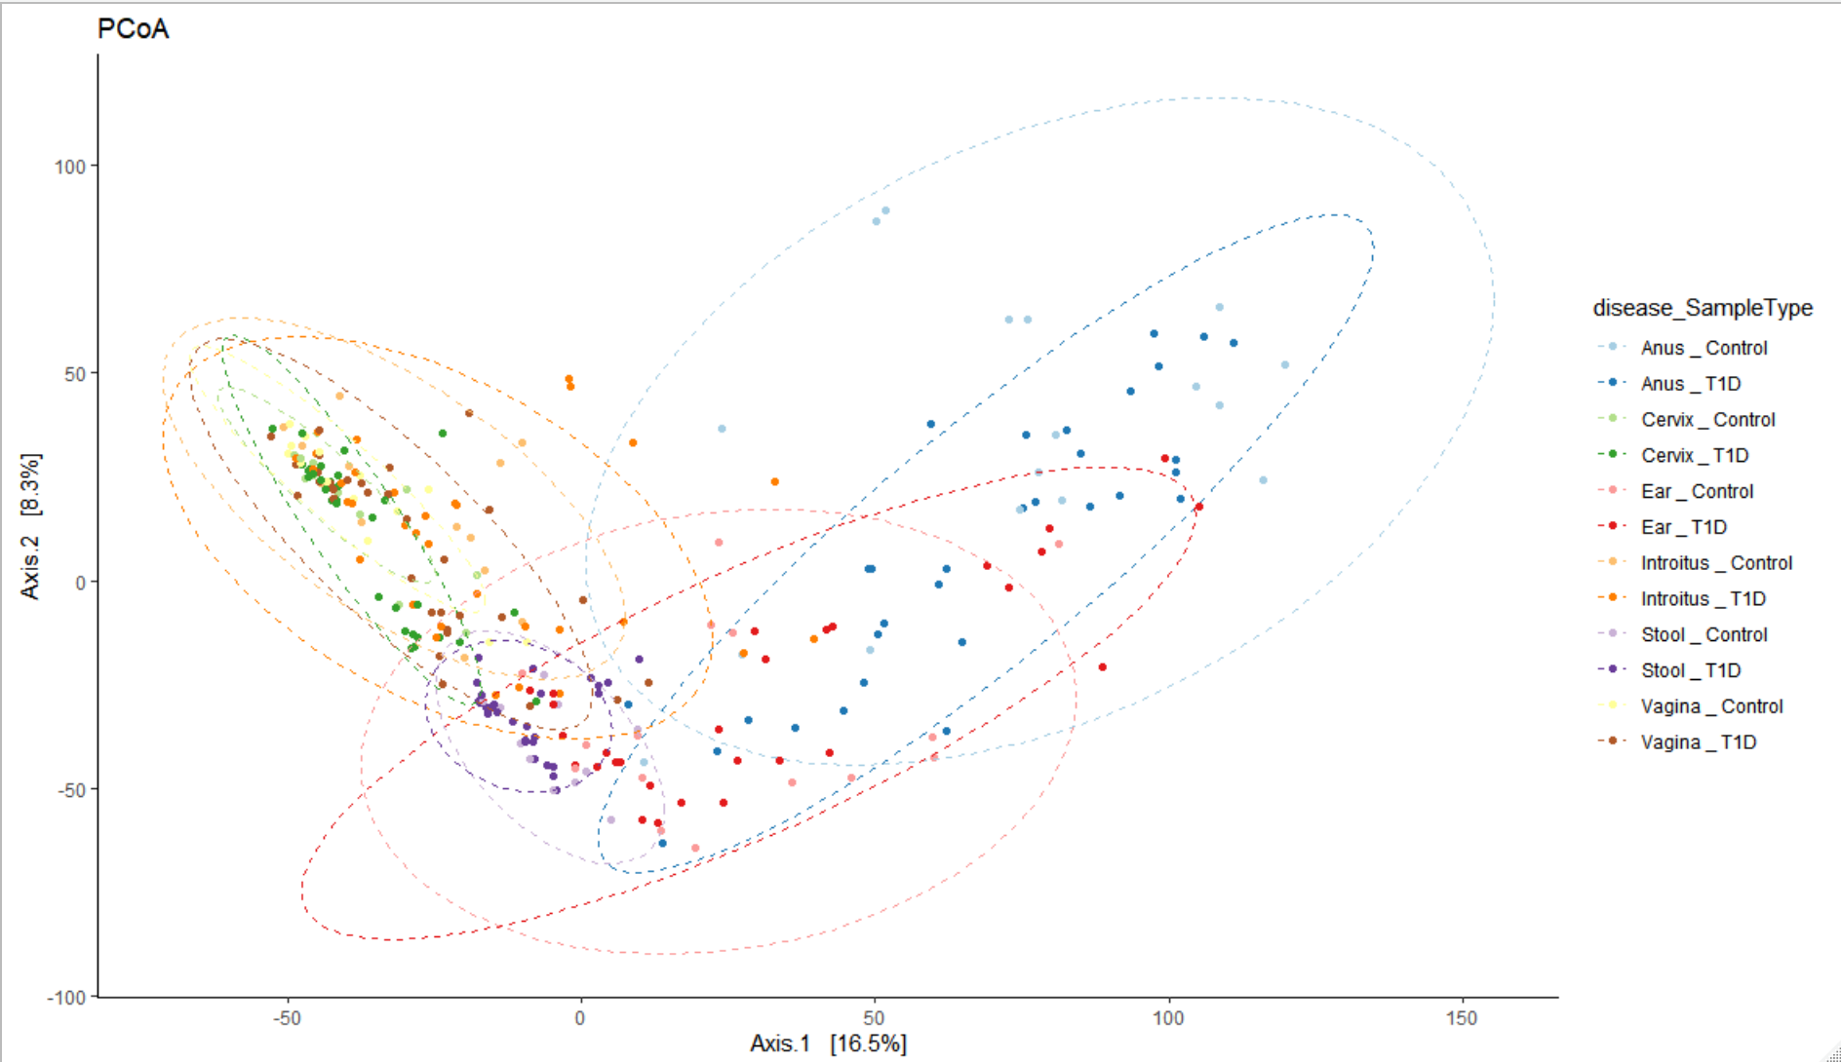
Dr. Aagaard: Make sure you don’t plot mom and baby on same plot
Figure X. Beta Diversity PCoA plots comparing the Type 1 Diabetes and control samples across all microbiome sample types.
Notes:
Dr. Aagaard: Make sure you don’t plot mom and baby on same plot

Slide 43
Data Summary Tables
Disease(n) | Delivery | Abx | No_Abx
Control | Csection | 14 | 6
 | Vaginal | 6 | 15
T1D | Csection | 27 | 4
 | Vaginal | 5 | 12
Disease(%) | Delivery | Abx | No_Abx
Control | Csection | 34.15 | 54.55
 | Vaginal | 65.85 | 45.45
T1D | Csection | 60.00 | 55.56
 | Vaginal | 40.00 | 44.44
 | With antibiotics |  |  | Without antibiotics
Disease (n) | Csection | Vaginal |  | Csection | Vaginal
Control | 14 | 6 |  | 6 | 15
T1D | 27 | 5 |  | 4 | 12
 | With antibiotics |  |  | Without antibiotics
Disease (%) | Csection | Vaginal |  | Csection | Vaginal
Control | 34.14634 | 54.54545 |  | 60 | 55.5556
T1D | 65.85366 | 45.45455 |  | 40 | 44.4444
Table X. Type 1 Diabetes Dataset Counts (Percentages)

Slide 44
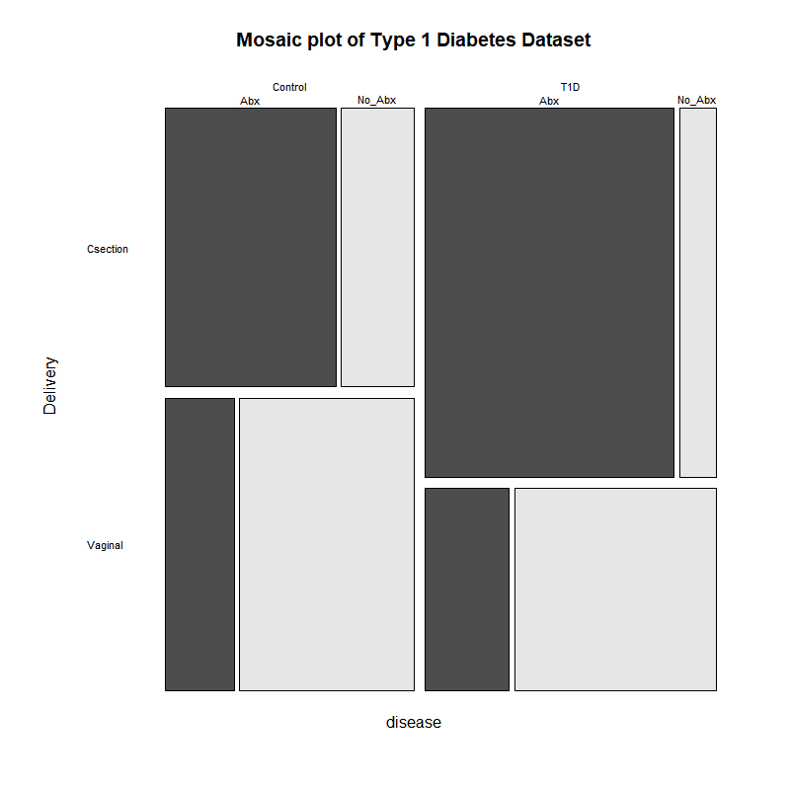
diseasexdelivery
Fisher's Exact Test for Count Data
p-value = 0.1306
95 percent CI: 0.1848469 1.2207114
OR=0.480279
diseaseXabs = deliveryXabs
Fisher's Exact Test for Count Data
p-value = 1.285e-06
95 percent CI: 3.410531 30.438495
OR=9.740854
disease_VS_Delivery+Antibiotics_2
Mantel-Haenszel chi-squared test with continuity correction
Mantel-Haenszel X-squared = 0.22697, df = 1,
p-value = 0.6338
95 CI: 0.2607369 1.8524035
common OR=0.6949748
August 4,2020

Slide 45
Beta Diversity Bray Curtis adonis permutational ANOVA for distinctly significant variables
Table X. Beta Diversity Bray Curtis adonis permanova of VST transformed counts versus week of delivery stratified by sample type.
Table X. Beta Diversity Bray Curtis adonis permanova of VST transformed counts versus Delivery stratified by sample type
 | Df | SumsOfSqs | MeanSqs | F.Model | R2 | Pr(>F)
Disease | 1 | 22417 | 22417 | 2.418 | 0.00731 | 0.0001 | ***
SampleType | 5 | 625668 | 125134 | 13.497 | 0.20389 | 0.0068 | **
Week of Deliv | 1 | 18741 | 18741 | 2.0215 | 0.00611 | 0.0005 | ***
Disease:SampleType | 5 | 51416 | 10283 | 1.1091 | 0.01675 | 0.1774
Disease:Week of Deliv | 1 | 18744 | 18744 | 2.0217 | 0.00611 | 0.0007 | ***
SampleType:Week of Deliv | 5 | 47951 | 9590 | 1.0344 | 0.01563 | 0.3848
Disease:SampleType:Week of Deliv | 5 | 40115 | 8023 | 0.8654 | 0.01307 | 0.903
Residuals | 242 | 2243635 | 9271 | 0.73114
Total | 265 | 3068686 | 1
---
Signif. codes: 0 ‘***’ 0.001 ‘**’ 0.01 ‘*’ 0.05 ‘.’ 0.1 ‘ ’ 1
 | Df | SumsOfSqs | MeanSqs | F.Model | R2 | Pr(>F)
disease | 1 | 15282 | 15282 | 1.6807 | 0.01828 | 0.0231 | *
SampleType | 1 | 98637 | 98637 | 10.8478 | 0.11796 | 0.0465 | *
Delivery | 1 | 16399 | 16399 | 1.8036 | 0.01961 | 0.004 | **
disease:SampleType | 1 | 10884 | 10884 | 1.197 | 0.01302 | 0.1296
disease:Delivery | 1 | 7380 | 7380 | 0.8116 | 0.00883 | 0.8889
SampleType:Delivery | 1 | 15319 | 15319 | 1.6848 | 0.01832 | 0.0075 | **
disease:SampleType:Delivery | 1 | 8538 | 8538 | 0.939 | 0.01021 | 0.5319
Residuals | 73 | 663773 | 9093 | 0.79379
Total | 80 | 836212 | 1
---
Signif. codes: 0 ‘***’ 0.001 ‘**’ 0.01 ‘*’ 0.05 ‘.’ 0.1 ‘ ’ 1
Table X. Beta Diversity Bray Curtis adonis permanova of VST transformed counts versus percent energy derived from protein stratified by sample type
Table X. Beta Diversity Bray Curtis adonis permanova of VST transformed counts versus Antibiotics stratified by sample type
 | Df | SumsOfSqs | MeanSqs | F.Model | R2 | Pr(>F)
disease | 1 | 22417 | 22417 | 2.4031 | 0.00731 | 0.0001 | ***
SampleType | 5 | 625668 | 125134 | 13.4139 | 0.20389 | 0.0871 | .
% energy protein | 1 | 15960 | 15960 | 1.7108 | 0.0052 | 0.0036 | **
disease:SampleType | 5 | 51445 | 10289 | 1.1029 | 0.01676 | 0.19
disease:% energy protein | 1 | 17635 | 17635 | 1.8904 | 0.00575 | 0.002 | **
SampleType:% energy protein | 5 | 37991 | 7598 | 0.8145 | 0.01238 | 0.9741
disease:SampleType:% energy protein | 5 | 40032 | 8006 | 0.8583 | 0.01305 | 0.9049
Residuals | 242 | 2257538 | 9329 | 0.73567
Total | 265 | 3068686 | 1
---
Signif. codes: 0 ‘***’ 0.001 ‘**’ 0.01 ‘*’ 0.05 ‘.’ 0.1 ‘ ’ 1
 | Df | SumsOfSqs | MeanSqs | F.Model | R2 | Pr(>F)
disease | 1 | 22417 | 22417 | 2.4139 | 0.00731 | 0.0001 | ***
SampleType | 5 | 625668 | 125134 | 13.4746 | 0.20389 | 0.0139 | *
Antibiotics_2 | 1 | 19292 | 19292 | 2.0774 | 0.00629 | 0.0002 | ***
disease:SampleType | 5 | 51411 | 10282 | 1.1072 | 0.01675 | 0.1846
disease:Antibiotics_2 | 1 | 19632 | 19632 | 2.114 | 0.0064 | 0.0001 | ***
SampleType:Antibiotics_2 | 5 | 41891 | 8378 | 0.9022 | 0.01365 | 0.8489
disease:SampleType:Antibiotics_2 | 5 | 41005 | 8201 | 0.8831 | 0.01336 | 0.8891
Residuals | 242 | 2247371 | 9287 | 0.73236
Total | 265 | 3068686 | 1
---
Signif. codes: 0 ‘***’ 0.001 ‘**’ 0.01 ‘*’ 0.05 ‘.’ 0.1 ‘ ’ 1
NOTE: I had to subset the samples in this analysis because not all of the samples had the variables (ie: protein energy % data)
Notes:
Deleted: Removal of the "SampleType" column in the adonis because we are stratifying against it. August 13, MJ

Slide 46
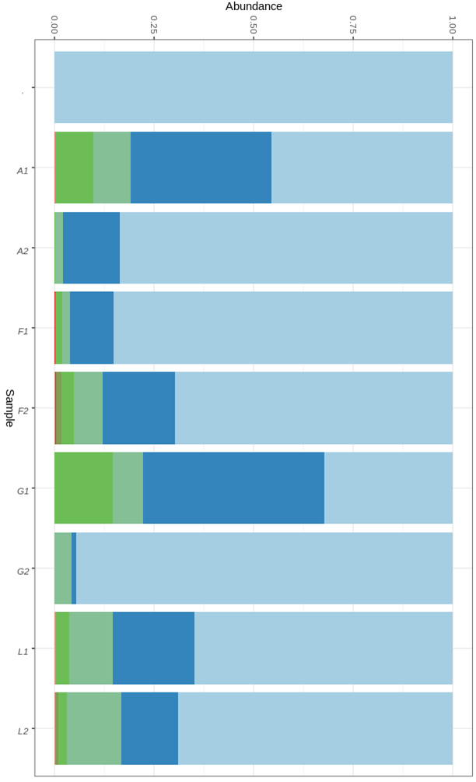
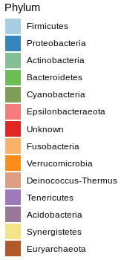
Delivery mode & relative microbiota abundance in materials derived from Newborns
No. of Infants’
materials
C-section, n=88 vs. Vaginal, n=72, ∑ 160
n
vaginal, stool, 17
c-section, stool, 26
vaginal, ear, 17
c-section, ear, 27
vaginal, stool, 17
c-section, stool, 13
vaginal, ear, 21
c-section, ear, 22
∑ 160
T1D
Controls
Notes:
C-section, n=88 vs. Vaginal, n=72, ∑ 160

Slide 47


Antibiotic prophylaxis (Abx) & microbiota relative abundance in materials derived from Newborns
No. of Newborns’
materials
n
no Abx, stool 15
Abx, stool 28
no Abx, ear 16
Abx, ear 28
no Abx, stool 17
Abx, stool 13
no Abx, ear 20
Abx, ear 23
∑ 160
T1D
Controls

Slide 48


Analyzes in progress:
Mothers’ microbiota (relative abundance) derived from Introitus/Vagina/Cervix_all materials together_who have delivered Newborns SGA/AGA/LGA
Newborns_AGA 32
Newborns_LGA 14
Newborns_SGA 4
Newborns_AGA 38
Newborns_LGA 3
∑ 91
Mothers_T1D
Mothers_Controls

Slide 49
Supplemental
Jochum, Michael D. 11 August 2020

Slide 50



Slide 51



Slide 52



Slide 53



Slide 54



Slide 55



Slide 56
4
3
2
5
1
A
B
6
C
7
Figure 1. Diagram of vesicovaginal fistula sites. A. Juxtacervical/vaginal apex (n=6) B. Midvaginal (n=5) C. Juxtaurethral (n=4). 1. Pubic symphysis 2. Bladder 3. Uterus 4. Ovary 5. Rectouterine pouch 6. Rectum 7. Anus
Notes:
Figure 1. Diagram of vesicovaginal fistula sites. A. Juxtacervical/vaginal apex (n=6) B. Midvaginal (n=5) C. Juxtaurethral (n=4). 1. Pubic symphysis 2. Bladder 3. Uterus 4. Ovary 5. Rectouterine pouch 6. Rectum 7. Anus

Slide 57


Continuous Variables_disease state and week of delivery
DELIVERY WEEK
*one newborn: week 36+6
Figure X. Violin plot comparison between disease state and week of delivery [p < 0.0001]
*one newborn 36+6

Slide 58
Table X. Log 2-fold change and p value of differentially expressed genera associated with Type 1 Diabetes
 | Cervix |  |  | Vagina |  |  | Introitus |  |  | Stool |  |  | Ear |  |  | Anus
Genus | lfc | p adj |  | lfc | p adj |  | lfc | p adj |  | lfc | p adj |  | lfc | p adj |  | lfc | p adj
Actinomyces | 0.18 | 1.00 |  | 1.67 | 0.34 |  | 0.71 | 1.00 |  | 2.88 | 0.01 |  | 0.82 | 0.96 |  | -0.47 | 1.00
Anaerococcus | -3.20 | 0.00 |  | -2.13 | 0.01 |  | -1.99 | 0.03 |  | 1.28 | 0.41 |  | 1.64 | 0.16 |  | 0.33 | 1.00
Anaeroglobus | -3.21 | 0.56 |  | 0.62 | 1.00 |  | -0.20 | 1.00 |  | 19.46 | 0.00 |  | -1.97 | 1.00 |  | -3.69 | 0.50
Atopobium | 6.62 | 0.00 |  | 6.82 | 0.00 |  | 2.88 | 0.08 |  | -0.11 | 1.00 |  | -1.89 | 0.54 |  | -2.04 | 0.45
Bacteroides | 6.34 | 0.00 |  | 2.14 | 0.19 |  | 1.26 | 1.00 |  | -3.03 | 0.01 |  | 1.58 | 0.42 |  | -0.09 | 1.00
Bifidobacterium | -5.86 | 0.00 |  | -0.29 | 1.00 |  | -3.03 | 0.04 |  | -0.01 | 1.00 |  | 0.96 | 1.00 |  | -1.74 | 0.55
Citrobacter | 2.57 | 0.51 |  | -0.10 | 1.00 |  | 15.31 | 0.00 |  | 1.25 | 1.00 |  | -0.65 | 1.00 |  | -4.74 | 0.04
Collinsella | -15.19 | 0.00 |  | -0.80 | 1.00 |  | -0.71 | 1.00 |  | -8.77 | 0.00 |  | 0.22 | 1.00 |  | -1.67 | 0.55
Dialister | -1.34 | 0.51 |  | -1.37 | 0.90 |  | -2.02 | 0.13 |  | 3.50 | 0.00 |  | -1.45 | 0.53 |  | -0.69 | 1.00
Enhydrobacter | 18.47 | 0.00 |  | -0.02 | 1.00 |  | -5.11 | 0.00 |  | 0.99 | 1.00 |  | 0.81 | 1.00 |  | -1.76 | 0.45
Enterococcus | -2.77 | 0.00 |  | 0.60 | 1.00 |  | 0.53 | 1.00 |  | 0.38 | 1.00 |  | 1.13 | 0.67 |  | 1.51 | 0.44
Escherichia/Shigella | 2.79 | 0.00 |  | -0.95 | 1.00 |  | -1.13 | 1.00 |  | -0.51 | 1.00 |  | -3.05 | 0.00 |  | 0.85 | 0.92
Fusicatenibacter | 14.24 | 0.00 |  | -0.02 | 1.00 |  | 1.62 | 1.00 |  | 26.44 | 0.00 |  | 3.29 | 0.07 |  | -1.18 | 0.94
Fusobacterium | -3.91 | 0.01 |  | -1.70 | 1.00 |  | -0.89 | 1.00 |  | 20.09 | 0.00 |  | -0.49 | 1.00 |  | -1.69 | 0.70
Gemella | 7.91 | 0.00 |  | 7.03 | 0.00 |  | 21.38 | 0.00 |  | -1.56 | 1.00 |  | -1.51 | 1.00 |  | -1.26 | 1.00
Intestinibacter | 17.92 | 0.00 |  | 14.82 | 0.00 |  | -1.35 | 1.00 |  | -2.97 | 0.22 |  | -1.29 | 1.00 |  | 0.00 | 1.00
Jonquetella | 15.35 | 0.00 |  | -1.29 | 1.00 |  | 5.47 | 0.12 |  | 2.97 | 0.93 |  | 0.21 | 1.00 |  | -6.37 | 0.05
Klebsiella | 2.10 | 0.67 |  | -2.07 | 1.00 |  | 7.79 | 0.00 |  | 1.50 | 1.00 |  | 0.06 | 1.00 |  | -5.03 | 0.02
Kocuria | 1.09 | 1.00 |  | -1.14 | 1.00 |  | -1.80 | 0.45 |  | 0.83 | 1.00 |  | -3.29 | 0.00 |  | -0.39 | 1.00
Lachnoclostridium | 0.00 | 1.00 |  | -0.53 | 1.00 |  | 0.10 | 1.00 |  | 3.84 | 0.01 |  | 1.57 | 0.67 |  | 0.12 | 1.00
Megasphaera | 4.17 | 0.02 |  | 7.80 | 0.00 |  | 3.28 | 0.27 |  | 15.61 | 0.00 |  | -1.60 | 1.00 |  | -2.02 | 0.72
Micrococcus | -0.58 | 1.00 |  | -2.24 | 0.11 |  | -0.32 | 1.00 |  | -0.98 | 1.00 |  | -3.71 | 0.00 |  | 0.78 | 1.00
Parabacteroides | 16.91 | 0.00 |  | 0.37 | 1.00 |  | 0.66 | 1.00 |  | -1.02 | 1.00 |  | 1.05 | 0.99 |  | -1.23 | 0.79
Peptoniphilus | -0.08 | 1.00 |  | 0.60 | 1.00 |  | 0.45 | 1.00 |  | 3.42 | 0.00 |  | 1.41 | 0.24 |  | 0.03 | 1.00
Prevotella_6 | 0.28 | 1.00 |  | 3.78 | 0.00 |  | 2.52 | 0.12 |  | 0.89 | 1.00 |  | -0.28 | 1.00 |  | -1.09 | 0.90
Pseudomonas | 1.24 | 0.66 |  | 1.05 | 1.00 |  | 0.03 | 1.00 |  | 7.51 | 0.00 |  | -0.95 | 0.90 |  | -0.54 | 1.00
Romboutsia | 0.00 | 1.00 |  | -0.43 | 1.00 |  | 0.05 | 1.00 |  | 6.40 | 0.00 |  | -0.03 | 1.00 |  | -1.86 | 0.55
Rothia | -0.67 | 1.00 |  | 2.01 | 0.65 |  | 1.07 | 1.00 |  | -0.78 | 1.00 |  | -7.75 | 0.00 |  | 0.18 | 1.00
Sneathia | 42.95 | 0.00 |  | 49.75 | 0.00 |  | 6.19 | 0.49 |  | -0.63 | 1.00 |  | 4.16 | 0.88 |  | 13.86 | 0.00
Staphylococcus | -2.09 | 0.00 |  | 0.35 | 1.00 |  | 2.43 | 0.00 |  | 0.96 | 0.71 |  | 0.58 | 1.00 |  | 3.13 | 0.00
Streptococcus | 0.07 | 1.00 |  | -3.58 | 0.00 |  | 1.82 | 0.16 |  | 0.21 | 1.00 |  | 0.57 | 1.00 |  | -1.42 | 0.48
Sutterella | -0.68 | 1.00 |  | -0.68 | 1.00 |  | -0.07 | 1.00 |  | -5.19 | 0.00 |  | 0.22 | 1.00 |  | -1.69 | 0.60
Terrisporobacter | 14.20 | 0.00 |  | 0.00 | 1.00 |  | 14.70 | 0.00 |  | -7.66 | 0.00 |  | 1.01 | 1.00 |  | 0.59 | 1.00

Slide 59
D) Anus
Figure X. Wilcox test comparisons of differentially expressed genera associated with Type 1 Diabetes in the A) Vaginal canal, B) Cervix, C) Vaginal Introitus, and D) Anus samples

Slide 60

GLYCAEMIC CONTROL
during first, second and third (before delivery) pregnancy trimesters in T1D mothers
Here, differences between first and second trimesters, and first and third trimesters were statistically significant;
Glycaemic control was satisfactory in second and third trimesters
Tukey multiple comparisons of means (95% family-wise confidence level)
Variable diff lwr upr p adj
Second.Trimester-First.Trimester -0.9965909 -1.15613634 -0.8370455 0.0000000
Delivery-First.Trimester -0.8482995 -1.00527833 -0.6913206 0.0000000
Delivery-Second.Trimester 0.1482914 -0.00868742 0.3052703 0.0687493
Notes:
July30, 2020, Figure – modify, remove duplicates

Slide 61
Notes:
30 July 2020

Slide 62


Alpha diversity estimates (Shannon)
Control T1D
Infant Mother Infant Mother
Ear
Stool
Introitus
Anus
Cervix
Vagina
Ear
Stool
Introitus
Anus
Cervix
Vagina
Notes:
OK: Alpha Diversity Estimates: Shannon only
X disease; color disease, shape null, size 10, opacity 1, max. Labels 30. angle 90; source data original, width 4, height 10
Disease_Host_Sample Type/Color: SampleType/null

Slide 63

Alpha diversity estimates (Shannon)
library(microbiome)
library(ggpubr)
sam<-data.frame(sample_data(ASV_physeq_core))
alpha<-alpha(x = ASV_physeq_core,index = "shannon")
sam$shannon<-alpha$diversity_shannon
ggviolin(sam, x = "disease", y = "shannon", fill = "disease",
palette =c("#61D04F","#2297E6"),theme_bw()+
add = "boxplot", add.params = list(fill = "white"))+
stat_compare_means(comparisons = my_comparisons, label = "p.signif")+ # Add significance levels
stat_compare_means(label.y = 10) +facet_grid(facets = ~SampleType) # Add global the p-value
Notes:
OK: Alpha Diversity Estimates: Shannon only
X disease; color disease, shape null, size 10, opacity 1, max. Labels 30. angle 90; source data original, width 4, height 10
Disease_Host_Sample Type/Color: SampleType/null

Slide 64
Continuous Variables_Delivery week (37-41, no preterm babies)
Mother's Clinical Characteristics
 | T1D group (n=50) | Control group (n=42)
Gestation (weeks), mean ± SD | 38,1 ± 0,7 | 39,2 ± 1,0
37 38 39 40 41

Slide 65
Here are a couple optional balloon plots that I created as optional replacements for the existing taxa plots

Slide 66

Microbiota relative abundance, Newborns and Mothers, separately
Control
T1D
Notes:
Just to remind

Slide 67



Microbiota composition_Phylum level_NMDS
Notes:
Just to remind

Slide 68

Mikrobiota abundance (Phylum level) in materials tested_separately
Control_introitus
Control_cervix
Control_annus
Control_ear
Control_stool
Control_vagina
T1D _introitus
T1D _cervix
T1D _annus
T1D _ear
T1D _stool
T1D_vagina
Notes:
Just to remind

Slide 69

Microbiota relative abundance, Newborns and Mothers, separately
Mean relative abundance
Notes:
Just to remind

