Slide 1
Differentially Expressed Taxa associated with Type 1 Diabetes
Jochum, Michael D. 11 August 2020

Slide 2
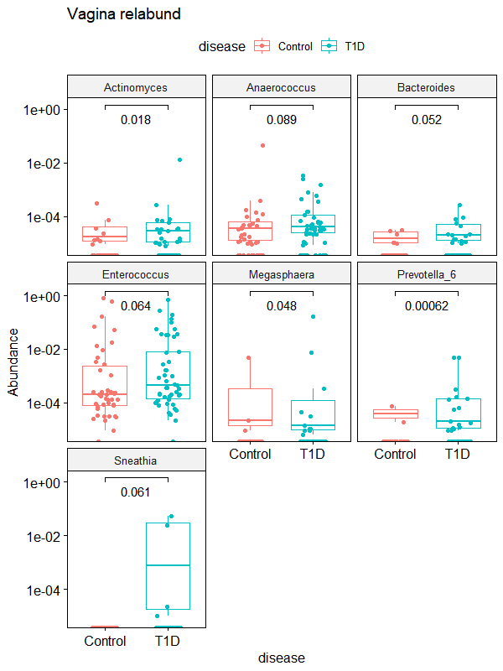
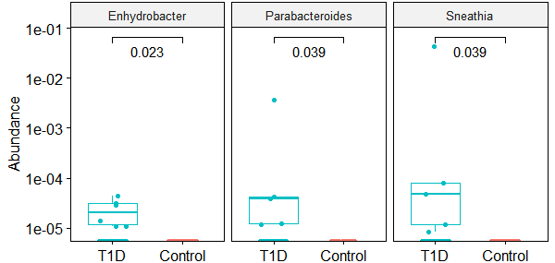
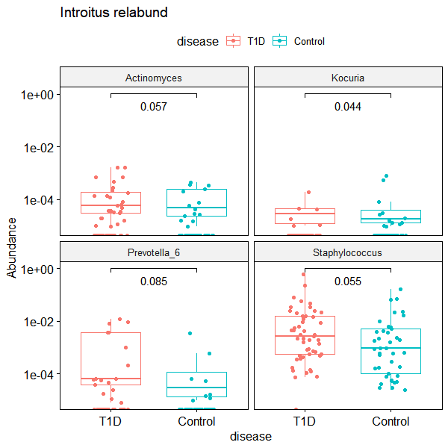
A) Vagina (Posterior Fornix?)
B) Cervix
C) Vaginal Introitus
Figure X. Wilcox test comparisons of differentially expressed genera associated with Type 1 Diabetes in the A) Posterior Fornix, B) Cervix, C) Vaginal Introitus, and D)Anus samples

Slide 3
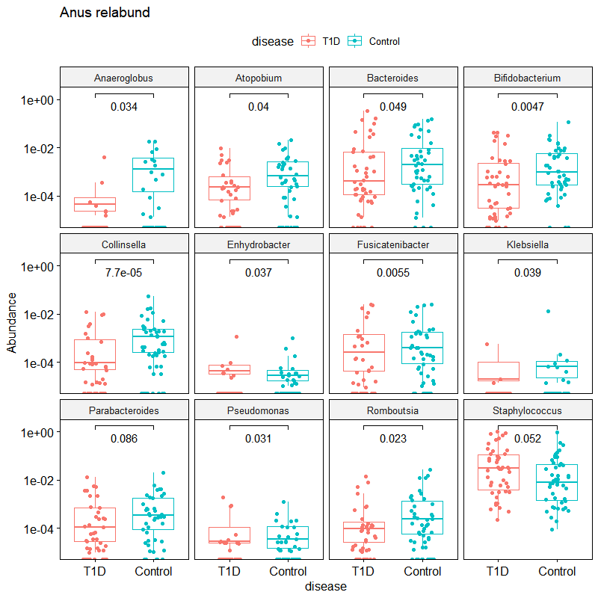
D) Anus
Figure X. Wilcox test comparisons of differentially expressed genera associated with Type 1 Diabetes in the A) Posterior Fornix, B) Cervix, C) Vaginal Introitus, and D)Anus samples

Slide 4
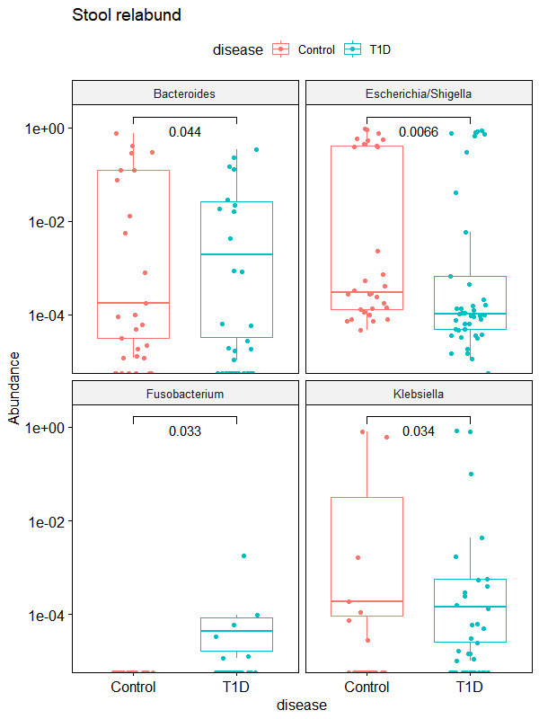
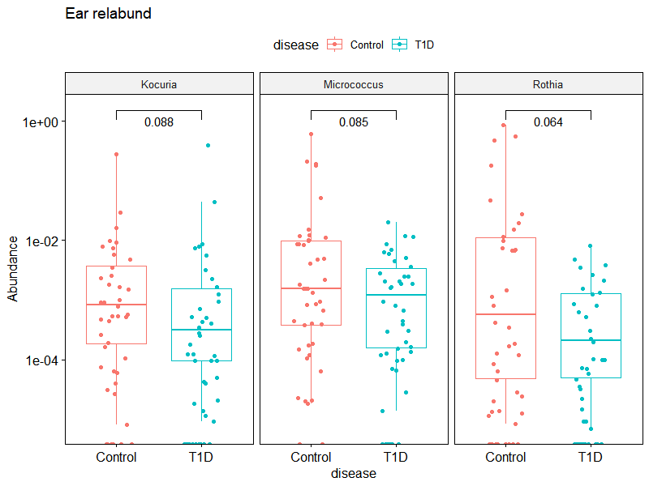
A) Infant Stool
B) Infant Ear canal
Figure X. Wilcox test comparisons of differentially expressed genera associated with Type 1 Diabetes in the A) Infant stool and B) Infant Ear Canal microbiome.

Slide 5
Supplemental
Jochum, Michael D. 11 August 2020

Slide 6
Table X. Log 2-fold change and p value of differentially expressed genera associated with Type 1 Diabetes
 | Cervix |  |  | Vagina |  |  | Introitus |  |  | Stool |  |  | Ear |  |  | Anus
Genus | lfc | p adj |  | lfc | p adj |  | lfc | p adj |  | lfc | p adj |  | lfc | p adj |  | lfc | p adj
Actinomyces | 0.18 | 1.00 |  | 1.67 | 0.34 |  | 0.71 | 1.00 |  | 2.88 | 0.01 |  | 0.82 | 0.96 |  | -0.47 | 1.00
Anaerococcus | -3.20 | 0.00 |  | -2.13 | 0.01 |  | -1.99 | 0.03 |  | 1.28 | 0.41 |  | 1.64 | 0.16 |  | 0.33 | 1.00
Anaeroglobus | -3.21 | 0.56 |  | 0.62 | 1.00 |  | -0.20 | 1.00 |  | 19.46 | 0.00 |  | -1.97 | 1.00 |  | -3.69 | 0.50
Atopobium | 6.62 | 0.00 |  | 6.82 | 0.00 |  | 2.88 | 0.08 |  | -0.11 | 1.00 |  | -1.89 | 0.54 |  | -2.04 | 0.45
Bacteroides | 6.34 | 0.00 |  | 2.14 | 0.19 |  | 1.26 | 1.00 |  | -3.03 | 0.01 |  | 1.58 | 0.42 |  | -0.09 | 1.00
Bifidobacterium | -5.86 | 0.00 |  | -0.29 | 1.00 |  | -3.03 | 0.04 |  | -0.01 | 1.00 |  | 0.96 | 1.00 |  | -1.74 | 0.55
Citrobacter | 2.57 | 0.51 |  | -0.10 | 1.00 |  | 15.31 | 0.00 |  | 1.25 | 1.00 |  | -0.65 | 1.00 |  | -4.74 | 0.04
Collinsella | -15.19 | 0.00 |  | -0.80 | 1.00 |  | -0.71 | 1.00 |  | -8.77 | 0.00 |  | 0.22 | 1.00 |  | -1.67 | 0.55
Dialister | -1.34 | 0.51 |  | -1.37 | 0.90 |  | -2.02 | 0.13 |  | 3.50 | 0.00 |  | -1.45 | 0.53 |  | -0.69 | 1.00
Enhydrobacter | 18.47 | 0.00 |  | -0.02 | 1.00 |  | -5.11 | 0.00 |  | 0.99 | 1.00 |  | 0.81 | 1.00 |  | -1.76 | 0.45
Enterococcus | -2.77 | 0.00 |  | 0.60 | 1.00 |  | 0.53 | 1.00 |  | 0.38 | 1.00 |  | 1.13 | 0.67 |  | 1.51 | 0.44
Escherichia/Shigella | 2.79 | 0.00 |  | -0.95 | 1.00 |  | -1.13 | 1.00 |  | -0.51 | 1.00 |  | -3.05 | 0.00 |  | 0.85 | 0.92
Fusicatenibacter | 14.24 | 0.00 |  | -0.02 | 1.00 |  | 1.62 | 1.00 |  | 26.44 | 0.00 |  | 3.29 | 0.07 |  | -1.18 | 0.94
Fusobacterium | -3.91 | 0.01 |  | -1.70 | 1.00 |  | -0.89 | 1.00 |  | 20.09 | 0.00 |  | -0.49 | 1.00 |  | -1.69 | 0.70
Gemella | 7.91 | 0.00 |  | 7.03 | 0.00 |  | 21.38 | 0.00 |  | -1.56 | 1.00 |  | -1.51 | 1.00 |  | -1.26 | 1.00
Intestinibacter | 17.92 | 0.00 |  | 14.82 | 0.00 |  | -1.35 | 1.00 |  | -2.97 | 0.22 |  | -1.29 | 1.00 |  | 0.00 | 1.00
Jonquetella | 15.35 | 0.00 |  | -1.29 | 1.00 |  | 5.47 | 0.12 |  | 2.97 | 0.93 |  | 0.21 | 1.00 |  | -6.37 | 0.05
Klebsiella | 2.10 | 0.67 |  | -2.07 | 1.00 |  | 7.79 | 0.00 |  | 1.50 | 1.00 |  | 0.06 | 1.00 |  | -5.03 | 0.02
Kocuria | 1.09 | 1.00 |  | -1.14 | 1.00 |  | -1.80 | 0.45 |  | 0.83 | 1.00 |  | -3.29 | 0.00 |  | -0.39 | 1.00
Lachnoclostridium | 0.00 | 1.00 |  | -0.53 | 1.00 |  | 0.10 | 1.00 |  | 3.84 | 0.01 |  | 1.57 | 0.67 |  | 0.12 | 1.00
Megasphaera | 4.17 | 0.02 |  | 7.80 | 0.00 |  | 3.28 | 0.27 |  | 15.61 | 0.00 |  | -1.60 | 1.00 |  | -2.02 | 0.72
Micrococcus | -0.58 | 1.00 |  | -2.24 | 0.11 |  | -0.32 | 1.00 |  | -0.98 | 1.00 |  | -3.71 | 0.00 |  | 0.78 | 1.00
Parabacteroides | 16.91 | 0.00 |  | 0.37 | 1.00 |  | 0.66 | 1.00 |  | -1.02 | 1.00 |  | 1.05 | 0.99 |  | -1.23 | 0.79
Peptoniphilus | -0.08 | 1.00 |  | 0.60 | 1.00 |  | 0.45 | 1.00 |  | 3.42 | 0.00 |  | 1.41 | 0.24 |  | 0.03 | 1.00
Prevotella_6 | 0.28 | 1.00 |  | 3.78 | 0.00 |  | 2.52 | 0.12 |  | 0.89 | 1.00 |  | -0.28 | 1.00 |  | -1.09 | 0.90
Pseudomonas | 1.24 | 0.66 |  | 1.05 | 1.00 |  | 0.03 | 1.00 |  | 7.51 | 0.00 |  | -0.95 | 0.90 |  | -0.54 | 1.00
Romboutsia | 0.00 | 1.00 |  | -0.43 | 1.00 |  | 0.05 | 1.00 |  | 6.40 | 0.00 |  | -0.03 | 1.00 |  | -1.86 | 0.55
Rothia | -0.67 | 1.00 |  | 2.01 | 0.65 |  | 1.07 | 1.00 |  | -0.78 | 1.00 |  | -7.75 | 0.00 |  | 0.18 | 1.00
Sneathia | 42.95 | 0.00 |  | 49.75 | 0.00 |  | 6.19 | 0.49 |  | -0.63 | 1.00 |  | 4.16 | 0.88 |  | 13.86 | 0.00
Staphylococcus | -2.09 | 0.00 |  | 0.35 | 1.00 |  | 2.43 | 0.00 |  | 0.96 | 0.71 |  | 0.58 | 1.00 |  | 3.13 | 0.00
Streptococcus | 0.07 | 1.00 |  | -3.58 | 0.00 |  | 1.82 | 0.16 |  | 0.21 | 1.00 |  | 0.57 | 1.00 |  | -1.42 | 0.48
Sutterella | -0.68 | 1.00 |  | -0.68 | 1.00 |  | -0.07 | 1.00 |  | -5.19 | 0.00 |  | 0.22 | 1.00 |  | -1.69 | 0.60
Terrisporobacter | 14.20 | 0.00 |  | 0.00 | 1.00 |  | 14.70 | 0.00 |  | -7.66 | 0.00 |  | 1.01 | 1.00 |  | 0.59 | 1.00

Slide 7
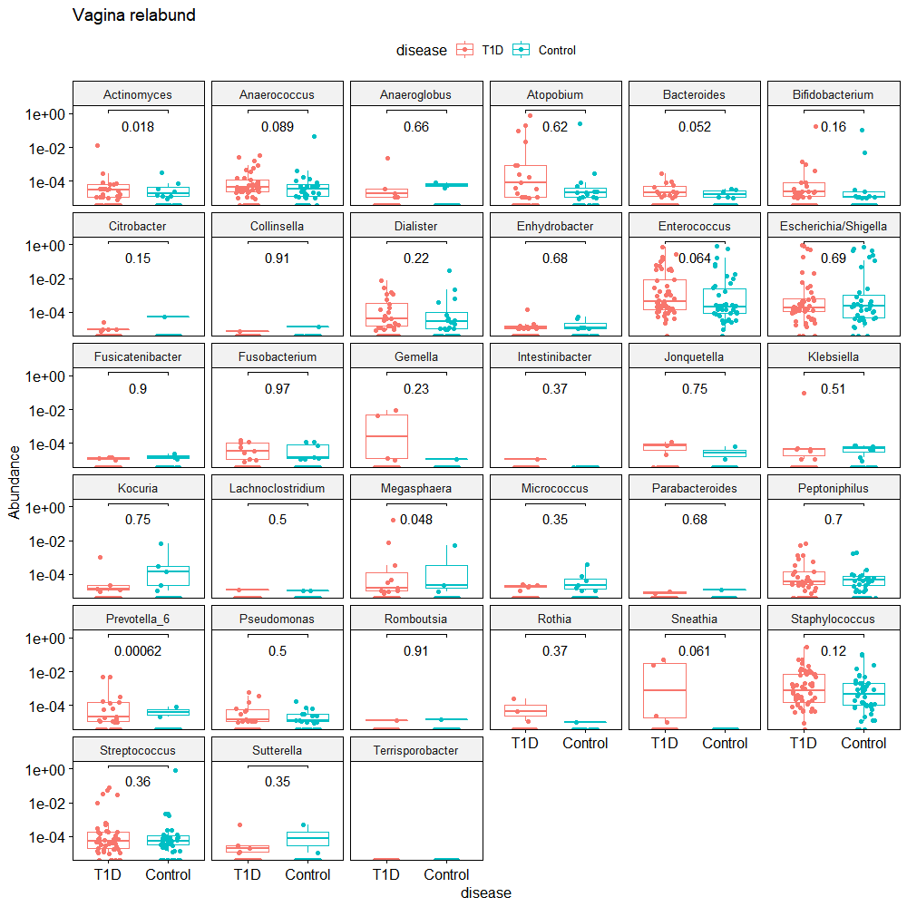

Slide 8
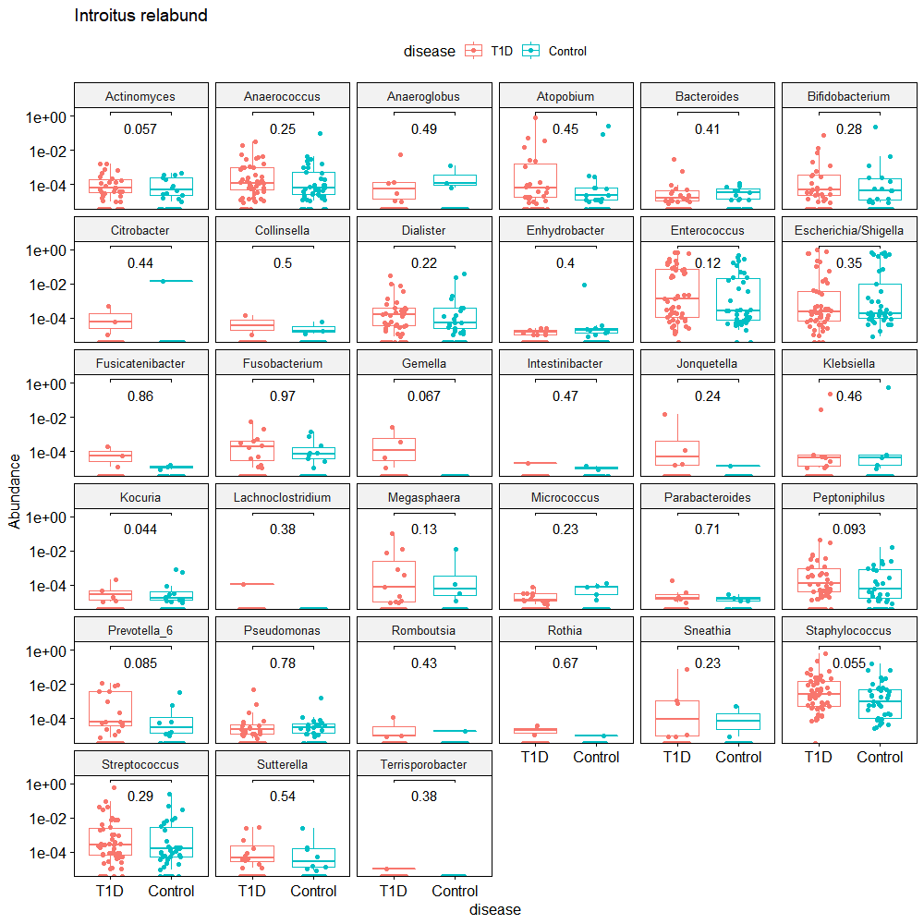

Slide 9
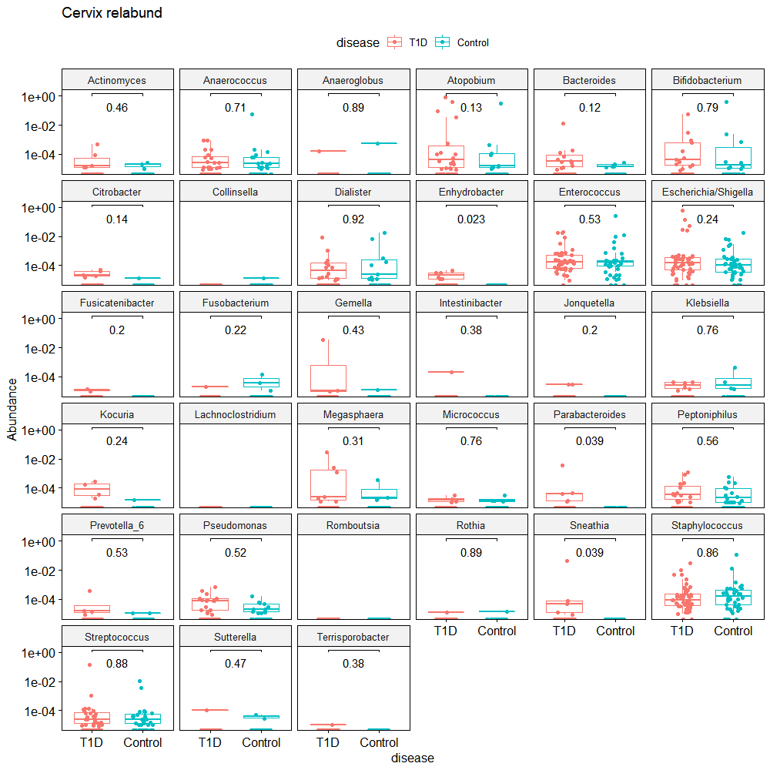
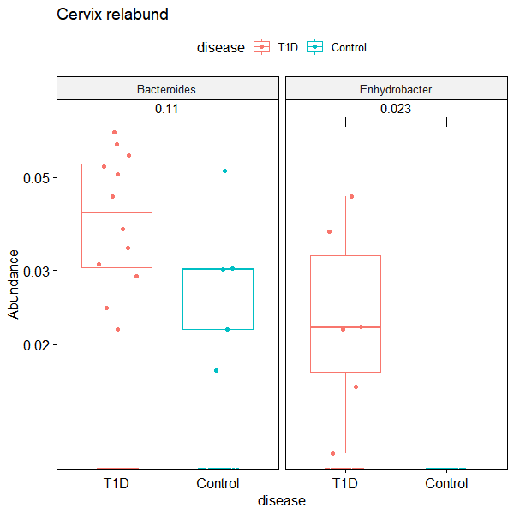

Slide 10
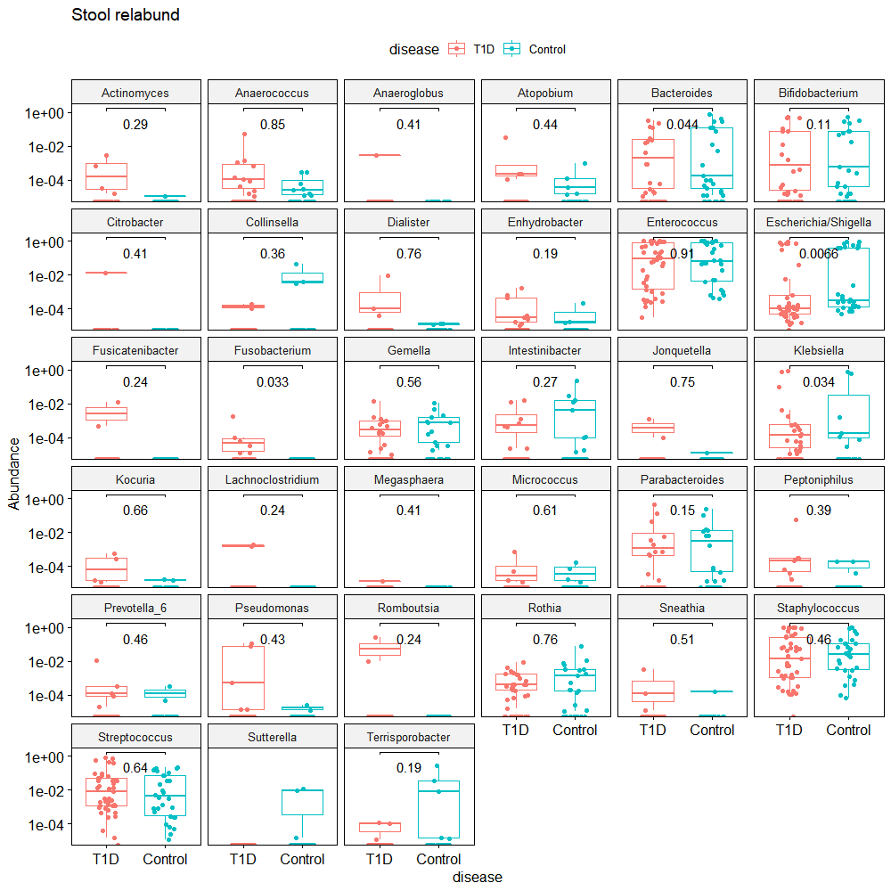

Slide 11
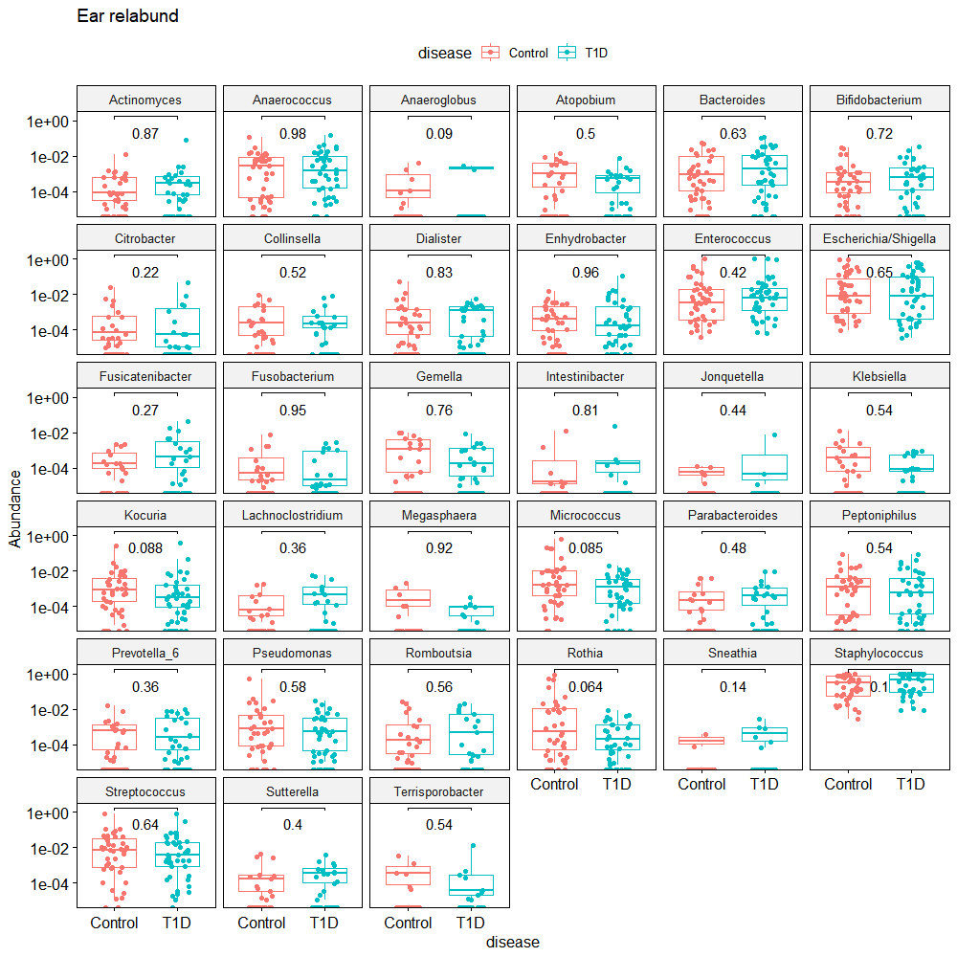

Slide 12
