Slide 1
Continuous Variables
Jochum, Michael D. 5 August 2020

Slide 2
Table X. Summary of logistical regression models for continuous variable and disease state.
Table X. ANOVA using a linear model fit for continuous variable and disease states comparisons.
Variable |  | estimate | std.error | conf.low | conf.high | statistic | p.value
Bialko_ogolem | (Intercept) | 1.53E+30 | 4.07 | 5.26E+26 | 4.44E+33 | 17.1 | 2.72E-21
 | disease | 1.28 | 4.86 | 9.41E-05 | 17400 | 0.0507 | 0.96
BMI_before | (Intercept) | 6.04E+09 | 0.439 | 2.55E+09 | 1.43E+10 | 51.2 | 7.55E-68
 | disease | 1.96 | 0.593 | 0.613 | 6.26 | 1.13 | 0.26
BMI_after | (Intercept) | 8.96E+11 | 0.548 | 3.06E+11 | 2.63E+12 | 50.2 | 1.54E-66
 | disease | 1.81 | 0.736 | 0.429 | 7.67 | 0.809 | 0.42
energ_bialko_proc | (Intercept) | 18598841 | 0.729 | 4458821 | 77580340 | 23 | 1.72E-26
 | disease | 5 | 0.87 | 0.909 | 27.5 | 1.85 | 0.0709
energ_tluszcz_proc | (Intercept) | 1.18E+12 | 1.37 | 8.04E+10 | 1.72E+13 | 20.3 | 2.79E-24
 | disease | 20.2 | 1.63 | 0.821 | 497 | 1.84 | 0.0725
tydzien_porodu | (Intercept) | 39.1905 | 0.1401 | 7.92E+16 | 1.39E+17 | 279.803 | 2E-16
 | disease | 0.323 | 0.190 | 0.221 | 0.472 | -5.845 | 8.01E-08 | ***
newborn_weight | (Intercept) | Inf | 73.5 | Inf | Inf | 46.3 | 1.42E-64
 | disease | 1.71E+65 | 99.6 | 2.58E-20 | 1.1E+150 | 1.51 | 0.135
Variable |  | Estimate | Std. Error | t value | Pr(>|t|)
Bialko_ogolem | (Intercept) | 69.502 | 4.0686 | 17.082 | <2e-16
 | disease | 0.2459 | 4.8556 | 0.051 | 0.96
BMI_before | (Intercept) | 27.5217 | 0.5484 | 50.183 | <2e-16
 | disease | 0.5955 | 0.7358 | 0.809 | 0.42
BMI_after | (Intercept) | 22.5213 | 0.4395 | 51.245 | <2e-16
 | disease | 0.672 | 0.5929 | 1.133 | 0.26
energ_bialko_proc | (Intercept) | 16.7386 | 0.7287 | 22.97 | <2e-16
 | disease | 1.6089 | 0.8696 | 1.85 | 0.0709 | .
energ_tluszcz_proc | (Intercept) | 27.794 | 1.369 | 20.295 | <2e-16
 | disease | 3.005 | 1.634 | 1.839 | 0.0725 | .
tydzien_porodu | (Intercept) | 39.1905 | 0.1401 | 279.803 | <2e-16
 | disease | -1.1105 | 0.1900 | -5.845 | 8.01e-08 | ***
newborn_weight | (Intercept) | 39.191 | 0.143 | 274.061 | <2e-16
 | disease | -1.131 | 0.194 | -5.828 | 0.1352
Table X. Welch's Two Sample t-test comparisons of continuous variables between Control and T1 Diabetes patients.
Table X. PostHoc Tukey HSD multiple comparisons of means between the continuous variables and disease state.
Variable | Control (avg) | T1D (avg) | 95% CI | t | df | p-value
Bialko_ogolem | 69.502 | 69.74794 | [-9.306434,8.814554] | -0.055404 | 30.419 | 0.9562
BMI_before | 22.52133 | 23.19337 | [-1.833947,0.4898567] | -1.1493 | 88.669 | 0.2535
BMI_after | 27.52166 | 28.11717 | [-2.0210605,0.8300311] | -0.83018 | 87.998 | 0.4087
energ_bialko_proc | 16.73861 | 18.34747 | [-3.002443,-0.2152756] | -2.3295 | 42.193 | 0.02469 | *
energ_tluszcz_proc | 27.7938 | 30.79929 | [-6.327365,0.3163973] | -1.8623 | 25.281 | 0.07422
tydzien_porodu | 39.19048 | 38.09 | [0.724145,1.4985379] | 5.7009 | 74.725 | 2.244E-07 | ***
newborn_weight | 3402.595 | 3552.8 | [-343.61315,43.20362] | -1.5431 | 89.187 | 0.1264
 | diff | lwr | upr | p adj
Bialko_ogolem | 0.2459396 | -9.53E+00 | 10.02555 | 0.959828
BMI_before | 0.6720452 | -5.06E-01 | 1.850115 | 0.26005
BMI_after | 0.5955147 | -0.86673 | 2.057758 | 0.420499
energ_bialko_proc | 1.608859 | -0.14268 | 3.360396 | 0.070881 | .
energ_tluszcz_proc | 3.005484 | -0.28624 | 6.297206 | 0.072525 | .
tydzien_porodu | -1.110476 | -1.48793 | -0.733023 | 1.00E-07
newborn_weight | 150.2048 | -47.767 | 348.1765 | 0.135229

Slide 3
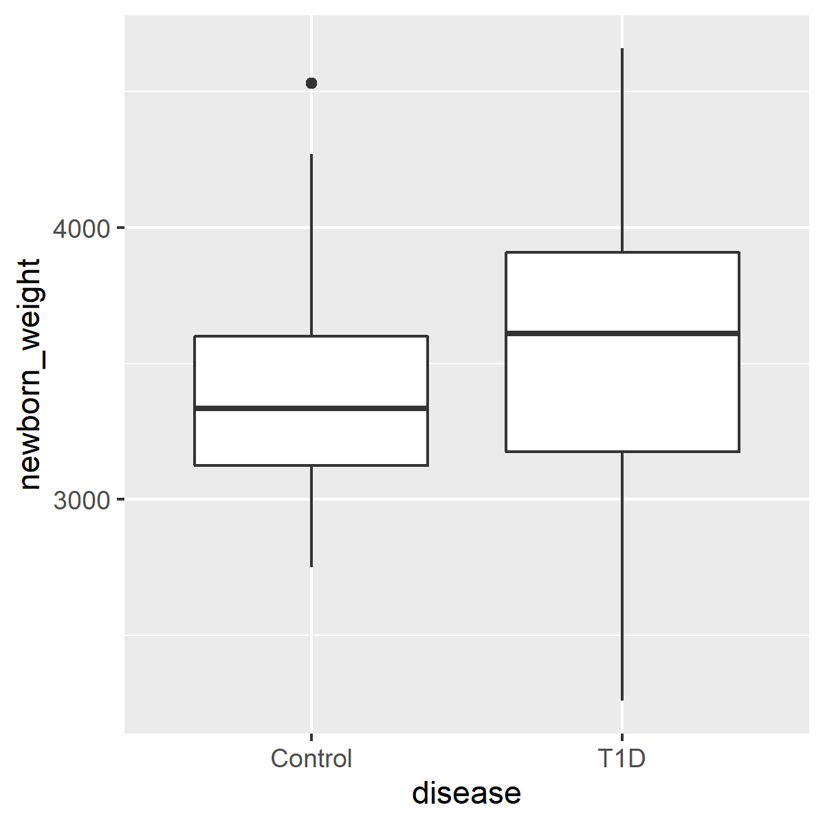
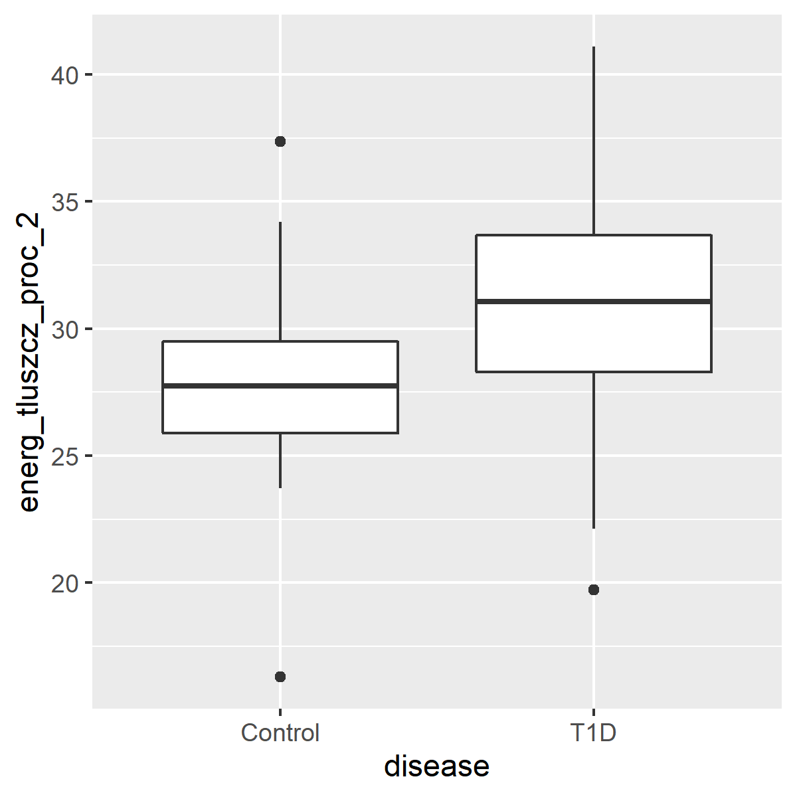
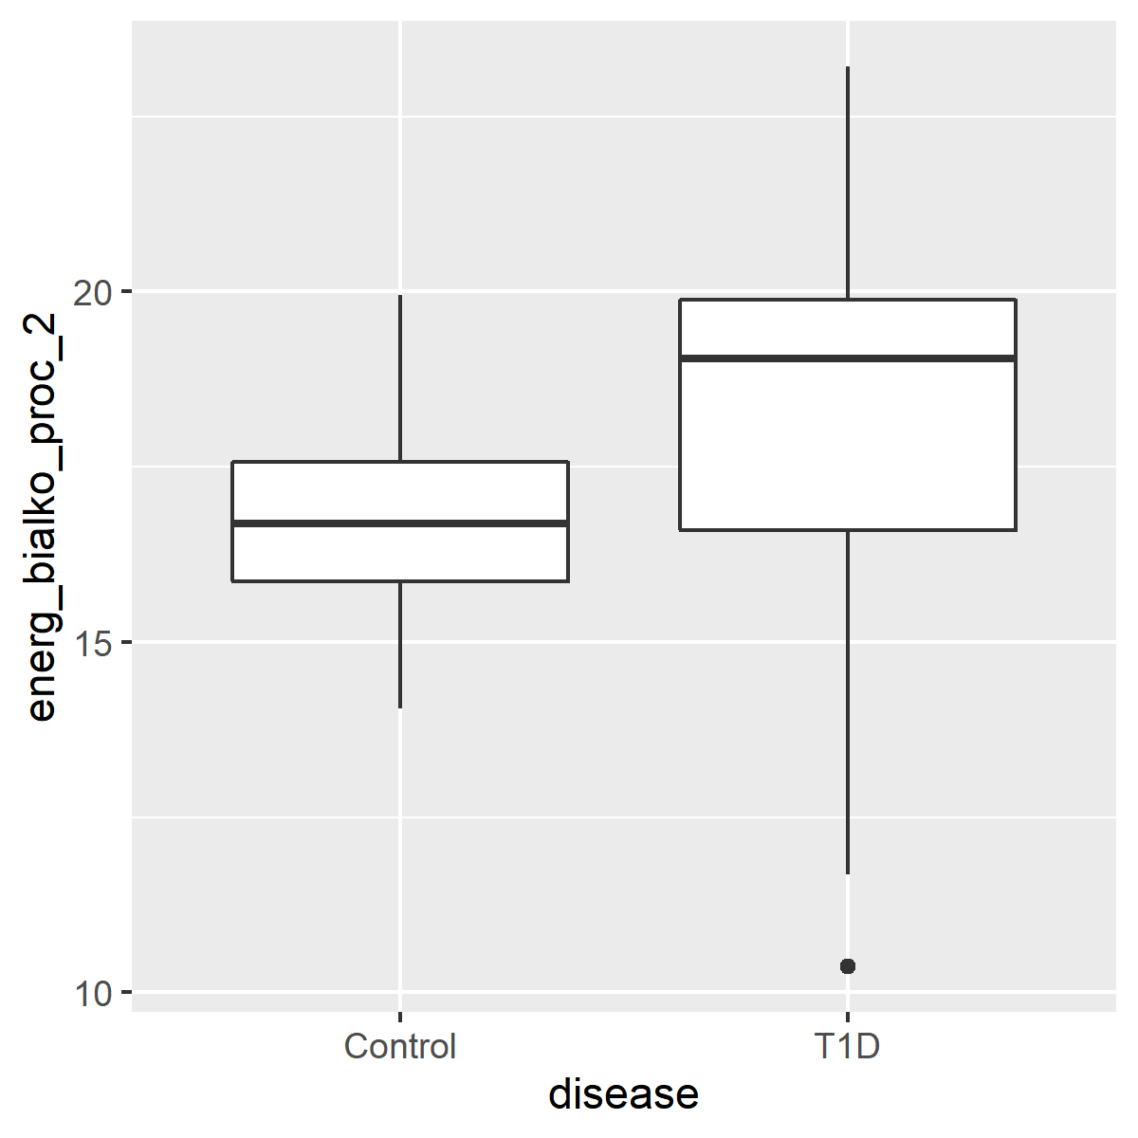
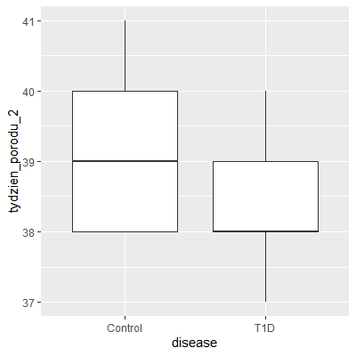
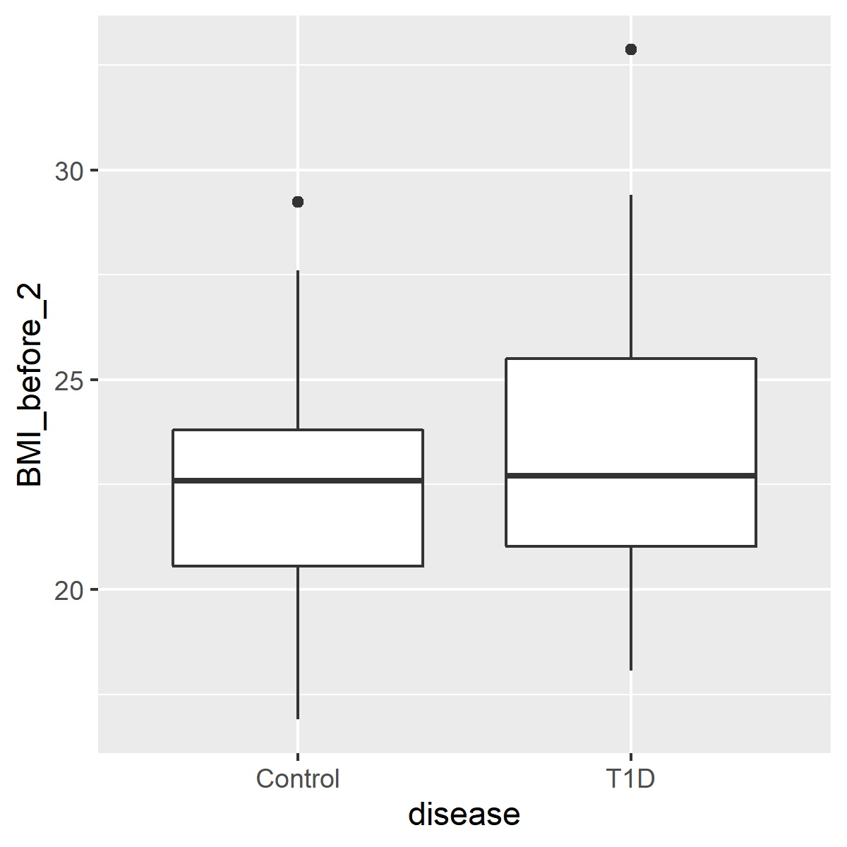
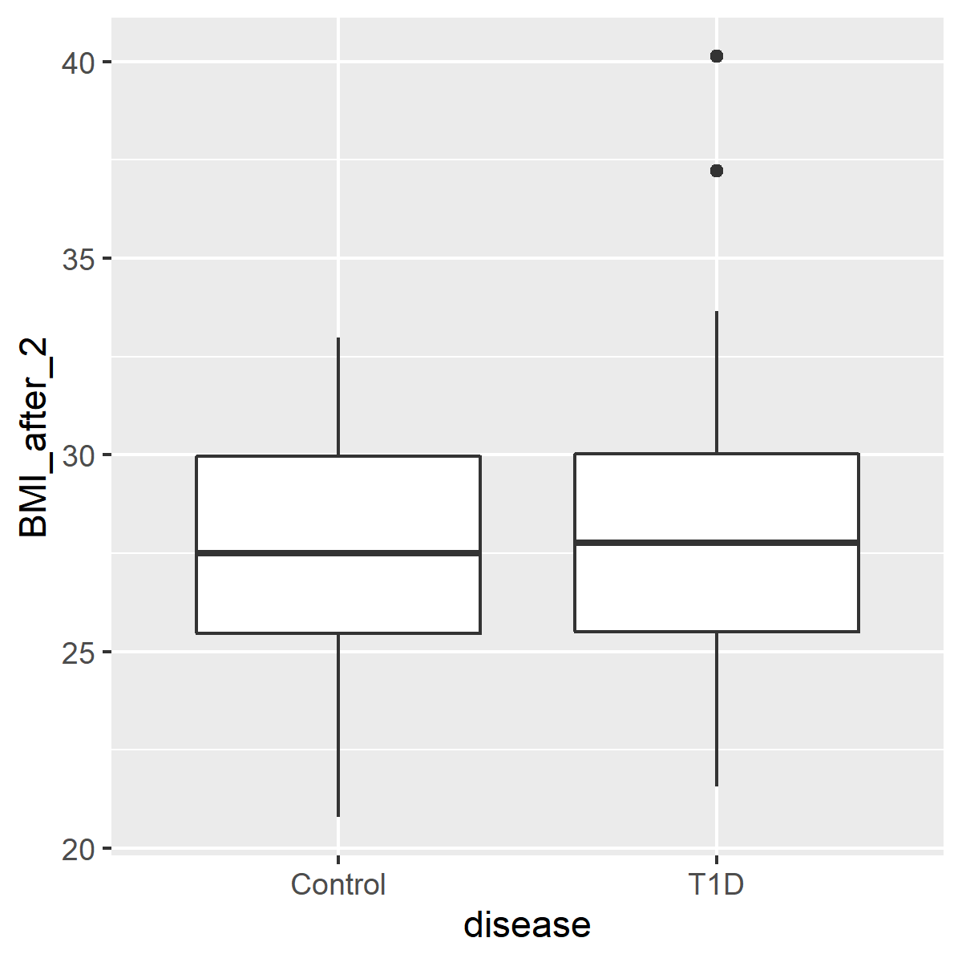
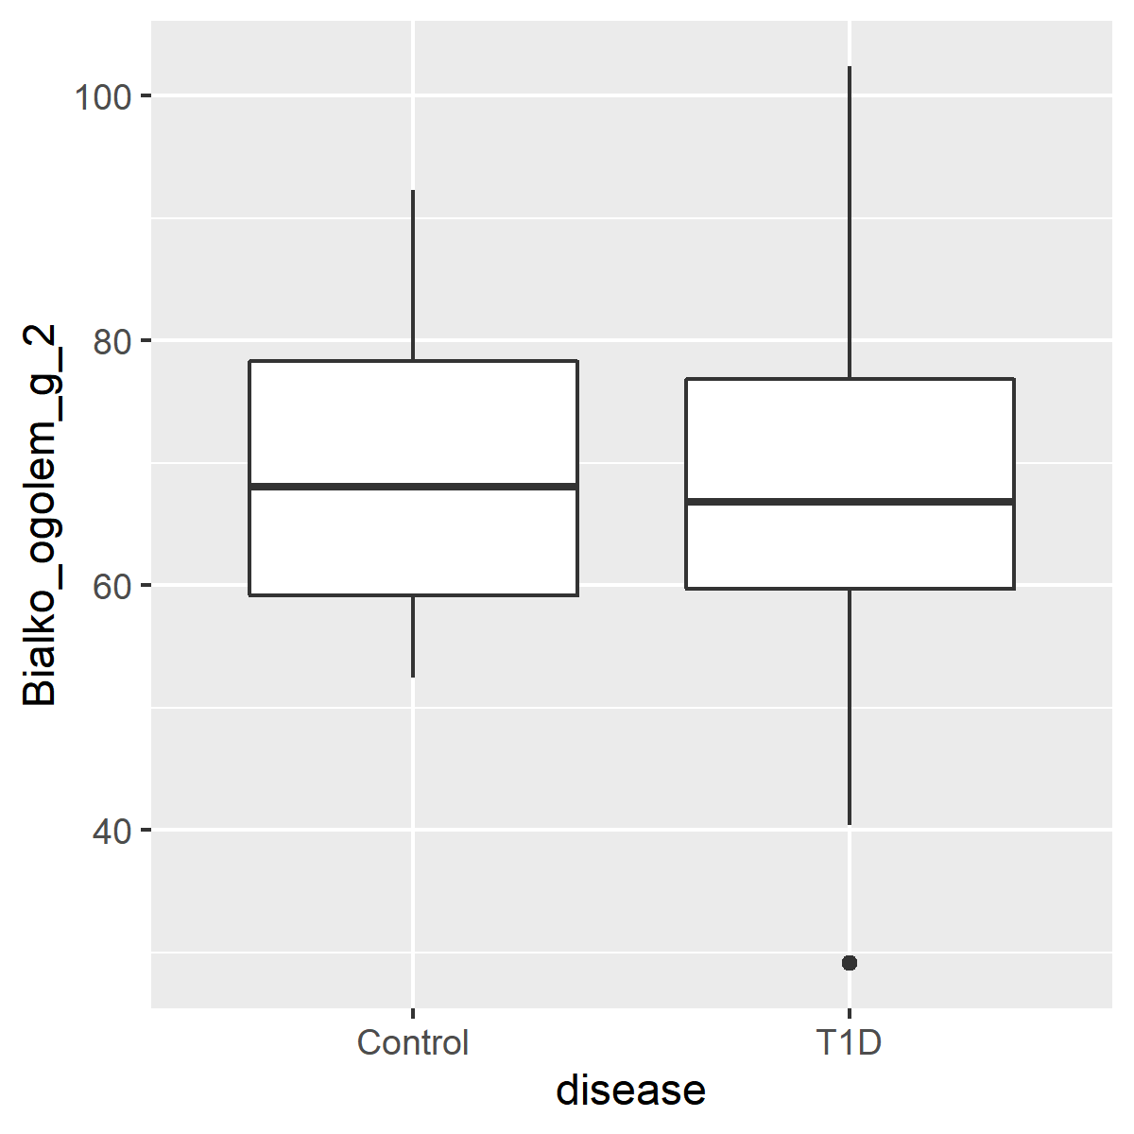
Figure X. Box and whisker plot comparisons of continuous variable and disease. Box enclosure and whiskers represent the 25th and 75th percentiles, respectively. Median is denoted by the horizontal line, and outliers are portrayed as points outside the box.

Slide 4
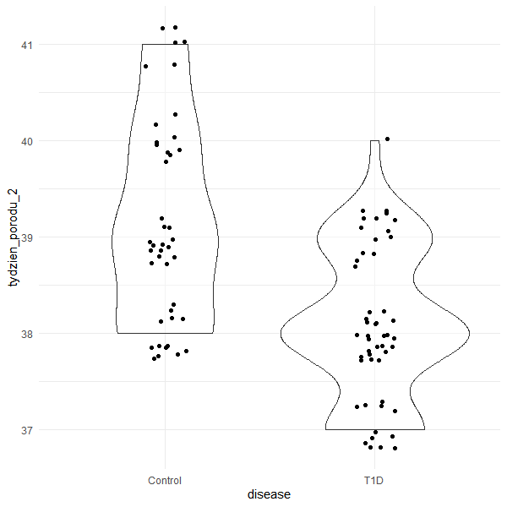
disease state | min | Q1 | median | Q3 | max | mean | sd | n
Control | 38 | 38 | 39 | 40 | 41 | 39.19048 | 1.04153 | 42
T1D | 37 | 38 | 38 | 39 | 40 | 38.08 | 0.778277 | 50
Figure X. Violin plot comparison between disease state and week of delivery [p < 0.0001].

