Slide 1



Multi-omics study of host-microbiota interactions to reveal and verify various microbiome aspects in pregnant women with type 1 diabetes (T1D) and their newborns
Marzena Gajecka, Michael Jochum
Prof. Aagaard Lab Meeting, August the 18th, 2020

Slide 2
Project questions
Characteristics of vaginal microbiota in T1D pregnant women vs unaffected pregnant women.
Characteristics of microbiota in samples derived from newborn babes (stool samples/ear swabs), taking into consideration differences between the mother’ phenotype (T1D vs unaffected mothers).
Aspects of microbiota transfer, based on microbiota found in mothers in the 3 various vaginal regions and anus, incl. mother’ phenotype differences.
Consequences of the c-section, and antibiotic prophylaxis in mothers for newborn babes: mother-newborn baby microbiota transfer.
Clinical correlations – various clinical findings vs. specific microbiota, over- and underrepresented.

Slide 3
Study design_T1D pregnant women, Controls, and materials in the Microbiome study
Ascertainement, clinical information obtained:
T1D Controls ∑
Pregnant women 50 42 92
Newborns 48 42 90
Sample sets of 6 materials:
Pregnant woman - 4 swabs: vaginal introitus,
vagina (vaginal canal, in the middle),
cervix,
anus;
Newborn: stool sample (no meconium samples, later feces) and
ear swab [collected 24-72 h after birth]
Sequencing method and analyzes:
16S rRNA, Illumina, Primers 515F–806R
530 samples sequenced
Seq data of 527 samples analyzed
Figure from Michael’ ms?

Slide 4
Mother's Clinical Characteristics
 | T1D group (n=50) | Control group (n=42)
Age, mean ± SD | 29,7 ± 4,3 | 32,4 ± 4,0
Ethnicity - Caucasian | 50 (100%) | 42 (100%)
Geographical location - Poland | 50 (100%) | 42 (100%)
Delivery mode
Caesarian | 33 (66%) | 20 (47.5%)
Vaginal | 12 (24%) | 17 (40.5%)
Vacuum-assisted vaginal delivery | 5 (10%) | 5 (12%)
Preterm(<37 weeks)
Yes | 0 (0%) | 0 (0%)
No | 50 (100%)* | 42 (100%)
Gestation (weeks), mean ± SD | 38,1 ± 0,7 | 39,2 ± 1,0
Parity
Primiparity | 28 (56%) | 14 (33.5%)
Multiparity | 20 (40%) | 27 (64.5%)
NA | 2 (4%) | 1 (2%)
Miscarriages
yes | 7 (14%) | 8 (19%)
no | 41 (82%) | 33 (79%)
NA | 2 (4%) | 1 (2%)
*one newborn wk 36+6
Notes:
No preterm babies involved

Slide 5
Mother's Clinical Characteristics
 | T1D group (n=50) | Control group (n=42)
Maternal diabetes
T1D | 50 (100%) | 0 (0%)
T2D | 0 (0%) | 0 (0%)
Gestational | 0 (0%) | 0 (0%)
None | 0 (0%) | 42 (100%)
Age at T1D diagnosis, mean ± SD | 17,91 ± 8,21 | NA
Duration of T1D (years), mean ± SD | 12,56 ± 7,02 | NA
Diabetes medication (insulin therapy)
Yes | 49 (98%) | 0 (0%)
No | 0 (0%) | 42 (100%)
NA | 1 (2%) | 0 (0%)
Time of insulin therapy (years), mean ± SD | 12,52 ± 17,09 | NA
Age at the beginning of insulin therapy (years), mean ± SD | 17,97 ± 8,30 | NA
Classification of pregestational diabetes (modified P. White classification)****
Class A | 0 (0%) | NA
Class B | 18 (36%) | NA
Class C | 15 (30%) | NA
Class D | 11 (22%) | NA
Class R | 5 (10%) | NA
Class F | 0 (0%) | NA
Class RF | 1 (2%) | NA
Class H | 0 (0%) | NA
Class T | 0 (0%) | NA
**** according to Wender-Ożegowska E, Bomba-Opoń D, et al. Standards of Polish Society of Gynecologists and Obstetricians in management of women with diabetes. Ginekol Pol. 2018;89(6):341-350. doi: 10.5603/GP.a2018.0059.
Notes:
No preterm babies involved

Slide 6
Mother's Clinical Characteristics
 | T1D group (n=50) | Control group (n=42)
Retinopathy
yes | 10 (20%) | 0 (0%)
no | 38 (76%) | 42 (100%)
NA | 2 (4%) | 0 (0%)
Hypothyroidism
yes | 23 (46%) | 10 (23.5%)
no | 27 (54%) | 31 (74%)
NA | 2 (4%) | 1 (2.5%)
Notes:
No preterm babies involved

Slide 7
Mother's Clinical Characteristics
 | T1D group (n=50) | Control group (n=42)
Probiotic before pregnancy (including synbiotics)
Yes | 12 (24%) | 15 (35.5%)
No | 28 (56%) | 15 (35.5%)
NA | 10 (20%) | 12 (29%)
Probiotic during pregnancy (including synbiotics)
yes | 5 (10%) | 29 (69%)
no | 35 (70%) | 1 (2%)
NA | 10 (20%) | 12 (29%)
Probiotic products before pregnancy
yes | 38 (76%) | 27 (64%)
no | 2 (4%) | 3 (7%)
NA | 10 (20%) | 12 (29%)
Probiotic products during pregnancy
yes | 38 (76%) | 30 (71%)
no | 2 (4%) | 0 (0%)
NA | 10 (20%) | 12 (29%)
Notes:
No preterm babies involved

Slide 8
Neonate's Clinical Characteristics
 | T1D group (n=48) | Control group (n=42)
Sex
Male | 26 (54%) | 24 (57%)
female | 22 (46%) | 18 (43%)
Birth weight
SGA | 4 (8%) | 0 (0%)
AGA | 31 (65%) | 39 (93%)
LGA | 13 (27%) | 3 (7%)
Birth weight (kg), mean ± SD | 3547,92 ± 522,59 | 3405,45 ± 395,51

Slide 9
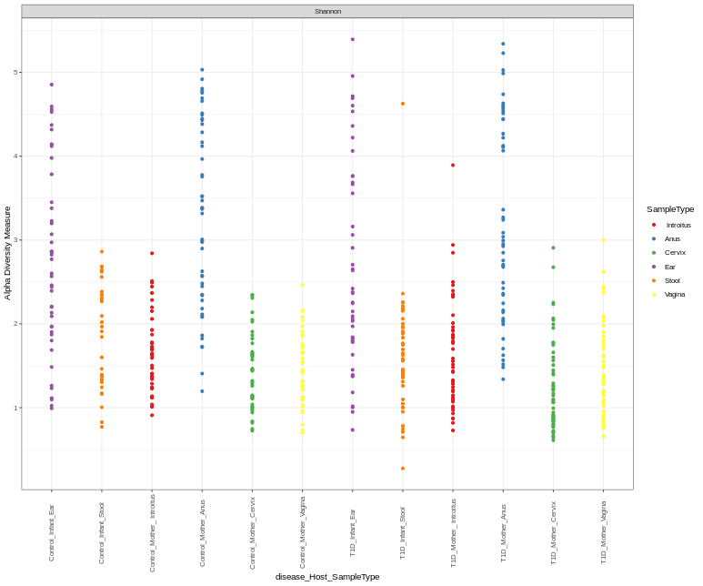
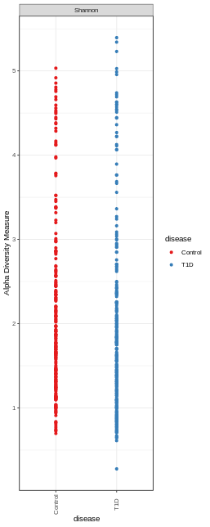
Alpha diversity estimates (Shannon)
Control T1D
Infant Mother Infant Mother
Ear
Stool
Introitus
Anus
Cervix
Vagina
Ear
Stool
Introitus
Anus
Cervix
Vagina
Notes:
OK: Alpha Diversity Estimates: Shannon only
X disease; color disease, shape null, size 10, opacity 1, max. Labels 30. angle 90; source data original, width 4, height 10
Disease_Host_Sample Type/Color: SampleType/null

Slide 10
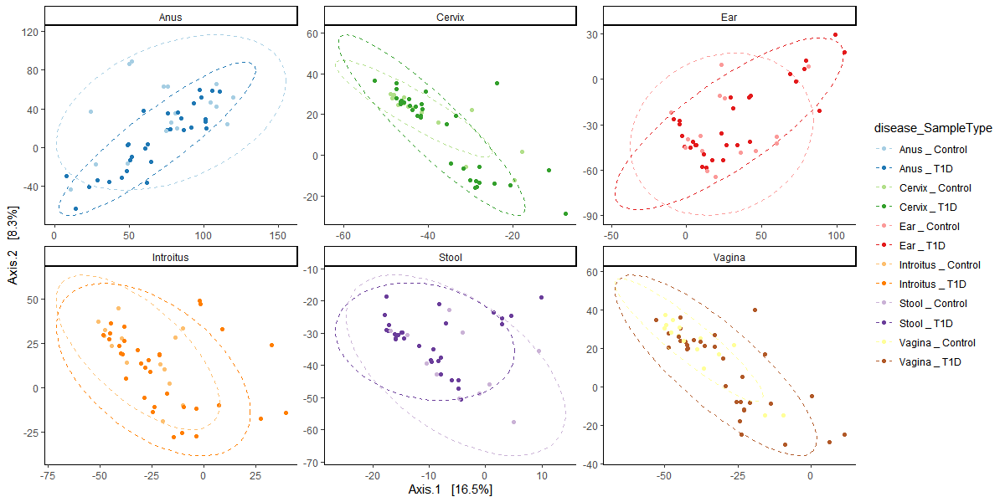
Beta Diversity PCoA plots comparing the T1D and control samples
across all microbiome sample types
Notes:
How different is the microbial composition in one material compared to another?

Slide 11
Continuous Variables_Delivery week (37-41, no preterm babies)
Mother's Clinical Characteristics
 | T1D group (n=50) | Control group (n=42)
Gestation (weeks), mean ± SD | 38,1 ± 0,7 | 39,2 ± 1,0
37 38 39 40 41

Slide 12
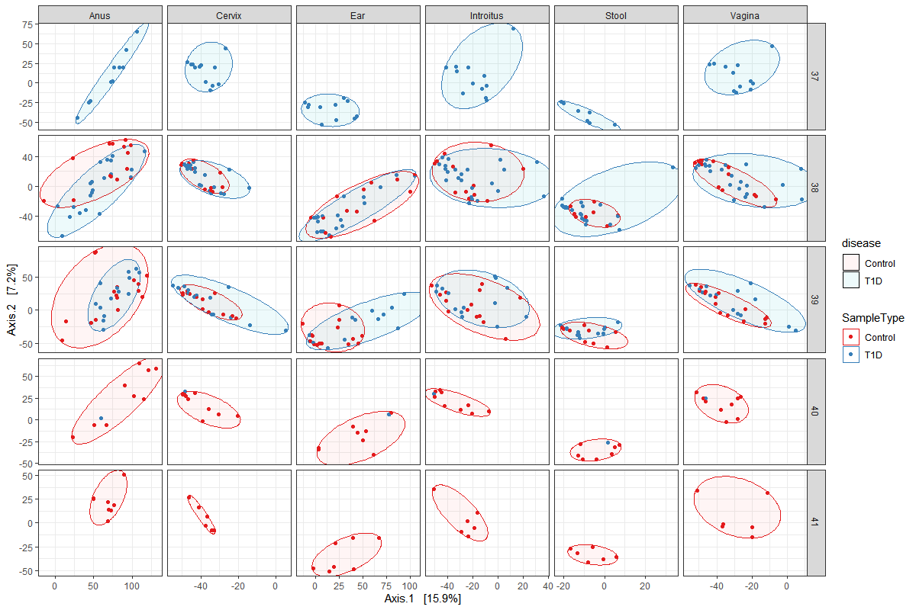
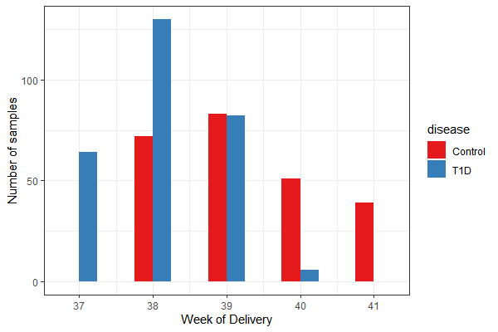
Delivery week (37-41, no preterm babies) and Beta diversity (adonis permanova)
Table X. Beta Diversity Bray Curtis adonis permanova of VST transformed counts versus week of delivery stratified by sample type.
 | Df | SumsOfSqs | MeanSqs | F.Model | R2 | Pr(>F)
disease | 1 | 23963 | 23963 | 1.9261 | 0.00377 | 0.0001 | ***
week of delivery | 1 | 18700 | 18700 | 1.5031 | 0.00294 | 0.0024 | **
disease:week of delivery | 1 | 18144 | 18144 | 1.4584 | 0.00285 | 0.002 | **
Residuals | 506 | 6295123 | 12441 |  | 0.99043
Total | 509 | 6355930 |  |  | 1
---
Signif. codes: 0 ‘***’ 0.001 ‘**’ 0.01 ‘*’ 0.05 ‘.’ 0.1 ‘ ’ 1
Notes:
Dr. Aagaard: The week of delivery stands in part because of such a strong inverse….no Type I DM goes past 39 weeks.

Slide 13
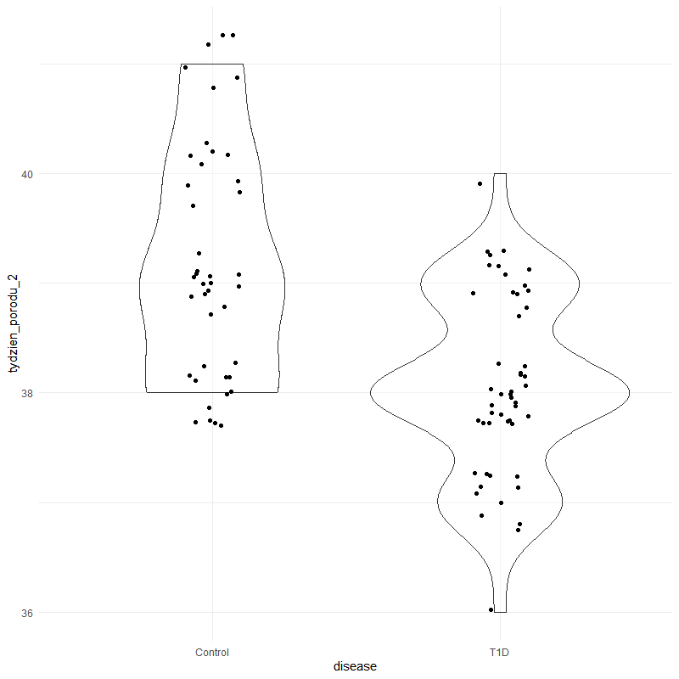
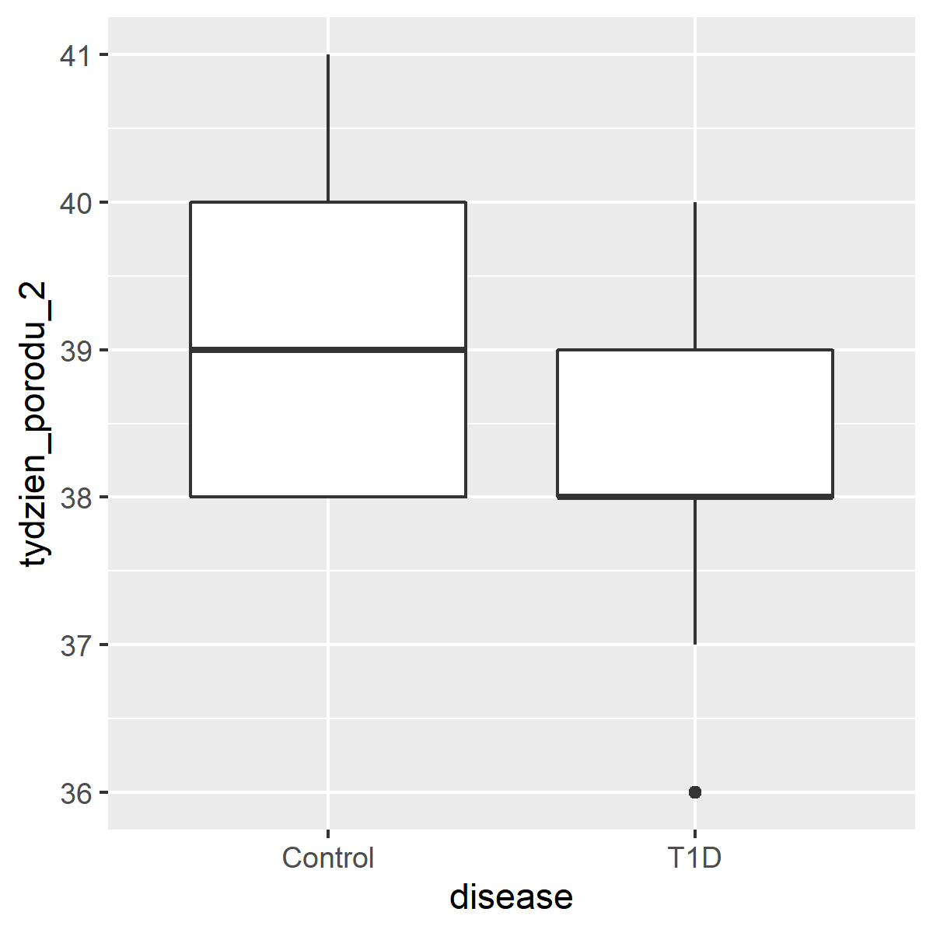
Continuous Variables_disease state and week of delivery
DELIVERY WEEK
*one newborn: week 36+6
Figure X. Violin plot comparison between disease state and week of delivery [p < 0.0001]
*one newborn 36+6

Slide 14
Continuous Variables_selected dietery aspects and BMI
Mother's Clinical Characteristics
 | T1D group (n=50) | Control group (n=42)
Pre-pregnancy BMI, mean ± SD | 23,19 ± 2,95 | 22,46 ± 2,56
Pre-pregnancy BMI
Underweight | 1 (2%) | 1 (2%)
Normal | 35 (70%) | 33 (79%)
Overweight | 13 (26%) | 7 (17%)
Obese | 1 (2%) | 0 (0%)
NA | 0 (0%) | 1 (2%)
Before-birth BMI, mean ± SD | 28,12 ± 3,75 | 27,46 ± 2,97
Weight gain (kg), mean ± SD | 13,61 ± 5,34 | 14,00 ± 3,79
Weight gain
Non-excess | 32 (64%) | 26 (62%)
Excess | 18 (38%) | 15 (36%)
NA | 0 (0%) | 1 (2%)
Energy from saturated fatt acids [%]**, mean ± SD | 30,80 ± 5,09 | 27,79± 4,83
Energy derived from carbohydrates [%]**, mean ± SD | 50,85 ± 5,33 | 55,47 ± 5,30
Energy derived from total protein [%]**, mean ± SD | 18,35 ± 3,01 | 16,74 ± 1,59
**counting based on 24-hours dietetic recall for 7-days received from 33 T1D patients and 14 controls

Slide 15
Continuous Variables_stat. tests and stat. significance
Table X. Summary of logistical regression models for continuous variable and disease state.
Table X. ANOVA using a linear model fit for continuous variable and disease states comparisons.
Variable |  | estimate | std.error | conf.low | conf.high | statistic | p.value
PROTEIN INTAKE_total protein [g] | (Intercept) | 1.53E+30 | 4.07 | 5.26E+26 | 4.44E+33 | 17.1 | 2.72E-21
 | disease | 1.28 | 4.86 | 9.41E-05 | 17400 | 0.0507 | 0.96
BMI_before pregnancy | (Intercept) | 6.04E+09 | 0.439 | 2.55E+09 | 1.43E+10 | 51.2 | 7.55E-68
 | disease | 1.96 | 0.593 | 0.613 | 6.26 | 1.13 | 0.26
BMI_after pregnancy | (Intercept) | 8.96E+11 | 0.548 | 3.06E+11 | 2.63E+12 | 50.2 | 1.54E-66
 | disease | 1.81 | 0.736 | 0.429 | 7.67 | 0.809 | 0.42
ENERGY DERIVED FROM PROTEIN [%] | (Intercept) | 18598841 | 0.729 | 4458821 | 77580340 | 23 | 1.72E-26
 | disease | 5 | 0.87 | 0.909 | 27.5 | 1.85 | 0.0709
ENERGY DERIVED FROM FAT [%] | (Intercept) | 1.18E+12 | 1.37 | 8.04E+10 | 1.72E+13 | 20.3 | 2.79E-24
 | disease | 20.2 | 1.63 | 0.821 | 497 | 1.84 | 0.0725
DELIVERY_WEEK | (Intercept) | 1.05E+17 | 0.143 | 7.92E+16 | 1.39E+17 | 274 | 2.7E-133
 | disease | 0.323 | 0.194 | 0.221 | 0.472 | -5.83 | 8.62E-08 | ***
newborn_weight | (Intercept) | Inf | 73.5 | Inf | Inf | 46.3 | 1.42E-64
 | disease | 1.71E+65 | 99.6 | 2.58E-20 | 1.1E+150 | 1.51 | 0.135
Variable |  | Estimate | Std. Error | t value | Pr(>|t|)
PROTEIN INTAKE_total protein [g] | (Intercept) | 69.502 | 4.0686 | 17.082 | <2e-16
 | disease | 0.2459 | 4.8556 | 0.051 | 0.96
BMI_before pregnancy | (Intercept) | 27.5217 | 0.5484 | 50.183 | <2e-16
 | disease | 0.5955 | 0.7358 | 0.809 | 0.42
BMI_after pregnancy | (Intercept) | 22.5213 | 0.4395 | 51.245 | <2e-16
 | disease | 0.672 | 0.5929 | 1.133 | 0.26
ENERGY DERIVED FROM PROTEIN [%] | (Intercept) | 16.7386 | 0.7287 | 22.97 | <2e-16
 | disease | 1.6089 | 0.8696 | 1.85 | 0.0709 | .
ENERGY DERIVED FROM FAT [% | (Intercept) | 27.794 | 1.369 | 20.295 | <2e-16
 | disease | 3.005 | 1.634 | 1.839 | 0.0725 | .
DELIVERY_WEEK | (Intercept) | 3402.6 | 73.46 | 46.317 | <2e-16
 | disease | 150.2 | 99.65 | 1.507 | 0.135
newborn_weight | (Intercept) | 39.191 | 0.143 | 274.061 | <
 | disease | -1.131 | 0.194 | -5.828 | 8.62E-08
Table X. Welch's Two Sample t-test comparisons of continuous variables between Control and T1 Diabetes patients.
Table X. PostHoc Tukey HSD multiple comparisons of means between the continuous variables and disease state.
Variable | Control (avg) | T1D (avg) | 95% CI | t | df | p-value
PROTEIN INTAKE_total protein [g] | 69.502 | 69.74794 | [-9.306434,8.814554] | -0.055404 | 30.419 | 0.9562
BMI_before pregnancy | 22.52133 | 23.19337 | [-1.833947,0.4898567] | -1.1493 | 88.669 | 0.2535
BMI_after pregnancy | 27.52166 | 28.11717 | [-2.0210605,0.8300311] | -0.83018 | 87.998 | 0.4087
ENERGY DERIVED FROM PROTEIN [%] | 16.73861 | 18.34747 | [-3.002443,-0.2152756] | -2.3295 | 42.193 | 0.02469 | *
ENERGY DERIVED FROM FAT [% | 27.7938 | 30.79929 | [-6.327365,0.3163973] | -1.8623 | 25.281 | 0.07422
DELIVERY_WEEK | 39.19048 | 38.06 | [0.7361217,1.5248307] | 5.708 | 77.186 | 2.02E-07 | ***
newborn_weight | 3402.595 | 3552.8 | [-343.61315,43.20362] | -1.5431 | 89.187 | 0.1264
 | diff | lwr | upr | p adj
PROTEIN INTAKE_total protein [g] | 0.2459396 | -9.53E+00 | 10.02555 | 0.959828
BMI_before pregnancy | 0.6720452 | -5.06E-01 | 1.850115 | 0.26005
BMI_after pregnancy | 0.5955147 | -0.86673 | 2.057758 | 0.420499
ENERGY DERIVED FROM PROTEIN [%] | 1.608859 | -0.14268 | 3.360396 | 0.070881 | .
ENERGY DERIVED FROM FAT [% | 3.005484 | -0.28624 | 6.297206 | 0.072525 | .
DELIVERY WEEK | -1.130476 | -1.51584 | -0.74511 | 1.00E-07
newborn_weight | 150.2048 | -47.767 | 348.1765 | 0.135229
Notes:
5 August 2020

Slide 16
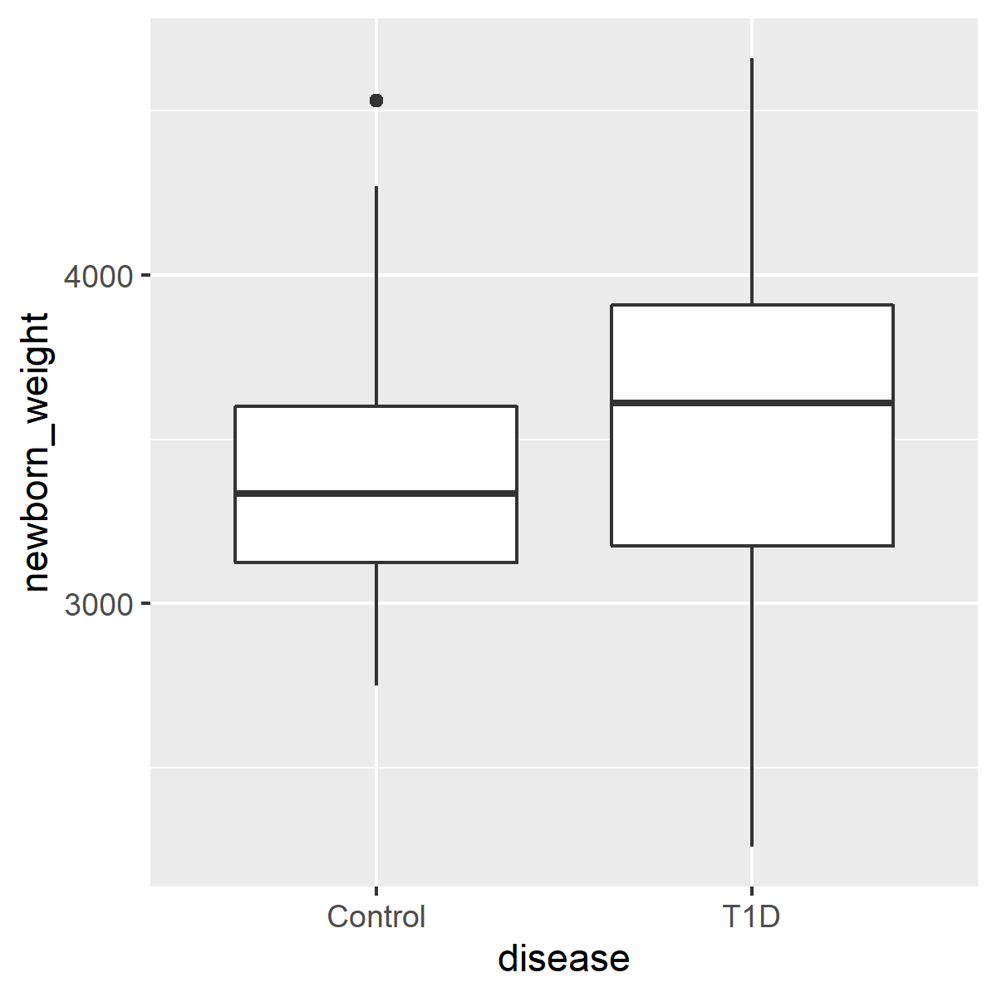
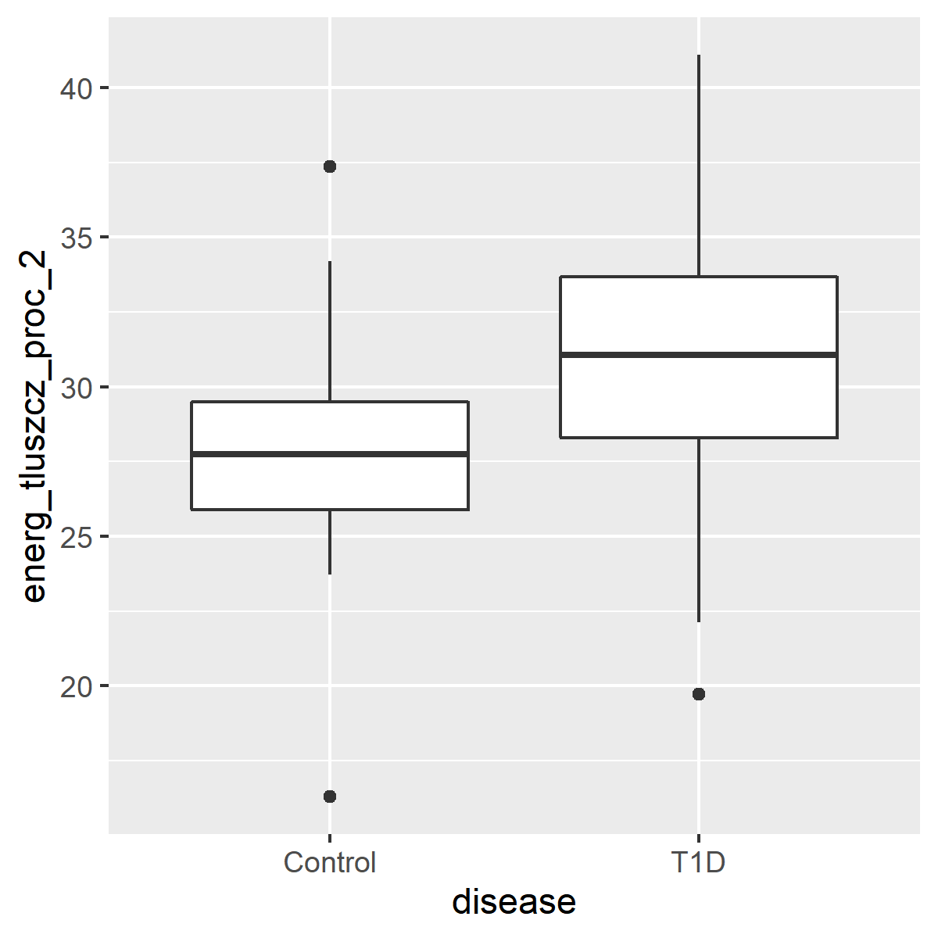
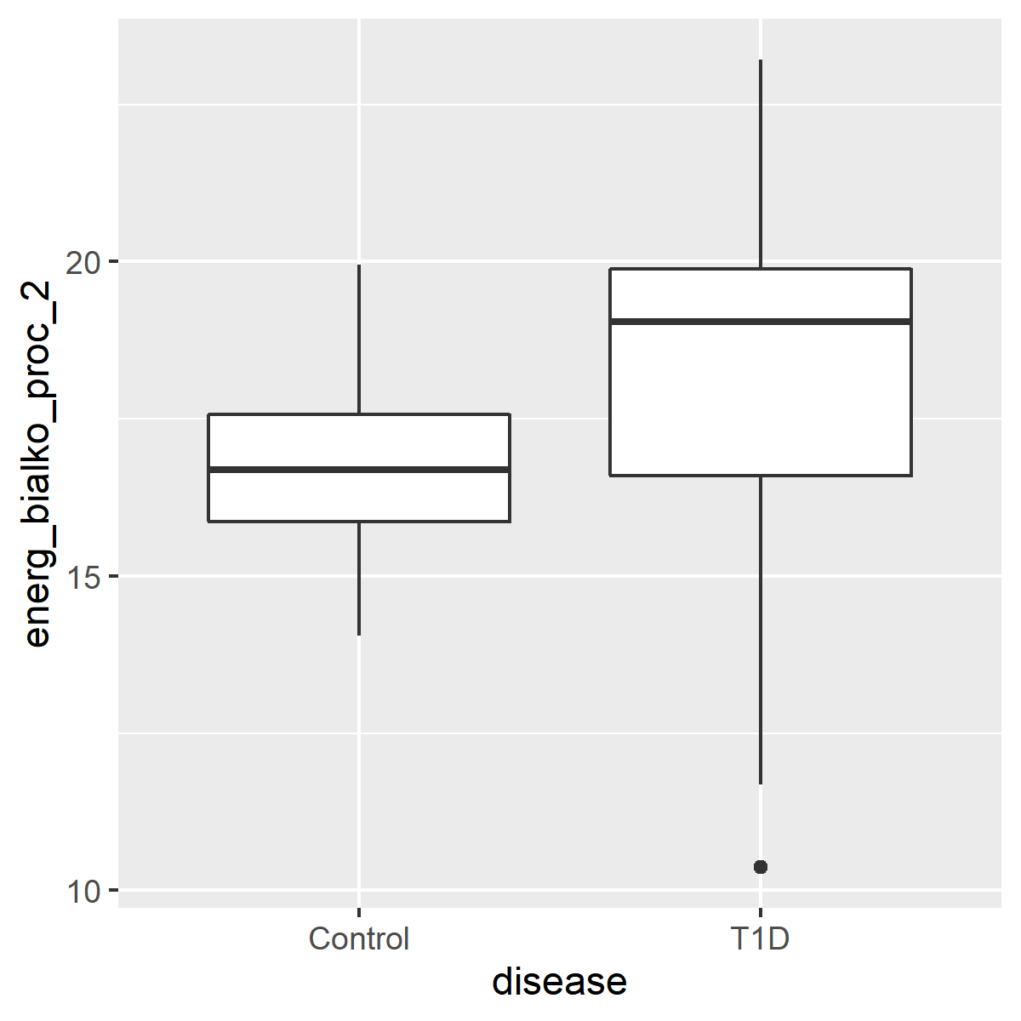
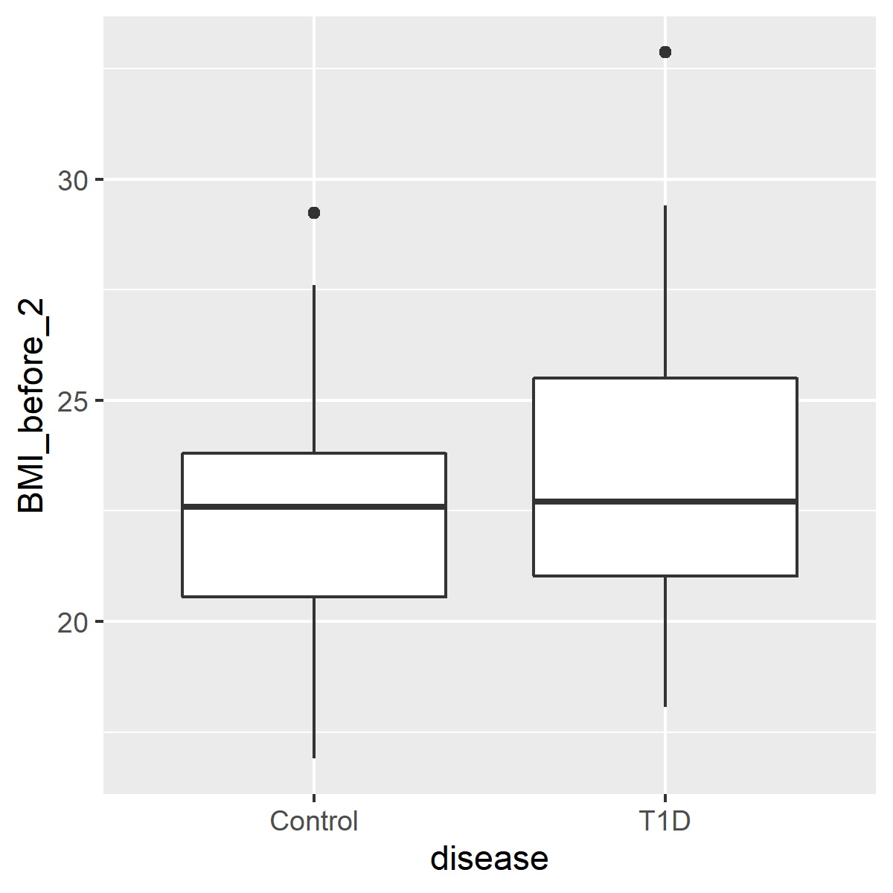
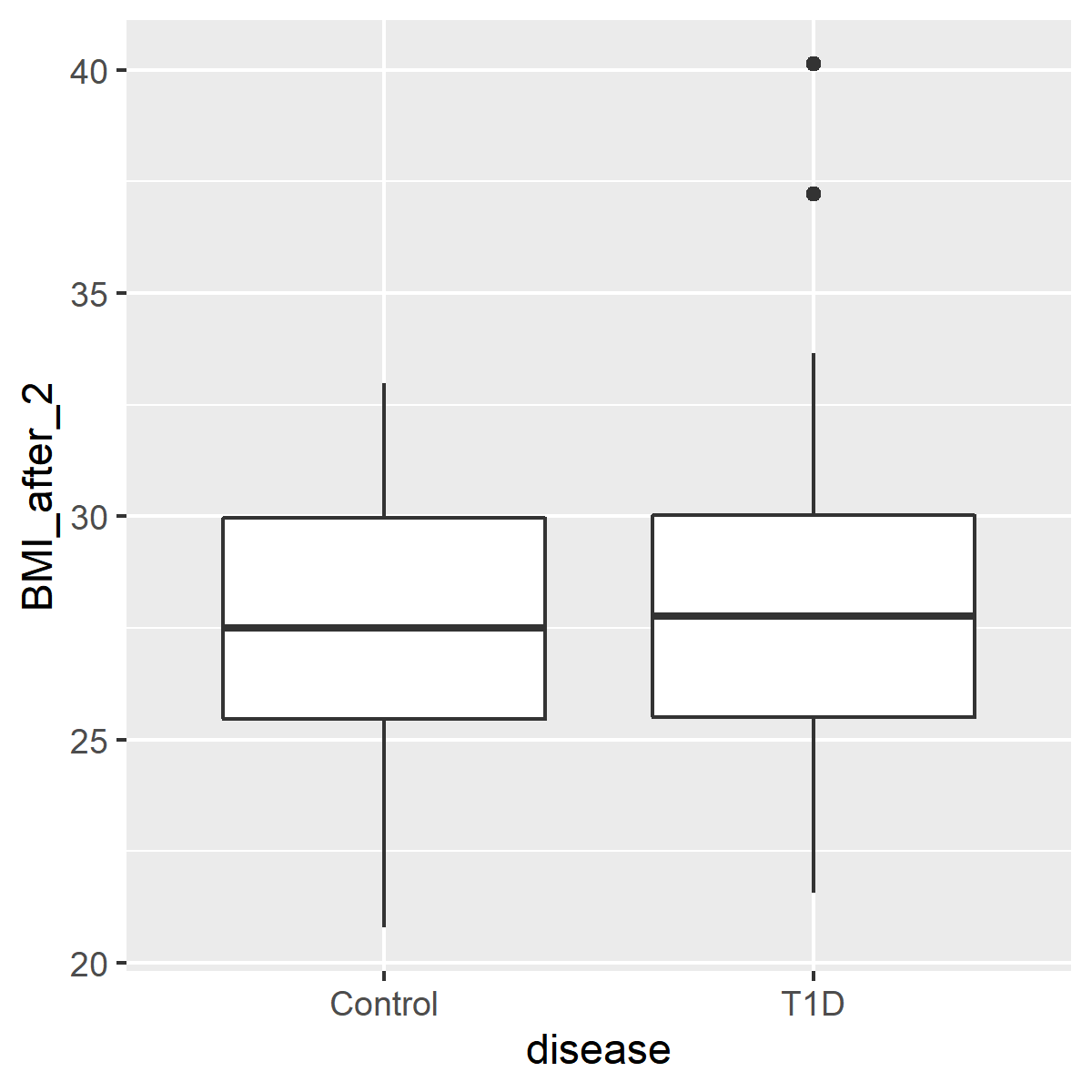
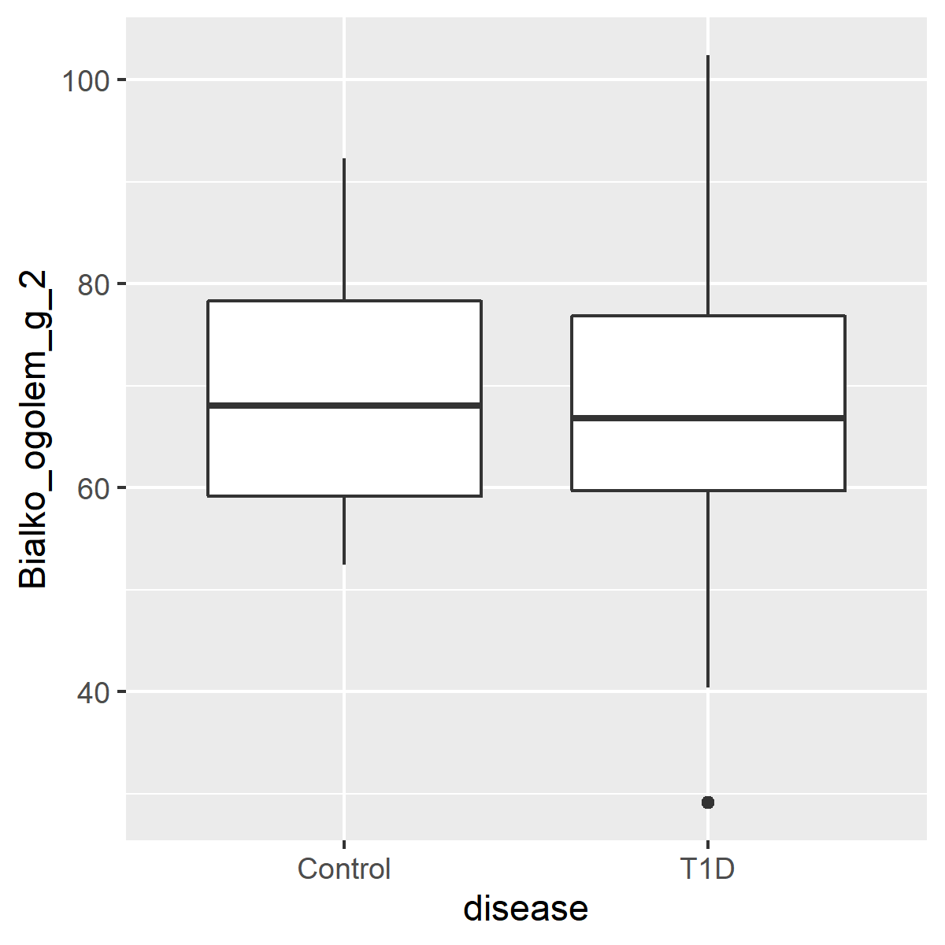
Continuous Variables
NEWBORN_WEIGHT ENERGY DERIVED FROM FAT [%] ENERGY DERIVED FROM PROTEIN [%] DELIVERY WEEK
BMI_BEFORE pregnancy BMI_AFTER (just before delivery) PROTEIN INTAKE_total protein [g]
*one newborn: week 36+6
Figure X. Box and whisker plot comparisons of continuous variable and disease. Box enclosure and whiskers represent the 25th and 75th percentiles, respectively. Median is denoted by the horizontal line, and outliers are portrayed as points outside the box.

Slide 17
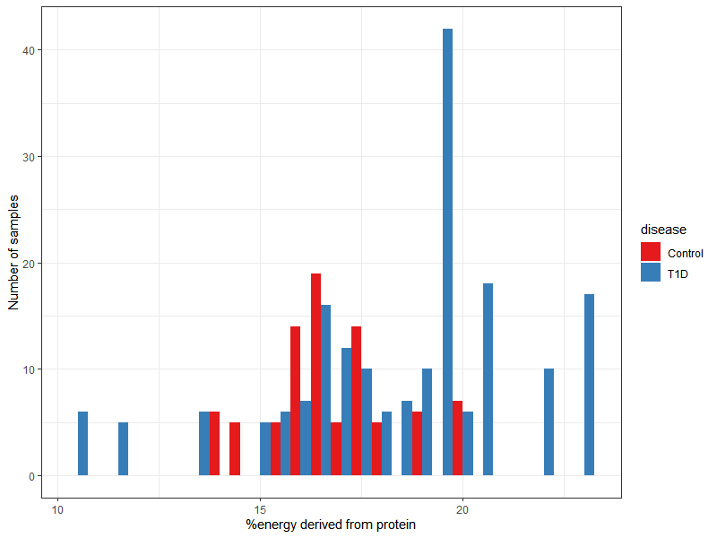
Beta Diversity Bray Curtis adonis permanova
% energy from protein
Table X. Beta Diversity Bray Curtis adonis permanova of VST transformed counts versus percent energy derived from protein stratified by sample type
 | Df | SumsOfSqs | MeanSqs | F.Model | R2 | Pr(>F)
disease | 1 | 23207 | 23207 | 1.9412 | 0.00728 | 0.0001 | ***
energ_bialko_proc_2 | 1 | 16539 | 16539 | 1.3835 | 0.00519 | 0.002 | **
disease:energ_bialko_proc_2 | 1 | 17810 | 17810 | 1.4898 | 0.00558 | 0.0027 | **
Residuals | 262 | 3132107 | 11955 |  | 0.98196
Total | 265 | 3189663 |  |  | 1
Signif. codes: 0 ‘***’ 0.001 ‘**’ 0.01 ‘*’ 0.05 ‘.’ 0.1 ‘ ’ 1

Slide 18
Delivery mode and Antibiotic prophylaxis
Mother's Clinical Characteristics
 | T1D group (n=50) | Control group (n=42)
Antibiotics prophylaxis
Yes | 34 (68%) | 20 (47.5%)
no | 16 (32%) | 22 (52.5%)
Cause of antibiotics prophylaxis*****
C-section | 28 (80%) | 12 (54%)
Streptococcus agalactiae | 5 (14%) | 5 (23%)
Chorioamnionitis | 0 (0%) | 0 (0%)
Maternal bacterial endocarditis | 0 (0%) | 0 (0%)
Premature rupture of membranes | 2 (6%) | 5 (23%)
Used Antibiotic******
cefuroxime | 18 (51,5%) | 7 (30,5%)
ampicillin | 6 (17%) | 4 (17%)
cefazolin | 11 (31,5%) | 10 (43,5%)
clindamycin | 0 (0%) | 1 (4,5%)
cefalexin | 0 (0%) | 1 (4,5%)
*****in one T1D patient and two controls there were more than one cause of using the antibiotics profilaxy
******in one T1D patient and three controls more than one antibiotic was administrated
Notes:
DZ: Tutaj abundance pomiędzy dwoma pierwszymi
PROM profilaktyka ( rozpoczęta 6h po pęknięciu błon płodowych
Chorioamnionitis (intra-amniotic infection (IAI)_
No preterm, dobrze kontrolowana cukrzyca

Slide 19
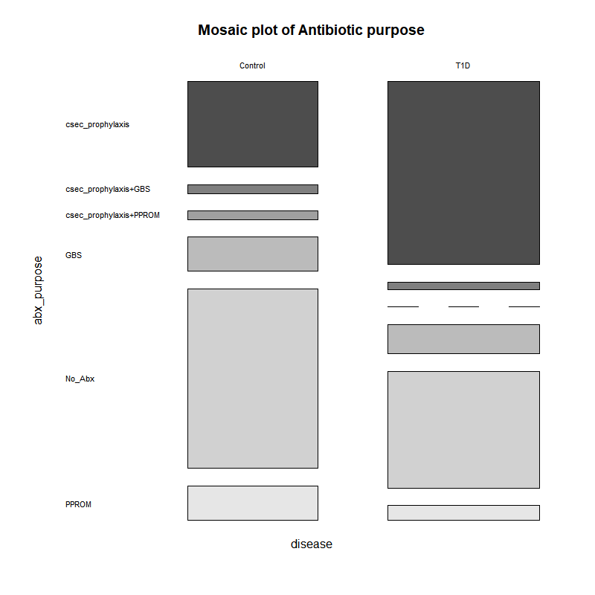

Slide 20
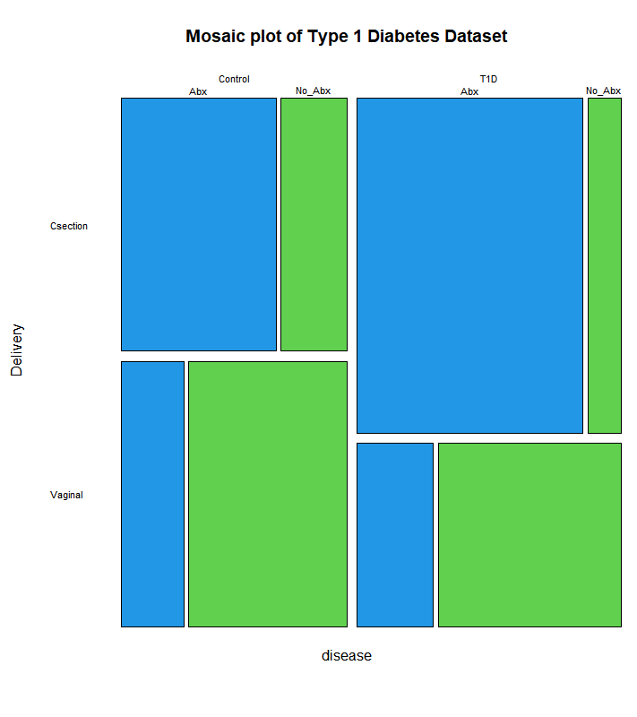
Beta Diversity Bray Curtis adonis permanova
C-section vs Vaginal
Table X. Beta Diversity Bray Curtis adonis permanova of VST transformed counts versus Delivery stratified by sample type
 | Df | SumsOfSqs | MeanSqs | F.Model | R2 | Pr(>F)
disease | 1 | 17149 | 17149 | 1.4868 | 0.00968 | 0.0248 | *
Delivery | 1 | 23172 | 23172 | 2.009 | 0.01309 | 0.0008 | ***
disease:Delivery | 1 | 11811 | 11811 | 1.024 | 0.00667 | 0.2259
Residuals | 149 | 1718543 | 11534 |  | 0.97056
Total | 152 | 1770674 |  |  | 1
---
Signif. codes: 0 ‘***’ 0.001 ‘**’ 0.01 ‘*’ 0.05 ‘.’ 0.1 ‘ ’ 1
Antibiotics
Table X. Beta Diversity Bray Curtis adonis permanova of VST transformed counts versus Antibiotics stratified by sample type
 | Df | SumsOfSqs | MeanSqs | F.Model | R2 | Pr(>F)
disease | 1 | 23963 | 23963 | 1.926 | 0.00377 | 0.0003 | ***
Antibiotics_2 | 1 | 19261 | 19261 | 1.5482 | 0.00303 | 0.0013 | **
disease:Antibiotics_2 | 1 | 17335 | 17335 | 1.3933 | 0.00273 | 0.0064 | **
Residuals | 506 | 6295371 | 12441 |  | 0.99047
Total | 509 | 6355930 |  |  | 1
---
Signif. codes: 0 ‘***’ 0.001 ‘**’ 0.01 ‘*’ 0.05 ‘.’ 0.1 ‘ ’ 1
Notes:
Dr Aagaard: So significance is lost on disease by delivery, but retained on disease by antibiotics. The week of delivery stands in part because of such a strong inverse….no Type I DM goes past 39 weeks (August 13, 2020)
Michael: Removal of the "SampleType" column in the adonis because we are stratifying against it (August 13, 2020)

Slide 21
Differentially Expressed Taxa associated with Type 1 Diabetes

Slide 22
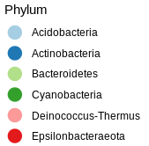
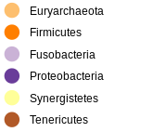
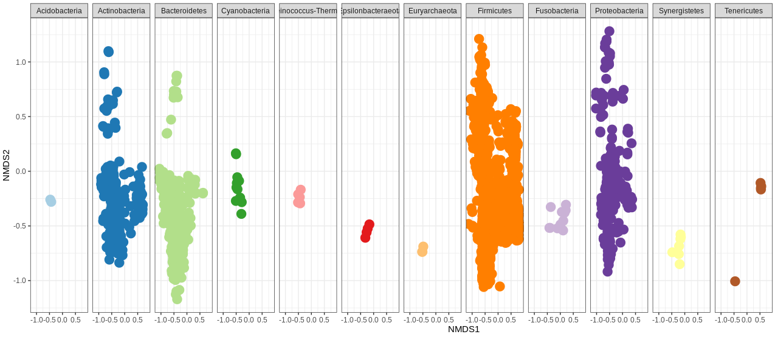
Microbiota composition_Phylum level_NMDS
Notes:
Just to remind

Slide 23
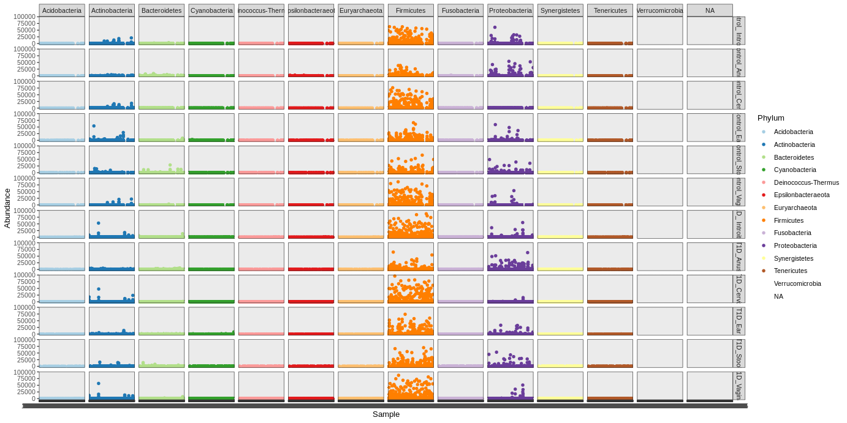
Mikrobiota abundance (Phylum level) in materials tested_separately
Control_introitus
Control_cervix
Control_annus
Control_ear
Control_stool
Control_vagina
T1D _introitus
T1D _cervix
T1D _annus
T1D _ear
T1D _stool
T1D_vagina
Notes:
Just to remind

Slide 24
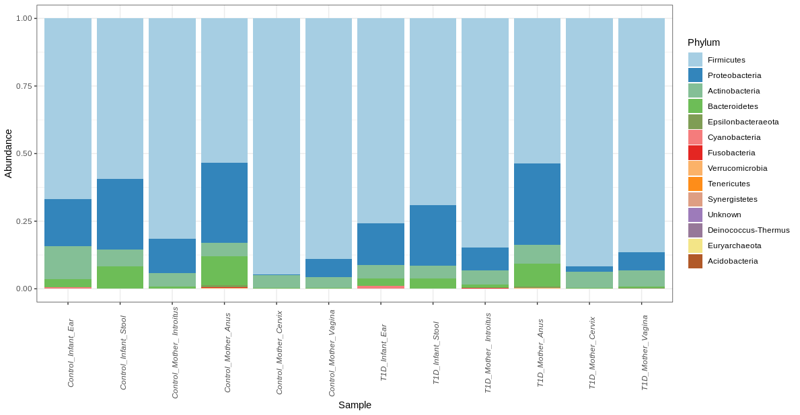
Microbiota relative abundance, Newborns and Mothers, separately
Control
T1D
Notes:
Just to remind

Slide 25
Table X. Log 2-fold change and p value of differentially expressed genera associated with Type 1 Diabetes
 | Cervix |  |  | Vagina |  |  | Introitus |  |  | Stool |  |  | Ear |  |  | Anus
Genus | lfc | p adj |  | lfc | p adj |  | lfc | p adj |  | lfc | p adj |  | lfc | p adj |  | lfc | p adj
Actinomyces | 0.18 | 1.00 |  | 1.67 | 0.34 |  | 0.71 | 1.00 |  | 2.88 | 0.01 |  | 0.82 | 0.96 |  | -0.47 | 1.00
Anaerococcus | -3.20 | 0.00 |  | -2.13 | 0.01 |  | -1.99 | 0.03 |  | 1.28 | 0.41 |  | 1.64 | 0.16 |  | 0.33 | 1.00
Anaeroglobus | -3.21 | 0.56 |  | 0.62 | 1.00 |  | -0.20 | 1.00 |  | 19.46 | 0.00 |  | -1.97 | 1.00 |  | -3.69 | 0.50
Atopobium | 6.62 | 0.00 |  | 6.82 | 0.00 |  | 2.88 | 0.08 |  | -0.11 | 1.00 |  | -1.89 | 0.54 |  | -2.04 | 0.45
Bacteroides | 6.34 | 0.00 |  | 2.14 | 0.19 |  | 1.26 | 1.00 |  | -3.03 | 0.01 |  | 1.58 | 0.42 |  | -0.09 | 1.00
Bifidobacterium | -5.86 | 0.00 |  | -0.29 | 1.00 |  | -3.03 | 0.04 |  | -0.01 | 1.00 |  | 0.96 | 1.00 |  | -1.74 | 0.55
Citrobacter | 2.57 | 0.51 |  | -0.10 | 1.00 |  | 15.31 | 0.00 |  | 1.25 | 1.00 |  | -0.65 | 1.00 |  | -4.74 | 0.04
Collinsella | -15.19 | 0.00 |  | -0.80 | 1.00 |  | -0.71 | 1.00 |  | -8.77 | 0.00 |  | 0.22 | 1.00 |  | -1.67 | 0.55
Dialister | -1.34 | 0.51 |  | -1.37 | 0.90 |  | -2.02 | 0.13 |  | 3.50 | 0.00 |  | -1.45 | 0.53 |  | -0.69 | 1.00
Enhydrobacter | 18.47 | 0.00 |  | -0.02 | 1.00 |  | -5.11 | 0.00 |  | 0.99 | 1.00 |  | 0.81 | 1.00 |  | -1.76 | 0.45
Enterococcus | -2.77 | 0.00 |  | 0.60 | 1.00 |  | 0.53 | 1.00 |  | 0.38 | 1.00 |  | 1.13 | 0.67 |  | 1.51 | 0.44
Escherichia/Shigella | 2.79 | 0.00 |  | -0.95 | 1.00 |  | -1.13 | 1.00 |  | -0.51 | 1.00 |  | -3.05 | 0.00 |  | 0.85 | 0.92
Fusicatenibacter | 14.24 | 0.00 |  | -0.02 | 1.00 |  | 1.62 | 1.00 |  | 26.44 | 0.00 |  | 3.29 | 0.07 |  | -1.18 | 0.94
Fusobacterium | -3.91 | 0.01 |  | -1.70 | 1.00 |  | -0.89 | 1.00 |  | 20.09 | 0.00 |  | -0.49 | 1.00 |  | -1.69 | 0.70
Gemella | 7.91 | 0.00 |  | 7.03 | 0.00 |  | 21.38 | 0.00 |  | -1.56 | 1.00 |  | -1.51 | 1.00 |  | -1.26 | 1.00
Intestinibacter | 17.92 | 0.00 |  | 14.82 | 0.00 |  | -1.35 | 1.00 |  | -2.97 | 0.22 |  | -1.29 | 1.00 |  | 0.00 | 1.00
Jonquetella | 15.35 | 0.00 |  | -1.29 | 1.00 |  | 5.47 | 0.12 |  | 2.97 | 0.93 |  | 0.21 | 1.00 |  | -6.37 | 0.05
Klebsiella | 2.10 | 0.67 |  | -2.07 | 1.00 |  | 7.79 | 0.00 |  | 1.50 | 1.00 |  | 0.06 | 1.00 |  | -5.03 | 0.02
Kocuria | 1.09 | 1.00 |  | -1.14 | 1.00 |  | -1.80 | 0.45 |  | 0.83 | 1.00 |  | -3.29 | 0.00 |  | -0.39 | 1.00
Lachnoclostridium | 0.00 | 1.00 |  | -0.53 | 1.00 |  | 0.10 | 1.00 |  | 3.84 | 0.01 |  | 1.57 | 0.67 |  | 0.12 | 1.00
Megasphaera | 4.17 | 0.02 |  | 7.80 | 0.00 |  | 3.28 | 0.27 |  | 15.61 | 0.00 |  | -1.60 | 1.00 |  | -2.02 | 0.72
Micrococcus | -0.58 | 1.00 |  | -2.24 | 0.11 |  | -0.32 | 1.00 |  | -0.98 | 1.00 |  | -3.71 | 0.00 |  | 0.78 | 1.00
Parabacteroides | 16.91 | 0.00 |  | 0.37 | 1.00 |  | 0.66 | 1.00 |  | -1.02 | 1.00 |  | 1.05 | 0.99 |  | -1.23 | 0.79
Peptoniphilus | -0.08 | 1.00 |  | 0.60 | 1.00 |  | 0.45 | 1.00 |  | 3.42 | 0.00 |  | 1.41 | 0.24 |  | 0.03 | 1.00
Prevotella_6 | 0.28 | 1.00 |  | 3.78 | 0.00 |  | 2.52 | 0.12 |  | 0.89 | 1.00 |  | -0.28 | 1.00 |  | -1.09 | 0.90
Pseudomonas | 1.24 | 0.66 |  | 1.05 | 1.00 |  | 0.03 | 1.00 |  | 7.51 | 0.00 |  | -0.95 | 0.90 |  | -0.54 | 1.00
Romboutsia | 0.00 | 1.00 |  | -0.43 | 1.00 |  | 0.05 | 1.00 |  | 6.40 | 0.00 |  | -0.03 | 1.00 |  | -1.86 | 0.55
Rothia | -0.67 | 1.00 |  | 2.01 | 0.65 |  | 1.07 | 1.00 |  | -0.78 | 1.00 |  | -7.75 | 0.00 |  | 0.18 | 1.00
Sneathia | 42.95 | 0.00 |  | 49.75 | 0.00 |  | 6.19 | 0.49 |  | -0.63 | 1.00 |  | 4.16 | 0.88 |  | 13.86 | 0.00
Staphylococcus | -2.09 | 0.00 |  | 0.35 | 1.00 |  | 2.43 | 0.00 |  | 0.96 | 0.71 |  | 0.58 | 1.00 |  | 3.13 | 0.00
Streptococcus | 0.07 | 1.00 |  | -3.58 | 0.00 |  | 1.82 | 0.16 |  | 0.21 | 1.00 |  | 0.57 | 1.00 |  | -1.42 | 0.48
Sutterella | -0.68 | 1.00 |  | -0.68 | 1.00 |  | -0.07 | 1.00 |  | -5.19 | 0.00 |  | 0.22 | 1.00 |  | -1.69 | 0.60
Terrisporobacter | 14.20 | 0.00 |  | 0.00 | 1.00 |  | 14.70 | 0.00 |  | -7.66 | 0.00 |  | 1.01 | 1.00 |  | 0.59 | 1.00

Slide 26
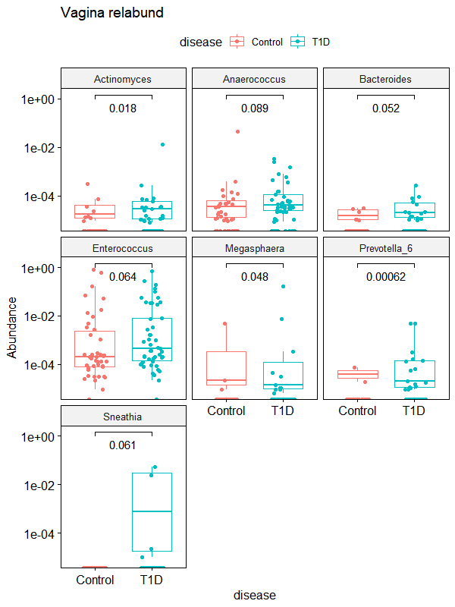
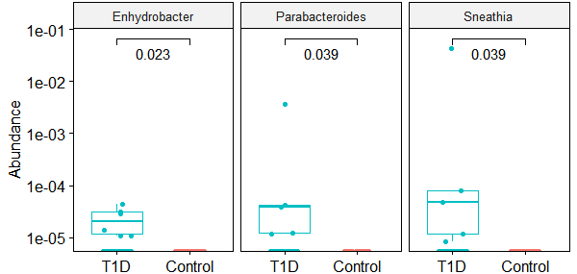
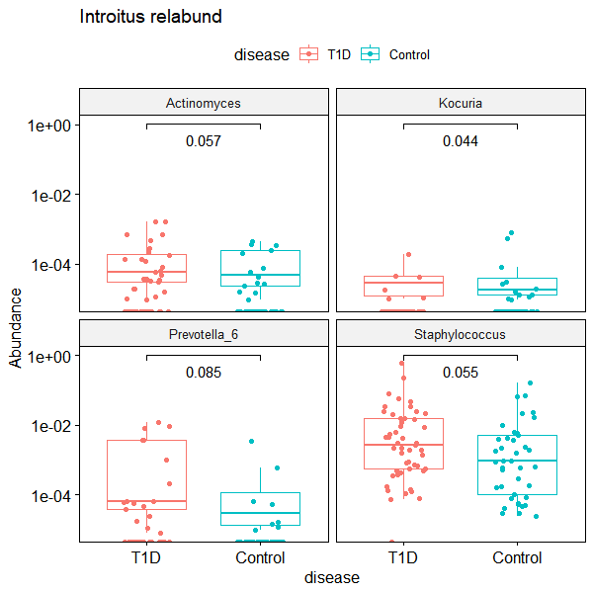
A) Vagina (Posterior Fornix? Vaginal canal, in the middle)
B) Cervix
C) Vaginal Introitus
Figure X. Wilcox test comparisons of differentially expressed genera associated with Type 1 Diabetes in the A) Vaginal canal, B) Cervix, C) Vaginal Introitus, and D) Anus samples

Slide 27
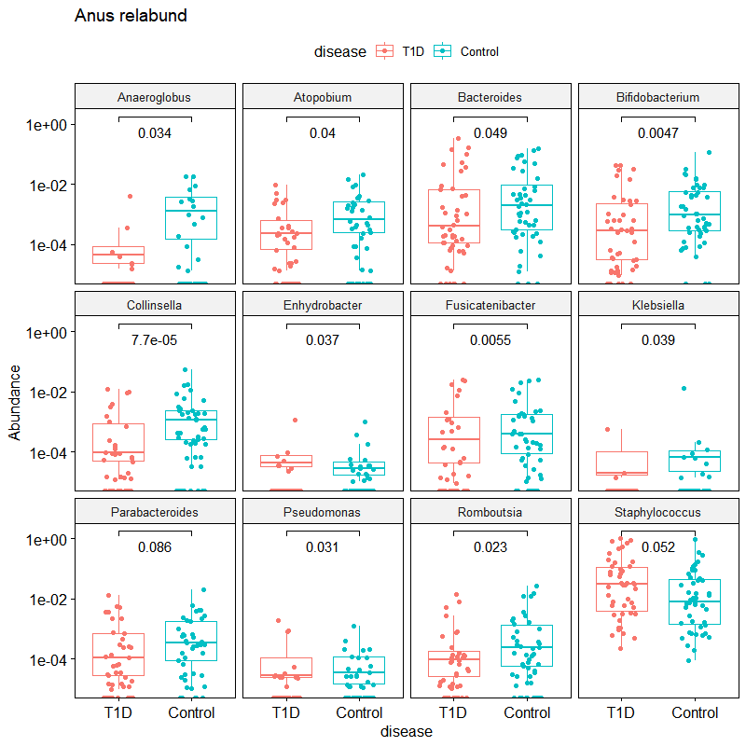
D) Anus
Figure X. Wilcox test comparisons of differentially expressed genera associated with Type 1 Diabetes in the A) Vaginal canal, B) Cervix, C) Vaginal Introitus, and D) Anus samples

Slide 28
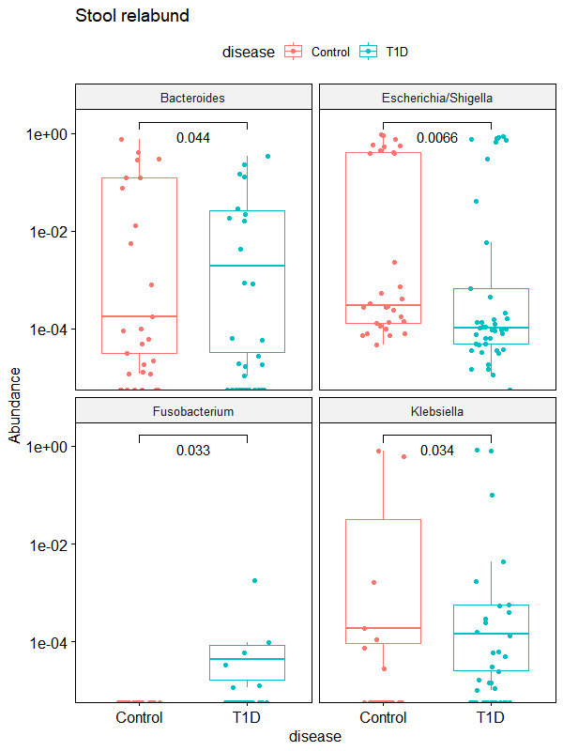
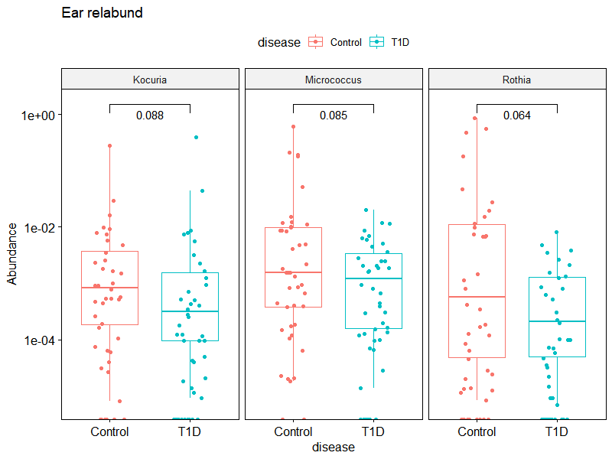
E) Stool smaples
F) Ear swab samples
Figure X. Wilcox test comparisons of differentially expressed genera associated with Type 1 Diabetes in the E) stool samples, and F) ear swab samples in newborns

Slide 29
Influence of GLYCEAMIC CONTROL in the first, second and third (before delivery) pregnancy trimesters in T1D mothers
on HYPOGLYCEMIA in their newborns
In accordance to the recommendations of the Polish Diabetes Association, one of the criteria for good diabetes control during pregnancy is a glycated hemoglobin level ≤ 6.1% (43 mmol/mol);
2-5 blood glucose level [mg/dl] measurements over time, in newborns of T1D mothers only

Slide 30
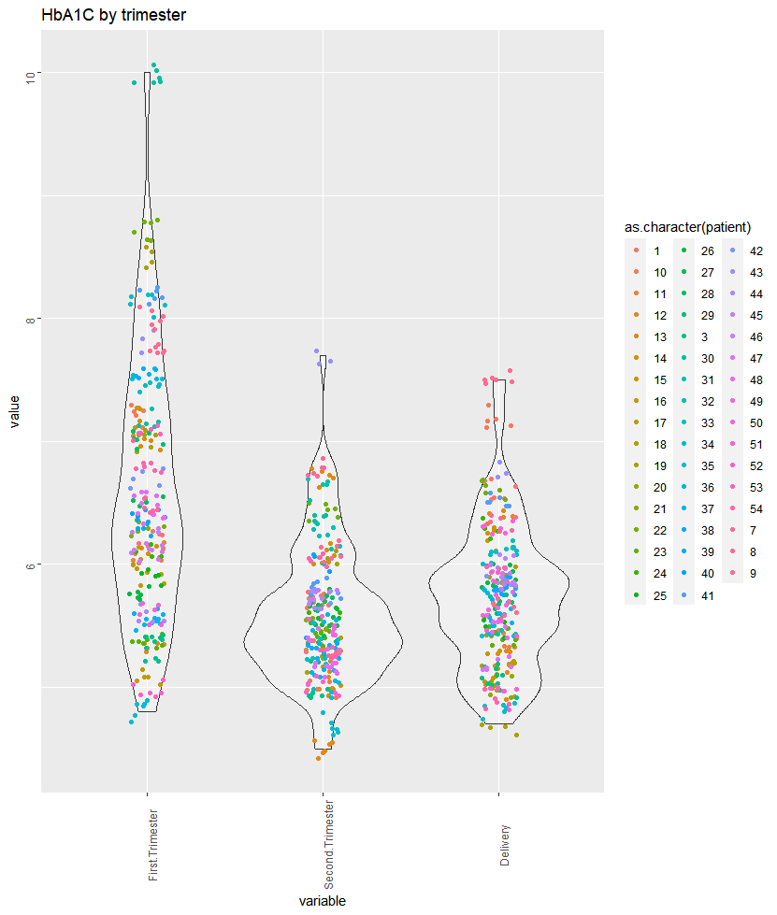
GLYCAEMIC CONTROL
during first, second and third (before delivery) pregnancy trimesters in T1D mothers
Here, differences between first and second trimesters, and first and third trimesters were statistically significant;
Glycaemic control was satisfactory in second and third trimesters
Tukey multiple comparisons of means (95% family-wise confidence level)
Variable diff lwr upr p adj
Second.Trimester-First.Trimester -0.9965909 -1.15613634 -0.8370455 0.0000000
Delivery-First.Trimester -0.8482995 -1.00527833 -0.6913206 0.0000000
Delivery-Second.Trimester 0.1482914 -0.00868742 0.3052703 0.0687493
Notes:
July30, 2020, Figure – modify, remove duplicates

Slide 31
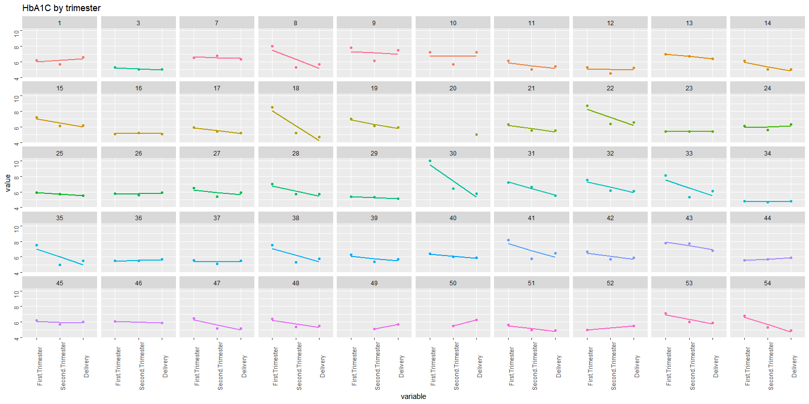
GLYCAEMIC control
during first, second and third (before delivery) pregnancy trimesters in T1D mothers

Slide 32
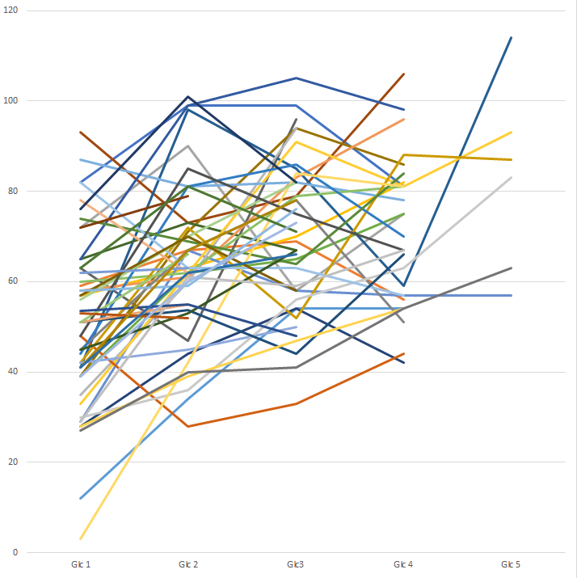
HYPOGLYCEMIA in newborns of T1D mothers_Glucose timepoints analysis
2-5 blood glucose level [mg/dl] measurements over time,
in newborns of T1D mothers only
blood glucose level [mg/dl]

Slide 33
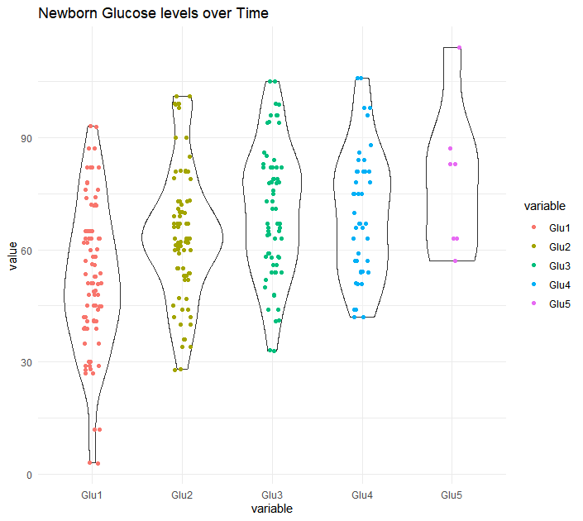
HYPOGLYCEMIA in newborns of T1D mothers_Glucose timepoints analysis
Notes:
30 July 2020

Slide 34
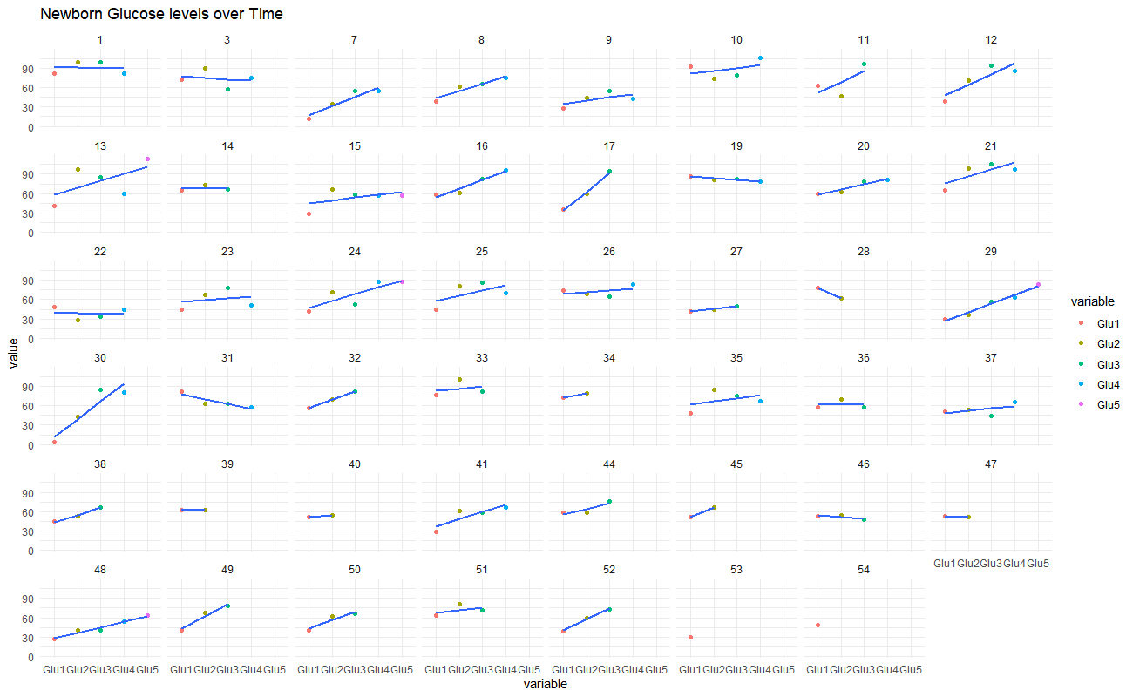
HYPOGLYCEMIA in newborns of T1D mothers_Glucose timepoints analysis
Notes:
30 July 2020

Slide 35
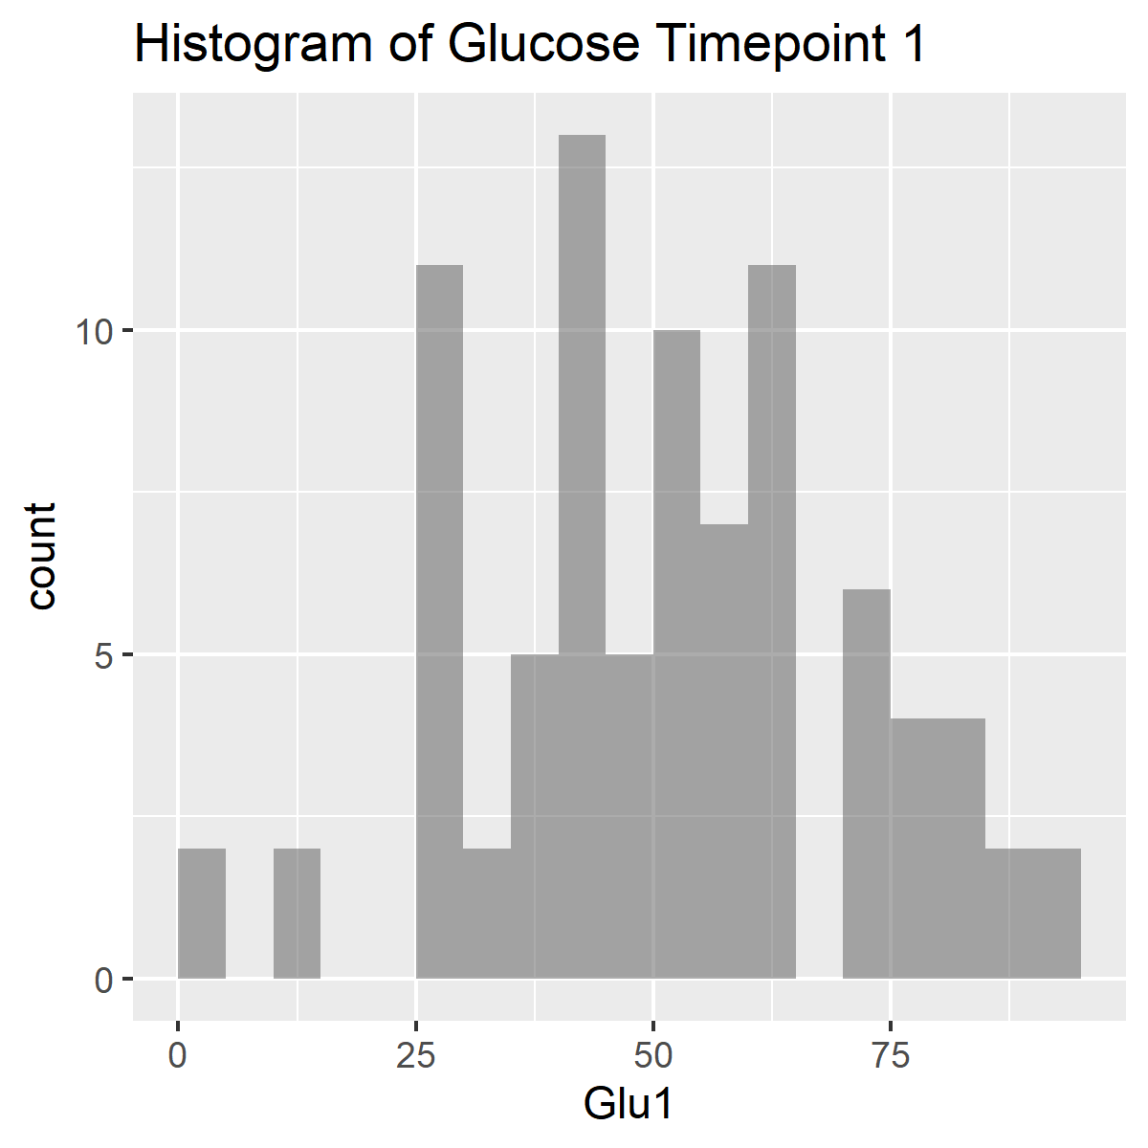
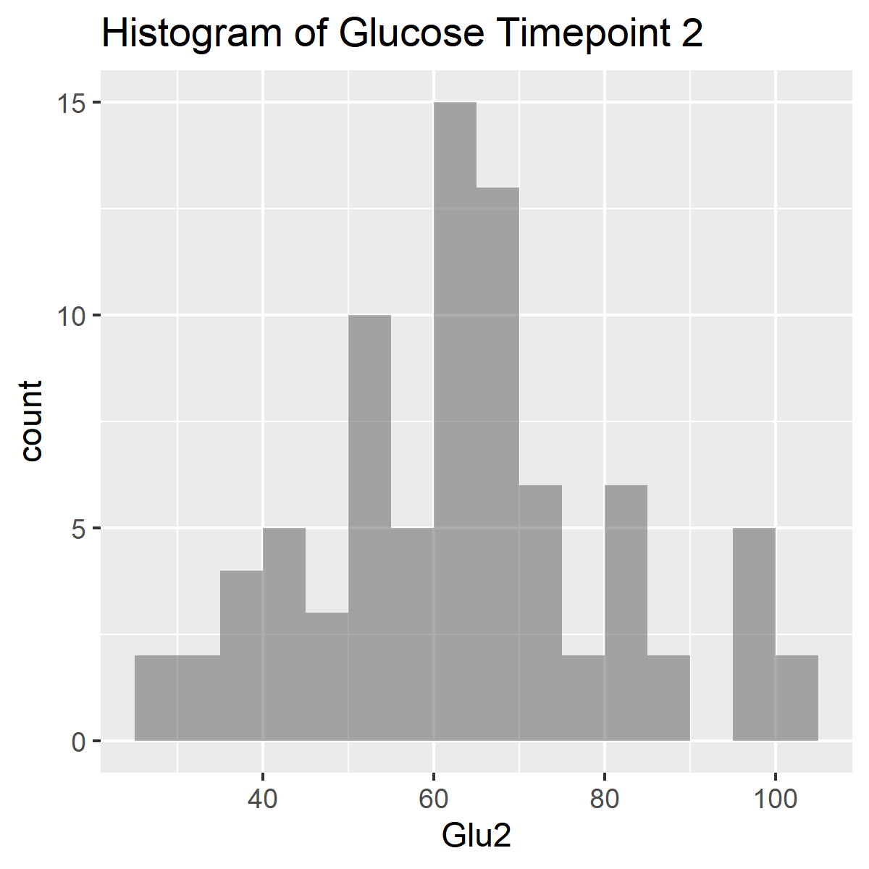
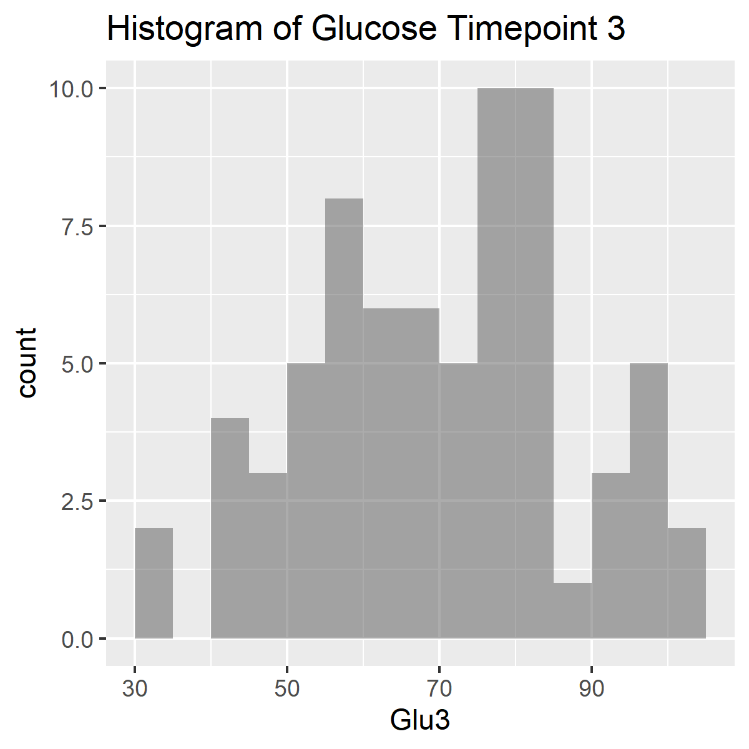
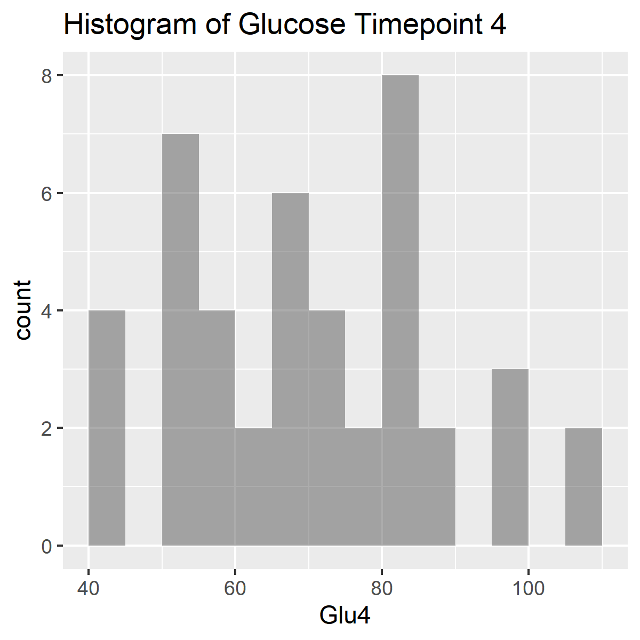
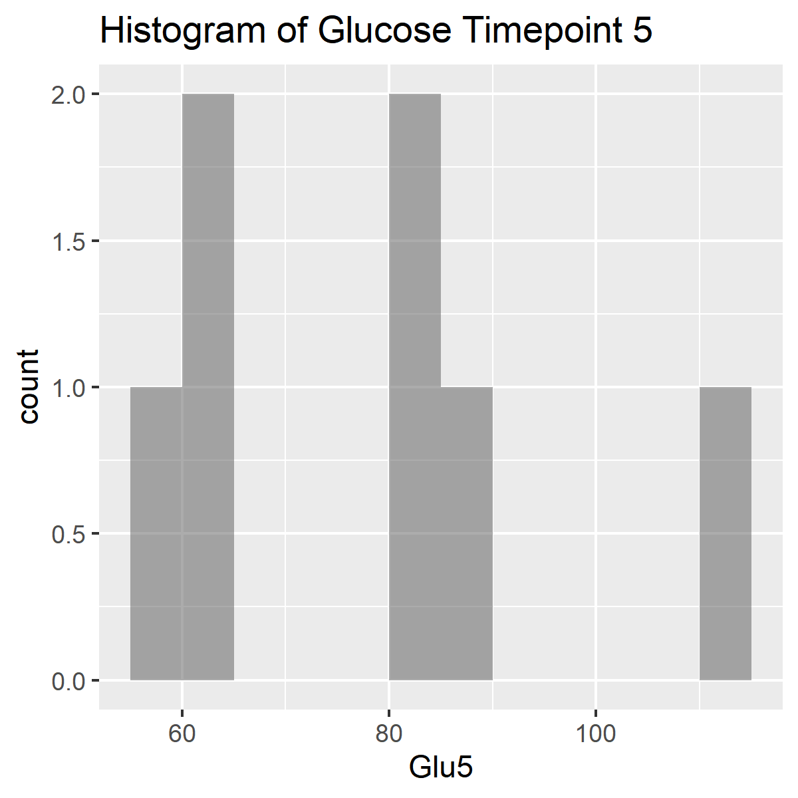
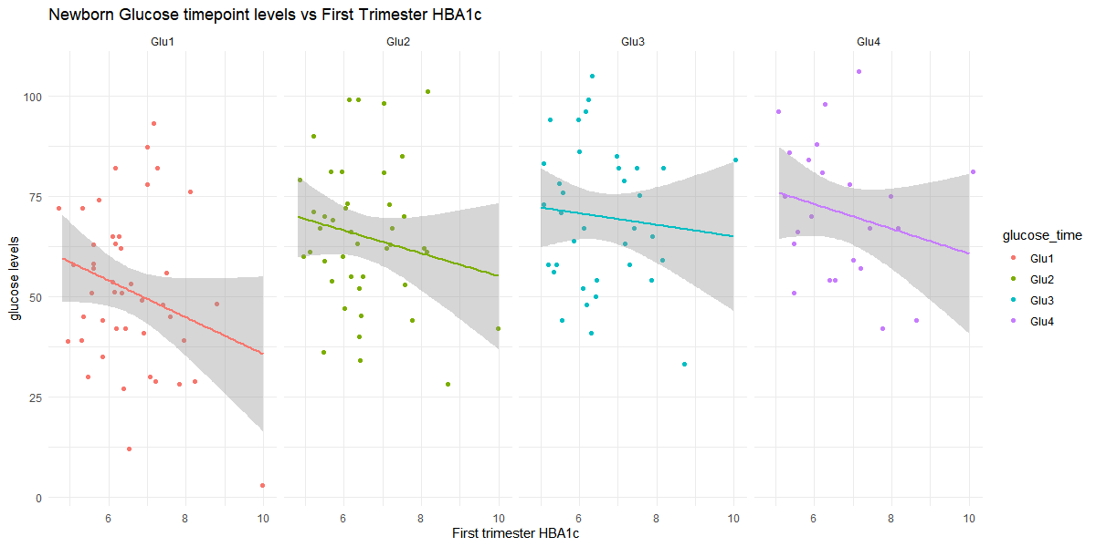
Notes:
30 July 2020

Slide 36
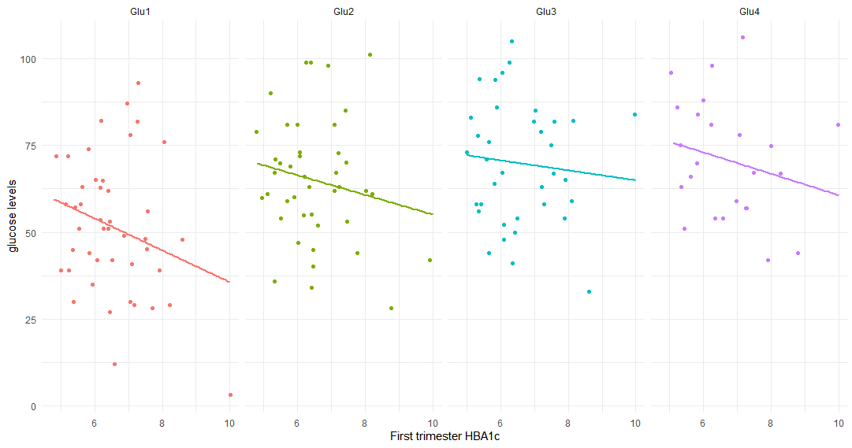
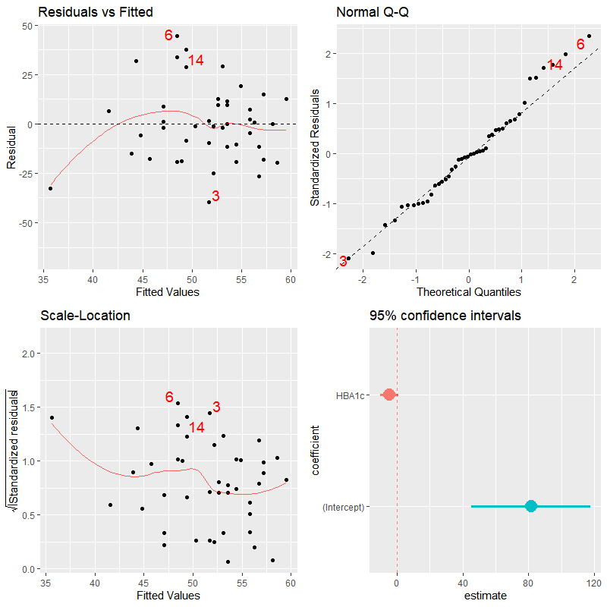
Pearson's product-moment correlation between 1st trimester HBA1c and glucose timepoint 1
data: HBA1c and glu1
t = -1.6874, df = 42, p-value = 0.09894
alternative hypothesis:
true correlation is not equal to 0
95 percent confidence interval:
-0.51065126 0.04854136
sample estimates:
Correlation : -0.2519701
Linear regression model for 1st trimester HBA1c and the interaction effects of glucose timepoints 1-4.
Coefficients:
Estimate Std. Error t value Pr(>|t|)
(Intercept) -2.990e+00 7.710e+00 -0.388 0.7011
glu1 2.345e-01 1.541e-01 1.521 0.1394
glu2 1.431e-01 1.419e-01 1.009 0.3218
glu3 1.771e-01 1.076e-01 1.646 0.1109
glu1:glu2 -3.305e-03 2.521e-03 -1.311 0.2005
glu1:glu3 -4.041e-03 2.049e-03 -1.972 0.0586 .
glu2:glu3 -2.551e-03 1.880e-03 -1.357 0.1856
glu1:glu2:glu3 5.500e-05 3.213e-05 1.712 0.0980 .
Dispersion parameter for gaussian family taken to be
1.263929)
Null deviance: 46.192 on 35 degrees of freedom
Residual deviance: 35.390 on 28 degrees of freedom
(8 observations deleted due to missingness)
AIC: 119.55
Number of Fisher Scoring iterations: 2
Notes:
30 July 2020

Slide 37
Notes:
30 July 2020

Slide 38
Clinicians involved:
Prof. Ewa Wender-Ozegowska, MD, PhD, and Dr. Pawel Gutaj, MD, PhD, gynaecologists
Prof. Tomasz Szczapa, MD, PhD, neonatologist
Poznan University of Medical Sciences, Poznan, Poland
Researchers (Microbiome study only):
Kasia Jaskiewicz, MSc, PhD Student
Institute of Human Genetics, PAS, Poznan, Poland
Dorota Kaminska, PhD
Poznan University of Medical Sciences, Poznan, Poland
Małgorzata Rydzanicz, PhD
Medical University of Warsaw, Warsaw, Poland

Slide 39
Thank you

Slide 40
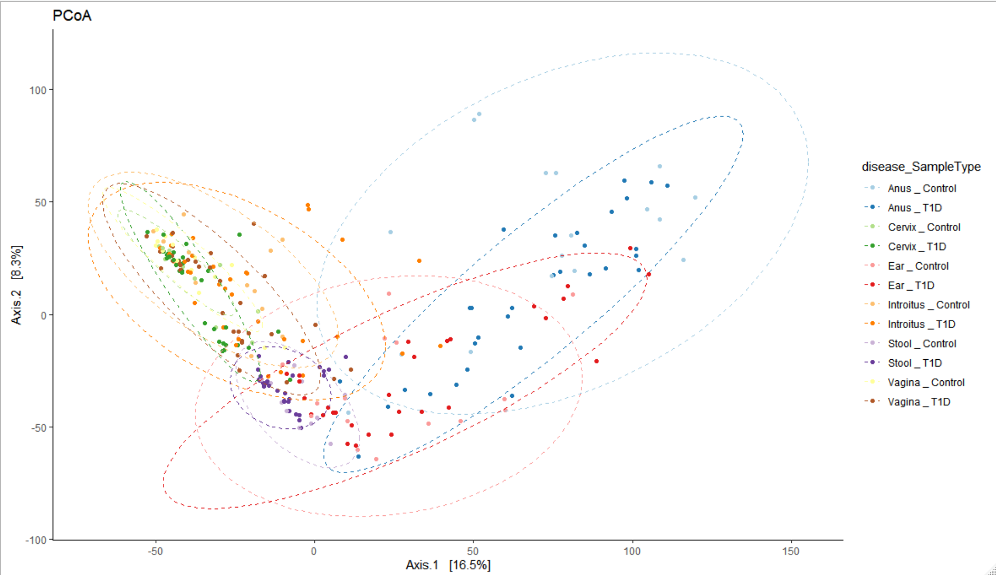
Dr. Aagaard: Make sure you don’t plot mom and baby on same plot
Figure X. Beta Diversity PCoA plots comparing the Type 1 Diabetes and control samples across all microbiome sample types.
Notes:
Dr. Aagaard: Make sure you don’t plot mom and baby on same plot

Slide 41
Data Summary Tables
Disease(n) | Delivery | Abx | No_Abx
Control | Csection | 14 | 6
 | Vaginal | 6 | 15
T1D | Csection | 27 | 4
 | Vaginal | 5 | 12
Disease(%) | Delivery | Abx | No_Abx
Control | Csection | 34.15 | 54.55
 | Vaginal | 65.85 | 45.45
T1D | Csection | 60.00 | 55.56
 | Vaginal | 40.00 | 44.44
 | With antibiotics |  |  | Without antibiotics
Disease (n) | Csection | Vaginal |  | Csection | Vaginal
Control | 14 | 6 |  | 6 | 15
T1D | 27 | 5 |  | 4 | 12
 | With antibiotics |  |  | Without antibiotics
Disease (%) | Csection | Vaginal |  | Csection | Vaginal
Control | 34.14634 | 54.54545 |  | 60 | 55.5556
T1D | 65.85366 | 45.45455 |  | 40 | 44.4444
Table X. Type 1 Diabetes Dataset Counts (Percentages)

Slide 42
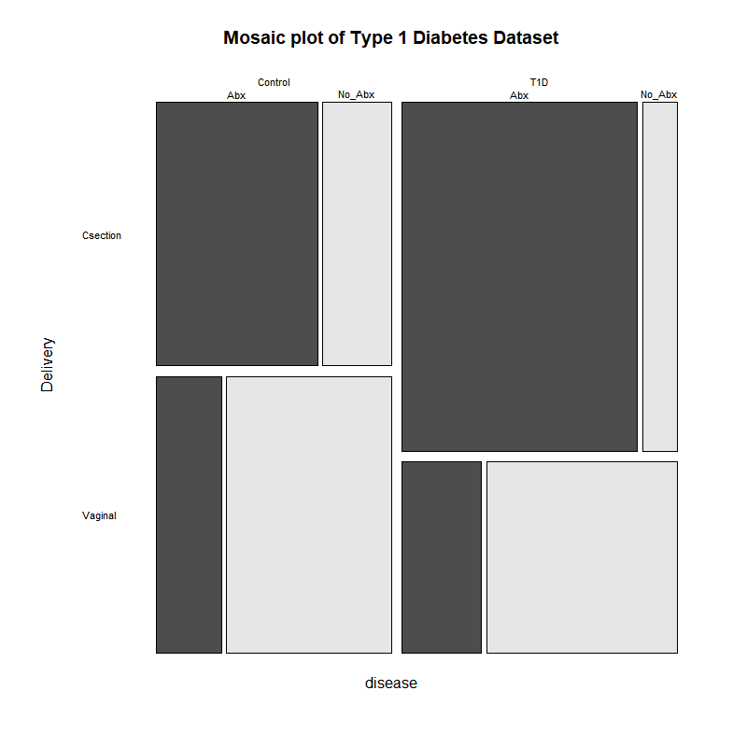
diseasexdelivery
Fisher's Exact Test for Count Data
p-value = 0.1306
95 percent CI: 0.1848469 1.2207114
OR=0.480279
diseaseXabs = deliveryXabs
Fisher's Exact Test for Count Data
p-value = 1.285e-06
95 percent CI: 3.410531 30.438495
OR=9.740854
disease_VS_Delivery+Antibiotics_2
Mantel-Haenszel chi-squared test with continuity correction
Mantel-Haenszel X-squared = 0.22697, df = 1,
p-value = 0.6338
95 CI: 0.2607369 1.8524035
common OR=0.6949748
August 4,2020

Slide 43
Beta Diversity Bray Curtis adonis permutational ANOVA for distinctly significant variables
Table X. Beta Diversity Bray Curtis adonis permanova of VST transformed counts versus week of delivery stratified by sample type.
Table X. Beta Diversity Bray Curtis adonis permanova of VST transformed counts versus Delivery stratified by sample type
 | Df | SumsOfSqs | MeanSqs | F.Model | R2 | Pr(>F)
Disease | 1 | 22417 | 22417 | 2.418 | 0.00731 | 0.0001 | ***
SampleType | 5 | 625668 | 125134 | 13.497 | 0.20389 | 0.0068 | **
Week of Deliv | 1 | 18741 | 18741 | 2.0215 | 0.00611 | 0.0005 | ***
Disease:SampleType | 5 | 51416 | 10283 | 1.1091 | 0.01675 | 0.1774
Disease:Week of Deliv | 1 | 18744 | 18744 | 2.0217 | 0.00611 | 0.0007 | ***
SampleType:Week of Deliv | 5 | 47951 | 9590 | 1.0344 | 0.01563 | 0.3848
Disease:SampleType:Week of Deliv | 5 | 40115 | 8023 | 0.8654 | 0.01307 | 0.903
Residuals | 242 | 2243635 | 9271 | 0.73114
Total | 265 | 3068686 | 1
---
Signif. codes: 0 ‘***’ 0.001 ‘**’ 0.01 ‘*’ 0.05 ‘.’ 0.1 ‘ ’ 1
 | Df | SumsOfSqs | MeanSqs | F.Model | R2 | Pr(>F)
disease | 1 | 15282 | 15282 | 1.6807 | 0.01828 | 0.0231 | *
SampleType | 1 | 98637 | 98637 | 10.8478 | 0.11796 | 0.0465 | *
Delivery | 1 | 16399 | 16399 | 1.8036 | 0.01961 | 0.004 | **
disease:SampleType | 1 | 10884 | 10884 | 1.197 | 0.01302 | 0.1296
disease:Delivery | 1 | 7380 | 7380 | 0.8116 | 0.00883 | 0.8889
SampleType:Delivery | 1 | 15319 | 15319 | 1.6848 | 0.01832 | 0.0075 | **
disease:SampleType:Delivery | 1 | 8538 | 8538 | 0.939 | 0.01021 | 0.5319
Residuals | 73 | 663773 | 9093 | 0.79379
Total | 80 | 836212 | 1
---
Signif. codes: 0 ‘***’ 0.001 ‘**’ 0.01 ‘*’ 0.05 ‘.’ 0.1 ‘ ’ 1
Table X. Beta Diversity Bray Curtis adonis permanova of VST transformed counts versus percent energy derived from protein stratified by sample type
Table X. Beta Diversity Bray Curtis adonis permanova of VST transformed counts versus Antibiotics stratified by sample type
 | Df | SumsOfSqs | MeanSqs | F.Model | R2 | Pr(>F)
disease | 1 | 22417 | 22417 | 2.4031 | 0.00731 | 0.0001 | ***
SampleType | 5 | 625668 | 125134 | 13.4139 | 0.20389 | 0.0871 | .
% energy protein | 1 | 15960 | 15960 | 1.7108 | 0.0052 | 0.0036 | **
disease:SampleType | 5 | 51445 | 10289 | 1.1029 | 0.01676 | 0.19
disease:% energy protein | 1 | 17635 | 17635 | 1.8904 | 0.00575 | 0.002 | **
SampleType:% energy protein | 5 | 37991 | 7598 | 0.8145 | 0.01238 | 0.9741
disease:SampleType:% energy protein | 5 | 40032 | 8006 | 0.8583 | 0.01305 | 0.9049
Residuals | 242 | 2257538 | 9329 | 0.73567
Total | 265 | 3068686 | 1
---
Signif. codes: 0 ‘***’ 0.001 ‘**’ 0.01 ‘*’ 0.05 ‘.’ 0.1 ‘ ’ 1
 | Df | SumsOfSqs | MeanSqs | F.Model | R2 | Pr(>F)
disease | 1 | 22417 | 22417 | 2.4139 | 0.00731 | 0.0001 | ***
SampleType | 5 | 625668 | 125134 | 13.4746 | 0.20389 | 0.0139 | *
Antibiotics_2 | 1 | 19292 | 19292 | 2.0774 | 0.00629 | 0.0002 | ***
disease:SampleType | 5 | 51411 | 10282 | 1.1072 | 0.01675 | 0.1846
disease:Antibiotics_2 | 1 | 19632 | 19632 | 2.114 | 0.0064 | 0.0001 | ***
SampleType:Antibiotics_2 | 5 | 41891 | 8378 | 0.9022 | 0.01365 | 0.8489
disease:SampleType:Antibiotics_2 | 5 | 41005 | 8201 | 0.8831 | 0.01336 | 0.8891
Residuals | 242 | 2247371 | 9287 | 0.73236
Total | 265 | 3068686 | 1
---
Signif. codes: 0 ‘***’ 0.001 ‘**’ 0.01 ‘*’ 0.05 ‘.’ 0.1 ‘ ’ 1
NOTE: I had to subset the samples in this analysis because not all of the samples had the variables (ie: protein energy % data)
Notes:
Deleted: Removal of the "SampleType" column in the adonis because we are stratifying against it. August 13, MJ

Slide 44
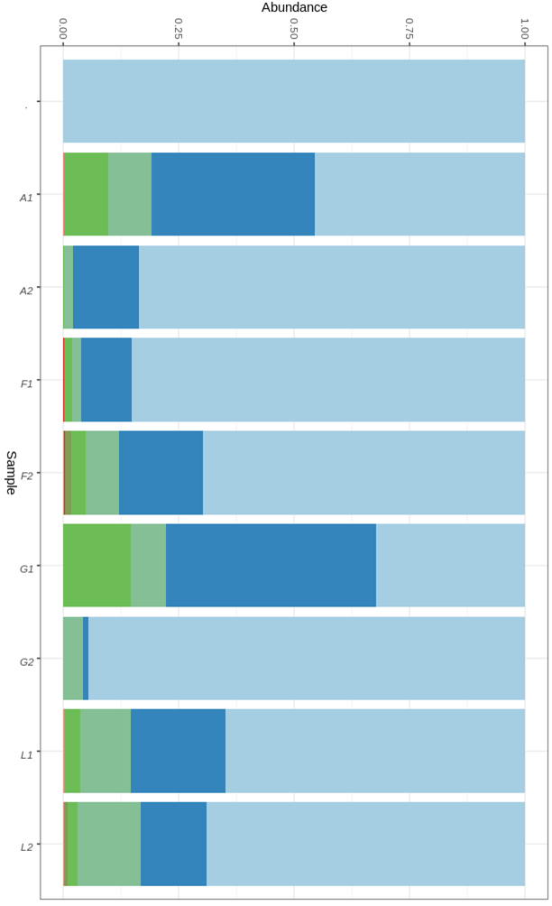
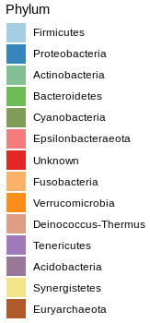
Delivery mode & relative microbiota abundance in materials derived from Newborns
No. of Infants’
materials
C-section, n=88 vs. Vaginal, n=72, ∑ 160
n
vaginal, stool, 17
c-section, stool, 26
vaginal, ear, 17
c-section, ear, 27
vaginal, stool, 17
c-section, stool, 13
vaginal, ear, 21
c-section, ear, 22
∑ 160
T1D
Controls
Notes:
C-section, n=88 vs. Vaginal, n=72, ∑ 160

Slide 45
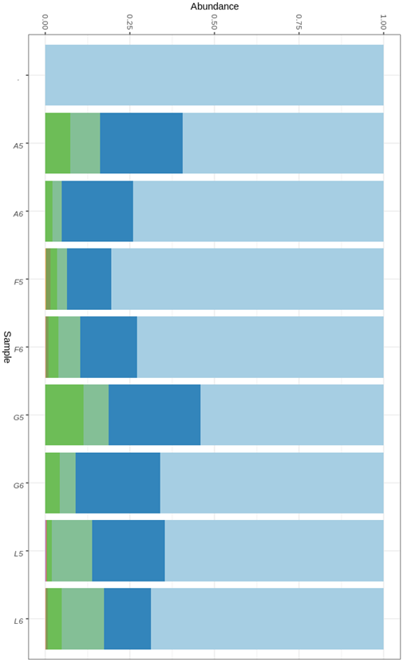
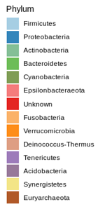
Antibiotic prophylaxis (Abx) & microbiota relative abundance in materials derived from Newborns
No. of Newborns’
materials
n
no Abx, stool 15
Abx, stool 28
no Abx, ear 16
Abx, ear 28
no Abx, stool 17
Abx, stool 13
no Abx, ear 20
Abx, ear 23
∑ 160
T1D
Controls

Slide 46
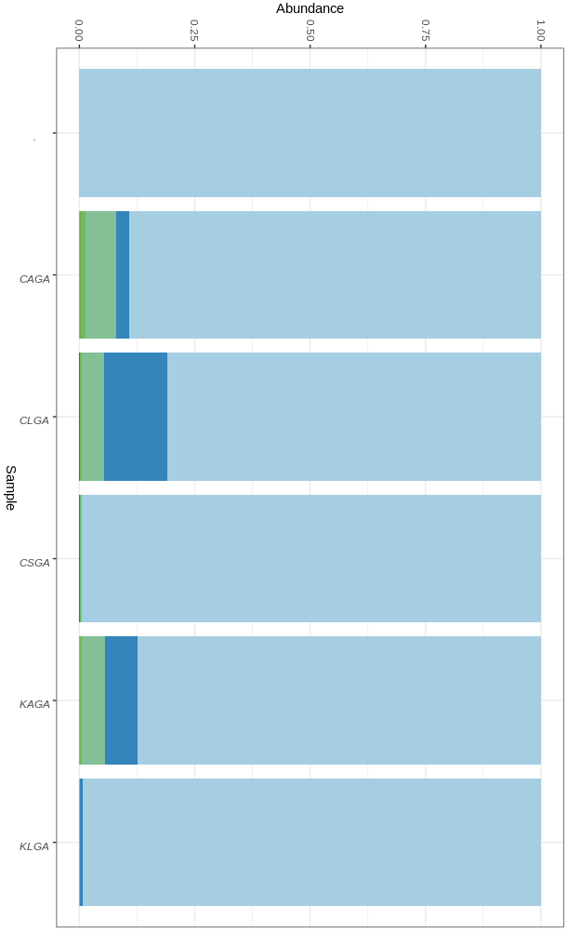
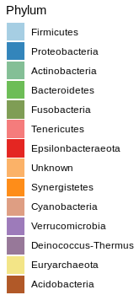
Analyzes in progress:
Mothers’ microbiota (relative abundance) derived from Introitus/Vagina/Cervix_all materials together_who have delivered Newborns SGA/AGA/LGA
Newborns_AGA 32
Newborns_LGA 14
Newborns_SGA 4
Newborns_AGA 38
Newborns_LGA 3
∑ 91
Mothers_T1D
Mothers_Controls

Slide 47
Supplemental
Jochum, Michael D. 11 August 2020

Slide 48
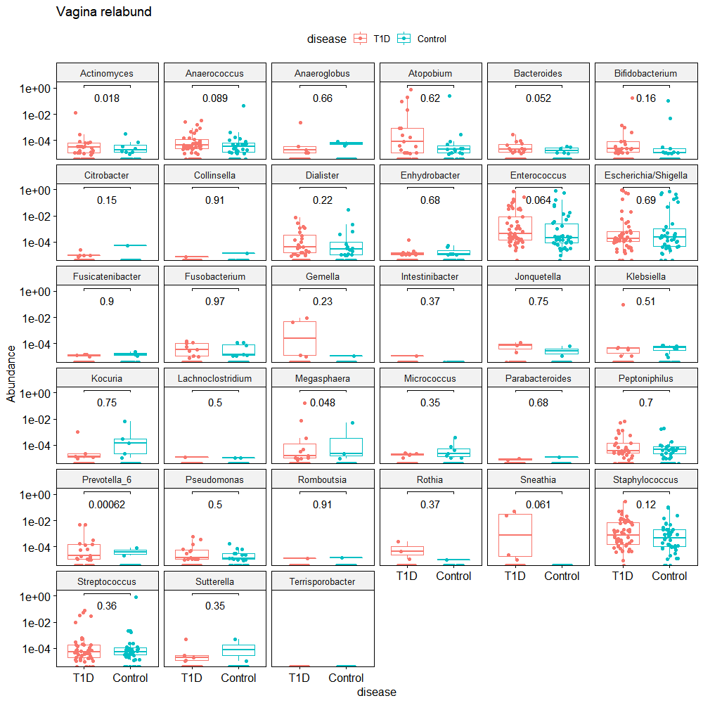

Slide 49
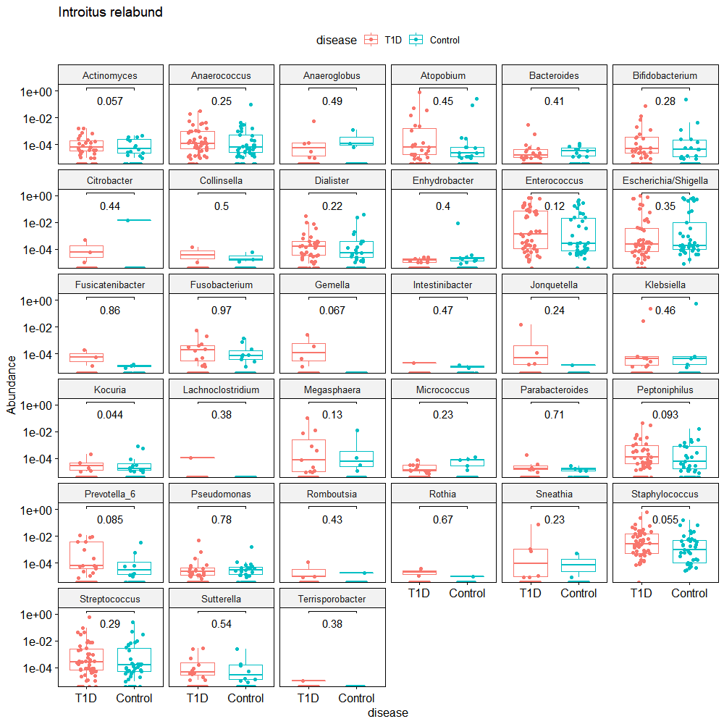

Slide 50



Slide 51


Slide 52


Slide 53


