Slide 1
DESEQ2 identified Taxa associated with Type 1 Diabetes
Genus | log2FoldChange | lfcSE | stat | pvalue | padj | Kingdom | Phylum | Class | Order | Family
Aerococcus | -18.113 | 3.867 | -4.683 | <0.0001 | <0.0001 | Bacteria | Firmicutes | Bacilli | Lactobacillales | Aerococcaceae
Anaerococcus | 2.567 | 0.900 | 2.851 | 0.004 | 0.049 | Bacteria | Firmicutes | Clostridia | Clostridiales | Family_XI
Staphylococcus | 2.932 | 0.827 | 3.546 | <0.0001 | 0.010 | Bacteria | Firmicutes | Bacilli | Bacillales | Staphylococcaceae
Bifidobacterium | 3.497 | 1.224 | 2.856 | 0.004 | 0.049 | Bacteria | Actinobacteria | Actinobacteria | Bifidobacteriales | Bifidobacteriaceae
Campylobacter | 4.495 | 1.305 | 3.444 | 0.001 | 0.010 | Bacteria | Epsilonbacteraeota | Campylobacteria | Campylobacterales | Campylobacteraceae
Atopobium | 4.630 | 1.342 | 3.449 | 0.001 | 0.010 | Bacteria | Actinobacteria | Coriobacteriia | Coriobacteriales | Atopobiaceae
Enterococcus | 5.462 | 0.923 | 5.921 | <0.0001 | <0.0001 | Bacteria | Firmicutes | Bacilli | Lactobacillales | Enterococcaceae
Mobiluncus | 5.523 | 1.918 | 2.880 | 0.004 | 0.049 | Bacteria | Actinobacteria | Actinobacteria | Actinomycetales | Actinomycetaceae
Fusobacterium | 8.176 | 2.304 | 3.548 | <0.0001 | 0.010 | Bacteria | Fusobacteria | Fusobacteriia | Fusobacteriales | Fusobacteriaceae
Mother
Genus | log2FoldChange | lfcSE | stat | pvalue | padj | Phylum | Class | Order | Family
Erysipelatoclostridium | -24.676 | 3.283 | -7.516 | <0.0001 | <0.0001 | Firmicutes | Erysipelotrichia | Erysipelotrichales | Erysipelotrichaceae
Methylobacterium | 2.825 | 0.726 | 3.890 | <0.0001 | 0.004 | Proteobacteria | Alphaproteobacteria | Rhizobiales | Beijerinckiaceae
Sphingomonas | 3.083 | 0.662 | 4.654 | <0.0001 | <0.0001 | Proteobacteria | Alphaproteobacteria | Sphingomonadales | Sphingomonadaceae
Micrococcus | 3.463 | 0.662 | 5.233 | <0.0001 | <0.0001 | Actinobacteria | Actinobacteria | Micrococcales | Micrococcaceae
Ruminococcaceae | 3.620 | 0.968 | 3.740 | <0.0001 | 0.006 | Firmicutes | Clostridia | Clostridiales | Ruminococcaceae
Paracoccus | 4.410 | 0.792 | 5.567 | <0.0001 | <0.0001 | Proteobacteria | Alphaproteobacteria | Rhodobacterales | Rhodobacteraceae
Collinsella | 4.709 | 1.124 | 4.191 | <0.0001 | <0.001 | Actinobacteria | Coriobacteriia | Coriobacteriales | Coriobacteriaceae
Infant

Slide 2
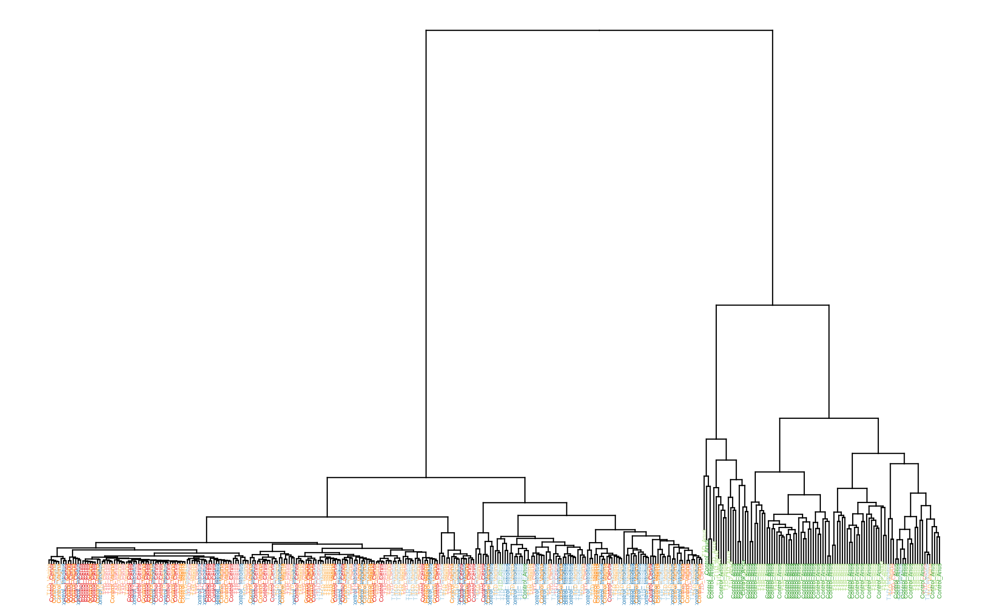
Maternal sample VST clustering by disease

Slide 3
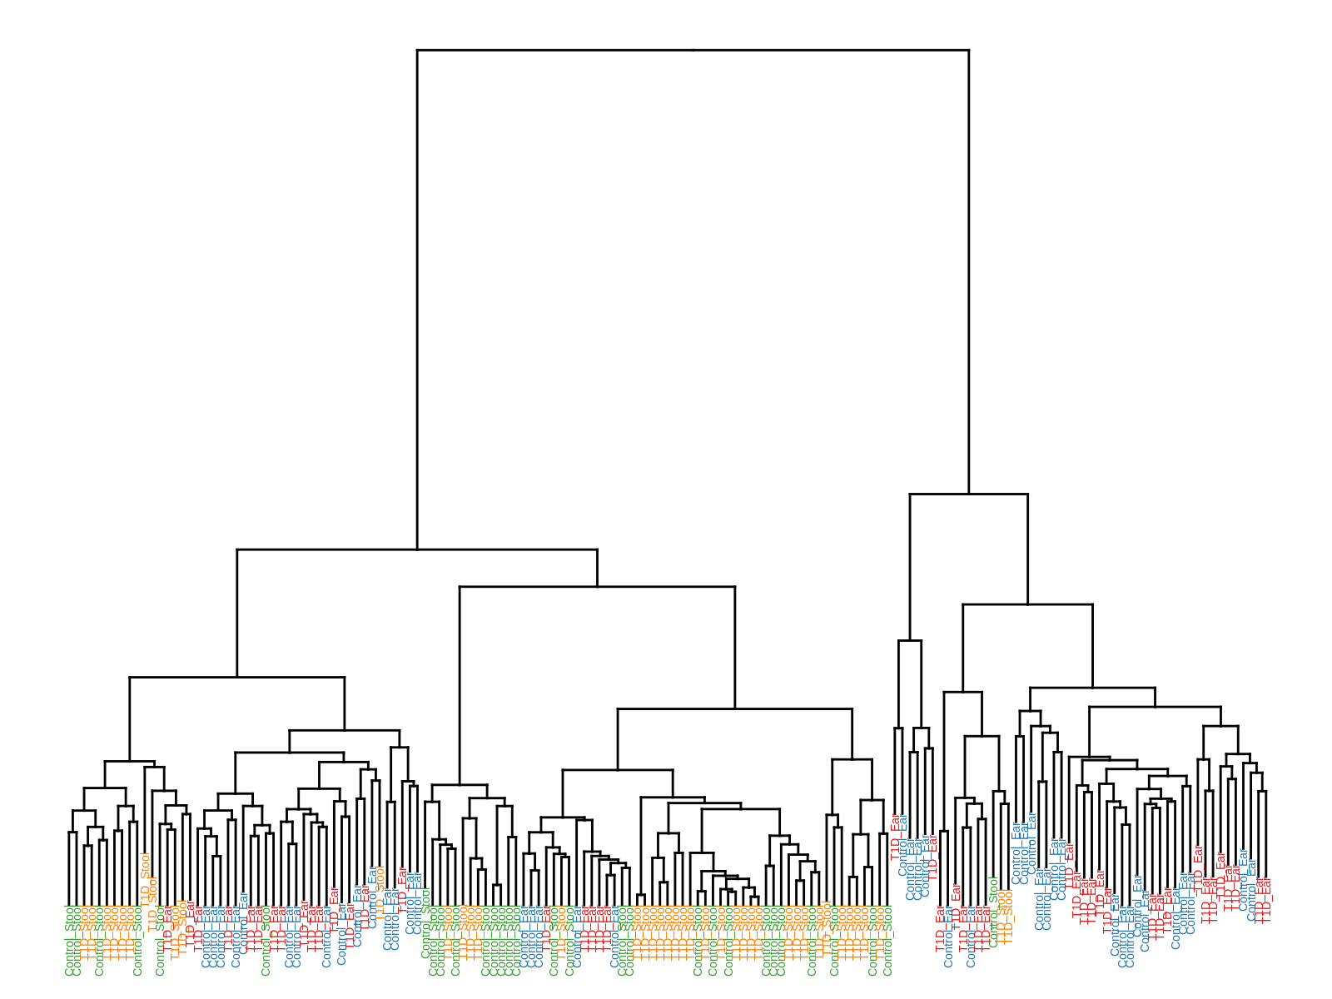
Infant sample VST clustering

Slide 4
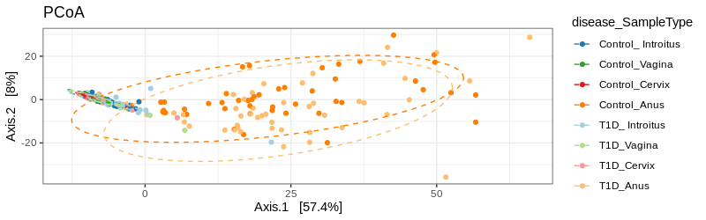
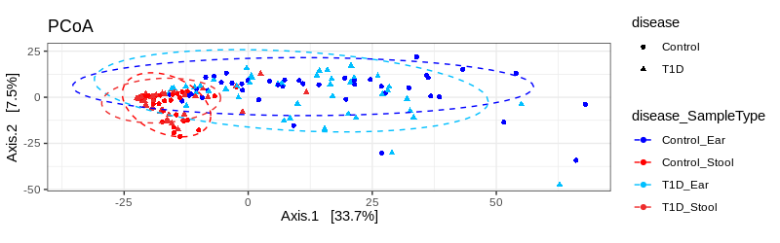
VST clustering
Mother
Infant

