Slide 1
24.09.2020 all samples together_ PATHWAY CLASSES
Feature | Mean_T1D_Control_Diff | Wilcoxon_P | BH_FDR_Adjust_P
Metabolism_Metabolism of cofactors and vitamins_Pantothenate and CoA biosynthesis | -0.00013 | 0.01099 | 0.40365
Metabolism_Metabolism of cofactors and vitamins_Folate biosynthesis | -0.00069 | 0.01447 | 0.40365
Unclassified_Metabolism_Carbohydrate metabolism | -0.00014 | 0.02315 | 0.40365
Unclassified_Poorly characterized_General function prediction only | -0.00055 | 0.0408 | 0.40365
Metabolism_Carbohydrate metabolism_Starch and sucrose metabolism | 0.00081 | 0.04772 | 0.40365
Cellular Processes_Cellular community - prokaryotes_Quorum sensing | 0.00021 | 0.05144 | 0.40365
Genetic Information Processing_Translation_Ribosome biogenesis | 0.00058 | 0.05248 | 0.40365
Metabolism_Carbohydrate metabolism_Propanoate metabolism | -0.00018 | 0.05429 | 0.40365
Metabolism_Amino acid metabolism_Arginine and proline metabolism | -0.00008 | 0.05479 | 0.40365
Metabolism_Metabolism of cofactors and vitamins_Ubiquinone and other terpenoid-quinone biosynthesis | -0.00025 | 0.05803 | 0.40365
Metabolism_Carbohydrate metabolism_Glycolysis / Gluconeogenesis | 0.00017 | 0.0592 | 0.40365
Metabolism_Amino acid metabolism_Lysine biosynthesis | 0.00016 | 0.06196 | 0.40365
Metabolism_Carbohydrate metabolism_Butanoate metabolism | -0.00006 | 0.06731 | 0.40365
Environmental Information Processing_Signal transduction_Two-component system | -0.00039 | 0.06809 | 0.40365
Metabolism_Energy metabolism_Sulfur metabolism | -0.00021 | 0.07569 | 0.41882
Cellular Processes_Cell motility_Flagellar assembly | -0.00009 | 0.09801 | 0.45472
Metabolism_Metabolism of terpenoids and polyketides_Terpenoid backbone biosynthesis | 0.00013 | 0.10697 | 0.45472
Metabolism_Metabolism of cofactors and vitamins_Porphyrin and chlorophyll metabolism | -0.00022 | 0.11045 | 0.45472

Slide 2
24.09.2020 all samples together_pathways
pathway | description | Control: mean rel. freq. (%) | Control: std. dev. (%) | T1D: mean rel. freq. (%) | T1D: std. dev. (%) | p-values | p-values (corrected)
LACTOSECAT-PWY | lactose and galactose degradation I | 0.273505054244 | 0.597151914587 | 0.149807988392 | 0.270357709941 | 0.00308439685067 | 0.00308439685067
PWY-4361 | S-methyl-5-thio-&alpha;-D-ribose 1-phosphate degradation | 0.000516383122263 | 0.00235468763404 | 0.000172101075396 | 0.00148092870861 | 0.0494785052389 | 0.0494785052389
PWY-5676 | acetyl-CoA fermentation to butanoate II | 0.0159452556718 | 0.0376001208892 | 0.0100241293925 | 0.0228497112618 | 0.0329342729837 | 0.0329342729837
PWY-6147 | 6-hydroxymethyl-dihydropterin diphosphate biosynthesis I | 0.204646830532 | 0.488450367966 | 0.110763201586 | 0.182850941683 | 0.00489292752235 | 0.00489292752235
PWY-7332 | superpathway of UDP-N-acetylglucosamine-derived O-antigen building blocks biosynthesis | 0.00849751719838 | 0.0263047712707 | 0.00404640794798 | 0.0147733953855 | 0.0197146720946 | 0.0197146720946
PWY-7431 | aromatic biogenic amine degradation (bacteria) | 0.00348793657654 | 0.0114990906563 | 0.00168824547496 | 0.00595826123665 | 0.0283424524219 | 0.0283424524219
Carbohydrate Degradation
Nucleoside and Nucleotide Degradation
To L-methionine
Generation of Precursor Metabolites and Energy
Folate biosynthesis
Carbohydrate biosynthesis
Amine and Polyamine Degradation

Slide 3
pathway | description | Control: mean rel. freq. (%) | Control: std. dev. (%)
LACTOSECAT-PWY | lactose and galactose degradation I | 0.273505054244 | 0.597151914587
PWY-4361 | S-methyl-5-thio-&alpha;-D-ribose 1-phosphate degradation | 0.000516383122263 | 0.00235468763404
PWY-5676 | acetyl-CoA fermentation to butanoate II | 0.0159452556718 | 0.0376001208892
PWY-6147 | 6-hydroxymethyl-dihydropterin diphosphate biosynthesis I | 0.204646830532 | 0.488450367966
PWY-7332 | superpathway of UDP-N-acetylglucosamine-derived O-antigen building blocks biosynthesis | 0.00849751719838 | 0.0263047712707
PWY-7431 | aromatic biogenic amine degradation (bacteria) | 0.00348793657654 | 0.0114990906563
Taking together all biological materials we observe that all pathways are more represented in the controls (higher proportion of sequences). After separation of biological samples types differences are visible in both directions.

Slide 4
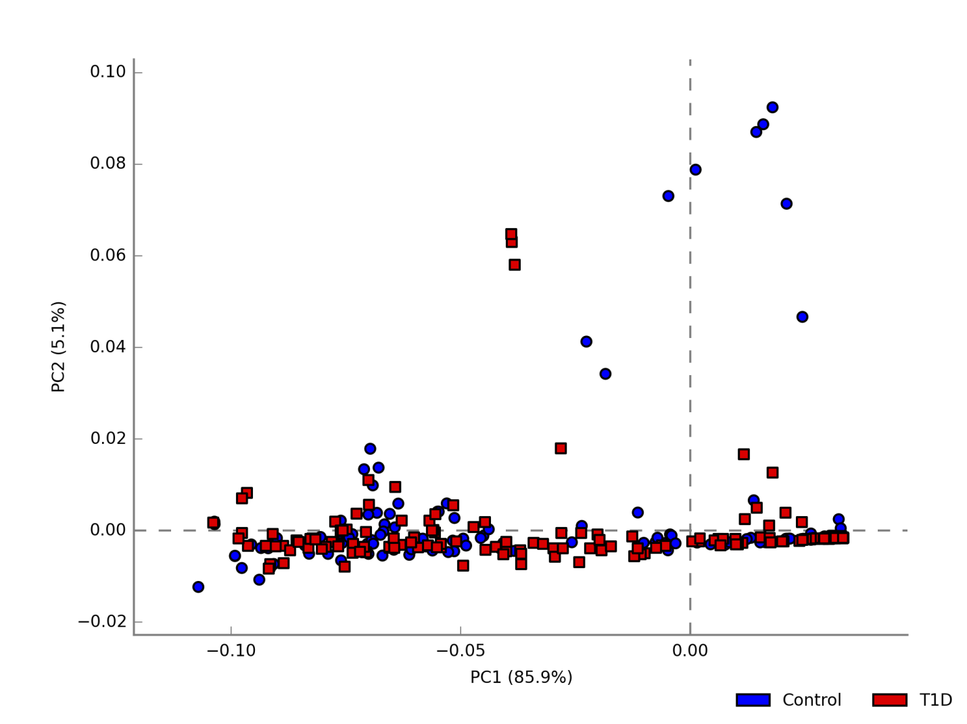

Slide 5
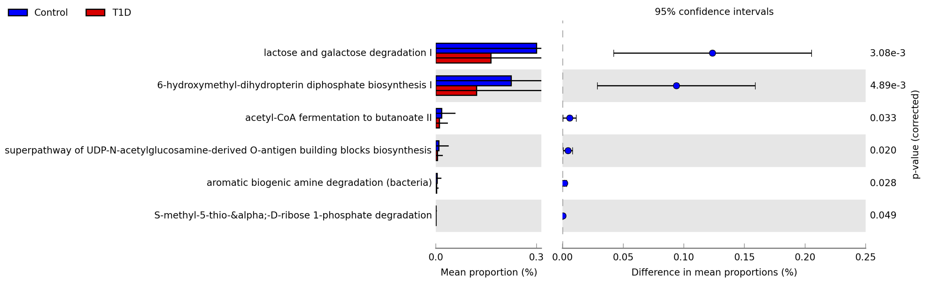

Slide 6
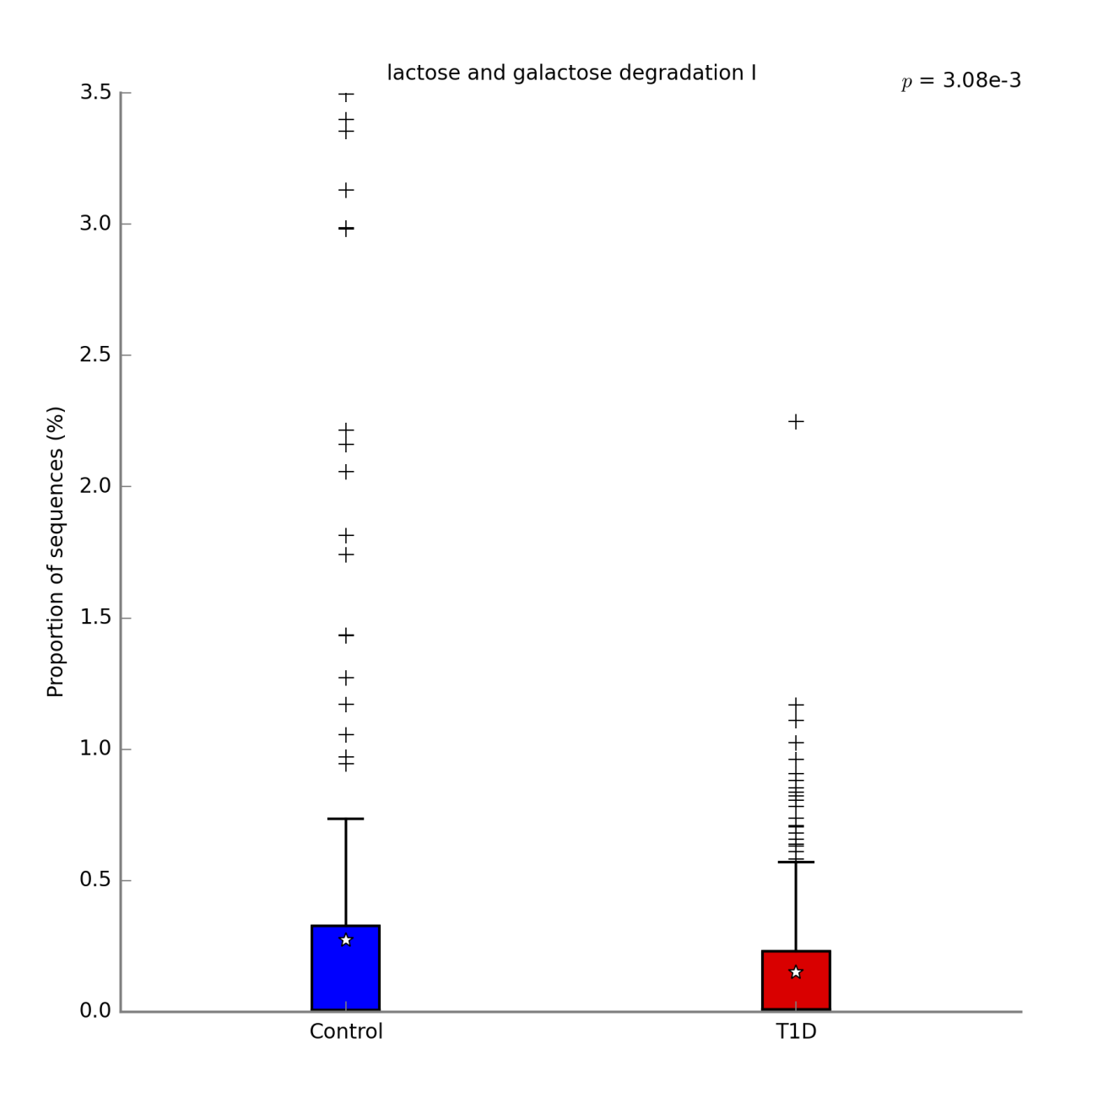

Slide 7
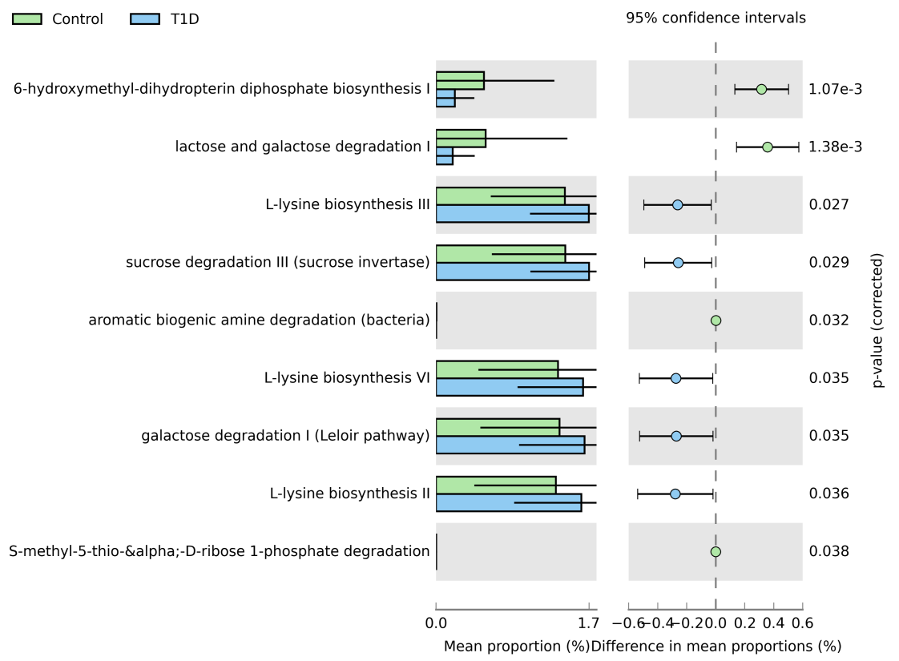
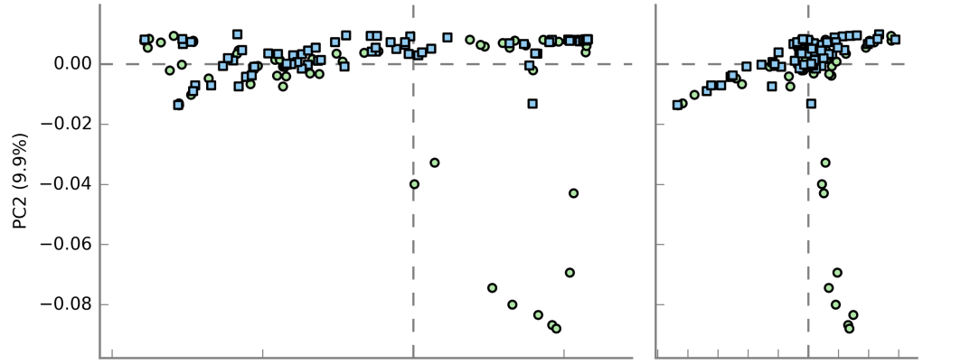
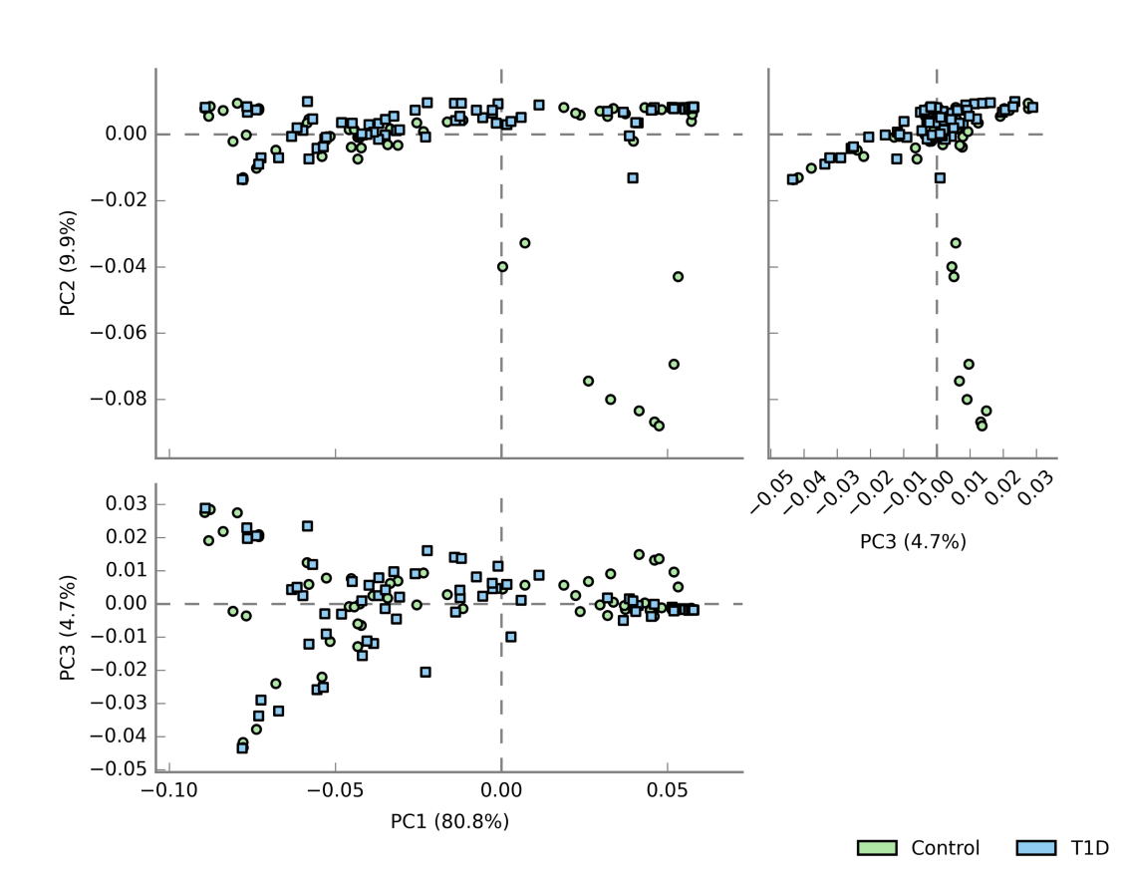
Infant PICRUST2 derived pathways comparisons (Combined Ear and Stool)
description | Control: mean rel. freq. (%) | Control: std. dev. (%) | T1D: mean rel. freq. (%) | T1D: std. dev. (%) | p-values | Difference between means | 95.0% lower CI | 95.0% upper CI
lactose and galactose degradation I | 0.54 | 0.89 | 0.18 | 0.24 | 0.00 | 0.36 | 0.14 | 0.57
L-lysine biosynthesis II | 1.30 | 0.89 | 1.58 | 0.73 | 0.04 | -0.28 | -0.54 | -0.02
L-lysine biosynthesis III | 1.40 | 0.81 | 1.66 | 0.64 | 0.03 | -0.26 | -0.50 | -0.03
S-methyl-5-thio-&alpha;-D-ribose 1-phosphate degradation | 0.00 | 0.00 | 0.00 | 0.00 | 0.04 | 0.00 | 0.00 | 0.00
L-lysine biosynthesis VI | 1.33 | 0.87 | 1.60 | 0.71 | 0.03 | -0.27 | -0.53 | -0.02
6-hydroxymethyl-dihydropterin diphosphate biosynthesis I | 0.52 | 0.77 | 0.20 | 0.21 | 0.00 | 0.32 | 0.13 | 0.50
sucrose degradation III (sucrose invertase) | 1.41 | 0.80 | 1.67 | 0.64 | 0.03 | -0.26 | -0.49 | -0.03
galactose degradation I (Leloir pathway) | 1.35 | 0.86 | 1.62 | 0.71 | 0.04 | -0.27 | -0.52 | -0.02
aromatic biogenic amine degradation (bacteria) | 0.00 | 0.01 | 0.00 | 0.01 | 0.03 | 0.00 | 0.00 | 0.01
Carbohydrate Degradation
Amino Acid Biosynthesis
Amino Acid Biosynthesis
Nucleoside and Nucleotide Degradation
Amino Acid Biosynthesis
Folate biosynthesis
Carbohydrate Degradation
Carbohydrate Degradation
Amine and Polyamine Degradation

Slide 8
Why is „lactose and galactose degradation” predominant in controls and „sucrose degradation”/ ”galactose galactose degradation I (Leloir pathway)” in T1D?
description | Control: mean rel. freq. (%) | Control: std. dev. (%) | T1D: mean rel. freq. (%)
lactose and galactose degradation I | 0.54 | 0.89 | 0.18
sucrose degradation III (sucrose invertase) | 1.41 | 0.80 | 1.67
galactose degradation I (Leloir pathway) | 1.35 | 0.86 | 1.62
Is it an effect of the glucose intolerance?
Is it an effect of the diet?
Is it an effect of the diet?
Sugars | GI value
Maltose | 105
Glucose | 100
Rice Syrup | 98
Sucrose/table sugar | 65
Lactose | 46
Fructose | 19
Galactose | ?
Galactose is one of the monosaccharides of importance in human nutrition. It is converted to glucose-1-phosphate in the liver and subsequently stored as glycogen, or is converted to glucose and released into the circulation. The increase in plasma glucose is known to be modest following galactose ingestion.
Lactose (disaccharide) = glucose+galactose
Sucrose (disaccharide) = glucose+fructose
Maltose (disaccharide) = glucose+glucose
Notes:
Is it sufficient explanation?

Slide 9
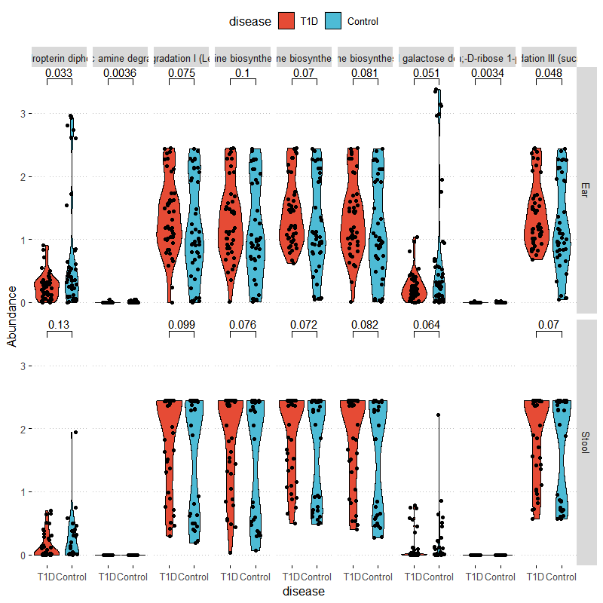
Infant PICRUST2 derived pathways comparisons
Pathways(left to Right) 6-hydroxymethyl-dihydropterin diphosphate biosynthesis
aromatic biogenic amine degradation (bacteria)
galactose degradation I (Leloir pathway)
L-lysine biosynthesis II
L-lysine biosynthesis III
L-lysine biosynthesis VI
lactose and galactose degradation I S-methyl-5-thio-&alpha;-D-ribose 1-phosphate degradation
sucrose degradation III (sucrose invertase)
Infant Ear
Infant Stool

Slide 10
Type 1 Diabetes assoc. pathways by Sample Type
description | Control: mean rel. freq. (%) | Control: std. dev. (%) | T1D: mean rel. freq. (%) | T1D: std. dev. (%) | p-values | Difference between means | 95.0% lower CI | 95.0% upper CI
reductive TCA cycle I | 0.095 | 0.153 | 0.022 | 0.055 | 0.018 | 0.018 | 0.073 | 0.013
superpathway of L-methionine biosynthesis (by sulfhydrylation) | 0.080 | 0.127 | 0.024 | 0.062 | 0.036 | 0.036 | 0.055 | 0.004
catechol degradation I (meta-cleavage pathway) | 0.048 | 0.083 | 0.010 | 0.032 | 0.027 | 0.027 | 0.037 | 0.004
superpathway of heme biosynthesis from glycine | 0.051 | 0.086 | 0.011 | 0.029 | 0.020 | 0.020 | 0.040 | 0.007
description | Control: mean rel. freq. (%) | Control: std. dev. (%) | T1D: mean rel. freq. (%) | T1D: std. dev. (%) | p-values | Difference between means | 95.0% lower CI | 95.0% upper CI
lactose and galactose degradation I | 0.762 | 1.048 | 0.248 | 0.232 | 0.003 | 0.514 | 0.18 | 0.847
6-hydroxymethyl-dihydropterin diphosphate biosynthesis I | 0.706 | 0.905 | 0.262 | 0.206 | 0.003 | 0.444 | 0.156 | 0.732
adenosine deoxyribonucleotides de novo biosynthesis II | 1.896 | 0.781 | 1.571 | 0.503 | 0.026 | 0.325 | 0.04 | 0.61
guanosine deoxyribonucleotides de novo biosynthesis II | 1.896 | 0.781 | 1.571 | 0.503 | 0.026 | 0.325 | 0.04 | 0.61
(5Z)-dodec-5-enoate biosynthesis | 0.08 | 0.089 | 0.131 | 0.121 | 0.028 | -0.051 | -0.097 | -0.006
glycogen degradation I (bacterial) | 0.129 | 0.124 | 0.212 | 0.21 | 0.03 | -0.083 | -0.157 | -0.008
starch degradation V | 0.13 | 0.125 | 0.212 | 0.206 | 0.03 | -0.082 | -0.155 | -0.008
adenine and adenosine salvage III | 0.404 | 0.297 | 0.567 | 0.388 | 0.032 | -0.164 | -0.313 | -0.015
superpathway of L-alanine biosynthesis | 0.186 | 0.164 | 0.272 | 0.2 | 0.033 | -0.086 | -0.165 | -0.007
superpathway of purine deoxyribonucleosides degradation | 0.27 | 0.215 | 0.397 | 0.314 | 0.033 | -0.127 | -0.243 | -0.011
glycogen biosynthesis I (from ADP-D-Glucose) | 0.085 | 0.086 | 0.144 | 0.156 | 0.034 | -0.059 | -0.113 | -0.004
pyruvate fermentation to acetate and lactate II | 2.117 | 0.938 | 1.733 | 0.68 | 0.034 | 0.384 | 0.03 | 0.739
sucrose degradation IV (sucrose phosphorylase) | 0.063 | 0.089 | 0.117 | 0.139 | 0.034 | -0.055 | -0.105 | -0.004
glycolysis III (from glucose) | 1.888 | 0.748 | 1.582 | 0.554 | 0.036 | 0.306 | 0.021 | 0.591
superpathway of adenosine nucleotides de novo biosynthesis I | 1.975 | 0.796 | 1.659 | 0.566 | 0.038 | 0.316 | 0.017 | 0.616
superpathway of adenosine nucleotides de novo biosynthesis II | 1.931 | 0.78 | 1.624 | 0.564 | 0.041 | 0.307 | 0.012 | 0.601
L-lysine biosynthesis I | 0.157 | 0.137 | 0.23 | 0.187 | 0.044 | -0.073 | -0.144 | -0.002
aromatic biogenic amine degradation (bacteria) | 0.006 | 0.011 | 0.002 | 0.007 | 0.044 | 0.004 | 0 | 0.008
C1 Compound Utilization and Assimilation
Amino Acid Biosynthesis
Infant Stool
Aromatic Compound Degradation
Enzyme Cofactor Biosynthesis
Carbohydrate Degradation
Folate biosynthesis
Nucleoside and Nucleotide Biosynthesis
Nucleoside and Nucleotide Biosynthesis
Unsaturated Fatty Acid Biosynthesis
Carbohydrate Degradation
Carbohydrate Degradation
Infant Ear
Nucleoside and Nucleotide Biosynthesis
Amino Acid Biosynthesis
Nucleoside and Nucleotide Degradation
Carbohydrate Biosynthesis
Generation of Precursor Metabolites and Energy
Carbohydrate Degradation
Generation of Precursor Metabolites and Energy
Nucleoside and Nucleotide Biosynthesis
Nucleoside and Nucleotide Biosynthesis
Amino Acid Biosynthesis
Amine and Polyamine Degradation
Notes:
Why do ears have more results?
Are ears more differentiate? How does look beta diversity?

Slide 11
To do:
Divide sample types: ear(newborn), stool (newborn), rectal swab (mother), genital swabs (3 swabs combined, mother)
Add variable- delivery mode
Fecal samples were collected too early to see the important role of breast milk in colonization of the infant gut microbiota

Slide 12
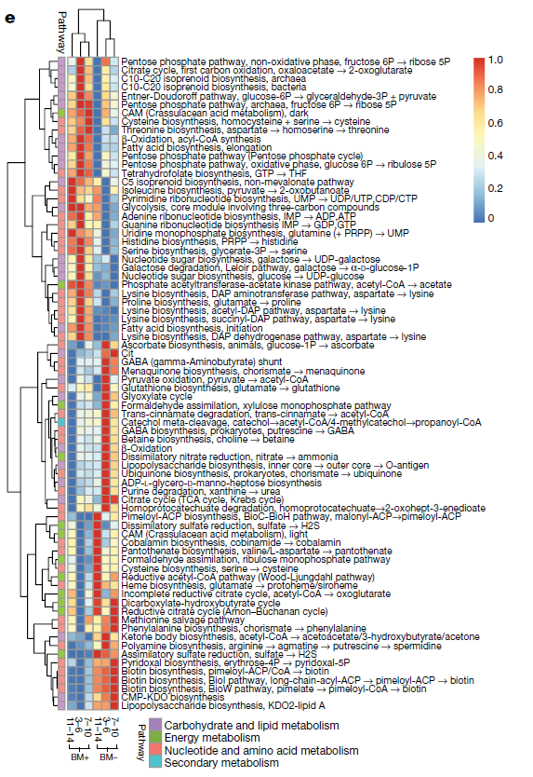
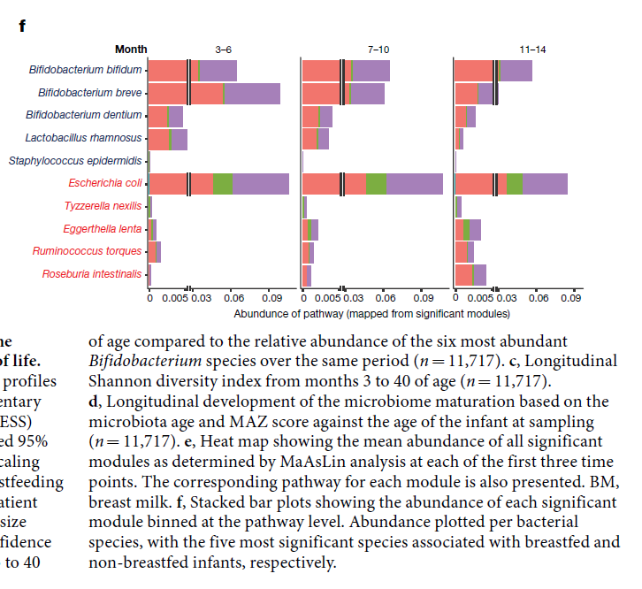
Maybe we perform analysis according to TEDDY study?
Maybe we perform analysis dividing pathways into two categories: biosynthesis and degradation?
Maybe in T1D is an enrichment in the degradation pathways?

Slide 13
DESEQ2 identified Taxa associated with Type 1 Diabetes
Genus | log2FoldChange | lfcSE | stat | pvalue | padj | Kingdom | Phylum | Class | Order | Family
Aerococcus | -18.113 | 3.867 | -4.683 | <0.0001 | <0.0001 | Bacteria | Firmicutes | Bacilli | Lactobacillales | Aerococcaceae
Anaerococcus | 2.567 | 0.900 | 2.851 | 0.004 | 0.049 | Bacteria | Firmicutes | Clostridia | Clostridiales | Family_XI
Staphylococcus | 2.932 | 0.827 | 3.546 | <0.0001 | 0.010 | Bacteria | Firmicutes | Bacilli | Bacillales | Staphylococcaceae
Bifidobacterium | 3.497 | 1.224 | 2.856 | 0.004 | 0.049 | Bacteria | Actinobacteria | Actinobacteria | Bifidobacteriales | Bifidobacteriaceae
Campylobacter | 4.495 | 1.305 | 3.444 | 0.001 | 0.010 | Bacteria | Epsilonbacteraeota | Campylobacteria | Campylobacterales | Campylobacteraceae
Atopobium | 4.630 | 1.342 | 3.449 | 0.001 | 0.010 | Bacteria | Actinobacteria | Coriobacteriia | Coriobacteriales | Atopobiaceae
Enterococcus | 5.462 | 0.923 | 5.921 | <0.0001 | <0.0001 | Bacteria | Firmicutes | Bacilli | Lactobacillales | Enterococcaceae
Mobiluncus | 5.523 | 1.918 | 2.880 | 0.004 | 0.049 | Bacteria | Actinobacteria | Actinobacteria | Actinomycetales | Actinomycetaceae
Fusobacterium | 8.176 | 2.304 | 3.548 | <0.0001 | 0.010 | Bacteria | Fusobacteria | Fusobacteriia | Fusobacteriales | Fusobacteriaceae
Mother
Genus | log2FoldChange | lfcSE | stat | pvalue | padj | Phylum | Class | Order | Family
Erysipelatoclostridium | -24.676 | 3.283 | -7.516 | <0.0001 | <0.0001 | Firmicutes | Erysipelotrichia | Erysipelotrichales | Erysipelotrichaceae
Methylobacterium | 2.825 | 0.726 | 3.890 | <0.0001 | 0.004 | Proteobacteria | Alphaproteobacteria | Rhizobiales | Beijerinckiaceae
Sphingomonas | 3.083 | 0.662 | 4.654 | <0.0001 | <0.0001 | Proteobacteria | Alphaproteobacteria | Sphingomonadales | Sphingomonadaceae
Micrococcus | 3.463 | 0.662 | 5.233 | <0.0001 | <0.0001 | Actinobacteria | Actinobacteria | Micrococcales | Micrococcaceae
Ruminococcaceae | 3.620 | 0.968 | 3.740 | <0.0001 | 0.006 | Firmicutes | Clostridia | Clostridiales | Ruminococcaceae
Paracoccus | 4.410 | 0.792 | 5.567 | <0.0001 | <0.0001 | Proteobacteria | Alphaproteobacteria | Rhodobacterales | Rhodobacteraceae
Collinsella | 4.709 | 1.124 | 4.191 | <0.0001 | <0.001 | Actinobacteria | Coriobacteriia | Coriobacteriales | Coriobacteriaceae
Infant

Slide 14
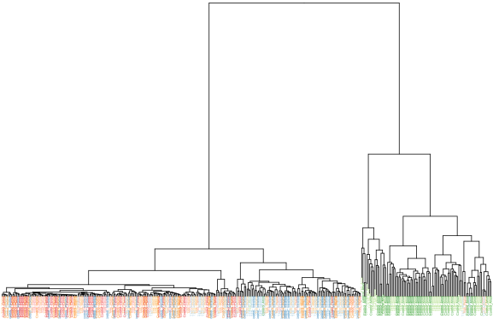

Maternal sample VST clustering by disease

Slide 15
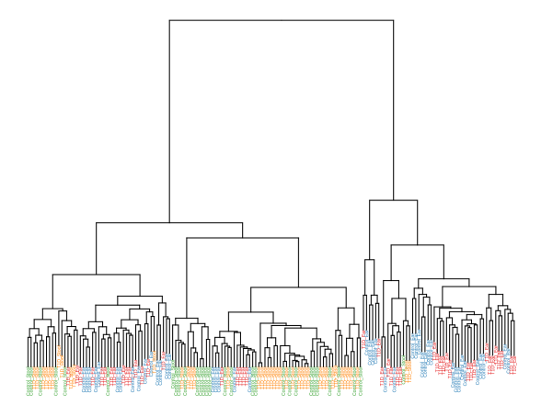

Infant sample VST clustering

Slide 16
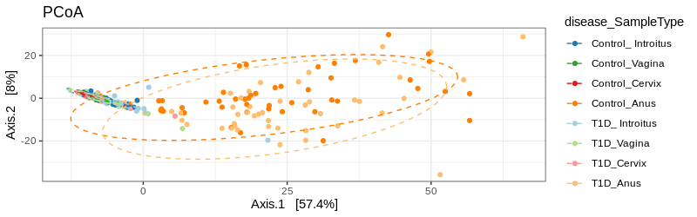
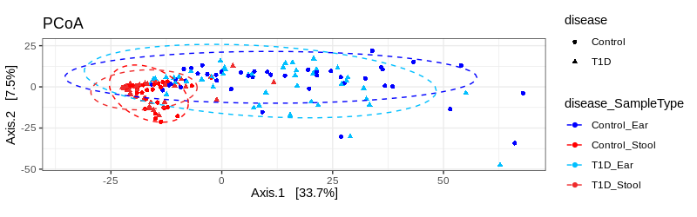
VST clustering
Mother
Infant

