Slide 1
T1D_cont. Continuous variables July, 29th, 2020 Marzena and Michael

Slide 2
Study design_T1D pregnant women, Controls, and materials
in the Microbiome study
Ascertainement, clinical information obtained:
T1D Controls ∑
Pregnant women 49 41 90
Newborns 48 40 88
Sample sets:
Pregnant woman: 4 swabs: 1) introitus, 2) vagina (in the middle), 3) cervix, 4) anus;
Newborn: 5) stool sample and 6) ear swab.
Completed sample sets:
T1D: 34 sets of 6 materials
Controls: 35 sets of 6 materials
21 uncompleted sets (1-2 missing samples)
∑ 90
Sequencing method and analyzes:
16S rRNA, Illumina, Primers 515F–806R
530 samples sequenced
Seq data of 527 samples analyzed

Slide 3
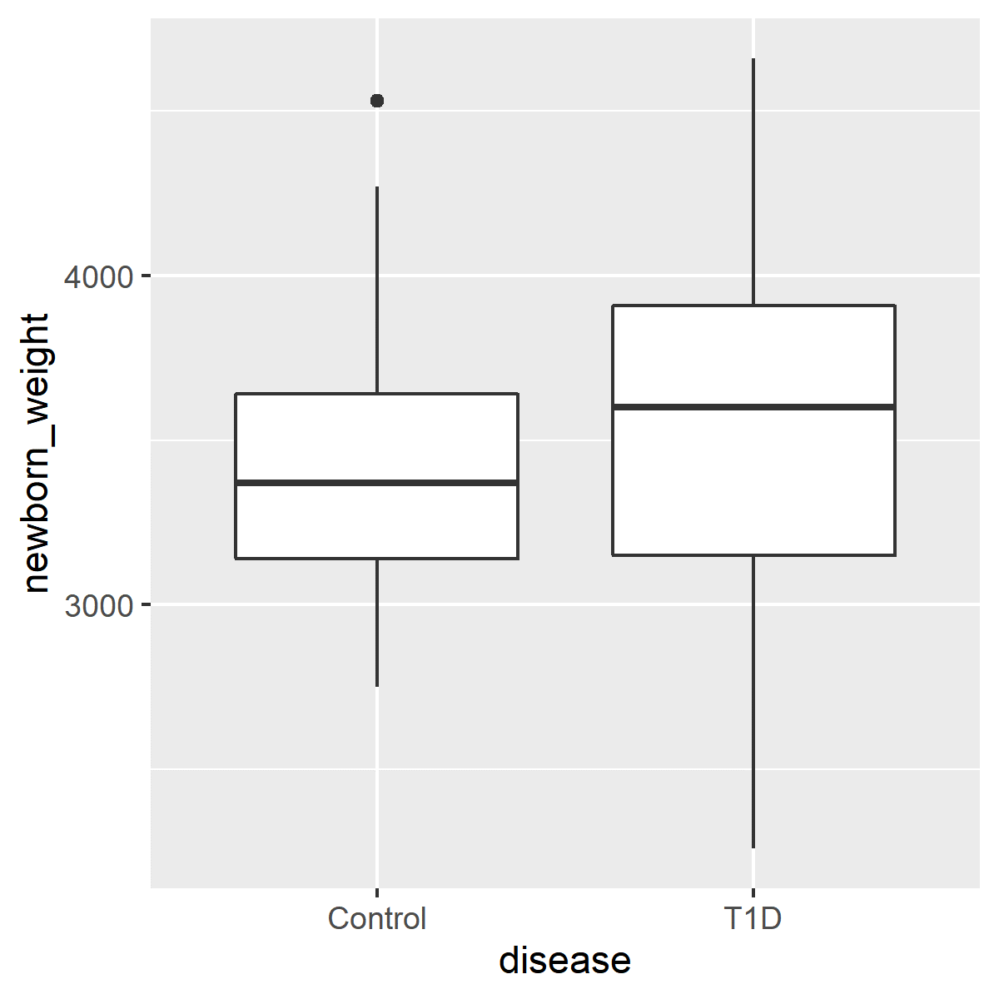
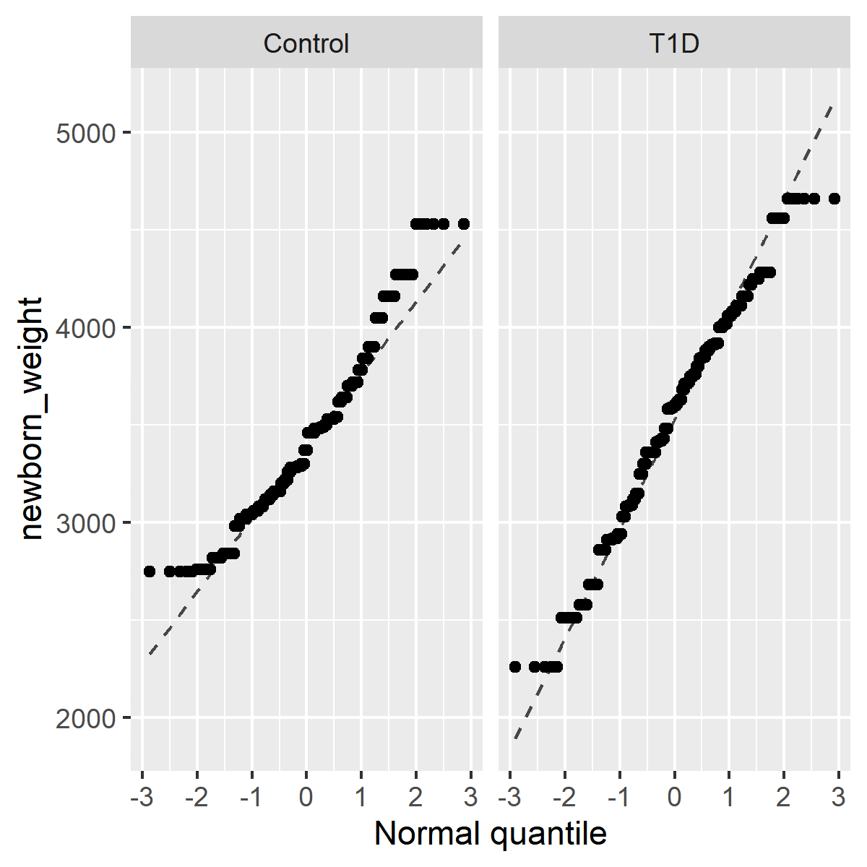
NEWBORN_WEIGHT_by disease
Disease min Q1 median Q3 max mean sd
Control 2750 3140 3370 3640.0 4530 3420.665 405.2484
T1D 2260 3150 3600 3907.5 4660 3542.660 520.2330
Welch Two Sample t-test: t = -3.0216, df = 519.02, p-value = 0.002638

Slide 4
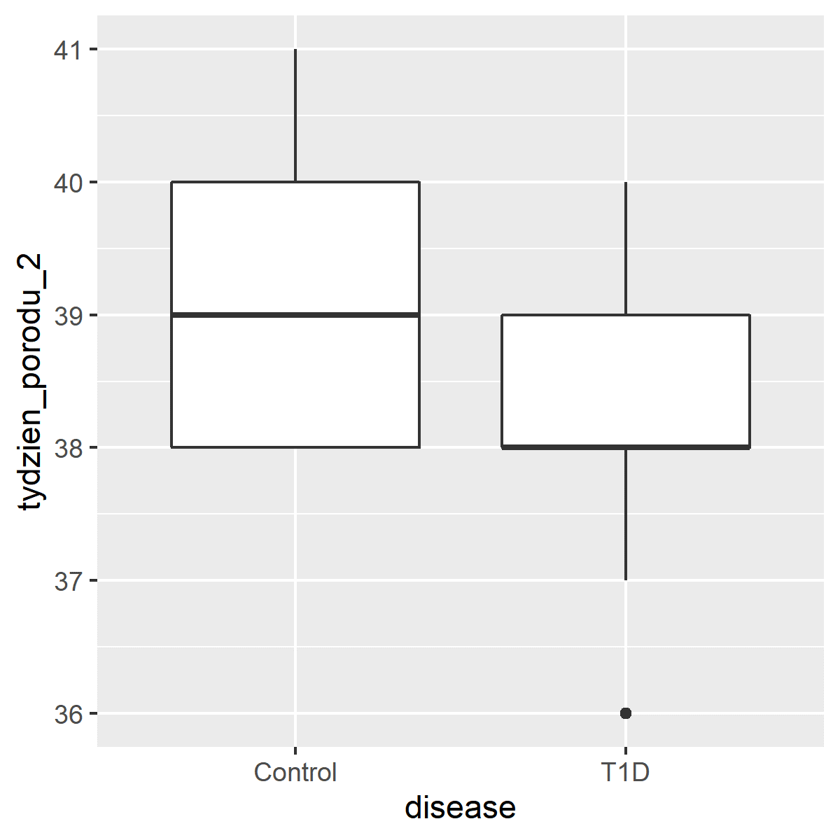
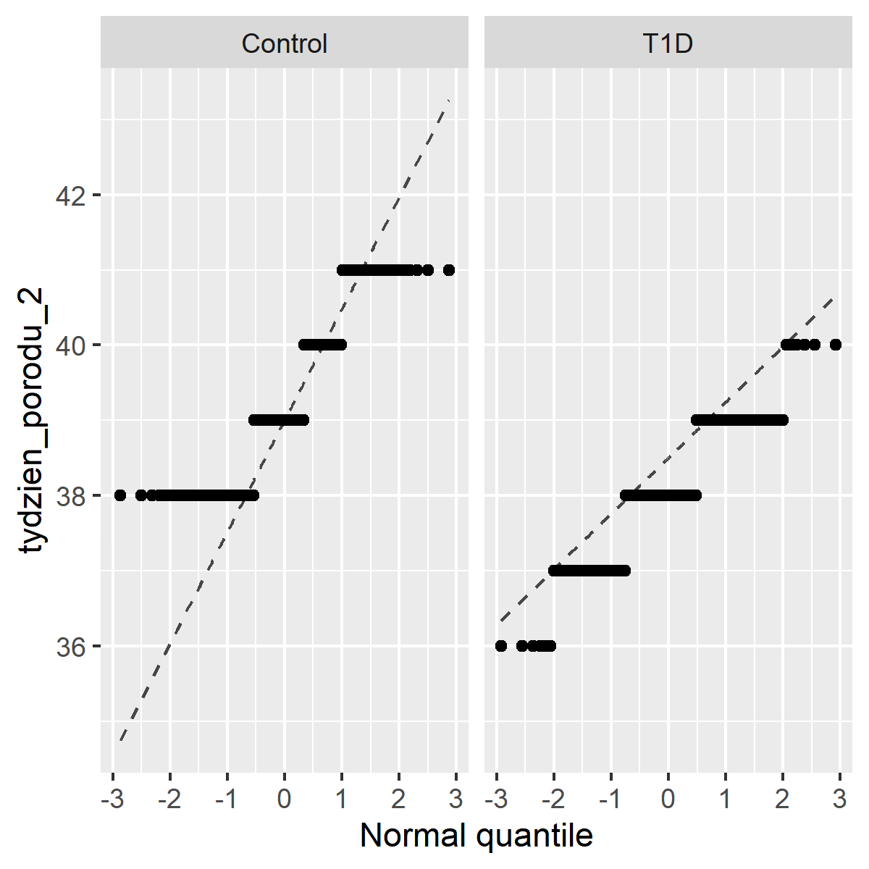
DELIVERY WEEK_by disease
Disease min Q1 median Q3 max mean sd
Control 38 38 39 40 41 39.23265 1.0435964
T1D 36* 38 38 39 40 38.08511 0.8134926
Welch Two Sample t-test: t = 13.924, df = 458.63, p-value < 2.2e-16
*one newborn 36+6

Slide 5
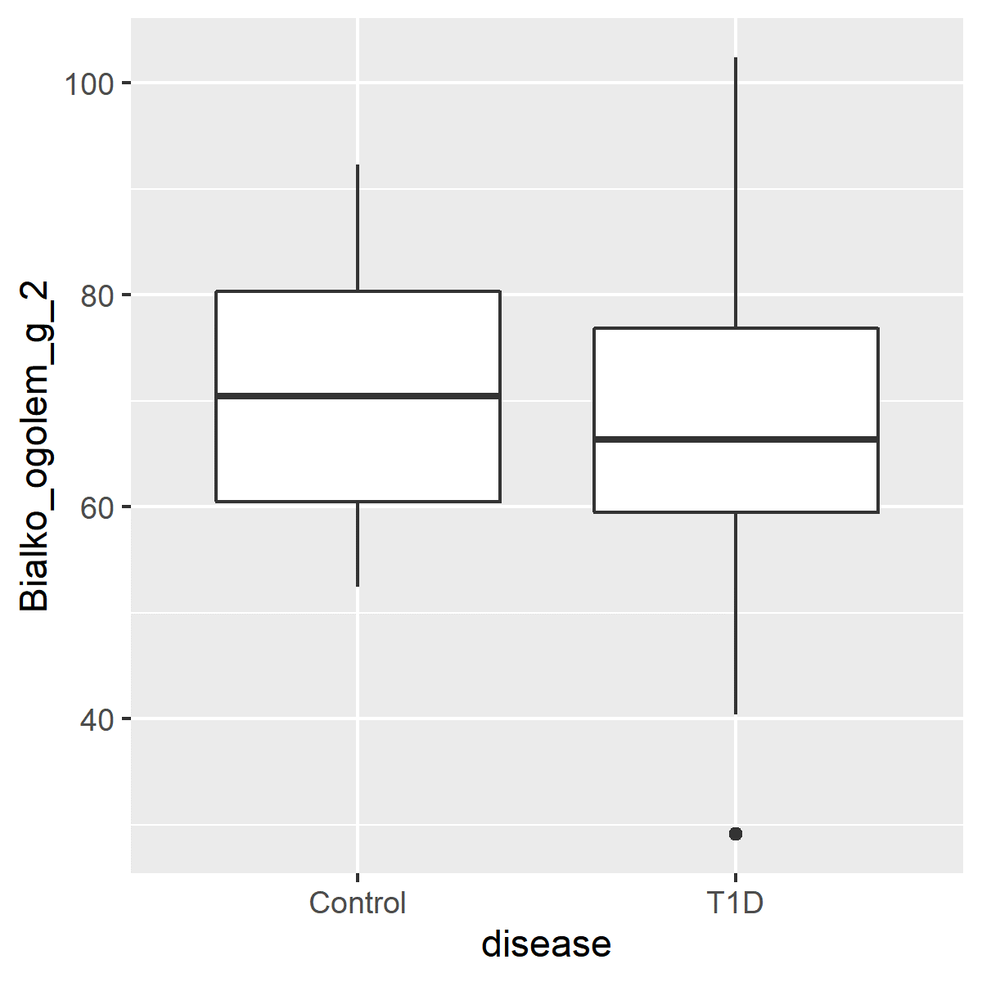
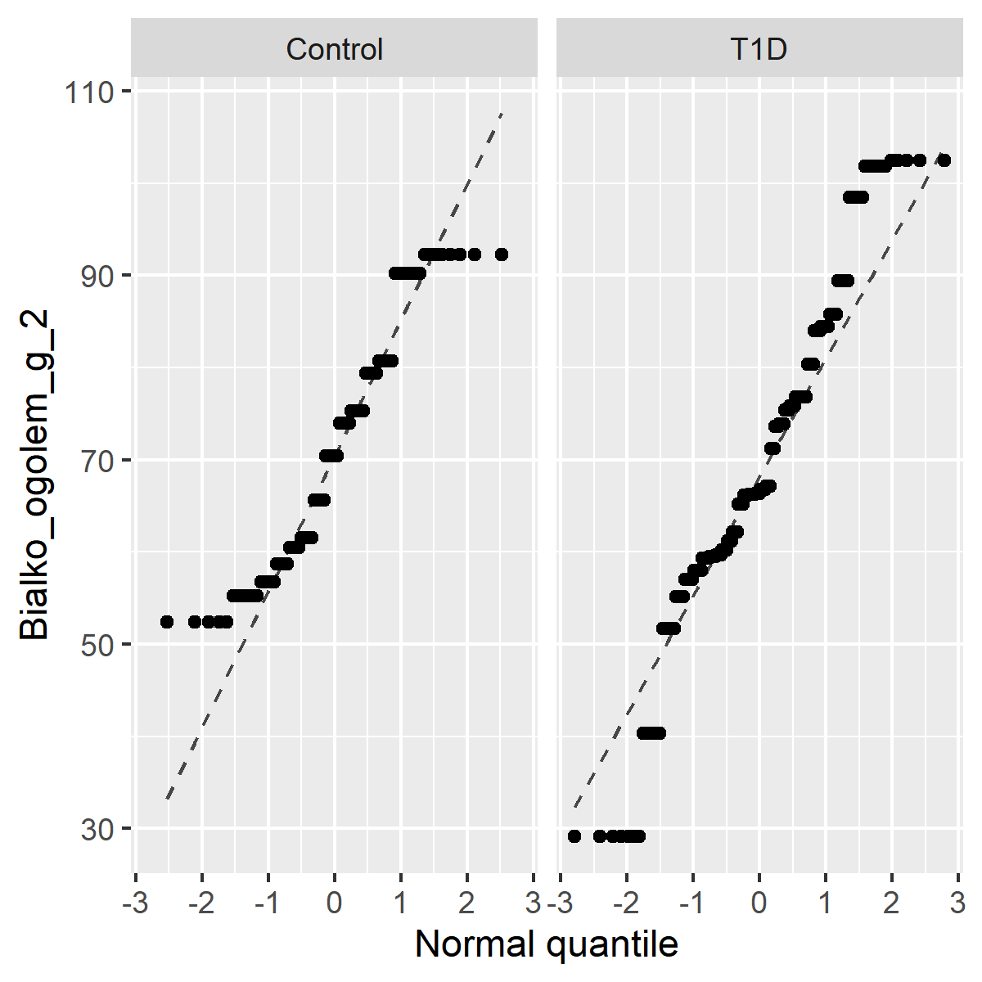
PROTEIN INTAKE_total protein [g] _by disease
Disease min Q1 median Q3 max mean sd
Control 52.42 60.48 70.45 80.3575 92.29 71.17151 12.83743
T1D 29.10 59.50 66.36 76.8500 102.43 69.25339 16.17804
Welch Two Sample t-test: t = 1.0557, df = 204.06, p-value = 0.2923

Slide 6
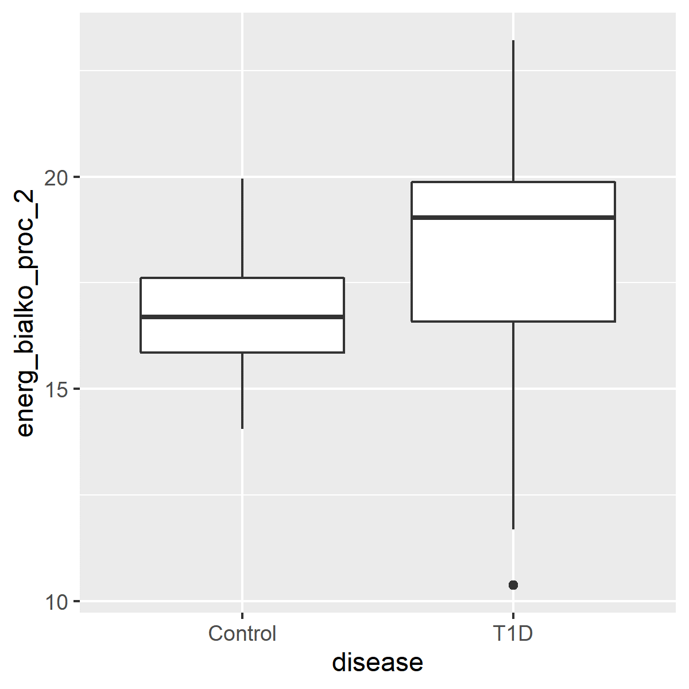
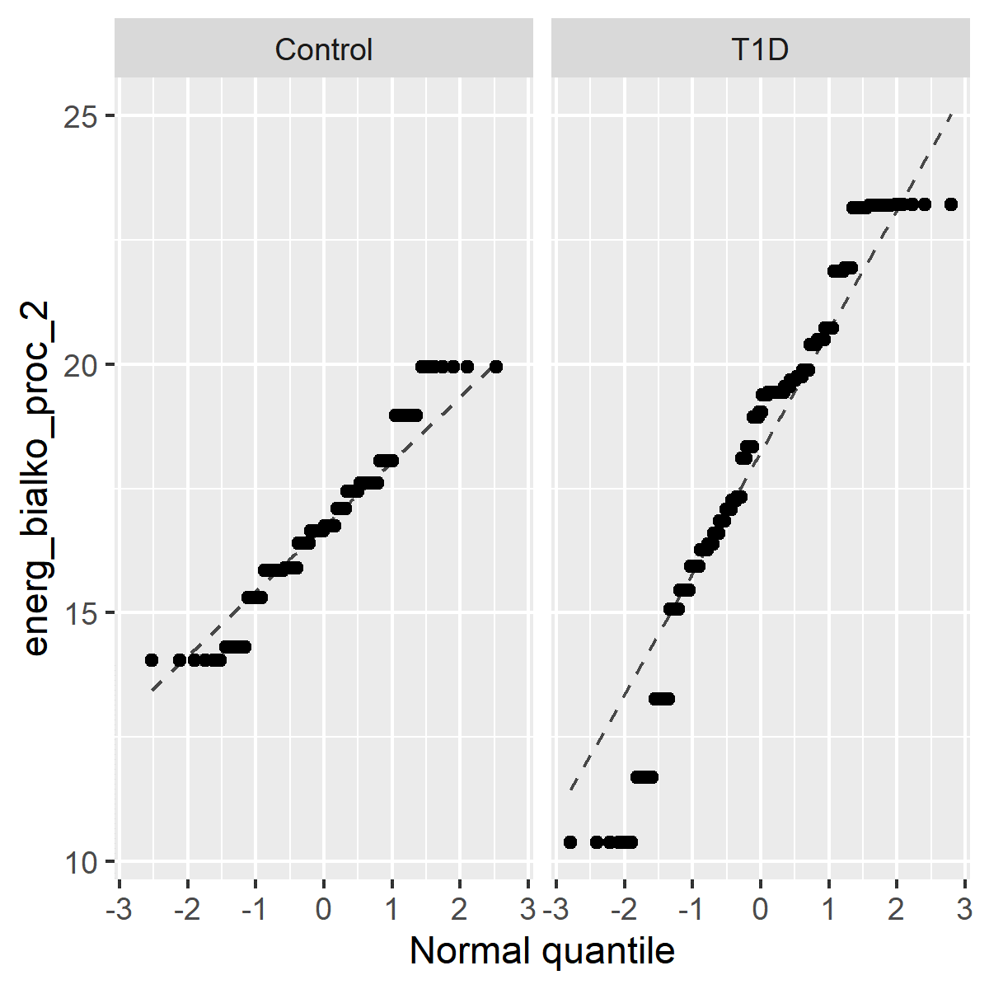
ENERGY DERIVED FROM PROTEIN [%] _by disease
Disease min Q1 median Q3 max mean sd
Control 14.05 15.85 16.695 17.61 19.95 16.79907 1.588497
T1D 10.37 16.59 19.040 19.88 23.22 18.34688 2.995189
Welch Two Sample t-test: t = -5.5849, df = 266.79, p-value = 5.756e-08

Slide 7
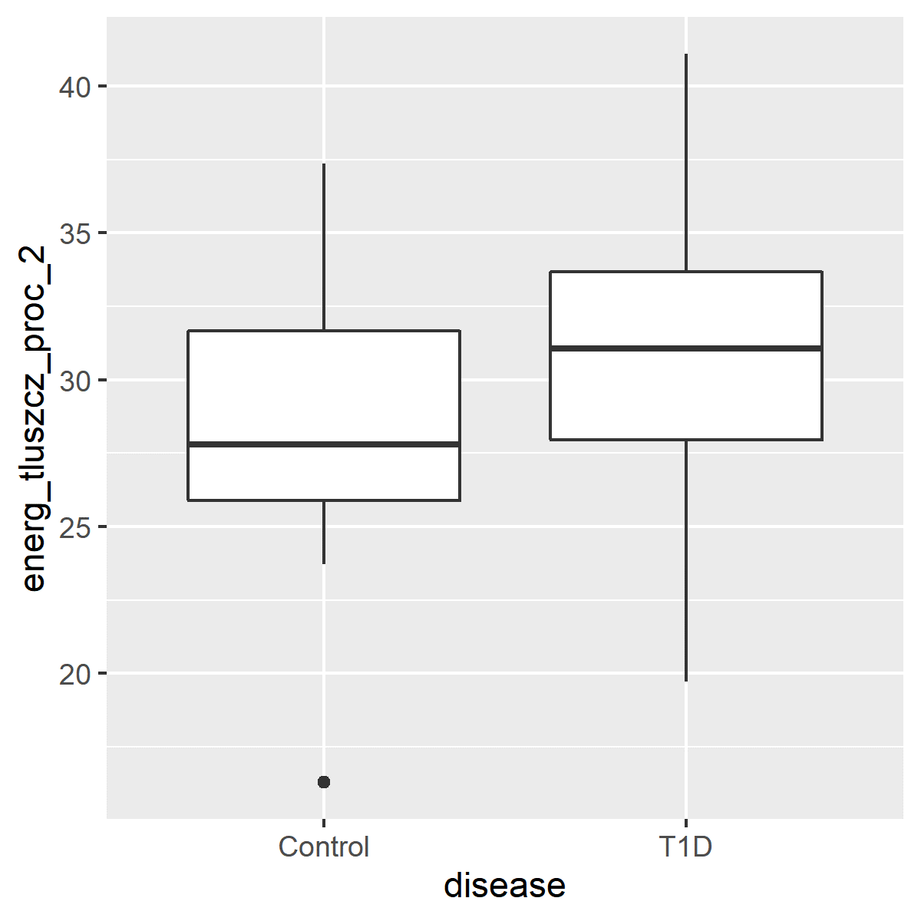
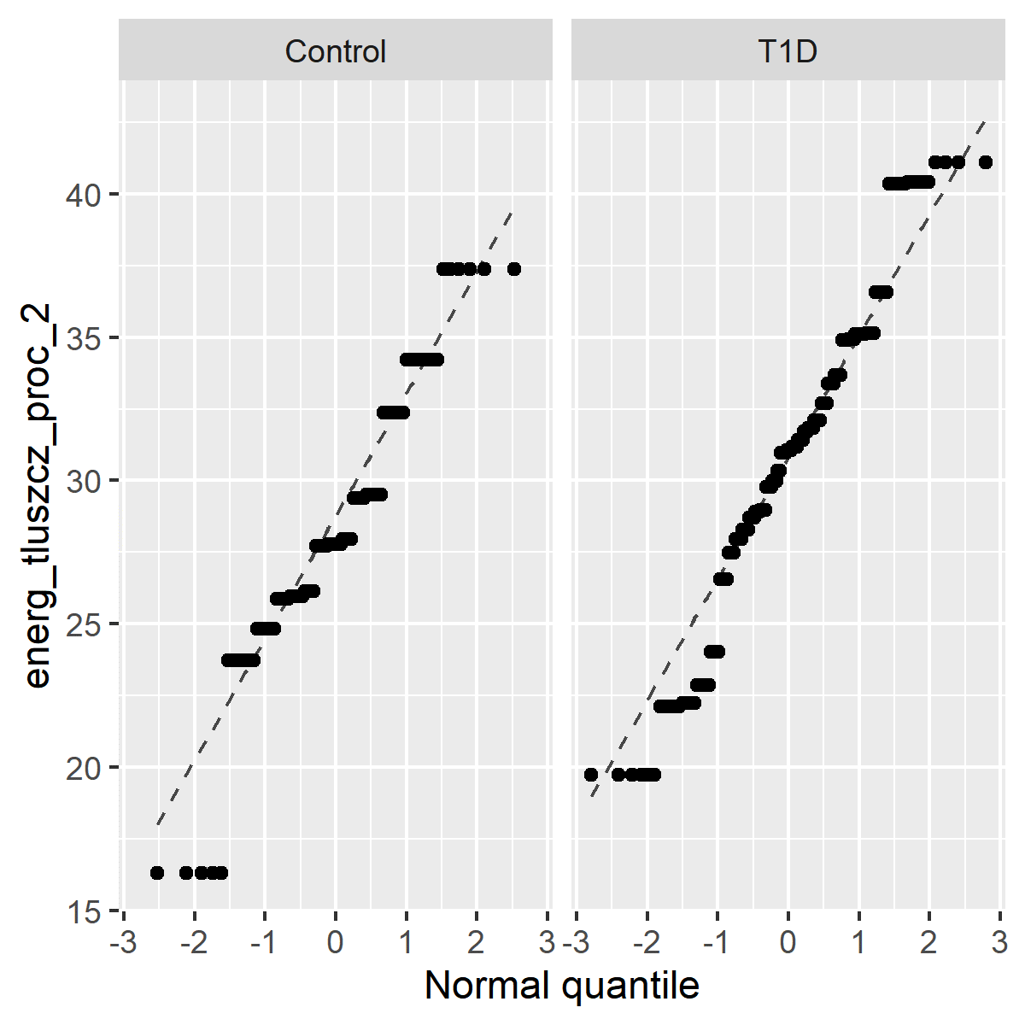
ENERGY DERIVED FROM FAT [%] _by disease
Disease min Q1 median Q3 max mean sd
Control 16.29 25.8875 27.79 31.65 37.36 28.24233 4.765754
T1D 19.72 27.9600 31.07 33.68 41.10 30.59307 5.068817
Welch Two Sample t-test: t = -3.7167, df = 174.16, p-value = 0.0002718

Slide 8
BMI_BEFORE pregnancy_by disease
Disease min Q1 median Q3 max mean sd
Control 16.90 20.55 22.58 23.83 29.24 22.62070 2.603728
T1D 18.07 20.97 22.71 25.63 32.87 23.15741 2.867411
Welch Two Sample t-test: t = -2.2492, df = 522.77, p-value = 0.02491
vs.
BMI_AFTER (just before delivery) _by disease
Disease min Q1 median Q3 max mean sd
Control 20.79 25.635 27.68 30.0400 32.99 27.66340 2.956985
T1D 21.56 25.510 27.44 30.0275 40.14 28.04472 3.713353
Welch Two Sample t-test: t = -1.303, df = 516.31, p-value = 0.1931

Slide 9
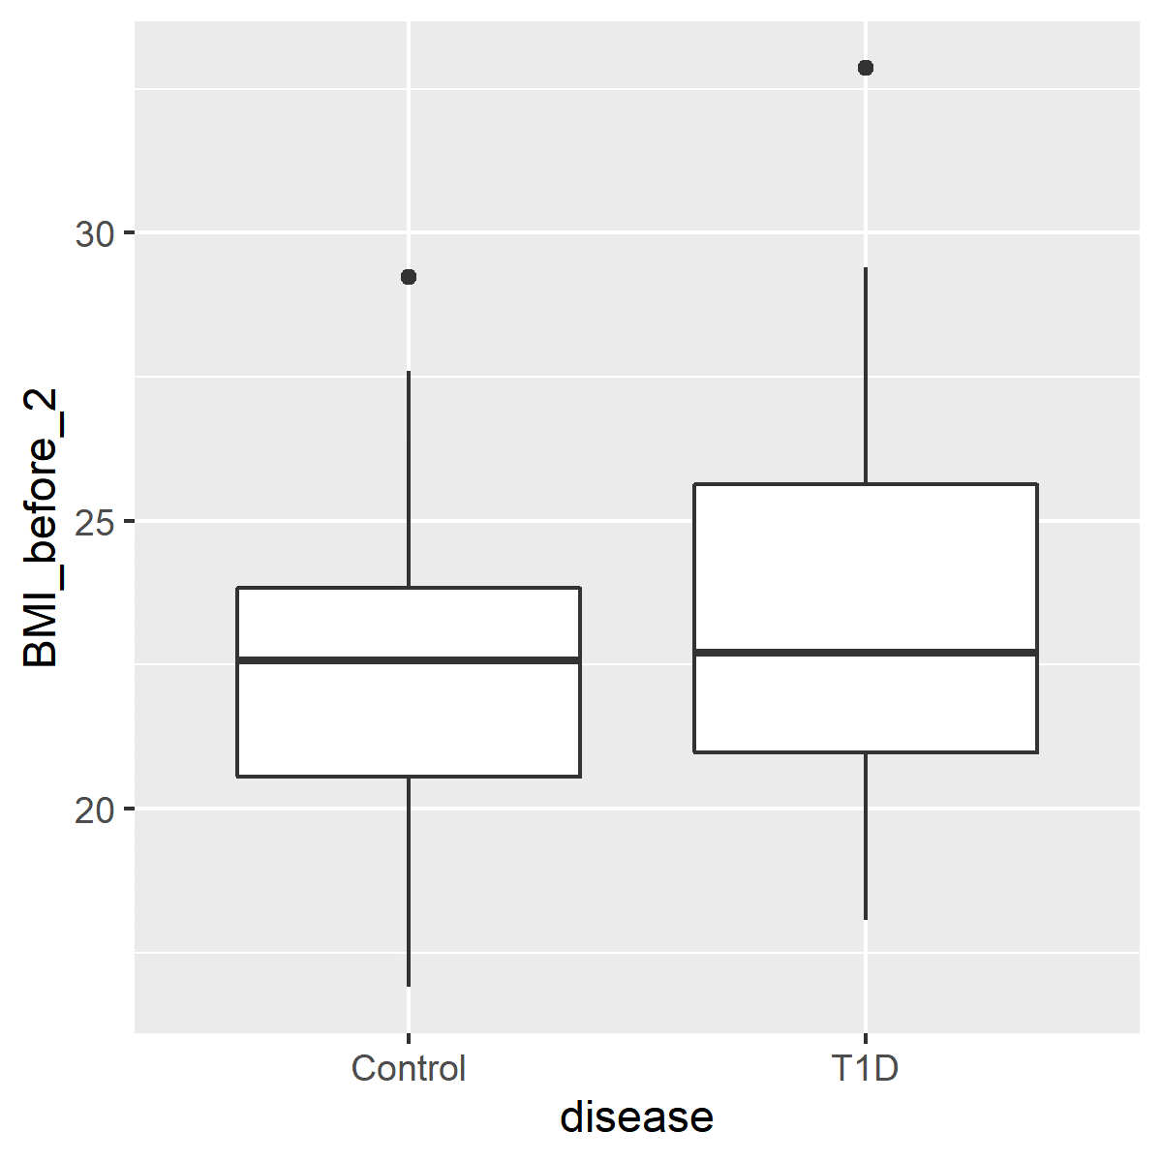
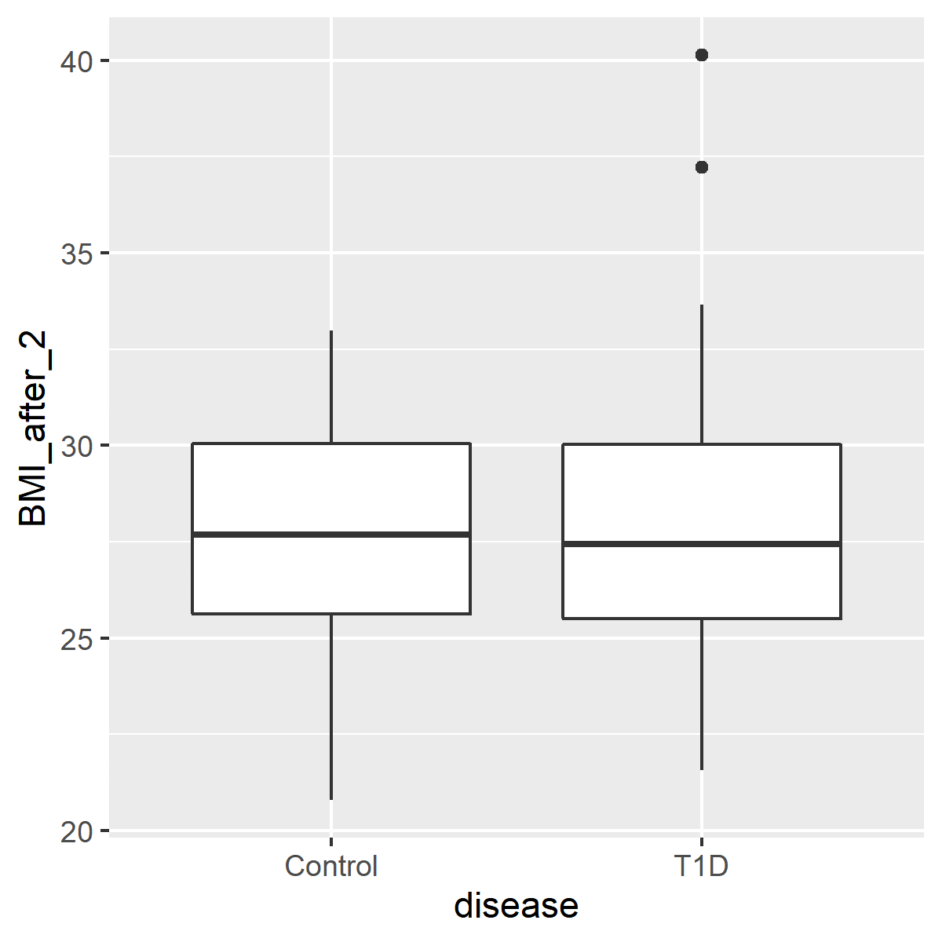
BMI_BEFORE pregnancy vs. BMI_AFTER (just before delivery)

Slide 10
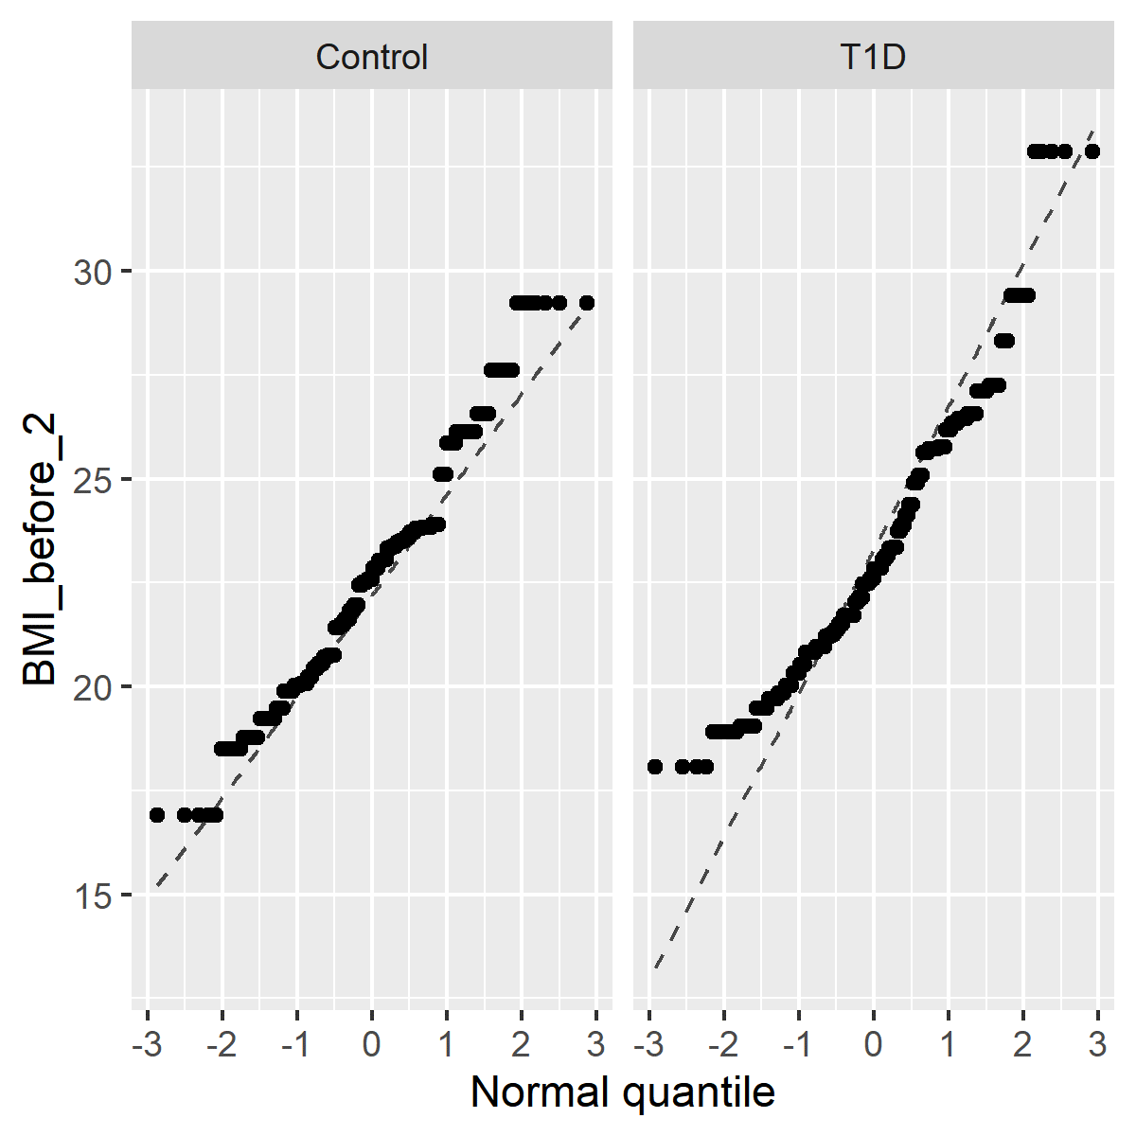
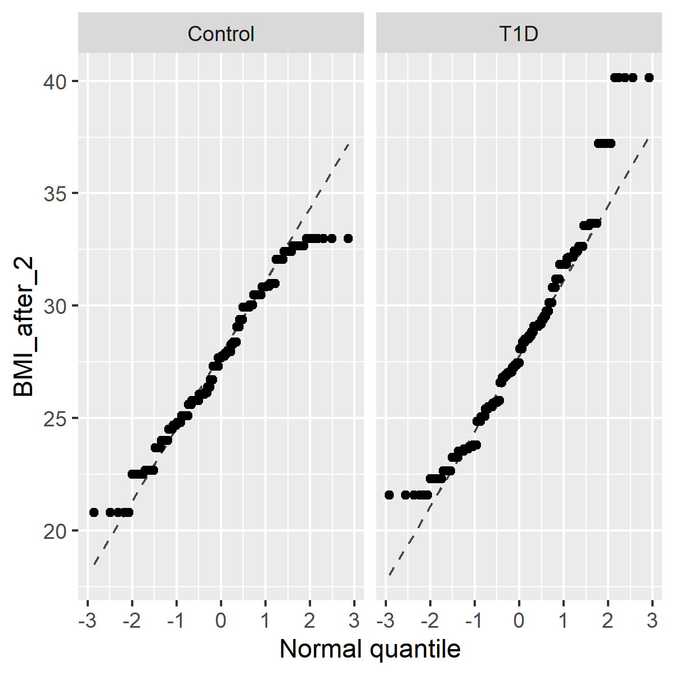
BMI_BEFORE pregnancy vs. BMI_AFTER (just before delivery)

Slide 11
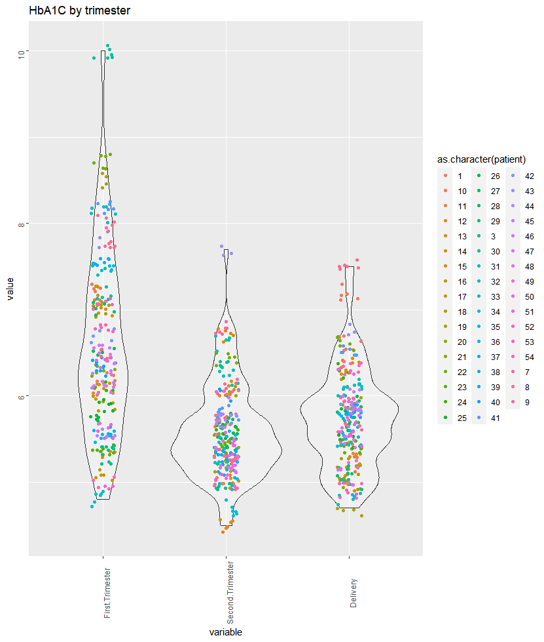
Glycaemic control
during first, second and third (before delivery) trimesters
In accordance to the recommendations of the Polish Diabetes Association, one of the criteria for good diabetes control during pregnancy is a glycated hemoglobin level ≤ 6.1% (43 mmol/mol);
Here, differences between first and second trimesters, and first and third trimesters were statistically significant;
Glycaemic control was satisfactory in second and third trimesters
Tukey multiple comparisons of means (95% family-wise confidence level)
Variable diff lwr upr p adj
Second.Trimester-First.Trimester -0.9965909 -1.15613634 -0.8370455 0.0000000
Delivery-First.Trimester -0.8482995 -1.00527833 -0.6913206 0.0000000
Delivery-Second.Trimester 0.1482914 -0.00868742 0.3052703 0.0687493

Slide 12
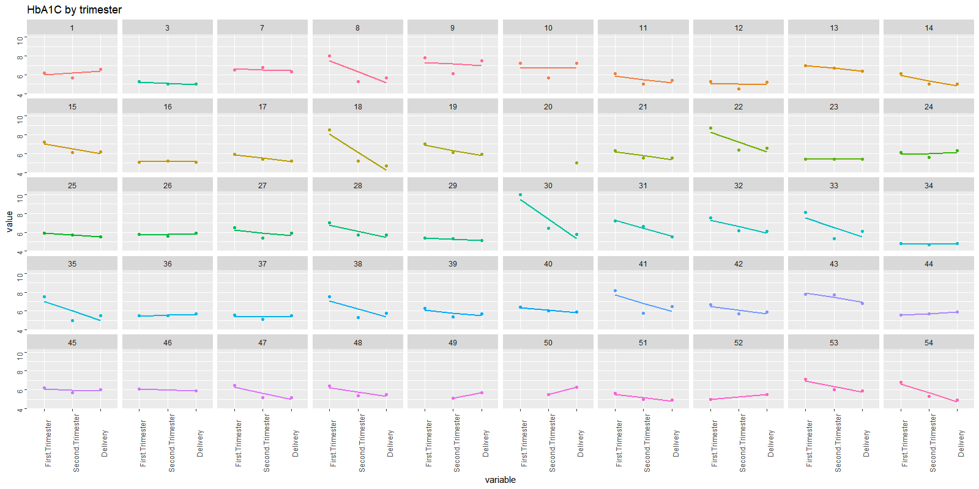
Glycaemic control during first, second and third (before delivery) trimesters in the T1D pregnant women

Slide 13
Glucose timepoints analysis
Jochum, Michael D
30 July 2020

Slide 14
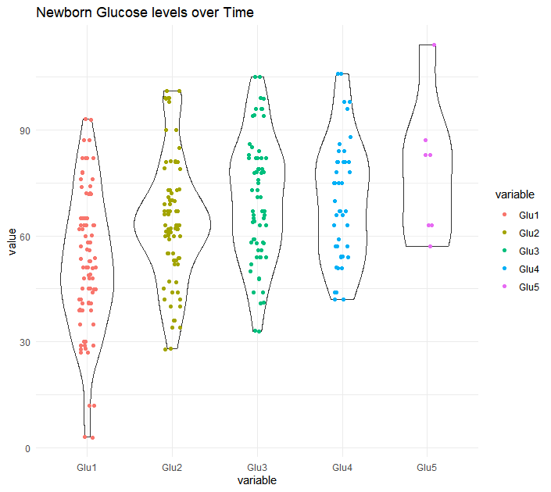

Slide 15
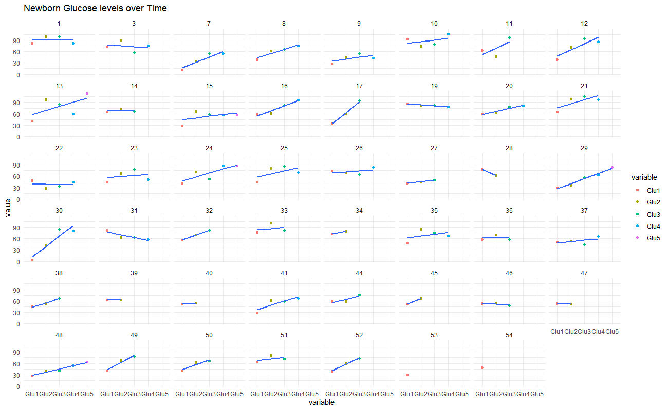

Slide 16
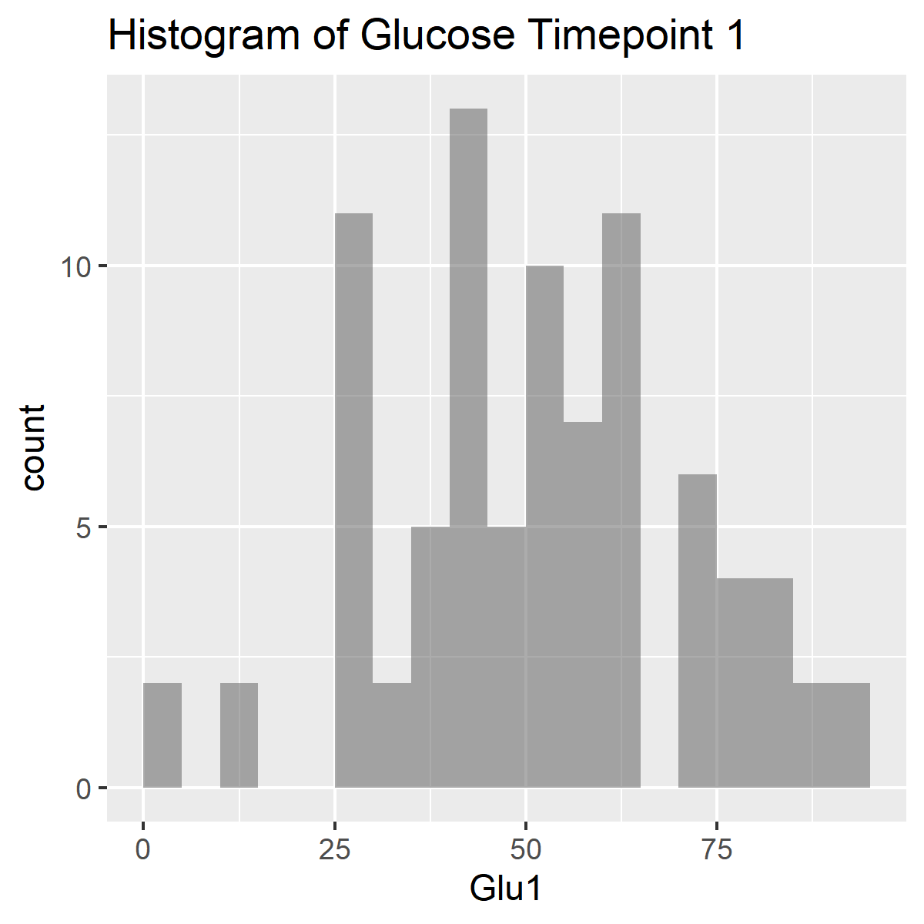
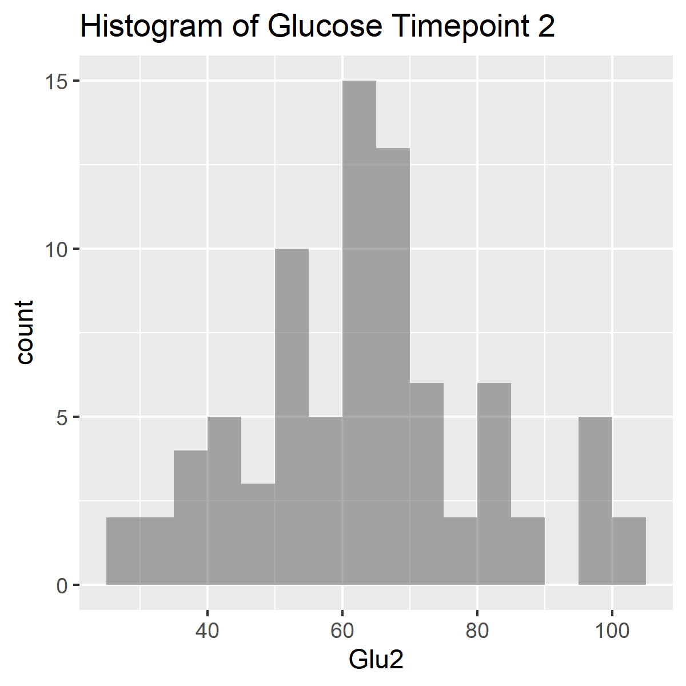
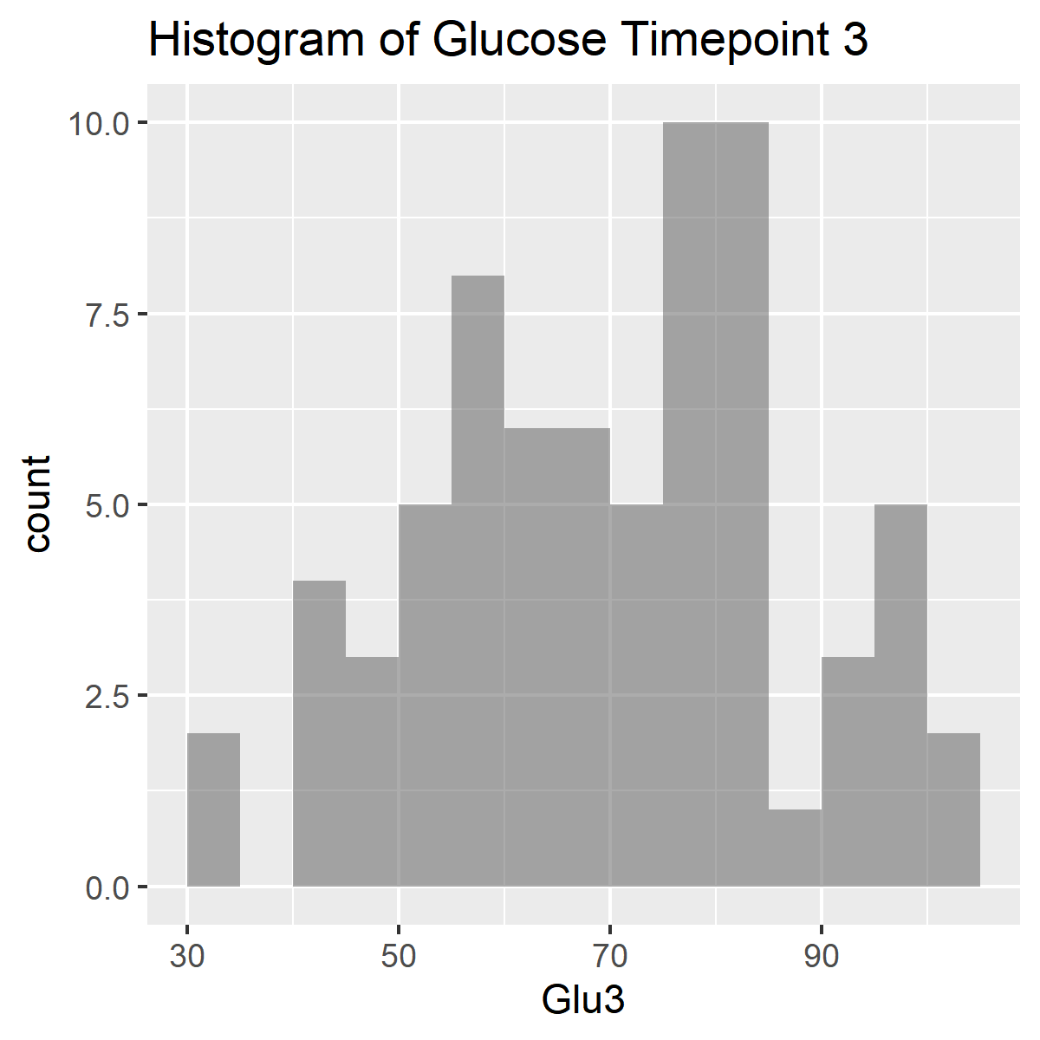
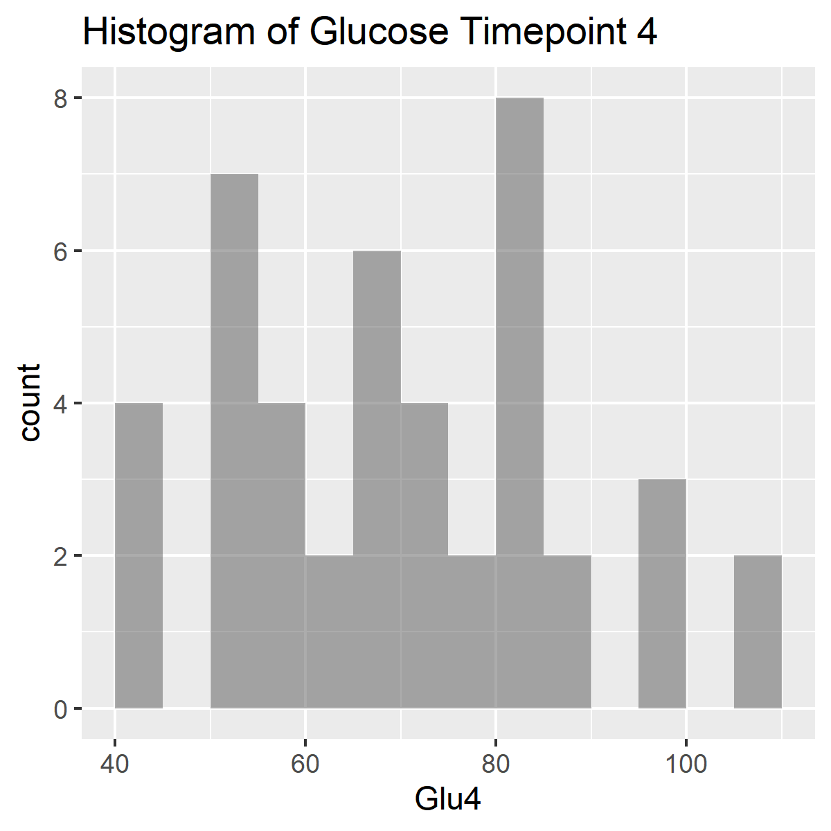
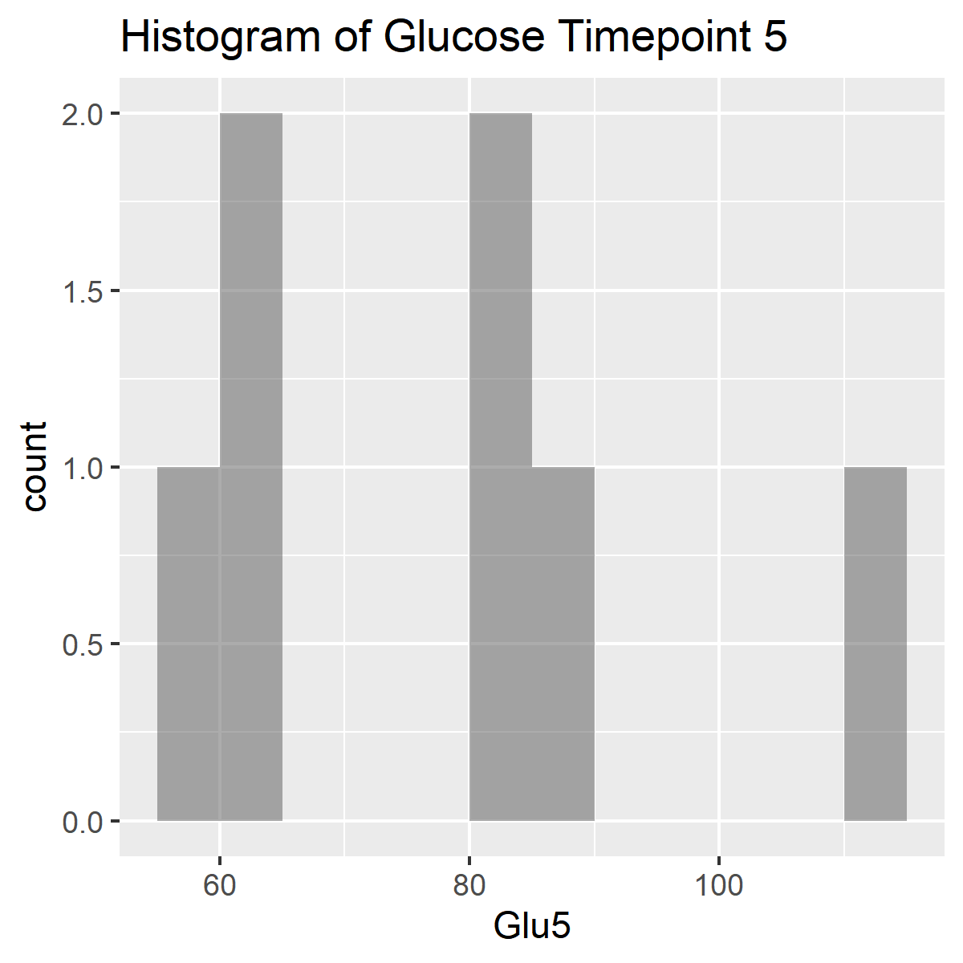
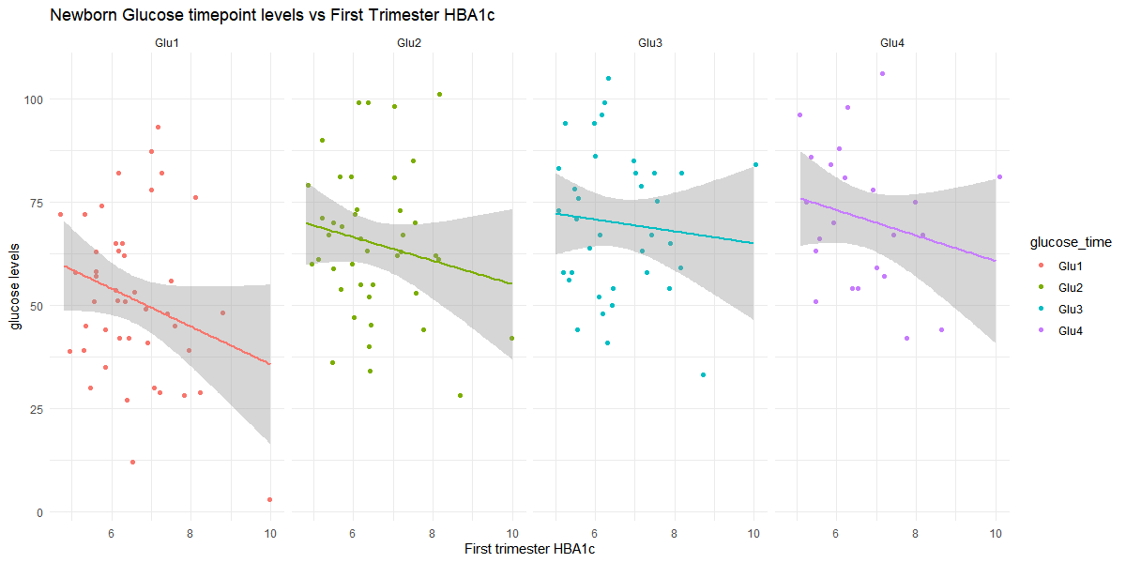

Slide 17
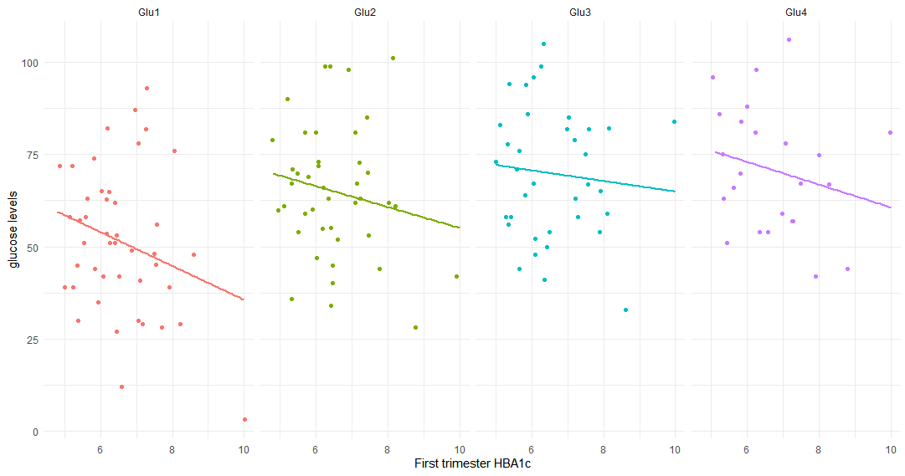
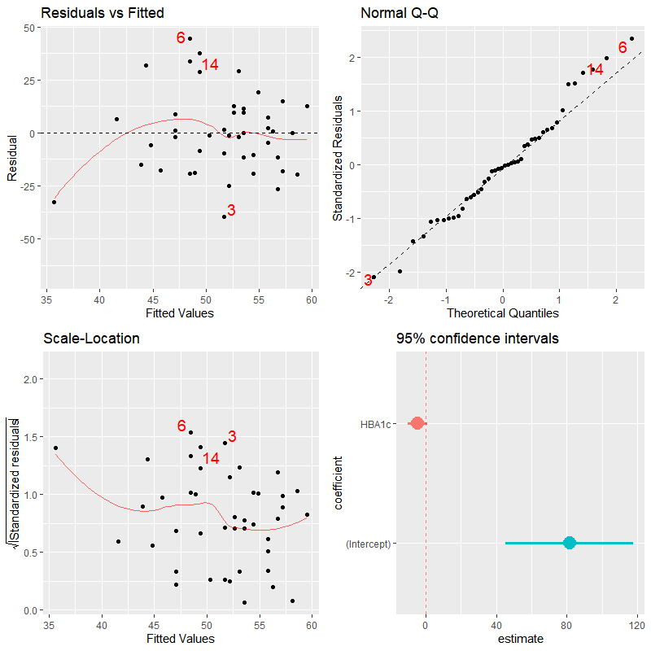
Pearson's product-moment correlation between 1st trimester HBA1c and glucose timepoint 1
data: HBA1c and glu1
t = -1.6874, df = 42, p-value = 0.09894
alternative hypothesis:
true correlation is not equal to 0
95 percent confidence interval:
-0.51065126 0.04854136
sample estimates:
Correlation : -0.2519701
Linear regression model for 1st trimester HBA1c and the interaction effects of glucose timepoints 1-4.
Coefficients:
Estimate Std. Error t value Pr(>|t|)
(Intercept) -2.990e+00 7.710e+00 -0.388 0.7011
glu1 2.345e-01 1.541e-01 1.521 0.1394
glu2 1.431e-01 1.419e-01 1.009 0.3218
glu3 1.771e-01 1.076e-01 1.646 0.1109
glu1:glu2 -3.305e-03 2.521e-03 -1.311 0.2005
glu1:glu3 -4.041e-03 2.049e-03 -1.972 0.0586 .
glu2:glu3 -2.551e-03 1.880e-03 -1.357 0.1856
glu1:glu2:glu3 5.500e-05 3.213e-05 1.712 0.0980 .
Dispersion parameter for gaussian family taken to be
1.263929)
Null deviance: 46.192 on 35 degrees of freedom
Residual deviance: 35.390 on 28 degrees of freedom
(8 observations deleted due to missingness)
AIC: 119.55
Number of Fisher Scoring iterations: 2

Slide 19
Microbiome analysis
Jochum, Michael D
30 July 2020

Slide 20
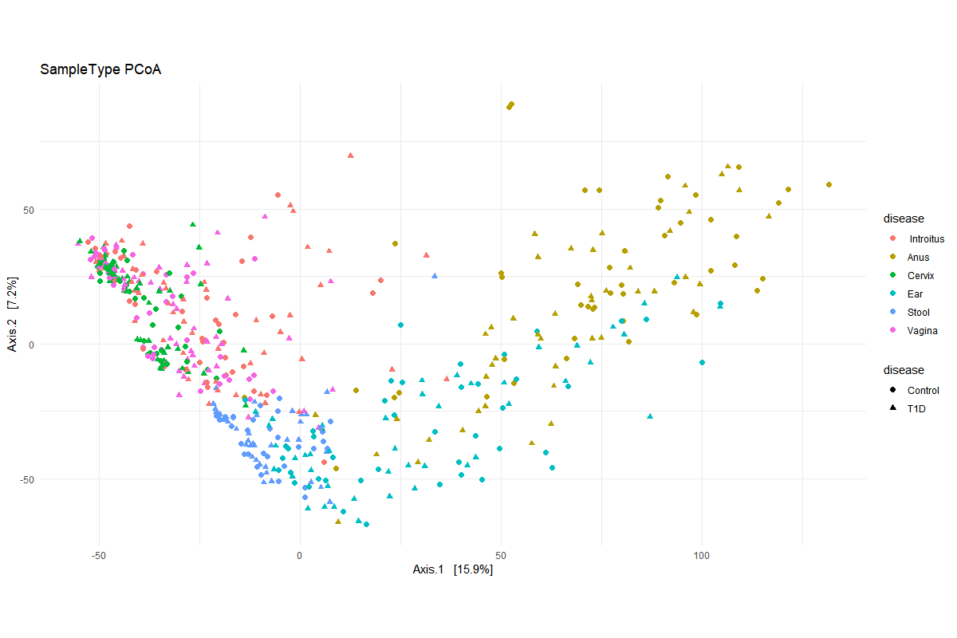
Euclidean Distance Ordination Plot of Variance Stabilizing Transformed (VST) Counts

Slide 21
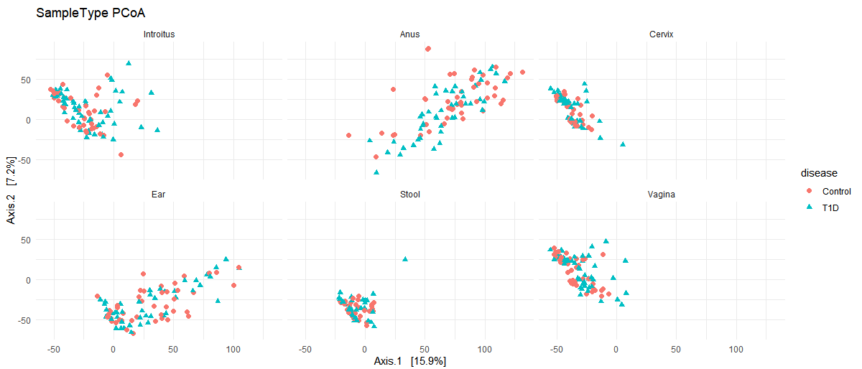
Euclidean Distance Ordination Plot of Variance Stabilizing Transformed (VST) Counts by Sample Type

Slide 22
Adonis PERMANOVA comparing normalized ASV counts and Disease state stratified for Sample Type
DESEQ2 Differential abundance comparisons of ASV counts and disease state
adonis(formula = euc_dist ~ disease, permutations = 9999, strata =SampleType)
Df SumsOfSqs MeanSqs F.Model R2 Pr(>F)
sample_info_tab$disease 1 2289 2288.9 1.933 0.00367 0.0396 *
Residuals 525 621686 1184.2 0.99633
Total 526 623975 1.00000
---
out of 2387 with nonzero total read count
adjusted p-value < 0.01
LFC > 0 (up) : 53, 2.2%
LFC < 0 (down) : 39, 1.6%
outliers [1] : 0, 0%
low counts [2] : 1481, 62%
Overall, there was a significant difference in the Beta diversity when comparing T1D to Control microbiome.
This tells us out of ~2,387ASVs, with adj-p < 0.01, there are 53 increased when comparing Control to T1D, and 39 decreased.
"decreased" in this case means at a lower count abundance in the Control than in the T1D, and "increased" means greater proportion in Control than in T1D cases.
Multivariate homogeneity of groups dispersions (variances)
Analysis of Variance Table
Response: Distances
Df Sum Sq Mean Sq F value Pr(>F)
Groups 1 1411 1410.7 1.1706 0.2798
Residuals 525 632662 1205.1
There was not a significant within group difference IN Beta diversity (precursor to the adonis PERMANOVA)

Slide 23
Genus agglomerated DESEQ2 Differential abundance comparisons of ASV counts and disease state
out of 228 with nonzero total read count
adjusted p-value < 0.01
LFC > 0 (up) : 15, 6.6%
LFC < 0 (down) : 7, 3.1%
outliers [1] : 0, 0%
low counts [2] : 137, 60%
Out of ~228 genera, with adj-p < 0.01, there are 15 increased and 7 decreased when comparing Control to T1D.
ASV | baseMean | log2FoldChange | lfcSE | stat | pvalue | padj | Kingdom | Phylum | Class | Order | Family | Genus
ASV_128 | 10.11059426 | 3.181066694 | 0.460431 | 6.908881609 | 4.88E-12 | 1.48E-10 | Bacteria | Actinobacteria | Actinobacteria | Micrococcales | Micrococcaceae | Kocuria | Control
ASV_210 | 2.523505969 | 3.065424925 | 0.715 | 4.287310435 | 1.81E-05 | 0.00015 | Bacteria | Firmicutes | Clostridia | Clostridiales | Peptostreptococcaceae | Terrisporobacter
ASV_120 | 5.710248608 | 2.846495067 | 0.699369 | 4.07008924 | 4.70E-05 | 0.000285 | Bacteria | Proteobacteria | Gammaproteobacteria | Enterobacteriales | Enterobacteriaceae | Citrobacter
ASV_57 | 13.66833658 | 2.647240679 | 0.496659 | 5.330099266 | 9.82E-08 | 1.28E-06 | Bacteria | Actinobacteria | Actinobacteria | Micrococcales | Micrococcaceae | Rothia
ASV_90 | 68.46939887 | 2.630087662 | 0.358827 | 7.329687615 | 2.31E-13 | 1.05E-11 | Bacteria | Actinobacteria | Actinobacteria | Bifidobacteriales | Bifidobacteriaceae | Bifidobacterium
ASV_52 | 1.57476449 | 2.455524732 | 0.684165 | 3.589081927 | 0.000331845 | 0.001887 | Bacteria | Firmicutes | Bacilli | Lactobacillales | Leuconostocaceae | Weissella
ASV_152 | 7.611591903 | 2.363600485 | 0.467266 | 5.058361065 | 4.23E-07 | 4.81E-06 | Bacteria | Bacteroidetes | Bacteroidia | Bacteroidales | Tannerellaceae | Parabacteroides
ASV_79 | 63.28731094 | 2.158967895 | 0.372004 | 5.803614596 | 6.49E-09 | 1.48E-07 | Bacteria | Bacteroidetes | Bacteroidia | Bacteroidales | Bacteroidaceae | Bacteroides
ASV_284 | 1.971102046 | 2.141904511 | 0.463975 | 4.616418955 | 3.90E-06 | 3.95E-05 | Bacteria | Actinobacteria | Coriobacteriia | Coriobacteriales | Coriobacteriaceae | Collinsella
ASV_174 | 2.391749557 | 1.889279785 | 0.611262 | 3.09078424 | 0.001996286 | 0.008651 | Bacteria | Firmicutes | Clostridia | Clostridiales | Peptostreptococcaceae | Intestinibacter
ASV_134 | 5.162022679 | 1.659591 | 0.398503 | 4.164561714 | 3.12E-05 | 0.000218 | Bacteria | Actinobacteria | Actinobacteria | Micrococcales | Micrococcaceae | Micrococcus
ASV_136 | 9.10707892 | 1.605500504 | 0.497362 | 3.228029371 | 0.001246462 | 0.005671 | Bacteria | Proteobacteria | Gammaproteobacteria | Pasteurellales | Pasteurellaceae | Haemophilus
ASV_219 | 14.12709413 | 1.331995179 | 0.397533 | 3.350654699 | 0.000806208 | 0.003861 | Bacteria | Epsilonbacteraeota | Campylobacteria | Campylobacterales | Campylobacteraceae | Campylobacter
ASV_306 | 7.055622061 | 1.26726588 | 0.358359 | 3.53630112 | 0.000405772 | 0.002071 | Bacteria | Actinobacteria | Actinobacteria | Corynebacteriales | Corynebacteriaceae | Lawsonella
ASV_364 | 25.42088737 | 1.205228571 | 0.341058 | 3.533789593 | 0.000409647 | 0.002071 | Bacteria | Firmicutes | Negativicutes | Selenomonadales | Veillonellaceae | Dialister
ASV_44 | 138.5986789 | -0.849308949 | 0.279239 | -3.041510734 | 0.002353942 | 0.009737 | Bacteria | Actinobacteria | Actinobacteria | Corynebacteriales | Corynebacteriaceae | Corynebacterium_1 | T1D
ASV_7 | 8962.058981 | -1.516573472 | 0.281926 | -5.379337056 | 7.48E-08 | 1.28E-06 | Bacteria | Firmicutes | Bacilli | Bacillales | Staphylococcaceae | Staphylococcus
ASV_215 | 2.591721409 | -2.475750135 | 0.582859 | -4.247593663 | 2.16E-05 | 0.000164 | Bacteria | Firmicutes | Bacilli | Lactobacillales | Aerococcaceae | Aerococcus
ASV_2498 | 1.320281427 | -2.867325722 | 0.694014 | -4.131511936 | 3.60E-05 | 0.000234 | Bacteria | Proteobacteria | Alphaproteobacteria | Rickettsiales | Anaplasmataceae | Wolbachia
ASV_99 | 23.73018761 | -2.943202701 | 0.550872 | -5.342808737 | 9.15E-08 | 1.28E-06 | Bacteria | Firmicutes | Clostridia | Clostridiales | Clostridiaceae_1 | Clostridium_sensu_stricto_1
ASV_139 | 2.431671673 | -3.155689433 | 0.72403 | -4.358505459 | 1.31E-05 | 0.000119 | Bacteria | Proteobacteria | Gammaproteobacteria | Enterobacteriales | Enterobacteriaceae | Raoultella
ASV_21 | 97.78573396 | -3.919981713 | 0.484554 | -8.089882119 | 5.97E-16 | 5.43E-14 | Bacteria | Actinobacteria | Coriobacteriia | Coriobacteriales | Atopobiaceae | Atopobium

Slide 24
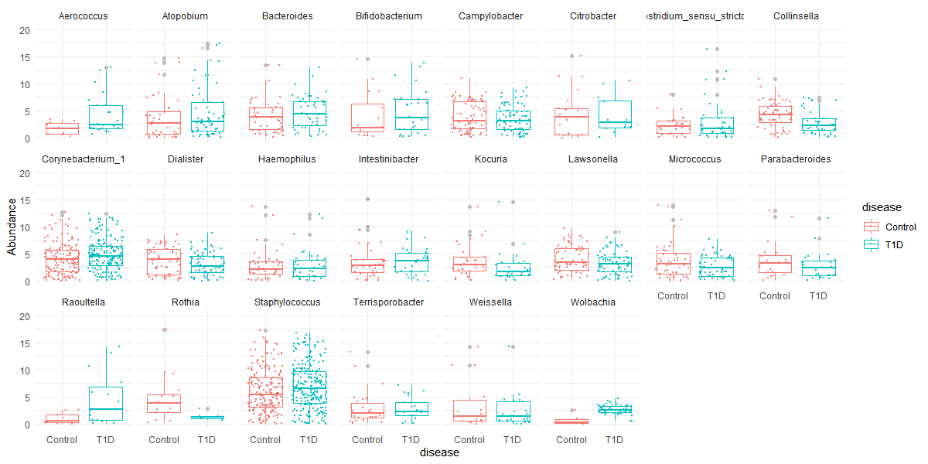
VST counts of Differential abundance Genera associated with Disease

Slide 25
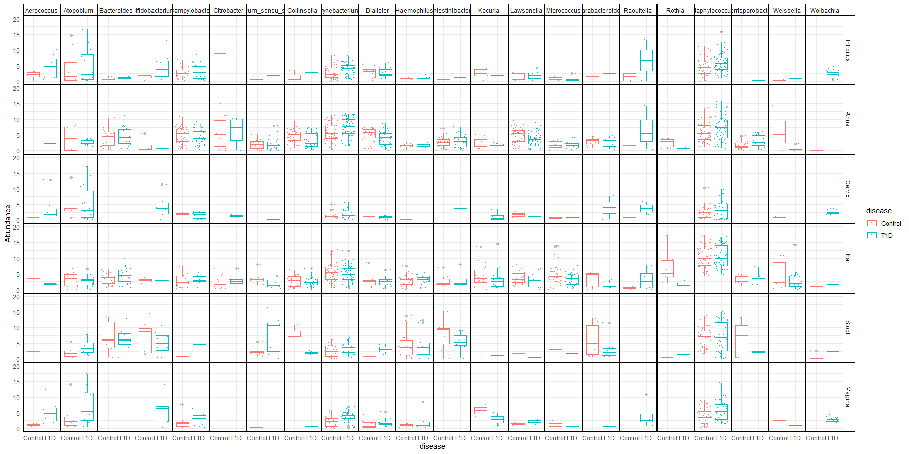
(VST) Counts of Differential abundance Genera associated with Disease by Sample Type
by Sample Type

Slide 26
