Slide 1
Beta Diversity PCOA PlotsType 1 Diabetes
Jochum, Michael D. 11 August 2020

Slide 2
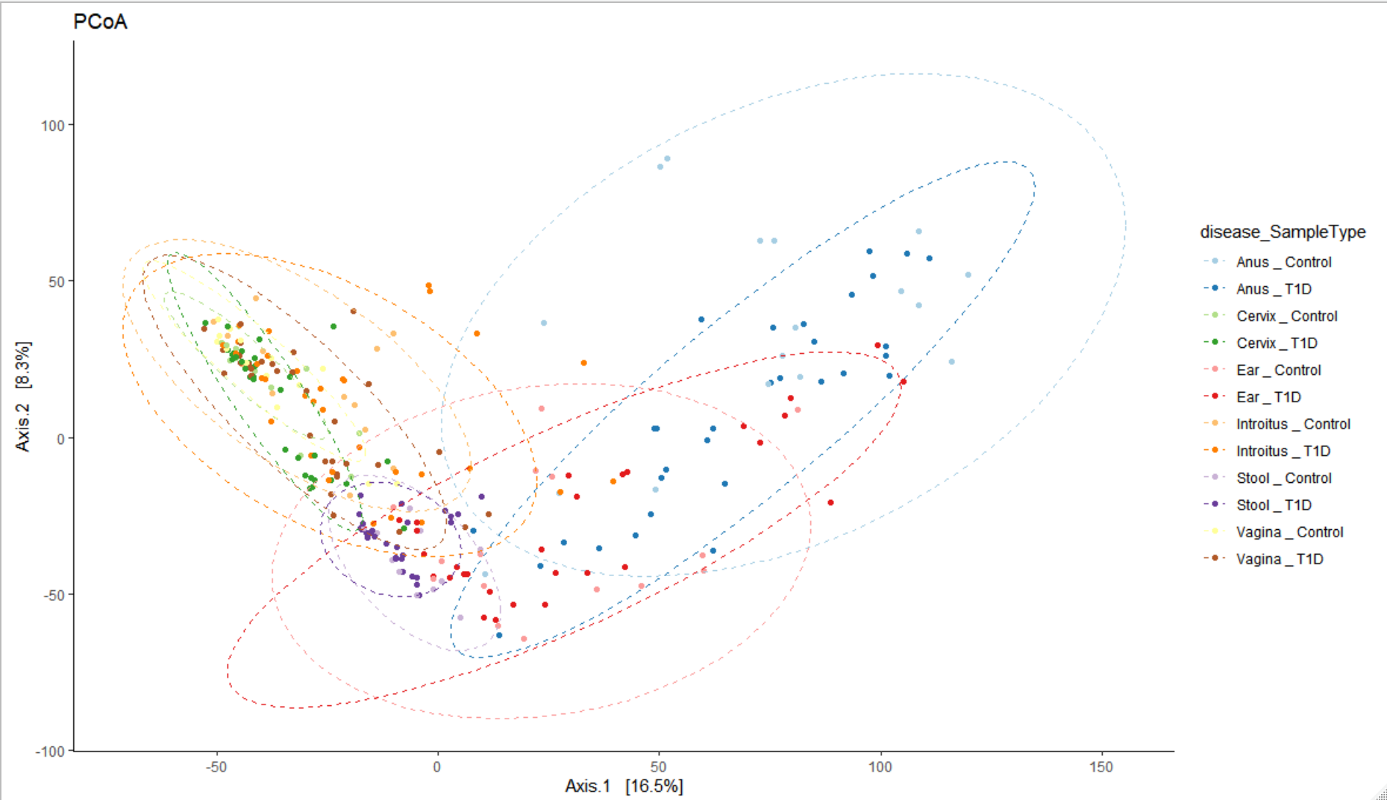
Figure X. Beta Diversity PCoA plots comparing the Type 1 Diabetes and control samples across all microbiome sample types.

Slide 3
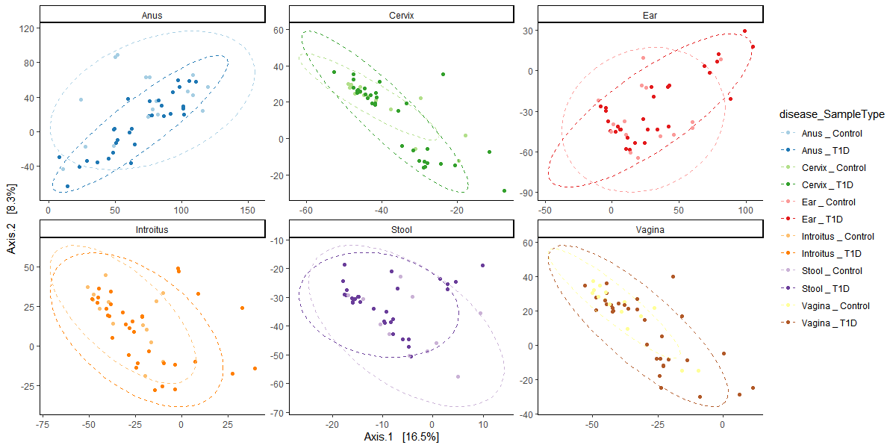
Figure X. Beta Diversity PCoA plots comparing the Type 1 Diabetes and control samples across all microbiome sample types.

Slide 4
Differentially Expressed Taxa associated with Type 1 Diabetes
Jochum, Michael D. 11 August 2020

Slide 5
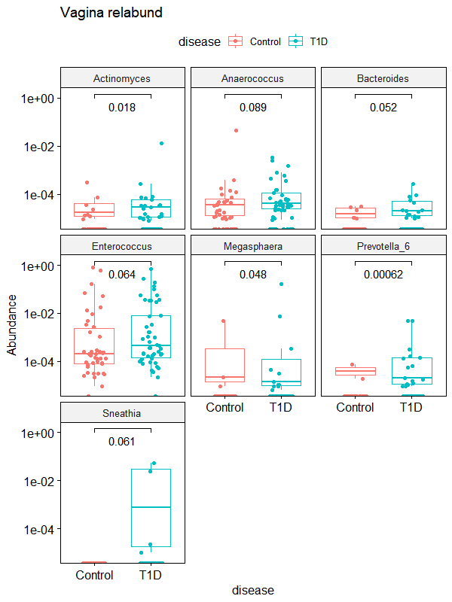
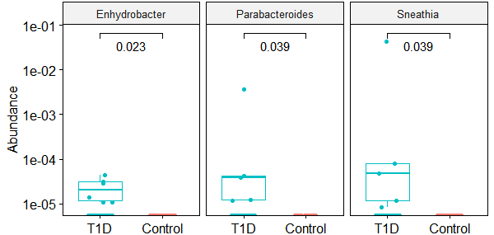
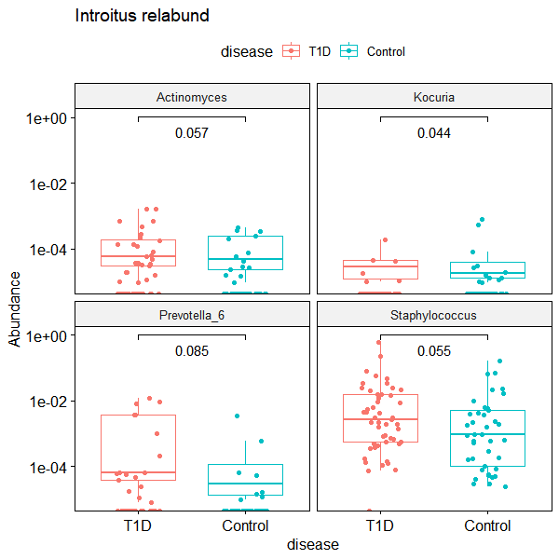
A) Vagina (Posterior Fornix?)
B) Cervix
C) Vaginal Introitus
Figure X. Wilcox test comparisons of differentially expressed genera associated with Type 1 Diabetes in the Maternal A) Posterior Fornix, B) Cervix, C) Vaginal Introitus, and D) Anus microbiomes.

Slide 6
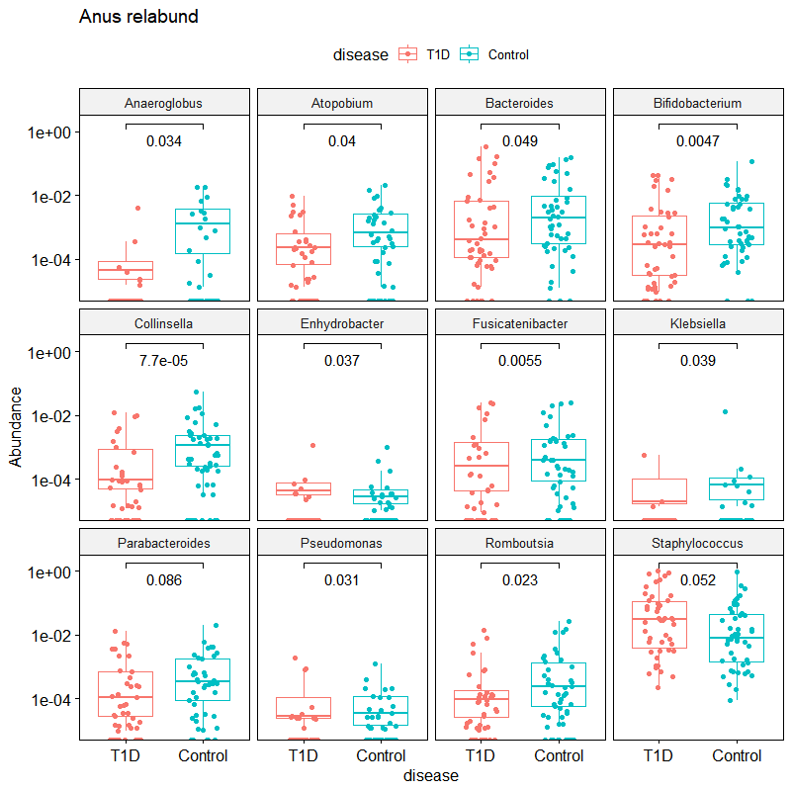
D) Anus
Figure X. Wilcox test comparisons of differentially expressed genera associated with Type 1 Diabetes in the A) Posterior Fornix, B) Cervix, C) Vaginal Introitus, and D)Anus samples

Slide 7
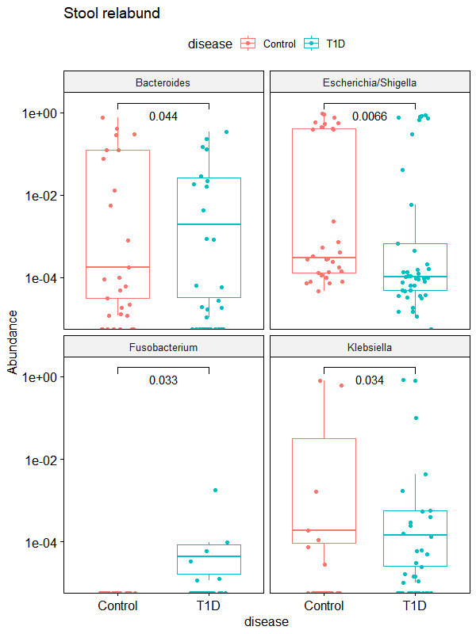
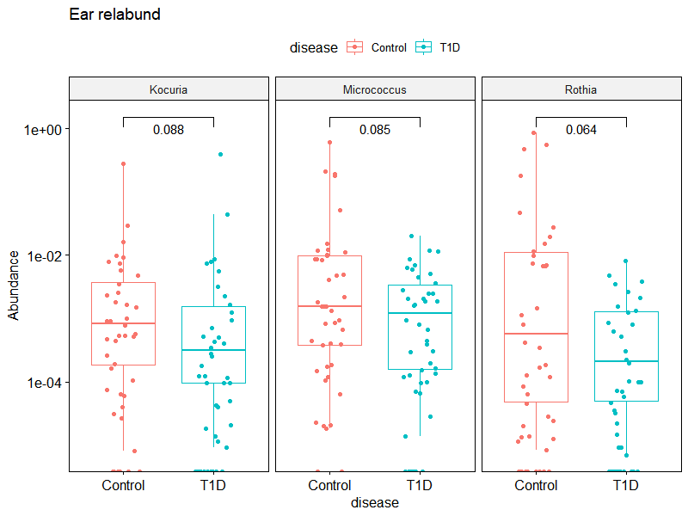
A) Infant Stool
B) Infant Ear canal
Figure X. Wilcox test comparisons of differentially expressed genera associated with Type 1 Diabetes in the A) Infant stool and B) Infant Ear Canal microbiome.

Slide 8
Beta Diversity Analyses
Jochum, Michael D. 5 August 2020

Slide 9
Beta Diversity Bray Curtis adonis permutational ANOVA for distinctly significant variables
Table X. Beta Diversity Bray Curtis adonis permanova of VST transformed counts versus week of delivery stratified by sample type.
Table X. Beta Diversity Bray Curtis adonis permanova of VST transformed counts versus Delivery stratified by sample type
 | Df | SumsOfSqs | MeanSqs | F.Model | R2 | Pr(>F)
Disease | 1 | 22417 | 22417 | 2.418 | 0.00731 | 0.0001 | ***
SampleType | 5 | 625668 | 125134 | 13.497 | 0.20389 | 0.0068 | **
Week of Deliv | 1 | 18741 | 18741 | 2.0215 | 0.00611 | 0.0005 | ***
Disease:SampleType | 5 | 51416 | 10283 | 1.1091 | 0.01675 | 0.1774
Disease:Week of Deliv | 1 | 18744 | 18744 | 2.0217 | 0.00611 | 0.0007 | ***
SampleType:Week of Deliv | 5 | 47951 | 9590 | 1.0344 | 0.01563 | 0.3848
Disease:SampleType:Week of Deliv | 5 | 40115 | 8023 | 0.8654 | 0.01307 | 0.903
Residuals | 242 | 2243635 | 9271 | 0.73114
Total | 265 | 3068686 | 1
---
Signif. codes: 0 ‘***’ 0.001 ‘**’ 0.01 ‘*’ 0.05 ‘.’ 0.1 ‘ ’ 1
 | Df | SumsOfSqs | MeanSqs | F.Model | R2 | Pr(>F)
disease | 1 | 15282 | 15282 | 1.6807 | 0.01828 | 0.0231 | *
SampleType | 1 | 98637 | 98637 | 10.8478 | 0.11796 | 0.0465 | *
Delivery | 1 | 16399 | 16399 | 1.8036 | 0.01961 | 0.004 | **
disease:SampleType | 1 | 10884 | 10884 | 1.197 | 0.01302 | 0.1296
disease:Delivery | 1 | 7380 | 7380 | 0.8116 | 0.00883 | 0.8889
SampleType:Delivery | 1 | 15319 | 15319 | 1.6848 | 0.01832 | 0.0075 | **
disease:SampleType:Delivery | 1 | 8538 | 8538 | 0.939 | 0.01021 | 0.5319
Residuals | 73 | 663773 | 9093 | 0.79379
Total | 80 | 836212 | 1
---
Signif. codes: 0 ‘***’ 0.001 ‘**’ 0.01 ‘*’ 0.05 ‘.’ 0.1 ‘ ’ 1
Table X. Beta Diversity Bray Curtis adonis permanova of VST transformed counts versus percent energy derived from protein stratified by sample type
Table X. Beta Diversity Bray Curtis adonis permanova of VST transformed counts versus Antibiotics stratified by sample type
 | Df | SumsOfSqs | MeanSqs | F.Model | R2 | Pr(>F)
disease | 1 | 22417 | 22417 | 2.4031 | 0.00731 | 0.0001 | ***
SampleType | 5 | 625668 | 125134 | 13.4139 | 0.20389 | 0.0871 | .
% energy protein | 1 | 15960 | 15960 | 1.7108 | 0.0052 | 0.0036 | **
disease:SampleType | 5 | 51445 | 10289 | 1.1029 | 0.01676 | 0.19
disease:% energy protein | 1 | 17635 | 17635 | 1.8904 | 0.00575 | 0.002 | **
SampleType:% energy protein | 5 | 37991 | 7598 | 0.8145 | 0.01238 | 0.9741
disease:SampleType:% energy protein | 5 | 40032 | 8006 | 0.8583 | 0.01305 | 0.9049
Residuals | 242 | 2257538 | 9329 | 0.73567
Total | 265 | 3068686 | 1
---
Signif. codes: 0 ‘***’ 0.001 ‘**’ 0.01 ‘*’ 0.05 ‘.’ 0.1 ‘ ’ 1
 | Df | SumsOfSqs | MeanSqs | F.Model | R2 | Pr(>F)
disease | 1 | 22417 | 22417 | 2.4139 | 0.00731 | 0.0001 | ***
SampleType | 5 | 625668 | 125134 | 13.4746 | 0.20389 | 0.0139 | *
Antibiotics_2 | 1 | 19292 | 19292 | 2.0774 | 0.00629 | 0.0002 | ***
disease:SampleType | 5 | 51411 | 10282 | 1.1072 | 0.01675 | 0.1846
disease:Antibiotics_2 | 1 | 19632 | 19632 | 2.114 | 0.0064 | 0.0001 | ***
SampleType:Antibiotics_2 | 5 | 41891 | 8378 | 0.9022 | 0.01365 | 0.8489
disease:SampleType:Antibiotics_2 | 5 | 41005 | 8201 | 0.8831 | 0.01336 | 0.8891
Residuals | 242 | 2247371 | 9287 | 0.73236
Total | 265 | 3068686 | 1
---
Signif. codes: 0 ‘***’ 0.001 ‘**’ 0.01 ‘*’ 0.05 ‘.’ 0.1 ‘ ’ 1
NOTE: I had to subset the samples in this analysis because not all of the samples had the variables (ie: protein energy % data)

Slide 10
Categorical data Mosaic plots
Jochum, Michael D. 4 August 2020

Slide 11
Data Summary Tables
Disease(n) | Delivery | Abx | No_Abx
Control | Csection | 14 | 6
 | Vaginal | 6 | 15
T1D | Csection | 27 | 4
 | Vaginal | 5 | 12
Disease(%) | Delivery | Abx | No_Abx
Control | Csection | 34.15 | 54.55
 | Vaginal | 65.85 | 45.45
T1D | Csection | 60.00 | 55.56
 | Vaginal | 40.00 | 44.44
 | With antibiotics |  |  | Without antibiotics
Disease (n) | Csection | Vaginal |  | Csection | Vaginal
Control | 14 | 6 |  | 6 | 15
T1D | 27 | 5 |  | 4 | 12
 | With antibiotics |  |  | Without antibiotics
Disease (%) | Csection | Vaginal |  | Csection | Vaginal
Control | 34.14634 | 54.54545 |  | 60 | 55.5556
T1D | 65.85366 | 45.45455 |  | 40 | 44.4444
Table X. Type 1 Diabetes Dataset Counts (Percentages)

Slide 12
Mosaic plot 1 disease x Abx use x Delivery method
3 versions, greyscale, color, and shaded

Slide 13
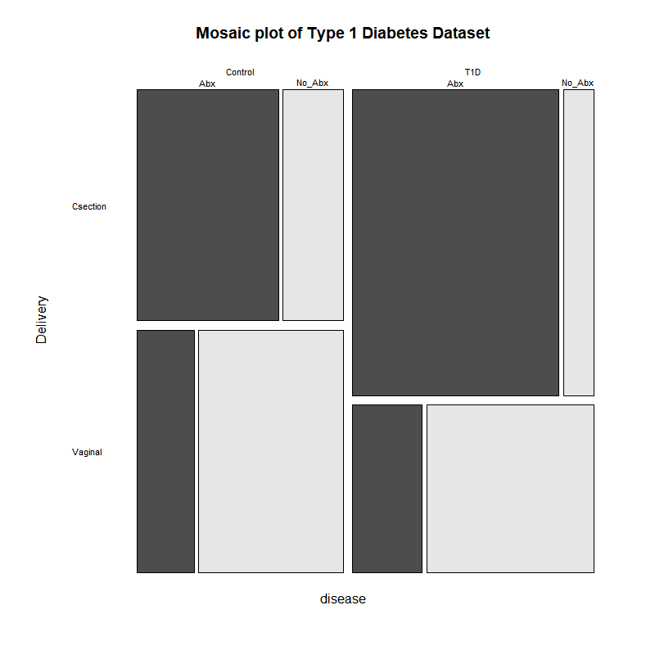
Figure X. Mosaic plot of Type 1 Diabetes Dataset

Slide 14
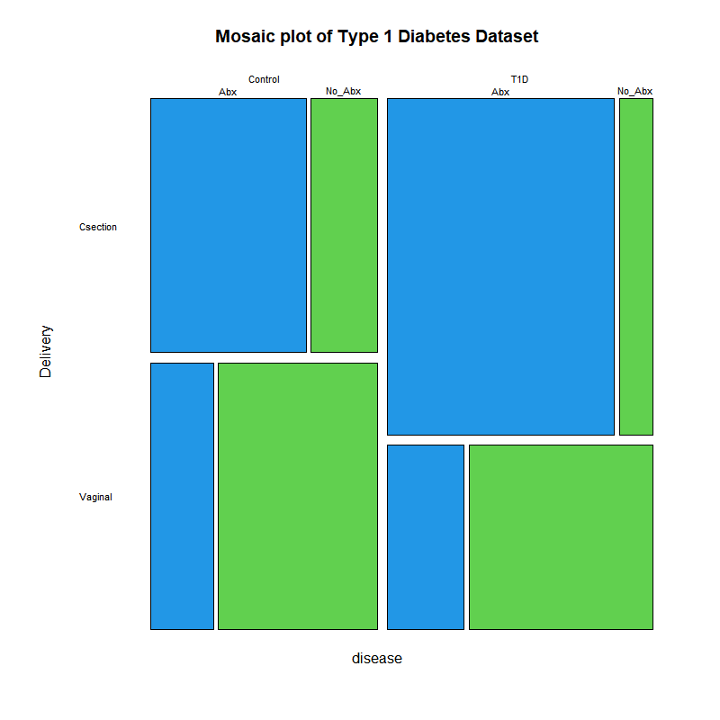
Figure X. Mosaic plot of Type 1 Diabetes Dataset

Slide 15
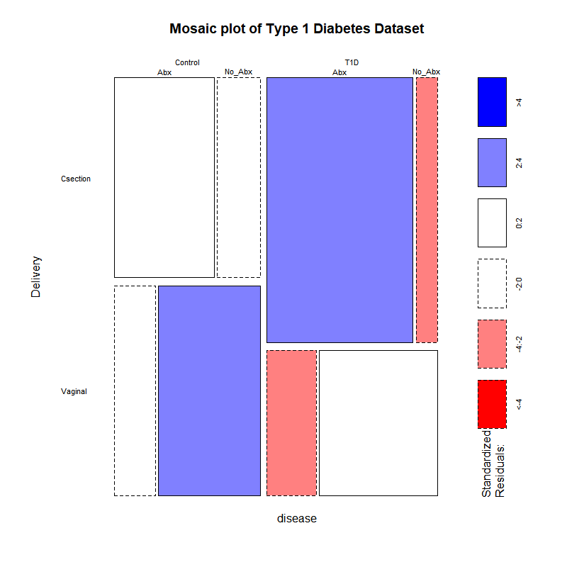
Figure X. Mosaic plot of Type 1 Diabetes Dataset

Slide 16
Mosaic plot 2 disease vs Abx purpose
3 versions, greyscale, color, and shaded

Slide 17
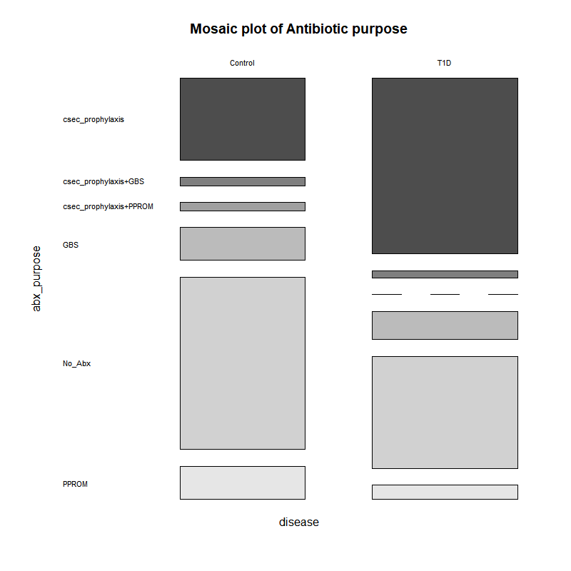
Figure X. Mosaic plot of antibiotic Rationale

Slide 18
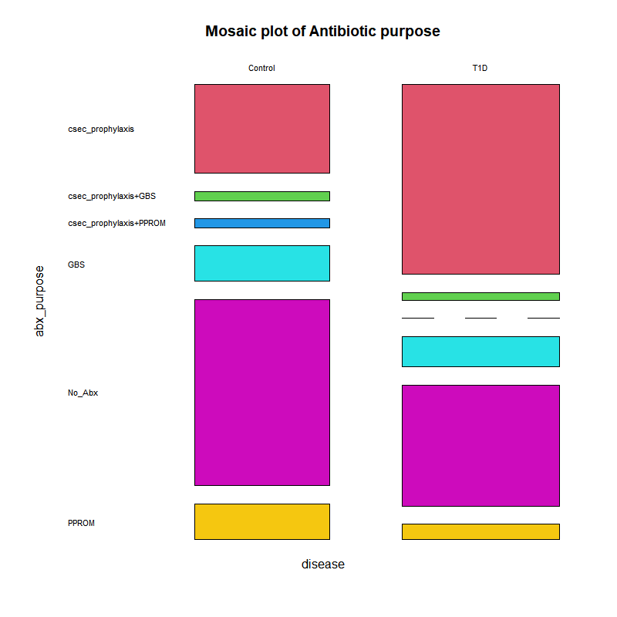
Figure X. Mosaic plot of antibiotic rationale

Slide 19
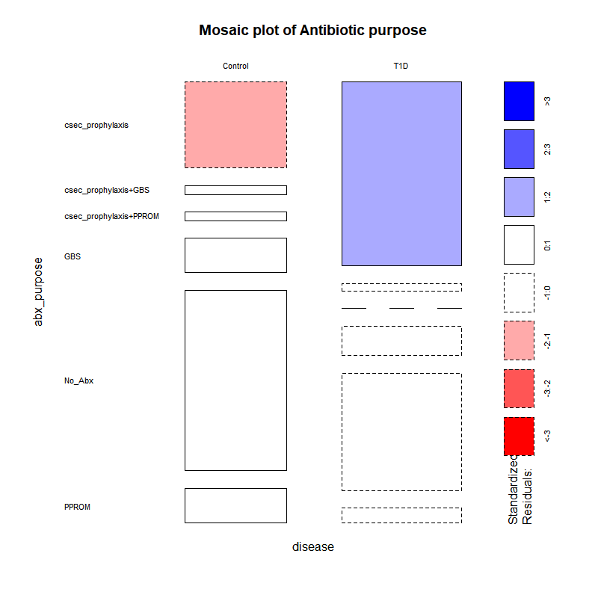
Figure X. Mosaic plot of antibiotic rationale

Slide 20
Continuous Variable Analysis
Jochum, Michael D. 5 August 2020

Slide 21
Table X. Summary of logistical regression models for continuous variable and disease state.
Table X. ANOVA using a linear model fit for continuous variable and disease states comparisons.
Variable |  | estimate | std.error | conf.low | conf.high | statistic | p.value
Bialko_ogolem | (Intercept) | 1.53E+30 | 4.07 | 5.26E+26 | 4.44E+33 | 17.1 | 2.72E-21
 | disease | 1.28 | 4.86 | 9.41E-05 | 17400 | 0.0507 | 0.96
BMI_before | (Intercept) | 6.04E+09 | 0.439 | 2.55E+09 | 1.43E+10 | 51.2 | 7.55E-68
 | disease | 1.96 | 0.593 | 0.613 | 6.26 | 1.13 | 0.26
BMI_after | (Intercept) | 8.96E+11 | 0.548 | 3.06E+11 | 2.63E+12 | 50.2 | 1.54E-66
 | disease | 1.81 | 0.736 | 0.429 | 7.67 | 0.809 | 0.42
energ_bialko_proc | (Intercept) | 18598841 | 0.729 | 4458821 | 77580340 | 23 | 1.72E-26
 | disease | 5 | 0.87 | 0.909 | 27.5 | 1.85 | 0.0709
energ_tluszcz_proc | (Intercept) | 1.18E+12 | 1.37 | 8.04E+10 | 1.72E+13 | 20.3 | 2.79E-24
 | disease | 20.2 | 1.63 | 0.821 | 497 | 1.84 | 0.0725
tydzien_porodu | (Intercept) | 39.1905 | 0.1401 | 7.92E+16 | 1.39E+17 | 279.803 | 2E-16
 | disease | 0.323 | 0.190 | 0.221 | 0.472 | -5.845 | 8.01E-08 | ***
newborn_weight | (Intercept) | Inf | 73.5 | Inf | Inf | 46.3 | 1.42E-64
 | disease | 1.71E+65 | 99.6 | 2.58E-20 | 1.1E+150 | 1.51 | 0.135
Variable |  | Estimate | Std. Error | t value | Pr(>|t|)
Bialko_ogolem | (Intercept) | 69.502 | 4.0686 | 17.082 | <2e-16
 | disease | 0.2459 | 4.8556 | 0.051 | 0.96
BMI_before | (Intercept) | 27.5217 | 0.5484 | 50.183 | <2e-16
 | disease | 0.5955 | 0.7358 | 0.809 | 0.42
BMI_after | (Intercept) | 22.5213 | 0.4395 | 51.245 | <2e-16
 | disease | 0.672 | 0.5929 | 1.133 | 0.26
energ_bialko_proc | (Intercept) | 16.7386 | 0.7287 | 22.97 | <2e-16
 | disease | 1.6089 | 0.8696 | 1.85 | 0.0709 | .
energ_tluszcz_proc | (Intercept) | 27.794 | 1.369 | 20.295 | <2e-16
 | disease | 3.005 | 1.634 | 1.839 | 0.0725 | .
tydzien_porodu | (Intercept) | 39.1905 | 0.1401 | 279.803 | <2e-16
 | disease | -1.1105 | 0.1900 | -5.845 | 8.01e-08 | ***
newborn_weight | (Intercept) | 39.191 | 0.143 | 274.061 | <2e-16
 | disease | -1.131 | 0.194 | -5.828 | 0.1352
Table X. Welch's Two Sample t-test comparisons of continuous variables between Control and T1 Diabetes patients.
Table X. PostHoc Tukey HSD multiple comparisons of means between the continuous variables and disease state.
Variable | Control (avg) | T1D (avg) | 95% CI | t | df | p-value
Bialko_ogolem | 69.502 | 69.74794 | [-9.306434,8.814554] | -0.055404 | 30.419 | 0.9562
BMI_before | 22.52133 | 23.19337 | [-1.833947,0.4898567] | -1.1493 | 88.669 | 0.2535
BMI_after | 27.52166 | 28.11717 | [-2.0210605,0.8300311] | -0.83018 | 87.998 | 0.4087
energ_bialko_proc | 16.73861 | 18.34747 | [-3.002443,-0.2152756] | -2.3295 | 42.193 | 0.02469 | *
energ_tluszcz_proc | 27.7938 | 30.79929 | [-6.327365,0.3163973] | -1.8623 | 25.281 | 0.07422
tydzien_porodu | 39.19048 | 38.09 | [0.724145,1.4985379] | 5.7009 | 74.725 | 2.244E-07 | ***
newborn_weight | 3402.595 | 3552.8 | [-343.61315,43.20362] | -1.5431 | 89.187 | 0.1264
 | diff | lwr | upr | p adj
Bialko_ogolem | 0.2459396 | -9.53E+00 | 10.02555 | 0.959828
BMI_before | 0.6720452 | -5.06E-01 | 1.850115 | 0.26005
BMI_after | 0.5955147 | -0.86673 | 2.057758 | 0.420499
energ_bialko_proc | 1.608859 | -0.14268 | 3.360396 | 0.070881 | .
energ_tluszcz_proc | 3.005484 | -0.28624 | 6.297206 | 0.072525 | .
tydzien_porodu | -1.110476 | -1.48793 | -0.733023 | 1.00E-07
newborn_weight | 150.2048 | -47.767 | 348.1765 | 0.135229

Slide 22
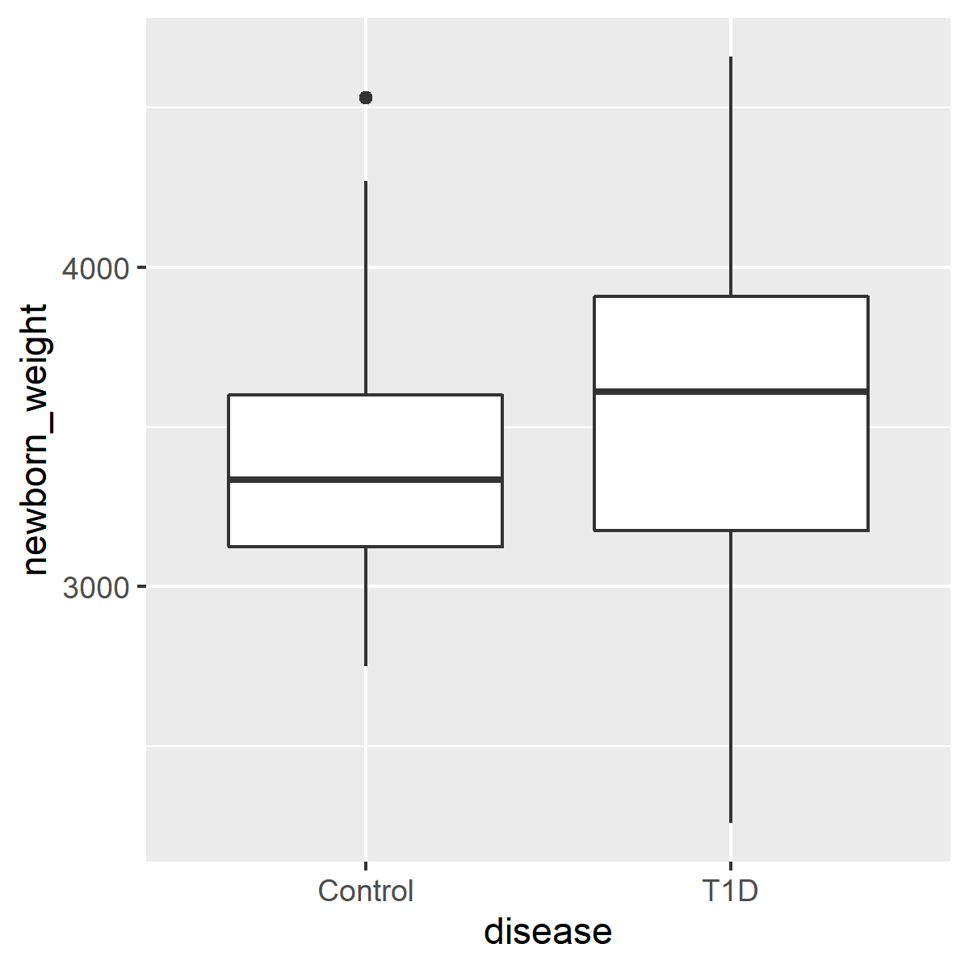
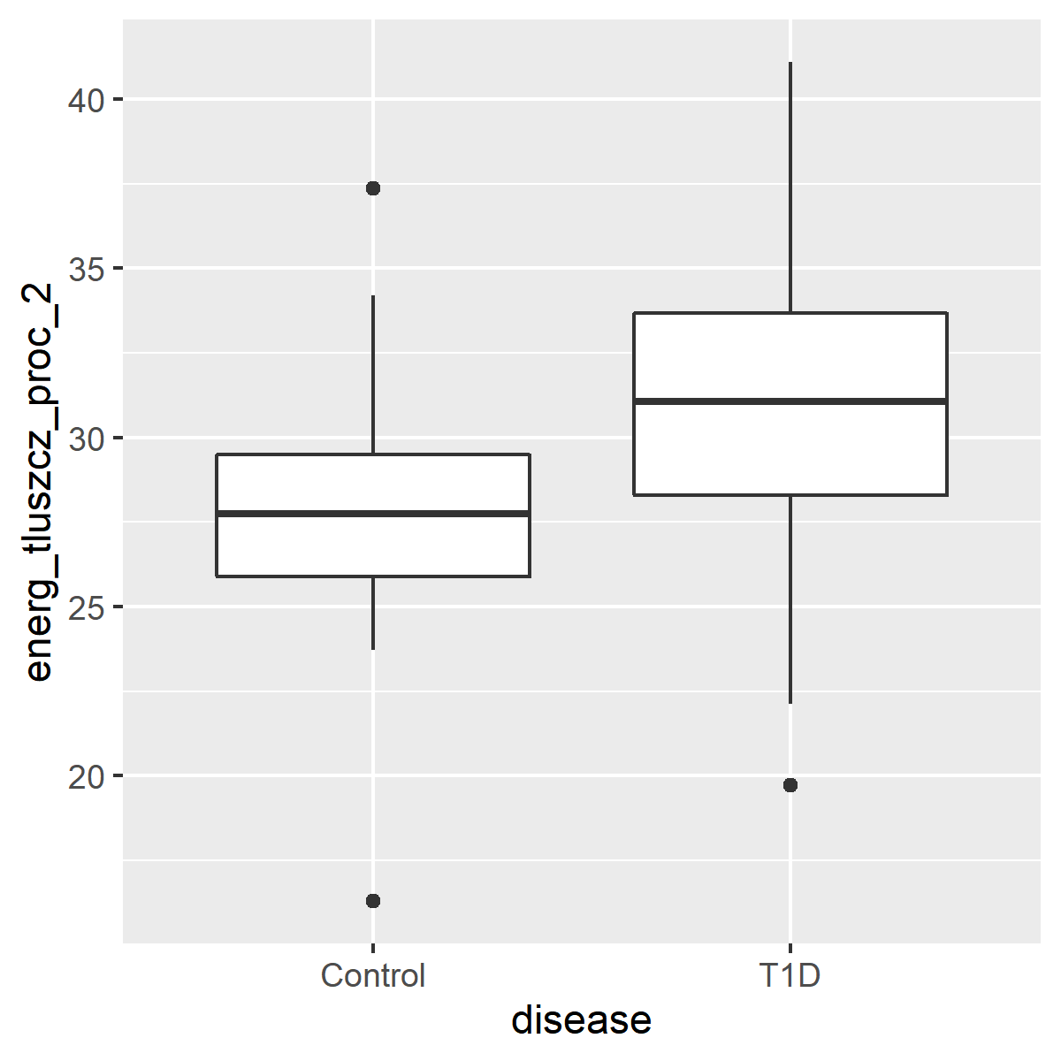
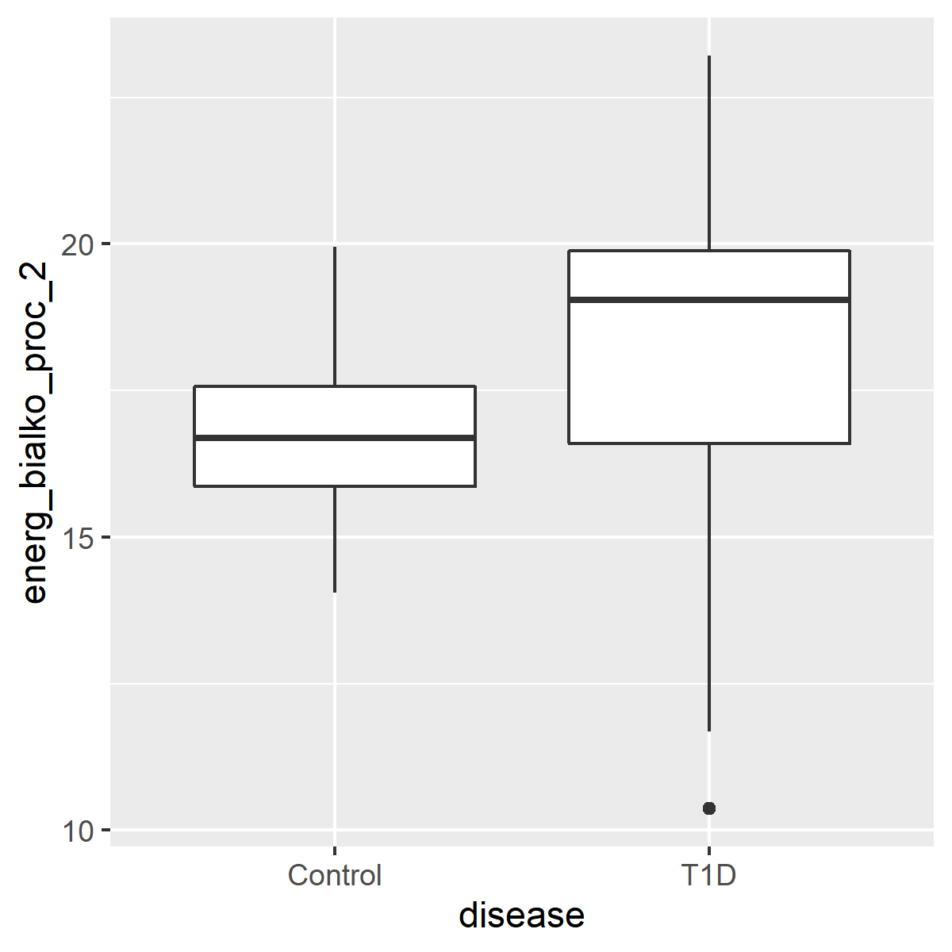
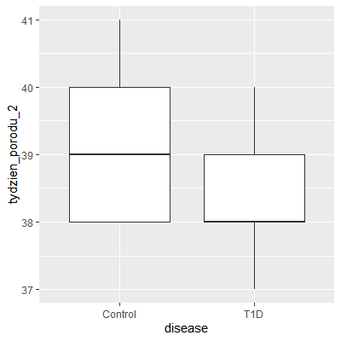
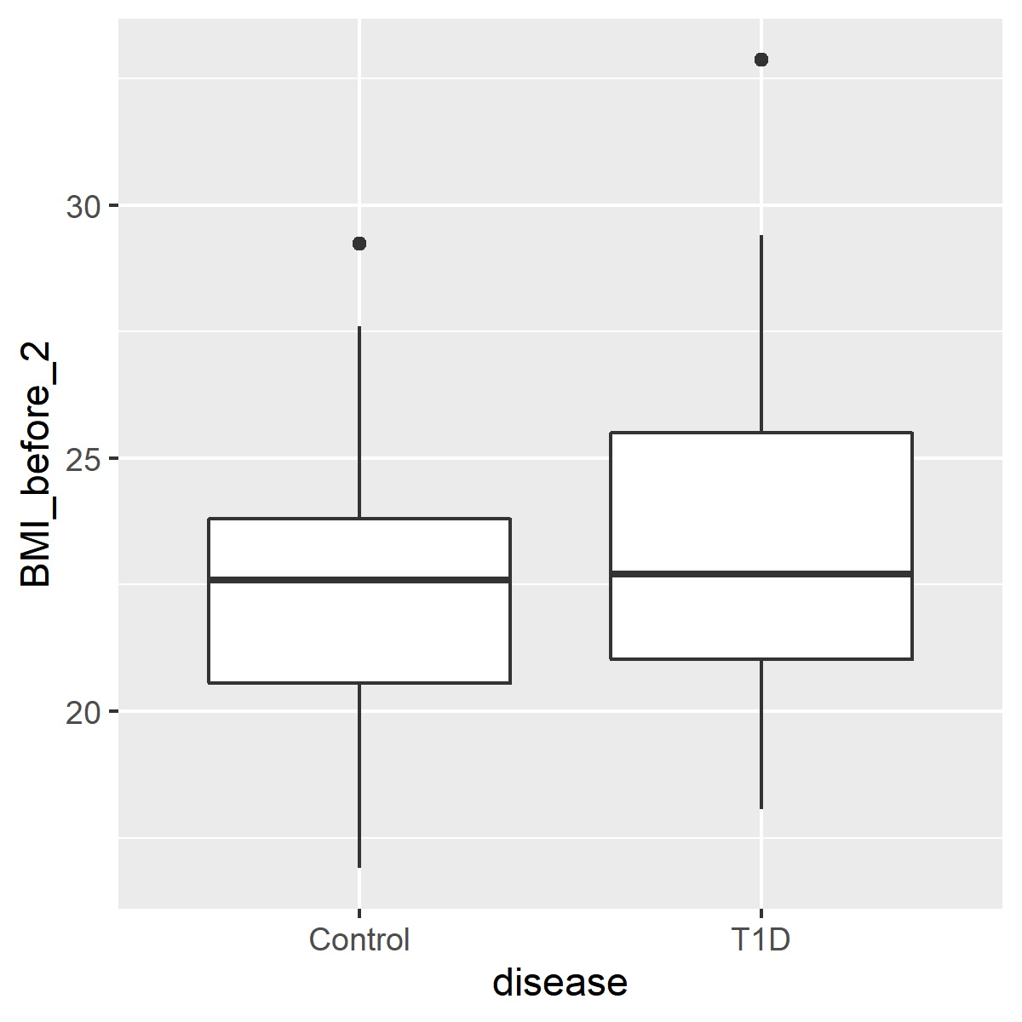
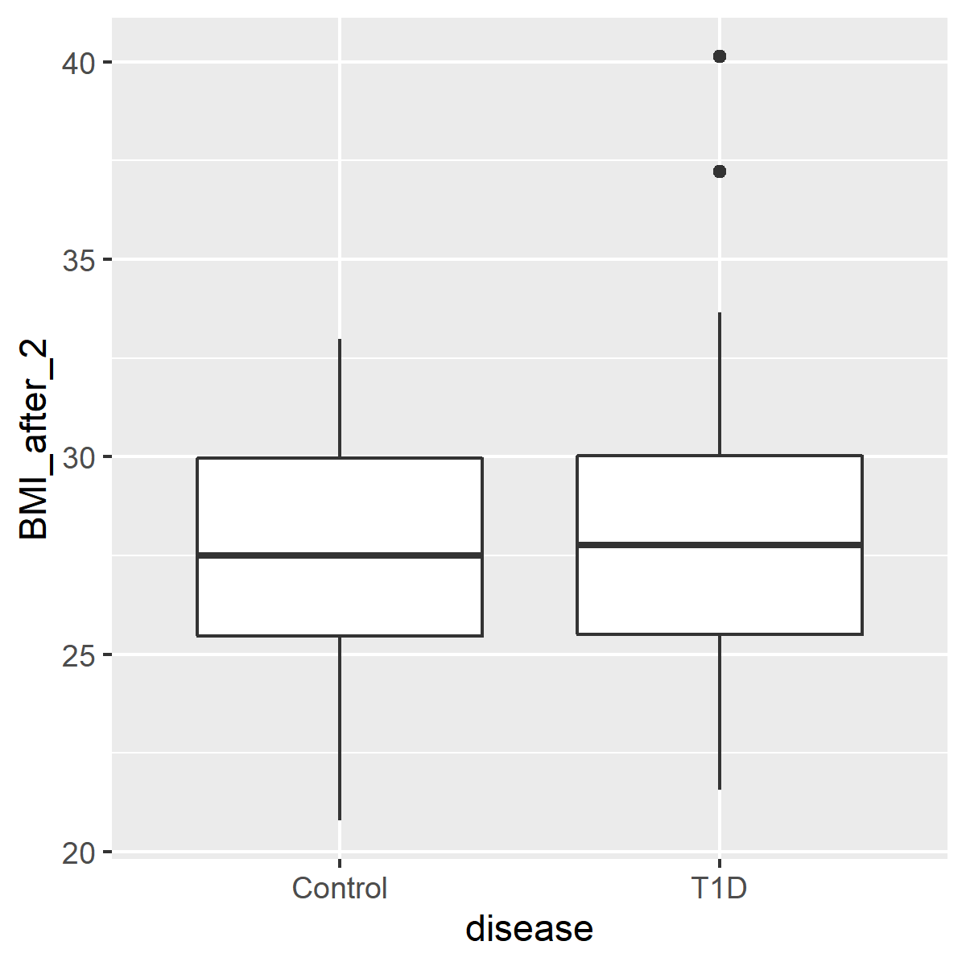
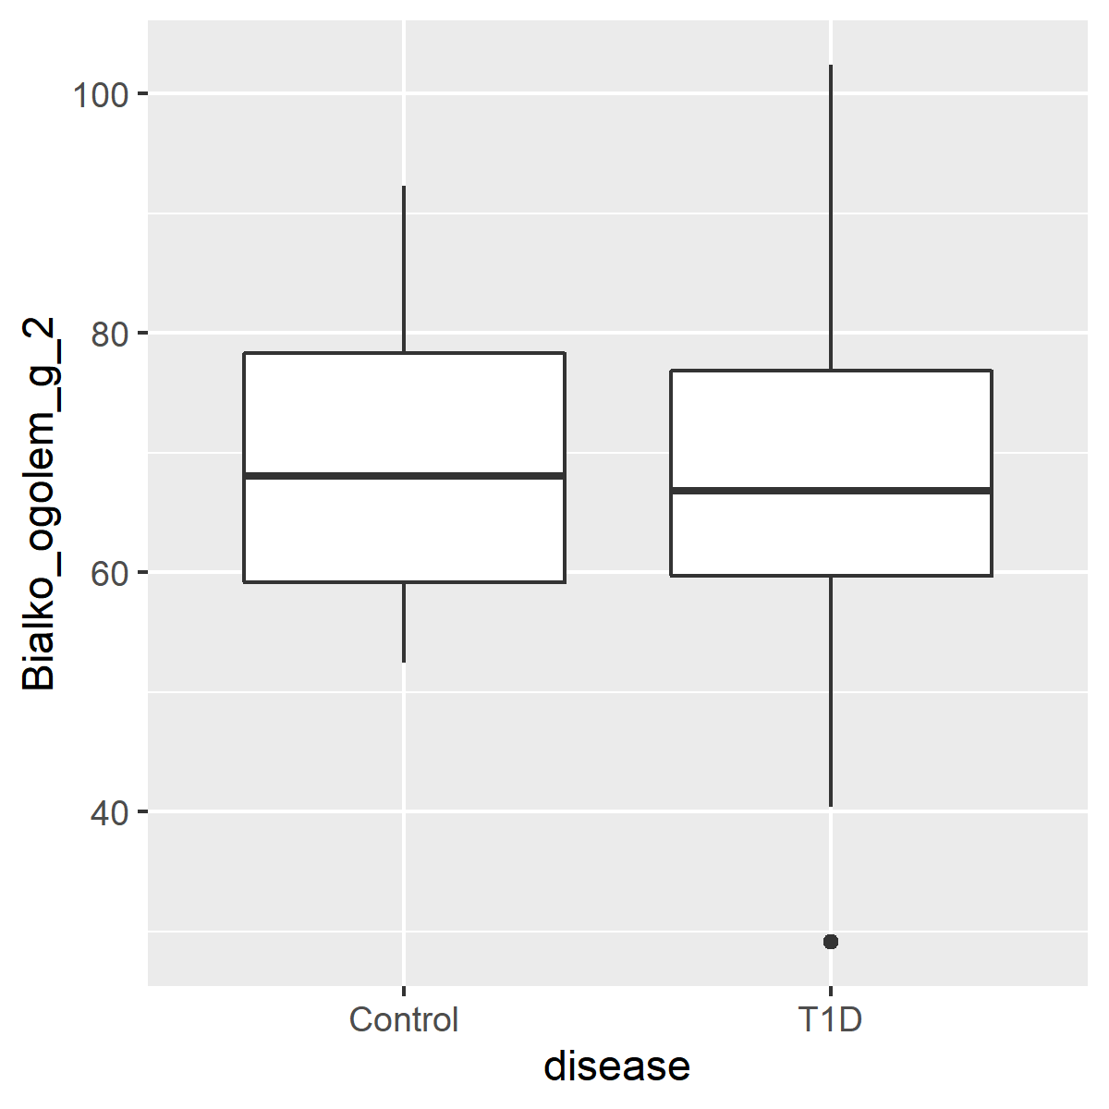
Figure X. Box and whisker plot comparisons of continuous variable and disease. Box enclosure and whiskers represent the 25th and 75th percentiles, respectively. Median is denoted by the horizontal line, and outliers are portrayed as points outside the box.

Slide 23
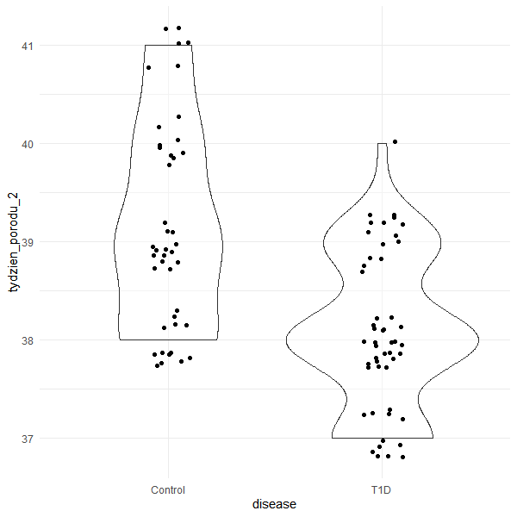
disease state | min | Q1 | median | Q3 | max | mean | sd | n
Control | 38 | 38 | 39 | 40 | 41 | 39.19048 | 1.04153 | 42
T1D | 37 | 38 | 38 | 39 | 40 | 38.08 | 0.778277 | 50
Figure X. Violin plot comparison between disease state and week of delivery [p < 0.0001].

Slide 24
Supplemental
Jochum, Michael D. 11 August 2020

Slide 25
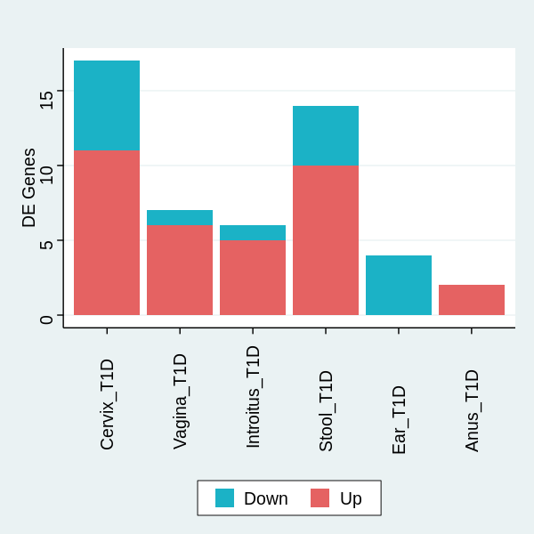
Table X. Log 2-fold change and p value of differentially expressed genera associated with Type 1 Diabetes
Vagina |  |  |  |  |  |  |  | Infant Stool
Genus | baseMean | log2FoldChange | lfcSE | stat | pvalue | padj |  | Genus | baseMean | log2FoldChange | lfcSE | stat | pvalue | padj
Sneathia | 0.91355325 | 49.75205694 | 3.13553 | 15.86719 | 1.07E-56 | 2.44E-54 |  | Fusicatenibacter | 4.220115 | 26.4382456 | 1.231132084 | 21.47474 | 2.68E-102 | 3.03E-100
Intestinibacter | 2.25394947 | 14.81940553 | 1.300908 | 11.39159 | 4.61E-30 | 5.25E-28 |  | Fusobacterium | 8.180648 | 20.08683224 | 1.35277147 | 14.84865 | 7.10E-50 | 4.01E-48
Atopobium | 96.63138911 | 6.817629914 | 1.005162 | 6.782617 | 1.18E-11 | 8.97E-10 |  | Megasphaera | 3.663976 | 15.61100439 | 1.620942737 | 9.630818 | 5.93E-22 | 2.23E-20
Megasphaera | 3.663975758 | 7.795750046 | 1.382241 | 5.639935 | 1.70E-08 | 9.70E-07 |  | Anaeroglobus | 2.730555 | 19.46259187 | 2.232914701 | 8.716227 | 2.88E-18 | 8.13E-17
Streptococcus | 1247.347326 | -3.575171258 | 0.710685 | -5.0306 | 4.89E-07 | 2.23E-05 |  | Pseudomonas | 5.238713 | 7.50531745 | 0.927683487 | 8.090386 | 5.95E-16 | 1.34E-14
Gemella | 7.791854732 | 7.025311314 | 1.569641 | 4.475743 | 7.61E-06 | 0.000289 |  | Collinsella | 5.822142 | -8.766264106 | 1.128939518 | -7.76504 | 8.16E-15 | 1.54E-13
Prevotella_6 | 30.81174732 | 3.78113307 | 0.950575 | 3.977733 | 6.96E-05 | 0.002266 |  | Romboutsia | 2.192765 | 6.40497023 | 1.202747682 | 5.325282 | 1.01E-07 | 1.63E-06
Introitus |  |  |  |  |  |  |  | Peptoniphilus | 132.7484 | 3.420168182 | 0.746132643 | 4.583861 | 4.56E-06 | 6.45E-05
Genus | baseMean | log2FoldChange | lfcSE | stat | pvalue | padj |  | Terrisporobacter | 2.507783 | -7.662802823 | 1.690229063 | -4.53359 | 5.80E-06 | 7.28E-05
Gemella | 7.791854732 | 21.37686055 | 1.594903 | 13.40323 | 5.79E-41 | 1.32E-38 |  | Sutterella | 3.176991 | -5.191498608 | 1.197334093 | -4.33588 | 1.45E-05 | 0.00016405
Citrobacter | 13.1186876 | 15.31044525 | 1.496272 | 10.2324 | 1.42E-24 | 1.62E-22 |  | Dialister | 33.95076 | 3.498783559 | 0.957451276 | 3.654268 | 0.000258 | 0.002649509
Terrisporobacter | 2.507782593 | 14.70171656 | 1.528636 | 9.617539 | 6.74E-22 | 5.12E-20 |  | Bacteroides | 325.9302 | -3.032249963 | 0.875592579 | -3.46308 | 0.000534 | 0.005028719
Enhydrobacter | 2.725316164 | -5.10656261 | 0.868546 | -5.87944 | 4.12E-09 | 2.35E-07 |  | Actinomyces | 7.449215 | 2.884909904 | 0.849028514 | 3.397895 | 0.000679 | 0.005902636
Klebsiella | 110.8625127 | 7.790694435 | 1.360577 | 5.726023 | 1.03E-08 | 4.69E-07 |  | Lachnoclostridium | 1.616491 | 3.844592112 | 1.188055273 | 3.236038 | 0.001212 | 0.009782669
Staphylococcus | 11942.16678 | 2.430468841 | 0.578343 | 4.202468 | 2.64E-05 | 0.001003 |  | Infant Ear
Cervix |  |  |  |  |  |  |  | Genus | baseMean | log2FoldChange | lfcSE | stat | pvalue | padj
Genus | baseMean | log2FoldChange | lfcSE | stat | pvalue | padj |  | Rothia | 104.7048 | -7.754220456 | 0.944265916 | -8.2119 | 2.18E-16 | 4.96E-14
Enhydrobacter | 2.725316164 | 18.47318766 | 0.920473 | 20.06924 | 1.37E-89 | 2.03E-87 |  | Micrococcus | 34.24541 | -3.706357826 | 0.738726707 | -5.01722 | 5.24E-07 | 5.98E-05
Parabacteroides | 10.16690706 | 16.90968828 | 0.981441 | 17.22944 | 1.60E-66 | 1.18E-64 |  | Escherichia/Shigella | 9056.504 | -3.049190658 | 0.743220907 | -4.10267 | 4.08E-05 | 0.003103903
Collinsella | 5.822141559 | -15.18735083 | 1.050767 | -14.4536 | 2.38E-47 | 1.17E-45 |  | Kocuria | 7.549618 | -3.286509007 | 0.821777475 | -3.99927 | 6.35E-05 | 0.003621694
Intestinibacter | 2.25394947 | 17.91541358 | 1.314871 | 13.62523 | 2.84E-42 | 1.05E-40
Sneathia | 0.91355325 | 42.94575628 | 3.185337 | 13.48233 | 1.99E-41 | 5.88E-40
Fusicatenibacter | 4.220114744 | 14.23939158 | 1.11886 | 12.7267 | 4.20E-37 | 1.04E-35
Terrisporobacter | 2.507782593 | 14.19701848 | 1.528636 | 9.287377 | 1.58E-20 | 3.34E-19
Bacteroides | 325.9301607 | 6.338634935 | 0.836282 | 7.579545 | 3.47E-14 | 6.42E-13
Jonquetella | 1.868206931 | 15.34681861 | 2.035424 | 7.539862 | 4.70E-14 | 7.74E-13
Atopobium | 96.63138911 | 6.622227482 | 1.020744 | 6.487647 | 8.72E-11 | 1.29E-09
Bifidobacterium | 521.8067153 | -5.863567853 | 0.969993 | -6.04496 | 1.49E-09 | 2.01E-08
Anaerococcus | 218.5977436 | -3.201892621 | 0.630139 | -5.08125 | 3.75E-07 | 4.62E-06
Gemella | 7.791854732 | 7.914833526 | 1.58885 | 4.981487 | 6.31E-07 | 7.18E-06
Enterococcus | 11413.42655 | -2.766598003 | 0.685799 | -4.03412 | 5.48E-05 | 0.000579
Escherichia/Shigella | 9056.503563 | 2.792875562 | 0.73106 | 3.82031 | 0.000133 | 0.001315
Staphylococcus | 11942.16678 | -2.088343619 | 0.580015 | -3.6005 | 0.000318 | 0.002938
Fusobacterium | 8.180647569 | -3.9099907 | 1.201969 | -3.25299 | 0.001142 | 0.009942
Anus
Genus | baseMean | log2FoldChange | lfcSE | stat | pvalue | padj
Staphylococcus | 11942.16678 | 3.133243112 | 0.56915 | 5.505127 | 3.69E-08 | 8.41E-06
Sneathia | 0.91355325 | 13.85718931 | 3.134176 | 4.421318 | 9.81E-06 | 0.001118
Notes:
Separate analysis by sample type

Slide 26
Table X. Log 2-fold change and p value of differentially expressed genera associated with Type 1 Diabetes
 | Cervix |  |  | Vagina |  |  | Introitus |  |  | Stool |  |  | Ear |  |  | Anus
Genus | lfc | p adj |  | lfc | p adj |  | lfc | p adj |  | lfc | p adj |  | lfc | p adj |  | lfc | p adj
Actinomyces | 0.18 | 1.00 |  | 1.67 | 0.34 |  | 0.71 | 1.00 |  | 2.88 | 0.01 |  | 0.82 | 0.96 |  | -0.47 | 1.00
Anaerococcus | -3.20 | 0.00 |  | -2.13 | 0.01 |  | -1.99 | 0.03 |  | 1.28 | 0.41 |  | 1.64 | 0.16 |  | 0.33 | 1.00
Anaeroglobus | -3.21 | 0.56 |  | 0.62 | 1.00 |  | -0.20 | 1.00 |  | 19.46 | 0.00 |  | -1.97 | 1.00 |  | -3.69 | 0.50
Atopobium | 6.62 | 0.00 |  | 6.82 | 0.00 |  | 2.88 | 0.08 |  | -0.11 | 1.00 |  | -1.89 | 0.54 |  | -2.04 | 0.45
Bacteroides | 6.34 | 0.00 |  | 2.14 | 0.19 |  | 1.26 | 1.00 |  | -3.03 | 0.01 |  | 1.58 | 0.42 |  | -0.09 | 1.00
Bifidobacterium | -5.86 | 0.00 |  | -0.29 | 1.00 |  | -3.03 | 0.04 |  | -0.01 | 1.00 |  | 0.96 | 1.00 |  | -1.74 | 0.55
Citrobacter | 2.57 | 0.51 |  | -0.10 | 1.00 |  | 15.31 | 0.00 |  | 1.25 | 1.00 |  | -0.65 | 1.00 |  | -4.74 | 0.04
Collinsella | -15.19 | 0.00 |  | -0.80 | 1.00 |  | -0.71 | 1.00 |  | -8.77 | 0.00 |  | 0.22 | 1.00 |  | -1.67 | 0.55
Dialister | -1.34 | 0.51 |  | -1.37 | 0.90 |  | -2.02 | 0.13 |  | 3.50 | 0.00 |  | -1.45 | 0.53 |  | -0.69 | 1.00
Enhydrobacter | 18.47 | 0.00 |  | -0.02 | 1.00 |  | -5.11 | 0.00 |  | 0.99 | 1.00 |  | 0.81 | 1.00 |  | -1.76 | 0.45
Enterococcus | -2.77 | 0.00 |  | 0.60 | 1.00 |  | 0.53 | 1.00 |  | 0.38 | 1.00 |  | 1.13 | 0.67 |  | 1.51 | 0.44
Escherichia/Shigella | 2.79 | 0.00 |  | -0.95 | 1.00 |  | -1.13 | 1.00 |  | -0.51 | 1.00 |  | -3.05 | 0.00 |  | 0.85 | 0.92
Fusicatenibacter | 14.24 | 0.00 |  | -0.02 | 1.00 |  | 1.62 | 1.00 |  | 26.44 | 0.00 |  | 3.29 | 0.07 |  | -1.18 | 0.94
Fusobacterium | -3.91 | 0.01 |  | -1.70 | 1.00 |  | -0.89 | 1.00 |  | 20.09 | 0.00 |  | -0.49 | 1.00 |  | -1.69 | 0.70
Gemella | 7.91 | 0.00 |  | 7.03 | 0.00 |  | 21.38 | 0.00 |  | -1.56 | 1.00 |  | -1.51 | 1.00 |  | -1.26 | 1.00
Intestinibacter | 17.92 | 0.00 |  | 14.82 | 0.00 |  | -1.35 | 1.00 |  | -2.97 | 0.22 |  | -1.29 | 1.00 |  | 0.00 | 1.00
Jonquetella | 15.35 | 0.00 |  | -1.29 | 1.00 |  | 5.47 | 0.12 |  | 2.97 | 0.93 |  | 0.21 | 1.00 |  | -6.37 | 0.05
Klebsiella | 2.10 | 0.67 |  | -2.07 | 1.00 |  | 7.79 | 0.00 |  | 1.50 | 1.00 |  | 0.06 | 1.00 |  | -5.03 | 0.02
Kocuria | 1.09 | 1.00 |  | -1.14 | 1.00 |  | -1.80 | 0.45 |  | 0.83 | 1.00 |  | -3.29 | 0.00 |  | -0.39 | 1.00
Lachnoclostridium | 0.00 | 1.00 |  | -0.53 | 1.00 |  | 0.10 | 1.00 |  | 3.84 | 0.01 |  | 1.57 | 0.67 |  | 0.12 | 1.00
Megasphaera | 4.17 | 0.02 |  | 7.80 | 0.00 |  | 3.28 | 0.27 |  | 15.61 | 0.00 |  | -1.60 | 1.00 |  | -2.02 | 0.72
Micrococcus | -0.58 | 1.00 |  | -2.24 | 0.11 |  | -0.32 | 1.00 |  | -0.98 | 1.00 |  | -3.71 | 0.00 |  | 0.78 | 1.00
Parabacteroides | 16.91 | 0.00 |  | 0.37 | 1.00 |  | 0.66 | 1.00 |  | -1.02 | 1.00 |  | 1.05 | 0.99 |  | -1.23 | 0.79
Peptoniphilus | -0.08 | 1.00 |  | 0.60 | 1.00 |  | 0.45 | 1.00 |  | 3.42 | 0.00 |  | 1.41 | 0.24 |  | 0.03 | 1.00
Prevotella_6 | 0.28 | 1.00 |  | 3.78 | 0.00 |  | 2.52 | 0.12 |  | 0.89 | 1.00 |  | -0.28 | 1.00 |  | -1.09 | 0.90
Pseudomonas | 1.24 | 0.66 |  | 1.05 | 1.00 |  | 0.03 | 1.00 |  | 7.51 | 0.00 |  | -0.95 | 0.90 |  | -0.54 | 1.00
Romboutsia | 0.00 | 1.00 |  | -0.43 | 1.00 |  | 0.05 | 1.00 |  | 6.40 | 0.00 |  | -0.03 | 1.00 |  | -1.86 | 0.55
Rothia | -0.67 | 1.00 |  | 2.01 | 0.65 |  | 1.07 | 1.00 |  | -0.78 | 1.00 |  | -7.75 | 0.00 |  | 0.18 | 1.00
Sneathia | 42.95 | 0.00 |  | 49.75 | 0.00 |  | 6.19 | 0.49 |  | -0.63 | 1.00 |  | 4.16 | 0.88 |  | 13.86 | 0.00
Staphylococcus | -2.09 | 0.00 |  | 0.35 | 1.00 |  | 2.43 | 0.00 |  | 0.96 | 0.71 |  | 0.58 | 1.00 |  | 3.13 | 0.00
Streptococcus | 0.07 | 1.00 |  | -3.58 | 0.00 |  | 1.82 | 0.16 |  | 0.21 | 1.00 |  | 0.57 | 1.00 |  | -1.42 | 0.48
Sutterella | -0.68 | 1.00 |  | -0.68 | 1.00 |  | -0.07 | 1.00 |  | -5.19 | 0.00 |  | 0.22 | 1.00 |  | -1.69 | 0.60
Terrisporobacter | 14.20 | 0.00 |  | 0.00 | 1.00 |  | 14.70 | 0.00 |  | -7.66 | 0.00 |  | 1.01 | 1.00 |  | 0.59 | 1.00
Notes:
Simultaneous analysis

Slide 27
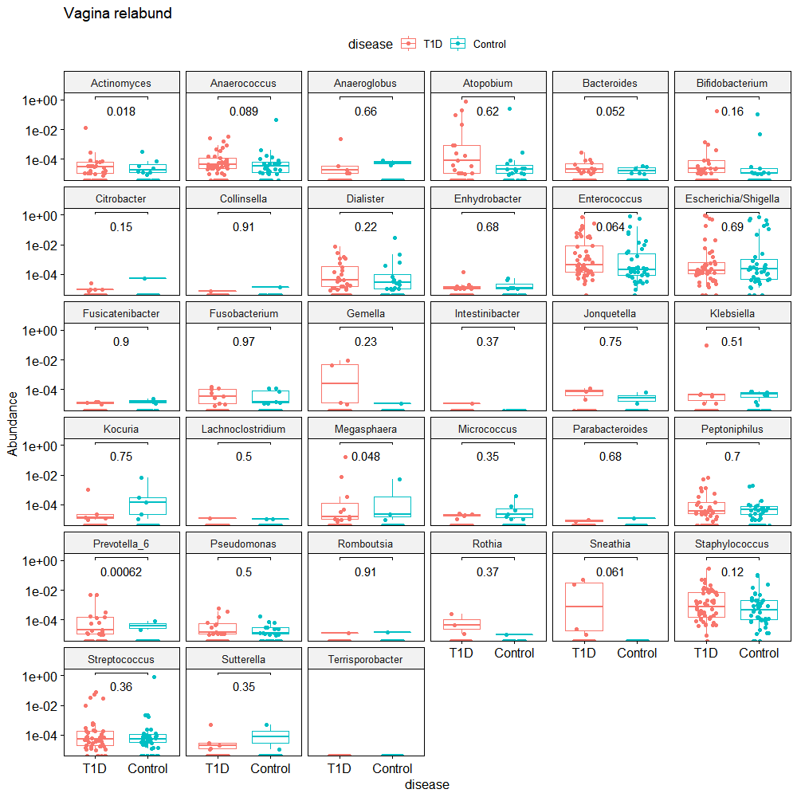

Slide 28
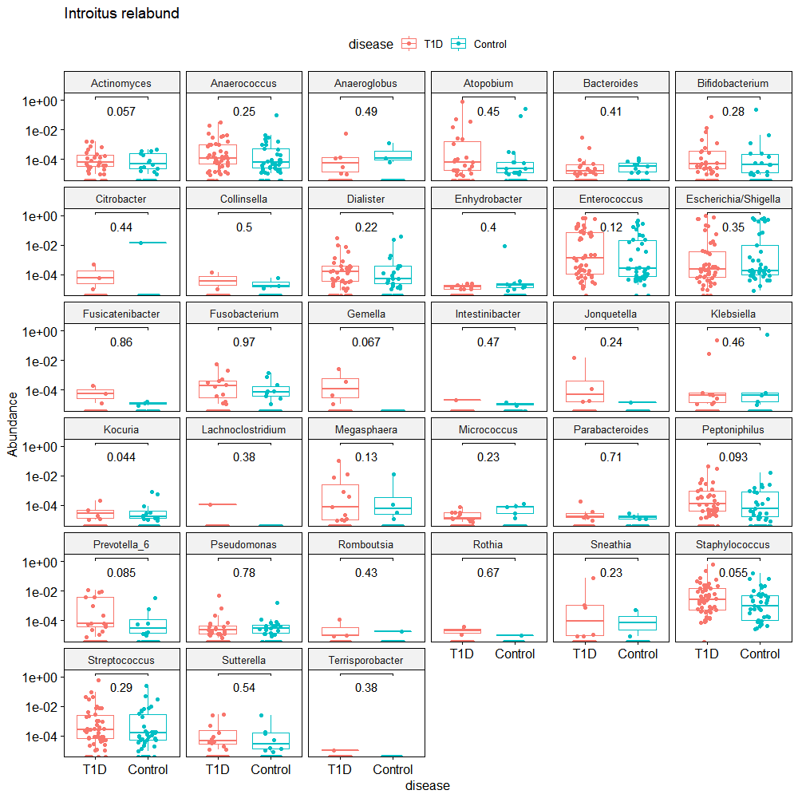

Slide 29
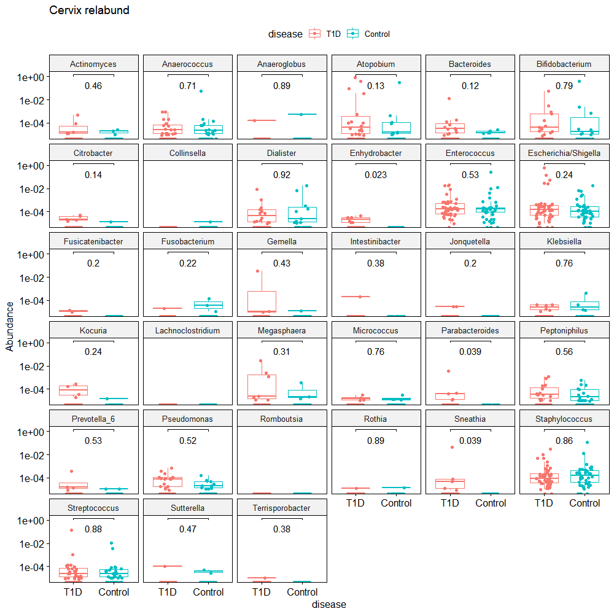
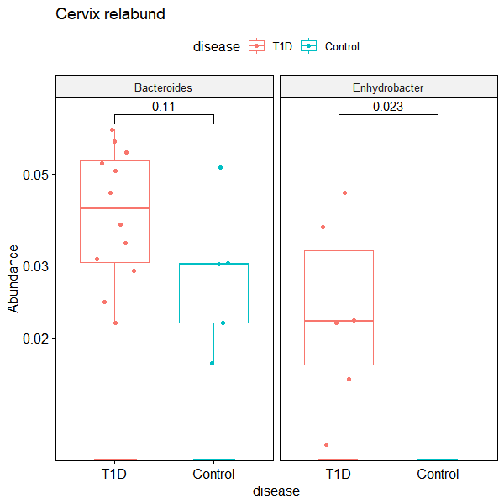

Slide 30
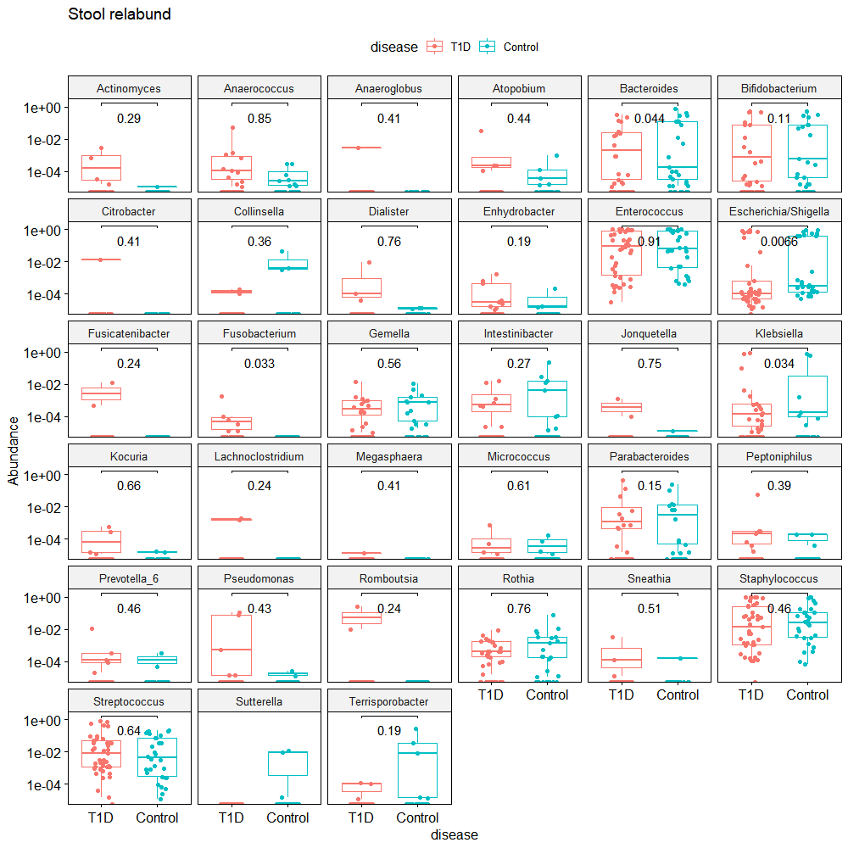

Slide 31
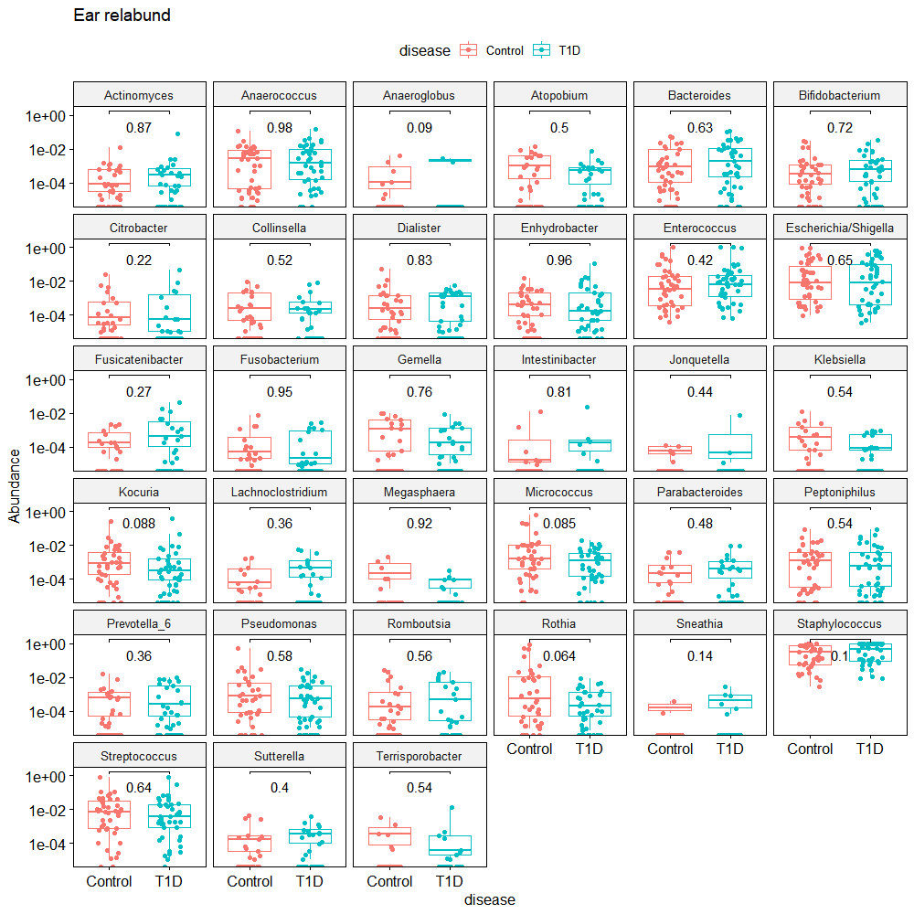

Slide 32
