Slide 1
Beta Diversity Analysis update Type 1 Diabetes
Jochum, Michael D. 13 August 2020

Slide 2
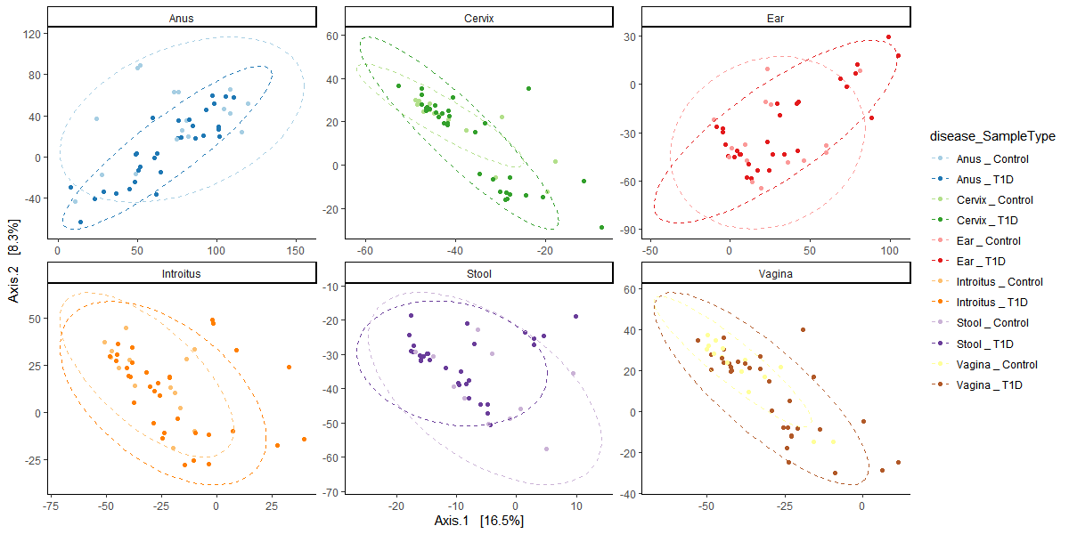
Figure X. Beta Diversity PCoA plots comparing the Type 1 Diabetes and control samples across all microbiome sample types.

Slide 3
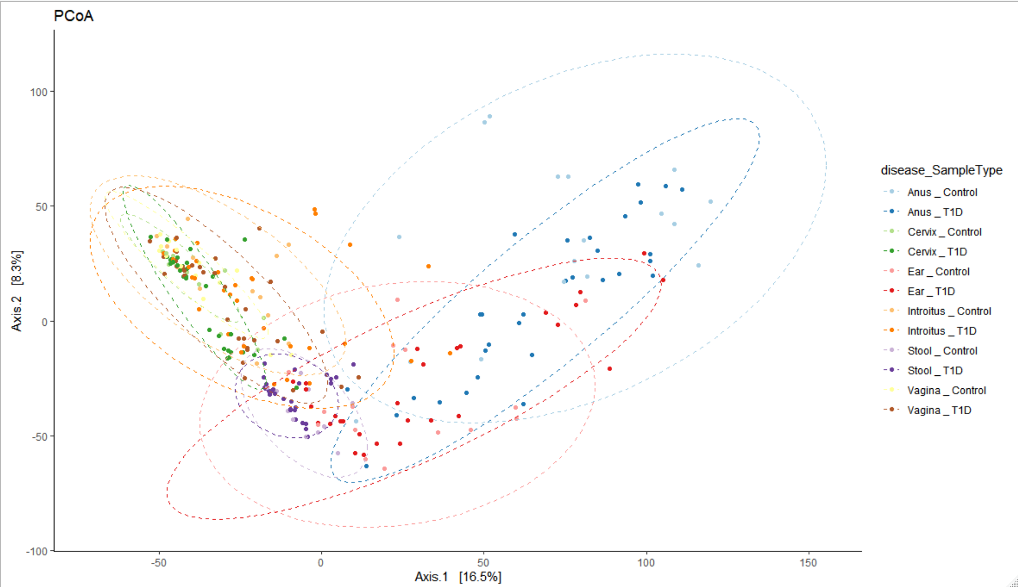
Figure X. Beta Diversity PCoA plots comparing the Type 1 Diabetes and control samples across all microbiome sample types.

Slide 4
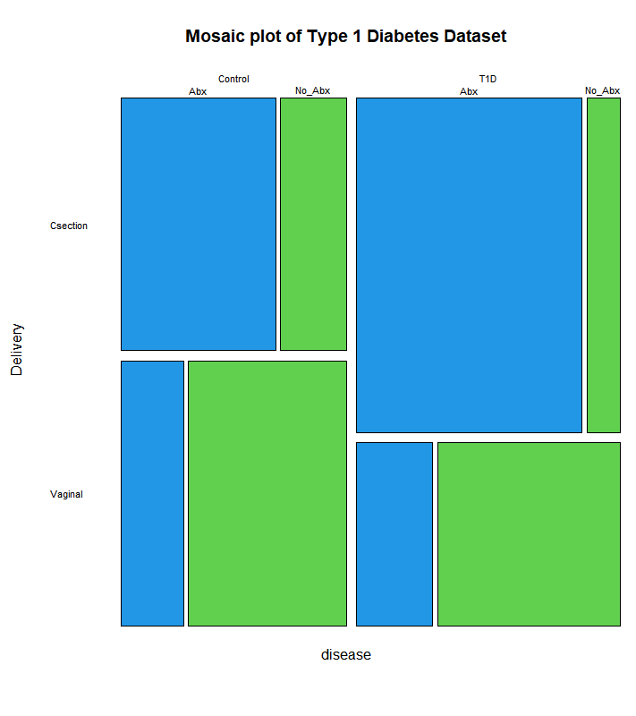
Beta Diversity Bray Curtis adonis permanova
Csection vs Vaginal
Table X. Beta Diversity Bray Curtis adonis permanova of VST transformed counts versus Delivery stratified by sample type
 | Df | SumsOfSqs | MeanSqs | F.Model | R2 | Pr(>F)
disease | 1 | 17149 | 17149 | 1.4868 | 0.00968 | 0.0248 | *
Delivery | 1 | 23172 | 23172 | 2.009 | 0.01309 | 0.0008 | ***
disease:Delivery | 1 | 11811 | 11811 | 1.024 | 0.00667 | 0.2259
Residuals | 149 | 1718543 | 11534 |  | 0.97056
Total | 152 | 1770674 |  |  | 1
---
Signif. codes: 0 ‘***’ 0.001 ‘**’ 0.01 ‘*’ 0.05 ‘.’ 0.1 ‘ ’ 1
Antibiotics
Table X. Beta Diversity Bray Curtis adonis permanova of VST transformed counts versus Antibiotics stratified by sample type
 | Df | SumsOfSqs | MeanSqs | F.Model | R2 | Pr(>F)
disease | 1 | 23963 | 23963 | 1.926 | 0.00377 | 0.0003 | ***
Antibiotics_2 | 1 | 19261 | 19261 | 1.5482 | 0.00303 | 0.0013 | **
disease:Antibiotics_2 | 1 | 17335 | 17335 | 1.3933 | 0.00273 | 0.0064 | **
Residuals | 506 | 6295371 | 12441 |  | 0.99047
Total | 509 | 6355930 |  |  | 1
---
Signif. codes: 0 ‘***’ 0.001 ‘**’ 0.01 ‘*’ 0.05 ‘.’ 0.1 ‘ ’ 1

Slide 5
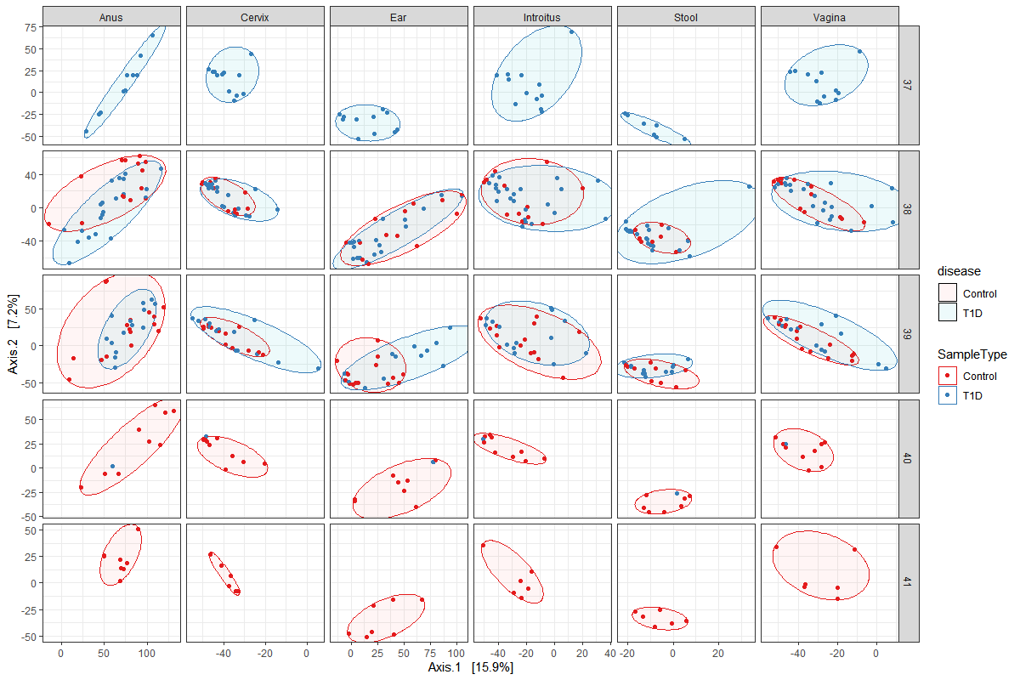
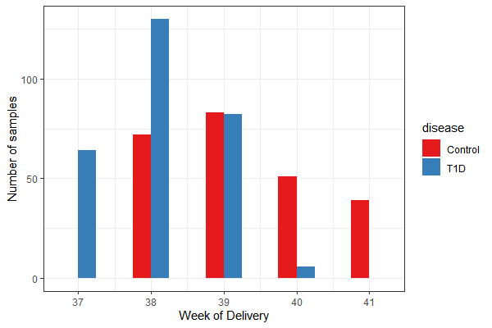
Beta diversity adonis permanova
Week of Delivery
Table X. Beta Diversity Bray Curtis adonis permanova of VST transformed counts versus week of delivery stratified by sample type.
 | Df | SumsOfSqs | MeanSqs | F.Model | R2 | Pr(>F)
disease | 1 | 23963 | 23963 | 1.9261 | 0.00377 | 0.0001 | ***
week of delivery | 1 | 18700 | 18700 | 1.5031 | 0.00294 | 0.0024 | **
disease:week of delivery | 1 | 18144 | 18144 | 1.4584 | 0.00285 | 0.002 | **
Residuals | 506 | 6295123 | 12441 |  | 0.99043
Total | 509 | 6355930 |  |  | 1
---
Signif. codes: 0 ‘***’ 0.001 ‘**’ 0.01 ‘*’ 0.05 ‘.’ 0.1 ‘ ’ 1

Slide 6
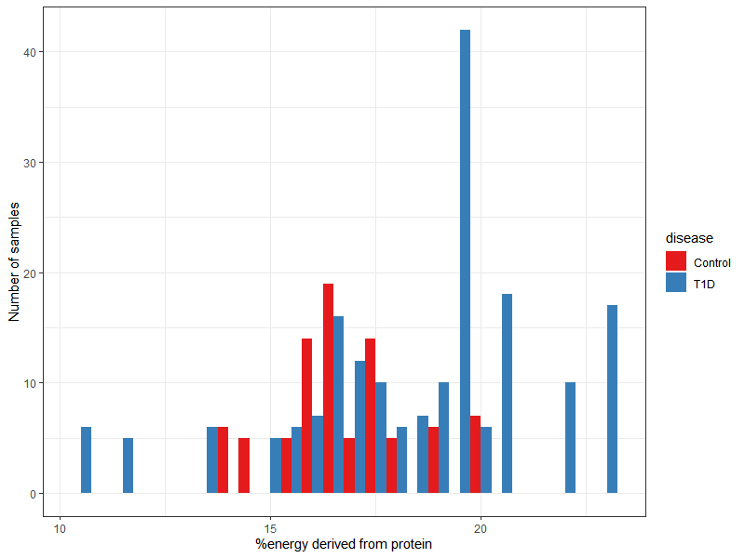
Beta Diversity Bray Curtis adonis permanova
% energy from protein
Table X. Beta Diversity Bray Curtis adonis permanova of VST transformed counts versus percent energy derived from protein stratified by sample type
 | Df | SumsOfSqs | MeanSqs | F.Model | R2 | Pr(>F)
disease | 1 | 23207 | 23207 | 1.9412 | 0.00728 | 0.0001 | ***
energ_bialko_proc_2 | 1 | 16539 | 16539 | 1.3835 | 0.00519 | 0.002 | **
disease:energ_bialko_proc_2 | 1 | 17810 | 17810 | 1.4898 | 0.00558 | 0.0027 | **
Residuals | 262 | 3132107 | 11955 |  | 0.98196
Total | 265 | 3189663 |  |  | 1
Signif. codes: 0 ‘***’ 0.001 ‘**’ 0.01 ‘*’ 0.05 ‘.’ 0.1 ‘ ’ 1

