Slide 1
Adonis permanova for each SampleType
 |  | Introitus |  |  |  |  |  |  | Vagina |  |  |  |  |  |  | Cervix
Maternal Sample Types |  | Df | SumsOfSqs | MeanSqs | F.Model | R2 | Pr(>F) |  | Df | SumsOfSqs | MeanSqs | F.Model | R2 | Pr(>F) |  | Df | SumsOfSqs | MeanSqs | F.Model | R2 | Pr(>F)
 | disease | 1 | 0.2359 | 0.2359 | 0.68604 | 0.00773 | 0.628 |  | 1 | 0.2198 | 0.21979 | 0.65406 | 0.0073 | 0.669 |  | 1 | 0.3342 | 0.33416 | 1.03124 | 0.01171 | 0.33
 | SGA_AGA_LGA | 3 | 0.7241 | 0.24135 | 0.7019 | 0.02372 | 0.857 |  | 4 | 0.6452 | 0.16131 | 0.48001 | 0.02144 | 0.992 |  | 3 | 0.3408 | 0.11359 | 0.35053 | 0.01194 | 0.993
 | Residuals | 86 | 29.5712 | 0.34385 | 0.96856 |  |  |  | 87 | 29.2361 | 0.33605 | 0.97126 |  |  |  | 86 | 27.8671 | 0.32404 | 0.97635
 | Total | 90 | 30.5312 | 1 |  |  |  |  | 92 | 30.1011 | 1 |  |  |  |  | 90 | 28.542 | 1
 |  | Stool |  |  |  |  |  |  | Ear Canal
 |  | Df | SumsOfSqs | MeanSqs | F.Model | R2 | Pr(>F) |  | Df | SumsOfSqs | MeanSqs | F.Model | R2 | Pr(>F)
Infant Sample Types | disease | 1 | 0.4168 | 0.41682 | 1.1095 | 0.01463 | 0.349 |  | 1 | 0.366 | 0.36606 | 0.96957 | 0.01104 | 0.458
 | Delivery | 1 | 2.277 | 2.27699 | 6.0609 | 0.07992 | 0.001 | *** | 1 | 0.645 | 0.6453 | 1.70916 | 0.01946 | 0.044 | *
 | Antibiotics | 1 | 0.2615 | 0.26151 | 0.6961 | 0.00918 | 0.717 |  | 1 | 0.36 | 0.36013 | 0.95386 | 0.01086 | 0.461
 | disease:Delivery | 1 | 0.5477 | 0.54769 | 1.4579 | 0.01922 | 0.152 |  | 1 | 0.558 | 0.55831 | 1.47875 | 0.01684 | 0.09 | .
 | disease:Antibiotics | 1 | 0.3615 | 0.36149 | 0.9622 | 0.01269 | 0.454 |  | 1 | 0.445 | 0.44482 | 1.17817 | 0.01342 | 0.243
 | Delivery:Antibiotics | 1 | 0.2105 | 0.21049 | 0.5603 | 0.00739 | 0.849 |  | 1 | 0.437 | 0.43658 | 1.15634 | 0.01317 | 0.239
 | disease:Delivery:Antibiotics | 1 | 0.3706 | 0.37061 | 0.9865 | 0.01301 | 0.416 |  | 1 | 0.518 | 0.51772 | 1.37124 | 0.01561 | 0.129
 | Residuals | 64 | 24.0438 | 0.37568 | 0.84396 |  |  |  | 79 | 29.827 | 0.37755 | 0.8996
 | Total | 71 | 28.4894 | 1 |  |  |  |  | 86 | 33.156 | 1
Results show a significant effect of Delivery Method in infant stool and ear canal microbiomes, but no interaction between disease and delivery method

Slide 2
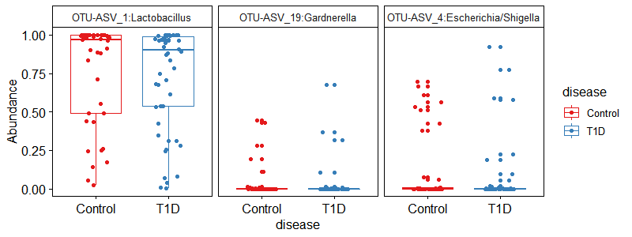
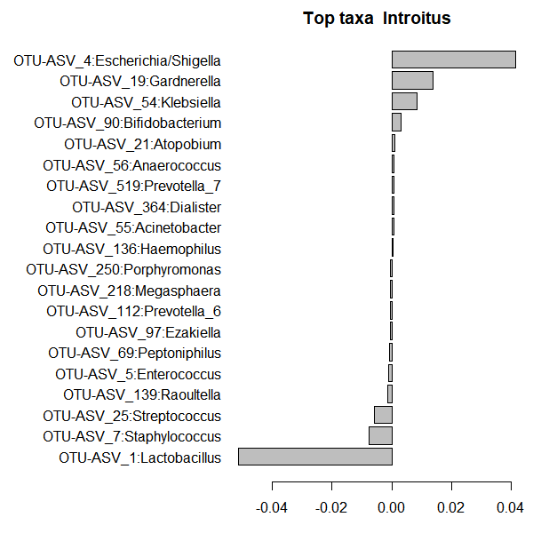
Introitus taxa associated with Type 1 Diabetes
Introitus

Slide 3
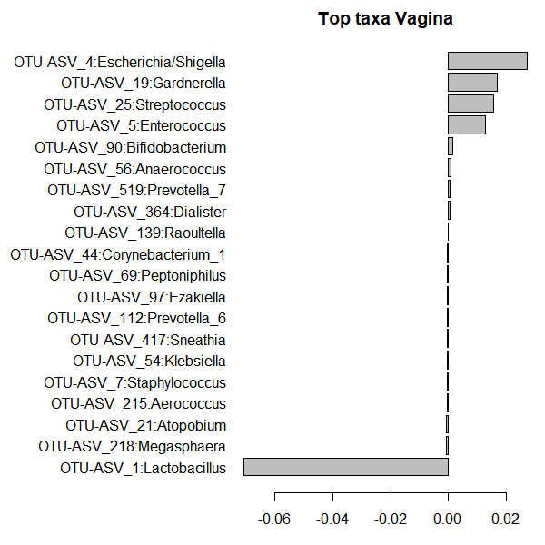
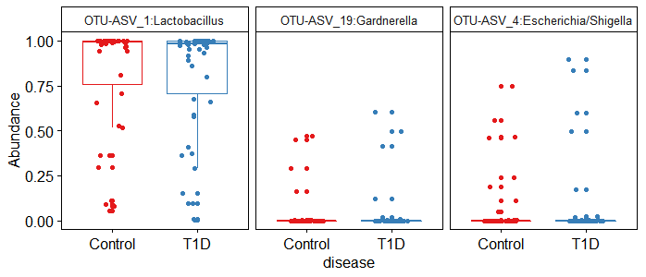
Vaginal taxa associated with Type 1 Diabetes
Vagina

Slide 4
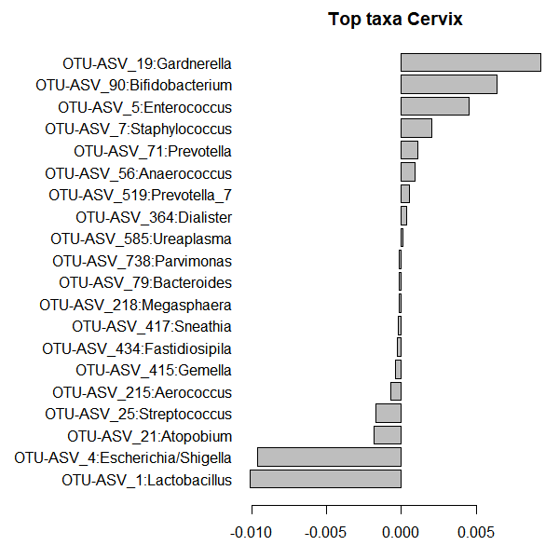
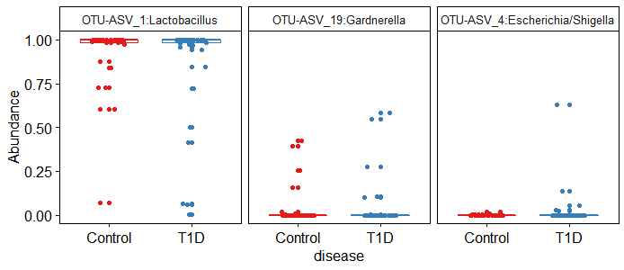
Cervical taxa associated with Type 1 Diabetes
Cervix

Slide 5
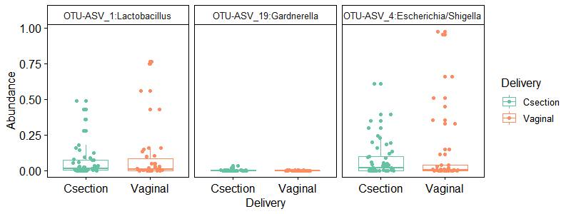
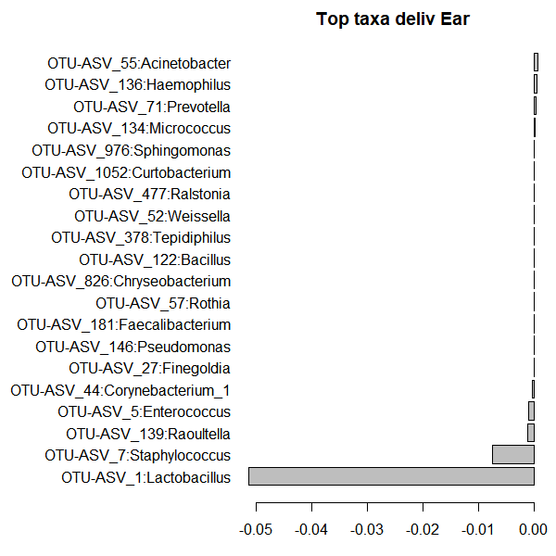
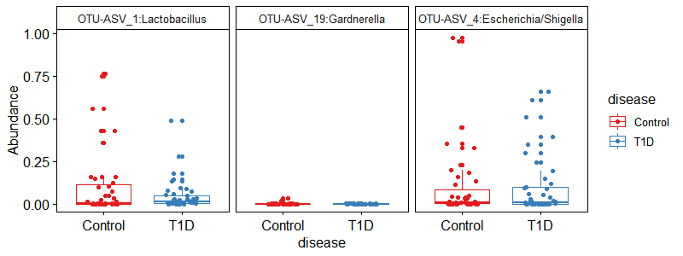
Infant Ear Canal taxa associated with Disease
Infant Ear Canal

Slide 6
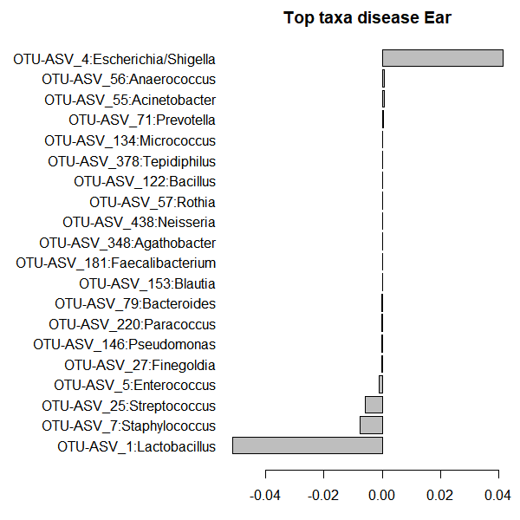
Infant Ear Canal taxa associated with Delivery
Infant Ear Canal

Slide 7
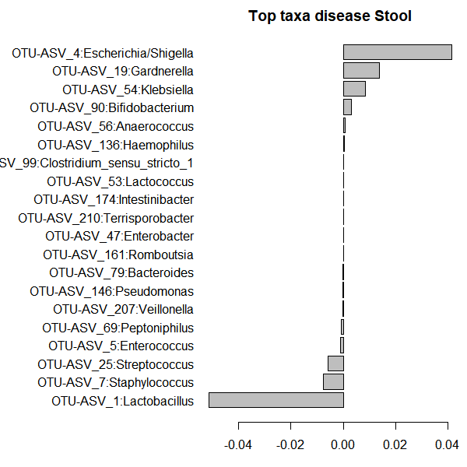
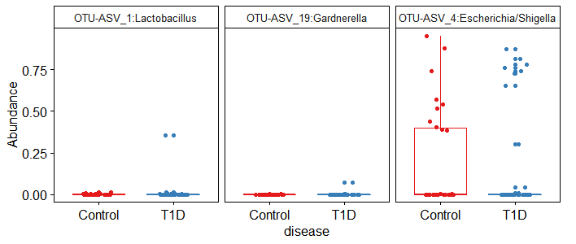
Infant Stool taxa associated with Disease
Infant stool

Slide 8
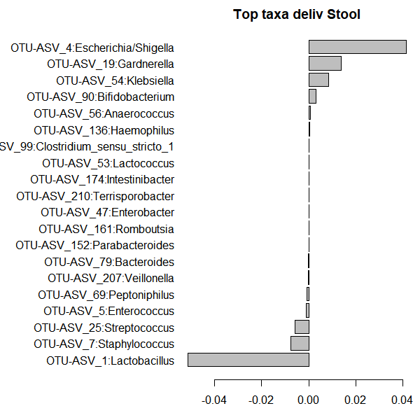
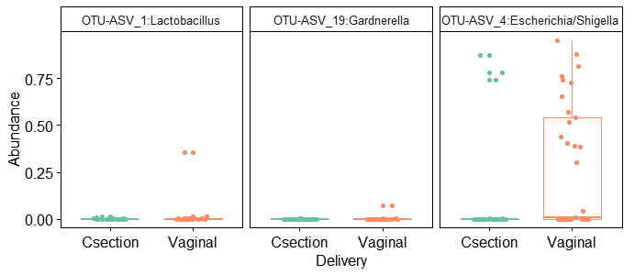
Infant Stool taxa associated with Delivery
Infant Stool

