Slide 1
T1d Feast results
8 March 2021
Jochum, Michael D.

Slide 2
Table X: Analysis of Variance Table of the microbial community contributions to neonatal microbiome
Variable | Df | Sum Sq | Mean Sq | F value | Pr(>F) | Sig.
Source | 4 | 82.755 | 20.6888 | 1118.716 | <0.00001 | ***
Disease | 1 | 0.002 | 0.0019 | 0.1014 | 0.75023
Neonate SampleType | 1 | 0 | 0 | 0.0001 | 0.99188
Source:Disease | 4 | 0.209 | 5.23E-02 | 2.8271 | 0.02403 | *
Residuals | 724 | 13.389 | 1.85E-02

Slide 3
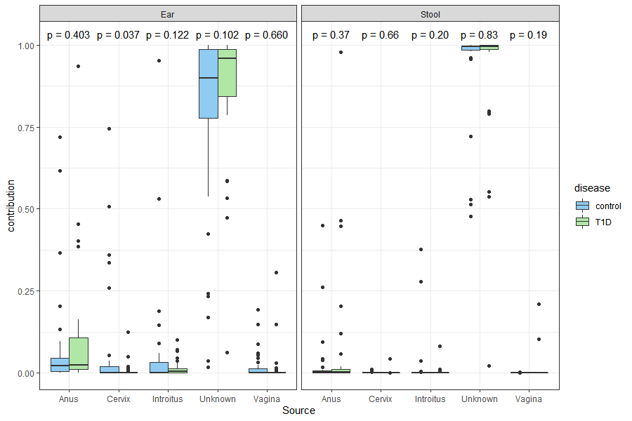
*

Slide 4
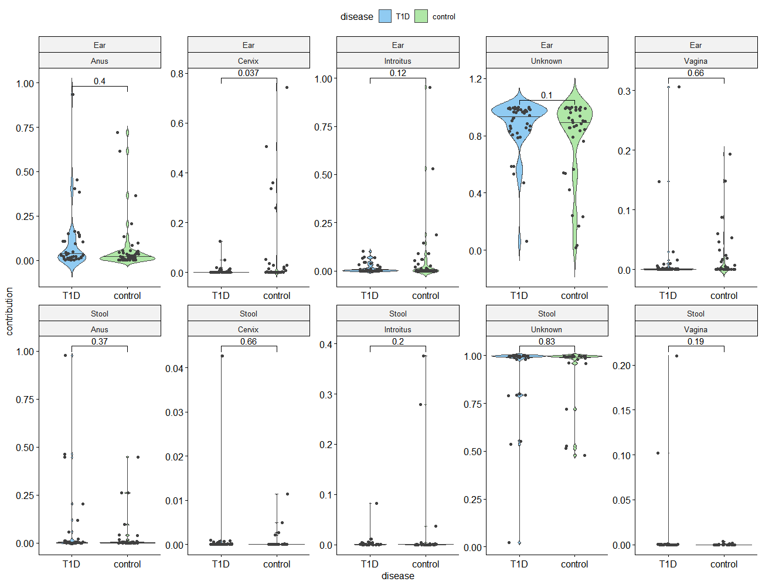
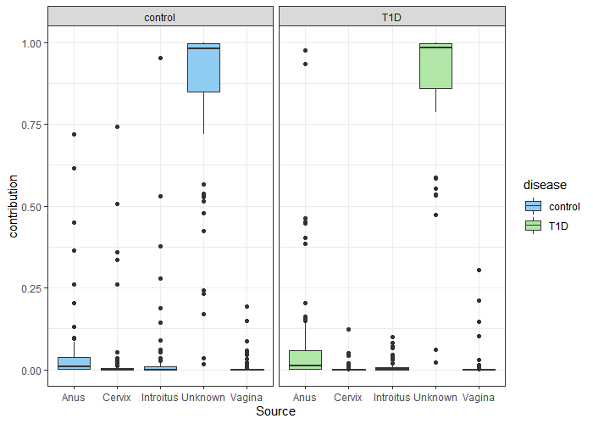
*
Ear
Stool

Slide 5
Table x. Summary of the microbial community contributions to each neonatal sample type.
Disease | Sink | Source | min | Q1 | median | Q3 | max | mean | sd | n
Control | Ear | Anus | 1.06E-04 | 4.63E-03 | 2.22E-02 | 4.44E-02 | 7.20E-01 | 6.56E-02 | 1.46E-01 | 45
 |  | Cervix | 2.71E-196 | 5.63E-09 | 1.17E-04 | 1.85E-02 | 7.44E-01 | 6.21E-02 | 1.60E-01 | 39
 |  | Introitus | 5.28E-09 | 4.10E-05 | 6.58E-04 | 3.15E-02 | 9.53E-01 | 5.90E-02 | 1.73E-01 | 39
 |  | Unknown | 1.80E-02 | 7.76E-01 | 8.99E-01 | 9.87E-01 | 9.99E-01 | 7.85E-01 | 2.90E-01 | 39
 |  | Vagina | 0.00E+00 | 1.98E-06 | 2.57E-04 | 1.30E-02 | 1.94E-01 | 1.74E-02 | 4.06E-02 | 41
 | Stool | Anus | 1.14E-13 | 4.52E-04 | 1.84E-03 | 6.29E-03 | 4.49E-01 | 3.69E-02 | 9.78E-02 | 33
 |  | Cervix | 8.76E-216 | 4.27E-10 | 3.50E-07 | 4.58E-05 | 1.14E-02 | 7.64E-04 | 2.35E-03 | 28
 |  | Introitus | 3.19E-13 | 3.19E-07 | 8.31E-05 | 5.73E-04 | 3.76E-01 | 2.51E-02 | 8.67E-02 | 28
 |  | Unknown | 4.77E-01 | 9.85E-01 | 9.94E-01 | 9.98E-01 | 1.00E+00 | 9.30E-01 | 1.59E-01 | 28
 |  | Vagina | 0.00E+00 | 1.47E-08 | 1.67E-06 | 1.14E-04 | 3.45E-03 | 2.86E-04 | 7.30E-04 | 30
Type 1 Diabetes | Ear | Anus | 1.67E-04 | 1.06E-02 | 2.43E-02 | 1.08E-01 | 9.34E-01 | 9.52E-02 | 1.75E-01 | 40
 |  | Cervix | 1.79E-62 | 2.71E-07 | 1.26E-04 | 1.57E-03 | 1.24E-01 | 6.36E-03 | 2.06E-02 | 42
 |  | Introitus | 4.82E-08 | 1.41E-04 | 4.21E-03 | 1.35E-02 | 1.01E-01 | 1.47E-02 | 2.43E-02 | 42
 |  | Unknown | 6.17E-02 | 8.44E-01 | 9.59E-01 | 9.86E-01 | 9.99E-01 | 8.75E-01 | 1.85E-01 | 42
 |  | Vagina | 4.97E-34 | 5.01E-06 | 2.93E-04 | 1.72E-03 | 3.06E-01 | 1.29E-02 | 5.17E-02 | 42
 | Stool | Anus | 5.21E-95 | 4.11E-04 | 2.70E-03 | 1.15E-02 | 9.77E-01 | 7.15E-02 | 1.99E-01 | 33
 |  | Cervix | 8.14E-75 | 2.13E-11 | 8.28E-07 | 1.62E-04 | 4.27E-02 | 1.32E-03 | 7.10E-03 | 36
 |  | Introitus | 4.38E-08 | 2.31E-06 | 3.03E-04 | 9.89E-04 | 8.22E-02 | 3.62E-03 | 1.37E-02 | 36
 |  | Unknown | 2.18E-02 | 9.86E-01 | 9.95E-01 | 9.99E-01 | 1.00E+00 | 9.21E-01 | 1.94E-01 | 36
 |  | Vagina | 2.07E-94 | 5.28E-08 | 1.84E-05 | 4.32E-04 | 2.10E-01 | 8.85E-03 | 3.85E-02 | 36

