Slide 2
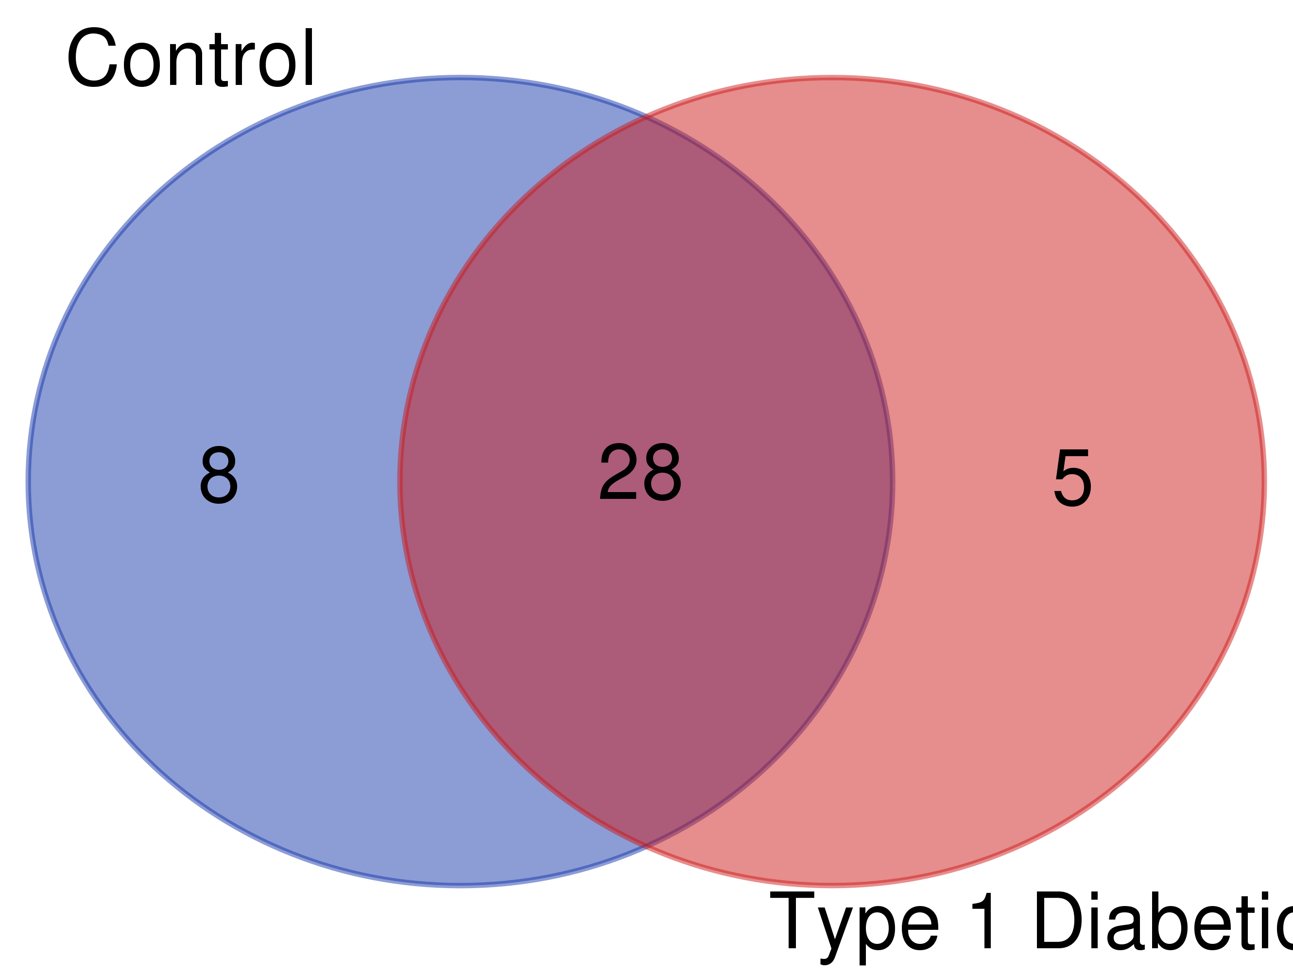

Slide 3
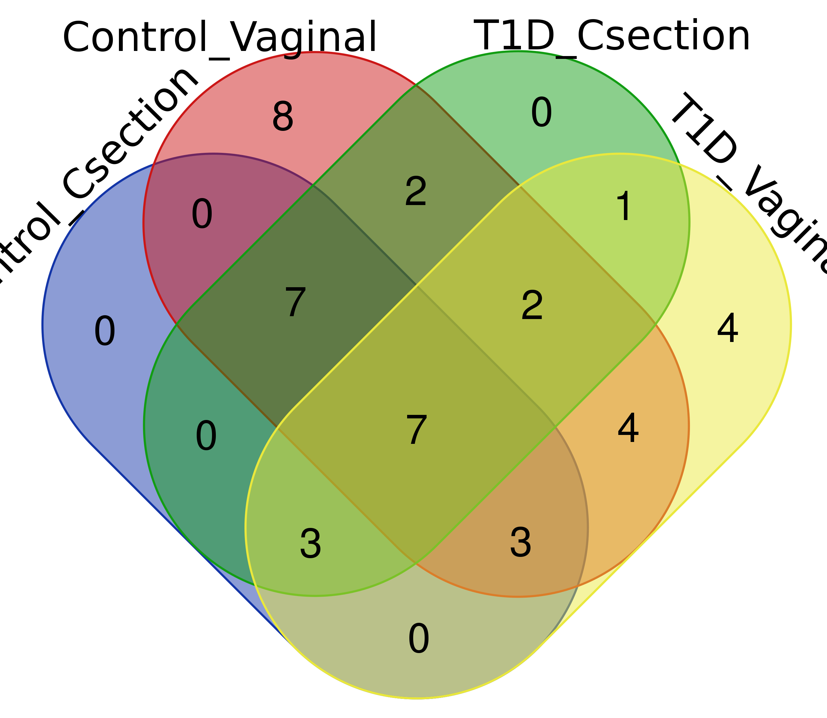

Slide 4
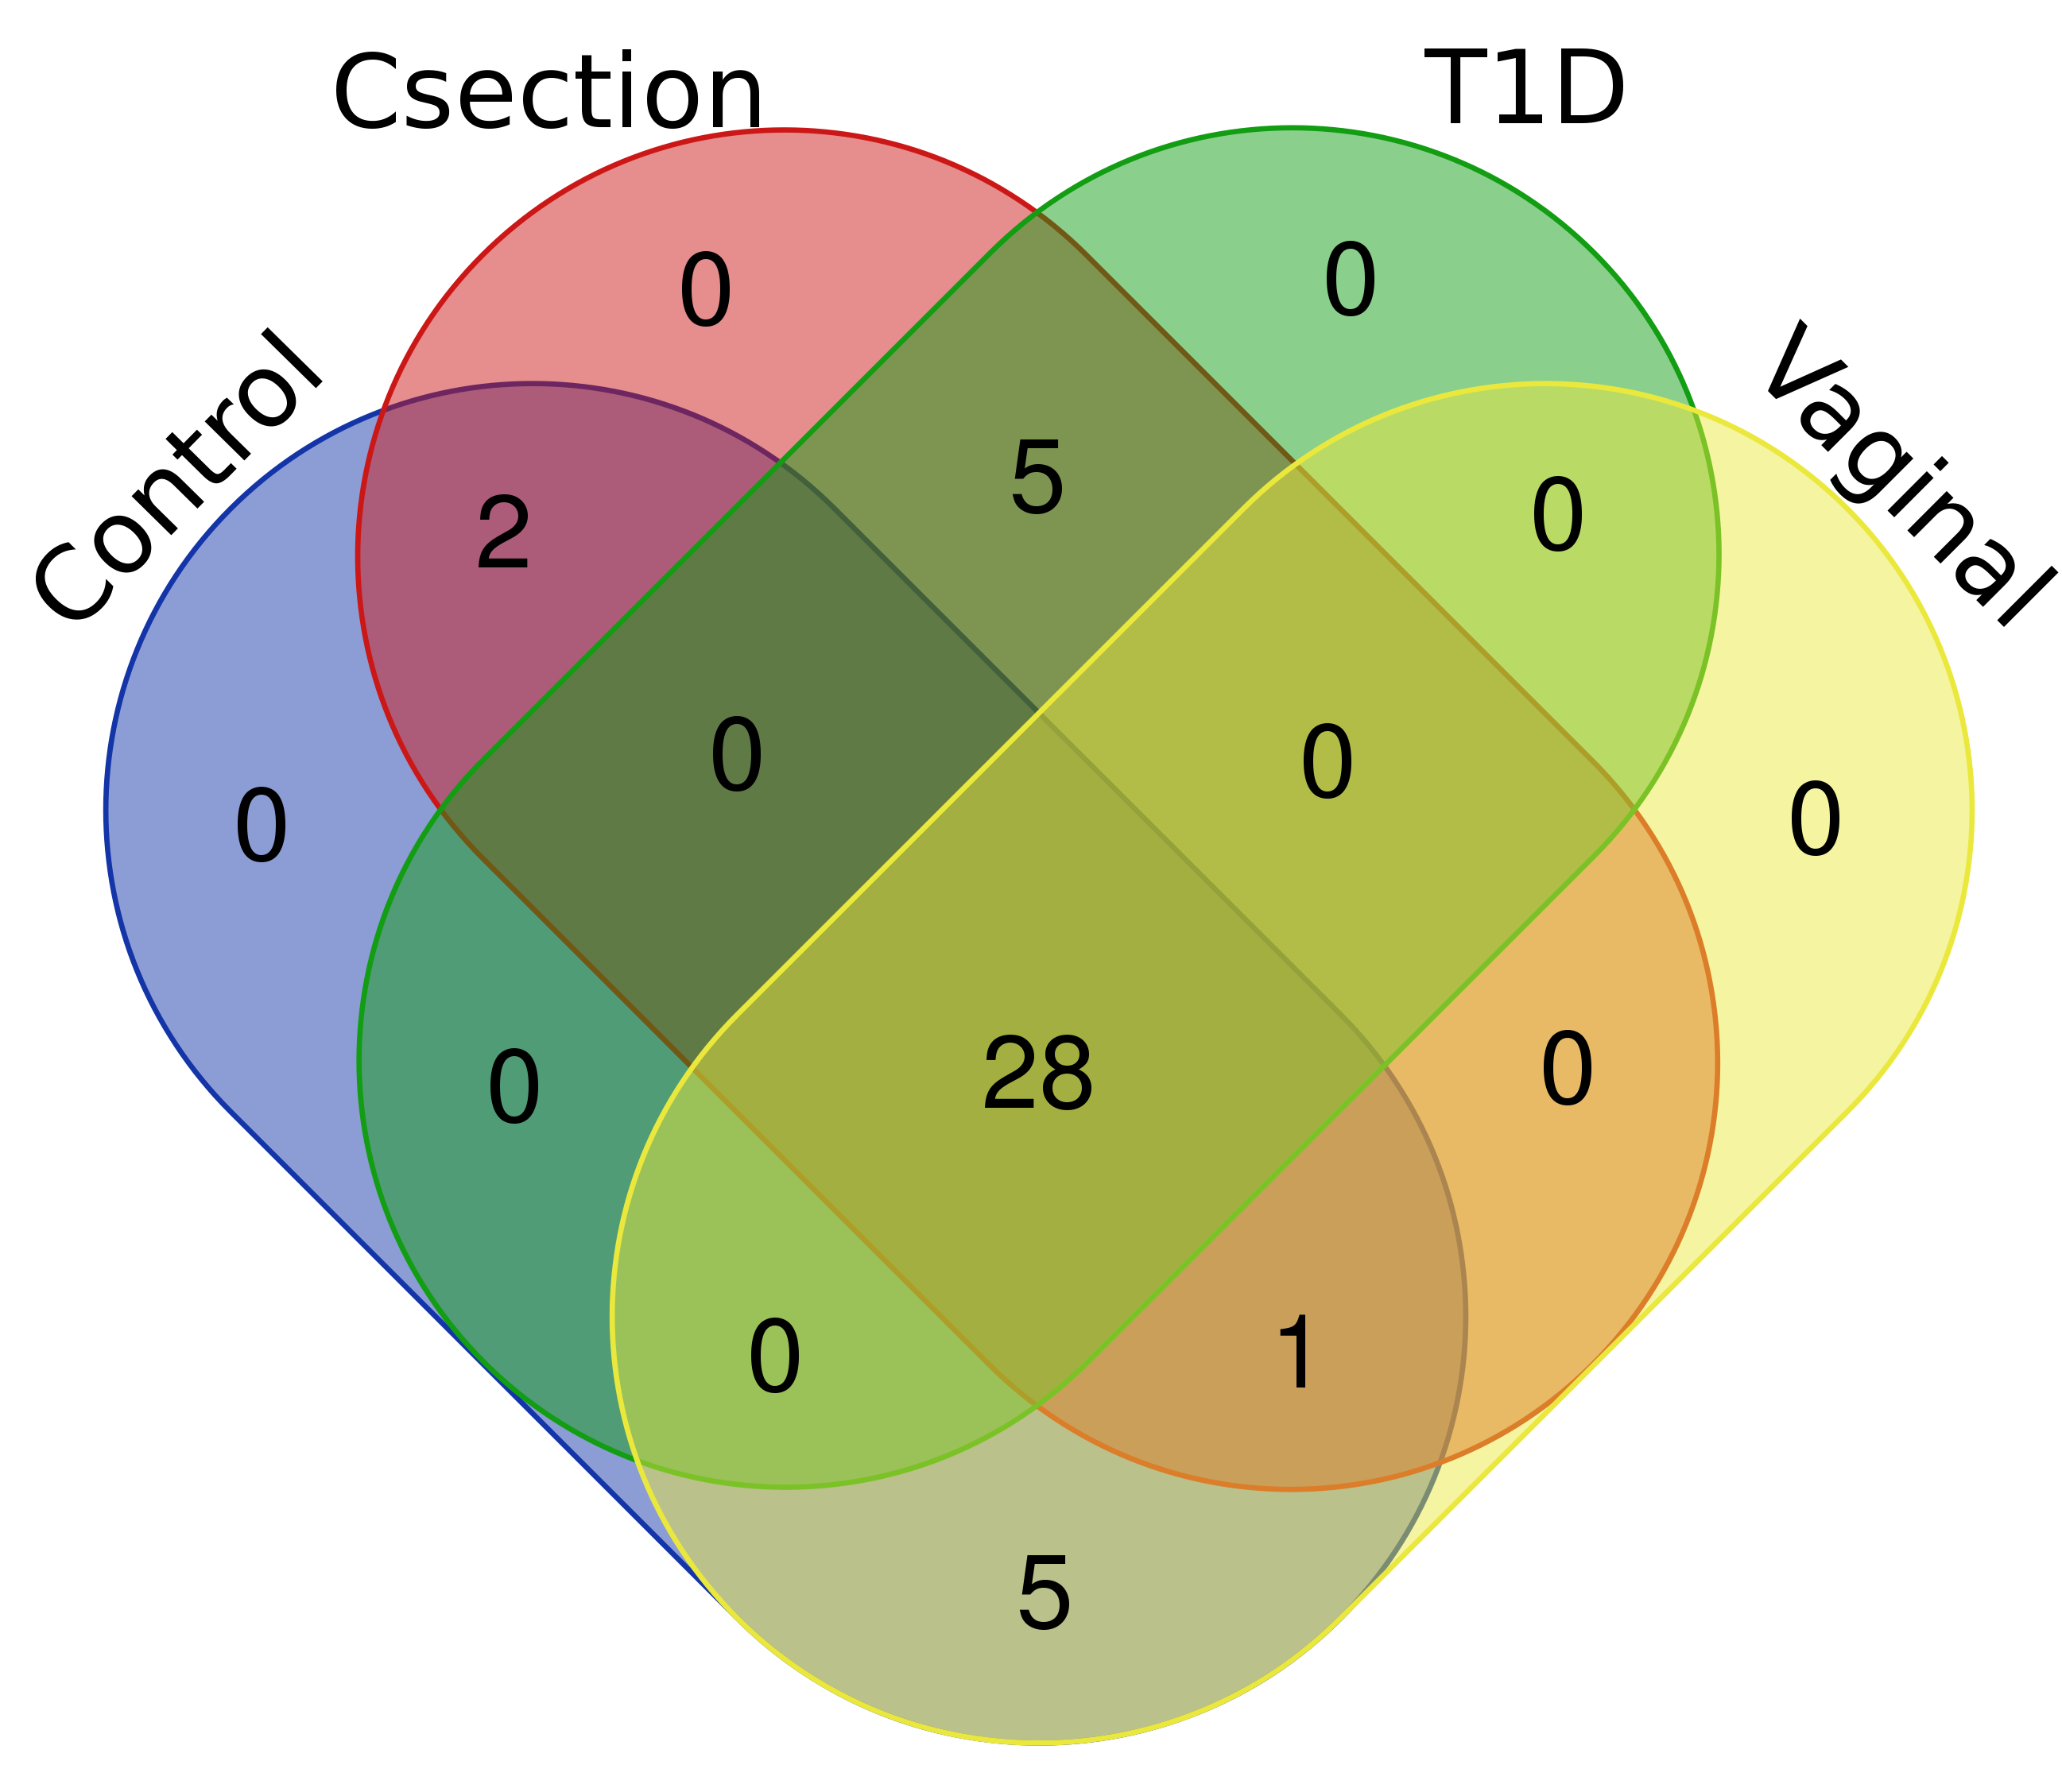
List names | number of elements | number of unique elements
Control | 92 | 36
Csection | 97 | 36
T1D | 93 | 33
Vaginal | 88 | 34
Overall number of unique elements |  | 41

Slide 5
Names | total | elements
Control Csection T1D Vaginal | 28 | Bifidobacterium Anaerococcus Finegoldia Escherichia/Shigella Kocuria Streptococcus Prevotella Bacteroides Parabacteroides Lawsonella Veillonella Micrococcus Ezakiella Gardnerella Faecalibacterium Pseudomonas Actinomyces Dialister Corynebacterium Prevotella_6 Staphylococcus Acinetobacter Corynebacterium_1 Porphyromonas Enterococcus Lactobacillus Peptoniphilus Blautia
Control Csection Vaginal | 1 | Agathobacter
Control Csection | 2 | Alistipes Subdoligranulum
Control Vaginal | 5 | Murdochiella Cutibacterium Romboutsia Bradyrhizobium Campylobacter
Csection T1D | 5 | Haemophilus Ralstonia Ruminococcus_2 Enhydrobacter Ruminococcaceae_UCG-002

