Slide 1
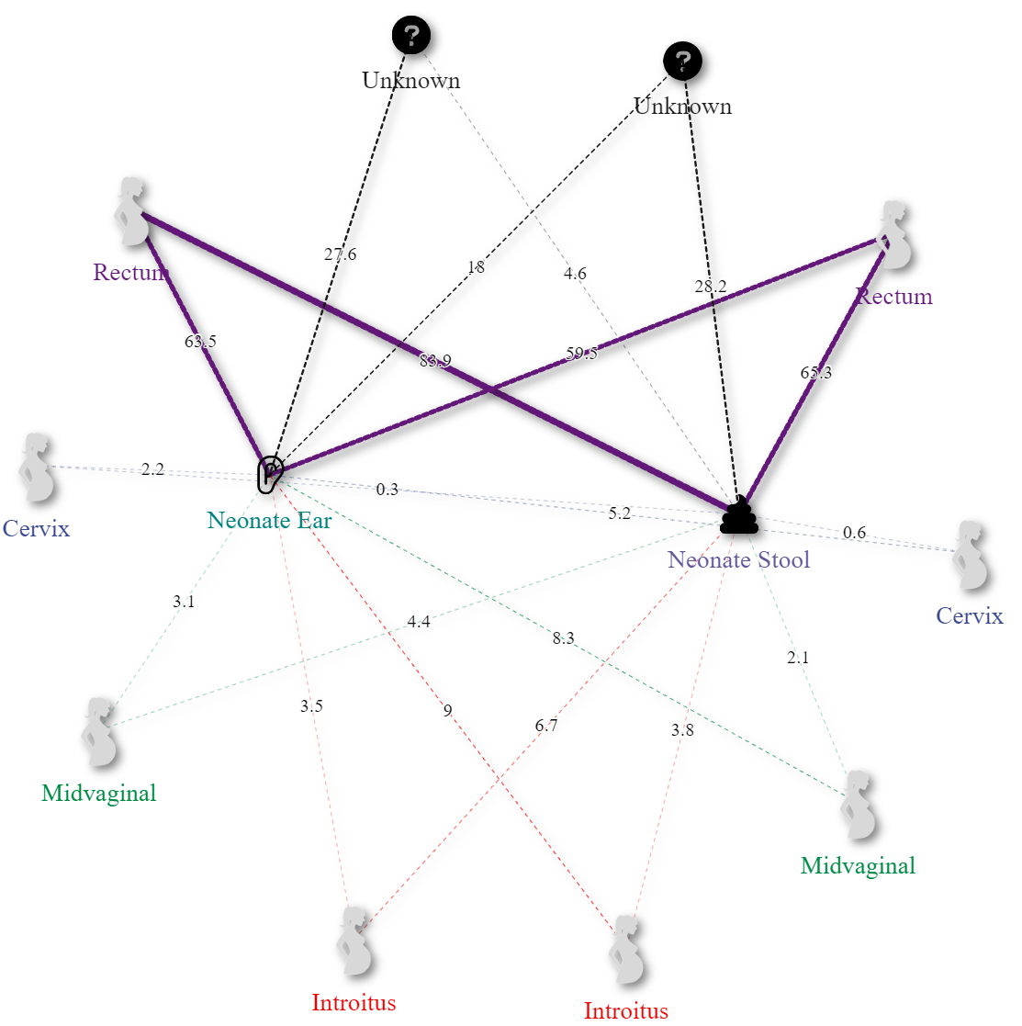
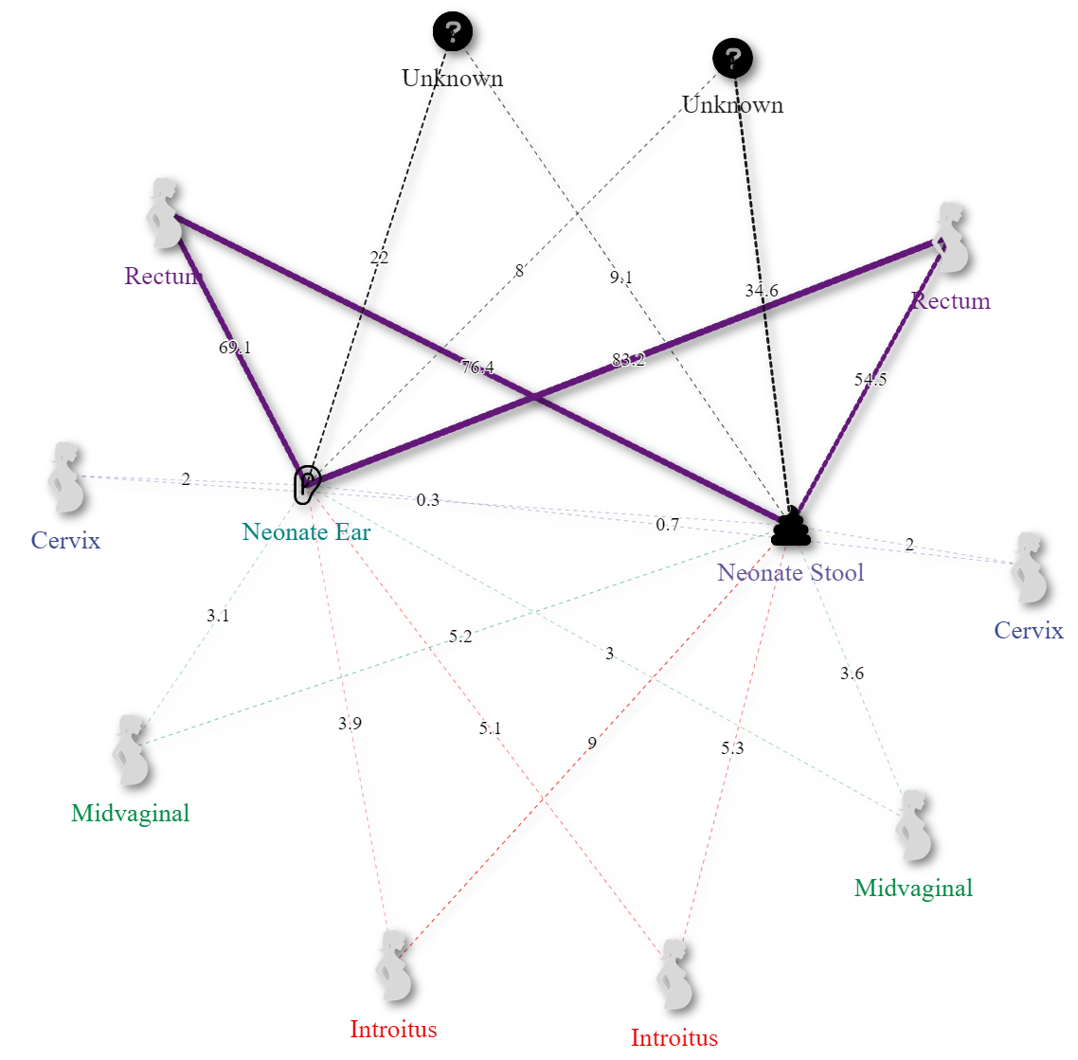
Control
T1D
Cesarean
Vaginal
Cesarean
Vaginal
A)
B)
Supplementary Figure 9. Network of Sourcetracker2 derived maternal contributions (outside nodes) to neonatal microbiomes (inside nodes) by disease states A) Control and B) Type one diabetes by delivery modes Cesarean (left) and Vaginal (right). Results show statistically significant increases in maternal source Anus contributions to the ear microbiome when comparing vaginally delivered neonatal ear microbiomes from type 1 diabetic mothers to the control.

Slide 2
Cesarean
Delivery
Control
Vaginal Delivery
Cesarean
Delivery
T1D
Vaginal Delivery
A)
B)
Cervical / Vaginal
Fraction

Slide 3
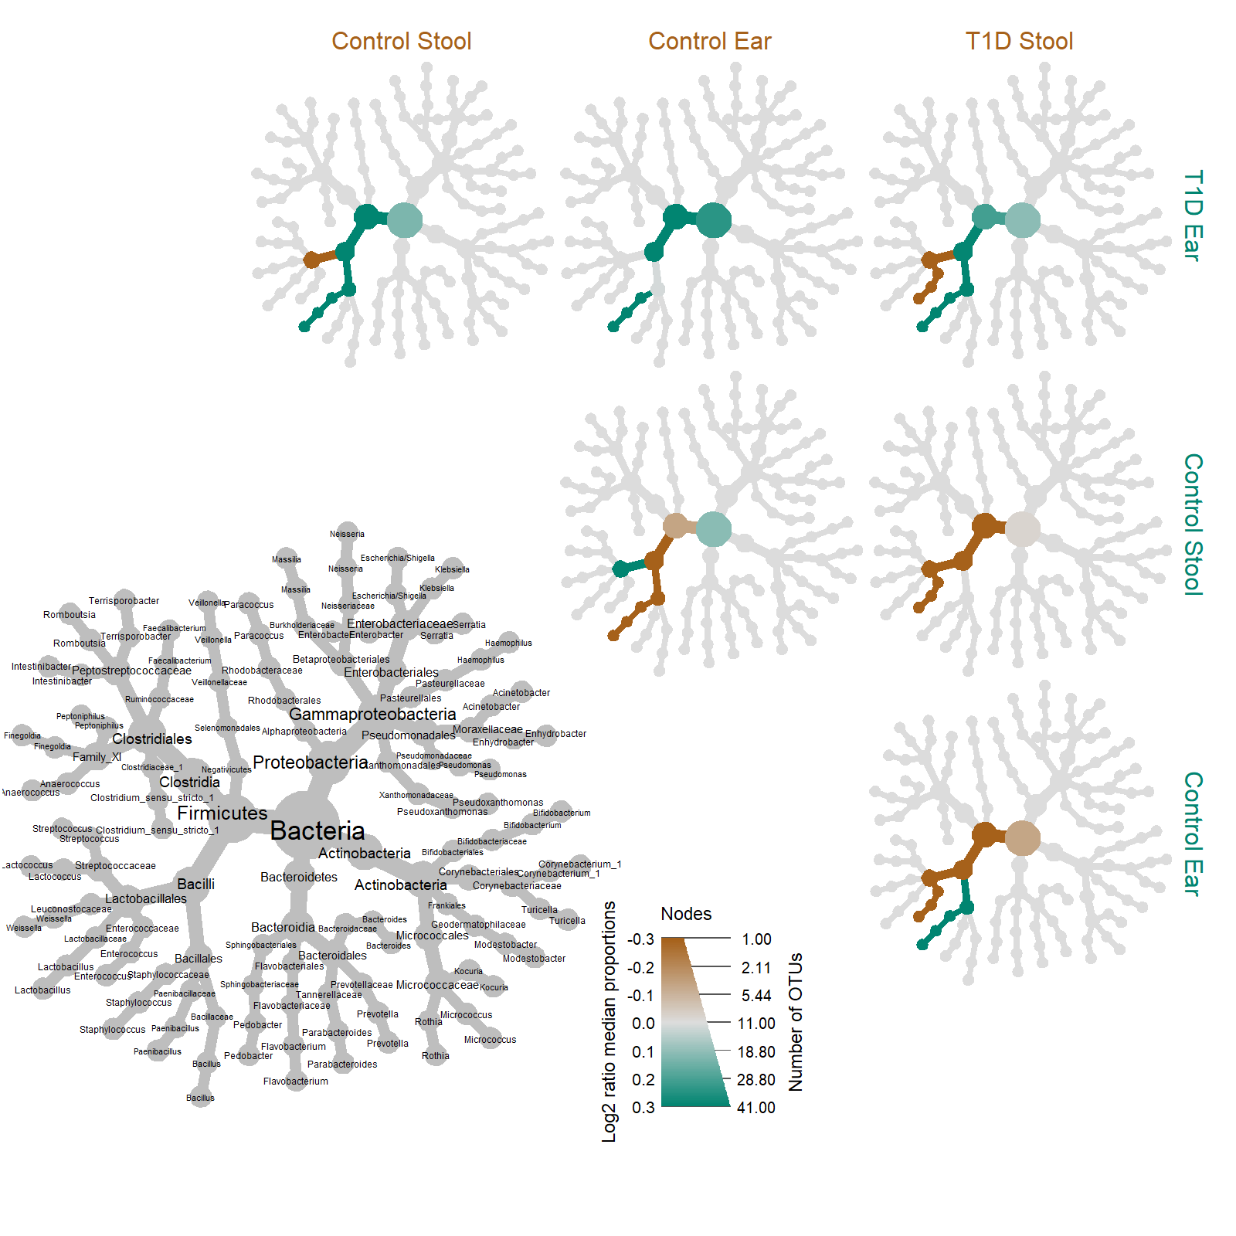

Slide 4
Supplementary Table X. Overview of maternal source mean contributions to newborn sinks by disease and delivery method.
 |  |  | Source (mean ± std. error)
Delivery | Sink | Disease | Anus | Cervix | Introitus | Unknown | Vagina
C-section | Ear | Control | 0.635 ± 0.31 | 0.022 ± 0.048 | 0.035 ± 0.043 | 0.276 ± 0.285 | 0.031 ± 0.051
 |  | T1D | 0.691 ± 0.28 | 0.02 ± 0.03 | 0.039 ± 0.038 | 0.22 ± 0.25 | 0.031 ± 0.032
 | Stool | Control | 0.839 ± 0.104 | 0.003 ± 0.003 | 0.067 ± 0.033 | 0.046 ± 0.111 | 0.044 ± 0.024
 |  | T1D | 0.764 ± 0.252 | 0.003 ± 0.005 | 0.09 ± 0.091 | 0.091 ± 0.209 | 0.052 ± 0.069
Vaginal | Ear | Control | 0.595 ± 0.311 | 0.052 ± 0.092 | 0.09 ± 0.096 | 0.18 ± 0.247 | 0.083 ± 0.105
 |  | T1D | 0.832 ± 0.198 | 0.007 ± 0.011 | 0.051 ± 0.076 | 0.08 ± 0.174 | 0.03 ± 0.047
 | Stool | Control | 0.653 ± 0.317 | 0.006 ± 0.006 | 0.038 ± 0.024 | 0.282 ± 0.331 | 0.021 ± 0.014
 |  | T1D | 0.545 ± 0.336 | 0.02 ± 0.062 | 0.053 ± 0.053 | 0.346 ± 0.343 | 0.036 ± 0.042

