Slide 1
Shared Pathway comparisons
16 Dec 2020
Jochum, Michael D.

Slide 2
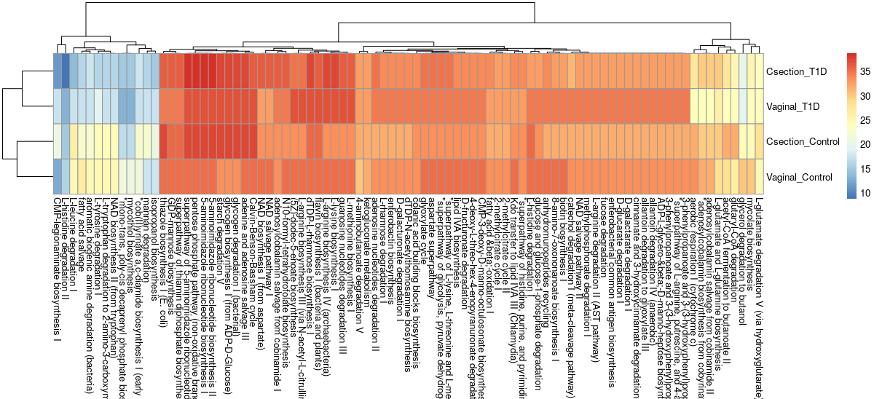
Pathways shared between mother and infant combinations
% samples in group

Slide 3
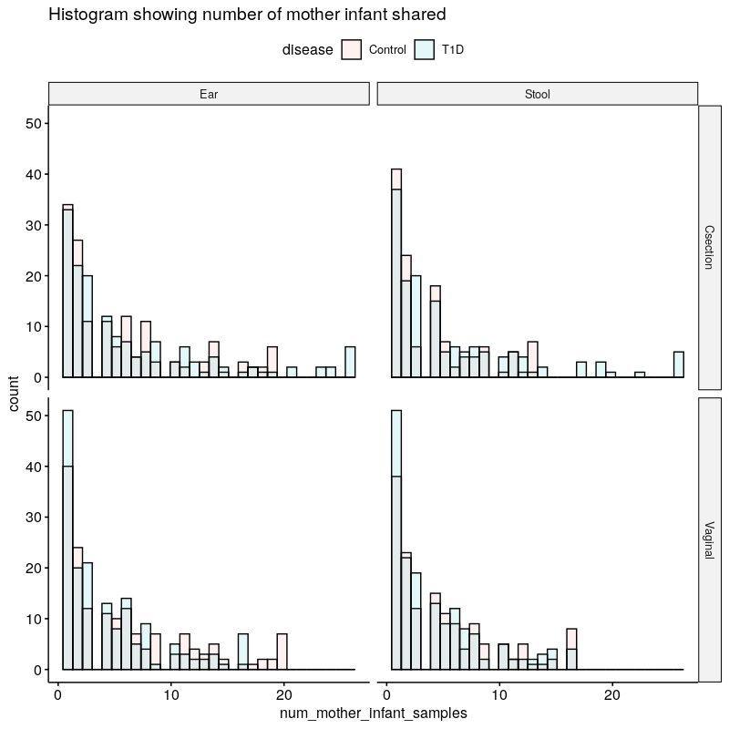

Slide 4
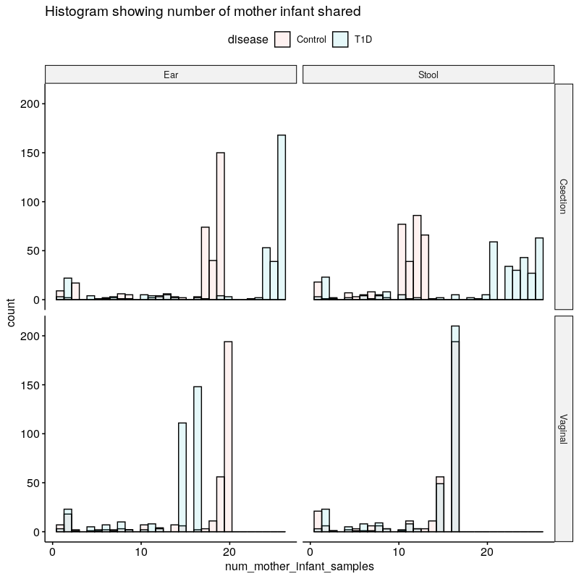
Taxonomy (Genus)
Inferred Pathways

Slide 5
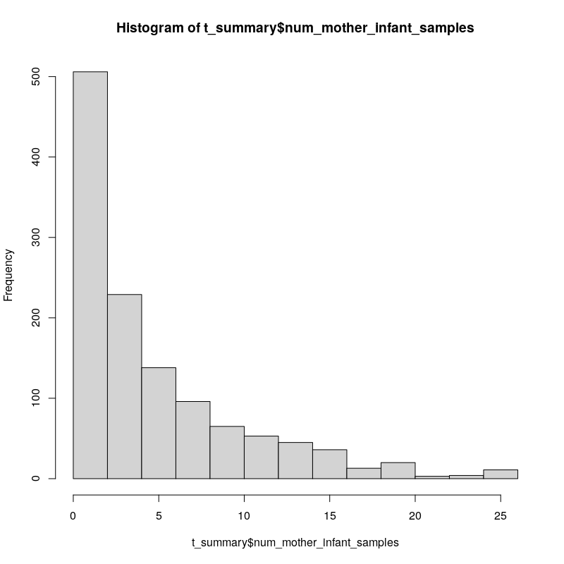
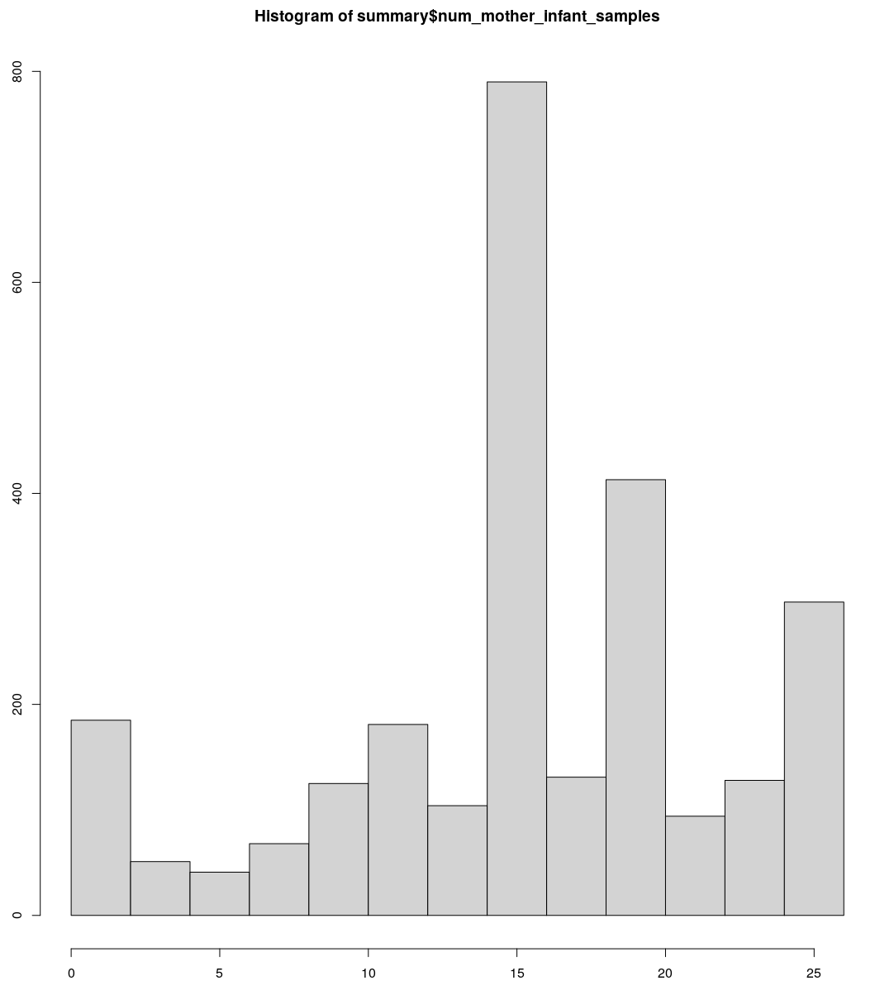
Taxonomy (Genus)
Inferred Pathways

Slide 6
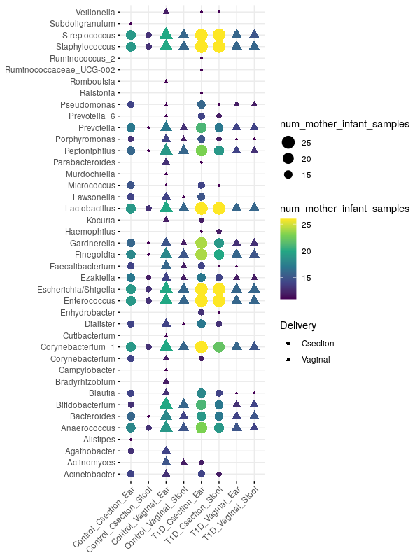
Taxonomy (Genus)
Inferred Pathways

