Slide 1
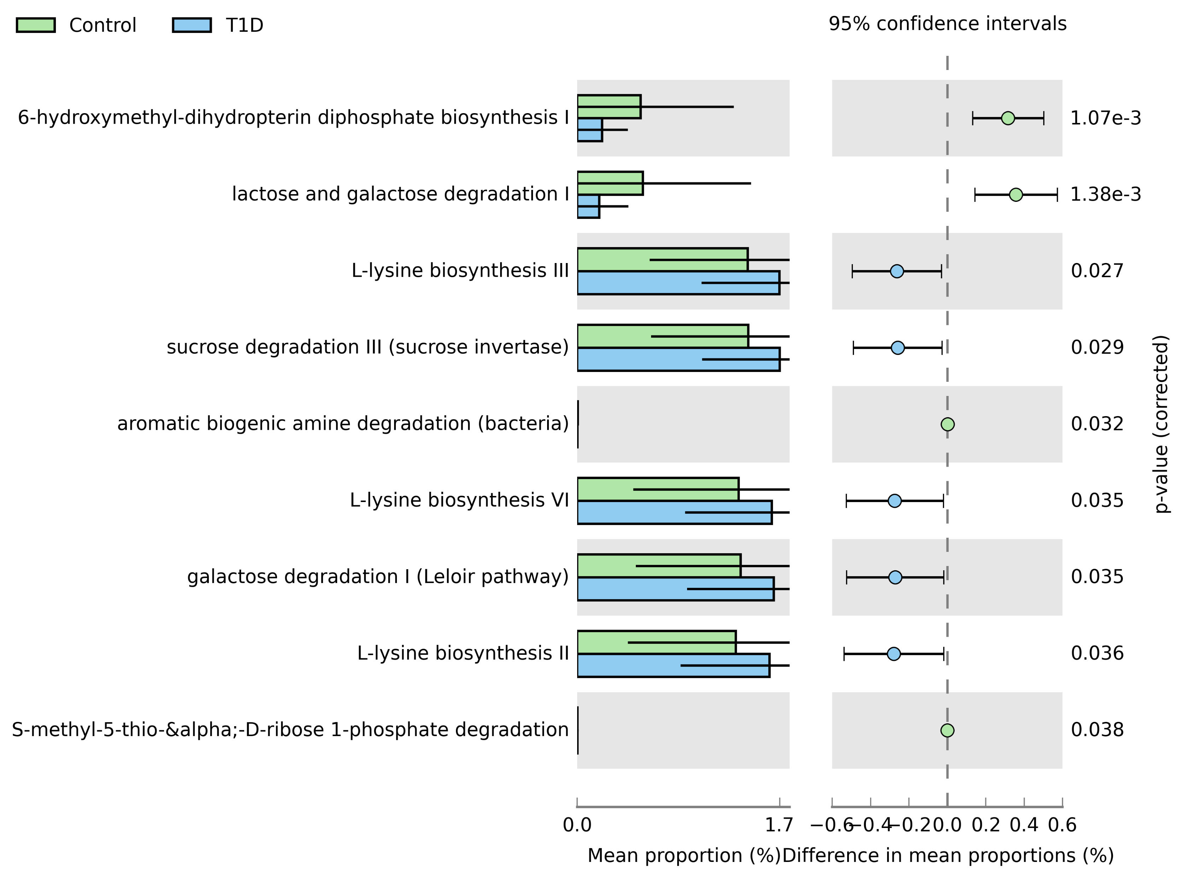
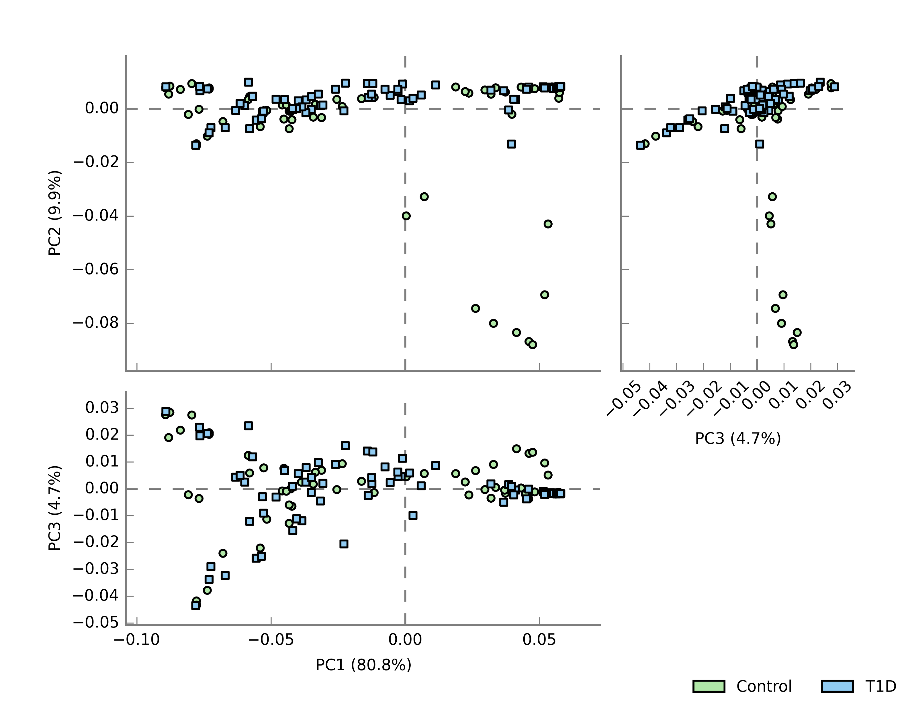
Infant PICRUST2 derived pathways comparisons (Combined Ear and Stool)
description | Control: mean rel. freq. (%) | Control: std. dev. (%) | T1D: mean rel. freq. (%) | T1D: std. dev. (%) | p-values | Difference between means | 95.0% lower CI | 95.0% upper CI
lactose and galactose degradation I | 0.54 | 0.89 | 0.18 | 0.24 | 0.00 | 0.36 | 0.14 | 0.57
L-lysine biosynthesis II | 1.30 | 0.89 | 1.58 | 0.73 | 0.04 | -0.28 | -0.54 | -0.02
L-lysine biosynthesis III | 1.40 | 0.81 | 1.66 | 0.64 | 0.03 | -0.26 | -0.50 | -0.03
S-methyl-5-thio-&alpha;-D-ribose 1-phosphate degradation | 0.00 | 0.00 | 0.00 | 0.00 | 0.04 | 0.00 | 0.00 | 0.00
L-lysine biosynthesis VI | 1.33 | 0.87 | 1.60 | 0.71 | 0.03 | -0.27 | -0.53 | -0.02
6-hydroxymethyl-dihydropterin diphosphate biosynthesis I | 0.52 | 0.77 | 0.20 | 0.21 | 0.00 | 0.32 | 0.13 | 0.50
sucrose degradation III (sucrose invertase) | 1.41 | 0.80 | 1.67 | 0.64 | 0.03 | -0.26 | -0.49 | -0.03
galactose degradation I (Leloir pathway) | 1.35 | 0.86 | 1.62 | 0.71 | 0.04 | -0.27 | -0.52 | -0.02
aromatic biogenic amine degradation (bacteria) | 0.00 | 0.01 | 0.00 | 0.01 | 0.03 | 0.00 | 0.00 | 0.01

Slide 2
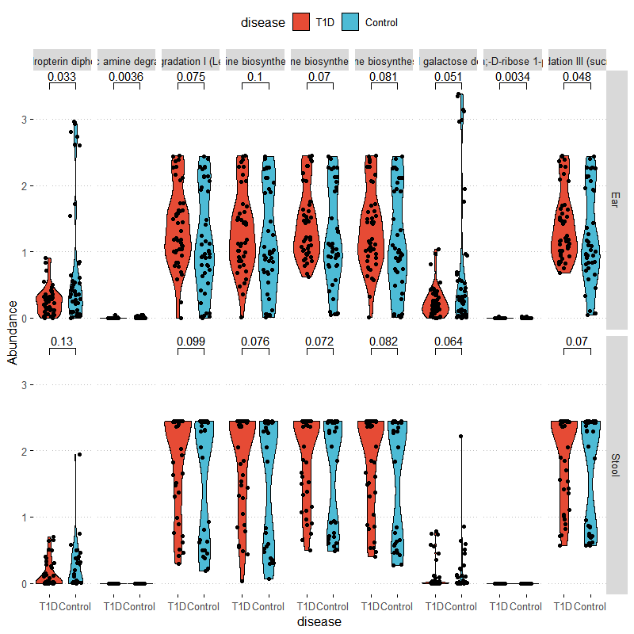
Infant PICRUST2 derived pathways comparisons
Pathways(left to Right) 6-hydroxymethyl-dihydropterin diphosphate biosynthesis
aromatic biogenic amine degradation (bacteria)
galactose degradation I (Leloir pathway)
L-lysine biosynthesis II
L-lysine biosynthesis III
L-lysine biosynthesis VI
lactose and galactose degradation I S-methyl-5-thio-&alpha;-D-ribose 1-phosphate degradation
sucrose degradation III (sucrose invertase)
Infant Ear
Infant Stool

Slide 3
Type 1 Diabetes assoc. pathways by Sample Type
description | Control: mean rel. freq. (%) | Control: std. dev. (%) | T1D: mean rel. freq. (%) | T1D: std. dev. (%) | p-values | Difference between means | 95.0% lower CI | 95.0% upper CI
reductive TCA cycle I | 0.095 | 0.153 | 0.022 | 0.055 | 0.018 | 0.018 | 0.073 | 0.013
superpathway of L-methionine biosynthesis (by sulfhydrylation) | 0.080 | 0.127 | 0.024 | 0.062 | 0.036 | 0.036 | 0.055 | 0.004
catechol degradation I (meta-cleavage pathway) | 0.048 | 0.083 | 0.010 | 0.032 | 0.027 | 0.027 | 0.037 | 0.004
superpathway of heme biosynthesis from glycine | 0.051 | 0.086 | 0.011 | 0.029 | 0.020 | 0.020 | 0.040 | 0.007
description | Control: mean rel. freq. (%) | Control: std. dev. (%) | T1D: mean rel. freq. (%) | T1D: std. dev. (%) | p-values | Difference between means | 95.0% lower CI | 95.0% upper CI
lactose and galactose degradation I | 0.762 | 1.048 | 0.248 | 0.232 | 0.003 | 0.514 | 0.18 | 0.847
6-hydroxymethyl-dihydropterin diphosphate biosynthesis I | 0.706 | 0.905 | 0.262 | 0.206 | 0.003 | 0.444 | 0.156 | 0.732
adenosine deoxyribonucleotides de novo biosynthesis II | 1.896 | 0.781 | 1.571 | 0.503 | 0.026 | 0.325 | 0.04 | 0.61
guanosine deoxyribonucleotides de novo biosynthesis II | 1.896 | 0.781 | 1.571 | 0.503 | 0.026 | 0.325 | 0.04 | 0.61
(5Z)-dodec-5-enoate biosynthesis | 0.08 | 0.089 | 0.131 | 0.121 | 0.028 | -0.051 | -0.097 | -0.006
glycogen degradation I (bacterial) | 0.129 | 0.124 | 0.212 | 0.21 | 0.03 | -0.083 | -0.157 | -0.008
starch degradation V | 0.13 | 0.125 | 0.212 | 0.206 | 0.03 | -0.082 | -0.155 | -0.008
adenine and adenosine salvage III | 0.404 | 0.297 | 0.567 | 0.388 | 0.032 | -0.164 | -0.313 | -0.015
superpathway of L-alanine biosynthesis | 0.186 | 0.164 | 0.272 | 0.2 | 0.033 | -0.086 | -0.165 | -0.007
superpathway of purine deoxyribonucleosides degradation | 0.27 | 0.215 | 0.397 | 0.314 | 0.033 | -0.127 | -0.243 | -0.011
glycogen biosynthesis I (from ADP-D-Glucose) | 0.085 | 0.086 | 0.144 | 0.156 | 0.034 | -0.059 | -0.113 | -0.004
pyruvate fermentation to acetate and lactate II | 2.117 | 0.938 | 1.733 | 0.68 | 0.034 | 0.384 | 0.03 | 0.739
sucrose degradation IV (sucrose phosphorylase) | 0.063 | 0.089 | 0.117 | 0.139 | 0.034 | -0.055 | -0.105 | -0.004
glycolysis III (from glucose) | 1.888 | 0.748 | 1.582 | 0.554 | 0.036 | 0.306 | 0.021 | 0.591
superpathway of adenosine nucleotides de novo biosynthesis I | 1.975 | 0.796 | 1.659 | 0.566 | 0.038 | 0.316 | 0.017 | 0.616
superpathway of adenosine nucleotides de novo biosynthesis II | 1.931 | 0.78 | 1.624 | 0.564 | 0.041 | 0.307 | 0.012 | 0.601
L-lysine biosynthesis I | 0.157 | 0.137 | 0.23 | 0.187 | 0.044 | -0.073 | -0.144 | -0.002
aromatic biogenic amine degradation (bacteria) | 0.006 | 0.011 | 0.002 | 0.007 | 0.044 | 0.004 | 0 | 0.008
Infant Stool
Infant Ear

Slide 5
DESEQ2 identified Taxa associated with Type 1 Diabetes
Genus | log2FoldChange | lfcSE | stat | pvalue | padj | Kingdom | Phylum | Class | Order | Family
Aerococcus | -18.113 | 3.867 | -4.683 | <0.0001 | <0.0001 | Bacteria | Firmicutes | Bacilli | Lactobacillales | Aerococcaceae
Anaerococcus | 2.567 | 0.900 | 2.851 | 0.004 | 0.049 | Bacteria | Firmicutes | Clostridia | Clostridiales | Family_XI
Staphylococcus | 2.932 | 0.827 | 3.546 | <0.0001 | 0.010 | Bacteria | Firmicutes | Bacilli | Bacillales | Staphylococcaceae
Bifidobacterium | 3.497 | 1.224 | 2.856 | 0.004 | 0.049 | Bacteria | Actinobacteria | Actinobacteria | Bifidobacteriales | Bifidobacteriaceae
Campylobacter | 4.495 | 1.305 | 3.444 | 0.001 | 0.010 | Bacteria | Epsilonbacteraeota | Campylobacteria | Campylobacterales | Campylobacteraceae
Atopobium | 4.630 | 1.342 | 3.449 | 0.001 | 0.010 | Bacteria | Actinobacteria | Coriobacteriia | Coriobacteriales | Atopobiaceae
Enterococcus | 5.462 | 0.923 | 5.921 | <0.0001 | <0.0001 | Bacteria | Firmicutes | Bacilli | Lactobacillales | Enterococcaceae
Mobiluncus | 5.523 | 1.918 | 2.880 | 0.004 | 0.049 | Bacteria | Actinobacteria | Actinobacteria | Actinomycetales | Actinomycetaceae
Fusobacterium | 8.176 | 2.304 | 3.548 | <0.0001 | 0.010 | Bacteria | Fusobacteria | Fusobacteriia | Fusobacteriales | Fusobacteriaceae
Mother
Genus | log2FoldChange | lfcSE | stat | pvalue | padj | Phylum | Class | Order | Family
Erysipelatoclostridium | -24.676 | 3.283 | -7.516 | <0.0001 | <0.0001 | Firmicutes | Erysipelotrichia | Erysipelotrichales | Erysipelotrichaceae
Methylobacterium | 2.825 | 0.726 | 3.890 | <0.0001 | 0.004 | Proteobacteria | Alphaproteobacteria | Rhizobiales | Beijerinckiaceae
Sphingomonas | 3.083 | 0.662 | 4.654 | <0.0001 | <0.0001 | Proteobacteria | Alphaproteobacteria | Sphingomonadales | Sphingomonadaceae
Micrococcus | 3.463 | 0.662 | 5.233 | <0.0001 | <0.0001 | Actinobacteria | Actinobacteria | Micrococcales | Micrococcaceae
Ruminococcaceae | 3.620 | 0.968 | 3.740 | <0.0001 | 0.006 | Firmicutes | Clostridia | Clostridiales | Ruminococcaceae
Paracoccus | 4.410 | 0.792 | 5.567 | <0.0001 | <0.0001 | Proteobacteria | Alphaproteobacteria | Rhodobacterales | Rhodobacteraceae
Collinsella | 4.709 | 1.124 | 4.191 | <0.0001 | <0.001 | Actinobacteria | Coriobacteriia | Coriobacteriales | Coriobacteriaceae
Infant

Slide 6
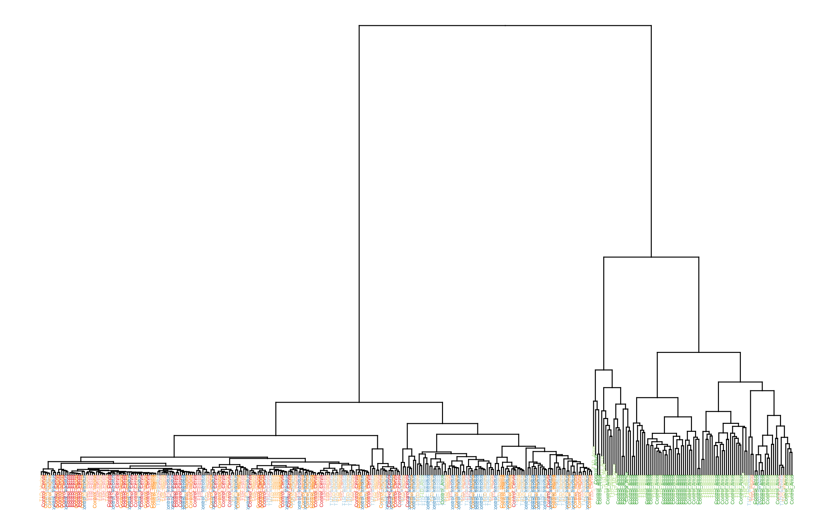
Maternal sample VST clustering by disease

Slide 7
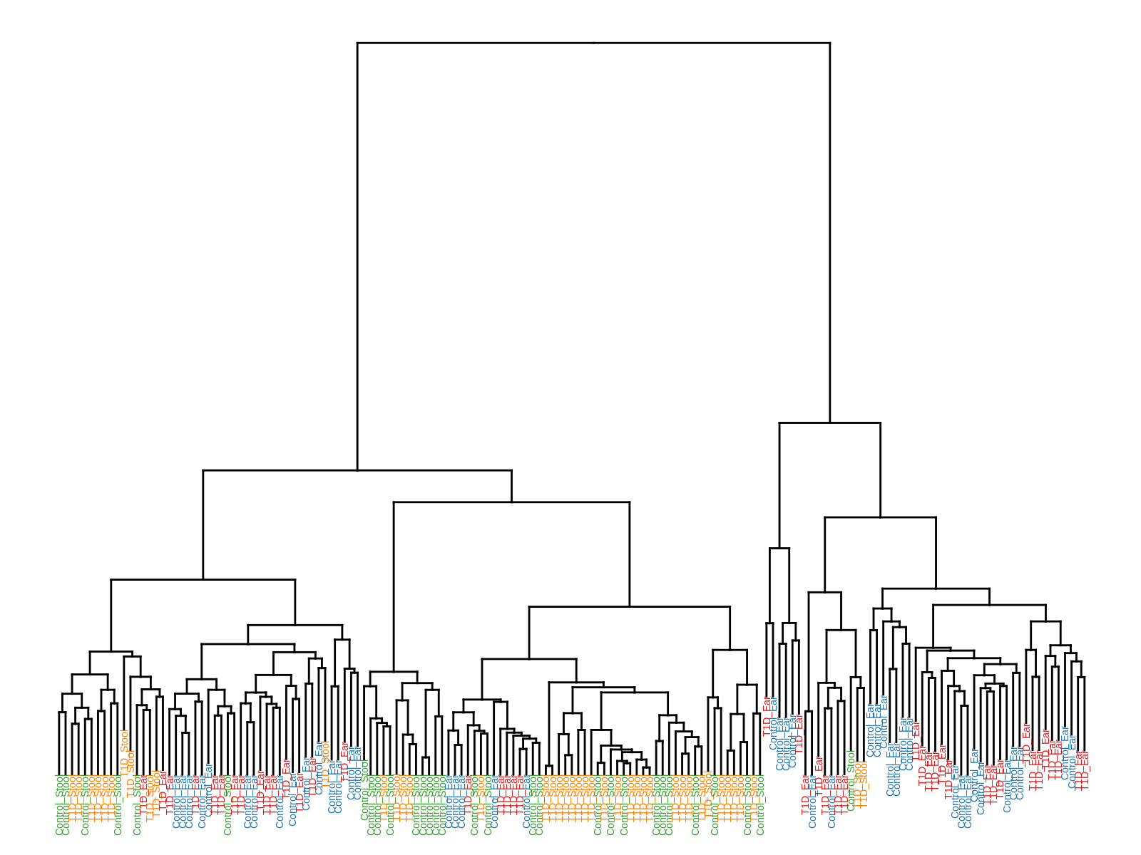
Infant sample VST clustering

Slide 8
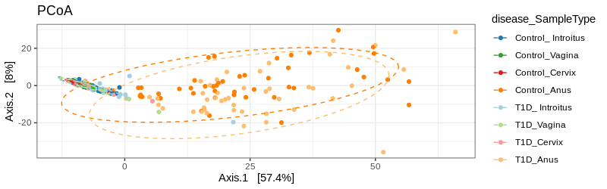
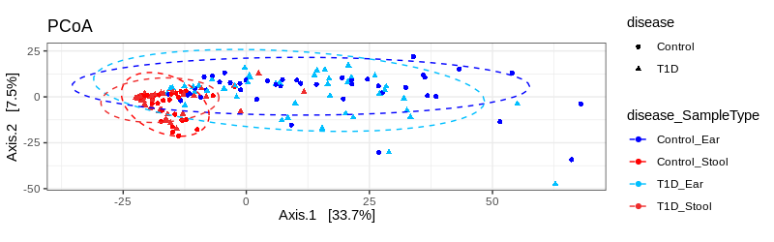
VST clustering
Mother
Infant

