Slide 1
Sourcetracker figure update
Jochum, Michael D
7 June 2022

Slide 2
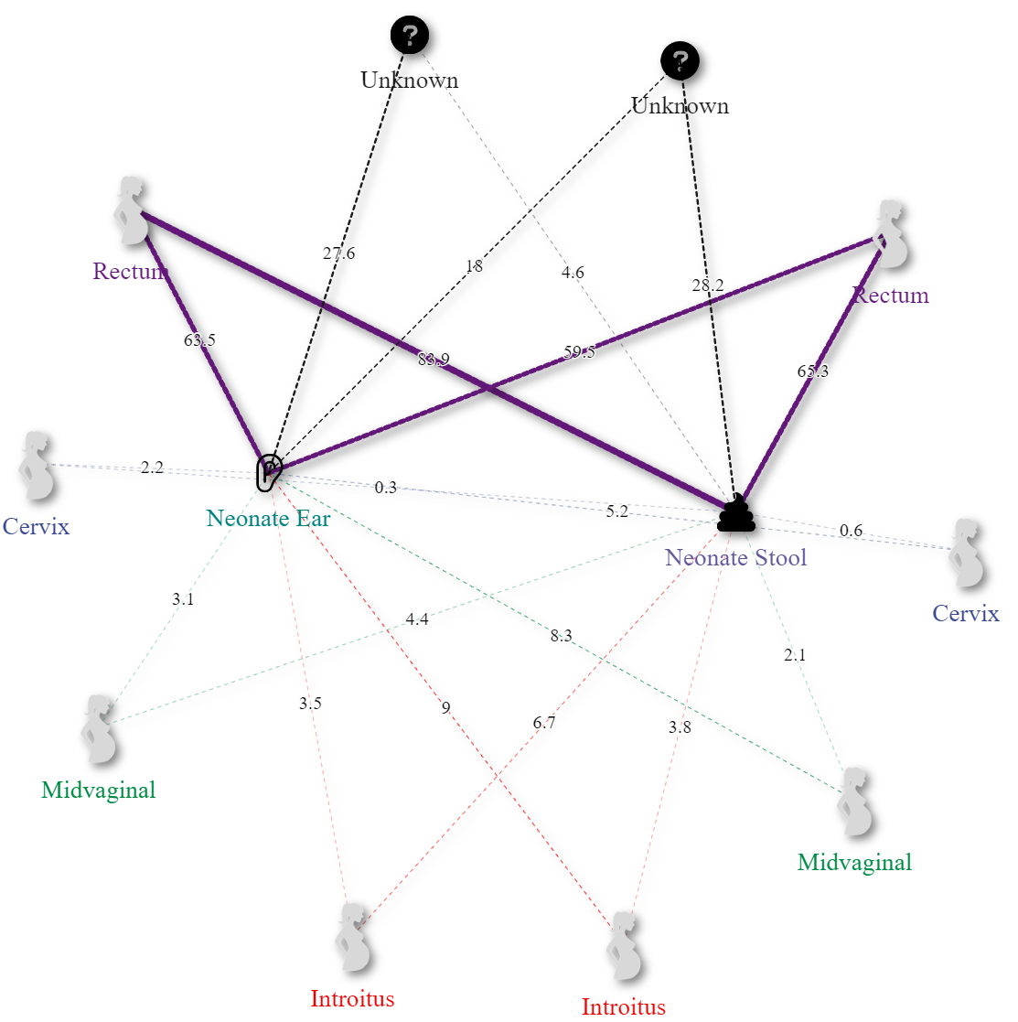
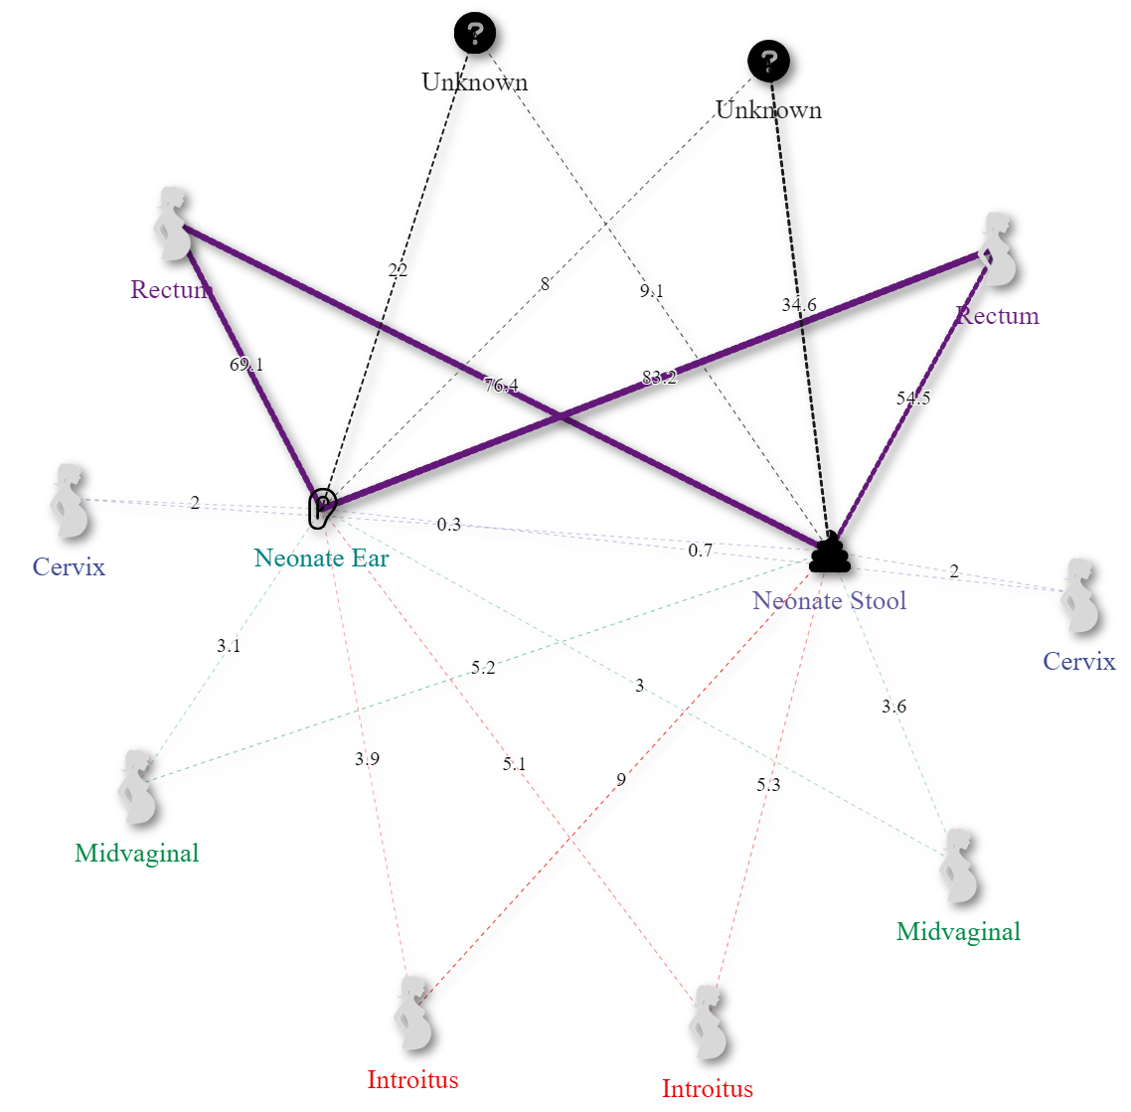
Control
T1D
Cesarean
Vaginal
Cesarean
Vaginal
A)
B)
Supplementary Figure 9. Network plot of Sourcetracker2 derived maternal contributions (outside nodes) to neonatal microbiomes (inside nodes) by disease states A) Control and B) Type one diabetes by delivery modes Cesarean (left) and Vaginal (right). Maternal contributions are depicted and annotated by line thickness and demonstrate a statistically significant increase in maternal Rectum source contributions to the neonatal ear microbiome when comparing vaginally delivered neonatal ear microbiomes from type 1 diabetic mothers to the control.

Slide 3
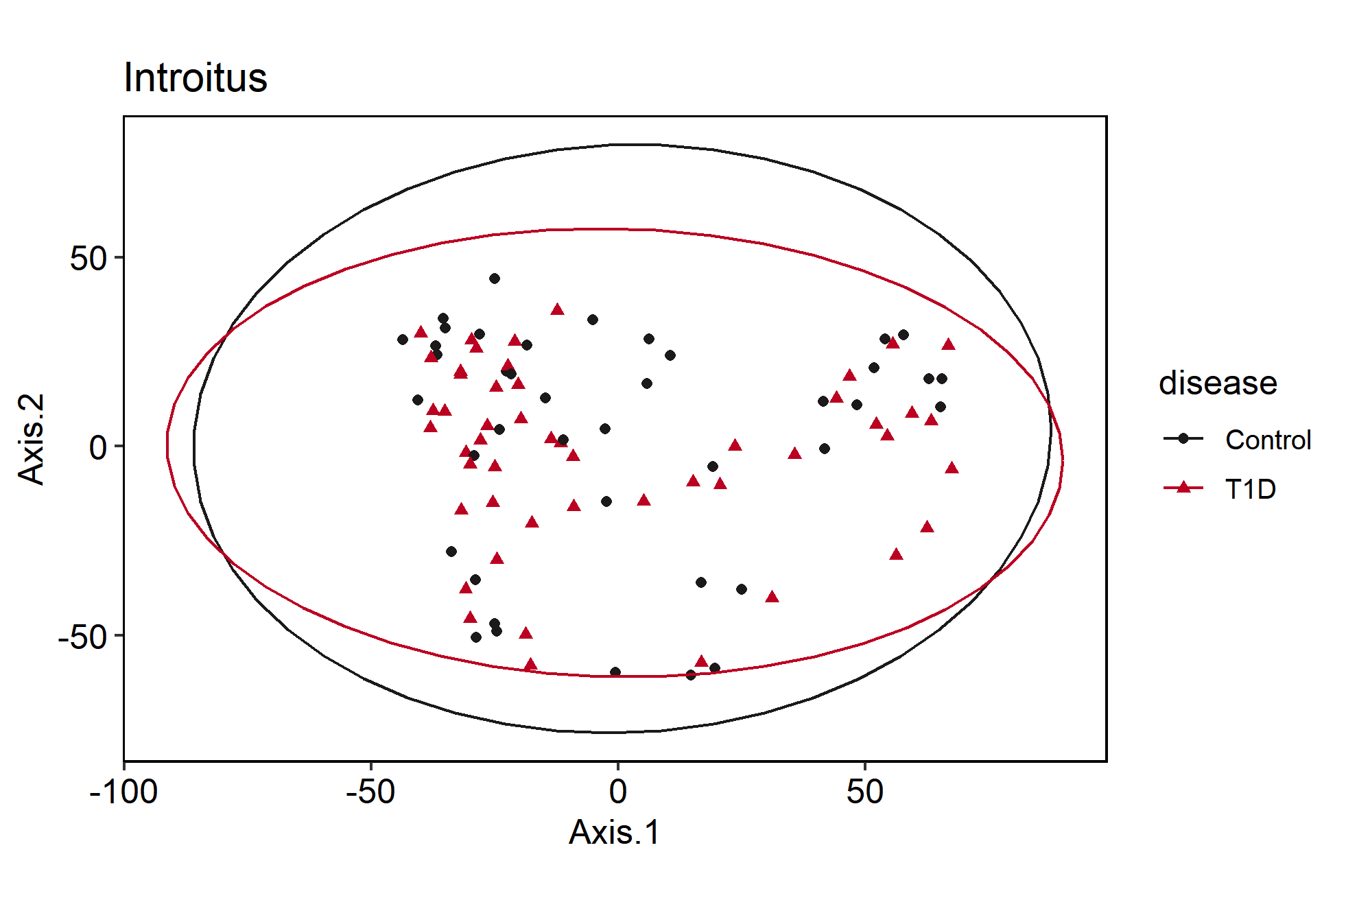
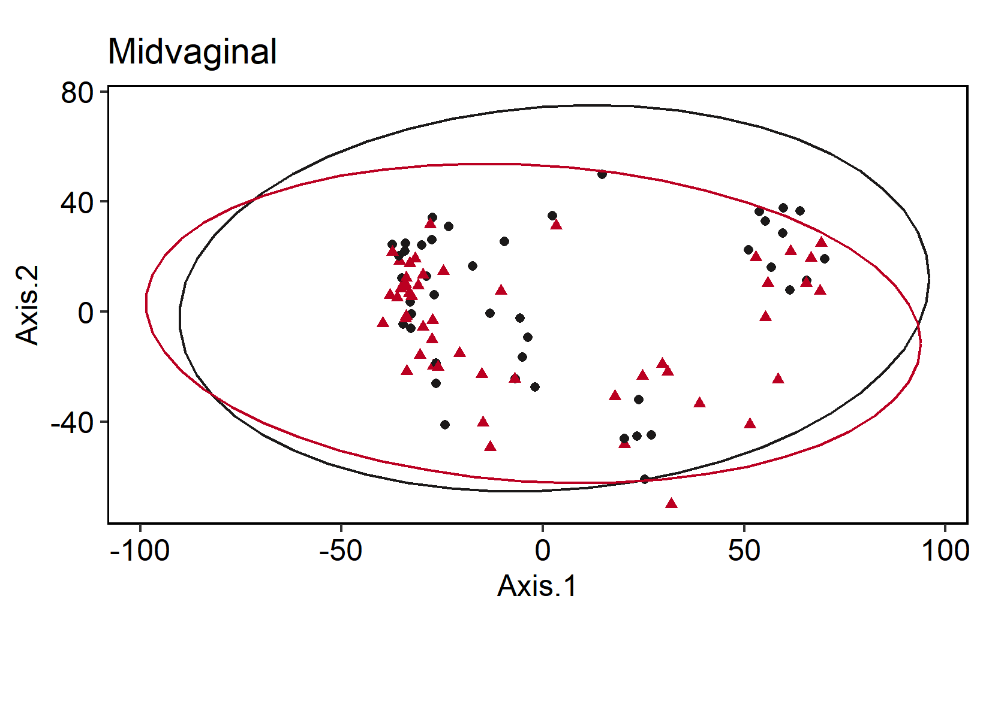
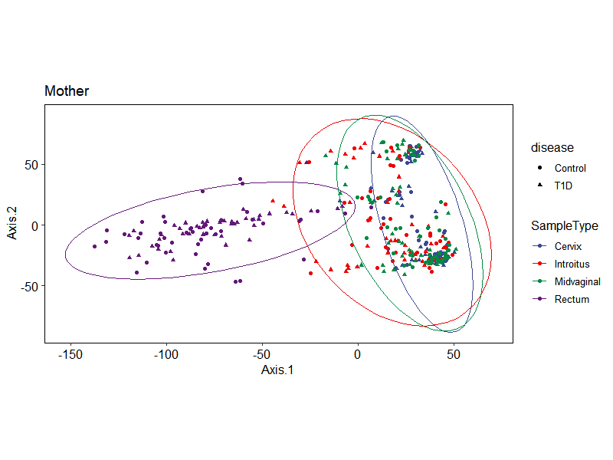
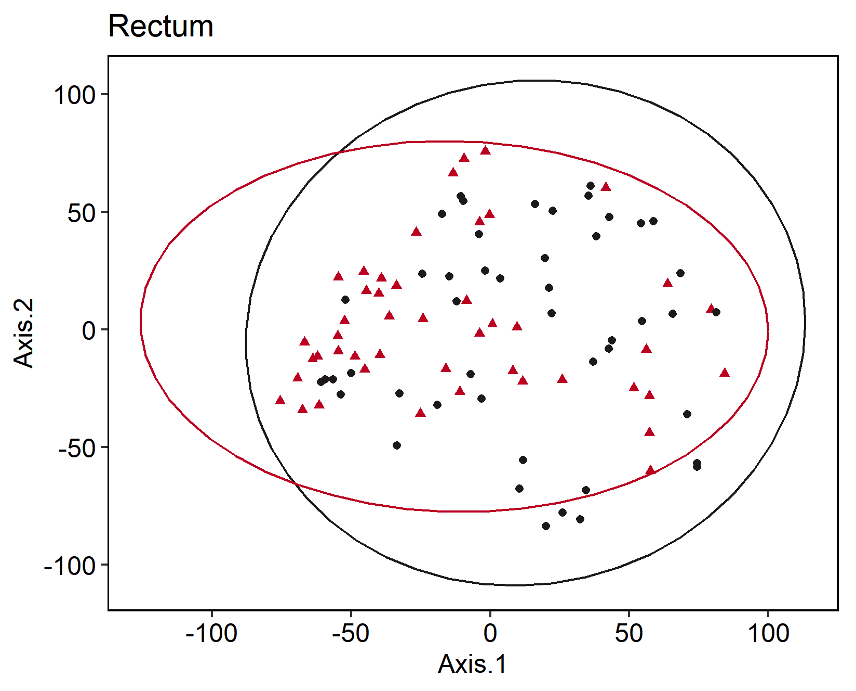
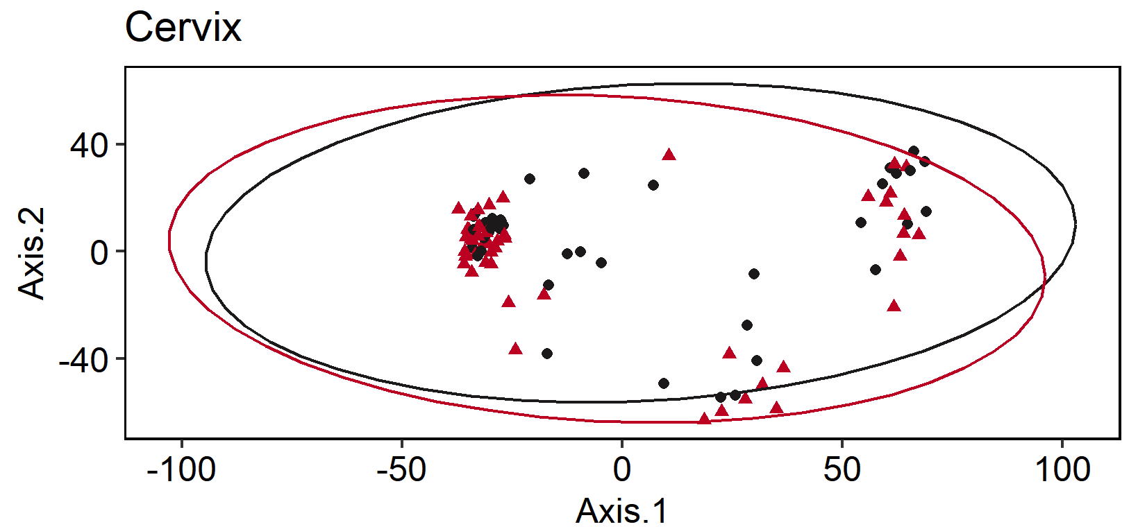
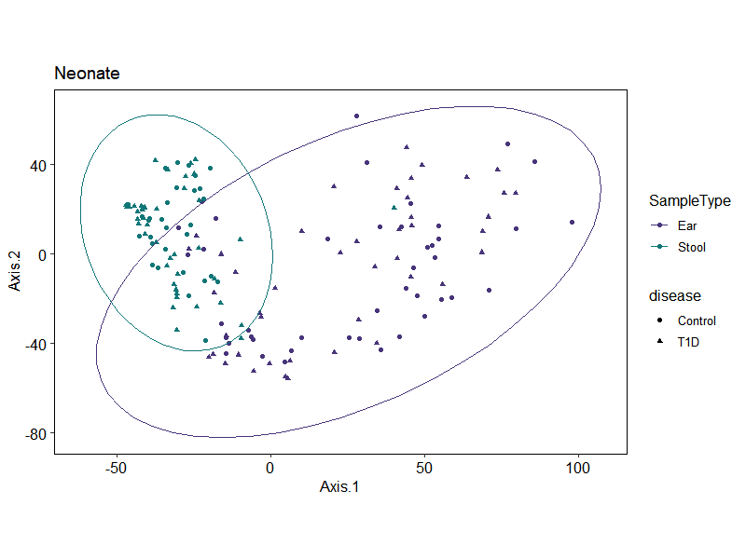
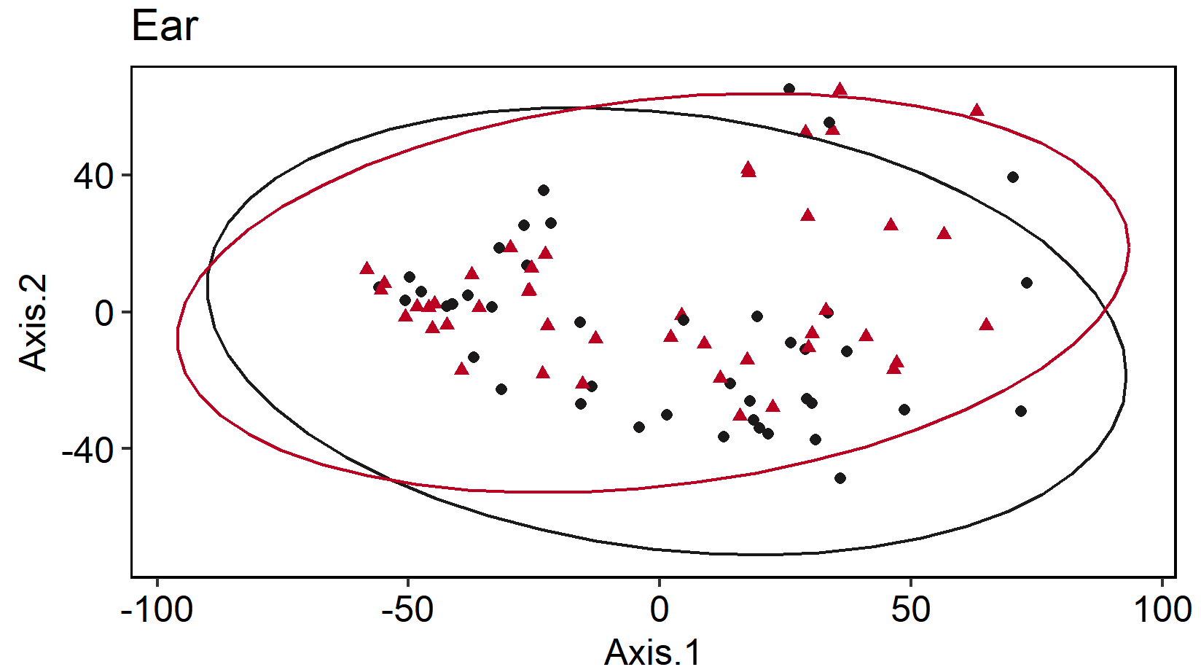
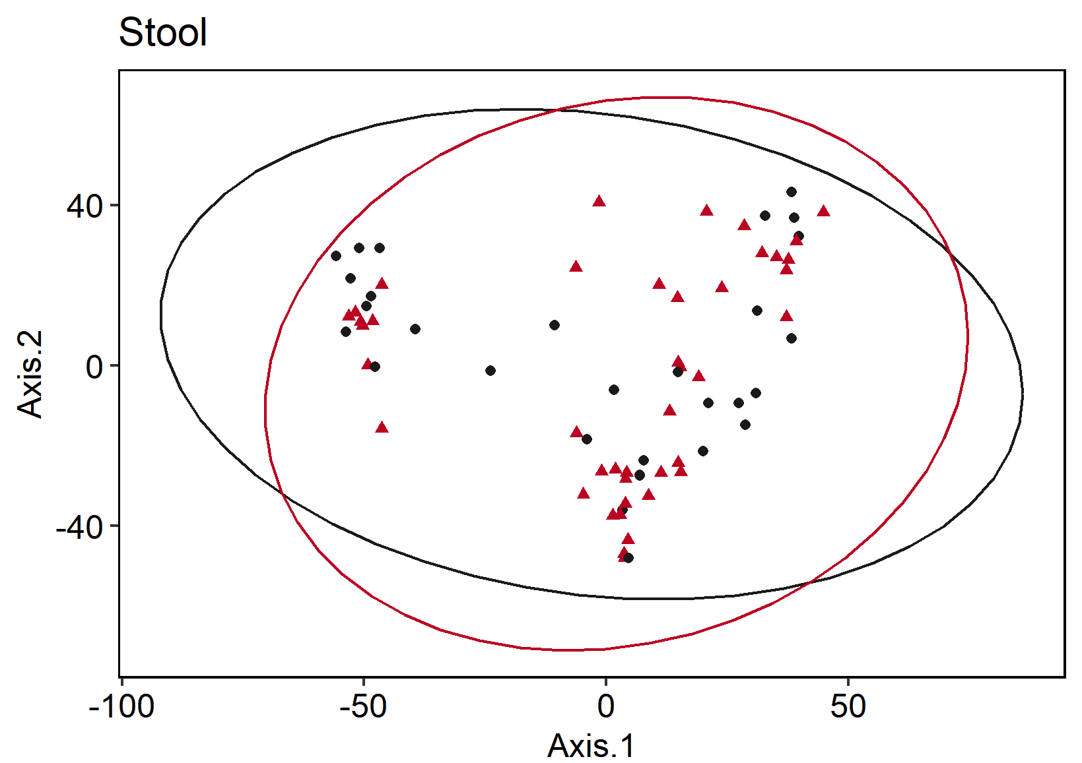
A
C
D
> list
# A tibble: 6 x 1
SampleType
<chr>
1 Anus
2 Cervix
3 Ear
4 Introitus
5 Stool
6 Vagina
> lapply(list$SampleType, function(X) day_adonis(X = X))
[[1]]
Permutation test for adonis under reduced model
Terms added sequentially (first to last)
Permutation: free
Number of permutations: 9999
adonis2(formula = Day_unifrac ~ disease, data = Day_meta, permutations = 9999, parallel = T)
Df SumOfSqs R2 F Pr(>F)
disease 1 10634.7 0.87192 619.51 0.1594
Residual 91 1562.1 0.12808
Total 92 12196.8 1.00000
[[2]]
Permutation test for adonis under reduced model
Terms added sequentially (first to last)
Permutation: free
Number of permutations: 9999
adonis2(formula = Day_unifrac ~ disease, data = Day_meta, permutations = 9999, parallel = T)
Df SumOfSqs R2 F Pr(>F)
disease 1 -5122 -0.07318 -6.0687 0.6145
Residual 89 75122 1.07318
Total 90 70000 1.00000
[[3]]
Permutation test for adonis under reduced model
Terms added sequentially (first to last)
Permutation: free
Number of permutations: 9999
adonis2(formula = Day_unifrac ~ disease, data = Day_meta, permutations = 9999, parallel = T)
Df SumOfSqs R2 F Pr(>F)
disease 1 -1034.0 -0.65223 -33.554 0.8989
Residual 85 2619.2 1.65223
Total 86 1585.2 1.00000
[[4]]
Permutation test for adonis under reduced model
Terms added sequentially (first to last)
Permutation: free
Number of permutations: 9999
adonis2(formula = Day_unifrac ~ disease, data = Day_meta, permutations = 9999, parallel = T)
Df SumOfSqs R2 F Pr(>F)
disease 1 -475.9 -0.0757 -6.2634 0.5513
Residual 89 6762.1 1.0757
Total 90 6286.3 1.0000
[[5]]
Permutation test for adonis under reduced model
Terms added sequentially (first to last)
Permutation: free
Number of permutations: 9999
adonis2(formula = Day_unifrac ~ disease, data = Day_meta, permutations = 9999, parallel = T)
Df SumOfSqs R2 F Pr(>F)
disease 1 181.88 0.41143 48.932 0.0741 .
Residual 70 260.20 0.58857
Total 71 442.08 1.00000
---
Signif. codes: 0 ‘***’ 0.001 ‘**’ 0.01 ‘*’ 0.05 ‘.’ 0.1 ‘ ’ 1
[[6]]
Permutation test for adonis under reduced model
Terms added sequentially (first to last)
Permutation: free
Number of permutations: 9999
adonis2(formula = Day_unifrac ~ disease, data = Day_meta, permutations = 9999, parallel = T)
Df SumOfSqs R2 F Pr(>F)
disease 1 -1783.5 -0.55289 -32.4 0.9332
Residual 91 5009.2 1.55289
Total 92 3225.8 1.00000
p = 0.933
p = 0.551
F
Maternal
E
p = 0.615
G
p = 0.159
B
p = 0.899
Neonatal
H
p = 0.074
Supplemental Figure 8. Beta Diversity PCoA plots comparing microbiome composition based on variance stabilizing transformed (VST) Euclidean distances in A) Maternal (top) and B) Neonatal (bottom) microbiomes faceted by maternal sample types C) Vaginal Introitus; D) Midvaginal; E) Cervix; F) Rectum; and neonatal sample types G) Ear; and H) Stool. Samples are shaped by disease state and colored by sample type in panels A and B, or disease state in panels C-H where Type 1 diabetic microbiomes are depicted in red and control samples are depicted in black. P values significance scores located in the bottom left of each plot were conducted using an adonis permutational ANOVA test comparing ASV counts against disease state (perm= 9999).

Slide 4
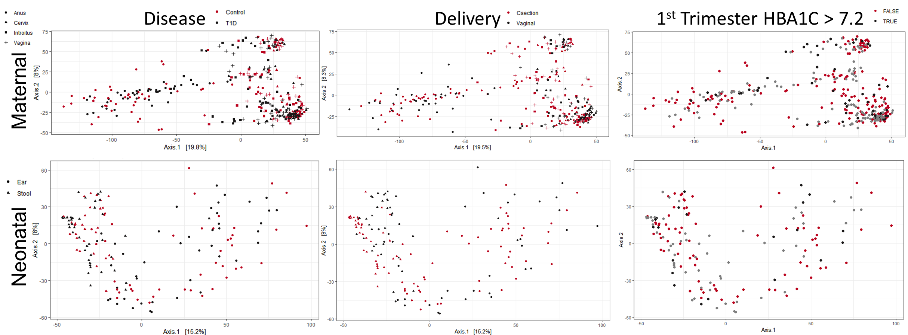
p = 0.1961
p = 0.614
Supplemental Figure 9. Beta Diversity PCoA plots visualizing microbiome community composition distances based on Bray-Curtis dissimilarity indices in maternal (top) and neonatal (bottom). Samples are shaped by sample type and colored by disease state (left) where T1D samples are depicted in red and control samples are depicted in black, delivery method (center) where Cesarean section samples are depicted in red and vaginal delivered microbiomes samples are depicted in black, and 1st trimester HbA1c values (right) where maternal 1st Trimester uncontrolled samples are depicted in red, controlled diabetes are depicted in black, and nondiabetic samples are depicted in grey. The threshold for defining controlled vs uncontrolled diabetes was based on 1st trimester HbA1C values > 7.2. P values significance scores located in the bottom left of each plot were conducted using an adonis permutational ANOVA test comparing ASV counts against disease state (perm= 9999).

Slide 5
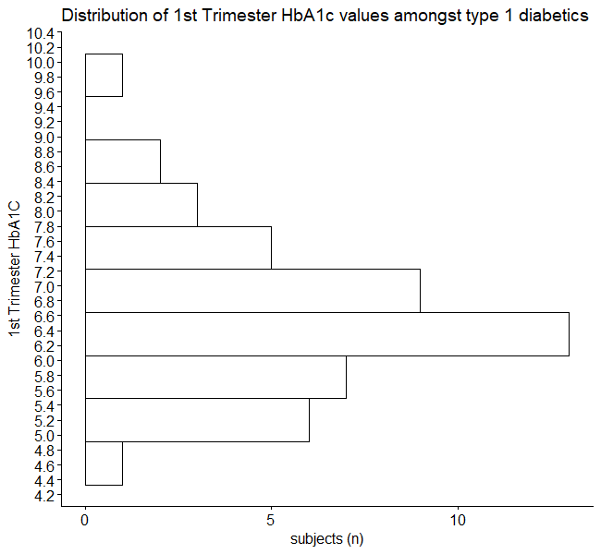
Rationale for the HbA1c cutoff of 7.2
min | Q1 | median | Q3 | max | mean | sd | n | missing
4.8 | 5.85 | 6.4 | 7.2 | 10 | 6.610638 | 1.096087 | 47 | 0

Slide 6
Old stuff

Slide 7
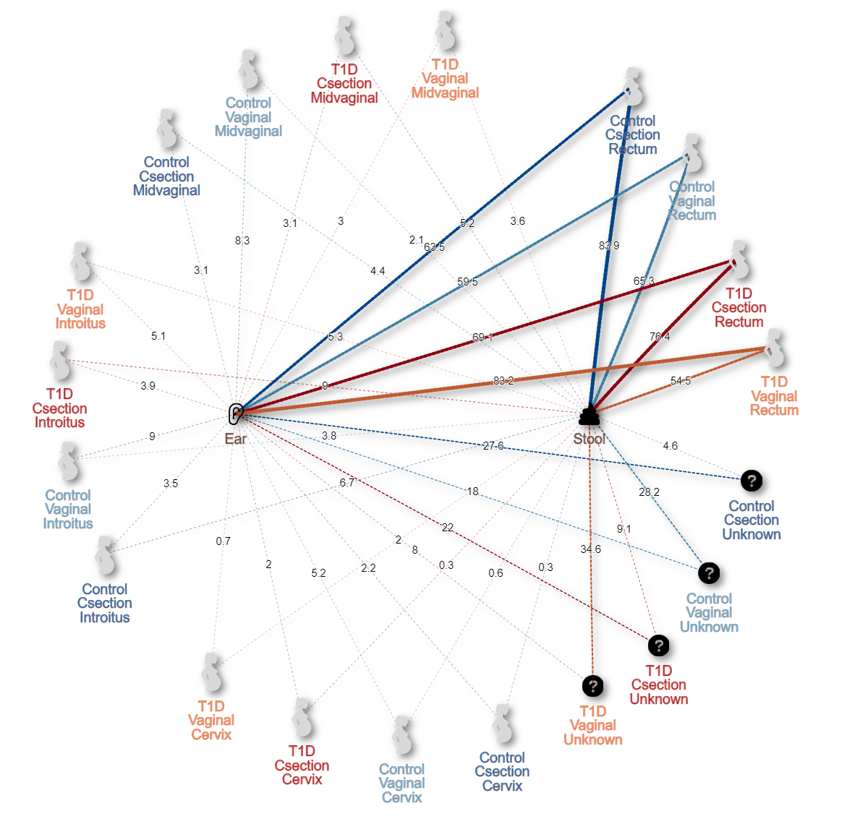
Supplementary Table X. Overview of maternal source mean contributions to newborn sinks by disease and delivery method.
 |  |  | Source (mean ± std. error)
Delivery | Sink | Disease | Anus | Cervix | Introitus | Unknown | Vagina
C-section | Ear | Control | 0.635 ± 0.31 | 0.022 ± 0.048 | 0.035 ± 0.043 | 0.276 ± 0.285 | 0.031 ± 0.051
 |  | T1D | 0.691 ± 0.28 | 0.02 ± 0.03 | 0.039 ± 0.038 | 0.22 ± 0.25 | 0.031 ± 0.032
 | Stool | Control | 0.839 ± 0.104 | 0.003 ± 0.003 | 0.067 ± 0.033 | 0.046 ± 0.111 | 0.044 ± 0.024
 |  | T1D | 0.764 ± 0.252 | 0.003 ± 0.005 | 0.09 ± 0.091 | 0.091 ± 0.209 | 0.052 ± 0.069
Vaginal | Ear | Control | 0.595 ± 0.311 | 0.052 ± 0.092 | 0.09 ± 0.096 | 0.18 ± 0.247 | 0.083 ± 0.105
 |  | T1D | 0.832 ± 0.198 | 0.007 ± 0.011 | 0.051 ± 0.076 | 0.08 ± 0.174 | 0.03 ± 0.047
 | Stool | Control | 0.653 ± 0.317 | 0.006 ± 0.006 | 0.038 ± 0.024 | 0.282 ± 0.331 | 0.021 ± 0.014
 |  | T1D | 0.545 ± 0.336 | 0.02 ± 0.062 | 0.053 ± 0.053 | 0.346 ± 0.343 | 0.036 ± 0.042
Supplementary Figure 9. Network of Sourcetracker2 derived maternal contributions to neonatal microbiomes by disease state, sample type, delivery mode. Results show statistically significant increases in maternal source Anus contributions to the ear microbiome when comparing vaginally delivered neonatal ear microbiomes from type 1 diabetic mothers to the control.

Slide 8
A
B
C
> list
# A tibble: 6 x 1
SampleType
<chr>
1 Anus
2 Cervix
3 Ear
4 Introitus
5 Stool
6 Vagina
> lapply(list$SampleType, function(X) day_adonis(X = X))
[[1]]
Permutation test for adonis under reduced model
Terms added sequentially (first to last)
Permutation: free
Number of permutations: 9999
adonis2(formula = Day_unifrac ~ disease, data = Day_meta, permutations = 9999, parallel = T)
Df SumOfSqs R2 F Pr(>F)
disease 1 10634.7 0.87192 619.51 0.1594
Residual 91 1562.1 0.12808
Total 92 12196.8 1.00000
[[2]]
Permutation test for adonis under reduced model
Terms added sequentially (first to last)
Permutation: free
Number of permutations: 9999
adonis2(formula = Day_unifrac ~ disease, data = Day_meta, permutations = 9999, parallel = T)
Df SumOfSqs R2 F Pr(>F)
disease 1 -5122 -0.07318 -6.0687 0.6145
Residual 89 75122 1.07318
Total 90 70000 1.00000
[[3]]
Permutation test for adonis under reduced model
Terms added sequentially (first to last)
Permutation: free
Number of permutations: 9999
adonis2(formula = Day_unifrac ~ disease, data = Day_meta, permutations = 9999, parallel = T)
Df SumOfSqs R2 F Pr(>F)
disease 1 -1034.0 -0.65223 -33.554 0.8989
Residual 85 2619.2 1.65223
Total 86 1585.2 1.00000
[[4]]
Permutation test for adonis under reduced model
Terms added sequentially (first to last)
Permutation: free
Number of permutations: 9999
adonis2(formula = Day_unifrac ~ disease, data = Day_meta, permutations = 9999, parallel = T)
Df SumOfSqs R2 F Pr(>F)
disease 1 -475.9 -0.0757 -6.2634 0.5513
Residual 89 6762.1 1.0757
Total 90 6286.3 1.0000
[[5]]
Permutation test for adonis under reduced model
Terms added sequentially (first to last)
Permutation: free
Number of permutations: 9999
adonis2(formula = Day_unifrac ~ disease, data = Day_meta, permutations = 9999, parallel = T)
Df SumOfSqs R2 F Pr(>F)
disease 1 181.88 0.41143 48.932 0.0741 .
Residual 70 260.20 0.58857
Total 71 442.08 1.00000
---
Signif. codes: 0 ‘***’ 0.001 ‘**’ 0.01 ‘*’ 0.05 ‘.’ 0.1 ‘ ’ 1
[[6]]
Permutation test for adonis under reduced model
Terms added sequentially (first to last)
Permutation: free
Number of permutations: 9999
adonis2(formula = Day_unifrac ~ disease, data = Day_meta, permutations = 9999, parallel = T)
Df SumOfSqs R2 F Pr(>F)
disease 1 -1783.5 -0.55289 -32.4 0.9332
Residual 91 5009.2 1.55289
Total 92 3225.8 1.00000
p = 0.933
p = 0.551
E
Maternal
D
p = 0.615
F
p = 0.159
H
p = 0.899
Neonatal
G
p = 0.074
Supplemental Figure 8. Beta Diversity PCoA plots comparing microbiome composition based on variance stabilizing transformed (VST) Euclidean distances in Maternal (top) and Neonatal (bottom) microbiomes faceted by sample type. Samples are shaped by disease state and colored by sample type in panels A and H, or disease state in panels B-G where T1D samples are depicted in red and control samples are depicted in black.

Slide 9
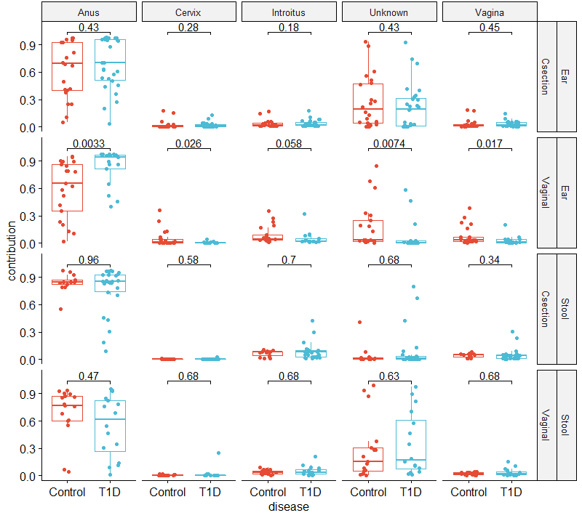
Supplementary Figure 10. Sourcetracker2 derived maternal contributions to neonatal microbiomes by sample type and delivery mode. Results show statistically significant increases in maternal source Anus contributions to the ear microbiome when comparing vaginally delivered neonatal ear microbiomes from type 1 diabetic mothers to the control.

Slide 10
Supplementary Table X. Overview of maternal source mean contributions to newborn sinks by disease and delivery method.
 |  |  | Source (mean ± std. error)
Delivery | Sink | Disease | Anus | Cervix | Introitus | Unknown | Vagina
C-section | Ear | Control | 0.635 ± 0.31 | 0.022 ± 0.048 | 0.035 ± 0.043 | 0.276 ± 0.285 | 0.031 ± 0.051
 |  | T1D | 0.691 ± 0.28 | 0.02 ± 0.03 | 0.039 ± 0.038 | 0.22 ± 0.25 | 0.031 ± 0.032
 | Stool | Control | 0.839 ± 0.104 | 0.003 ± 0.003 | 0.067 ± 0.033 | 0.046 ± 0.111 | 0.044 ± 0.024
 |  | T1D | 0.764 ± 0.252 | 0.003 ± 0.005 | 0.09 ± 0.091 | 0.091 ± 0.209 | 0.052 ± 0.069
Vaginal | Ear | Control | 0.595 ± 0.311 | 0.052 ± 0.092 | 0.09 ± 0.096 | 0.18 ± 0.247 | 0.083 ± 0.105
 |  | T1D | 0.832 ± 0.198 | 0.007 ± 0.011 | 0.051 ± 0.076 | 0.08 ± 0.174 | 0.03 ± 0.047
 | Stool | Control | 0.653 ± 0.317 | 0.006 ± 0.006 | 0.038 ± 0.024 | 0.282 ± 0.331 | 0.021 ± 0.014
 |  | T1D | 0.545 ± 0.336 | 0.02 ± 0.062 | 0.053 ± 0.053 | 0.346 ± 0.343 | 0.036 ± 0.042

