Slide 1
Sourcetracker figure update
Jochum, Michael D
7 June 2022

Slide 2
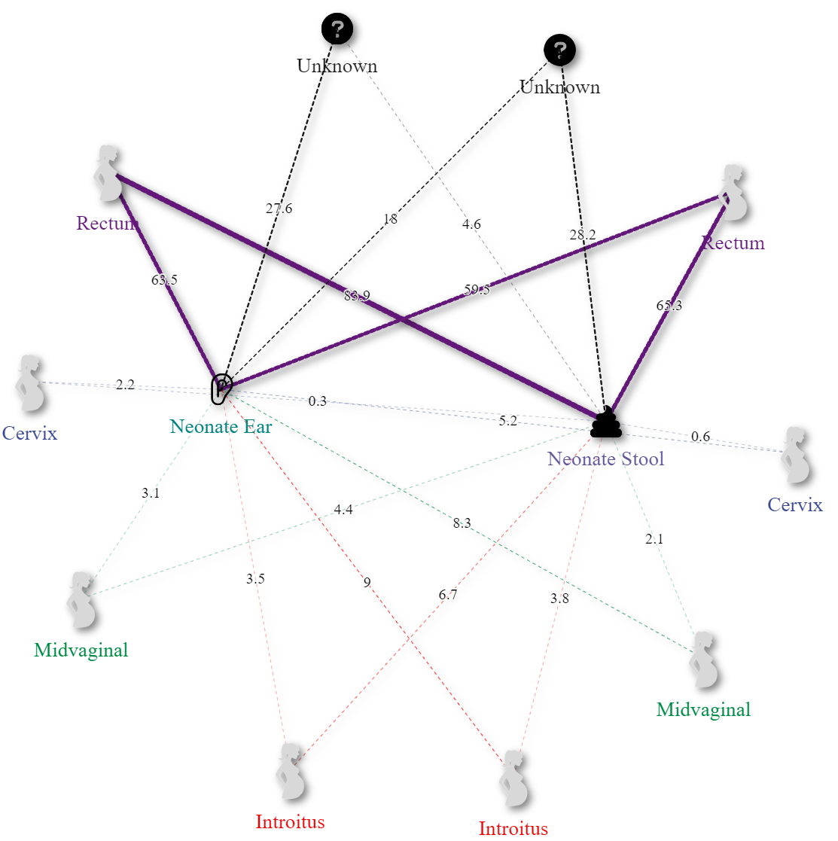
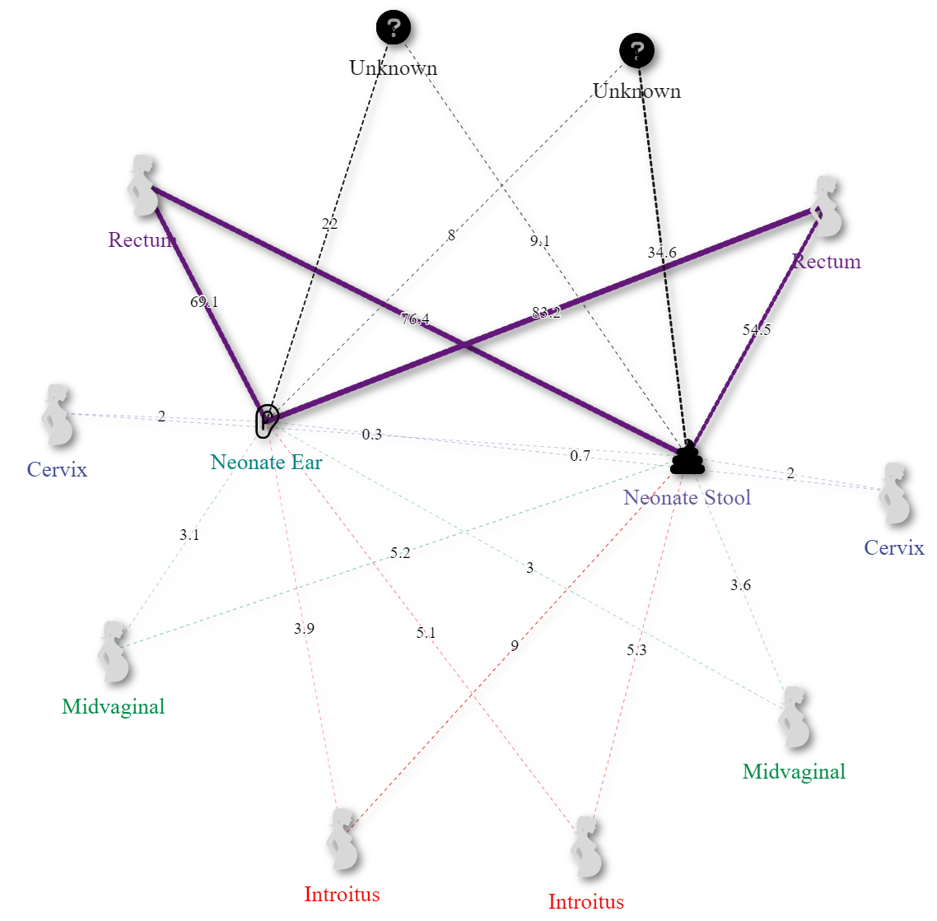
Control
T1D
Cesarean
Vaginal
Cesarean
Vaginal
A)
B)
Supplementary Figure 9. Network of Sourcetracker2 derived maternal contributions (outside nodes) to neonatal microbiomes (inside nodes) by disease states A) Control and B) Type one diabetes by delivery modes Cesarean (left) and Vaginal (right). Results show statistically significant increases in maternal source Anus contributions to the ear microbiome when comparing vaginally delivered neonatal ear microbiomes from type 1 diabetic mothers to the control.

Slide 3
Old stuff

Slide 4
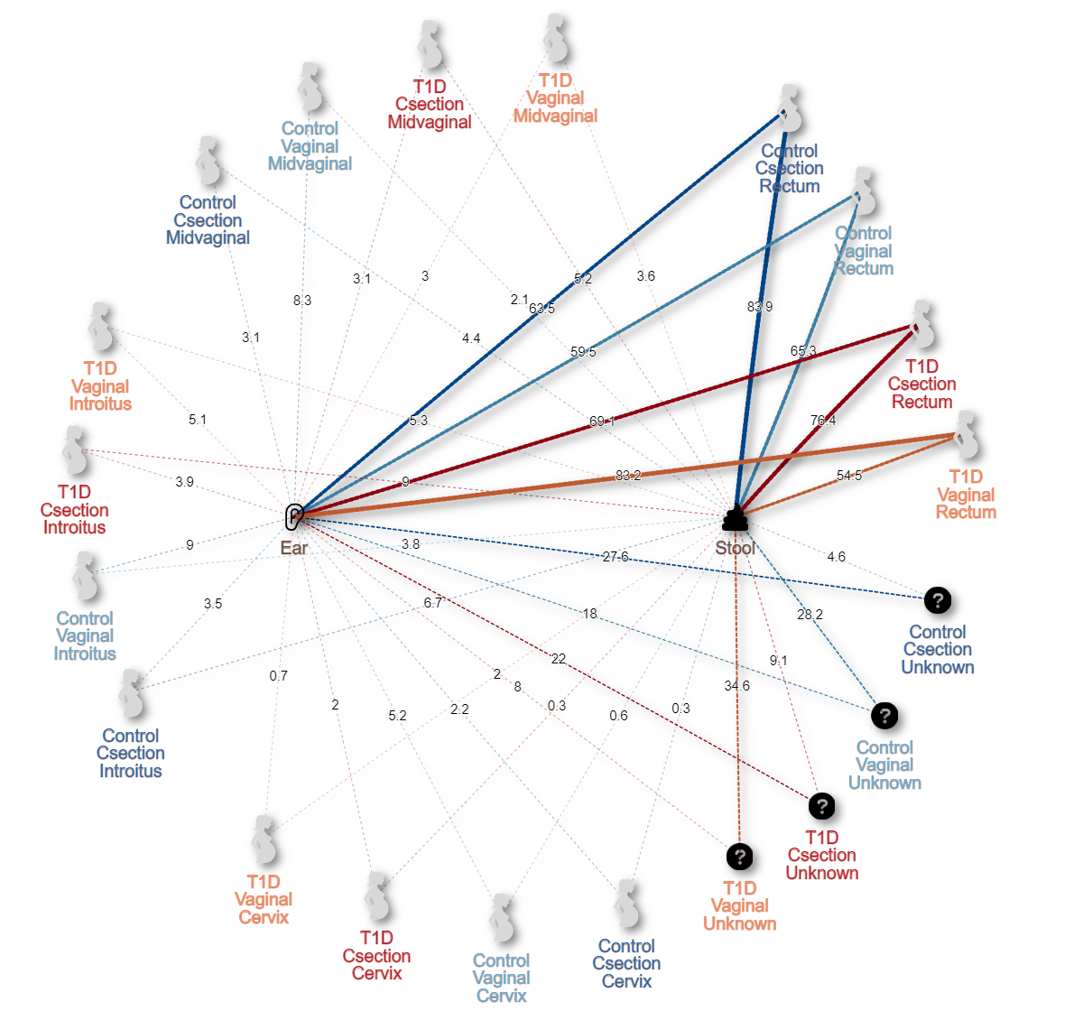
Supplementary Table X. Overview of maternal source mean contributions to newborn sinks by disease and delivery method.
 |  |  | Source (mean ± std. error)
Delivery | Sink | Disease | Anus | Cervix | Introitus | Unknown | Vagina
C-section | Ear | Control | 0.635 ± 0.31 | 0.022 ± 0.048 | 0.035 ± 0.043 | 0.276 ± 0.285 | 0.031 ± 0.051
 |  | T1D | 0.691 ± 0.28 | 0.02 ± 0.03 | 0.039 ± 0.038 | 0.22 ± 0.25 | 0.031 ± 0.032
 | Stool | Control | 0.839 ± 0.104 | 0.003 ± 0.003 | 0.067 ± 0.033 | 0.046 ± 0.111 | 0.044 ± 0.024
 |  | T1D | 0.764 ± 0.252 | 0.003 ± 0.005 | 0.09 ± 0.091 | 0.091 ± 0.209 | 0.052 ± 0.069
Vaginal | Ear | Control | 0.595 ± 0.311 | 0.052 ± 0.092 | 0.09 ± 0.096 | 0.18 ± 0.247 | 0.083 ± 0.105
 |  | T1D | 0.832 ± 0.198 | 0.007 ± 0.011 | 0.051 ± 0.076 | 0.08 ± 0.174 | 0.03 ± 0.047
 | Stool | Control | 0.653 ± 0.317 | 0.006 ± 0.006 | 0.038 ± 0.024 | 0.282 ± 0.331 | 0.021 ± 0.014
 |  | T1D | 0.545 ± 0.336 | 0.02 ± 0.062 | 0.053 ± 0.053 | 0.346 ± 0.343 | 0.036 ± 0.042
Supplementary Figure 9. Network of Sourcetracker2 derived maternal contributions to neonatal microbiomes by disease state, sample type, delivery mode. Results show statistically significant increases in maternal source Anus contributions to the ear microbiome when comparing vaginally delivered neonatal ear microbiomes from type 1 diabetic mothers to the control.

Slide 5
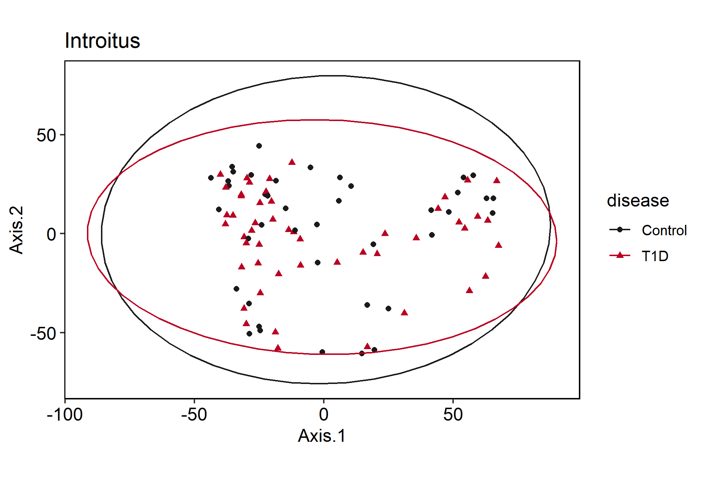
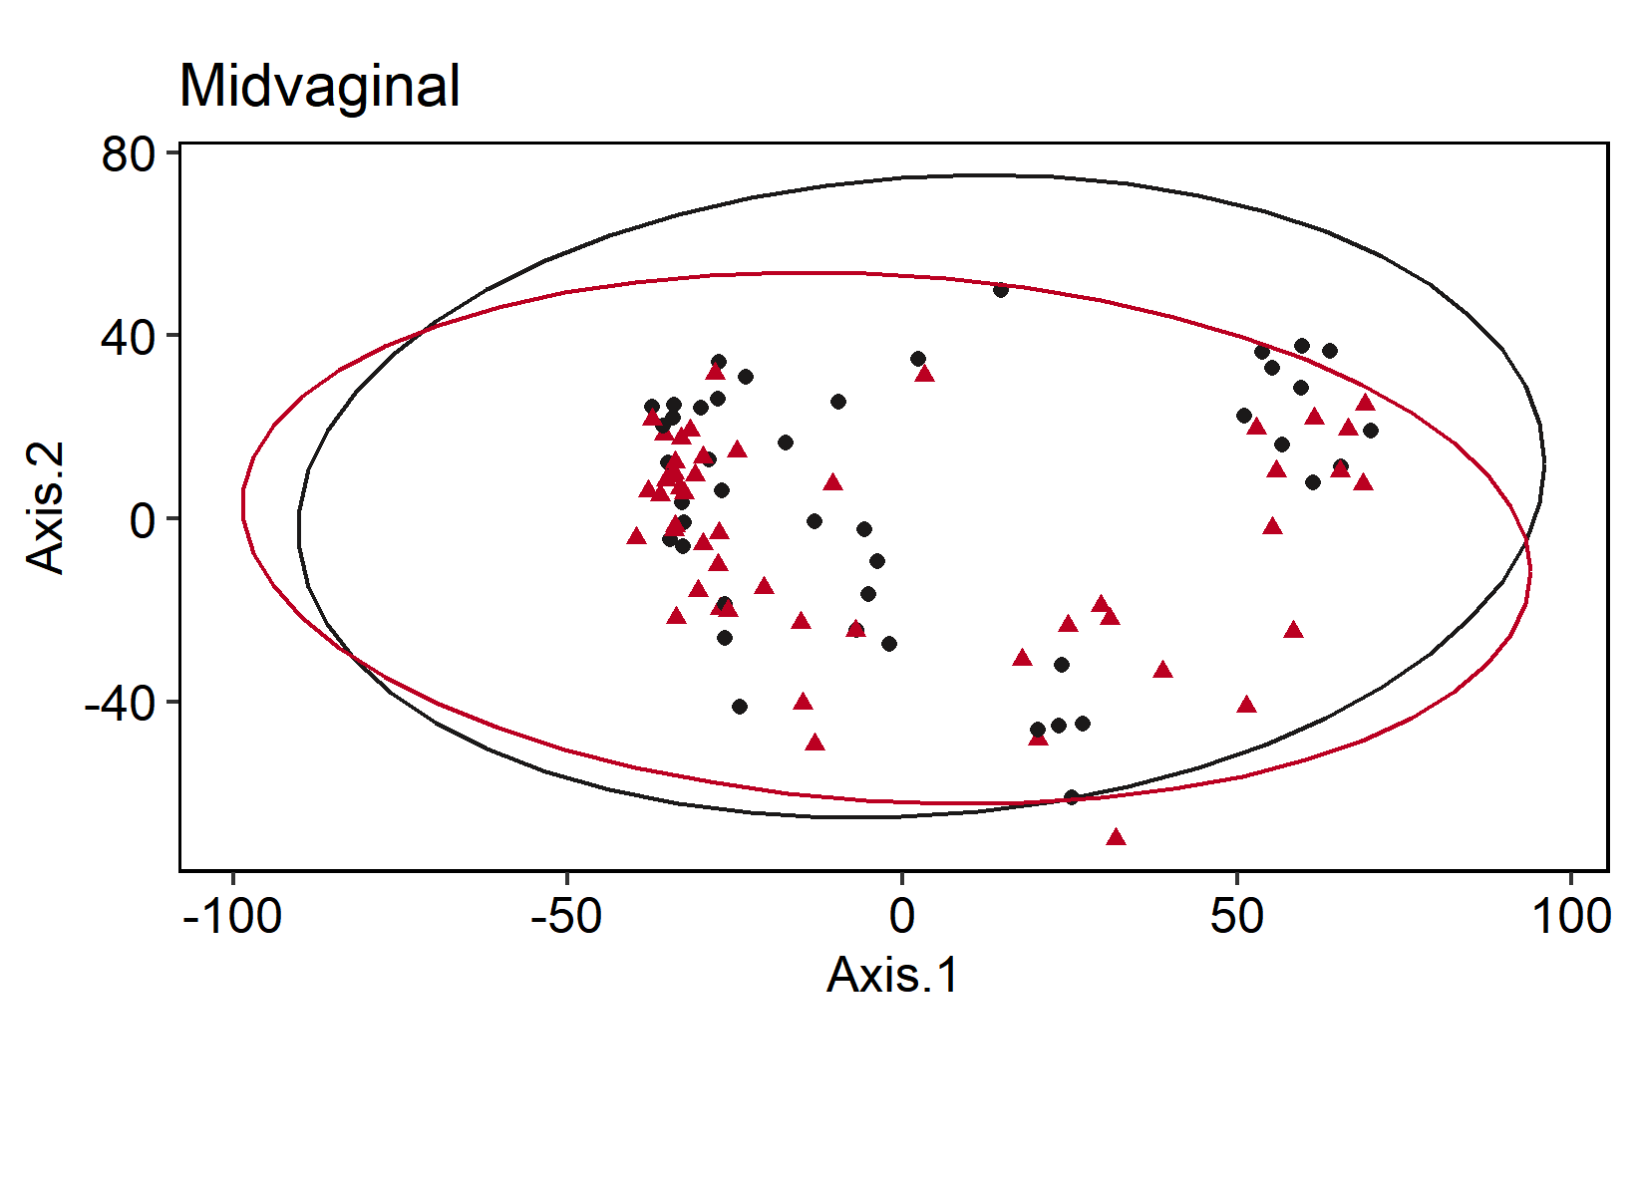
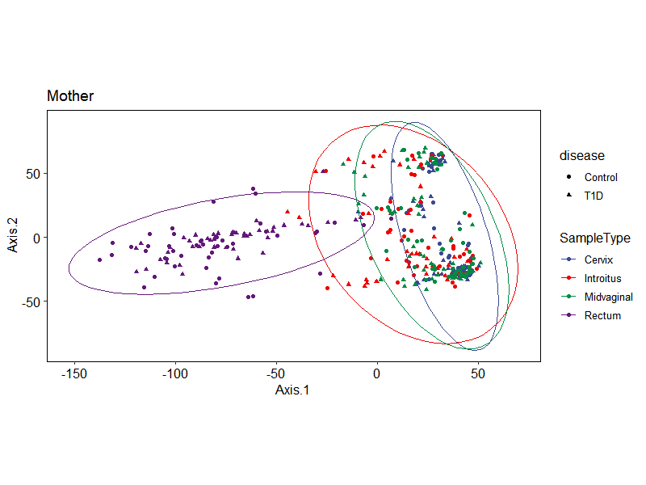
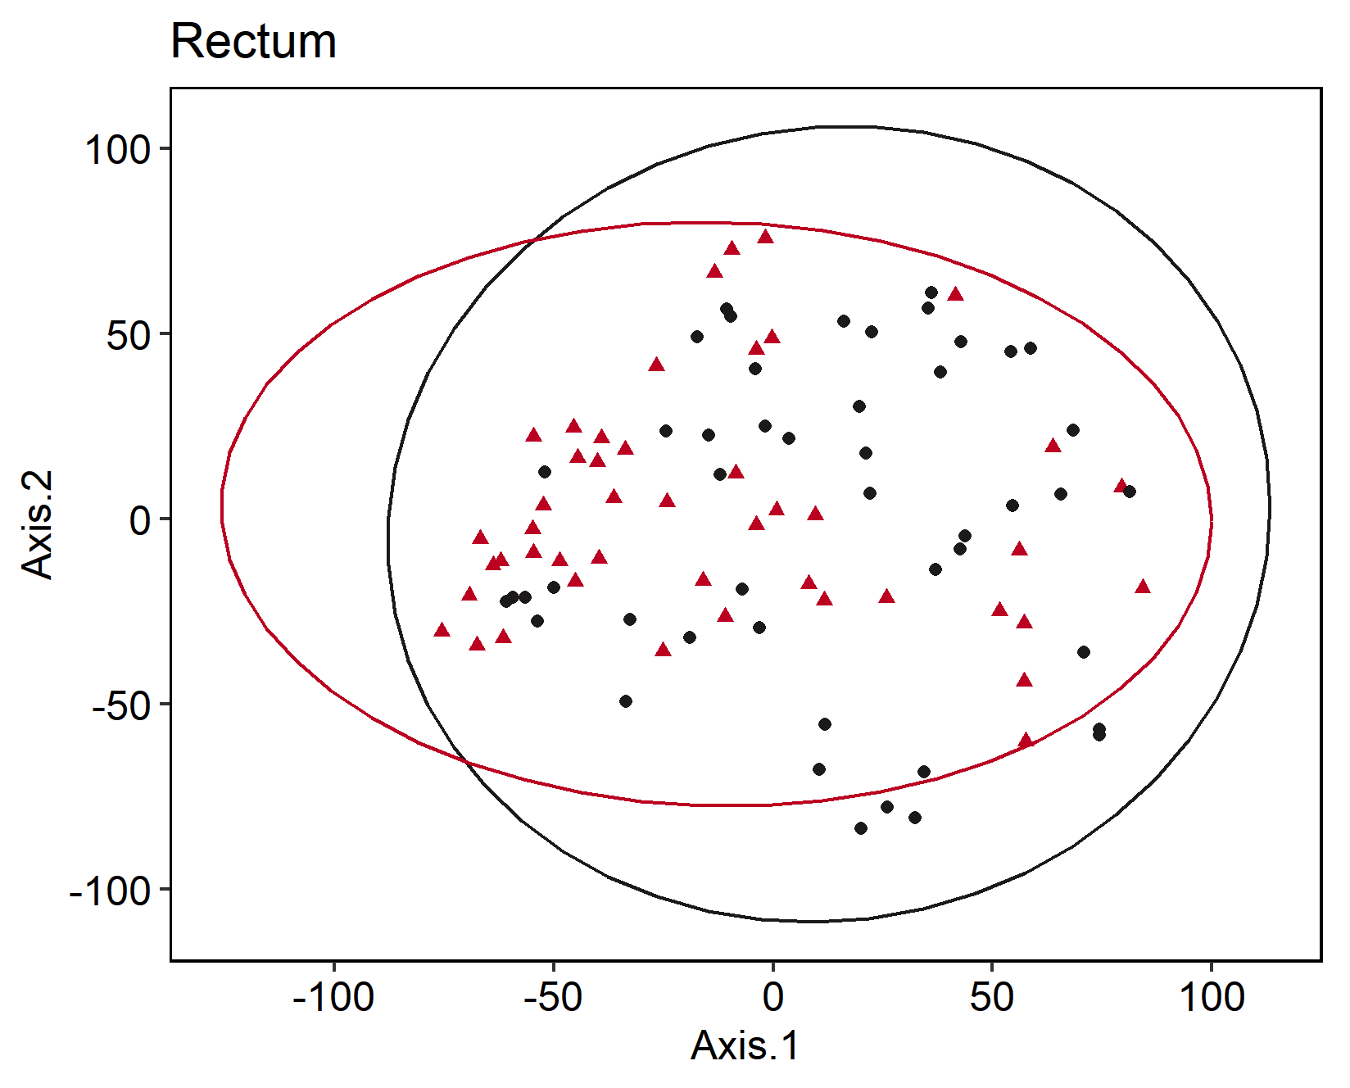
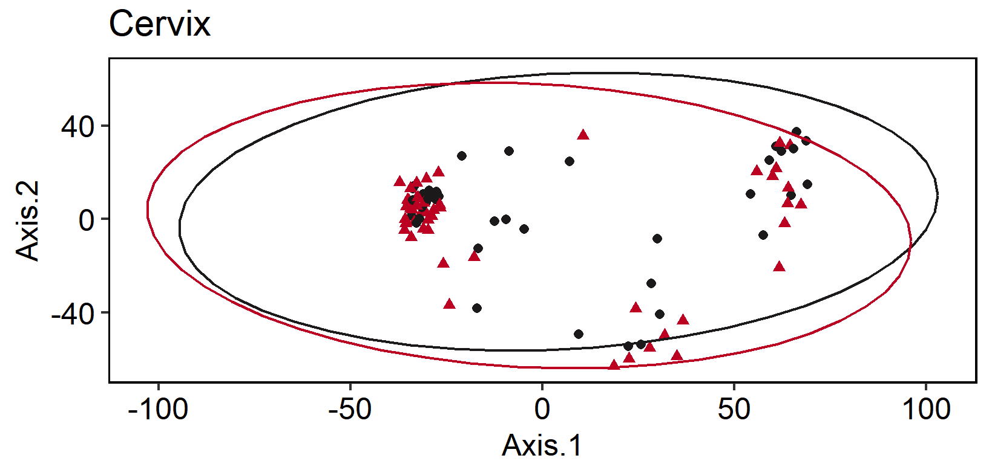
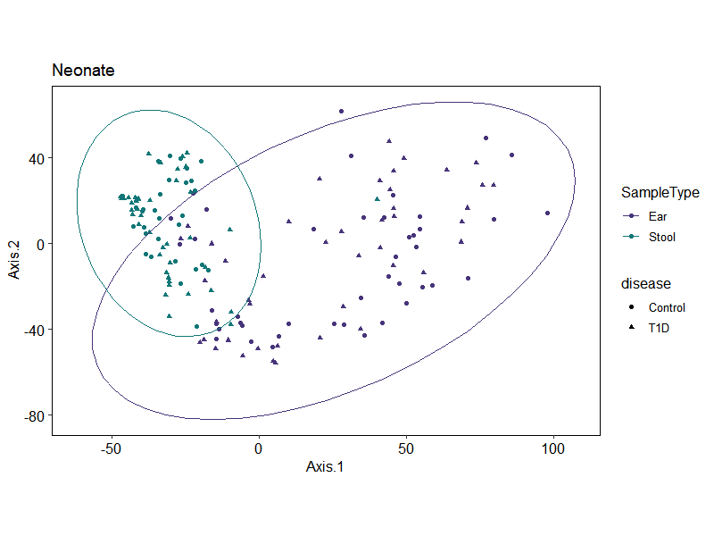
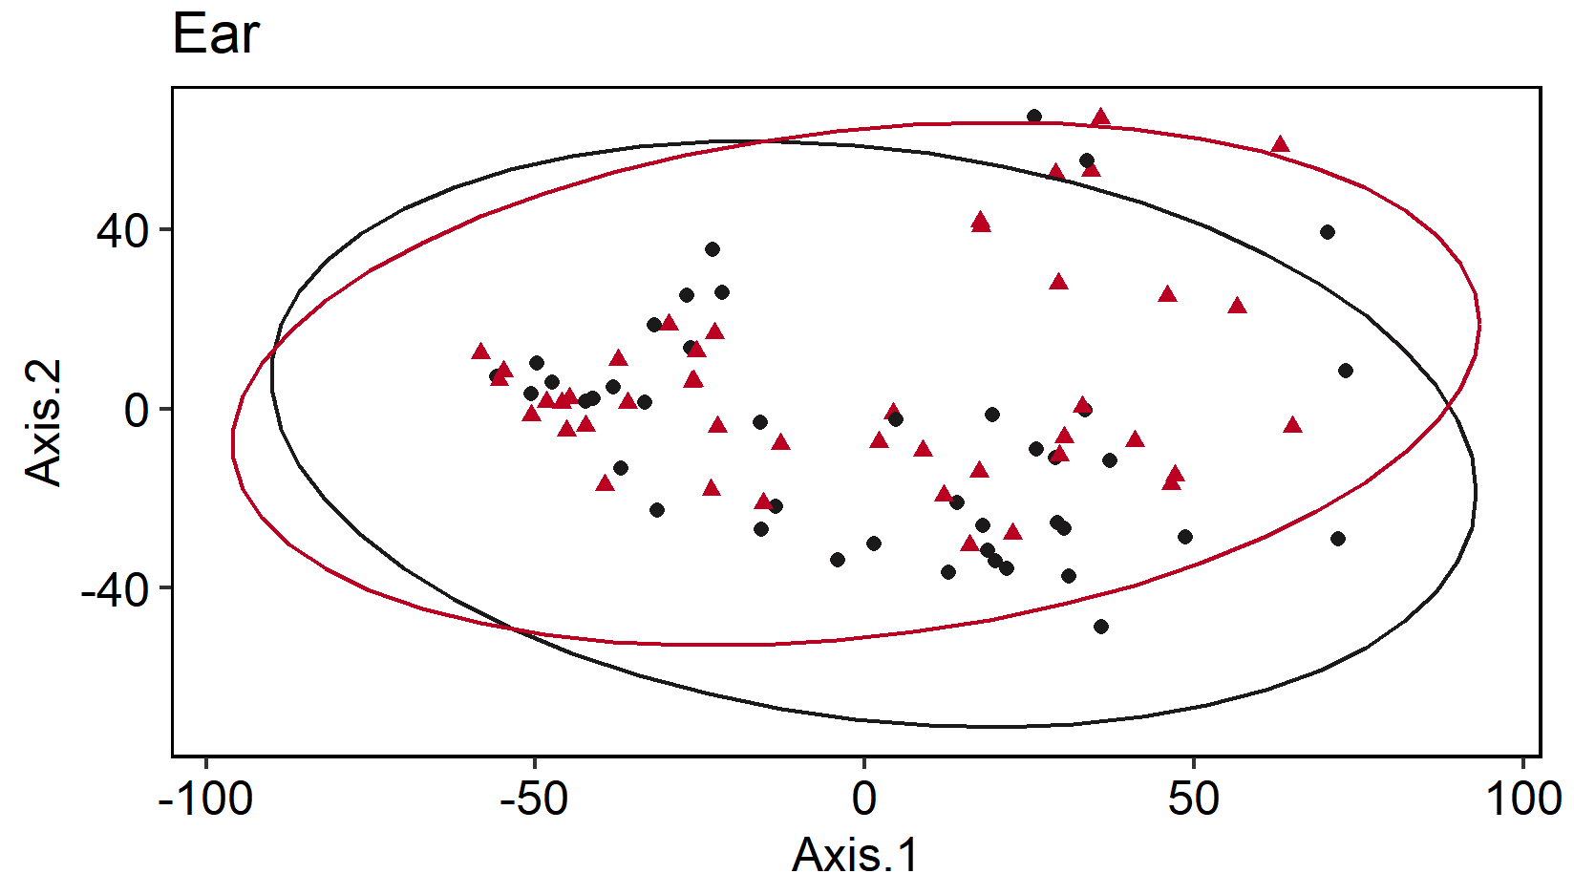
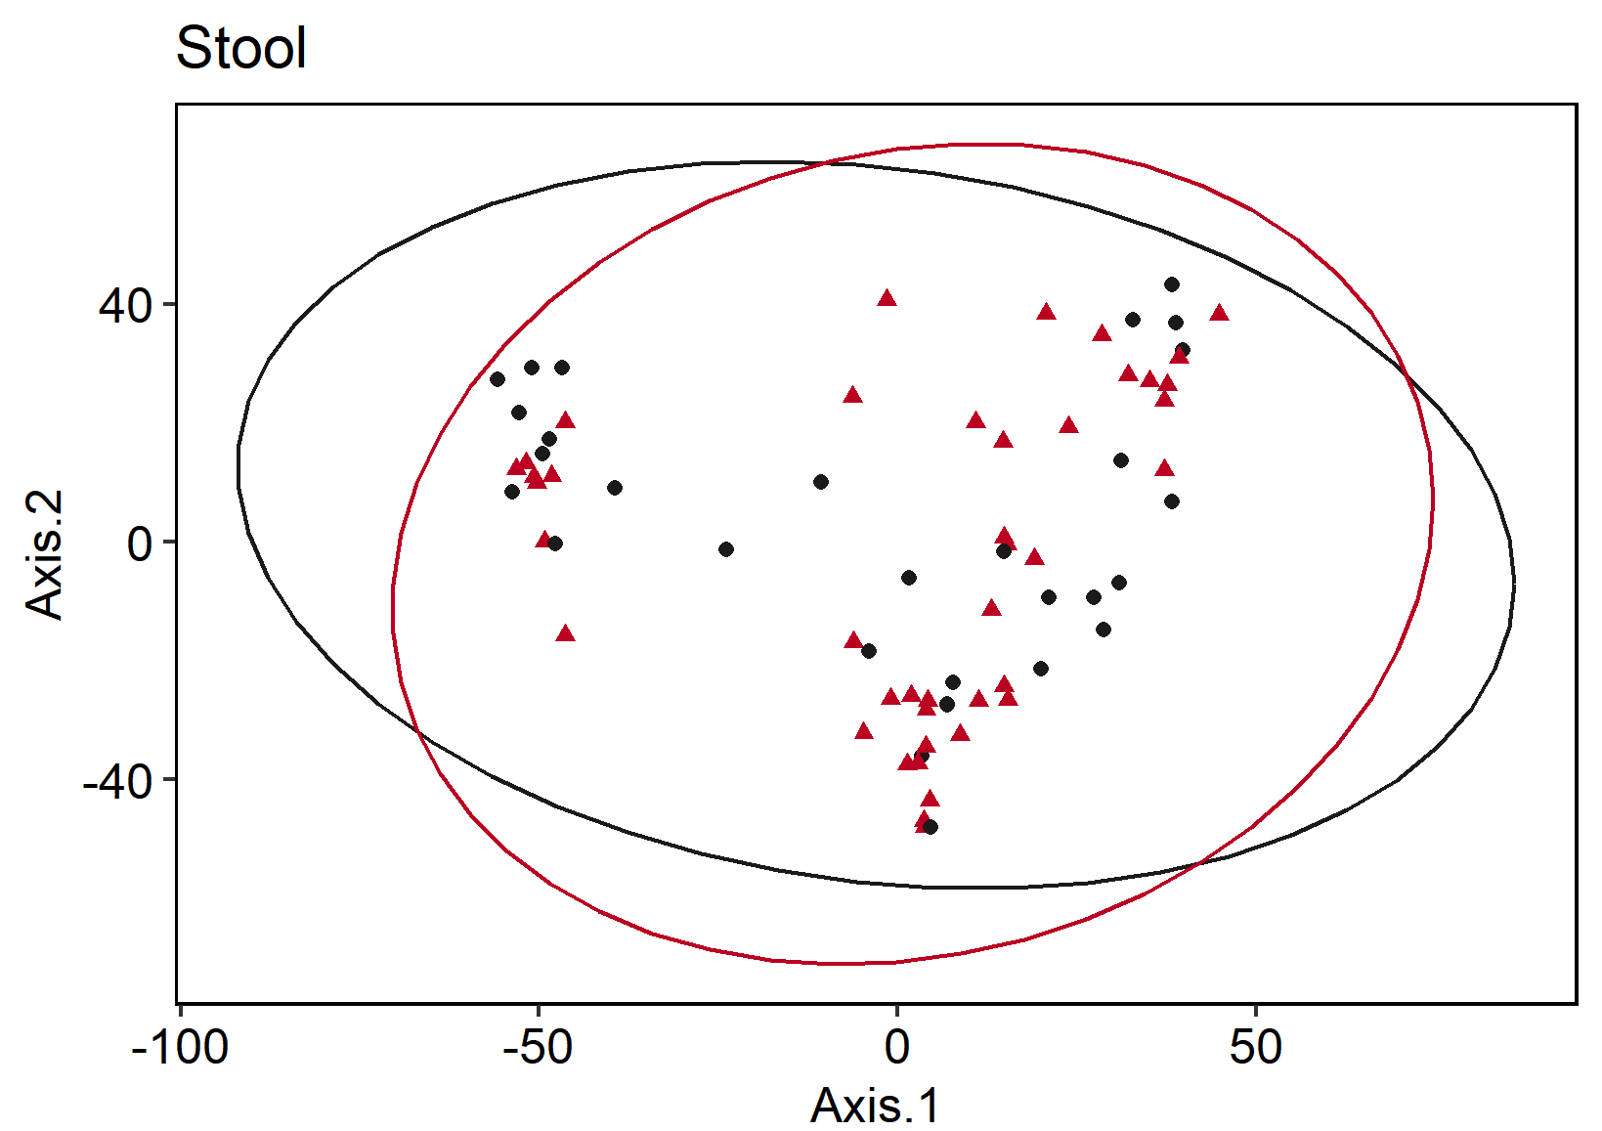
A
B
C
E
Maternal
D
H
F
Neonatal
G
Supplemental Figure 8. Beta Diversity PCoA plots comparing microbiome composition based on variance stabilizing transformed (VST) Euclidean distances in Maternal (top) and Neonatal (bottom) microbiomes faceted by sample type. Samples are shaped by disease state and colored by sample type in panels A and H, or disease state in panels B-G where T1D samples are depicted in red and control samples are depicted in black.

Slide 6
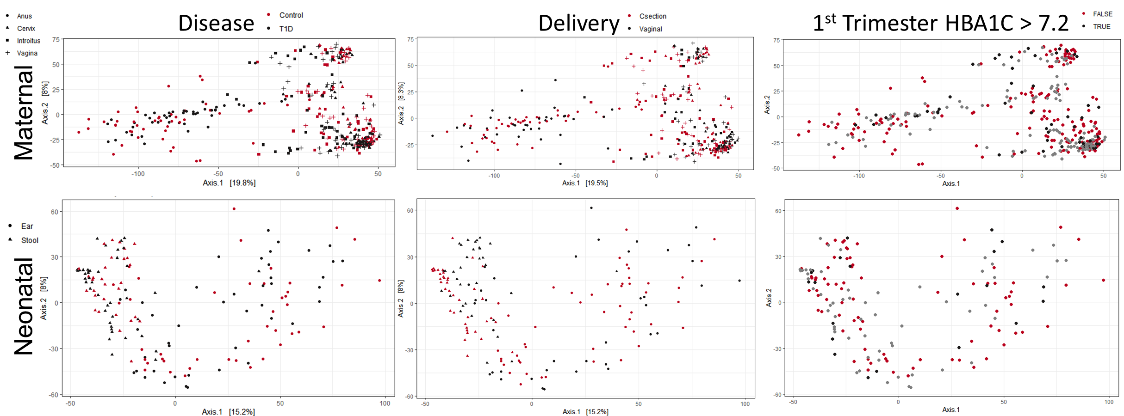
Supplemental Figure 9. Beta Diversity PCoA plots comparing microbiome composition distances based on Bray curtis dissimilarity indices in Maternal (top) and Neonatal (bottom). Samples are shaped by sample type and colored by disease state (left) where T1D samples are depicted in red and control samples are depicted in black, delivery method (center) where Csection samples are depicted in red and vaginal delivered microbiomes samples are depicted in black, and 1st trimester HbA1c values (right) where maternal 1st Trimester uncontrolled samples are depicted in red, controlled diabetes are depicted in black, and nondiabetic samples are depicted in grey. The threshold for defining controlled vs uncontrolled diabetes was based on 1st trimester HbA1C values > 7.2.

Slide 7
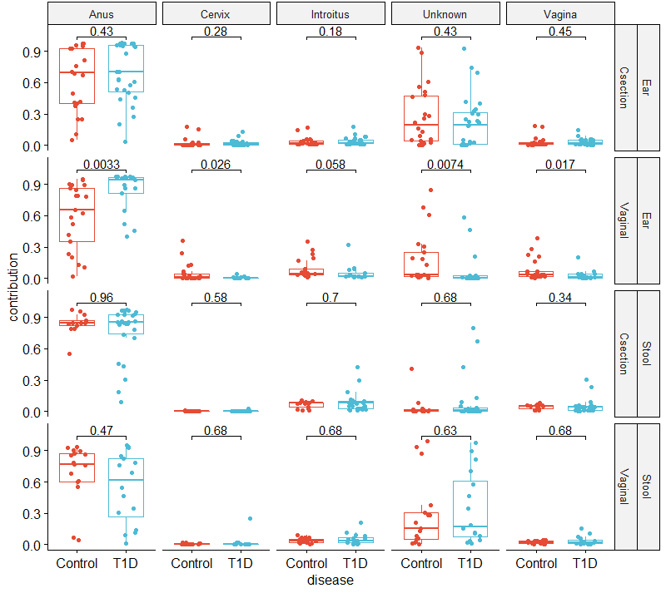
Supplementary Figure 10. Sourcetracker2 derived maternal contributions to neonatal microbiomes by sample type and delivery mode. Results show statistically significant increases in maternal source Anus contributions to the ear microbiome when comparing vaginally delivered neonatal ear microbiomes from type 1 diabetic mothers to the control.

Slide 8
Supplementary Table X. Overview of maternal source mean contributions to newborn sinks by disease and delivery method.
 |  |  | Source (mean ± std. error)
Delivery | Sink | Disease | Anus | Cervix | Introitus | Unknown | Vagina
C-section | Ear | Control | 0.635 ± 0.31 | 0.022 ± 0.048 | 0.035 ± 0.043 | 0.276 ± 0.285 | 0.031 ± 0.051
 |  | T1D | 0.691 ± 0.28 | 0.02 ± 0.03 | 0.039 ± 0.038 | 0.22 ± 0.25 | 0.031 ± 0.032
 | Stool | Control | 0.839 ± 0.104 | 0.003 ± 0.003 | 0.067 ± 0.033 | 0.046 ± 0.111 | 0.044 ± 0.024
 |  | T1D | 0.764 ± 0.252 | 0.003 ± 0.005 | 0.09 ± 0.091 | 0.091 ± 0.209 | 0.052 ± 0.069
Vaginal | Ear | Control | 0.595 ± 0.311 | 0.052 ± 0.092 | 0.09 ± 0.096 | 0.18 ± 0.247 | 0.083 ± 0.105
 |  | T1D | 0.832 ± 0.198 | 0.007 ± 0.011 | 0.051 ± 0.076 | 0.08 ± 0.174 | 0.03 ± 0.047
 | Stool | Control | 0.653 ± 0.317 | 0.006 ± 0.006 | 0.038 ± 0.024 | 0.282 ± 0.331 | 0.021 ± 0.014
 |  | T1D | 0.545 ± 0.336 | 0.02 ± 0.062 | 0.053 ± 0.053 | 0.346 ± 0.343 | 0.036 ± 0.042

