Slide 1
Bioinformatics Tutorial Lecture 3
Michael Jochum, PhD Postdoctoral Research Associate Department of Obstetrics & Gynecology Baylor College of Medicine 1 Baylor Plaza, Houston TX 77401 email michael.jochum@bcm.edu

Slide 2
Objectives
Marker Gene Sequencing overview
Background of sequencing technology
Intro to FASTA/FASTQ file formats
Compression formats and tools (zip, gzip, pbzip, bzip2, pigz)
Demultiplexing example (Sabre / QIIME demux)
Trimming / QA/QC (Trimmomatic, cutadapt, FASTQC/MultiQC)
QIIME2 Pipeline

Slide 3

Introduction to Sequencing by Synthesis
Watch this video
Watch this video

Slide 4
FASTQ Files
A FASTQ file normally uses four lines per sequence.
Line 1 begins with a '@' character and is followed by a sequence identifier and an optional description (like a FASTA title line).
Line 2 is the raw sequence letters.
Line 3 begins with a '+' character and is optionally followed by the same sequence identifier (and any description) again.
Line 4 encodes the quality values for the sequence in Line 2, and must contain the same number of symbols as letters in the sequence.
A FASTQ file containing a single sequence might look like this:
@SEQ_ID GATTTGGGGTTCAAAGCAGTATCGATCAAATAGTAAATCCATTTGTTCAACTCACAGTTT + !''*((((***+))%%%++)(%%%%).1***-+*''))**55CCF>>>>>>CCCCCCC65
The byte representing quality runs from 0x21 (lowest quality; '!' in ASCII) to 0x7e (highest quality; '~' in ASCII). Here are the quality value characters in left-to-right increasing order of quality (ASCII):
!"#$%&'()*+,./0123456789:;<=>?@ABCDEFGHIJKLMNOPQRSTUVWXYZ[\]^_`abcdefghijklmnopqrstuvwxyz{|}~

Slide 5
Compression formats and tools (zip, gzip, pbzip, bzip2, pigz)
Compression formats and tools (zip, gzip, pbzip, bzip2, pigz)
Demultiplexing example (Sabre / QIIME demux)
Trimming / QA/QC (Trimmomatic, cutadapt, FASTQC/MultiQC)

Slide 6
Demultiplexing Example
cd ~
curl -L -o demultiplex_ex.tar.gz https://ndownloader.figshare.com/files/11461430
tar -xzvf demultiplex_ex.tar.gz
rm demultiplex_ex.tar.gz
cd demultiplex_ex

Slide 7




Compression formats and tools (zip, gzip, pbzip, bzip2, pigz)
Compression formats and tools (zip, gzip, pbzip, bzip2, pigz)

Slide 8
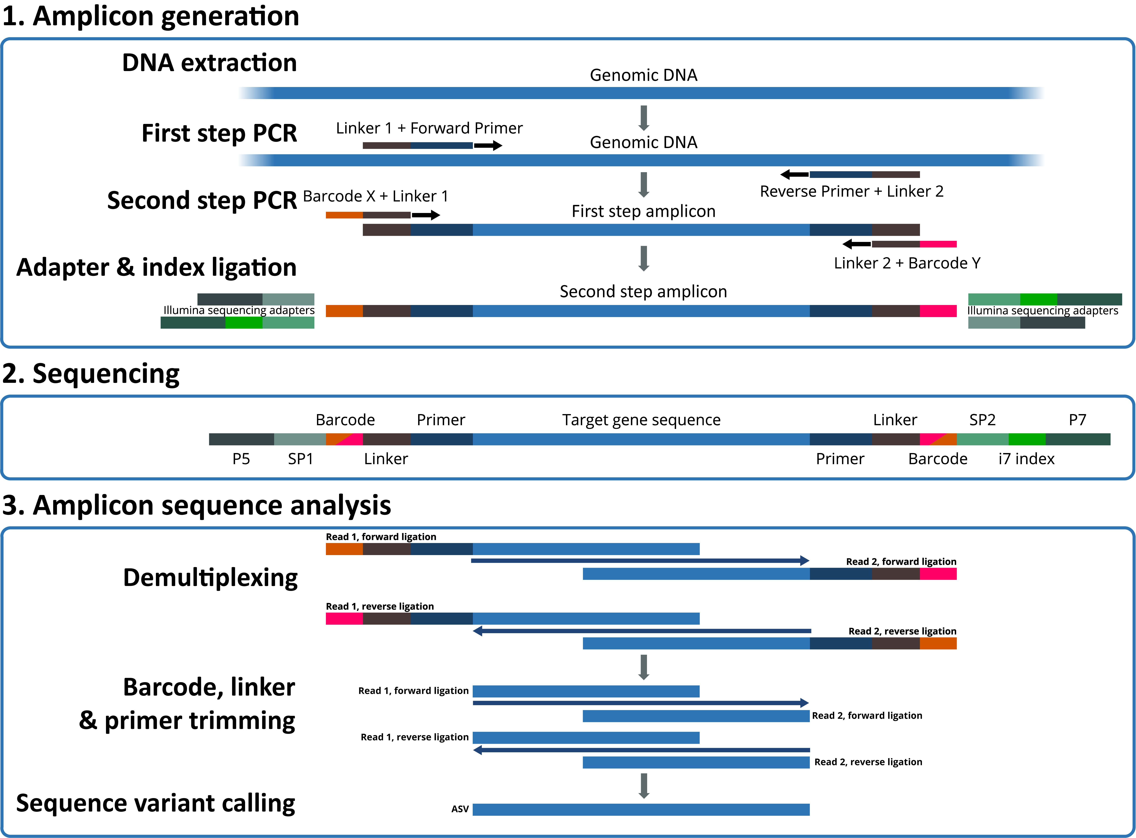
Demultiplexing, Trimming, and QA/QC
https://jmf.csb.univie.ac.at/highly-multiplexed-gene-amplicon-sequencing

Slide 9
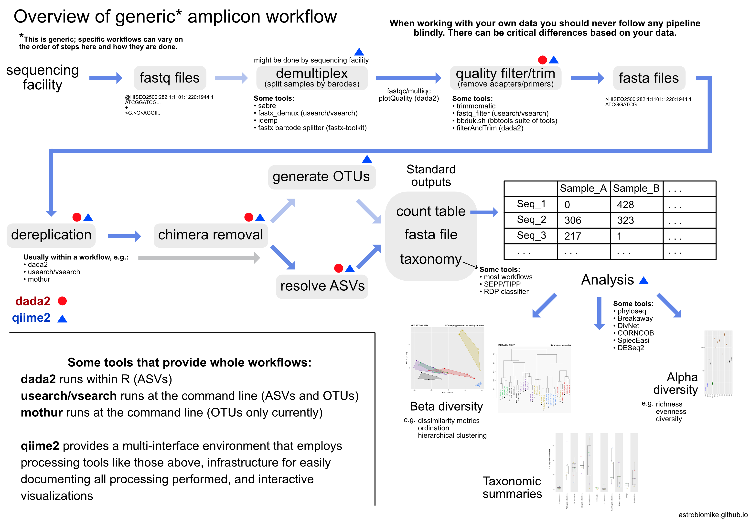
https://astrobiomike.github.io/about/

Slide 10

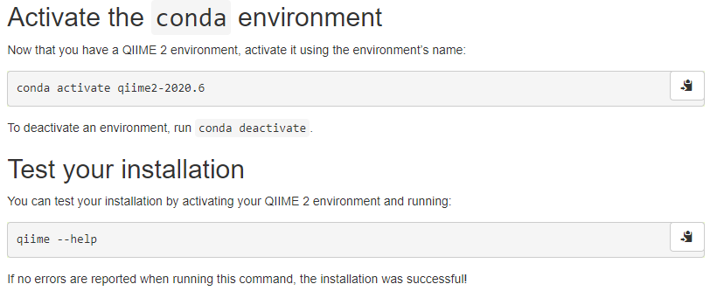
QIIME 2™ is a next-generation microbiome bioinformatics platform that is extensible, free, open source, and community developed.
QIIME2 encompasses many tools in a single environment that allow for streamlined microbiome processing and analysis.
QIIME2 is easy and fast to use but has limitations with custom analyses.
MAC USERS
Windows Subsystem for Linux USERS
wget https://data.qiime2.org/distro/core/qiime2-2020.6-py36-osx-conda.yml
conda env create -n qiime2-2020.6 --file qiime2-2020.6-py36-osx-conda.yml
# OPTIONAL CLEANUP rm qiime2-2020.6-py36-osx-conda.yml
# These instructions are identical to the Linux (64-bit) instructions
wget https://data.qiime2.org/distro/core/qiime2-2020.6-py36-linux-conda.yml
conda env create -n qiime2-2020.6 --file qiime2-2020.6-py36-linux-conda.yml
# OPTIONAL CLEANUP rm qiime2-2020.6-py36-linux-conda.yml
https://docs.qiime2.org/2020.6/install/native/#install-qiime-2-within-a-conda-environment

Slide 11
We are now going to be performing the “Moving Pictures Tutorial” from the QIIME2 Website
In this tutorial you’ll use QIIME 2 to perform an analysis of human microbiome samples from two individuals at four body sites at five timepoints, the first of which immediately followed antibiotic usage.
A study based on these samples was originally published in Caporaso et al. (2011).
The data used in this tutorial were sequenced on an Illumina HiSeq using the Earth Microbiome Project hypervariable region 4 (V4) 16S rRNA sequencing protocol.
Please click the following link and proceed and proceed with the tutorial: https://docs.qiime2.org/2020.6/tutorials/moving-pictures/.

