Slide 1
Bioinformatics Tutorial Lecture 4
Michael Jochum, PhD Postdoctoral Research Associate Department of Obstetrics & Gynecology Baylor College of Medicine 1 Baylor Plaza, Houston TX 77401 email michael.jochum@bcm.edu

Slide 2
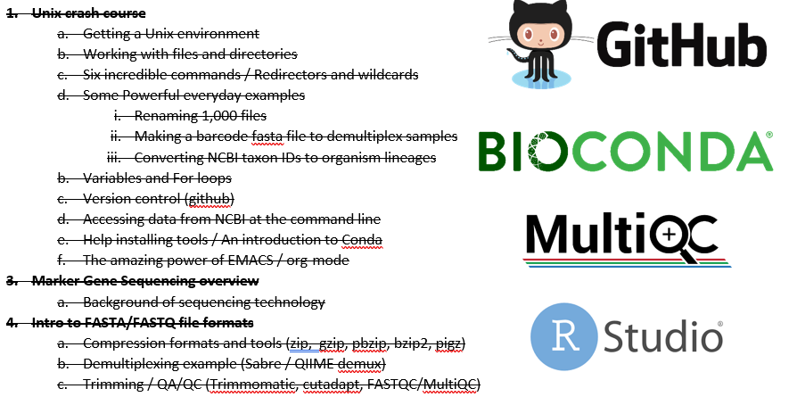
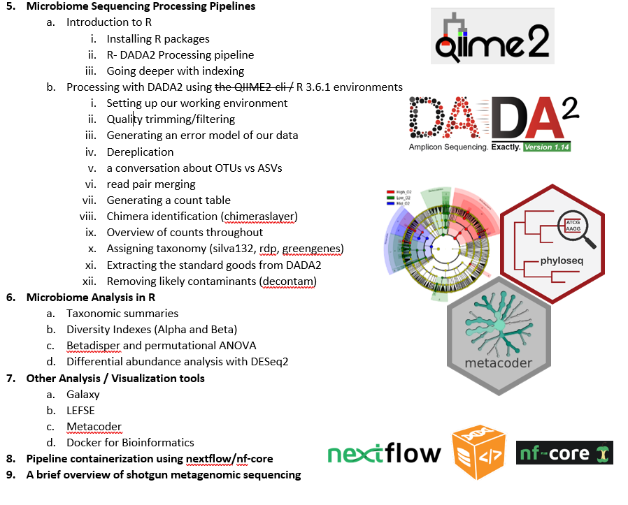
Objectives
Completed
Future

Slide 3

R is our friend
R is generally a big, glorious calculator.
More specifically, it’s a programming language and working environment for statistical analyses and figure generation, and it’s pretty sweet.
What really makes R powerful is that it is completely open source and it has a tremendous number of incredible people that contribute “packages” to it for all to use.
Packages are bundles of code that perform specific tasks, and they are kinda like Apps in the sense that for most of the things you’ll want to do, “there’s a package for that”.
Often you will end up searching for a package that you know exists already either from hearing about it from someone, or seeing it used in a paper, but you can also search the Comprehensive R Archive Network (CRAN) for packages directly.
R serves as the foundation upon which you can utilize this large swath of tools that people all over the world have developed and contributed, and it also is invaluable for parsing tables and creating figures.
There is extensive documentation on R at the CRAN Introduction to R site, and it would probably be worthwhile going through it at some point. Consistent with the general approach of the site here, I try to distill things down to just the baseline skills to start in the R basics page.

Slide 4



Installing R
Download R 4.0.2 for Windows (
R-4.0.2.pkg
Step 1) Install R
Step 2) Install Rstudio
Play this video during the install

Slide 5

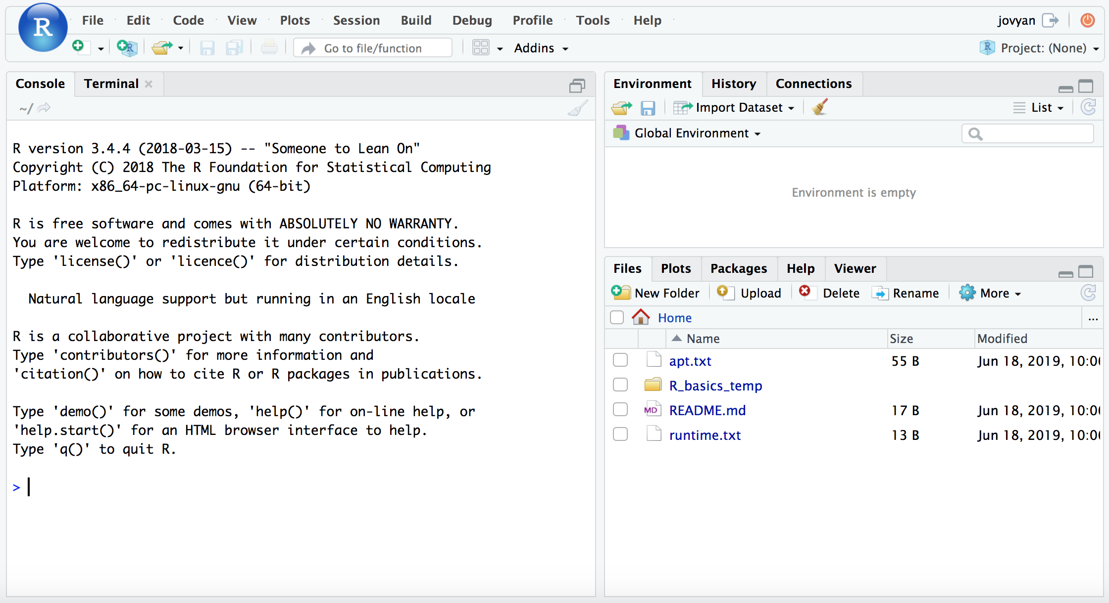

Backup option
Binder is an incredible project with incredible people behind it.
I’m still pretty new to it, but the general idea is it makes it easier to setup and share specific working environments in support of open science.
What this means for us here is that we can just click this little badge and it’ll open up the proper R environment with all our needed example files in a web-browser ready to rock…
how awesome is that?!?
So yeah, if you want to work in the binder, click it already!
When that page finishes loading (it may take a couple minutes), you will see a screen like this:

Slide 6
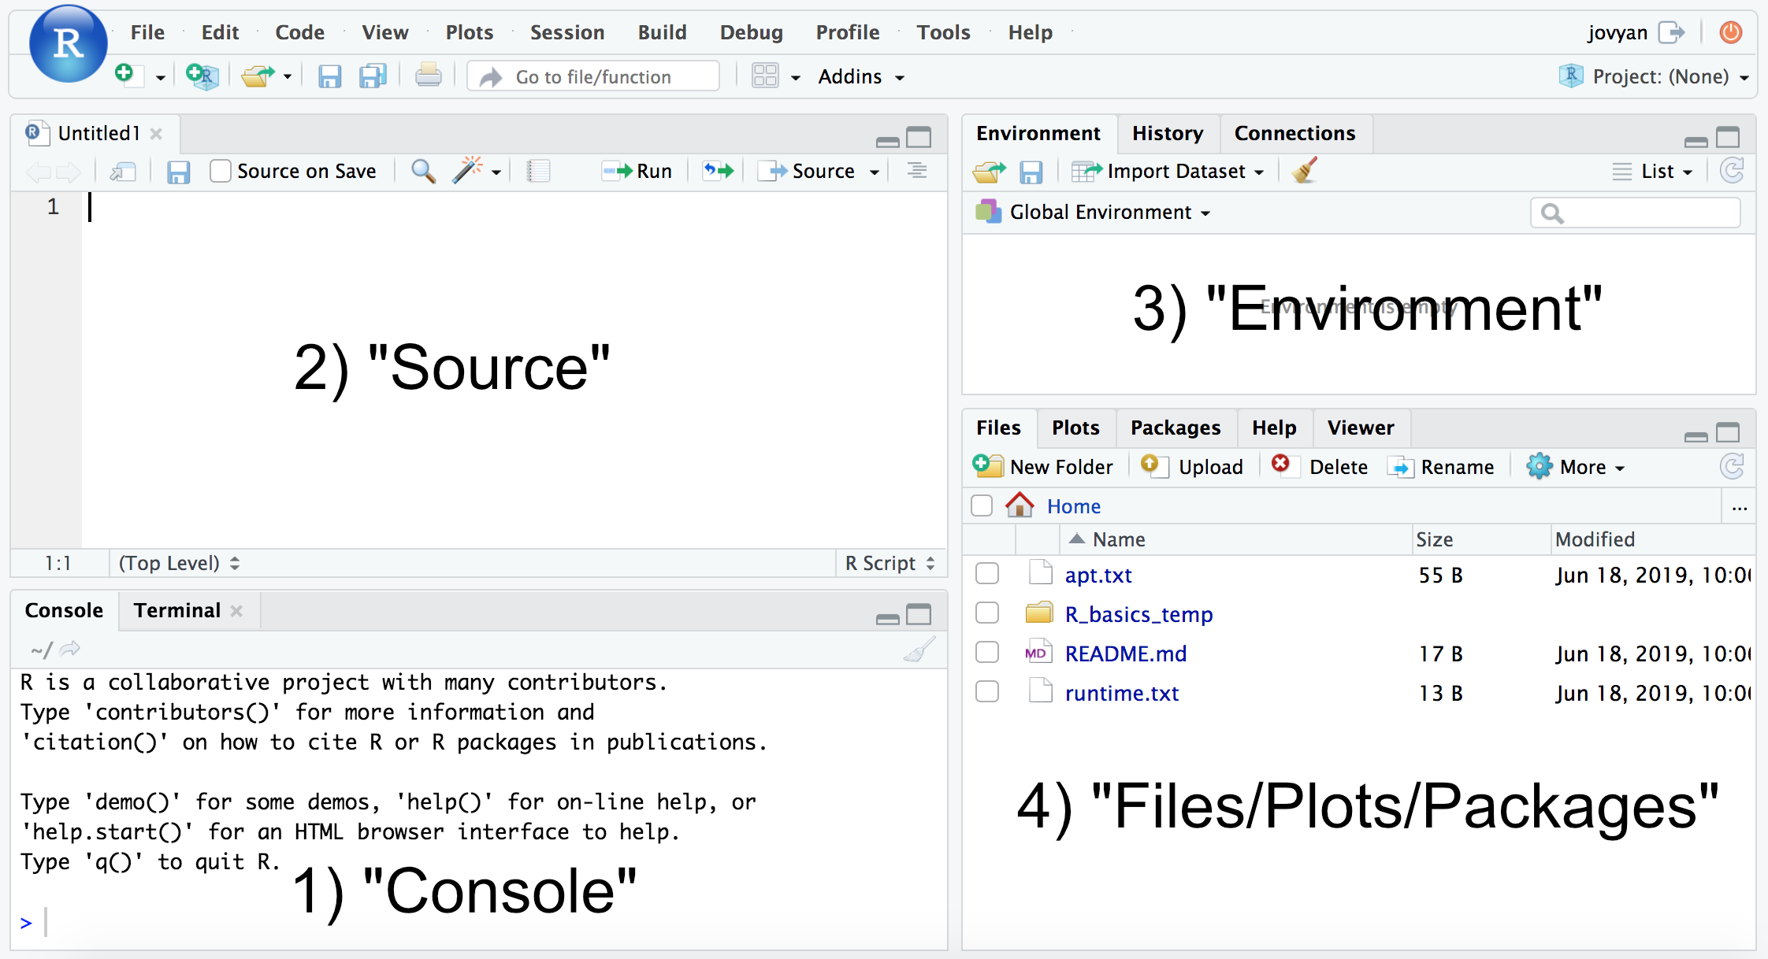
RStudio layout

Slide 7
Intro to R - Some practice data
cd ~/unix_intro/
curl -O https://AstrobioMike.github.io/tutorial_files/R_basics_temp.tar.gz
tar -xvf R_basics_temp.tar.gz
rm R_basics_temp.tar.gz
cd R_basics_temp
Setting up our working environment
Basic calculations
Variables in R
The wonderful world of indexing
by position
conditional statements
Tables
Reading in and writing out data
read.table()
write.table()
getwd(), setwd(), and list.files()
4+4, 4/2, 4*4, 2^4
x<-4, w <- "europa“, y <- c(5, 6, 7)
y[1]
y[c(1,3)]
y[y >= 6]
our_table
our_table[2, 2]
gene_annotations_tab <- read.table("gene_annotations.txt")
write.table(KEGG_only_tab, "KEGG_annotated.tsv",
sep="\t", row.names=F, quote=FALSE)

Slide 8
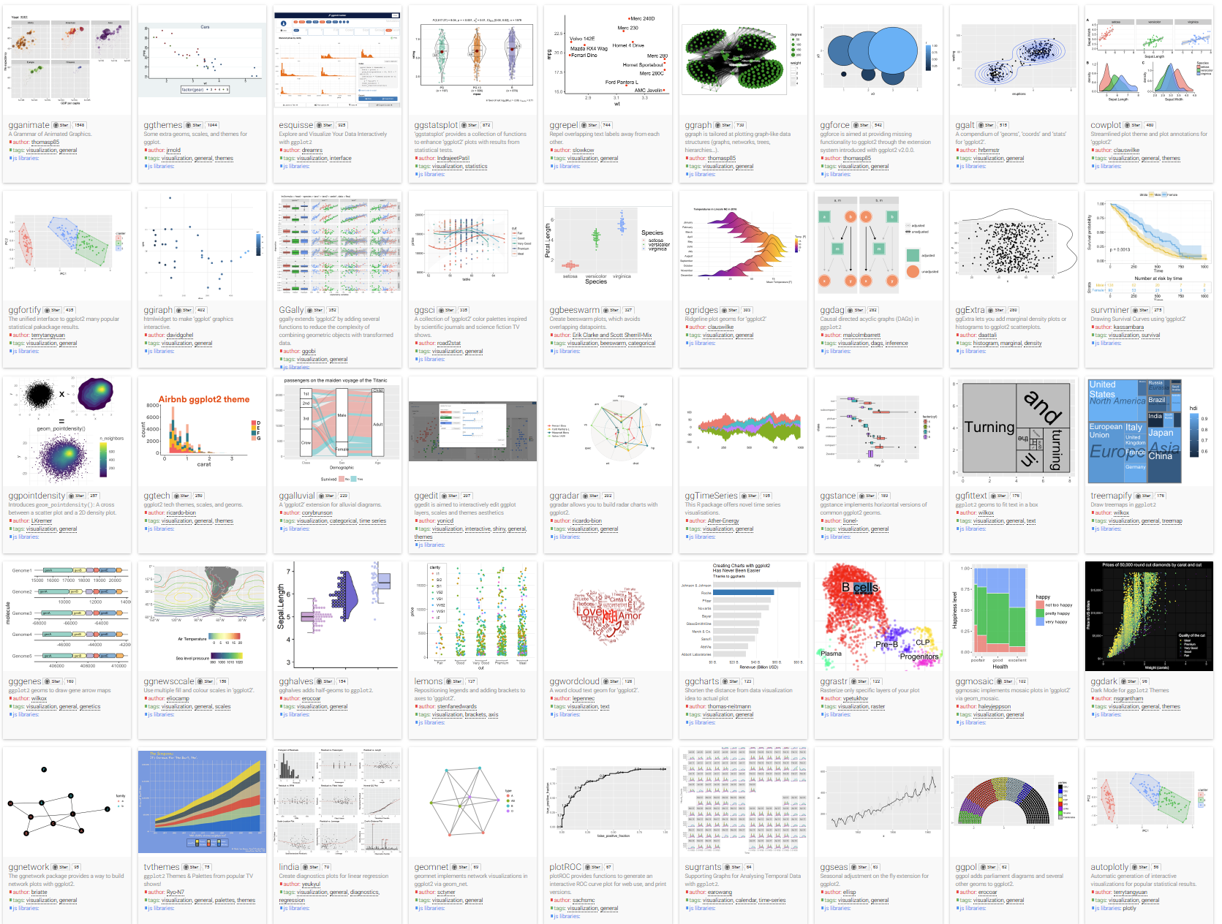

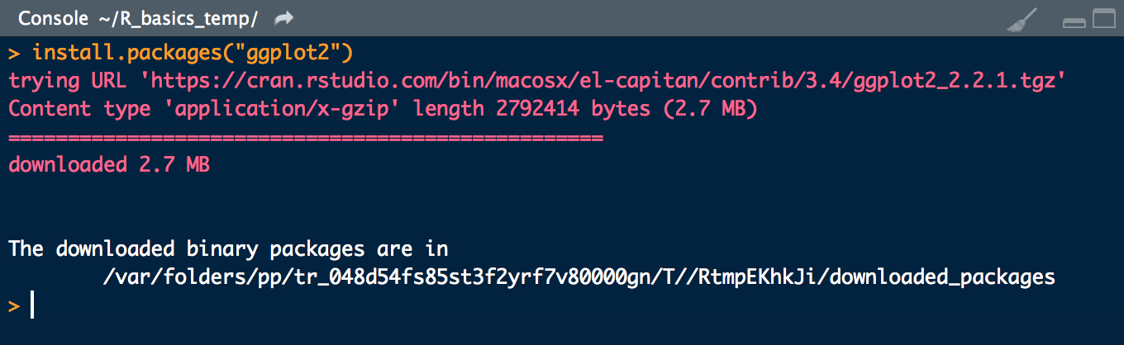


Intro to R – Installing R packages
1) Install.packages()
install.packages("ggplot2")
2) BiocManager::install()
3) install_github()

Slide 9
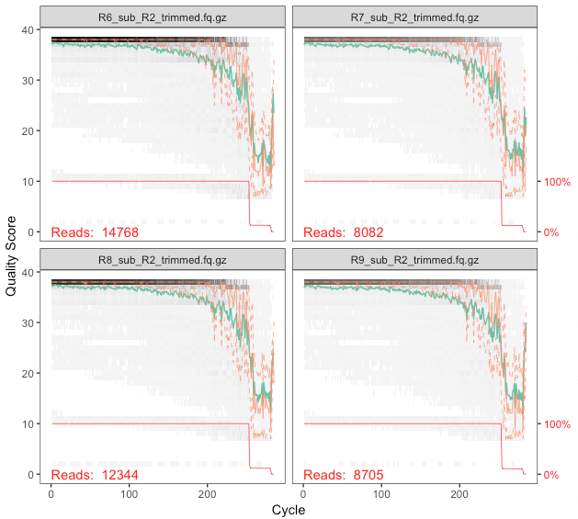
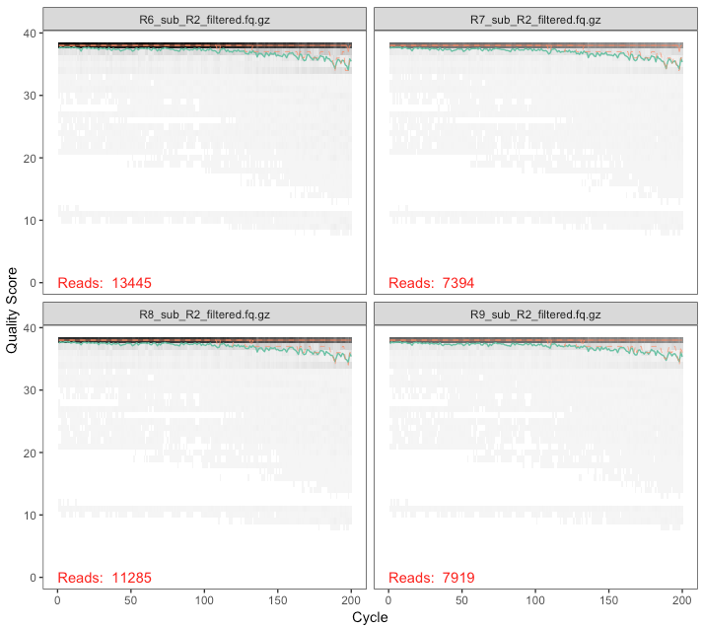
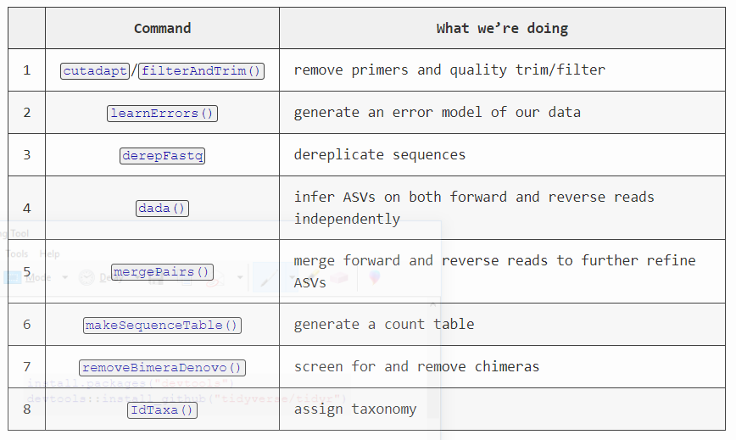
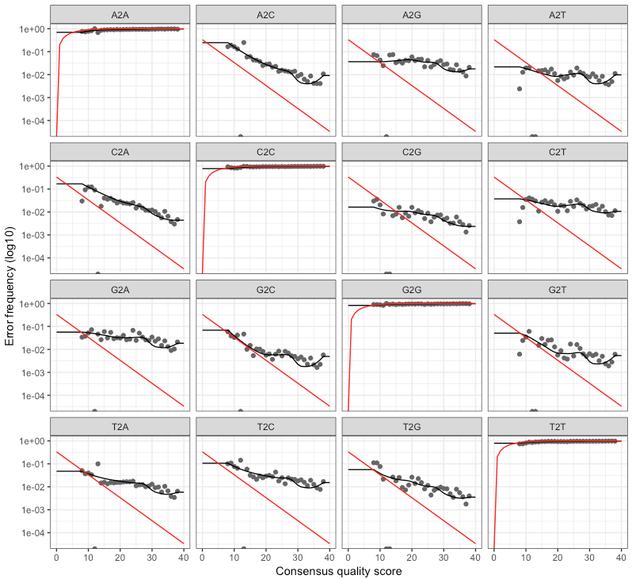
A full example workflow of amplicon data
Processing overview
https://astrobiomike.github.io/amplicon/dada2_workflow_ex

