Slide 1

DOMOTICA MAY MONTH
Sander Claassen
John Heesterbeek
Ad van Berlo
Marco van Nieuwenhoven
Hans Willemen
MADspace community

Slide 2
Programma
* Avond 1 - 2 mei Domoticz @ RasbperryPi
* Avond 2 - 9 mei Sensors & actuators
* Avond 3 - 16 mei Domotics bus-systems
* Avond 4 - 23 mei JSON, MQTT & Python
* Avond 5 - 30 mei Strut your stuff

Slide 3

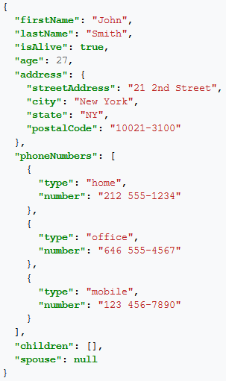
Message type: JSON
JavaScript Object Notation aka JSON
is an open-standard file/data format that uses human-readable text
Json structures can contain strings, integers, booleans, arrays.
Json structures can contain nested json structures.
Json supports unicode text/characters:
{ "face": "\uD83D\uDE02" } or {“text”: u“TextAsUnicode“}
https://www.domoticz.com/wiki/Presence_detection
3
Notes:
3
3

Slide 4
Sending/Receiving JSON
JSON-RPC:
is a remote procedure call (RPC) protocol built on JSON.
JSON-RPC lets a system send notifications (information to the server that does not require a response) and multiple calls to the server that can be answered out of order.
Client packs the parameters in a message to the os to send to server.
Server receives message and sends response.
4
Notes:
4
4

Slide 5
Sending/Receiving JSON
Domoticz json via http url:
Get all devices of a certain type:
http://192.168.1.1:8080/json.htm?type=devices&filter=all&used=true&order=Name
http://192.168.1.1:8080/json.htm?type=devices&filter=temp&used=true&order=Name
Domoticz json via python: http requests library:
postdata = {'type':'devices', 'filter':'light','used':'true','order':'Name'}
response = requests.get(url=self.apiUrl, params=postdata,headers=self.headers)
print("Lights/Switches:\n{}".format(response.json))
5
https://www.domoticz.com/wiki/Domoticz_API/JSON_URL%27s
Notes:
5
5

Slide 6

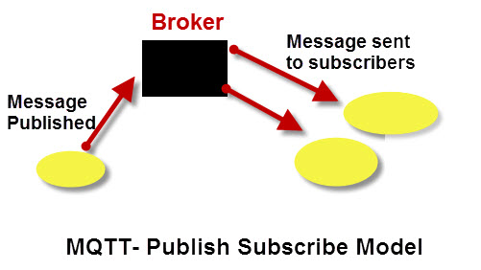
Network protocol: MQTT
MQTT ia a ISO standard publish-subscribe-based messaging protocol.
It works on top of the TCP/IP protocol.
It is designed for "small code footprint" and limited network bandwidth.
The publish-subscribe messaging pattern requires a message broker (Mosquitto).
Multiple nodes/sensors can publish data to a broker
Multiple services can subscribe to that data.
For example Domoticz subsribes to a weather publisher.
A remote wifi display subscribes to same weather.
The Things Network (LoraWAN) uses
MQTT to send/receive data.
Node-Red (uses Blockly code) can interface to MQTT
6
Notes:
6
6

Slide 7
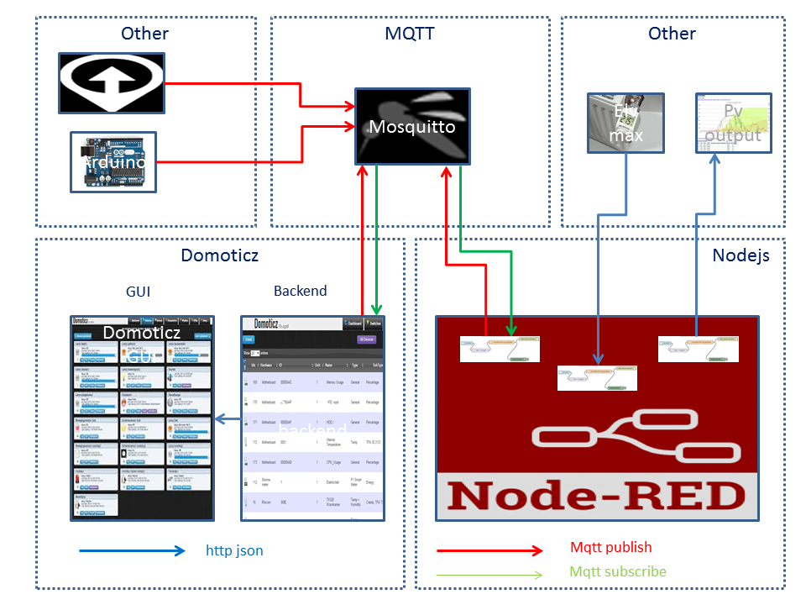
Network protocol: MQTT
Running MQTT broker on Raspberry:
You'll need:
Domoticz on Raspberry Pi
Node.JS
Node-RED
A MQTT broker (Mosquitto)
A few Node-RED example Flows
7
https://www.domoticz.com/wiki/MQTT
Notes:
7
7

Slide 8
Network protocol: MQTT
domoticz/in (to publish data to)
domoticz/out (to subscribe to)
Uses json compatible message format:
{
"idx" : 5,
"name" : "Internal Temperature",
"id" : "00080A",
"unit" : 1
"dtype" : "Temp",
"stype" : "TFA 30.3133",
"nvalue" : 0,
"svalue1" : "41.2",
"Battery" : 100,
"RSSI" : 12,
}
8
Notes:
8
8

Slide 9

Script/programming: Python
Scripting language that is interpreted (and also compiled) on the fly.
Next run it uses the compiled file (.pyc) to run faster (if no changes), that is why it also counts as high level programming language.
Standalone scripts can interface with Domoticz through the json interface.
Scripts called from Domoticz can import DomoticzEvents library to check for changed devices/variables.
Python is much more compex to learn than Blockly
Python is however more powerful.
Python is a textual language, so saving a script is as simple as saving .py file.
That being said, Domoticz Python Events are a different story since those seem to be hidden in a datbase. (cannot be found in the domoticz/scripts/python folder.
9
Notes:
9
9

Slide 10
Quick introduction: Python
Indentation: indentation is very important in python and must be consistent throughout the code.
(don’t mix tabs with spaces)
Methods/funtions: defined by “def” keyword
Statements: if <condition>, elif <condition>, else (optional)
for i in range(0,max_value+1), while
Error catching: try, except statements.
== (compare by value) vs “is” (compare by object reference)
and, or and not: binary condition operators (equavalents to &&, || and !)
Print() function and string .format(): print(“some string with var1={}\n and var2={}“.format(5,”C”))
10
Notes:
10
10

Slide 11
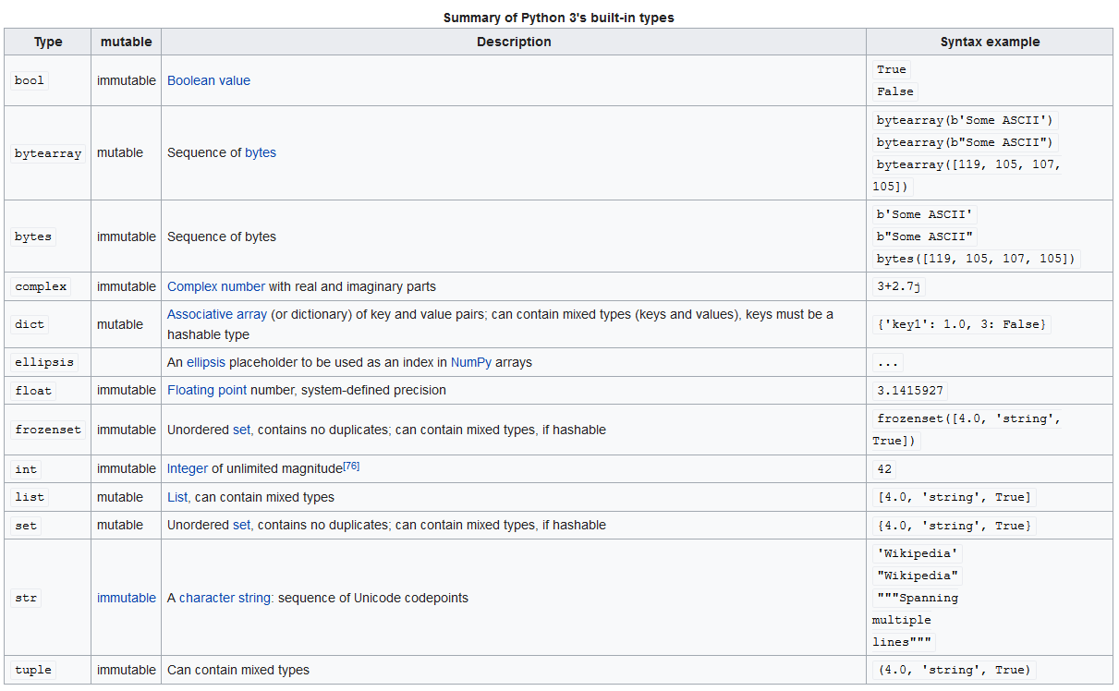
Quick introduction: Python
11
https://en.wikipedia.org/wiki/Python_(programming_language)
Notes:
11
11

Slide 12
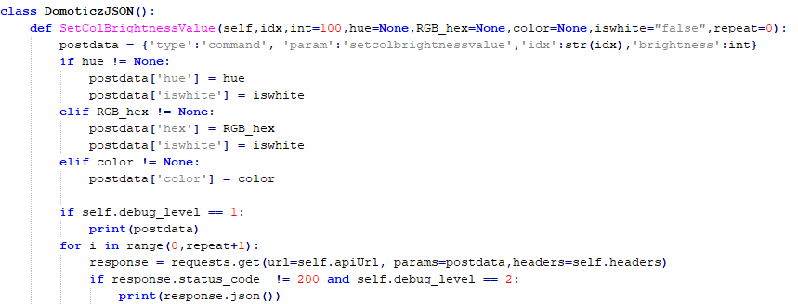
example: Python
https://github.com/vortexico/Domoticz-JSON
(under construction)
This script can also be run standalone from any machine in the network with python.
12
Notes:
12
12

Slide 13
install: Python libraries
On the commandline via ssh:
$ python --version
$ sudo apt-get install python-pip
$ pip install requests
$ pip install jsonrpclib (not needed yet)
13
Notes:
13
13

Slide 14
assignment: Python
With the script: check a sensor / alarm status and print the value on the command line
Check if the temperature value is above X or if the sensor is triggered and switch lightswitch on/off
Fun case 1: ESP sensor from workshop2 with temperature sensor. If temperature is above 22 degrees: switch on 433MHz switch (Fan)
Fun case 2: depending on a temperature (from ESP or Darksky API) set the color of your light (MiLight, Hue, etc)
Fun case 3: depending on rf moisture sensor level turn on a very slow water pump
14
Notes:
14
14

