Slide 1

DOMOTICA MAY MONTH
Sander Claassen
John Heesterbeek
Ad van Berlo
Marco van Nieuwenhoven
Hans Willemen
MADspace community

Slide 2
Programma
* Avond 1 - 2 mei Domoticz @ RasbperryPi
* Avond 2 - 9 mei Sensors & actuators
* Avond 3 - 16 mei Domotics bus-systems
* Avond 4 - 23 mei Blockly & node red
* Avond 5 - 30 mei Strut your stuff

Slide 3
Workshop
1. Intro Blockly
2. Hello Blockly
3. Connect all the things!
4. Demo & Node Red…

Slide 4
What is Blockly
Open source Google project (2011)
Client side JavaScript library
Visual programming, using drag ’n drop ‘blocks’
All programming can be done within the browser
Blocky comes with Domoticz by default, alongside with Lua & Python...

Slide 5
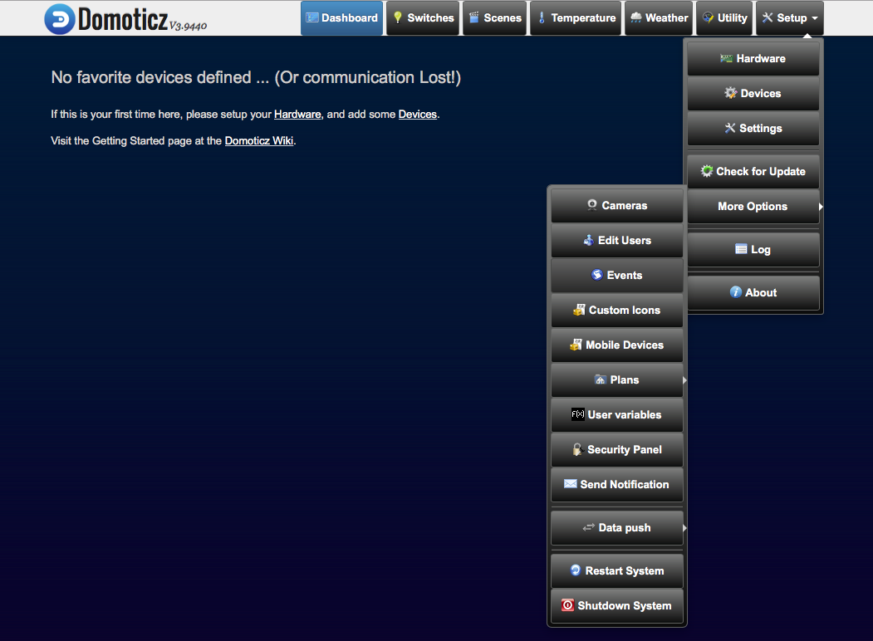
Starting with Blockly
Click ‘Events’ to define ‘Rules’ using (for example) Blockly
Notes:
Click Events to define ‘Rules’ using (for example) Blockly

Slide 6
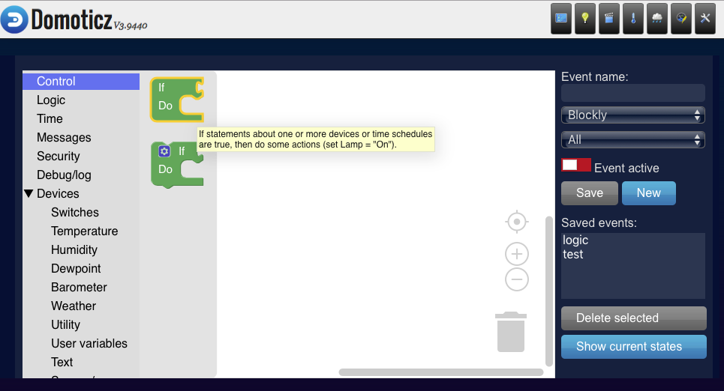
The Blockly environment
Always start with a ‘control’ statement, and select the necessary logic in order to connect all your sensors to your actuators

Slide 7
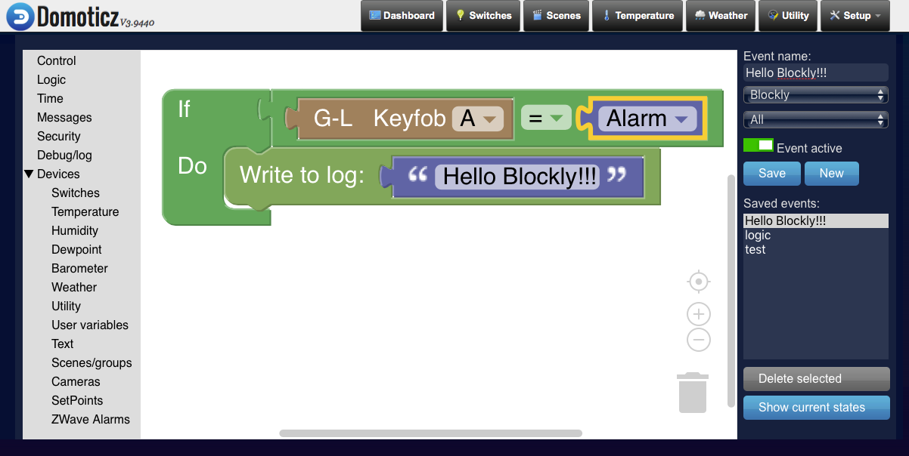
Hello Blockly! (for debugging)
Pro-tip: Always provide a logical name, and make sure to enable your event in order to activate it!

Slide 8
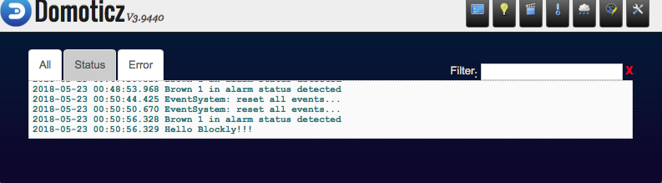
Hello Blockly! (for debugging)
Go to System -> Log
Then click ‘Status’-tab *
*Because “All” logging apparently does not include Blockly loging ;)
Pro-tip: Always make sure to enable your event in order to activate it!

Slide 9
Blockly examples
Possibilities are endless…
On doorbell trigger, send webcam image to e-mail
Connect light to scenes
Connect gas-sensors to fans
Connect humidity sensors to windows / screens
Implement triggers according time-schedule
Integrate a complete alarm system within Domoticz
Connect events to your local Raspberry Pi GPIO’s…

Slide 10
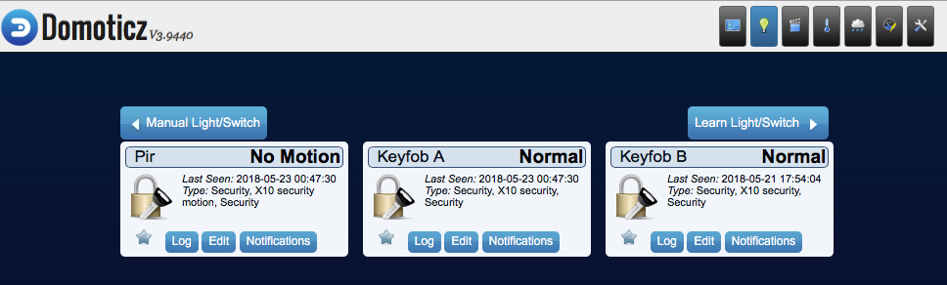
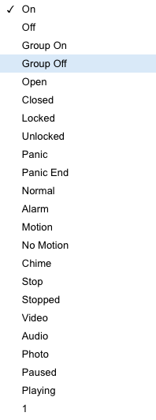
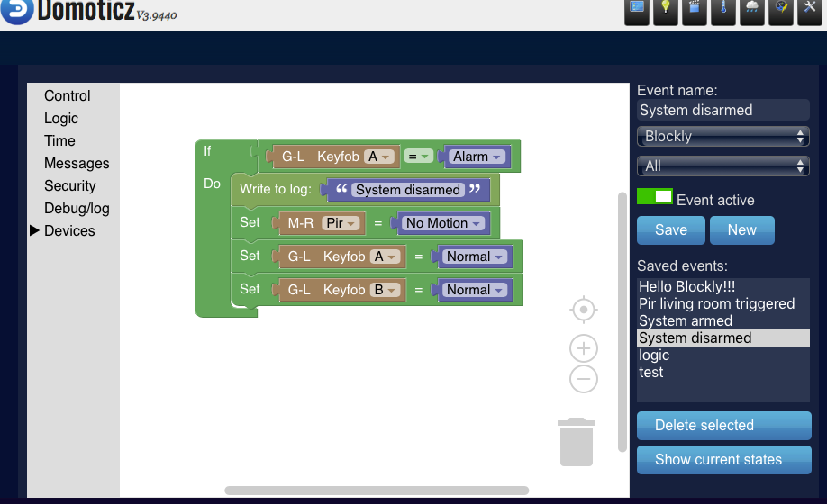
Basic alarm system
Disarming a system after PIR trigger using a Keyfob (A)

Slide 11
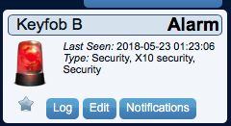
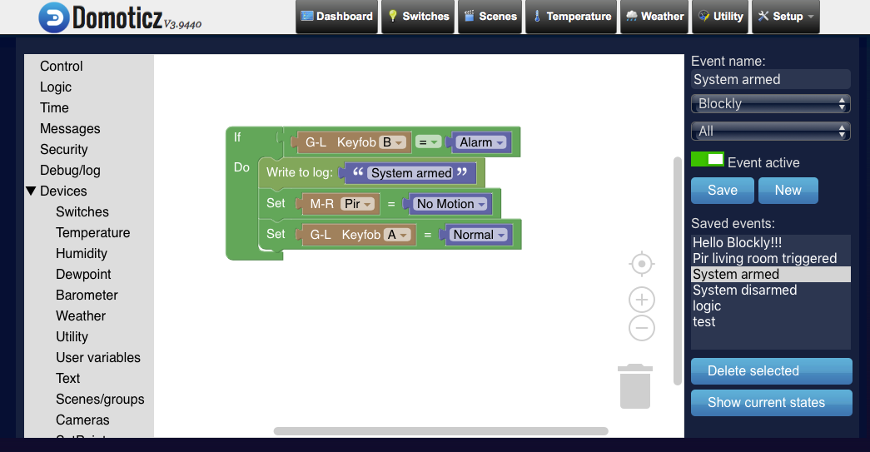
Basic alarm system
Arming system…

Slide 12
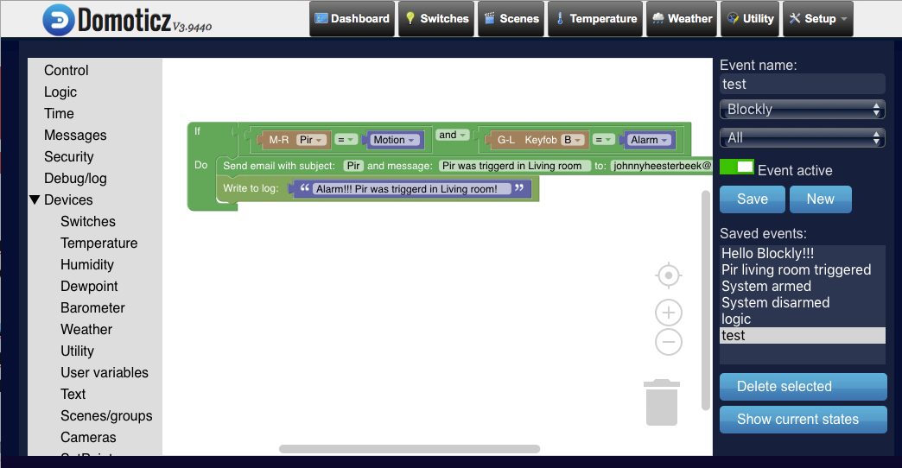
Basic alarm system
(Silent) alarm trigger mail, webcam or anything else…
Pro tip: Instead of mail, you can also address your ESP directly using this URL to switch a relay or buzzer:
http://192.168.4.1/control?cmd=GPIO,0,1
http://192.168.4.1/control?cmd=GPIO,0,0

Slide 13
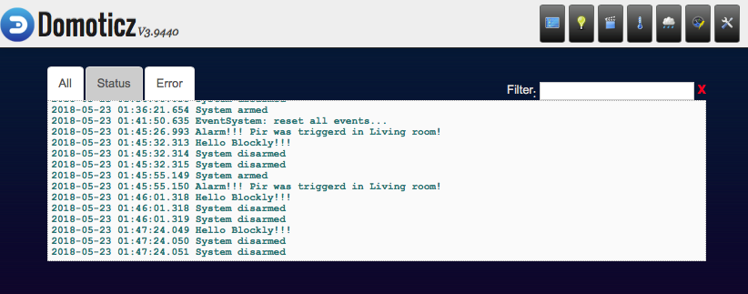
When system armed and PIR triggers; alarm will pound
So… it works! ☺

Slide 14
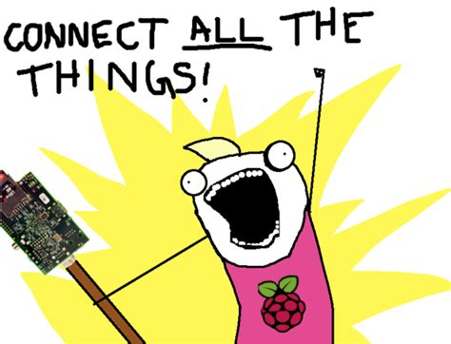
Workshop

Slide 15
Workshop
Demo & Node Red…

Slide 16
Programma
* Avond 1 - 2 mei Domoticz @ RasbperryPi
* Avond 2 - 9 mei Sensors & actuators
* Avond 3 - 16 mei Domotics bus-systems
* Avond 4 - 23 mei Blocky & node red
* Avond 5 - 30 mei Strut your stuff

