Slide 1
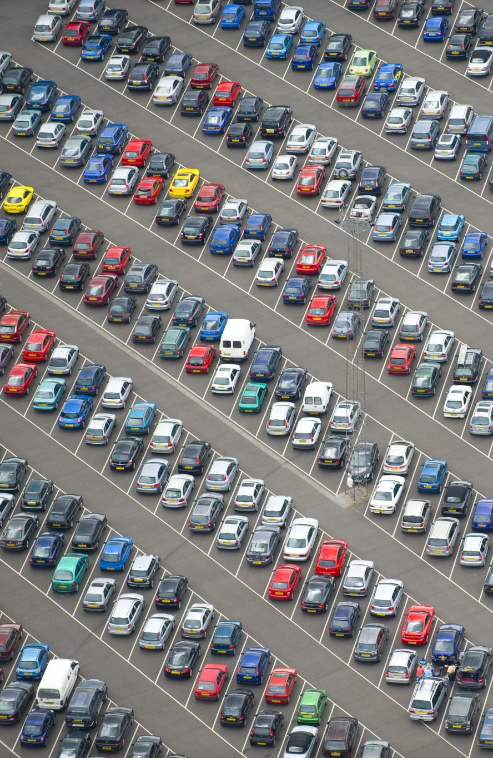
Car Price Prediction Using Machine Learning
A Modern Approach to Predict Vehicle Prices
Presented by: Muhammad Ali Farooq

Slide 2
Problem Statement
Predict car prices accurately using machine learning techniques
• Predict prices based on model, year, mileage, and condition.
• Helps buyers/sellers make informed decisions.
• Optimizes pricing strategies for manufacturers.

Slide 3
Objectives
What we aim to achieve:
• Develop an ML model for car price predictions.
• Evaluate and compare multiple algorithms.
• Determine factors most influencing car prices.

Slide 4
Data Collection
Dataset Details:
• 301 records with features like mileage, model, brand.
• Includes car fiscal power, gear type, and fuel type.
• Enables effective analysis and accurate predictions.

Slide 5
Data Preprocessing
Key Steps:
• Handled missing/irrelevant data.
• Created 'Age of Car' and removed redundant columns.
• Detected and treated outliers using visual analysis.
• Standardized numerical features for scaling.

Slide 6
Exploratory Data Analysis
Insights gained through EDA:
• Price negatively correlates with car age and mileage.
• Visualized data patterns with scatter plots and heatmaps.
• Tools used: Pandas, Matplotlib, Seaborn.

Slide 7
Machine Learning Models
Algorithms Applied:
1. Linear Regression: 70% accuracy.
2. Random Forest Regressor: 75% accuracy.
3. Gradient Boosting Regression: 87% accuracy.
4. XGBoost Regression: ~90% accuracy.

Slide 8
Evaluation Metrics
How models were assessed:
• Metrics: R², RMSE, Accuracy.
• XGBoost outperformed others with the lowest MSE.
• Achieved ~90% accuracy with strong robustness.

Slide 9
Results and Deliverables
Key Achievements:
• XGBoost Regression: Best performance.
• Trained models ready for deployment.
• Insights shared with visualizations and analysis.

Slide 10

Conclusion
• Developed an accurate car price prediction model.
• Identified key factors influencing pricing.
• Future Work: Incorporate market trends and expand the dataset.

