Slide 1
Clustering Lecture 14
David Sontag New York University
Slides adapted from Luke Zettlemoyer, Vibhav Gogate, Carlos Guestrin, Andrew Moore, Dan Klein

Slide 2
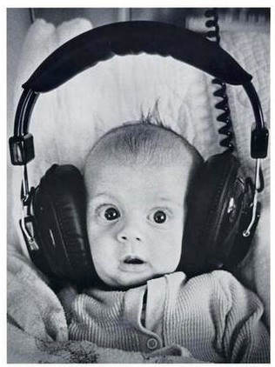
Clustering
Clustering:
Unsupervised learning
Requires data, but no labels
Detect patterns e.g. in
Group emails or search results
Customer shopping patterns
Regions of images
Useful when don’t know what you’re looking for
But: can get gibberish

Slide 3




Clustering
Basic idea: group together similar instances
Example: 2D point patterns

Slide 4


Clustering
Basic idea: group together similar instances
Example: 2D point patterns

Slide 5




Clustering
Basic idea: group together similar instances
Example: 2D point patterns
What could “similar” mean?
– One option: small Euclidean distance (squared)
2
dist(x, y) = ||x − y||
2
– Clustering results are crucially dependent on the measure of similarity (or distance) between “points” to be clustered

Slide 6
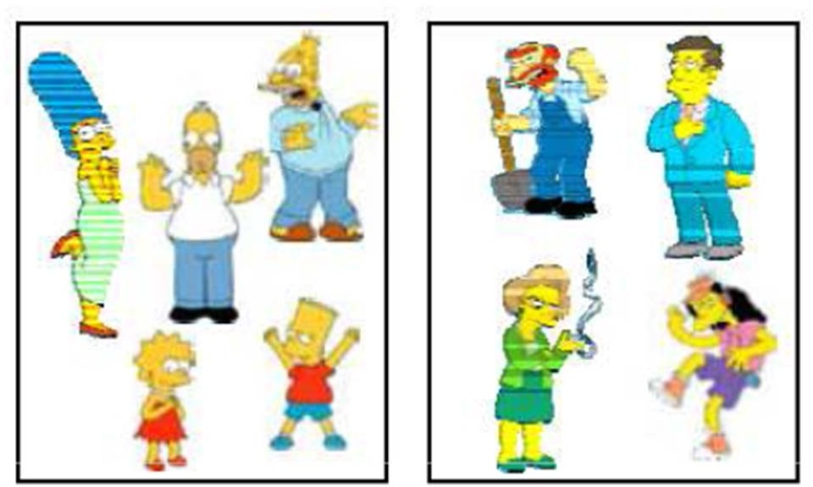
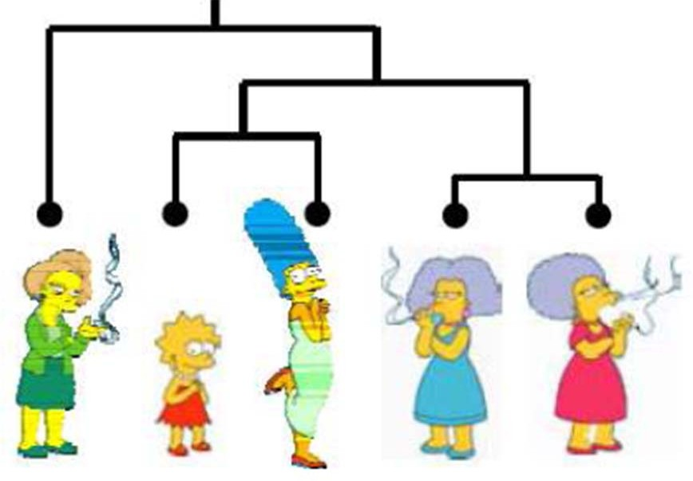
Clustering algorithms
8+'%(%(,) +"*,'(%-.$ 9:"+%;
– <−.&+)$
– =(>%#'& ,? @+#$$(+)
– A2&0%'+" !"#$%&'()*
/(&'+'0-(0+" +"*,'(%-.$
– 1,%%,. #2 3 +**",.&'+%(4&
– 5,2 6,7) 3 6(4($(4&

Slide 7
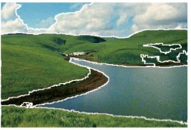
Clustering examples
Image segmentation
Goal: Break up the image into meaningful or perceptually similar regions
[Slide from James Hayes]

Slide 8
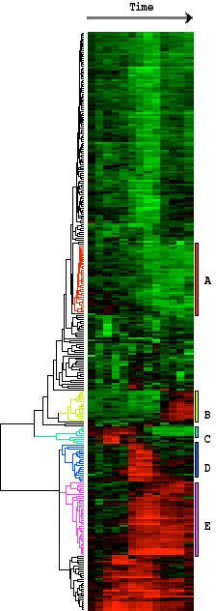
Clustering examples
Clustering gene expression data
Eisen et al, PNAS 1998

Slide 9
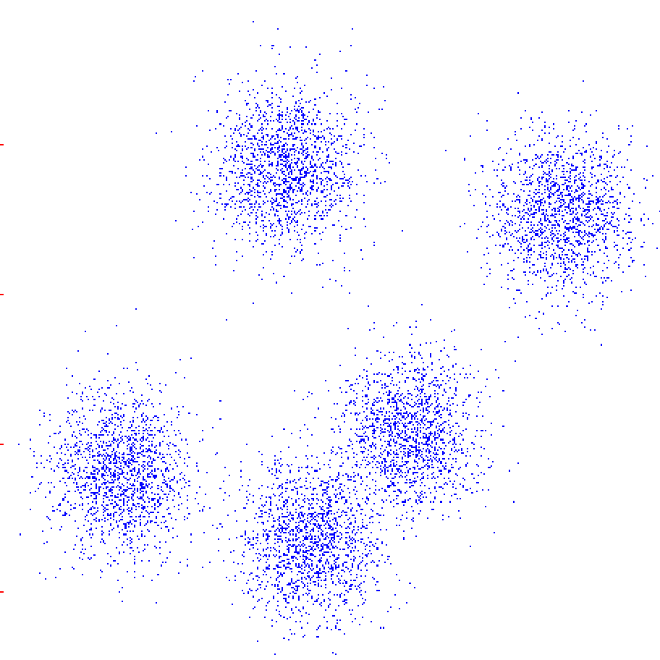
K-Means
An iterative clustering algorithm
Initialize: Pick K random points as cluster centers
Alternate:
Assign data points to closest cluster center
Change the cluster center to the average of its assigned points
Stop when no pointsʼ assignments change

Slide 10
K-Means
An iterative clustering algorithm
Initialize: Pick K random points as cluster centers
Alternate:
Assign data points to closest cluster center
Change the cluster center to the average of its assigned points
Stop when no pointsʼ assignments change

Slide 11
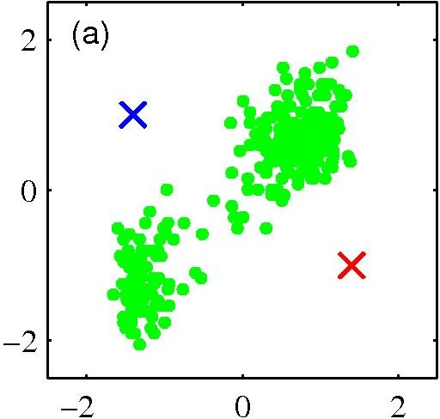
K-­‐means clustering: Example
Pick K random points as cluster centers (means)
Shown here for K=2
11

Slide 12
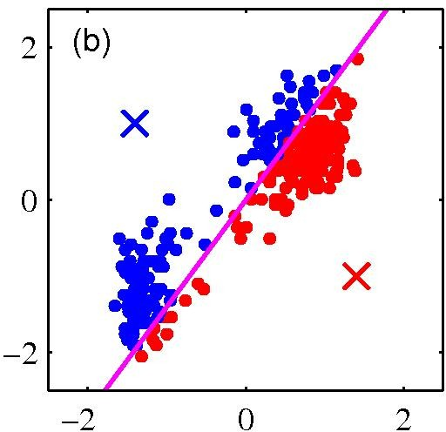
K-­‐means clustering: Example
Iterative Step 1
Assign data points to closest cluster center
12

Slide 13
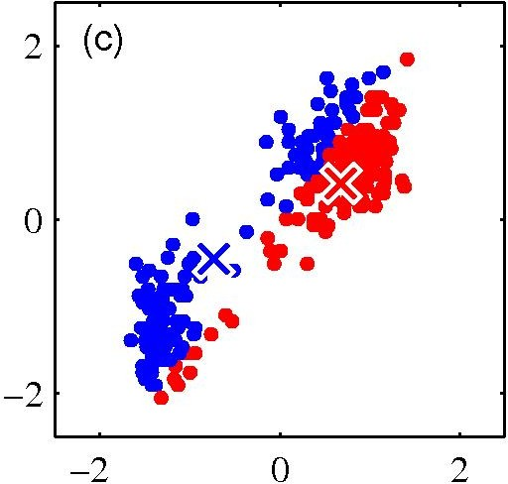
K-­‐means clustering: Example
Iterative Step 2
Change the cluster center to the average of the assigned points
13

Slide 14
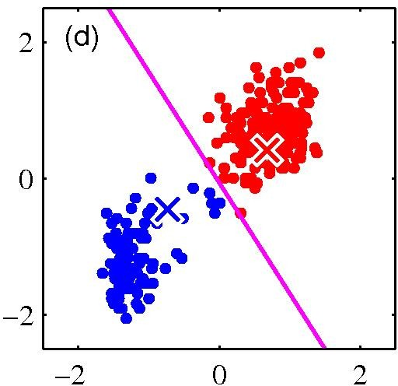
K-­‐means clustering: Example
Repeat until convergence
14

Slide 15
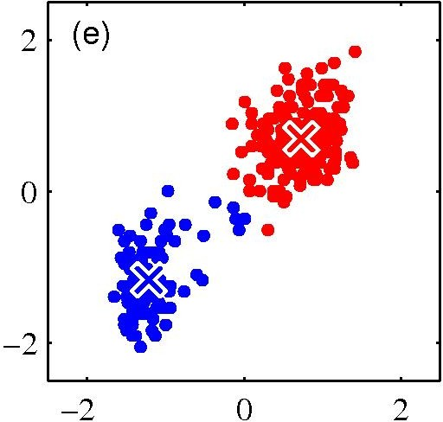
K-­‐means clustering: Example
15

Slide 16
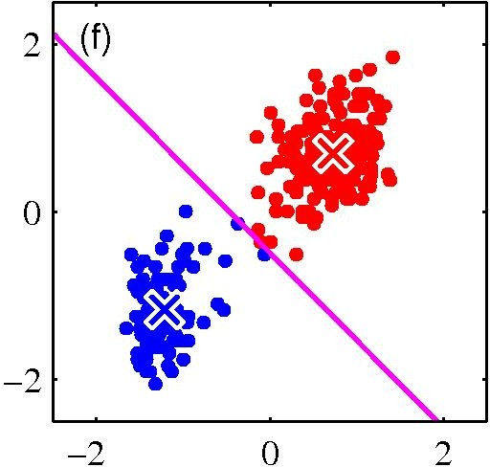
K-­‐means clustering: Example
16

Slide 17

K-­‐means clustering: Example
17

Slide 18
Properties of K-­‐means algorithm
Guaranteed to converge in a ﬁnite number of iterations
Running time per iteration:
Assign data points to closest cluster center
O(KN) time
Change the cluster center to the average of its assigned points
O(N)

Slide 19
What properties should a distance measure have?
3400($&)/
– 56789:;56987:
– <$"(&=)*(8 =( /#. *#4 7 ,''>* ,)>( 9 ?+$ 9 -'(* .'$ ,''>
,)>( 7
@'*)$)1)$48 #.- *(,A−*)0),#&)$4
– 56789:≤B8 #.- 56789:;B )AA 7;9
– <$"(&=)*( $"(&( =),, -)AA(&(.$ '?C(/$* $"#$ =( /#..'$ $(,,
#%#&$
D&)#.E,( ).(F+#,)$4
– 56789:G5698H: ≤ 5678H:
– <$"(&=)*( '.( /#. *#4 I7 )* ,)>( 98 9 )* ,)>( H8 ?+$ 7 )* .'$
,)>( H #$ #,,J
[Slide from Alan Fern]

Slide 20
!"#$%& '(%)#*+#%,#
!"#$%&'($
minmin Σ^{k} x — µ_{i} ²
i=1 ^{Σ}sCC
µ C
-. /01 µ2 (340"05# !"
k
i
!"#$ % &' ()#*+,
n
min Σ Σ x — µ
² = min Σ x — µ
2
C
i
c
i
s_{i}
i=1 sCC_{i}
i
6. /01 !# (340"05# µ:
min Σ^{k} x — µ_{i} ²
i=1 ^{Σ}sCC
µ
i
– 7$8# 3$*40$9 :#*0)$40)# (; µ_{i} $%: &#4 4( 5#*(2 <# =$)#
1
Σ x
sCC_{i}
µ =
!"#$ - &' ()#*+,
i
|C_{i}|
!"#$%& 4$8#& $% $94#*%$40%+ (340"05$40(% $33*($,=2 #$,= &4#3 0& +>$*$%4##: 4(
:#,*#$&# 4=# (?@#,40)# A 4=>& +>$*$%4##: 4( ,(%)#*+#
[Slide from Alan Fern]

Slide 21
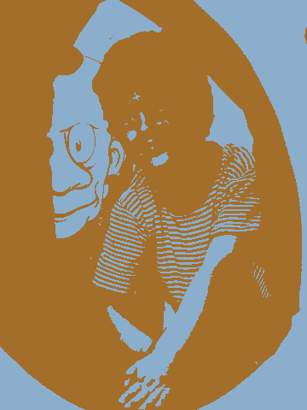
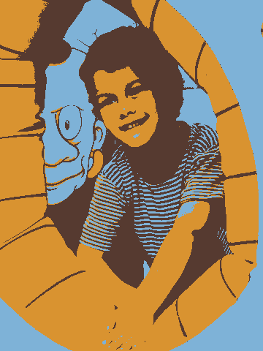
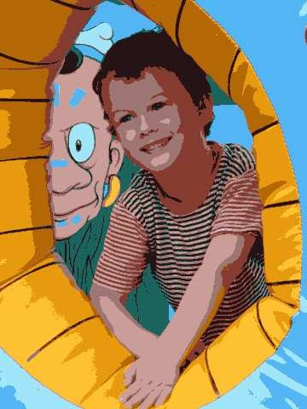
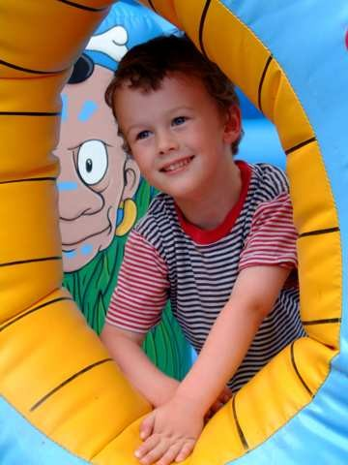
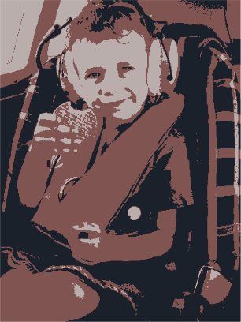
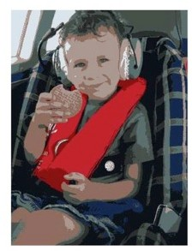
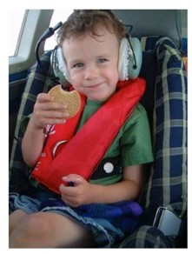
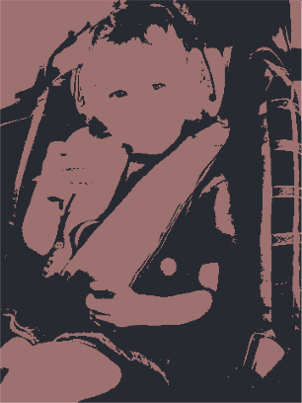
Example: K-Means for Segmentation
K=2
Original
K =2
Goal of Segmentation is
K =3 K = 10
Original image
to partition an image into regions each of which has reasonably homogenous visual appearance.

Slide 22
Example: K-Means for Segmentation
K=2
K=3
K=10
Original
K =2
K =3
K = 10
Original image

Slide 23
Example: K-Means for Segmentation
K=2
K=3
K=10
Original
K =2
K =3
K = 10
Original image
4%
8%
17%

Slide 24
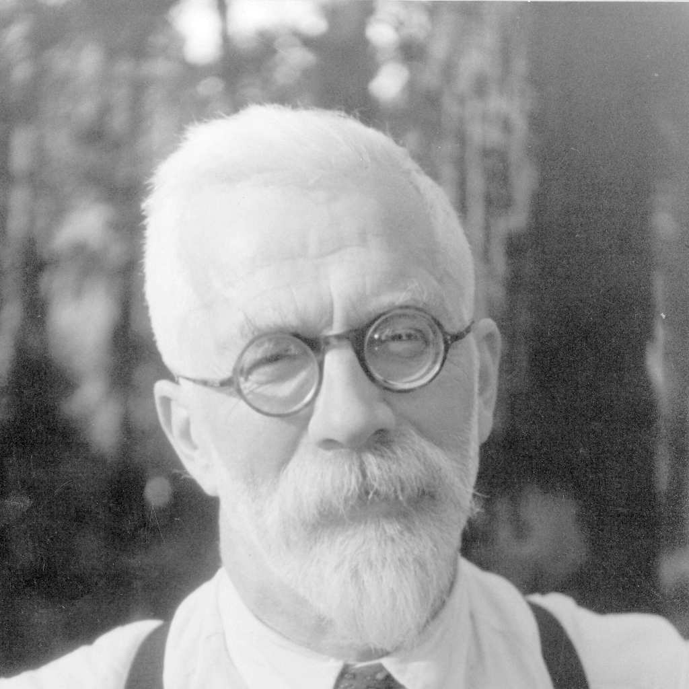
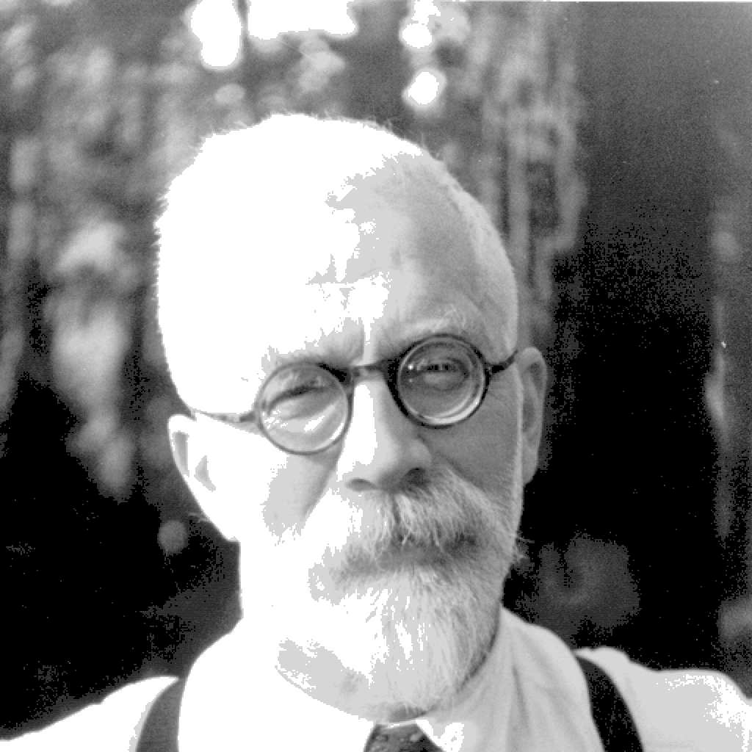
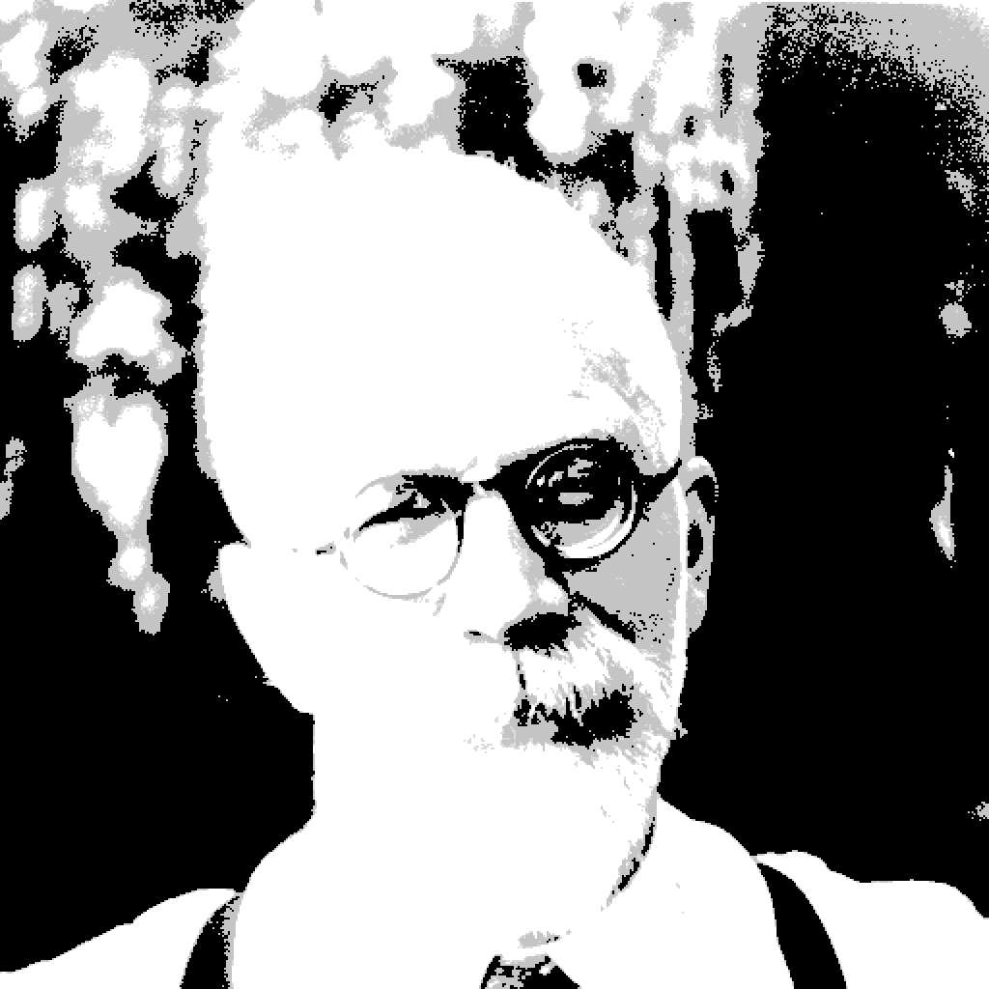
Example: Vector quantization
FIGURE 14.9. Sir Ronald A. Fisher (1890 − 1962) was one of the founders of modern day statistics, to whom we owe maximum-likelihood, sufficiency, and many other fundamental concepts. The image on the left is a 1024×1024 grayscale image at 8 bits per pixel. The center image is the result of 2 × 2 block VQ, using 200 code vectors, with a compression rate of 1.9 bits/pixel. The right image uses only four code vectors, with a compression rate of 0.50 bits/pixel
[Figure from Hastie et al. book]

Slide 25

Initialization
K-means algorithm is a heuristic
Requires initial means
It does matter what you pick!
What can go wrong?
Various schemes for preventing this kind of thing: variance-based split / merge, initialization heuristics

Slide 26

K-Means Getting Stuck
A local optimum:
Would be better to have one cluster here
… and two clusters here

Slide 27









K-means not able to properly cluster
Y
X

Slide 28








Changing the features (distance function) can help
R
θ

Slide 29
Agglomerative Clustering
Agglomerative clustering:
First merge very similar instances
Incrementally build larger clusters out of smaller clusters
Algorithm:
Maintain a set of clusters
Initially, each instance in its own cluster
Repeat:
Pick the two closest clusters
Merge them into a new cluster
Stop when thereʼs only one cluster left
Produces not one clustering, but a family of clusterings represented by a dendrogram

Slide 30
Agglomerative Clustering
How should we define “closest” for clusters with multiple elements?

Slide 31
Agglomerative Clustering
How should we define “closest” for clusters with multiple elements?
Many options:
Closest pair
(single-link clustering)
Farthest pair
(complete-link clustering)
Average of all pairs
Different choices create different clustering behaviors

Slide 32
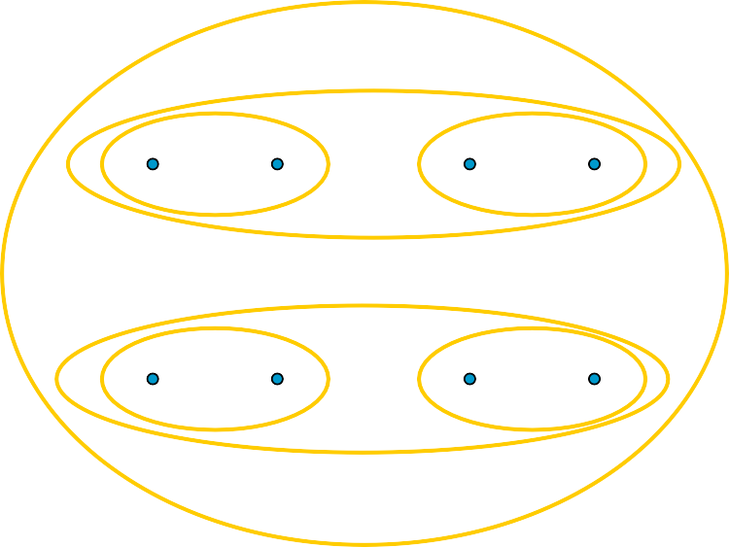
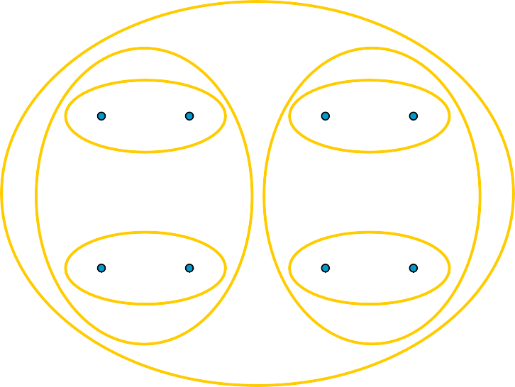
Agglomerative Clustering
How should we define “closest” for clusters with multiple elements?
Closest pair
(single-link clustering)
Farthest pair
(complete-link clustering)
1
2
5
6
1
2
5
6
3
4
7 8
3
4
7 8
[Pictures from Thorsten Joachims]

Slide 33
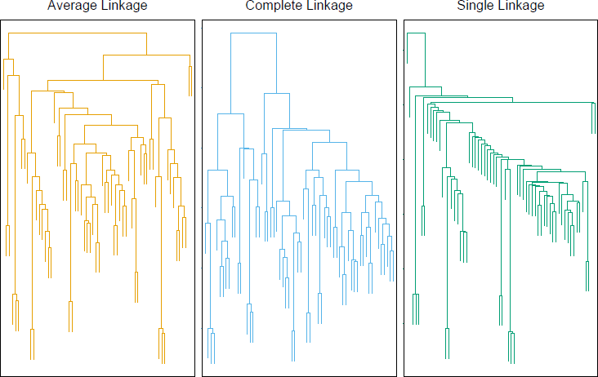
Clustering Behavior
Average Farthest Nearest
Mouse tumor data from [Hastie et al.]

Slide 34
Agglomerative Clustering Questions
Will agglomerative clustering converge?
– To a global optimum?
Will it always find the true patterns in the data?
Do people ever use it?
How many clusters to pick?

Slide 35
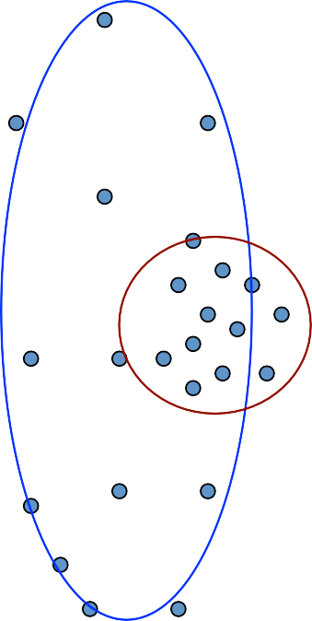
Reconsidering “hard assignments”?
Clusters may overlap
Some clusters may be “wider” than others
Distances can be deceiving!

Slide 36
Extra
K-­‐means Applets:
http://home.dei.polimi.it/matteucc/Clustering/ tutorial_html/AppletKM.html
http://www.cs.washington.edu/research/ imagedatabase/demo/kmcluster/

