Slide 1

Secure Multi-VM Isolation and Threat Detection System in Virtualized Environments
CSA 1522 – Cloud Computing and Big Data Analytics
Presented by Aravind Kumar S (19252410) Brijesh T (1925211391) Magesh S (192525002)
Guided by Dr. P. Rajaram

Slide 2


Problem Statement
Virtualized environments allow multiple Virtual Machines (VMs) to share the same physical hardware through a hypervisor. Although virtualization improves resource utilization, it also introduces security risks such as:
VM Escape attacks
Side-channel attacks
Unauthorized inter-VM communication
Hypervisor vulnerabilities
Traditional security solutions mainly protect individual VMs and often fail to detect attacks occurring at the virtualization layer.

Slide 3
Objectives
Improve isolation between virtual machines.
Detect suspicious activities at the hypervisor level.
Prevent cross-VM attacks before they spread.
Generate real-time alerts for security incidents.
Provide a centralized dashboard for monitoring virtual infrastructure.

Slide 4
Existing System
Existing System | Limitations
Current virtualization platforms provide: Basic VM isolation Standard firewall protection Limited hypervisor monitoring Manual log analysis | Poor visibility into hypervisor activities Delayed attack detection Higher false positives Lack of centralized monitoring

Slide 5
Proposed System
The proposed system integrates:
Secure VM isolation
Hypervisor-level monitoring
Intrusion Detection System (Snort)
Python-based monitoring scripts
Grafana dashboard
Automated incident alerting

Slide 6
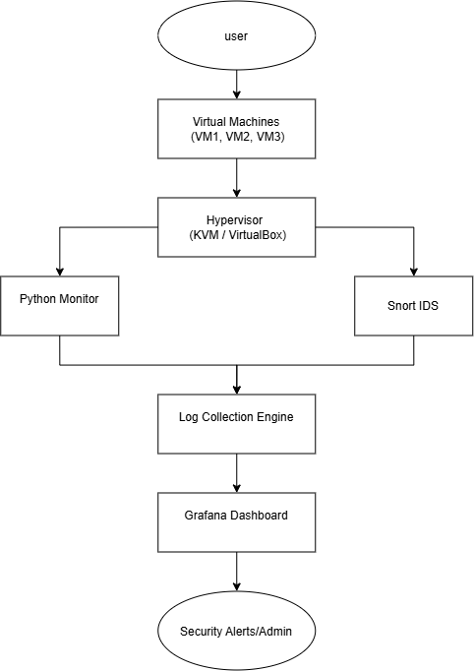
System Architecture

Slide 7
Module 1: VM Isolation and Access Control
Objective
To establish strong isolation between virtual machines and enforce secure access control policies that prevent unauthorized communication and cross-VM attacks.
Functionalities
Create and configure multiple virtual machines using KVM/VirtualBox.
Implement VM isolation through virtual networking and hypervisor configurations.
Apply Role-Based Access Control (RBAC) for administrators and users.
Restrict unauthorized VM-to-VM communication using firewall rules and security groups.
Monitor resource allocation (CPU, Memory, Storage, Network) to prevent resource abuse.
Prevent privilege escalation and unauthorized access to host resources.

Slide 8
Inputs
Virtual Machine configurations
User authentication details
Hypervisor security policies
Network access rules
Outputs
Securely isolated VMs
Authorized resource access
Blocked unauthorized communication
Isolation status reports

Slide 9
Module 2: Hypervisor-level Threat Monitoring Module
Objective
To continuously monitor hypervisor activities and detect virtualization-layer attacks in real time using intrusion detection and anomaly analysis techniques.
Functionalities
Collect logs from the hypervisor and virtual machines.
Monitor CPU, memory, disk, and network activities.
Detect VM Escape attacks.
Identify Side-Channel attacks through abnormal resource usage.
Detect privilege escalation attempts.
Analyze system logs using Snort IDS and Python monitoring scripts.
Perform anomaly detection based on predefined thresholds and behavioral patterns.
Generate threat severity levels (Low, Medium, High, Critical).

Slide 10
Inputs
Hypervisor logs
VM activity logs
Network traffic
System resource utilization
IDS alerts
Outputs
Detected security threats
Attack classification
Risk severity reports
Event logs

Slide 11
Module 3: Incident Alerting & Reporting Dashboard Module
Objective
To provide centralized visualization of detected threats, generate real-time alerts, and produce security reports for efficient incident response.
Functionalities
Aggregate security events from monitoring components.
Generate real-time alerts for suspicious activities.
Display VM health and security status using Grafana dashboards.
Visualize attack trends and system performance.
Store historical security logs for forensic analysis.
Generate daily, weekly, and monthly security reports.
Notify administrators through Email, SMS, or webhook alerts.
Maintain audit logs for compliance and investigation.

Slide 12
Inputs
IDS alerts
Hypervisor monitoring data
Security logs
System performance metrics
Outputs
Live Grafana dashboard
Incident notifications
Security analytics reports
Historical event database

Slide 13
Technologies Used
Software | Programming | Monitoring
KVM / VirtualBox Snort IDS Python Grafana Linux | Python Shell Scripting | System Logs Event Logs Hypervisor Logs

Slide 14
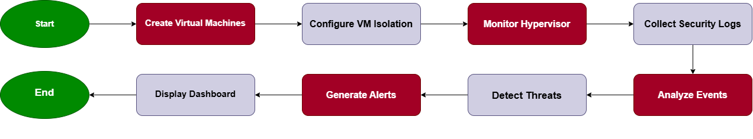
Project Workflow

Slide 15
Performance Parameters
Parameter | Description
Detection Accuracy | Percentage of attacks correctly detected
False Positive Rate | Incorrect alerts generated
Isolation Breach Attempts Blocked | Number of prevented attacks
Response Time | Time taken to generate alert
System Availability | Continuous monitoring uptime

Slide 16
Expected Outcomes
Future Scope
Strong VM isolation
Real-time threat detection
Faster incident response
Lower false positives
Secure virtualization environment
Centralized monitoring dashboard
Improved overall cloud security
AI-based threat prediction
Machine Learning for anomaly detection
Cloud deployment (AWS/OpenStack)
Automated threat response
Integration with SIEM platforms
Multi-hypervisor support

Slide 17
Literature Review
Year | Author(s) | Research Paper / Study | Method / Focus | Key Finding | Limitation / Gap
2024 | Zhang et al. | HClave: An Isolated Execution Environment Design for Hypervisor Runtime Security | Isolated execution environments for hypervisors | Limits the impact of each VM on the virtualization layer and reduces the trusted computing base. | Focuses mainly on hypervisor runtime isolation rather than complete threat detection and alerting.
2024 | Authors of Morpheus | Morpheus: An Efficient Timing-Based Attestation Framework for Safeguarding Hypervisor Integrity with Dynamic Trust | Timing-based hypervisor integrity verification | Provides an efficient approach for detecting compromised hypervisor environments. | Primarily focuses on hypervisor integrity rather than complete VM-level attack prevention.
2024 | Authors of vDefender | vDefender: An Explainable and Introspection-Based Approach for Identifying Emerging Malware Behaviour at Hypervisor-Layer | Hypervisor introspection and malware behavior analysis | Enables fine-grained monitoring of VM processes from the hypervisor layer and detects malicious behavior. | Mainly targets malware behavior; broader cross-VM attacks require additional monitoring mechanisms.
2024 | Authors of Temporal Isolation Study | Temporal Isolation Assessment in Virtualized Safety-Critical Mixed-Criticality Systems: A Case Study on Xen Hypervisor | Temporal isolation analysis using Xen | Demonstrates methods for assessing and improving temporal isolation in virtualized systems. | Focuses on timing isolation rather than security incident detection and alerting.

Slide 18


