Slide 1
Map
Need Finding
For Bump

Slide 2
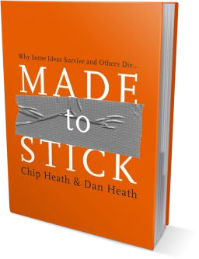
What is Bump
Promoting healthy pregnancies, Bump is a website which helps to ensure soon-to-be moms are eating right and getting enough exercise. We also have application’s like sugar tracking and shopping list features to promote healthy eating.

Slide 3
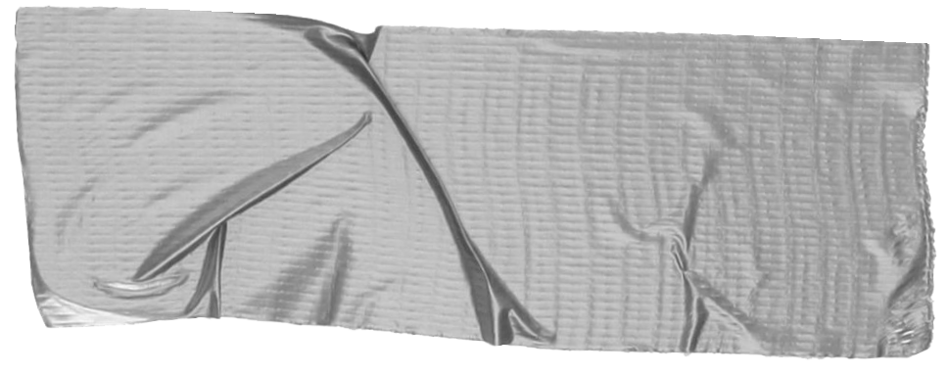

Methodology
We will start the methodology by ﬁrst gathering more data on the requirement of the design or product by interviewing people.
➔ Planning and Design
Pose a few questions for insights.
➔ Execution
Make a note of the answers given.
➔ Analysis
Make an empathy to understand what happened and conclude from it.

Slide 4
1. Planning and Design

Slide 5

List of Questions for Interviewees
Which food is healthy for pregnant women?
Which food a pregnant women shouldn’t eat?
What are the problems faced by Pregnant women who doesn’t take healthy food.
Do you like more info about you’re
health and healthy food you should
take when you’re pregnant?
Details
In this phase, we take the initiative to interview a few people on their pregnancy experience on a platform and as well as healthy foods taken by then during pregnancy.

Slide 6
1. Execution

Slide 7
The Feedback we got
Mainly fresh fruits and vegetables.
Pregnant women who eat an unhealthy diet may be putting their children at risk of developing long term, irreversible health issues like obesity, blood sugar etc.
I would like to know more about my health and healthy foods I should take.
4. Uncooked seafood, Deli meat,
unpasteurized milk, cheese which
contains listeria, Papaya etc.
Tip
In this phase, we make a list of the answers given as feedback for the posed questions on people on their pregnancy experience on a platform and as well as healthy foods taken by then during pregnancy.

Slide 8
2. Examples
By the end of this section, your audience should be able to visualize:
➔ What
What is the pain you cure with your solution?
➔ Who
Show them a speciﬁc person who would beneﬁt from your solution.

Slide 9

Meet Stacy.
She recently Got to know that she is pregnant, she is so excited
She is so happy, but feared she would make any mistakes in taking healthy food for her unborn child’s growth.
Tip
Tell the audience about the problem through a story, ideally a person.

Slide 10

Meet Karen.
She is 2 months pregnant, she is happy but still felt something is off.
She was worried about her health and her unborn child’s health, what to consume to be safe etc.
Tip
If one example isn’t suﬃcient to help people understand the breadth of your idea, pick a couple of examples.

Slide 11
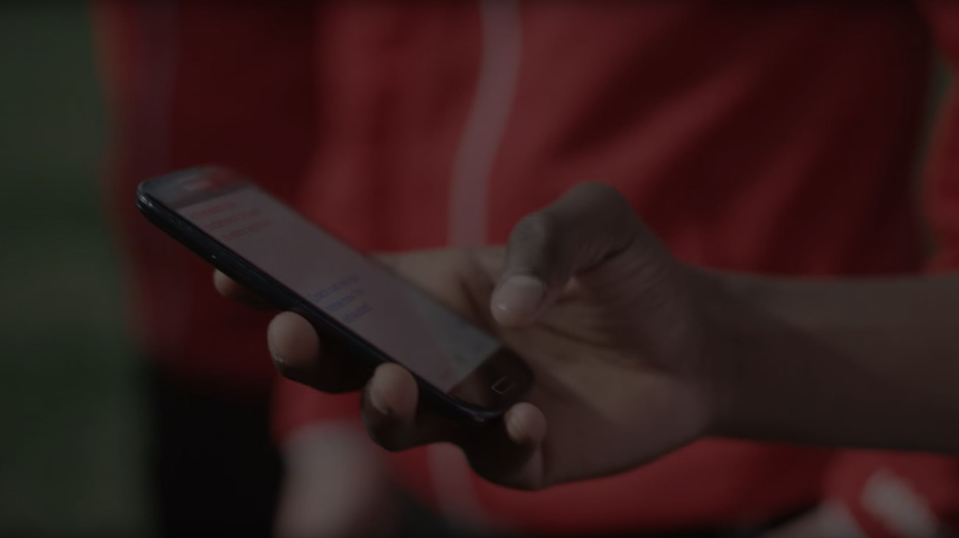
All these thoughts left Stacy and Karen feeling stressed and confused.
Tip
Ideally, speak of people in very diﬀerent situations, but where each could beneﬁt from your solution.

Slide 12
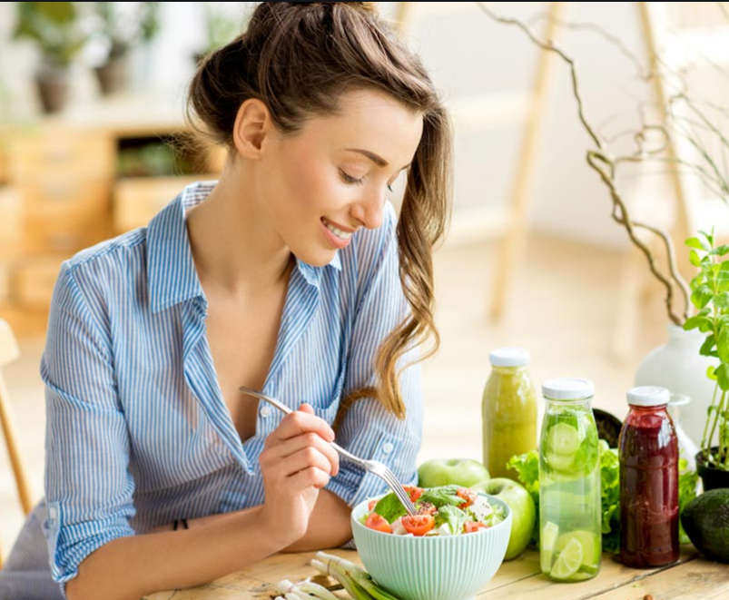
A simple gesture
Karen didn’t Know what to eat to be healthy.
She used Bump to check her health and also“The food she can eat to stay healthy and to provide good nutritious food to her unborn child.”
Tip
Show how your solution helps the person in
the story reach his or
her goals.

Slide 13
3. Examples
People need to understand how rare or frequent your examples are.
Pick 1 or 2 statistics and make them as concrete as possible. Stats are generally not sticky, but here are a few tactics:
➔ Relate
Deliver data within the context of a story you’ve already told
➔ Compare
Make big numbers digestible by putting them in the context of something familiar

Slide 14
It’s no surprise Karen uses Bump regularly for her health and also the shopping list feature for healthy eating.
There are more things to do for pregnant women and to take care of them.
Tip
Don’t let data stand alone. Always relate it back to a story you’ve already told, in this case, Karen.

Slide 15
4. Closing
Build conﬁdence around your product or idea by including at least one of the these slides:
➔ Testimonials
Who supports your idea (or doesn’t)?
➔ What’s next?
How can the audience get involved or ﬁnd out more?

Slide 16
What people are saying
With this website, I’m conﬁdent to plan a healthy diet.
Bharathi,India.
Visual healthy food for pregnant feels like magic
R a m a , NYC

Slide 17

Know you are pregnant?
Make Bump even
better by joining
the community
Tip
Inspire your audience to act on the information they just learned.
Depending on your idea, this can be anything from downloading
an app to joining
an organization.

