Slide 1
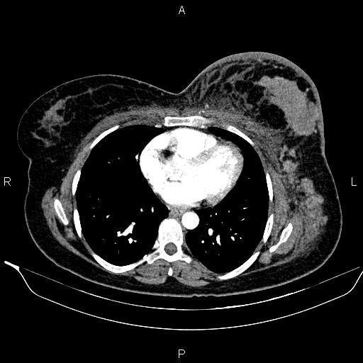
Breast: Case 2
Prompt:
May you please write a report for the image?
GPT-4V:
The image you've shared appears to be an axial (cross-sectional) view of a computed tomography (CT) scan of the thorax (chest).
Here are a few general observations based on the image:
Lungs: The black areas represent the lungs which seem to be well-aerated. No evident masses or consolidations can be seen in this slice.
Mediastinum: This is the central part of the thorax which contains structures like the heart, major blood vessels, trachea, and esophagus. It appears to be in the midline without any evident abnormal widening.
Heart: The heart can be seen in the mediastinal compartment, and at this slice, it appears normal in size and position.
Bones: The ribs and the vertebra can be seen. There doesn't seem to be any evident fractures or bony lesions in this slice.
Soft Tissues: The surrounding soft tissues appear unremarkable without any evident masses or swelling.
Prompt:
Can you notice any abnormality in breast?
GPT-4V:
From the image you've shared, it's challenging to provide a detailed assessment of the breast tissue as CT is not the primary modality used for breast imaging. Mammography, breast ultrasound, and breast MRI are more commonly used for evaluating breast tissue.
Reference answer:
Modality: CT, Anatomy: Chest, Diagnosis: Invasive ductal carcinoma of the breast
Description:
A large breast mass with irregular margin, several satellite lesions and multiple ipsilateral axillary and retro-pectoral enlarged lymph nodes are seen on the left side.

