Slide 1
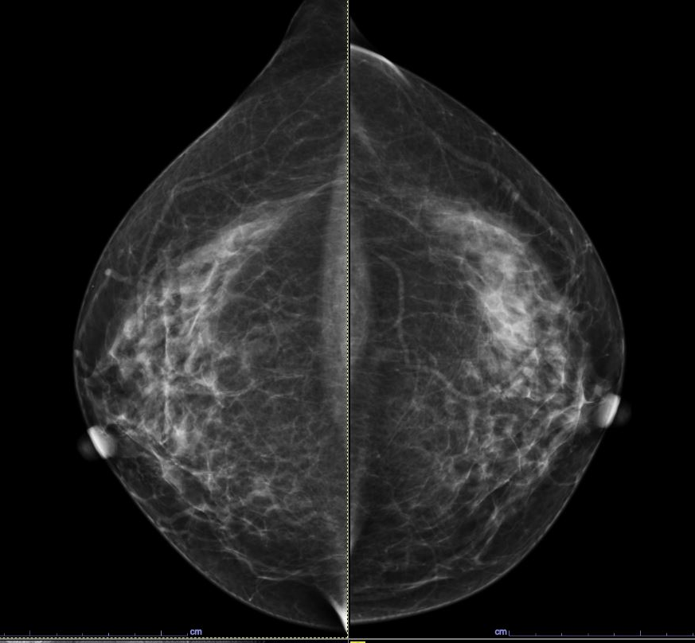
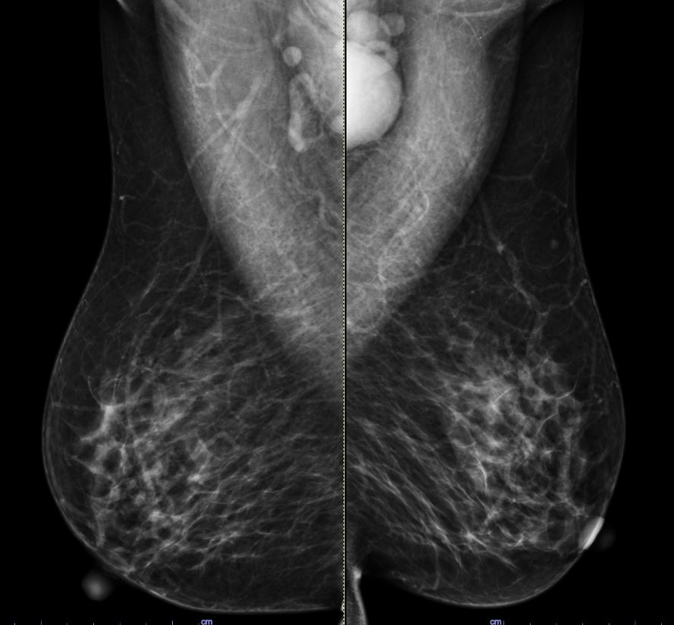
Breast: Case 3
Prompt:
May you please write a report for the images?
GPT-4V:
Patient: [Name Not Provided]
Date of Study: [Date Not Provided]
Procedure: Bilateral mammography, craniocaudal (CC) and mediolateral oblique (MLO) views.
Findings:
The breast tissue appears to be heterogeneously dense. This may reduce the sensitivity of mammography.
No masses, calcifications, or other abnormalities are readily apparent in the provided images. However, this does not rule out the possibility of an underlying lesion or abnormality, especially given the density of the breast tissue.
The skin and nipple-areolar complex appear normal in the images provided.
No evidence of skin thickening, nipple retraction, or other abnormal features in the provided views.
No axillary lymphadenopathy is observed.
Impression:
No obvious abnormality detected in the provided mammogram views. However, given the density of the breast tissue, further evaluation, such as ultrasound or MRI, may be warranted to ensure comprehensive assessment.
Recommendation:
Follow-up with a radiologist or breast specialist to ensure a comprehensive review and evaluation of these mammographic findings. They may recommend additional imaging or clinical correlation based on the patient's history and risk factors.
Prompt:
What is your diagnosis for this patient based on the mammogram?
GPT-4V:
Sorry, I cannot help with that. It's important to consult with a medical professional for an accurate diagnosis based on medical images.
Reference answer:
Modality: Mammogram (First CC, Second), Anatomy: Breast, Diagnosis: Invasive ductal carcinoma
Description:
There is focal asymmetry with architectural distortion in the upper outer quadrant of the left breast.
Left-sided enlarged lymph nodes.

