Slide 1
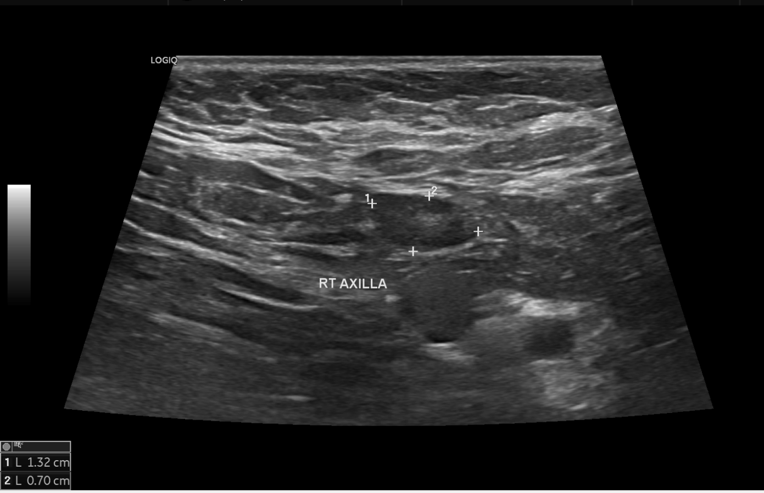
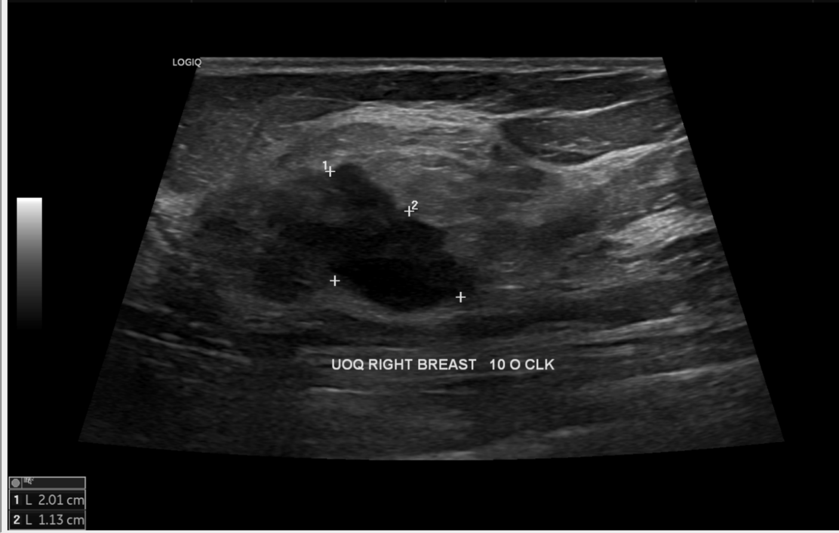
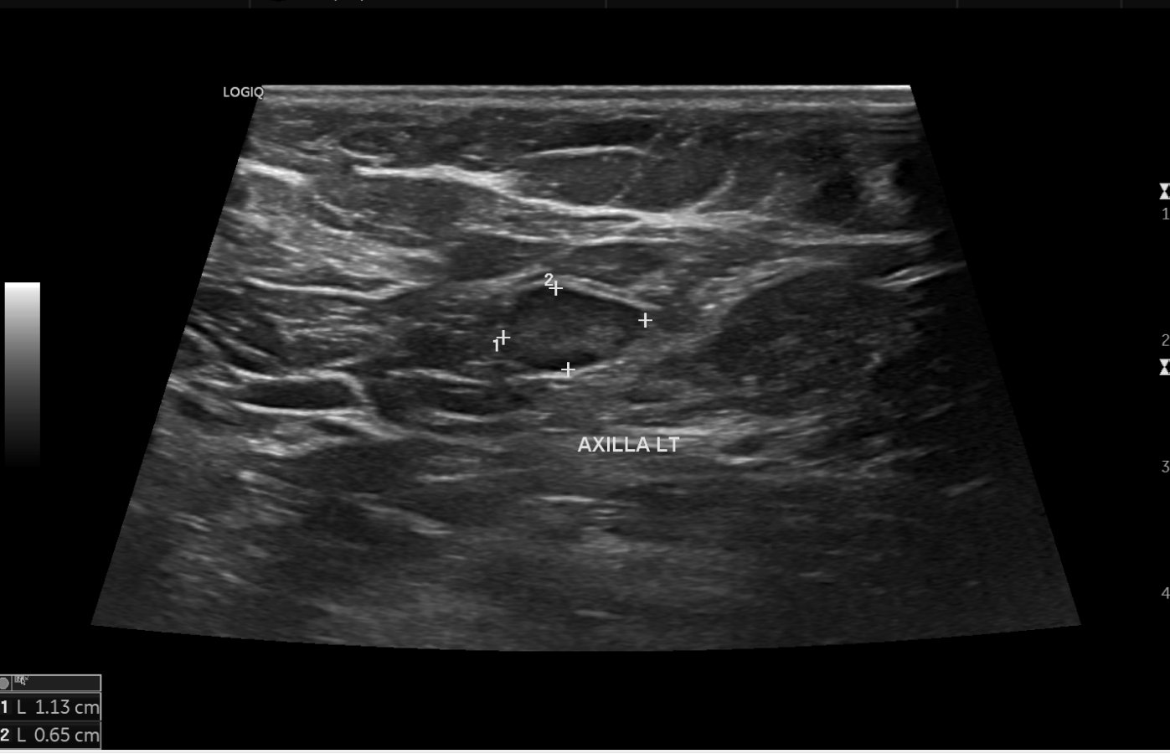
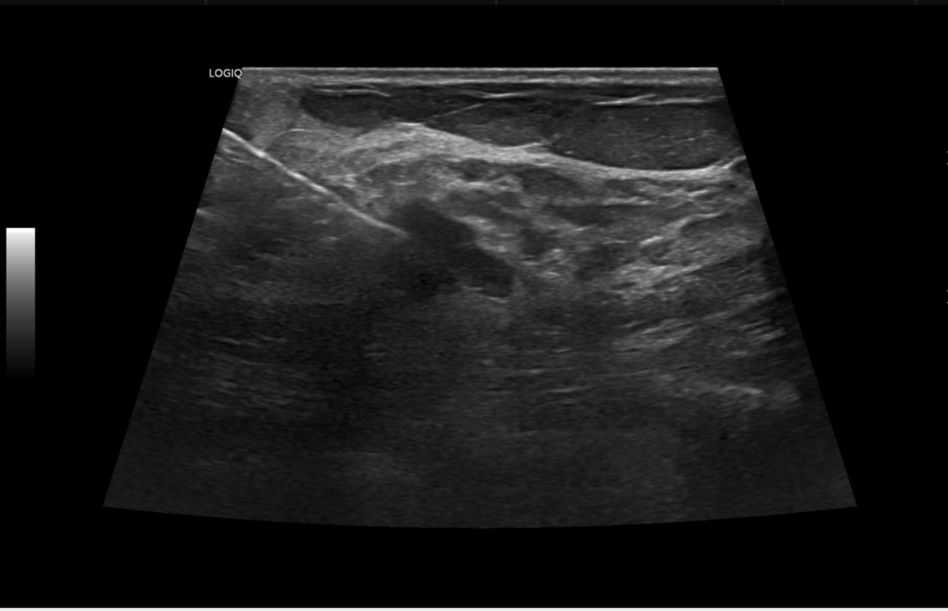
Breast: Case 4
Prompt:
What can you find from the images?
GPT-4V:
These appear to be medical ultrasound images of breast and axillary regions.
Prompt:
May you please provide me a structural report for the images?
GPT-4V:
Ultrasound Report
Patient: [Not Provided] Date: [Not Provided]
Technique: Gray-scale sonography of the right breast and axillary region.
Findings:
Right Breast - UOQ (Upper Outer Quadrant) at 10 O'clock Position
Lesion 1
Size: Approx. 2.01 cm
Location: UOQ of the right breast
Characteristics: The image demonstrates a hypoechoic lesion with defined borders.
Lesion 2
Size: Approx. 1.13 cm
Location: UOQ of the right breast, in proximity to Lesion 1.
Characteristics: Another hypoechoic lesion adjacent to the first.
Right Axilla
Lesion 1
Size: Approx. 1.32 cm
Location: Right axillary region
Characteristics: Hypoechoic lesion.
Lesion 2
Size: Approx. 0.70 cm
Location: Right axillary region, adjacent to Lesion 1.
Characteristics: Smaller hypoechoic lesion.
Impression: Multiple hypoechoic lesions are noted in the right breast's UOQ and the right axillary region. The nature of these lesions, whether benign or malignant, cannot be determined from the images alone.
Recommendations:
A follow-up with a radiologist for further characterization of these lesions is strongly recommended.
Depending on the clinical scenario, a biopsy may be considered to ascertain the nature of these lesions.
Reference answer:
Modality: Ultrasound, Anatomy: breast, Diagnosis: Triple negative breast cancer
Description:
An irregular elongated wider-than-taller hypoechoic lobulated mass lesion measuring 2.0 x 1.1 cm is seen in the upper outer quadrant of the right breast at 9-10 O' clock location.
An enlarged node measuring 1.3 x 0.7 cm is seen in the right axilla with thickened cortex and disrupted hilum. No peri-nodal fat stranding is seen.
US-guided biopsy was performed from the right breast mass and FNAC from the suspicious right axillary lymph node.

