Slide 1
Foodie
Android application
Cse 499B
Section: 12

Slide 2
Group members
Name | ID
Sadia Hossain Meem | 1620268042
Md. Mahadi Hasan | 1631551042

Slide 3
Problem analysis
There are few food delivery service in town like Foodpanda. Their activity is to deliver food from local restaurant to customers’ door. Now-a-days “Home Made Food” has become more popular to the food lovers but there is no such platform that can provide this service to the customers.
Facebook
Our goal is to make a suitable platform/android application where anyone who can cook or love to cook can create his/her own profile to sell home made foods to the customer.
This was a bit difficult because of the upgration of the documentation.
Setting up the environment was one of the major issues.

Slide 4
Related Works
Foodpanda,HungryNaki.com dedicated food delivery company, currently delivering food to the customers’ doorstep from local restaurants. They use mobile app to recieve orders from customers. Their are few other delivery companies they also deliver foods as per conditions like pathao food, shohoj food etc. All of these delivers local restaurants foods. We found none works with ‘Home Made Food.’

Slide 5
What we did over the course
a. Approaches that we follow
We tried to find out if there is any similar app developed before like ours but we found nothing. At first we designed our app layout through figma. Then we went for app implementation following the design.
b. How I collaborated with group members
We did all the works together through Zoom Meeting.
c. Who did what part
Sadia Hossain Meem – App layout design using figma
Md. Mahadi Hasan – Backend code implementation.
d. Who did most of the coding
Md. Mahadi Hasan implemented most of the code. Because Sadia had lack of required PC configuration to setup the app developing environment. Sadia is also newbie in this platform but most of the time we code together via Zoom meeting.

Slide 6
What part of the project is most unique/original
a. How we addressed it
Application layout Design was the most unique and original part of the project beacuse we did not find any similar app like this. We found several software to design out layout like adobe illustrator, canva etc but we choose figma because it is comparatively easier to make design.
b. Did teamwork helped? How?
Yes, it helped. Team work is always good. Sadia designed the layout and helped me to find the necessary resources to implement the code.

Slide 7
Tools we used
Hardware : PC
Softwares :
Figma – App layout design
Android Studio – For application code implementation
Database – Google FireBase Database
Group participation – Zoom Cloud Meeting

Slide 8
Design of the project
Welcome Screen
Flash Screen
Customer
Chef
New User?
Registration
Login
Chef Work Station
Customer Work Station

Slide 9
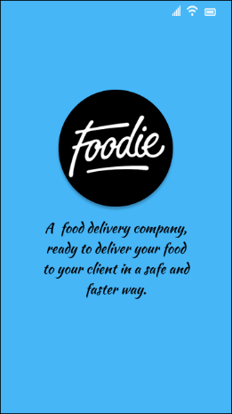
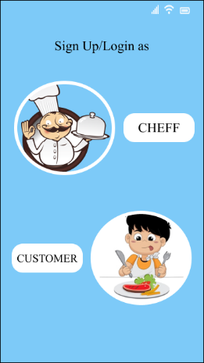
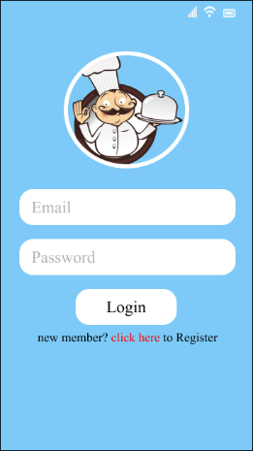
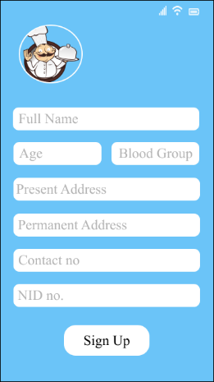
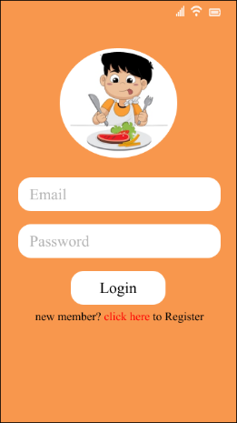
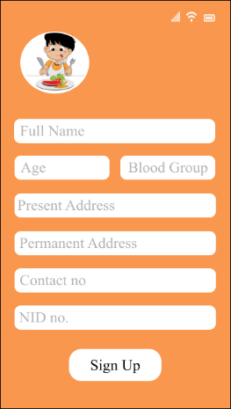
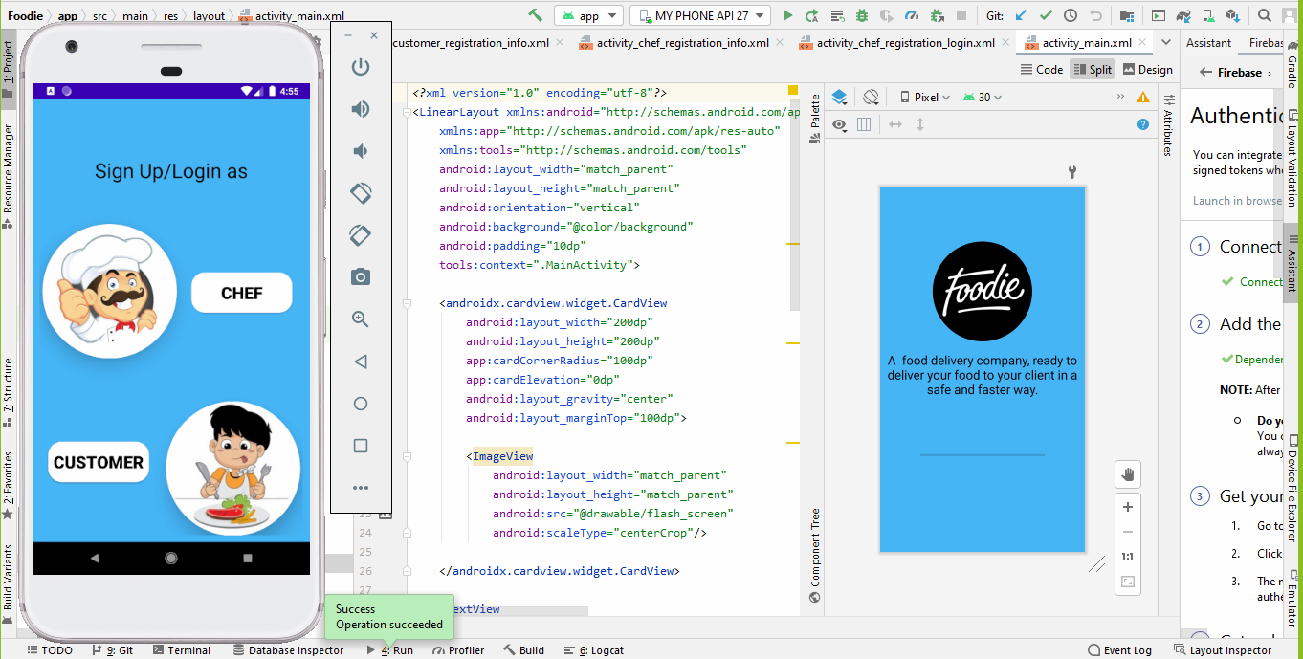
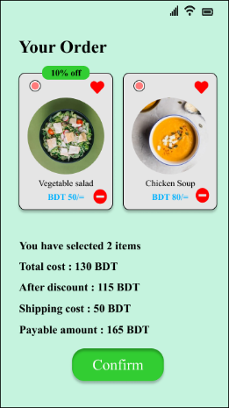
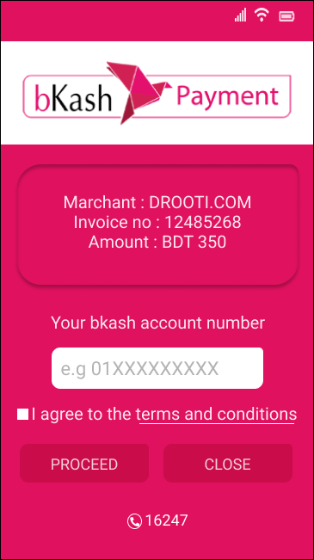

Slide 10
Result Analysis
Result we got so far
Done whole app layout design.
Successfully done registration for new chefs and customers.
Done login for existing chefs and customers.
work with work station from both end chef and customer
Cart
Payment

