Slide 1

MAHAMAIA SYSTEMS
Compression Infrastructure and Evaluation Standards for Machine-Oriented Video
SEED ROUND PITCH DECK | 2026

Slide 2

The Structural Failure of Modern Video
HUMAN-CENTRIC LEGACY
THE STRUCTURAL MISMATCH
Optimized for the Wrong Consumer
Bitrate vs. Accuracy
Current codecs (H.264/H.265) were built to produce "beautiful pixels" for human eyes. Machine perception systems don't need pixels; they need semantic structure.
Every camera in every surveillance deployment today is compressing video the wrong way for its actual consumer—the GPU.
THE SCALING PROBLEM
A Review Crisis
PIXEL FIDELITY ≠ SEMANTIC ACCURACY
Surveillance generates more footage than humans can ever review. Machine perception is the only viable model at scale, yet the stack remains human-centric.

Slide 3

Why Now? The Convergence of Three Forces
STANDARDIZATION
REGULATION
HARDWARE
MPEG VCM Formalization
EU AI Act Enforcement
Edge GPU Maturity
ISO/IEC is actively standardizing machine-oriented video coding. Compliance will become mandatory for all camera and VMS vendors.
High-risk AI systems now require technical documentation of task accuracy and privacy. LeWM-Eval provides the missing standard.
NVIDIA Jetson Orin and AMD Ryzen AI have made real-time neural inference economically viable at the camera level in 2026.

Slide 4

The MAHAMAIA Solution
THE REFERENCE CODEC
THE EVALUATION STANDARD
LeWM-VC
LeWM-Eval
A semantic video codec built specifically for machine perception pipelines. It preserves what models need while discarding human-centric pixel overhead.
The first reproducible framework that measures task accuracy at matched bitrates, designed to become the "BD-rate" of machine-oriented codecs.
/
62% Bitrate reduction vs. H.265
/
Standardized accuracy metrics
/
Latent semantic representation
/
Cross-codec leaderboard
/
Real-time edge inference (80+ FPS)
/
Regulatory compliance (EU AI Act)
CAMERA → LeWM-VC → MACHINE PERCEPTION → LeWM-EVAL

Slide 5

Core Technical Insight: Latent Space Prediction
THE PARADIGM SHIFT
COMPETITIVE COMPARISON
Beyond Pixel Reconstruction
Dimension
Traditional (H.26x)
LeWM-VC
Traditional codecs predict future frames in pixel space using hand-crafted motion vectors. LeWM-VC predicts future frames in latent semantic space using a learned transformer.
Motion Model
Hand-crafted
Learned Transformer
Prediction Space
Pixel
Latent Semantic
Optimization
Human Fidelity
Task Accuracy
THE ADVANTAGE
Semantic Moat
None
Native Preservation
Superior Efficiency
By predicting what downstream models actually need, we achieve smaller files, better semantic preservation, and zero motion vector overhead.

Slide 6

Proven Performance Results
62%
7.2pp
80+
Bitrate Reduction
Accuracy Gain
FPS Throughput
Reduction for P-frames versus all-intra coding on surveillance video. Equivalent storage cost with better detection accuracy.
Class accuracy advantage of LeWM-VC latents over H.265 decoded frames at matched bitrate. Preserves critical semantic data.
Inference throughput on an NVIDIA T4 GPU. Real-time capable on commodity edge hardware today.
STORAGE EFFICIENCY
EDGE PERFORMANCE
TASK ACCURACY

Slide 7

The Moat: Owning the Evaluation Standard
HISTORICAL PARALLEL
MOAT MECHANICS
The BD-rate Precedent
MPEG VCM Integration
In 2001, a one-page document defined how to measure video codecs. For 25 years, every researcher has had to speak that language. LeWM-Eval is designed to be the BD-rate for the machine-oriented era.
Becoming the reference implementation for the ISO/IEC machine-oriented video standard.
Research Dominance
Integration into CompressAI and mandatory citation in academic papers via Papers With Code.
The Dolby Model
Dolby doesn't build speakers; they build the certification that speakers pay for. We are building the neutral measurement standard that the entire industry must adopt to prove compliance.
Institutional Neutrality
A standard owned by a hardware vendor is never adopted by rivals. Independence is our structural advantage.

Slide 8

Current Traction and Momentum
OPEN SOURCE
COMMUNITY
STRATEGIC
GitHub
arXiv
AMD
Public code and pretrained checkpoints at github.com/MAHAMAIA/lewm-vc
Preprint published with active downloads and academic engagement
MI300X compute partnership for large-scale training and validation
PyPI
Leaderboard
MPEG VCM
LeWM-Eval standalone package launched for community evaluation
Multiple codecs evaluated using the LeWM-Eval framework
Active engagement and participation in standardization meetings

Slide 9

Market Opportunity: First Principles Growth
BEACHHEAD: GDPR SMART CITIES
EXPANSION & MOAT
Annual Camera Deployments (EU/UK)
8,000,000
Global Machine Perception
Smart/Enterprise Segment (25%)
2,000,000
Expansion into Autonomous Vehicles, Industrial Inspection, and Logistics provides a 10x multiplier, targeting a $1B+ ARR outcome.
Target SDK License Fee / Unit
$50.00
ADDRESSABLE BEACHHEAD ARR
Certification Revenue Layer
$100,000,000
LeWM-Eval certification for 50+ major camera OEMs at $200K/year adds $10M high-margin ARR from the standard play alone.

Slide 10
Multi-Stream Business Model
12–18 MONTHS
18–36 MONTHS
24–48 MONTHS
SaaS / Edge SDK
Codec SDK Licensing
Certification & Consulting
Per-camera-per-month subscription for the LeWM-VC compression and analytics pipeline. Immediate revenue from smart city design partners.
Per-device royalty for hardware manufacturers (camera OEMs, NVR vendors) embedding LeWM-VC in firmware. Triggered by VCM standardization.
Paid LeWM-Eval certification for codec vendors and consulting for VCM compliance. High-margin, recurring moat similar to the Dolby model.
RECURRING REVENUE
SCALABLE ROYALTIES
HIGH MARGIN MOAT

Slide 11

The Team: Technical and Strategic Depth
INSTITUTIONAL ACCESS
TECHNICAL LEADERSHIP
Founder & Lead Architect
AMD:
MI300X Compute Partnership
MPEG VCM:
Active Standardization Access
Deep Tech Infrastructure Specialist
Academic:
Global Research Network
LeWM-VC Architecture & Codec Design
Our team combines deep technical moats with the institutional relationships required to drive global standards adoption.
JEPA Implementation & ML Optimization
Open-Source Track Record & Reproducibility
Active Search: We are currently seeking a co-founder with production engineering or enterprise BD background to scale operations.

Slide 12
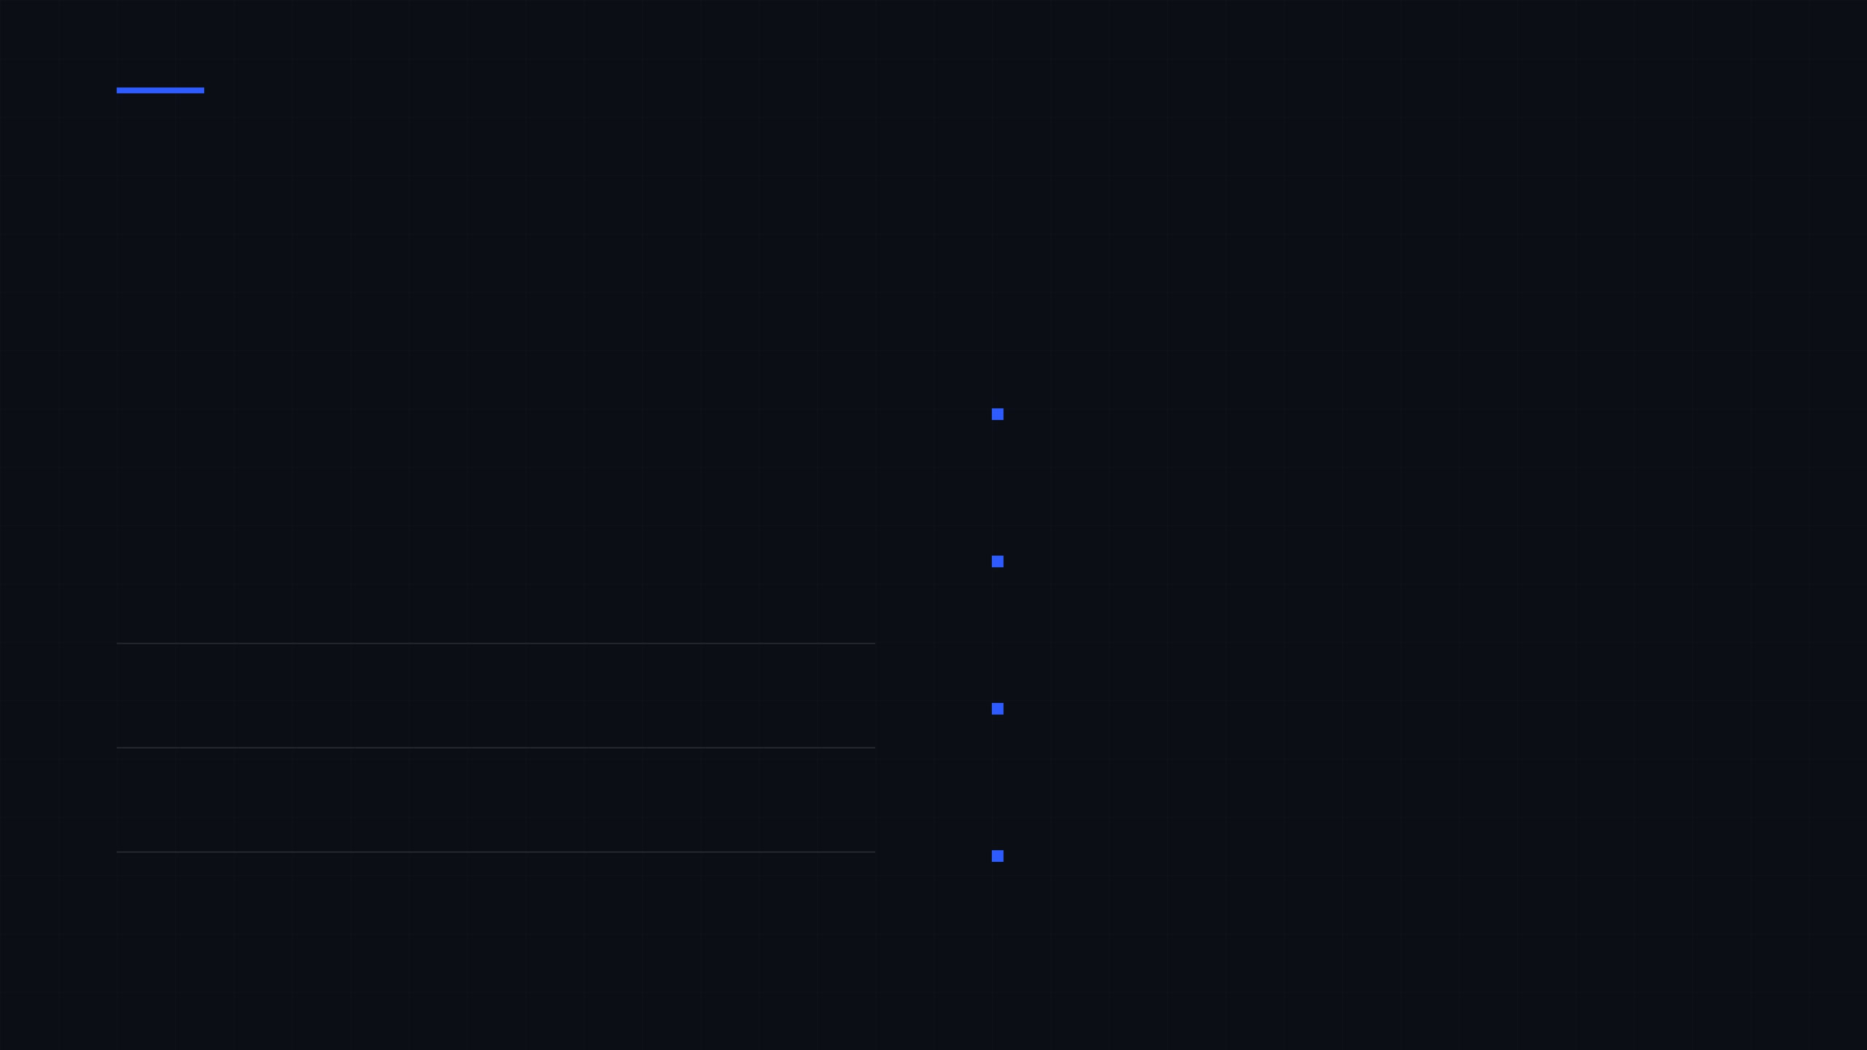
The Ask: Building the Infrastructure
SEED ROUND
18-MONTH MILESTONES
$3–5M
Academic Leadership
LeWM-VC v2 and LeWM-Eval benchmark papers submitted to
CVPR and NeurIPS 2027.
Standard Adoption
WHAT WE ARE BUILDING
LeWM-Eval leaderboard featuring 15+ codecs across 3
independent institutions.
Engineering Team Expansion
50%
Commercial Traction
First paying design partner or revenue-stage LOI secured in the
Data & Compute Infrastructure
30%
beachhead market.
Regulatory Influence
Operations & IP Strategy
20%
MPEG VCM contribution submitted and acknowledged as a
reference implementation.

