Slide 1


MAHAMAIA
Compression Infrastructure for Machine-Oriented Video
Preetam Mukherjee
Founder · preetam@mahamaia.com
MAHAMAIA Systems
Seed Deck · 2026

Slide 2
02 // THE PROBLEM
Codecs optimize for human eyes. Your consumer is a GPU.
SURVEILLANCE
AUTONOMOUS
SMART CITY
INDUSTRIAL
Every camera in every surveillance deployment today is compressing video the wrong way for its actual consumer—the machine perception pipeline.
MAHAMAIA Systems
Seed Deck · 2026

Slide 3
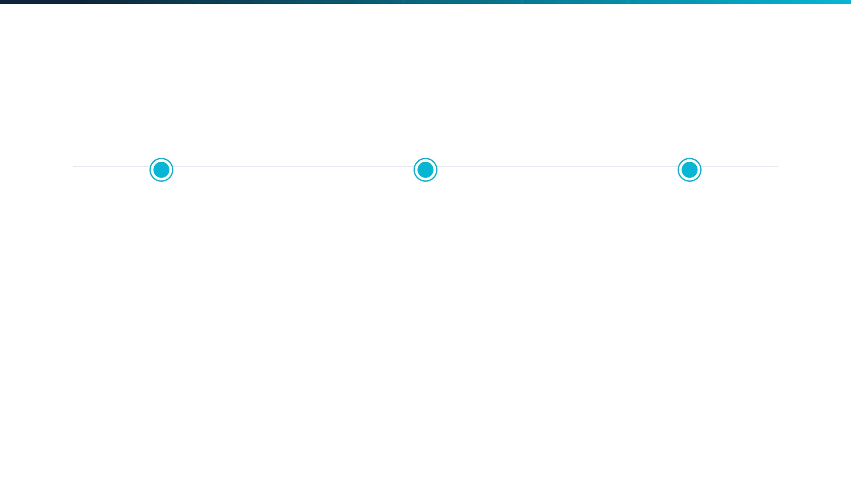
03 // WHY NOW?
The Convergence of Three Forces
STANDARDIZATION
REGULATION
HARDWARE
MPEG VCM Formalization
EU AI Act Enforcement
Edge GPU Maturity
ISO/IEC is actively standardizing machine-oriented video coding. Compliance will become mandatory for all camera vendors.
High-risk AI systems now require technical documentation of task accuracy. LeWM-Eval provides the missing standard.
NVIDIA Jetson Orin and AMD Ryzen AI have made real-time neural inference economically viable at the camera level.
MAHAMAIA Systems
Seed Deck · 2026

Slide 4


04 // THE SOLUTION
A unified infrastructure for machine video.
→
LeWM-VC
→
→
LeWM-Eval
CAMERA
CODEC
PERCEPTION
STANDARD
THE REFERENCE CODEC
THE EVALUATION STANDARD
LeWM-VC
LeWM-Eval
A semantic video codec built for machine perception. Compresses footage to a semantic latent representation rather than pixels, achieving 62% bitrate reduction at matched task accuracy.
The first reproducible framework that measures what matters—task accuracy at matched bitrate. Designed to become the "BD-rate" of machine-oriented codecs.
MAHAMAIA Systems
Seed Deck · 2026

Slide 5



05 // CORE TECHNOLOGY
Beyond Pixel Reconstruction
→
LeWM-VC
→
CAMERA
LATENT SPACE
PERCEPTION
THE PARADIGM SHIFT
COMPETITIVE EDGE
Traditional codecs predict future frames in pixel space using hand-crafted motion vectors. LeWM-VC predicts future frames in latent semantic space using a learned transformer.
Motion Model
Learned Transformer
Prediction Space
Latent Semantic
Optimization
Task Accuracy
Semantic Moat
Native Preservation
MAHAMAIA Systems
Seed Deck · 2026

Slide 6
06 // PERFORMANCE RESULTS
Performance that redefines the infrastructure.
62%
7.2pp
80+
BITRATE REDUCTION
ACCURACY GAIN
FPS THROUGHPUT
Reduction for P-frames versus all-intra coding on surveillance video.
Class accuracy advantage over H.265 at matched bitrates.
Real-time capable on commodity edge hardware (NVIDIA T4).
MAHAMAIA Systems
Seed Deck · 2026

Slide 7
07 // THE MOAT
You don't need the best codec forever. You need to define what "best" means.
HISTORICAL PARALLEL
BUSINESS MODEL
The BD-rate Precedent
The Dolby Strategy
In 2001, a one-page document defined how to measure video codecs. For 25 years, every researcher has had to speak that language. LeWM-Eval is the BD-rate for the machine-oriented era.
Dolby doesn't build speakers; they build the certification that speakers pay for. We are building the neutral measurement standard that the entire industry must adopt to prove compliance.
MECHANICS OF THE MOAT
MPEG VCM Integration · Research Dominance via CompressAI · Institutional Neutrality as an Independent Standard Maintainer
MAHAMAIA Systems
Seed Deck · 2026

Slide 8
08 // TRACTION
Current Traction and Momentum
OPEN SOURCE
COMMUNITY
STRATEGIC
Code & Models
Engagement
Partnerships
Public code repository live on GitHub
›
LeWM-Eval package on PyPI
›
AMD MI300X compute partnership
›
Pretrained checkpoints for LeWM-VC
›
arXiv preprint with active downloads
›
MPEG VCM standardization access
›
Reproducibility posture established
›
Cross-codec leaderboard entries
›
Design partner outreach initiated
›
ACTIVE DEVELOPMENT
GROWING REACH
INSTITUTIONAL TIES
MAHAMAIA Systems
Seed Deck · 2026

Slide 9

09 // MARKET OPPORTUNITY
Building the market from first principles.
BEACHHEAD: GDPR SMART CITIES
Annual Camera Deployments (EU/UK)
8,000,000
Global Expansion
Autonomous Vehicles, Industrial Inspection, and Logistics provide a 10x multiplier, targeting a $1B+ ARR outcome.
Smart/Enterprise Segment (25%)
2,000,000
Target SDK License Fee / Unit
$50.00
ADDRESSABLE BEACHHEAD ARR
$100M
Certification Layer
LeWM-Eval certification for 50+ major camera OEMs at $200K/year adds $10M high-margin ARR from the standard play alone.
MAHAMAIA Systems
Seed Deck · 2026

Slide 10
10 // BUSINESS MODEL
Multi-Stream Revenue Strategy
SHORT TERM
MEDIUM TERM
LONG TERM
SaaS / Edge SDK
Codec SDK Licensing
Certification & Consulting
Per-camera-per-month subscription for the LeWM-VC compression and analytics pipeline. Immediate revenue from smart city design partners.
Per-device royalty for hardware manufacturers (camera OEMs, NVR vendors) embedding LeWM-VC in firmware. Triggered by VCM standardization.
Paid LeWM-Eval certification for codec vendors and consulting for VCM compliance. High-margin, recurring moat similar to the Dolby model.
12–18 MONTHS
18–36 MONTHS
24–48 MONTHS
MAHAMAIA Systems
Seed Deck · 2026

Slide 11
11 // THE TEAM
Technical depth meets institutional access.
TECHNICAL LEADERSHIP
INSTITUTIONAL ACCESS
Preetam Mukherjee
Strategic Moat
Founder & Lead Architect
Partnerships & Networks
LeWM-VC Architecture & Codec Design
›
AMD: MI300X Compute Partnership
›
JEPA Implementation & ML Optimization
›
MPEG VCM: Active Standardization Access
›
Open-Source Track Record & Reproducibility
›
Academic: Global Research Network
›
DEEP TECH INFRASTRUCTURE
ACTIVE SEARCH: CO-FOUNDER
MAHAMAIA Systems
Seed Deck · 2026

Slide 12
12 // THE ASK
Building the Infrastructure of the Future
SEED ROUND FUNDING
$3,000,000 – $5,000,000
50%
30%
20%
ENGINEERING TEAM
DATA & COMPUTE
OPERATIONS & IP
18-MONTH MILESTONES
•
•
Academic Leadership: CVPR and NeurIPS 2027 submissions for LeWM-VC v2 and LeWM-Eval.
Commercial Traction: First paying design partner or revenue-stage LOI secured.
•
Regulatory Influence: MPEG VCM contribution acknowledged as reference implementation.
•
Standard Adoption: LeWM-Eval leaderboard with 15+ codecs across 3 institutions.
MAHAMAIA Systems
Seed Deck · 2026

